Slide 1
Financial Policies and
Procedures Meeting
November 14, 2024
District Facilitator: Sheila Summers, Northwest BOCES

Slide 2
AGENDA
Call to Order
Approval of Agenda
Approval of Minutes
Legislative Session
  Governor’s Budget Request
  Upcoming Legislative Meetings
  Mid-Year True Up
Mill Levy Certification
  Introduce Kim Reeves
  Important Dates
  Certification Forms
  Training for New Finance Staff
Locale factor
New Annual Audit Review Process
Office of the State Auditor
  School District Fiscal Health Report
  Fund Balance Discussion
  Extension Requests
GASB 101 Compensated Absences
Trainings
Financial Reporting
  COA Subcommittee: Results of VOTE #s 4 & 5
  Data Pipeline: Finance December
Other Topics of Interest
Upcoming Meetings

Slide 3
Approval of Agenda

Slide 4
Approval of Minutes

Slide 5
Legislative Session

Slide 6
Overview of State Budget
Governor’s Budget Letter
Governor’s Budget Rollout Slides
There is only $391M available for General Fund due to lower inflation, and annualizations.
Caseload, capital and common policy costs result in us being $500M below the reserve even before addressing “discretionary costs.”
General operating costs including for non-executive branches and the reserve require add another $140M.
This budget has ~$640M in balancing proposals, including $29M from Electrifying School Buses program.

Slide 7
Important Dates for K-12 Education - Student October
November 8 to 18: Student October Count data will be locked down
November 15 or 18: Duplicate Count decisions made
November 18 to 27: Data will be unlocked for districts with duplicate count changes
November 27: Data will be locked back down
December 6: Sign off sheets due
December 24: District payments reflect first part of mid-year true-up
January 25: District payments reflect final part of mid-year true-up

Slide 8
Important Dates for K-12 Education - Legislative
December 1: Report of School Transportation Task Force
December 3: JBC Briefing: All CDE except Asst to Public Schools
December 5: JBC Briefing: School Finance and Categoricals
December 16: JBC Hearing for CDE
January 3: Reports of Adequacy Studies
January 15: School Finance Mid-Year True-Up Request
January TBD: Report on New At-Risk Measure on Census Block
January TBD: CDE SMART Act Hearing

Slide 9
2024-25 Governor’s Budget Requests
Governor’s State Share of Total Program Request
Incremental funding request of -$264,012,260
Assumes a 2.5% inflation rate
Increases statewide average per pupil by $299 to $11,747 in FY25-26
Assumes lower local share revenue for Total Program
Extending new formula implementation from 6 to 7 years
Eliminates 4 year pupil count averaging
Places a cap on BEST cash grants at $129M in FY25-26, then increase by rate of TABOR cap
Governor’s Categorical Programs Request
Incremental funding request of $13,536,016
Assumes a 2.5% inflation rate
Funds required inflationary increase for Special Education per SB22-127 = $9,389,129
Remaining funds allocated based upon standardized formula (aka gap analysis) = $4,146,887

Slide 10
2025-26 CDE/CSI/CSDB Budget Requests
CSI Mill Levy Equalization
Supporting Instructional Coherence
Student Engagement
READ Act Training Support
CTBL Security
National Student Clearinghouse
Statewide Student Information System
CSDB Inflationary Increase
Career Training and Basic Skills Reduction
Inactive Cash Funds Sweep

Slide 11
Mill Levy Certification

Slide 12
Important Dates
CDE Trainings—
November 12, 9:00-10:30 am
November 14, 2:00-3:30 pm (targeted training for districts totally locally funded)
On or before December 10, 2024—county assessor will provide FINAL Certificate of Valuations. Advisable to contact your County assessor to find out when they will be providing certifications.
December 16, 2024—District Board of Education must certify levies and provide to County Commissioners by this date as well as submit to CDE. Determine what is needed by the County Commissioners before this date in order to meet this deadline

Slide 13
Mill Levy Certification Process Changes
Submission
  Districts submit their mill levies to CDE using a web-based application. Each County’s Certification of Valuation for all levies need to be sent via the provided email link at the bottom of the application.
  REMINDER: For efficiency, Districts should no longer mail or fax mill levy certification documents to CDE.
  Districts may send district’s calculation worksheet as back up when submitting their mill levies but this is not required to be submitted.

Slide 14
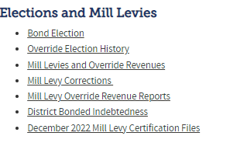
Mill Levy Certification Process
https://www.cde.state.co.us/cdefinance
There will be a link on the School Finance homepage to the new December 2024 Mill Levy Certification Files

Slide 15
Mill Levy Certification
Submittal Process
CDE has a web-based application for districts to report their mill levies to CDE
Access is through the State Equal System
https://idm.cde.state.co.us/equal/
Each district’s Local Access Manager (LAM) will need to grant permission to the district individual responsible for submission of mill levy data
CDE will notify all districts once the new application is available so that LAMs can grant access
LAMS need to grant access under State Equal and not Data Pipeline

Slide 16
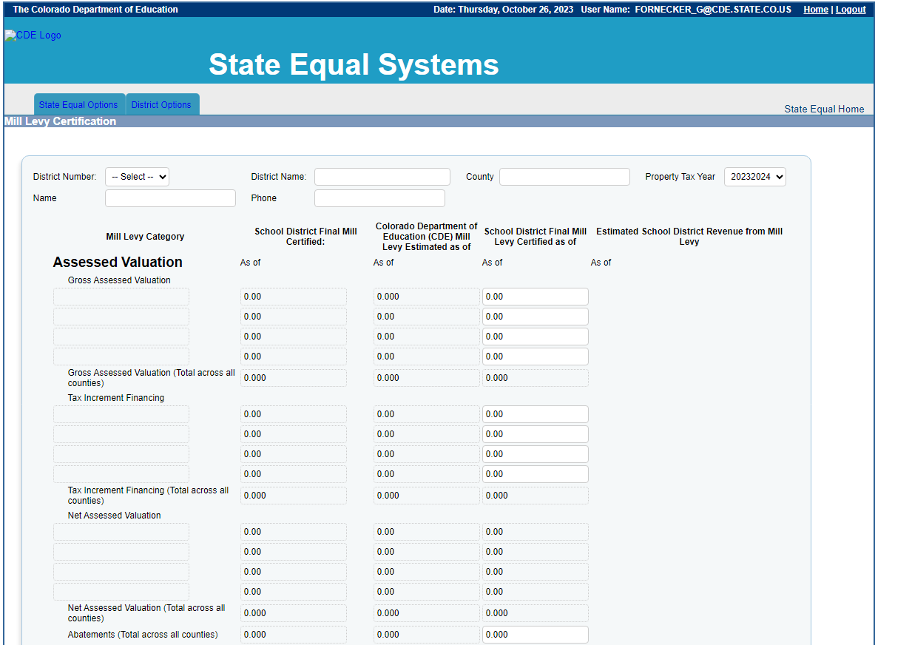
Mill Levy Certification
Submittal Process

Slide 17
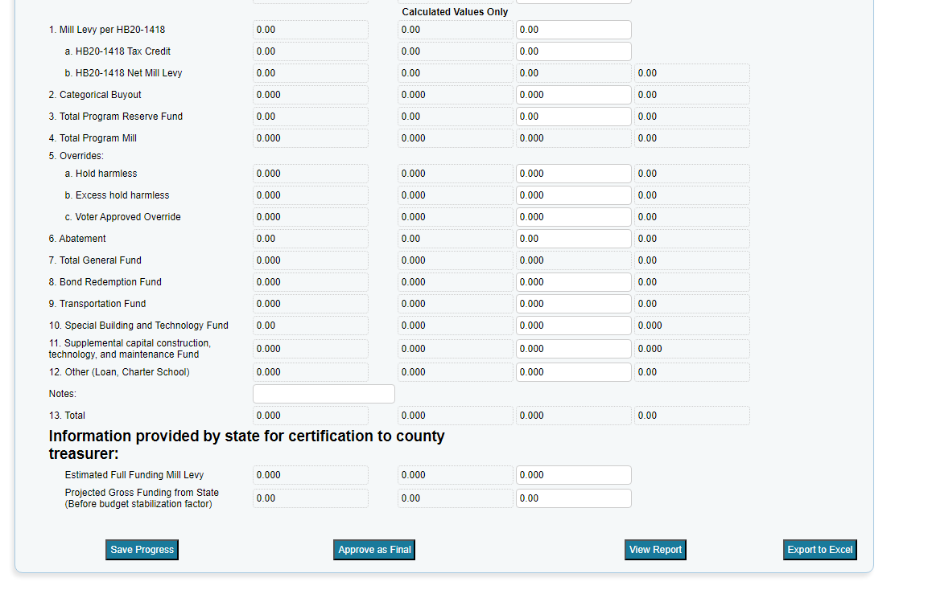
Mill Levy Certification
Submittal Process

Slide 18
Locale factor

Slide 19
Locale Factor
HB24-1448 includes a locale factor which is based upon the classification criteria by the USDE National Center for Education Statistics (NCES).
If a district does not align with the NCES classification, CDE and LCS shall designate the locale factor based on considerations that align with similarly situated districts.
Based upon input from districts and discussions with Rural Alliance, CDE has begun work on a Locale Analysis. To date, 24 districts have been identified for review for potential adjustments.
Districts should contact Jennifer Okes (okes_j@cde.state.co.us) if they believe their district does not align with the NCES locale classification.

Slide 20
New Annual Audit Review Process

Slide 21
New Audit Approach
Starting with the 2024-2025 fiscal year, the School Auditing Office will be shifting its audit approach.
All districts and BOCES (that operate their own schools and/or submit data during the Student October data collection) will participate in the Annual Audit Review.
No later than December 11, 2024, all districts and BOCES must:
  Complete all funded count audit questionnaires (pupil, at-risk, and ELL), and
  Upload initial audit documentation (as described in the corresponding questionnaires) to Syncplicity.
The School Auditing Office anticipates that the new audit approach will evolve over the next few years - questionnaires and initial audit documentation will also update each year as needed.
For more information, refer to the training “Preparing for the New Annual Audit Review” (slides; recording), or contact the School Auditing Office (audit@cde.state.co.us) directly.

Slide 22
Office of the State Auditor

Slide 23

FPP Meeting
OSA Update
November 14, 2024
Crystal Dorsey, CPA
Local Government Audit Manager

Slide 24

Discussion Today
Process to request an extension of time
Colorado School District Fiscal Health Analysis
  Fiscal Years 2021-2023

Slide 25
Audit Law Deadlines
School Districts – June 30 year end
  Audit shall be completed within 5 months
    Submit to the OSA within 30 days of receipt of audit report
  December 31st – Deadline to file an extension
    Extension may be granted for 60 days
      March 1

Slide 26
Extension – FAQs
Can I request an extension every year? Yes
What if I was late last year, can I still get an extension this year? No
Do I have to have a board member sign the extension form? Yes
Can’t I just call the OSA to request an extension? No
Can CDE grant the extension? No
Can I request an extension now, or should I wait until 12/31? Please submit the form as soon as possible.

Slide 27
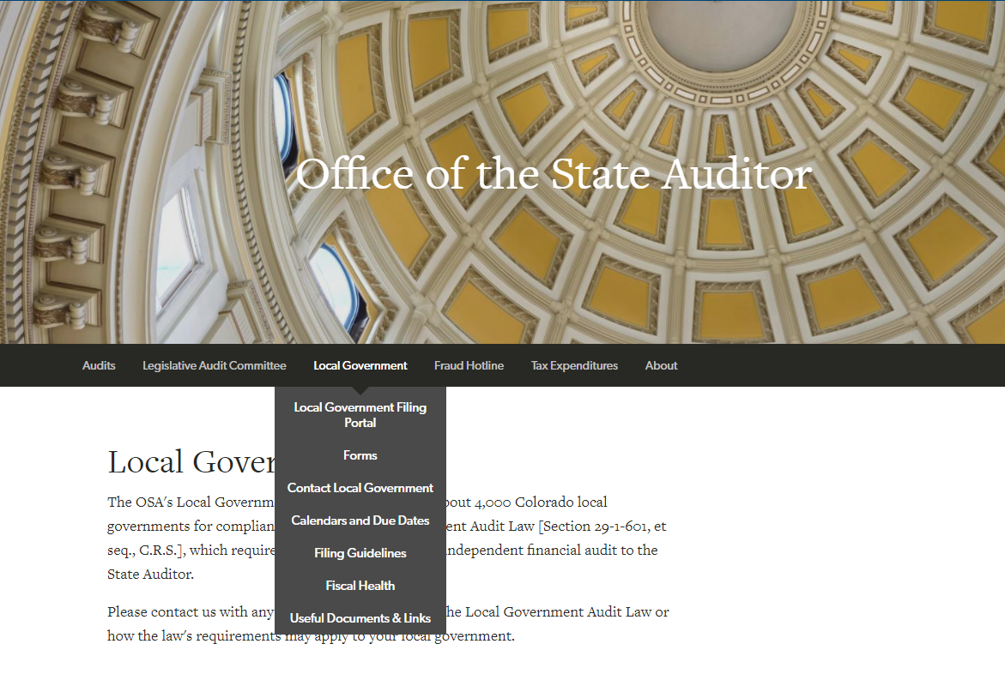
Office of the State Auditor | Colorado General Assembly
How do I request an extension of time?
Hover on Local Government
Click on Local Government Portal

Slide 28
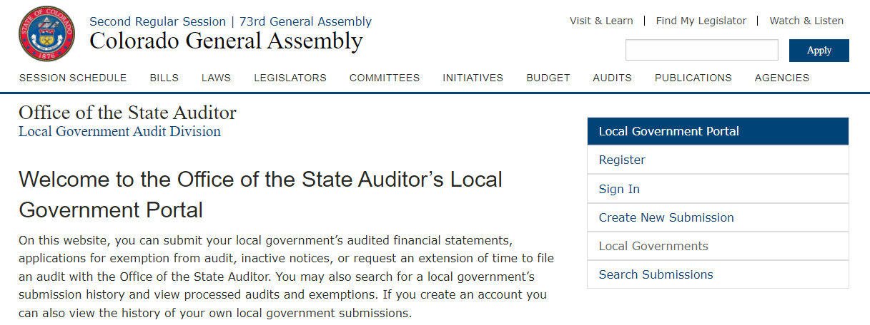
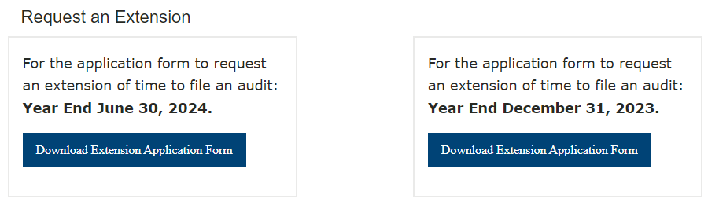
Scroll to the bottom of the portal page to find the form to request for an extension

Slide 29
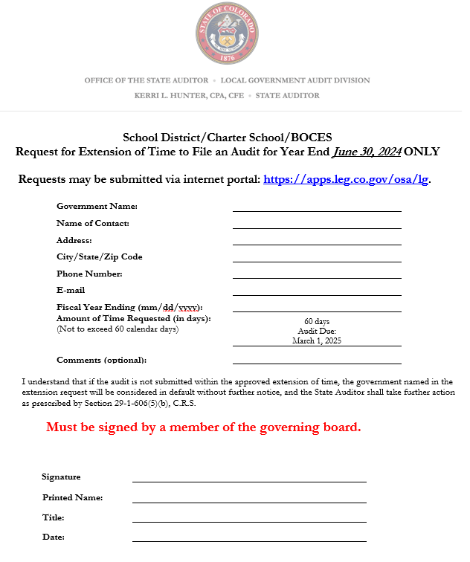
OSA
Print and have a board member sign.
Submit through the OSA Local Government Portal.

Slide 30
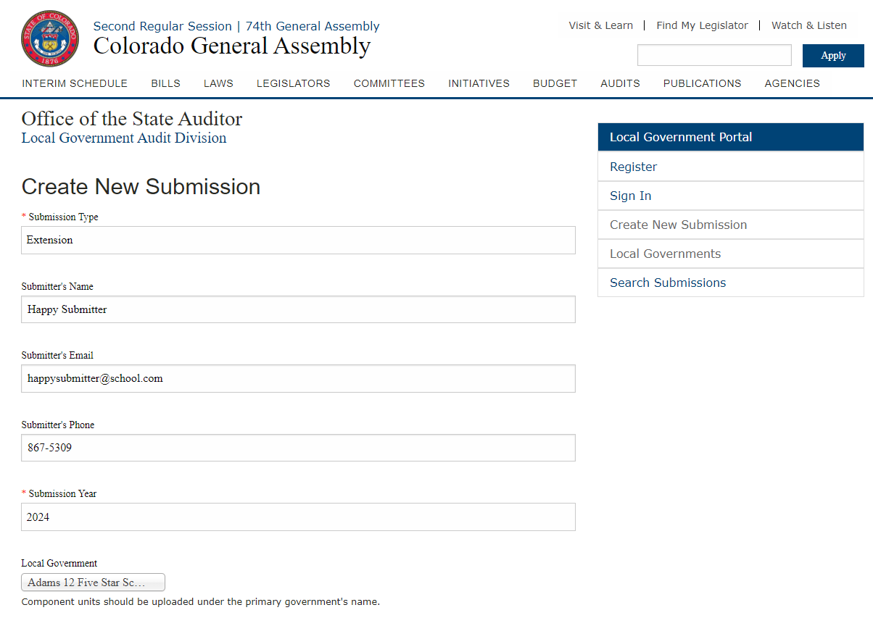
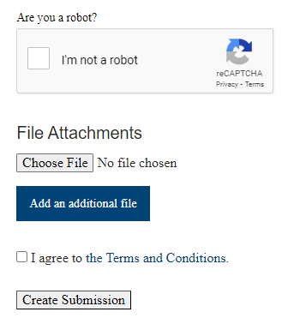
OSA
Start with “Create New Submission”
Submission Type: Extension
Complete all other fields
Use the drop down for Local Government, enter part of the district’s name to search.
Make sure you select your school district’s name and not the county by mistake.

Slide 31
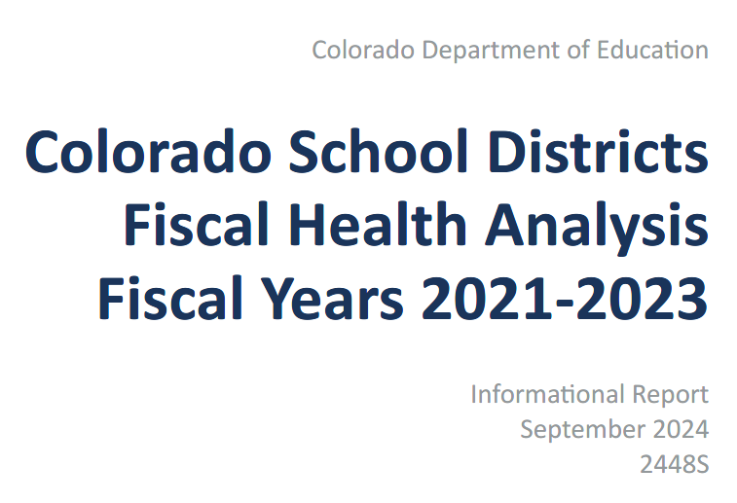
School District Fiscal Health

Slide 32
School District Fiscal Health Analysis
October 14, 2024
  Legislative Audit Committee
178 School Districts
Reviewed trends over Fiscal Years ended 2021, 2022, 2023

Slide 33
School District Fiscal Health Ratios
Asset Sufficiency
  General Fund Assets / Liabilities
Debt Burden
  Revenue paying debt / debt payments
Operating Reserve
  GF fund balance / GF expenditures
Operating Margin
  GF revenues-expenditures / GF fund balance
Deficit Fund Balance
  Total deficit fund balance(s) – fund balance of the general fund (if positive)/Total revenues in deficit fund balance(s)
Change in Fund Balance
  Current year GF fund balance-prior year / GF prior year fund balance

Slide 34
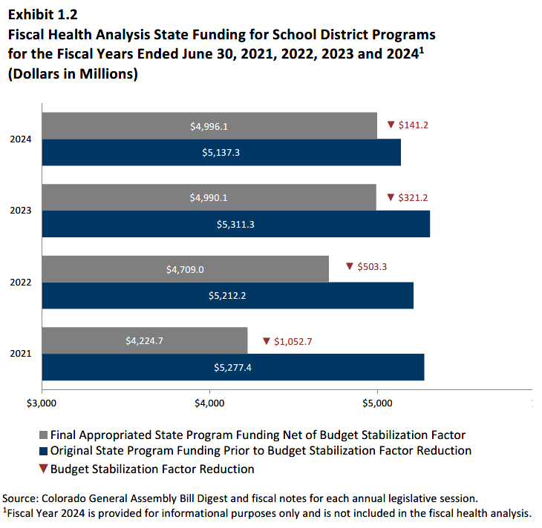
School District Fiscal Health Analysis

Slide 35
School District Fiscal Health Analysis
36 school districts with one or more missed benchmarks
  14 districts with two
  2 districts with three
    Elizabeth (Elbert)
    Fountain (El Paso)
  1 district with five
    Miami/Yoder 60 JT (El Paso)

Slide 36
School District Fiscal Health Analysis
  14 districts with two
    Adams Arapahoe 28J
    Adams 14 (Adams)
    Alamosa (Alamosa)
    Arickaree (Washington)
    Aspen 1 (Pitkin)
    Calhan RJ-1 (El Paso)
    Clear Creek RE-1

Slide 37
School District Fiscal Health Analysis
  14 districts with two (continued)
    East Grand 2 (Grand)
    Las Animas RE-1 (Bent)
    Peyton 23 (El Paso)
    Poudre R-1 (Larimer)
    Sangre De Cristo (Alamosa)
    Weld RE-1 (Weld)
    Wildefield 3 (El Paso)

Slide 38
School District Fiscal Health Analysis
Missed benchmarks do not always mean there is a problem
  Salaries/benefits to remain competitive
  Capital needs and maintenance
  Fluctuating student count

Slide 39
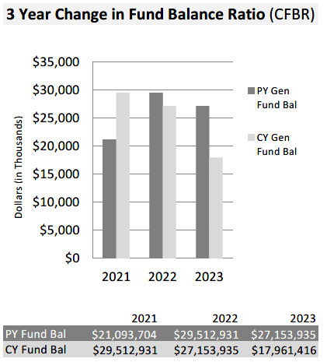
OSA
Fund balance – a closer look

Slide 40
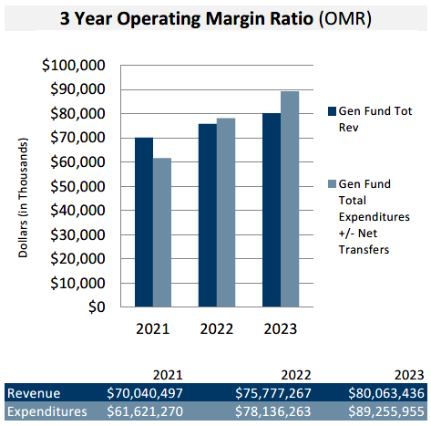
OSA
Fund balance – a closer look

Slide 41

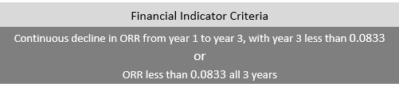

OSA
Fund balance – a closer look

Slide 42

OSA
Fund balance – a closer look

Slide 43
School District Fiscal Health Analysis
However: the more missed benchmarks, the greater the risk
  Identify potential problems early
Understand the reasons for fund balance decline

Slide 44
Colorado Office of the State Auditor
1525 Sherman Street, 7th Floor, Denver, Colorado 80203
303.869.3000 http://www.colorado.gov/auditor/
Crystal Dorsey: crystal.dorsey@coleg.gov (303) 869-3002 osa.lg@coleg.gov
All OSA Email addresses have changed to “@coleg.gov”

Slide 45
GASB 101
Compensated Absences
Link to GASB 101

Slide 46
GASB 101 - Compensated Absences (again)
Effective Date
The requirements of this Statement are effective for fiscal years beginning after December 15, 2023, and all reporting periods thereafter. Earlier application is encouraged.
In other words - For FY 24/25 Financials/Audit

Slide 47
GASB 101 - Compensated Absences (con’t)
This Statement requires that liabilities for compensated absences be recognized for:
(1) leave that has not been used and
(2) leave that has been used but not yet paid in cash or settled through non-cash means

Slide 48
GASB 101 - Compensated Absences(con’t)
A liability should be recognized for leave that has not been used if:
(a) the leave is attributable to services already rendered,
(b) the leave accumulates, and
(c) the leave is more likely than not to be used for time off or otherwise paid in cash or settled through non-cash means.

Slide 49
GASB 101 - Compensated Absences (con’t)
In estimating the leave that is more likely than not to be used or otherwise paid or settled, a government should consider relevant factors
such as employment policies related to compensated absences and
historical information about the use or payment of compensated absences.
However, leave that is more likely than not to be settled through conversion to defined benefit postemployment benefits should not be included in a liability for compensated absences.

Slide 50
GASB 101 - Compensated Absences(con’t)
This Statement requires that a liability for certain types of compensated absences—including parental leave, military leave, and jury duty leave—not be recognized until the leave commences.
This Statement also requires that a liability for specific types of compensated absences not be recognized until the leave is used.

Slide 51
GASB 101 - Compensated Absences(con’t)
This Statement also establishes guidance for measuring a liability for leave that has not been used, generally using an employee’s pay rate as of the date of the financial statements.
A liability for leave that has been used but not yet paid or settled should be measured at the amount of the cash payment or non-cash settlement to be made.
Certain salary-related payments that are directly and incrementally associated with payments for leave also should be included in the measurement of the liabilities.

Slide 52
GASB 101 - Compensated Absences (con’t)
With respect to financial statements prepared using the current financial resources measurement focus(modified accrual):
this Statement requires that expenditures be recognized for the amount that normally would be liquidated with expendable available financial resources.

Slide 53
GASB 101 - Compensated Absences (con’t)
CDE GASB FAct Sheet

Slide 54
Trainings

Slide 55
Trainings
November 7, Budget Planning Part I
November 12, Certifying District Mills
November 14, 2-3:30 Certifying District Mills for 100% Locally Funded Districts
December 5, 9-10:30 Finance Policy Review
January 16, 9-10:30 Fund Balance
February 27, 9-10:30 Budget Planning Part II
Regional Meetings in 2026

Slide 56
Financial Reporting

Slide 57
COA/FT Subcommittee

Slide 58
Subcommittee Members
District Members
Ashley Zhang, Accounting Supervisor, Mesa 51
Jamie Duran, Finance Coordinator, Pueblo 70
Kirk Youngman, Manager-Enterprise Systems, St Vrain
Lana Niehans, Director of Budget and Finance, Pueblo 60
Gina Lanier, Chief Financial Office , Adams 12
Sondra Vela, Finance Director, Harrison 2
Colorado Department of Education
Dawna Gudka, Data Specialist, IMS Data Service
Peter Hoffman, Data Specialist, IMS Data Service
Robert Hawkins, Lead Grants Fiscal Analyst
Lindsey Heitman, Principal Consultant, IMS Data Service
Colorado Department of Education - School Finance
Glenn Gustafson, School Finance Program Manager
Kim Reeves, Government Finance Analyst
Kelly Wiedemer, Fiscal Data Analyst
Yolanda Lucero, Fiscal Data Coordinator

Slide 59
Upcoming Meeting Schedule
High-Level Review - NCES Handbook Chapters 1-5
and Review of Outstanding Items
December 4th, 9:00am-10:30am
Financial Transparency - Changes/Enhancements
January 15th, 9:00am-10:30am
Work on Appendices: Indirect Costs, etc.
Date: TBD
Topic: TBD
Date: TBD
Wrap Up
Date: TBD

Slide 60
COA/FT Subcommittee
Request Form for Topics/Ideas -
Reminder: The subcommittee created a form to for business officials and others to share topics that they would like the sub-committee to address.
Review Slides and Provide Feedback on recommended changes:
FPP Recommended changes (slides)
Provide your feedback (form)

Slide 61
NCES - updated COA
NCES is working on an update to their COA.
CDE is part of a Review Committee who will provide feedback to NCES on proposed changes.
Received Chapters 1-5. Chapters 6-8 will follow (TBD)
  Chapter 6 includes object codes & descriptions
The subcommittee is hoping to have the NCES updates to help guide updates to certain object & program codes

Slide 62
COA Subcommittee Stats
and Online Vote Results

Slide 63
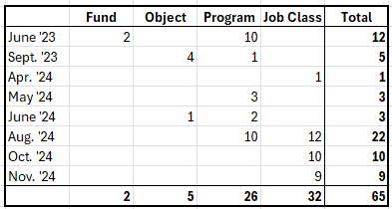
Subcommittee Stats
The Subcommittee has met at least 25 times. The 1st meeting was held on November 10, 2022.
This translates into a minimum of 37.5 hours of discussion time!
The number of recommended COA changes submitted for a vote so far:

Slide 64
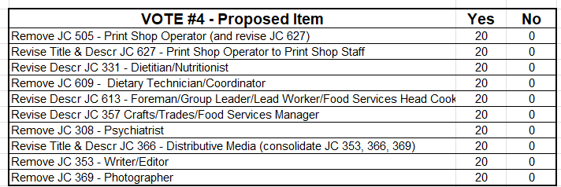
Summary Results - Vote #4
There are 24 voting members; a majority is 13 votes. Note that votes were cast In Oct/Nov 2024.
Future FPP Recommendations (slides)

Slide 65
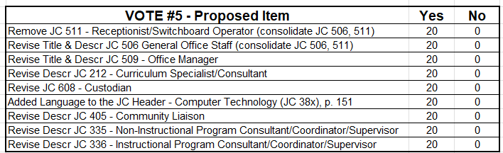
Summary Results - Vote #5
There are 24 voting members; a majority is 13 votes. Note that votes were cast In Oct/Nov 2024.
Future FPP Recommendations (slides)

Slide 66
Collection Update
Finance December

Slide 67
Collection Update: Finance December
FY 2023-24 Data Submission
Soft Open: August 1st
Official Open: September 16th
Submissions are Due December 31st to CDE and OSA
Extensions may be granted for 60 days, from OSA
CDE honors the extension approved by OSA
Overview of Data Pipeline, recordings posted on School Finance Trainings
Data Pipeline Resources, posted on School Finance webpage in lower right corner.

Slide 68
Collection Update: Finance December
Submissions are Due December 31st
Colorado Department of Education
School Finance Division, submit electronically to schoolfinance@cde.state.co.us
What to send
FY 2023-2024 Financial Audits
Assurances for Financial Accreditation
Single Audit, if issued separately (Uniform Guidance/2CFR 200) – Districts that expend $750,000 or more in Federal Awards.
Charter School Audits, if applicable
Reconciliation Reports and Other Supporting Documentation

Slide 69
Collection Update: Finance December
Submissions are Due December 31st
Office of the State Auditor
Local Government Division, Website Submission: https://apps.leg.co.gov/osa/lg
What to send
FY 2023-2024 Financial Audit
Audit, exemptions (meeting electronic signature policy) and extension can be submitted to the OSA via our online portal at: https://apps.leg.co.gov/osa/lg. Registration is not required but recommended if someone will be making multiple submissions. When submitted through the portal the sender will receive an automated reply that the OSA has received the submission.

Slide 70
Other Topics of Interest

Slide 71
Title
CASB
CASBO
CASE-DBO
CGFOA
COCPA

Slide 72
Upcoming Meetings

Slide 73
Upcoming Meetings
Thursday, February 13, 2025
Facilitator: Donna Murphy, Littleton Public Schools
Thursday, April 17, 2025
Facilitator: Brian Gustafson, Poudre R-1
Thursday, June 26, 2025
Facilitator: Cathay Watts, Academy 20

Slide 74
Meeting Adjourn

