Slide 1
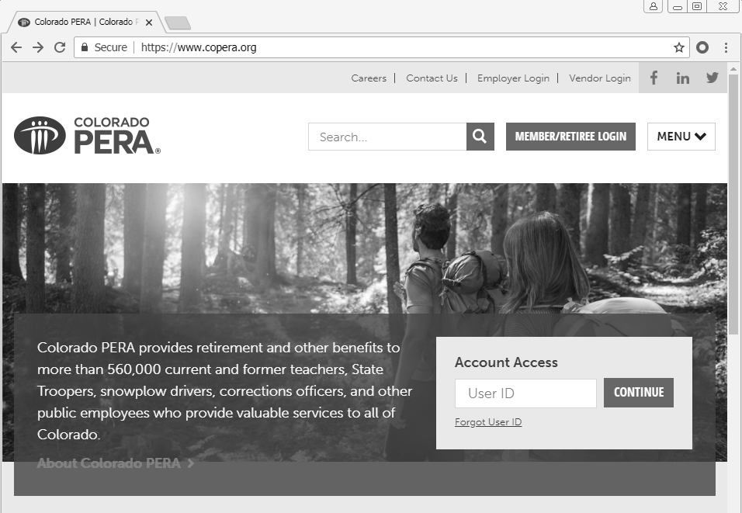
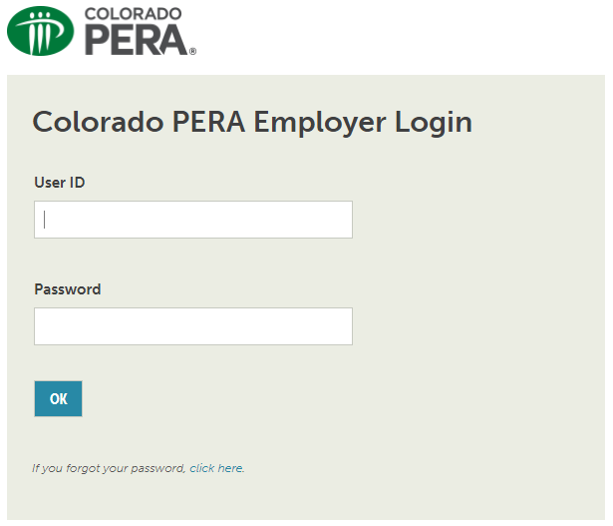
Log-In to Employer Stars Account
Access your Colorado PERA Employer STARS Account by visiting https://www.copera.org and then selecting the “Employer Login” option at the top of the page.

Slide 2
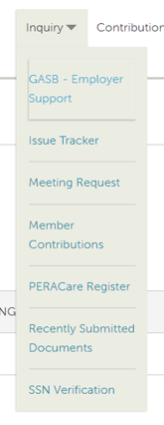
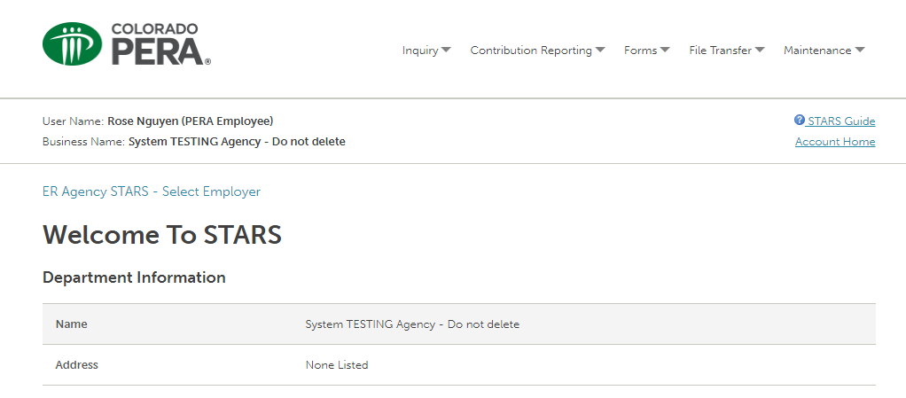
Access GASB
Once logged into your STARS account, select the “Inquiry” dropdown menu and choose the “GASB – Employer Support” option.

Slide 3
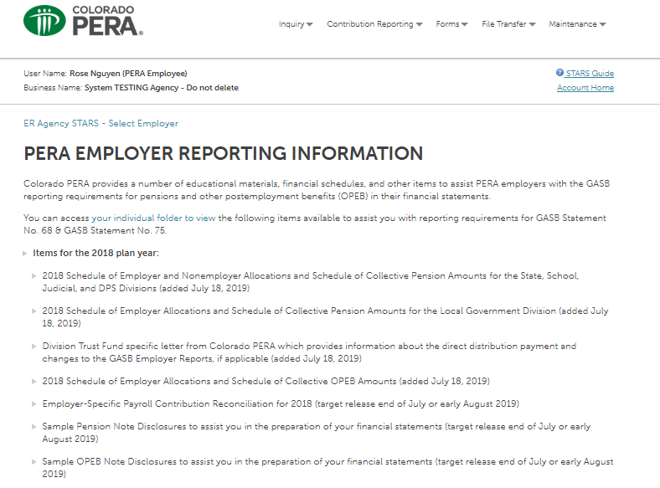
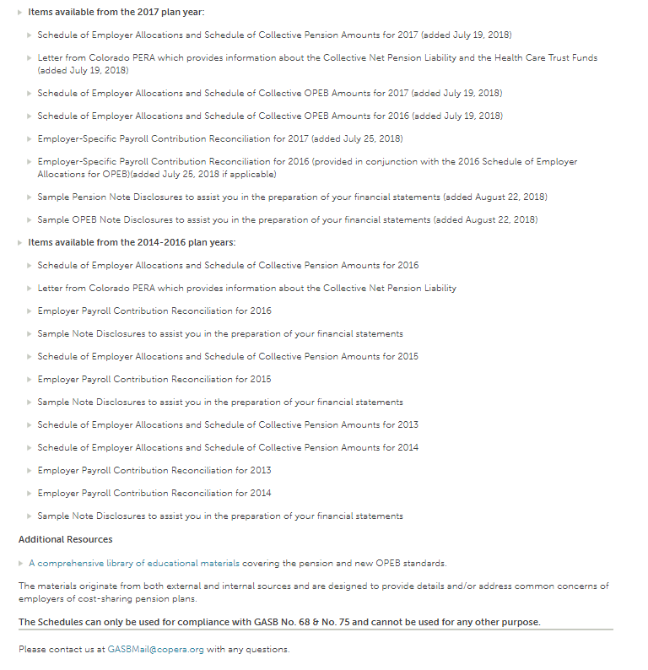
PERA Employer Reporting Information
On this page, Colorado PERA provides a number of educational materials, financial schedules, and other items to assist PERA employers with the GASB reporting requirements for pensions and other postemployment benefits (OPEB) in their financial statements. Listed are items available.

Slide 4
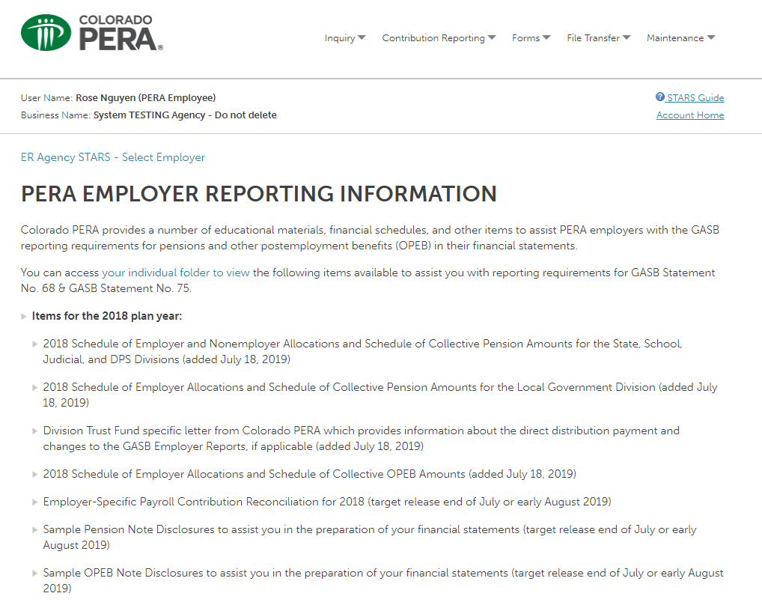
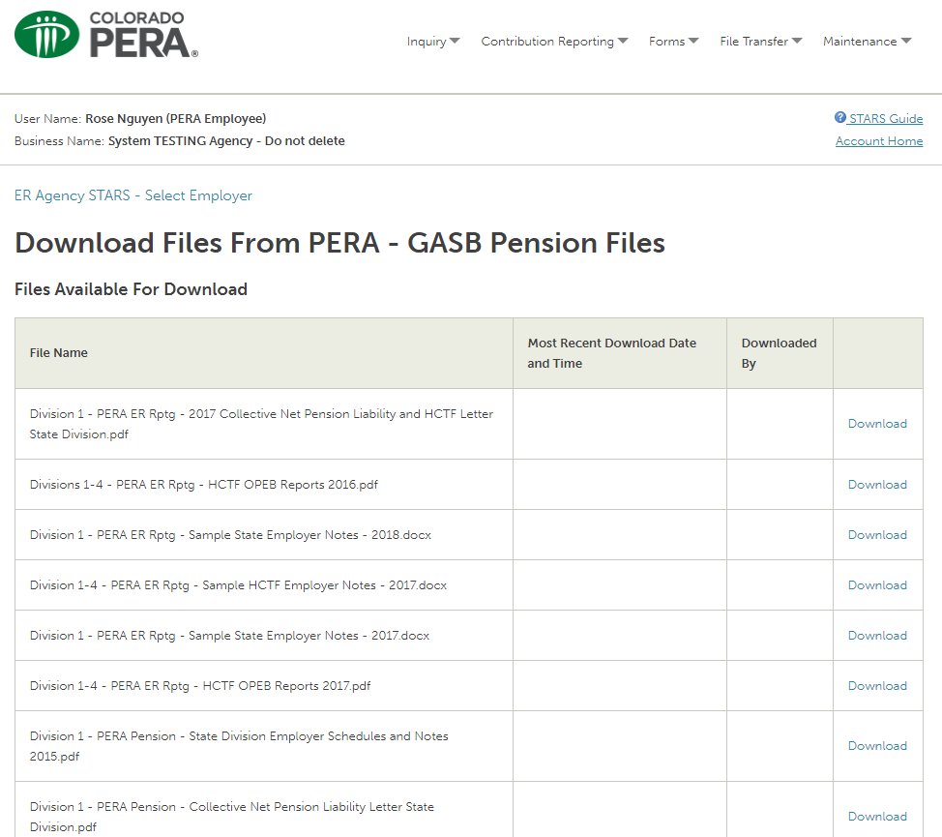
Individual Folder to View
You can access your individual folder to view the following items available to assist you with reporting requirements for GASB Statement No. 68 & GASB Statement No. 75. Click on the following link “your individual folder to view” and “download” file.

