Slide 1
Financial Policies and
Procedures Meeting
April 17, 2025
District Facilitator
Brian Gustafson, Poudre R-1

Slide 2
AGENDA
Call to Order
Approval of Agenda
Approval of Minutes
Introduction of Corey Evans and Tabitha Tyree
Legislative Session
Charter Intercept
At-Risk FPP Subcommittee - School Finance Rules Cleanup
Office of the State Auditor
Grant Updates
UPK Updates
Other Topics of Interest
Upcoming Meetings

Slide 3
Approval of Agenda

Slide 4
Approval of Minutes

Slide 5
Introduction of
Corey Evans and Tabitha Tyree

Slide 6
Legislative Session

Slide 7
FY 2025-26 School Finance Bill as Amended
Implementation of the New School Finance Formula
Extends the implementation period for the new funding formula per HB24-1448 by one year, from 6 to 7 years
Phase-in (difference between new formula and old formula) of the new formula for the first three years:
15% of the new funding formula in 2025-26
30% of the new funding formula in 2026-27
45% of the new funding formula in 2027-28

Slide 8
FY 2025-26 School Finance Bill as Amended (continued)
Addresses averaging
Maintains 4-year averaging in 2025-26
Reduces to 3-year averaging in 2026-27 only if the new funding formula is implemented at 30%, otherwise 4-year averaging will be maintained
3-year averaging in 2027-28 and each year after, or a smoothing factor if the State Education Fund balance is below $200 million

Slide 9
FY 2025-26 School Finance Bill as Amended (continued 2)
Holds schools harmless to 2024-25 funding for the 2025-26 and 2026-27 school years. The hold harmless as written in HB24-1448 will continue beginning in FY 2027-28.
Continues JBC oversight to review fiscal impacts annually and develop a sustainability plan for full funding of the new formula.
Maintains the JBC and Legislature tools provided in HB24-1448 (such as the economic triggers) to ensure stable and predictable funding of schools year after year.
Removes MDOL student counts in the size factor calculation

Slide 10
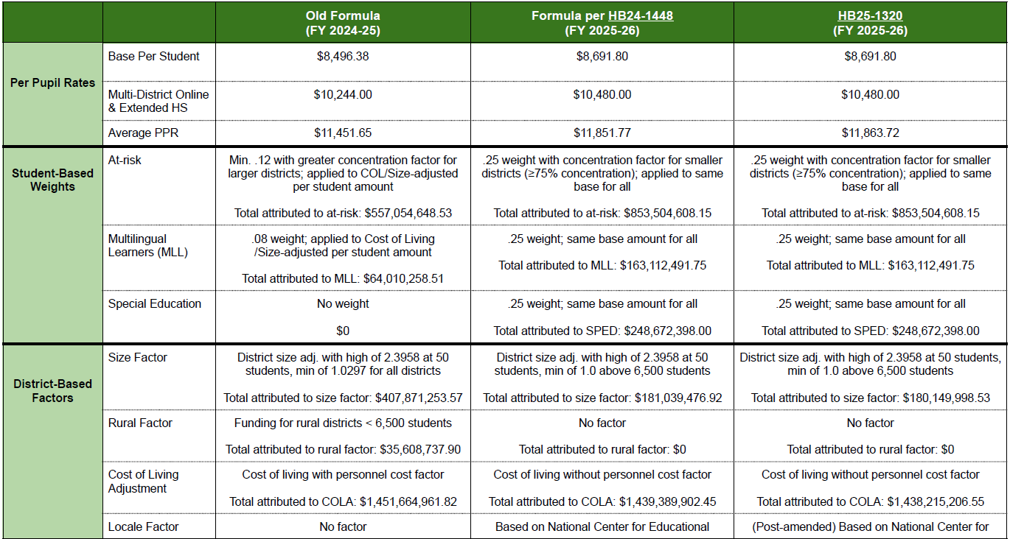
School Finance Comparison

Slide 11
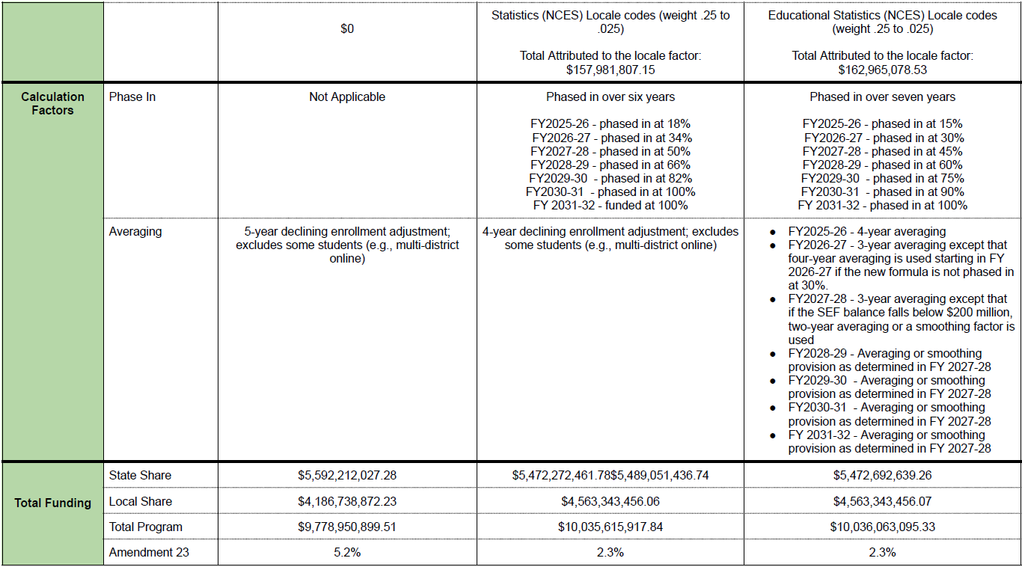
School Finance Comparison continued

Slide 12
Total Program Breakdown Between State Local Share
Fiscal Year | Total Program |  | State Share |  |  | Local Share
 | Total | Per Pupil | Total | Per Pupil | Percentage of Total Program | Total | Per Pupil | Percentage of Total Program
FY 16-17 | $ 6,372,827,460.0 | $ 7,419.38 | $ 4,115,122,505 | $ 4,791.31 | 64.57% | $ 2,257,704,955 | 2,628.07 | 35.43%
FY 17-18 | $ 6,627,868,142.0 | $ 7,662.02 | $ 4,120,519,822 | $ 4,763.54 | 62.17% | $ 2,507,348,320 | 2,898.48 | 37.83%
FY 18-19 | $ 7,067,290,190.0 | $ 8,121.82 | $ 4,468,539,273 | $ 5,135.79 | 63.23% | $ 2,598,750,917 | 2,986.03 | 36.77%
FY 19-20 | $ 7,605,920,602.0 | $ 8,488.02 | $ 4,628,743,996 | $ 5,166.05 | 60.86% | $ 2,977,176,606 | 3,321.97 | 39.14%
FY 20-21 | $ 7,238,095,116.0 | $ 8,121.01 | $ 4,224,466,369 | $ 4,740.79 | 58.36% | $ 3,013,628,747 | 3,380.22 | 41.64%
FY 21-22 | $ 7,989,006,868.0 | $ 9,014.17 | $ 4,709,740,482 | $ 5,314.35 | 58.95% | $ 3,279,266,386 | 3,699.82 | 41.05%
FY 22-23 | $ 8,438,652,216.0 | $ 9,595.86 | $ 4,989,526,241 | $ 5,673.75 | 59.13% | $ 3,449,125,975 | 3,922.11 | 40.87%
FY 23-24 | $ 9,173,863,406.0 | $ 10,669.61 | $ 4,995,052,575 | $ 5,809.78 | 54.45% | $ 4,178,810,831 | 4,859.82 | 45.55%
FY 24-25 | $ 9,778,950,900.0 | $ 11,451.65 | $ 5,592,212,027 | $ 6,548.76 | 57.19% | $ 4,186,738,873 | 4,902.89 | 42.81%
FY 25-26 (Proposed) | $ 10,036,036,095.0 | $ 11,861.55 | $ 5,472,692,639 | $ 6,469.34 | 54.53% | $ 4,563,343,456 | 5,392.21 | 45.47%
4

Slide 13
Notable House Bills
Other financially focused education related house bills:
HB25-1059 - Encourages policies to reduce food waste and seek grants or technical assistance
HB25-1061 - Creates community schoolyards grant program
HB25-1158 - Requires contract terms for vendors with digital content
HB25-1245 - Requirements re: HVAC infrastructure improvements
HB25-1274 - Refers 2 ballot issues to the voters at the November 2025 election
HB25-1199 - Allows for alternate real property tax payment option

Slide 14
Notable Senate Bills
Other financially focused education related senate bills:
SB25-023 - Adjusts local government audit exemption thresholds
SB25-028 - Requires PERA actuarial experience study and audit in law (Became law)
SB25-119 - Measures to modify the Department of Early Childhood
SB25-147 - Modifies management of PERA board
SB25-125 - Repeals School Finance Rules 3.04, 5.04, and 5.12(6) which will eliminate the transfer enrollment exception for students
SB25-153 - Requires reporting of marketing, recruitment, lobbying, contractor, education management provider expenditures and all sources of revenue
SB25-167 - Concerning the investment of state fund money to benefit Colorado communities
SB25-214 - Modifies Healthy School Meals for All reimbursements under different scenarios based upon election results

Slide 15
Charter Intercept

Slide 16
Charter Intercept
CDE and Treasury are working together to determine the processes for charter intercepts in FY 2025-26
SB 24-017 allows school districts to choose to have their State Share payments funded over 9 months instead of the traditional 12 months
Trustees have established payment schedules based on a 12 month cycle
More information will be provided as it becomes available.

Slide 17
At-Risk Reminders and
At-Risk FPP Subcommittee

Slide 18
HB 25-1320 Specific to At-Risk Funding Inputs
CDE is following the development of HB 25-1320, currently making its way through the legislative process.
As of 4/15/2025, the current draft of bill HB 25-1320 delays implementation of the new at-risk measure another year, to begin with the 2026-27 school year.
This new at-risk measure was originally outlined in HB 22-1202. As written, it will include:
Funding-eligible free lunch students who are directly certified or categorical eligible, and
A neighborhood socioeconomic status index linked to each student’s census block group (i.e., based on their address)

Slide 19
Planning for the 2025-26 school year
Anticipating that implementation of the new measure will be delayed, for the 2025-26 school year, districts and schools should continue:
Distributing, collecting and processing income forms
Applications for Free and Reduced-Price Lunch Meals, Family Economic Data Survey (FEDS) forms, and/or Combo forms (as applicable)
Directly certifying students as free or reduced-price lunch eligible
Maintaining categorical eligibility designations and lists
Collecting student-level census block data

Slide 20
Reminders
Student-level data from the Student October Count data collection is used to determine each district’s At-Risk Count.
At-Risk Counts are included in each district’s Total Program funding as outlined in the School Finance Act.
Currently At-Risk Counts include students:
In Grades K through 12
Who are funding eligible and
Reported as free or reduced-price lunch eligible

Slide 21
At-Risk Student Documentation
Districts must have documentation for each student to support free or reduced-price lunch eligibility reported in the Student October Count data collection.
Eating lunch for free (i.e., through participation in CEP or HSMA) is not the same as being eligible for free or reduced-price lunch.

Slide 22
At-Risk Count Resources
School Auditing Office’s At-Risk Count website
2025 At-Risk Count Audit Resource Guide (to be published July 1, 2025)
This guide outlines funding and audit documentation requirements for the At-Risk Count
Contact the School Auditing Office with questions
Data Pipeline Interchanges: At-Risk website
Contains information regarding the census block data collection
Contact the At-Risk Measure support team with questions

Slide 23
At-Risk FPP Subcommittee
CDE hosted two sub-committee meetings:
March 25, 2025
April 4, 2025
Discussed:
Recent issues with At-Risk (FRL) reporting in Student October
Potential changes to School Finance Rules re: At-Risk reporting
Potential training approaches

Slide 24
Recent At-Risk Reporting Issues
In December 2024, CDE identified 20,000+ students who were incorrectly reported as Paid in the 2024 Student October Count when they were either Free or Reduced-price eligible.
These reporting issues resulted from a variety of factors.

Slide 25
General FRL Requirements
Student October:
Student status as of October 1st plus carry forward from prior year
Carry forward through October 1st (more than 30 school days in many cases)
CEP schools are allowed to carry-over student status for 4 years
Nutrition:
Student status for the CEP cycle is April 1st
Carry forward for 30 school day

Slide 26
CEP Sites
With the introduction of Health School Meals for All in the 2023/2024 school year, the number of CEP sites has increased exponentially:
SY 24-25 1,359 CEP Sites
SY 23-24 600 CEP Sites
SY 22-23 118 CEP Sites
SY 21-22 101 CEP Sites

Slide 27
At-Risk Rules Reviewed
6.02(2) Absent the current year documentation evidencing any lunch eligibility status, a district may submit the pupil's prior year documentation, which shall be valid evidence through the applicable count date of the current year.
6.02(4) For a district with a school or schools operating under a federal Special Assistance Certification and Reimbursement Alternative, documentation must include evidence of the pupil’s inclusion on the district’s base year count and further evidence that such pupil remains included in a Special Assistance Certification and Reimbursement Alternative site within the district’s pupil enrollment. This method shall not be available if a district alters the boundaries of the participating schools.

Slide 28
At-Risk FPP Subcommittee Recommendations
Maintain Rule 6.02(2) regarding carryover through October Count date
Districts will need to track student status at expiration of USDA carryover AND expiration of Student October carryover
Remove Rule 6.02(4) allowing four year carry forward for CEP schools
FRL status for Student October will be based as of October count date with prior year carryover as applicable
Host joint trainings for pupil count, IT, and nutrition staff
Look for announcement of training date soon

Slide 29
School Finance Rules Clean-Up

Slide 30
Proposed School Finance Rule Clean-Up
DELETE 6.02(4) For a district with a school or schools operating under a federal Special Assistance Certification and Reimbursement Alternative, documentation must include evidence of the pupil’s inclusion on the district’s base year count and further evidence that such pupil remains included in a Special Assistance Certification and Reimbursement Alternative site within the district’s pupil enrollment. This method shall not be available if a district alters the boundaries of the participating schools.

Slide 31
Proposed School Finance Rule Clean-Up (con’t)
TBD CHANGES based upon HB 25-1320 including data collection of student-level census block data

Slide 32
Proposed School Finance Rule Clean-Up (con’t )
1.14 “Private school pupil” means a pupil enrolled in an independent or parochial school which provides a basic academic education pursuant to Section 22-33-104(2)(b), C.R.S. and who HAS is also BEEN enrolled BY A PARENT and receiving instruction part-time from a Colorado public school.
POTENTIAL other changes to provide additional clarification regarding private school and district partnerships

Slide 33
Proposed School Finance Rule Clean-Up ( con’t )
TBD CHANGES consistent with memo that homebound, expelled and incarcerated students exclusively taking supplemental online courses do not need to be enrolled in an online program

Slide 34
School Finance Rule Changes Per SB 25-125
DELETE 3.04 The applicable 11-day count period is defined as the five school days preceding the applicable count date, the applicable count date, and the five school days following the applicable count date as determined by the district’s adopted calendar.

Slide 35
School Finance Rule Changes Per SB 25-125 continued
DELETE 5.04 Pupils that first establish attendance after the applicable count date but within the applicable 11- day count period may be included in a district’s pupil membership only if one of the following exceptions applies:
5.04(1) The pupil (1) moves to Colorado within 30 calendar days preceding the district’s applicable count date and (2) establishes attendance after the applicable count date, but before the end of the 11-day count period.
5.04(2) The pupil (1) established attendance during the current school year prior to the applicable count date in any Colorado public school district, (2) transfers and establishes attendance in the receiving district after the applicable count date, but before the end of the 11-day count period, and (3) does not meet the attendance requirements for funding at the sending district.

Slide 36
School Finance Rule Changes Per SB 25-125 continued 2
DELETE 5.12(6) If a pupil transfers from one Colorado public school district to another, after the pupil enrollment count date but within the 11-day count period, the pupil is eligible for funding at the receiving district only if the pupil did not meet the funding criteria at the sending district and the pupil established attendance during the current year in a Colorado public school prior to the pupil enrollment count date.

Slide 37
Potential Changes Given SB 25-125
3.05 In no instance shall a district solicit pupils from other districts for the sole purpose of attendance FOR THE PUPIL ENROLLMENT COUNT DATE during the applicable count period.
3.06 In no instance shall a district solicit pupils from the home school population solely for purposes of attendance FOR THE PUPIL ENROLLMENT COUNT DATE during the applicable count period.

Slide 38
Discussion of Potential Changes
Potential discussion with State Board of Education if lunch should be required or if guidance in Audit Resource Guide is sufficient:
Currently decisions regarding lunch periods are left to the discretion of districts
Studies indicate students should have at least 20 minutes of seated lunch time.
For contracted services:
Form AUD108 requires contracted services must be “of comparable quality and meet the same requirements and standards” at school/district (e.g. match typical lunch period at district school)
Employment requirements may also be a model (e.g. 30-minute meal break for 5 hours and 10-minute rest break for every 4 hours)

Slide 39
Office of the State Auditor

Slide 40
Grant Updates

Slide 41
Grant Updates:
Contracts (IDC) and Other Updates
Updated Uniform Grant Guidance – Effective Dates and Key Changes
On April 22, 2024, the Office of Management and Budget (OMB) finalized and released revisions to the Uniform Grant Guidance for Federal Assistance.
These changes take effect for all federal awards issued on or after October 1, 2024.
In addition to the revised guidance, OMB provided clarification on how these changes can be applied to existing awards.
Specifically, awardees may choose to apply the new guidance to federal awards issued after June 21, 2024. CDE has designated July 1, 2024, as the effective date for adopting the new guidance on existing awards issued after June 21, 2024, for fiscal reporting consistency, should your LEA choose to do so. (retroactive application in 2CFR dated 2/2025, https://www.federalregister.gov/d/2025-02396/p-13).
Based on this, CDE emphasizes the following considerations:
If your organization plans to adopt the revised Uniform Grant Guidance on an existing award issued after June 21, 2024 (with CDE’s adopted
effective date of July 1, 2024), there are many considerations in adopting this change in threshold, ie., updating internal policies and procedures, correcting capital entries, etc.
For grants managed in GAINS, please be aware of the following system limitations:
GAINS cannot apply different Indirect Cost Rates (ICRs) within a single award period. It does not support transitioning from one ICR to another mid-award.
GAINS is unable to calculate ICR differences for contracts when the applicable thresholds change part way through an award period.
For any questions or concerns about how this may apply to your award, please reach out to your GFMU Analyst.

Slide 42
Grant Updates:
Contracts (IDC) and Other Updates Cont.
Specific Updates:
Single Audit Threshold: Raised from $750,000 to $1,000,000 in federal expenditures, reducing audit burdens for smaller recipients.
Fixed Amount Subawards: Threshold requiring prior written approval increased from $250,000 to $500,000. ​
Equipment and Supplies: Capitalization threshold for equipment and unused supplies increased from $5,000 to $10,000. ​
Indirect Cost Rate: De minimis indirect cost rate increased from 10% to 15% of Modified Total Direct Costs (MTDC).
Contract/Purchased Services: Threshold of amount of contract exclusions increased from $25,000 to $50,000.

Slide 43
Grant Updates:
Year-End Reminders
For reimbursements to post by 6/30, submit RFF/FR no later than 6/2/24
Reconcile all non-categorical grants prior to year end to confirm Grants Receivable or Unearned Revenue - remember, NO federal Grant should have Unearned Revenue. MANY State awards will no longer allow carryover (see subsequent slides) so review all STATE Unearned Revenue as well.
Reconcile annual grant revenues to your CDE Distribution Tool and tie to General Ledger
Write off old grant receivables (if not accurate) to the General Fund
Ensure all non-categorical grant revenues = grant expenditures
State competitive grants can have Exp > Revenue, just can’t have Rev > Exp
Are your final budget revisions in?
It’s a good time to review grant files and make sure your supporting documentation is in shape!
Think about trainings for FY 25-26 on Grants Management, etc., that GFMU would be happy to provide your LEA.

Slide 44
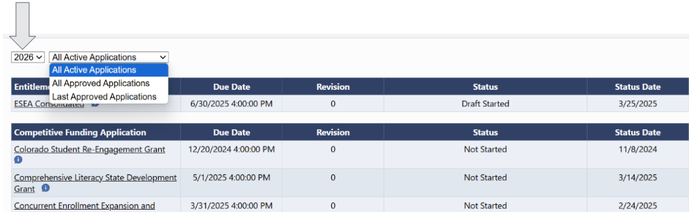
Grant Updates:
GAINS Reminders
Funding Application Fiscal Year
2025 and 2026 grants are now available in GAINS
Version of applications are available

Slide 45
Grant Updates:
Final Expenditure Report (FER) Requirements
The FER (AFR) closes out grant applications annually and is required for both
State and Federal awards.
For State Awards - Applicants will report the amount expended (obligated) up to 6/30.
For Federal Awards - FER is required annually regardless if it is a multi-year award.
General Ledgers are REQUIRED to be submitted upon the completion of a FER (AFR).
If the Grant is NOT yet in GAINS, but still managed outside of GAINS, an AFR and General Ledger is still required in the same schedule and submitted through the AFR link.
Expenditures reported on the FER (AFR) MUST TIE to the expenditures indicated in the General Ledger.
For awards OUTSIDE of GAINS a review of the AFR and general ledger will determine compliance or if a return of funds is required.
For FEDERAL awards, AT NO TIME should expenditures EVER be less that reimbursements requested. This is against CMIA regulation and if this is the case, awardees MUST reach out to GFMU immediately (there is a 3 day window before we are in violation).
Note: As more awards are managed through GAINS, AFRs and the AFR Submission tool will be sunsetted.

Slide 46
Grant Updates:
Elimination of No Cost Extensions for State Grants &
Return of Funds Process
After a review state fiscal policies and laws related to state grants—CDE has determined it cannot allow unspent funds to carry over or extend the grant period for competitive state awards, beginning in FY 2024-25.
Important Highlights:
Legislation authorizing the award must specifically approve the carryover of funds from one fiscal year to the next. No-cost extensions will continue to be allowed where statute explicitly authorizes it. If statute is silent, a no cost extension will not be considered.
Categorical funds are generally formula funds, are generally not competed, and may not utilize Grant Award Letters, may be strictly distributions, and would be exempt. An example would be EASI, where the legislation of the award provides multiple years to expend the funds and carry out the program.
Each award is going through a review to ensure the appropriate category is determined and CDE program managers will reach out to awardee program managers if their grant is impacted.
Awardees will be notified if their state award does not qualify for the exemption. This notification will occur via email as well as through a GAINS notification.

Slide 47
Grant Updates:
Elimination of No Cost Extensions for State Grants &
Return of Funds Process Continued
General Housekeeping:
State grant funds must be obligated and spent within the fiscal year in which they were appropriated.
FER (AFRs) will be due September 30th, along with a General Ledger for verification of unspent funds.
We will be reviewing for unearned revenue as well and will request those entries to be reversed for state funds.
Unspent State Funds not exempted, will be required to be returned to CDE by 10/31, beginning this fiscal year.
GFMU Analyst will review FER/AFR and if a determination is made that a return of funds is required, GFMU will provide instructions to return via EFT (we will not be posting this detail online).
If a FER/AFR is not received by 9/30, future funding or awards may be withheld until the report is complete and a General Ledger is submitted.

Slide 48
Grant Updates:
Return of Funds Process in GAINS
For all awards in GAINS, if it is determined there are LESS expenditures than funding received, GAINS will create a return of funds, indicating that a refund is required.
Information on how to return funds will be provided from GFMU.
Grants cannot be closed out until CDE has received the refund.
Refunds are required no later than 10/31.
Failing to return those funds or submit a FER/AFR will result in future payments being withheld until received.
GAINS FER Small Bite
Written Instructions
Recording

Slide 49
UPK Updates

Slide 50
UPK Updates
CDE has not received updates on:
Clarification on CDEC’s requested quarterly reports given district annual reporting to CDE and EDAC requirements for data demands
Process for CDEC overpayments to be adjusted in upcoming payments
Summary of CDEC’s LCO rates for FY 2025-26
CDEC hosts office hours for all providers. Office hours are noted on the CDEC Calendar at https://cdec.colorado.gov/
Upcoming office hours are
Monday April 28th at 1pm
Monday May 26th at 1pm
Monday June 23rd at 1pm

Slide 51
Other Topics of Interest

Slide 52
Other Topics of Interest - CASBO
SFO preferred provider - SFO CPE Certification will be issued for attending CASBO Conferences
Gina Lanier from Adams 12 Five Star Schools is running for VP of International ASBO - We'd appreciate your support (Voting Fall of 2026)
Committee Opportunities - Membership and Professional Development Committees, if interested in participating contact lacey.fisher@coloradoasbo.org
Reminder of the upcoming conference - CASBO 72nd Annual Conference and Exhibits, April 23-25, 2025, Pueblo CO

Slide 53
Other Topics of Interest - CGFOA
Updates and Upcoming events with CGFOA
2nd Annual CGFOA Top Golf Social
May 2nd 2025
Audit 101 training
CGFOA: www.cgfoa.org
Chelsea Bunker, chelsea@cgfoa.org

Slide 54
Other Topics of Interest
CASB
CASE-DBO
COCPA

Slide 55
Upcoming Meetings

Slide 56
Upcoming Meetings
Thursday, June 26, 2025
Facilitator: Cathy Watts, Academy 20

Slide 57
Meeting Adjourn

