Slide 1
Rural Education Achievement Program (REAP)
March 2022

Slide 2
What is REAP?
REAP (or Title V, Part B) is intended to address the unique needs of rural school districts that may lack the personnel and resources to compete effectively for Federal competitive grants and that often receive grant allocations in amounts too small to be effective in meeting their intended purposes.
REAP consists of two formula grant programs:
Rural and Low-Income School (RLIS) – U.S. Department of Education makes grants to State educational agencies (SEAs) and SEAs administer subgrants
Small, Rural School Achievement (SRSA) – U.S. Department of Education makes grants directly to local educational agencies (LEAs)

Slide 3
RLIS Eligibility
A local educational agency (LEA) is eligible to participate in the RLIS program if it meets the criteria of being both low-income and rural:
To be considered low-income, at least 20 percent of the children (ages 5 to 17) served by the LEA must be from families with incomes below the poverty line, based on data from the U.S. Census Bureau’s Small Area Income and Poverty Estimates (SAIPE).
The U.S. Department of Education is required to use SAIPE data as the metric in determining whether an LEA meets the low-income requirement.
When SAIPE data is available for an LEA, States are not permitted to submit alternate poverty data.
To be considered rural, all schools comprising the LEA must have a school locale code of 32, 33, 41, 42, or 43 (as assigned by NCES, the National Center for Education Statistics), or meet the State’s rural definition.
School locale code 32 – Distant Town
School locale code 33 – Remote Town
School locale code 41 – Fringe Rural
School locale code 42 – Distant Rural
School locale code 43 – Remote Rural

Slide 4
SRSA Eligibility
A local educational agency (LEA) is eligible to participate in the SRSA program if it meets the criteria of being both small and rural:
To be considered small, an LEA must have a total average daily attendance (ADA) of fewer than 600 students, or exclusively serve schools that are located in counties with a population density of fewer than 10 persons per square mile.
ADA is determined based on a census conducted, between the start of the school year and December 1, of the number of students in attendance in kindergarten through grade 12 at the schools served by each LEA.
For the purposes of REAP eligibility, CDE utilizes data from the Student October Snapshot from the preceding year to calculate ADA.
To be considered rural, all schools comprising the LEA must have a school locale code of 41, 42, or 43 (as assigned by NCES, the National Center for Education Statistics), or meet the State’s rural definition.
School locale code 41 – Fringe Rural
School locale code 42 – Distant Rural
School locale code 43 – Remote Rural

Slide 5
Dual-Eligibility
LEAs meeting the eligibility requirements for both RLIS and SRSA are considered dual-eligible.
Under the “Choice of Participation” provision in ESEA, Title V, Part B, Subpart 2, Section 5225, an LEA that is eligible for both SRSA and RLIS may only receive funds under one of those programs.
If an LEA intends to participate in SRSA, they must submit the U.S. Department of Education’s SRSA Application.
If an LEA intends to participate in RLIS, they should not complete the SRSA Application. The U.S. Department of Education will automatically include that LEA on the list of LEAs to receive RLIS funds.

Slide 6
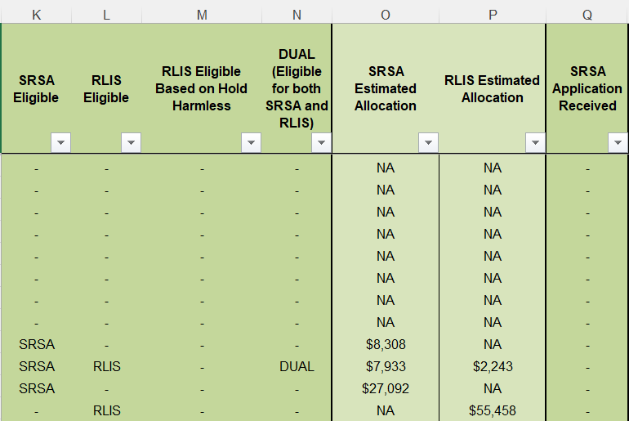
REAP Master Eligibility Spreadsheet
LEAs can view their eligibility for RLIS and SRSA on the REAP Master Eligibility Spreadsheet

Slide 7
Considerations for Dual-Eligible LEAs
Topic | RLIS | SRSA
Award Disbursement | SEAs disburse funds to LEAs | U.S. Department of Education disburses funds to LEAs
Application for Funds | LEAs submit budgets as part of CDE’s Consolidated Application | LEAs complete ED’s SRSA Application
Uses of Funds | Title I, Part A activities Title II, Part A activities Title III activities Title IV, Part A activities Parental involvement activities | Title I, Part A activities Title II, Part A activities Title III activities Title IV, Part A activities Title IV, Part B activities
All LEAs eligible for SRSA may participate in the Alternative Fund Use Authority (AFUA). Dual-eligible LEAs may participate in AFUA even if they elect to receive RLIS funds instead of SRSA funds.
AFUA is designed to allow SRSA-eligible LEAs greater flexibility in spending the funds they receive under Title II, Part A and Title IV, Part A to best address their particular needs. Under AFUA, LEAs are able to use their Title II, Part A and Title IV, Part A funds to pay for activities under any of the allowable uses for SRSA grant funds.

Slide 8
SRSA Application
Each SRSA eligible and dual-eligible LEA will receive an email invitation that contains a direct link to its unique SRSA application and estimated SRSA award (and RLIS award, if applicable)
It should take no more than 30 minutes for an LEA to fill out and submit the application
LEAs must submit a GEPA statement as part of their application:
Section 427 of the General Education Provisions Act (GEPA) requires that an applicant describes the steps they propose to take to ensure equitable access to, and participation in, the SRSA program
The GEPA statement should explain the LEA’s proposed use(s) of SRSA grant funds, and how the LEA will use SRSA funds in a way that addresses barriers to access and does not discriminate on the basis of any federally-protected category
After submitting the application, an LEA will receive a confirmation email with a list of important next steps
SRSA applications must be submitted by April 15, 2022
Contact: REAP@ed.gov

Slide 9
Contact Information
Tina Negley
Data, Accountability, Reporting and Evaluation (DARE) Coordinator
Colorado’s REAP State Coordinator
Negley_T@cde.state.co.us
720-766-2793

