Slide 1
New At-Risk Measure for School Finance
May 2023
r

Slide 2
At-Risk Measure Working Group Report
HB 22-1202 At-risk Student Measure For School Finance
Created a new At-Risk Measure for the School Finance formula
Established a working group to provide input on several topics
The working group’s report was submitted to the General Assembly on January 30, 2023:
Report of the At-Risk Measure for School Finance Working Group
Notes:
The at-risk measure working group consisted of school district superintendents, school district CFOs, school social workers, school principal, representatives from advocacy organizations, and state agency representatives.

Slide 3
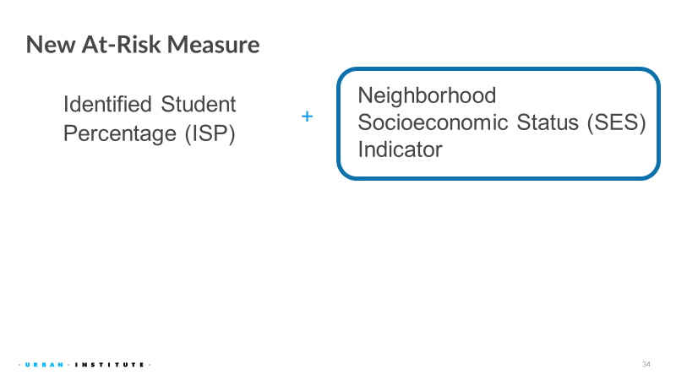
New At-Risk Measure

Slide 4
Current At-Risk Measure
Free Lunch Eligible Students
Direct Certified Students
  SNAP, TANF, FDPIR
Categorically Eligible Students
  Homeless, Foster Care, Migrant, Head Start, Runaway, Extended Eligibility
Qualified through Free and Reduced-Price Lunch (FRL) Application or FEDS form
Reduced-Price Lunch Eligible Students
Qualified through FRL Application or FEDS form
Notes:
Food Distribution Program on Indian Reservations

Slide 5
New At-Risk Measure
Free Lunch Eligible Students Identified Student Percentage
Direct Certified Students
  SNAP, TANF, FDPIR, Medicaid
Categorically Eligible Students
  Homeless, Foster Care, Migrant , Head Start, Runaway, Extended Eligibility
Qualified through Free and Reduced-Price Lunch (FRL) Application or Family Economic Data Survey (FEDS) form
Reduced-Price Lunch Eligible Students
Qualified through FRL Application or FEDS form
Neighborhood Socioeconomic Status (SES Indicator)
Note: Districts will still need to collect and process FRL applications for nutrition programs!

Slide 6
Student October Data Collection Implications
Neighborhood Socio-Economic Status
  CDE is currently working on developing a process that would minimize the data collection needs
    During the summer/fall 2023 - Use modeled data and/or optional data collection from volunteer districts
    FY 2024-25 - Mandatory data collection
Notes:
Modelled data is based upon all children under 18. It is not limited to students in public schools (e.g. it includes children in private schools and homeschool students). Additionally, it does not account for student choice.
FY2023-24 Develop student level SES Student Interchange and pilot with volunteer districts

Slide 7
Implications for Free and Reduced-Priced Lunch Data
CDE will continue to have Free and Reduced-Price Lunch (FRL) data in SY23-24 and beyond
FRL Counts and Percentages will change starting in SY23-24
  Medicaid eligible students will increase Free lunch counts (estimated increase from 7.5% to 31%)
  FRL Applications will decrease with HSMA as all students in participating districts will eat for free
  FRL Applications will decrease as more schools and districts implement CEP which is mandatory if participating in HSMA
  USDA rule changes may further increase the number of CEP eligible schools and districts

