Slide 1
Kindergarten School Readiness:
Assessment, Plans, and State Reporting
Schools of Choice Unit
Bill Kottenstette, Executive Director
Elizabeth Anzalone, Charter School Technical Assistant Lead
Presenters

Slide 2
Colorado’s Achievement Plan for Kids (CAP4K)
Align Colorado’s preschool through postsecondary system.
Close gaps early and prevent other gaps from starting.
Identify needs to provide responsive learning environment.
Support later school success.

Slide 3
Colorado’s Definition of School Readiness
School readiness describes both the preparedness of a child to engage in and benefit from learning experiences, and the ability of a school to meet the needs of all students enrolled in publicly funded preschool or kindergarten. School readiness is enhanced when schools, families, and community service providers work collaboratively to ensure that every child is ready for higher levels of learning in academic content.
Readopted by the State Board of Education in 2017

Slide 4
Statutory Requirements
CAP4K includes provisions related to school readiness for the State Board of Education, local education providers, and CDE.
CAP4K
CDE
Local Education Providers
State Board of Education

Slide 5
CAP4K Requirements
State Board of Education – C.R.S. § 22-7-1004
Adopt description of school readiness.
Adopt research-based and reliable assessments.
Adopt a system for reporting data.
CDE – C.R.S. § 22-7-1019(1)
Submit annual report to legislative education committees.

Slide 6
CAP4K Requirements (cont.)
Local Education Providers – C.R.S. § 22-7-1019(4)
Administer school readiness assessments.
Create individualized readiness plans informed by school readiness assessment data for each kindergarten student.
Report school readiness data.

Slide 7
School Readiness Domains
CAP4K delineates the following minimum domains to be included in assessment of school readiness.
Physical well-being and motor development
Language comprehension and development
Cognition and general knowledge
Social and emotional development

Slide 8
School Readiness Domains (cont.)
The State Board of Education adopted a reporting format that includes the following domains.
The State Board of Education-approved kindergarten school readiness assessment tools report on these domains.
i.e., DRDP-K, COR, and TS Gold
Physical well-being and motor development
Language comprehension and development
Cognition
Social and emotional development
Math (general knowledge)
Literacy (general knowledge)

Slide 9
School Readiness Assessments C.R.S. § 22-7-1014(2)(a)
Research-based, valid, and reliable to facilitate systematic increase in knowledge, skills, and accomplishments in classroom context.
Administered within the first 60 calendar days of the school year.
Continuing assessments to help direct teacher’s practice and thereby maximize each student’s progress.
Not used to deny student admission or progression.

Slide 10
Individualized Readiness Plans C.R.S. § 22-7-1014(1)(a)
Local education providers must create an individualized readiness plan for each kindergarten student.
Plans must be informed by school readiness assessment data.
CAP4K does not contain specific requirements for plan content.
Local education providers have a high degree of flexibility for the design and content of plans.
e.g., assessment system reports, district templates, CDE template
Plans should incorporate other student plans (i.e., READ plans, RtI plans) but for IEPs.
Plans should be created through collaboration between teacher, families, and caregivers.

Slide 11
School Readiness Data Collection C.R.S. § 22-7-1019(4)
Local education providers must cooperate with CDE in providing information necessary for the annual report.
Charter schools report to school districts.
School districts report to CDE via Data Pipeline.
Data collection window open now until mid-December.
Submission of aggregate data by number of domains in which students demonstrate readiness.
Reporting system intended to provide baseline data for measuring improvement in students’ knowledge and skills over time.

Slide 12
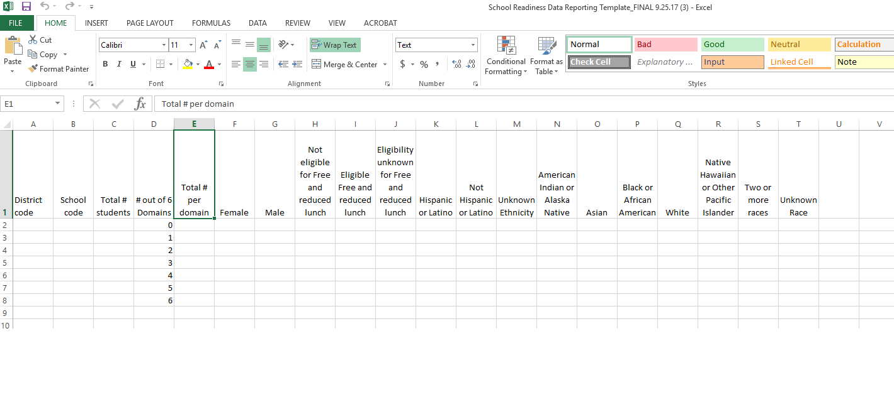
School Readiness Data Reporting Template

Slide 13
Why might charter schools have difficulty reporting?
Many charter schools may be collecting data on 4 domains while being asked to report data on 6 domains.
Many charter schools may have incorporated their literacy indicator into their language and comprehension development indicator rather than their general knowledge indicator.
Charter schools in their first year of reporting that are using assessments that differ from the State Board of Education-approved assessments may report data across these domains in a variety of ways.

Slide 14
What should charter schools do if they have difficulty reporting?
Work with your school district.
Make a good-faith effort to report data in the State Board of Education-approved reporting format.
Report any concerns and challenges to CDE’s Schools of Choice Unit.
REMEMBER: This year is only a trial year!

Slide 15
Waiver of C.R.S. § 22-7-1014 (Assessment)
When a charter school has been relieved from only the assessment component of CAP4K, it is still required to do the following:
Administer an assessment that assesses the 6 domains.
Use a valid and reliable assessment.
Develop an individualized readiness plan informed by school readiness assessment data for each kindergarten student.
Report school readiness data to your school district.

Slide 16
Waiver of C.R.S. §§ 22-7-1014 & 1019 (Assessment & Data Reporting)
When a charter school has been relieved from the assessment and data reporting components of CAP4K, it is still required to do the following:
Administer an assessment, but only to assess the minimum statutory domains.
Use a valid and reliable assessment.
Develop an individualized readiness plan informed by school readiness assessment data for each
kindergarten student.
Address school readiness assessment and data reporting waivers in same RRP.

Slide 17
Components of a School Readiness RRP
Identify which domains will be assessed and with which assessment(s).
Illustrate with a crosswalk.
Provide evidence of the assessment being research-based and reliable.
State your commitment to:
Administering the assessment within first 60 calendar days of school year.
Assessing the domains.
Providing each kindergarten student with an individualized readiness plan informed by the school readiness assessment.
Report school readiness data to school district.

Slide 18
School Readiness and READ Act C.R.S. § 22-7-1014(2)(a)
May use READ Act reading assessment for literacy component of school readiness assessment.
Must be an approved READ Act reading assessment.
e.g., Aimsweb, DIBELS Next, FAST, i Ready, ISIP ER Istation, PALS, STAR Early Learning
OR
May use your own assessment to assess literacy, but must also administer a READ Act-approved reading assessment.

Slide 19
Questions?
For assistance related to school readiness, please contact Emily Kielmeyer in CDE’s Office of Early Learning and School Readiness at (720) 822- 0640 or Kielmeyer_E@cde.state.co.us.
For assistance related to the kindergarten school readiness data collection, please contact Tara Rhodes in CDE’s Office of Early Learning and School Readiness at (303) 866-6243 or Rhodes_T@cde.state.co.us.
For assistance related to waiver requests, please contact Elizabeth Anzalone in CDE’s Office of Schools of Choice at (303) 866-6897 or Anzalone_E@cde.state.co.us.

