Slide 1
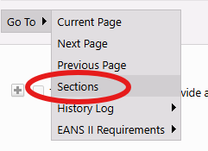
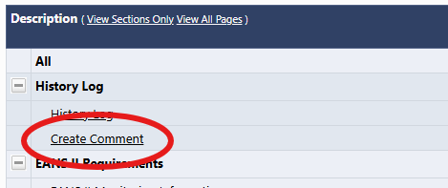
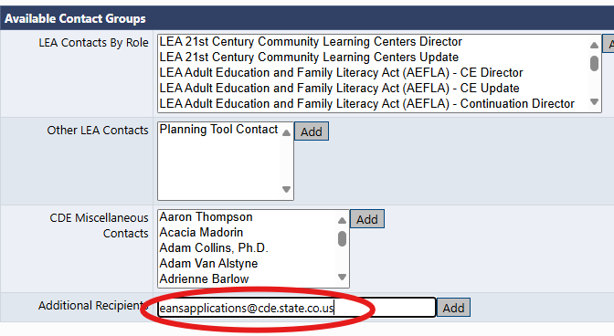
Resubmission GAINS Instructions for Non-Public Schools: EANS II
1) Once you have completed addressing all monitoring comments, click on ‘Save and Go To >> Sections’
2) Click on ‘Create A Comment’.
3) Add a note to the comment field, Stating “ (School Name) has finished addressing the comments provided in the monitoring instrument.
4) click on the “Send Email to Grant Administration...” and add eansapplications@cde.state.co.us to the Additional Recipients box.

