Slide 1
ARP EANS II
Monitoring
Notes:
DC 1-13

Slide 2
Monitoring Overview/Purpose
Monitoring is a collaborative process that includes input from both the non-public school and Colorado Department of Education (CDE). This is to ensure that both parties involved in the Monitoring Process are aware of the expectations and requirements. CDE aims to help non-public schools understand the requirements associated with participating in the ARP EANS II program.
Monitoring emphasizes accountability for using resources to respond to the disruptions caused by the pandemic. A set of clear monitoring activities clarifies for non-public schools, and CDE monitoring personnel, the critical components of this accountability and provides a standard against which non-public schools participation can be measured.
Notes:
EANS I PPT

Slide 3
Monitoring Activities
CDE will use the GAINS system to process and collect evidence from non-public schools to demonstrate compliance. Non-public schools will complete all elements within that system.
Today we will go over:
Accessing GAINS
Monitoring Indicators
Submitting Monitoring Instrument & Notifications
Monitoring Timelines and Resources

Slide 4
Accessing GAINS

Slide 5
Access To GAINS
EANS II Monitoring will take place in CDE's Grant Management System called, GAINS.
All EANS II monitoring recipients should have received an email communication that included the GAINS Non-Public School Access Request.
This form must be complete prior to accessing the GAINS platform. CDE is utilizing this form to setup the appropriate GAINS access for everyone involved with the EANS II Monitoring process.
Once CDE creates you as a user, you will receive a password setup email from noreply@egrantsmanagement.com
Sometimes this email address can end up in your spam/junk folder.
If you received the email but have not setup the password, please let us know at EANSapplications@cde.state.co.us and we will resend the password setup email.

Slide 6
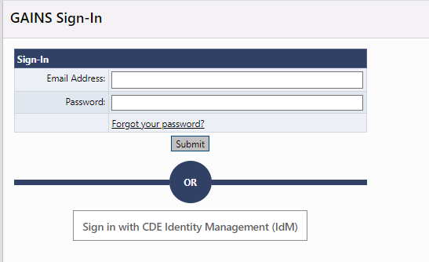
Logging into GAINS
Once on the GAINS Home page, locate the Sign-In button in the top right corner.
Users will sign in using the top "Sign-in" box (the native authentication).

Slide 7
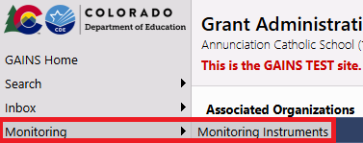
Navigate to the Monitoring Instruments
Once signed in, the left-hand navigation menu will expand with more options.
Hover over Monitoring and select Monitoring Instruments.

Slide 8
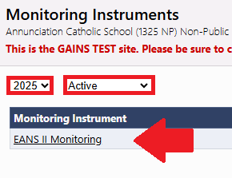
Select EANS II Monitoring
The Monitoring Instruments page will list all applicable instruments for each organization.
Users will want to ensure the Fiscal Year is in 2025 and the Instrument Status is on Active. This will allow users to select the EANS II Monitoring instrument.

Slide 9
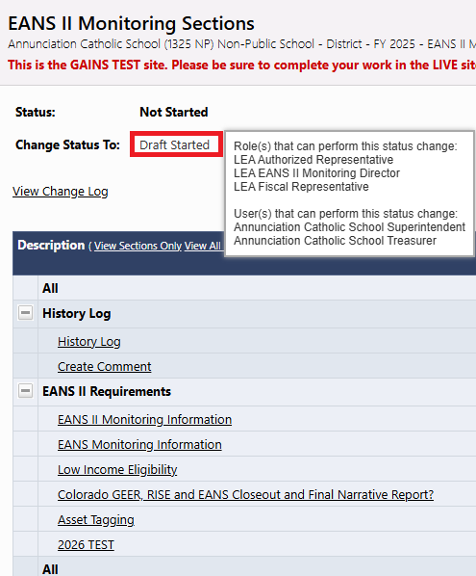
EANS II Monitoring Sections
The sections page for the EANS II Monitoring instrument will open once users select EANS II Monitoring from the Monitoring Instruments page.
The Sections page is the primary location for easy navigation between the pages.
Users will need to change the status to DRAFT STARTED.
Note: Only certain roles can change the status. You can hover over the "Draft Started" link to see the individuals and roles in your organization with these permissions.
Please be aware that the instrument won't be editable until the status is changed to Draft Started!

Slide 10
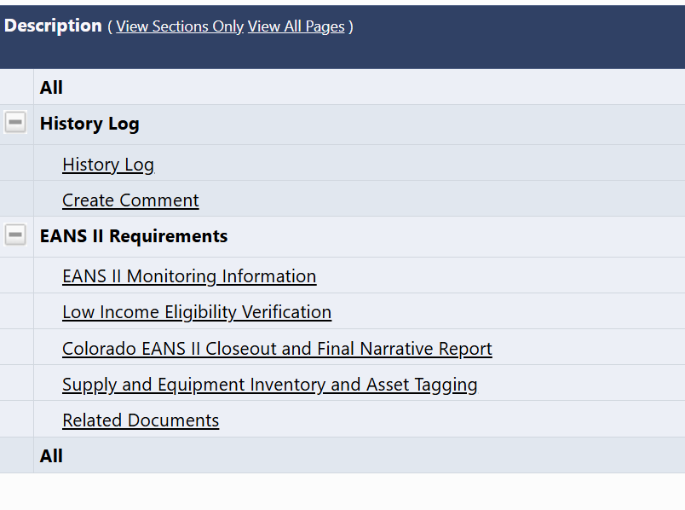
Completing Monitoring Sections
Applicants will click on each section to complete the required information.
EANS II Monitoring Information provides information about monitoring.
Low Income Eligibility Verification will be required for some, not all, applicants.
Colorado EANS II Closeout and Final Narrative Report & Supply and Equipment Inventory and Asset Tagging will be required for almost all applicants.

Slide 11
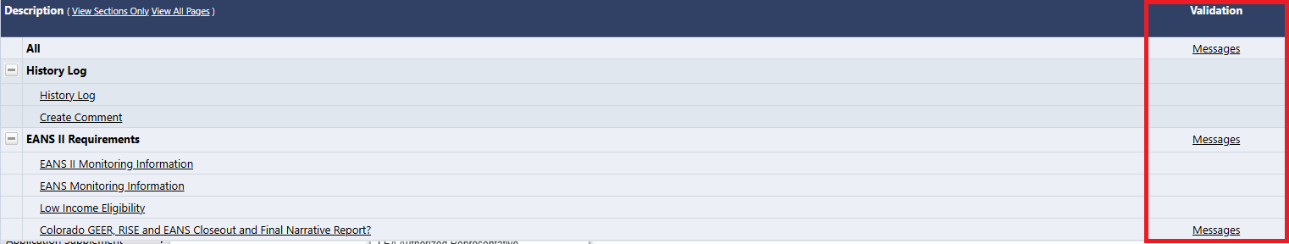
Complete the EANS II Monitoring Instrument
Go through and complete each page within the GAINS platform.
Every item with an asterisk (*) is required and will prevent submission of the instrument until the asterisk has been fill out.
The Validations column will show "Messages" where required content is missing and must be addressed or reviewed before submission.

Slide 12
Monitoring Workflow Status
Submission
Draft Started
Draft Completed
LEA Authorized Representative Approved (or Returned)
Not Started
Review
CDE Director Reviewed (or Returned)
LEA Results Review Started
CDE Consultant Reviewed (or Returned)
Monitoring Closed
CDE Director Reviewed

Slide 13
Monitoring Indicators
Notes:
MVB 14 - 25

Slide 14

ARP EANS II Monitoring Indicators
Monitoring indicators are the items that will be used to assess the school's compliance with the program rules.
Low-income Eligibility Verification
Colorado EANS II Closeout and Final Narrative Report
Supply and Equipment Inventory and Asset Tagging

Slide 15
Low-Income Eligibility Verification
Under section 2002(a) of the American Rescue Plan Act (ARP), services or assistance to non-public schools under the ARP EANS program are limited to “non-public schools that enroll a significant percentage of [students from low-income families] and are most impacted by the [COVID-19] emergency.” CDE set the poverty percentage at 21% and worked with the Colorado Department of Public Health and Environment to identify areas that have been most impacted by COVID-19.

Slide 16
Low-income Eligibility Verification - continue
ARP EANS II participants will not submit enrollment or low-income data to CDE. Instead, some applicants will be required to answer questions about the process used to verify the low-income student count that was provided in the application submitted for funding. The following will prompt the page to be required for schools:
The Non-Public School may have not participated in EANS I Monitoring,
Or the Non-Public School data from EANS I Monitoring had discrepancies.

Slide 17
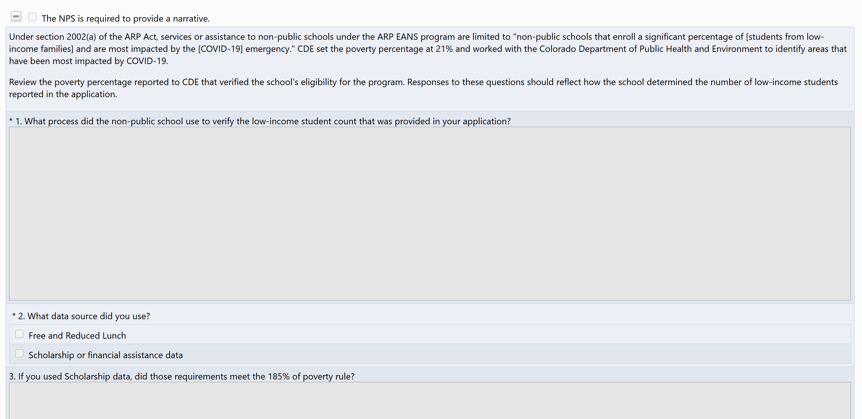
Low Income Eligibility Verification
If required, the box at the top of the page will be checked.
1. This description can include what is collected and when, how forms are reviewed, how and when determinations are made.
2. The data sources listed are the only data sources that were allowed to be used to verify eligibility.
If scholarship or financial assistance data was used, share the school's poverty thresholds that meet the 185% of poverty rule.

Slide 18
Colorado EANS II Closeout and Final Narrative Report
All non-public schools will need to respond to the two questions on this page including:
How did your project contribute to the COVID-19 pandemic in terms of responding to, preparing for, and preventing it from spreading, or to address learning loss?
What populations were served with the grant funds? Select all that apply and please indicate the total population served (teachers and/or students) for each category.
Once you select a checkbox, an additional textbox will appear to indicate the total population served.
Assurances

Slide 19
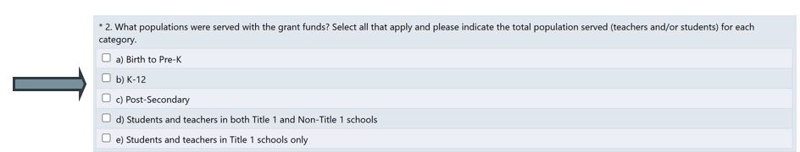
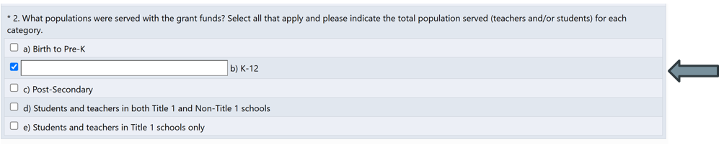
Colorado EANS II Closeout and Final Narrative Report, cont.
First, check all boxes that apply.
Once checked, enter the total population served.

Slide 20
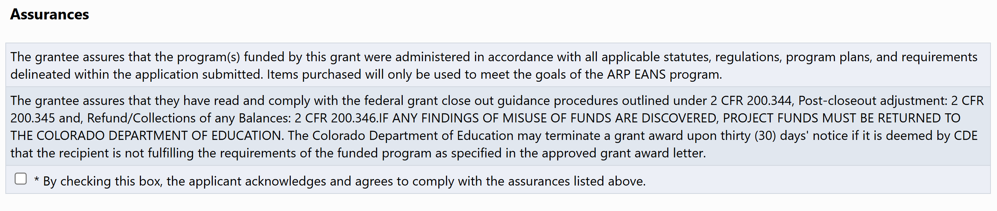
Close out and Final Narrative Report - Assurances

Slide 21
Equipment and Supply Inventory and Asset Tagging
CDE will pre-load information for the Equipment and Supply Inventory section. Non-Publics will then need to respond to the Condition, Continued Use, and what Federal Program the item will support.
Each individual line can contain multiple quantities, report the condition of most of the items listed.
If there are a few items that have a different condition, use the narrative box provided under Question 2 to indicate the different conditions.
If "Other" is selected for the Federal Program, please use the same textbox under Question 2 to specify which Federal Program the items will support or provide additional context.
In your EANS II Monitoring communication email, you should have received your Asset Tagging sheet. Once tags are received, complete the Asset Tagging sheet tab and upload it to question 3 within GAINS.

Slide 22
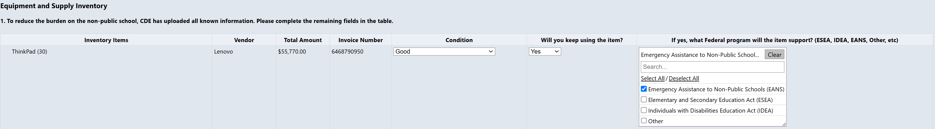
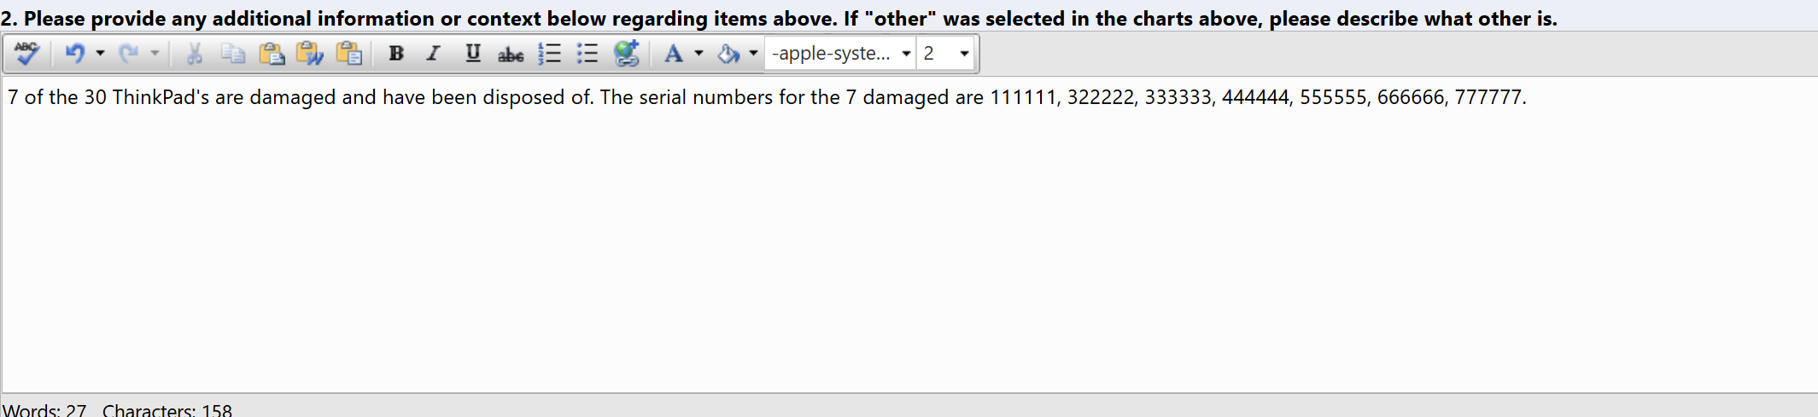
Equipment and Supply Inventory Example
Applicants will need to include serial numbers for the disposed items in the narrative description.

Slide 23
Equipment and Supply Inventory and Asset Tagging, cont.
Asset Tagging
CDE will mail asset tags and instructions for asset tagging.
The spreadsheet sent via email contains a list of items that need to be tagged and serial numbers, if known.
If a serial number for the item purchased is not listed, you will need to add it to the spreadsheet before uploading the completed tagging spreadsheet into GAINS.
Any items that were purchased with ARP EANS II funds but were not listed on the asset tagging spreadsheet can be added.
If additional tags are needed, please reach out to CDE

Slide 24
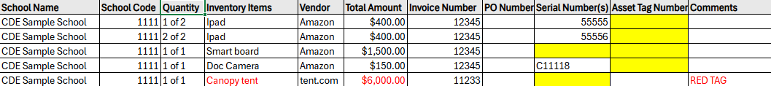
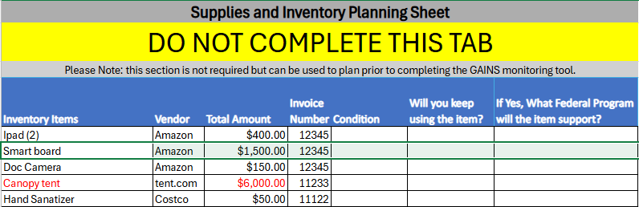
Asset Tagging Sheet
Asset Tagging Tab
Highlighted fields must be filled out
If unable to complete the field, add the reason to the comment column on the asset tag sheet.
Supplies and Inventory Tab
Use this tab for planning purposes. The information listed on this tab is in GAINS and applicants will respond to the questions listed in GAINS.
Does not need to be completed

Slide 25
Submitting ARP EANS II Monitoring Instrument & Notifications
Notes:
DC - Submssion

Slide 26
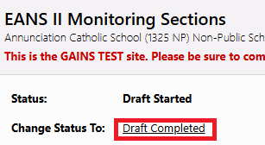
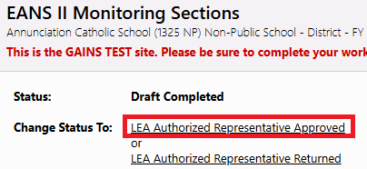
Submit ARP EANS II Monitoring Instrument
Once the validation messages are addressed and you are ready to submit, change the status to Draft Completed.
Once in Draft Completed, the LEA Authorized Representative will be notified that they need to approve the application. The LEA Authorized Representative will then need to login to GAINS and approve the application if there are no changes
The instrument is officially submitted to CDE once in, LEA Authorized Representative Approved status.
Notes:
DC 26-29

Slide 27
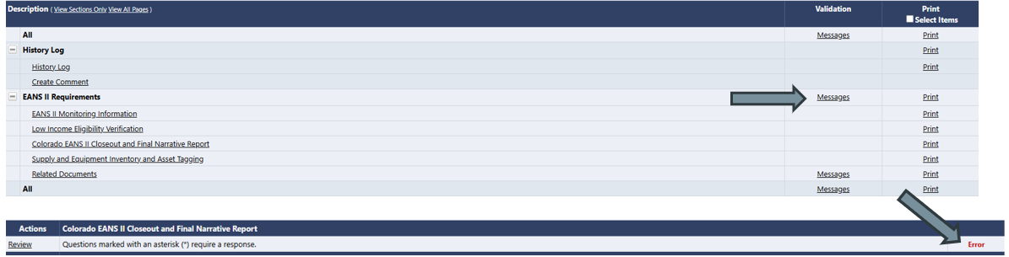
Submitting ARP EANS II Monitoring Instrument - Errors and Warnings
After you have completed all pages, you can check that all required information has been complete in the sections page. There you will see 'messages' for any validation issues.
Error: An error indicates that a response that is required has not been completed. Please return to the section and complete the required elements.
Warning: A warning indicates that a response was expected but not required. It is important to review warnings, but they may not require action by your school

Slide 28
Notifications From GAINS
Each time a status is changed, the person assigned to the LEA Authorized Representative role and the LEA EANS II Monitoring Director role will receive a communication indicating the status of the monitoring instrument.
Some notifications are informational and some require action.
Draft Complete
LEA Authorized Representative Returned
CDE Consultant Returned
CDE Review Reopened
LEA Results Review Started

Slide 29
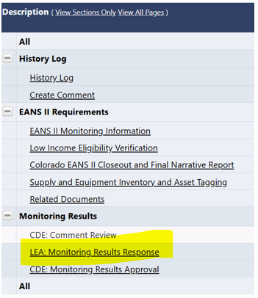
Notifications From GAINS, cont.
Applicants will click on LEA: Monitoring Results Response page to see what needs to be revised or uploaded.
If the section that needs to be revised is a narrative section, applicants will navigate to that section of the monitoring instrument and make the necessary changes to the narrative.

Slide 30
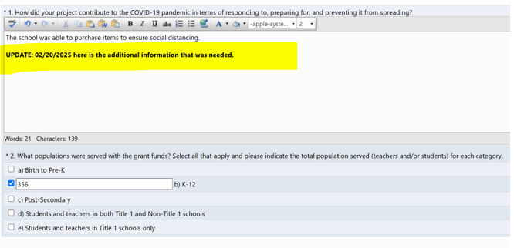
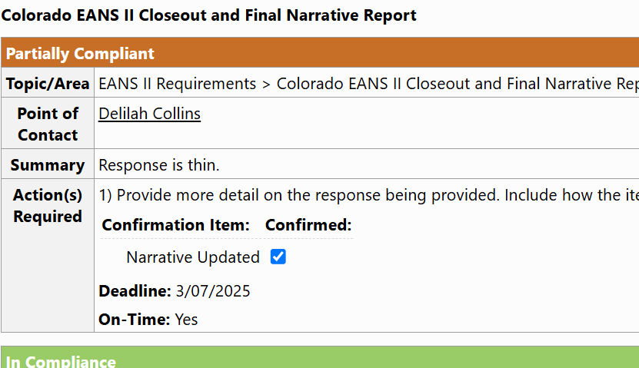
Updating Narratives
For edits to your narrative, please indicate changes by emphasizing the location and date of the change. Once update is made, applicants will confirm the update on the LEA: Monitoring Results Response page.

Slide 31
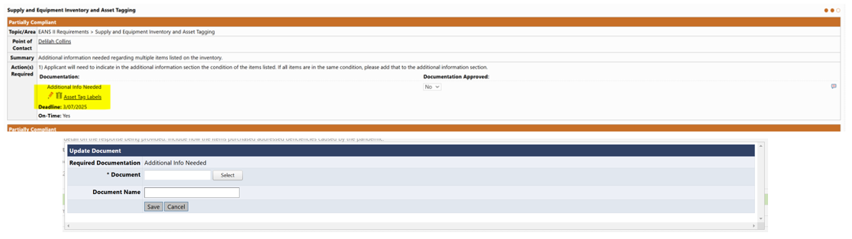
Additional Attachments
Attaching new documents will happen on the LEA: Monitoring Results Response page. Applicants will click on the pencil icon next to the item that needs to be updated. A window will open on the screen to upload the new document.

Slide 32
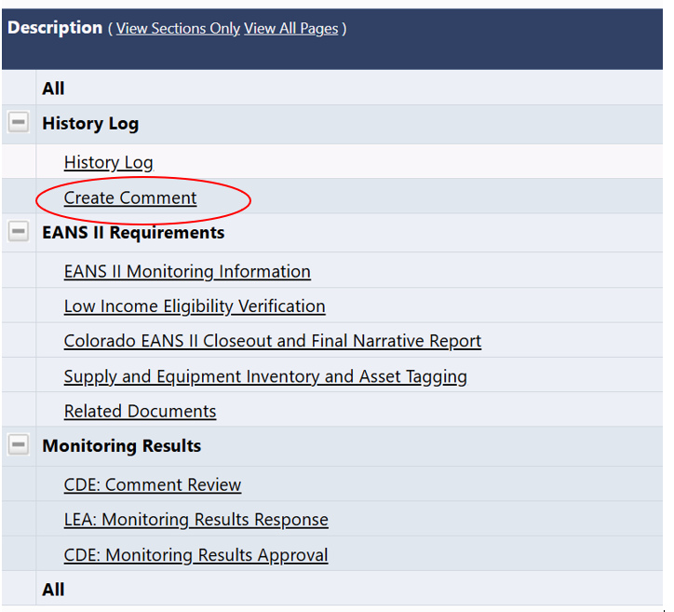
Notifying CDE When Done Addressing Actions
Applicants will need to Create a Comment in GAINS to notify CDE that all actions have been addressed.

Slide 33
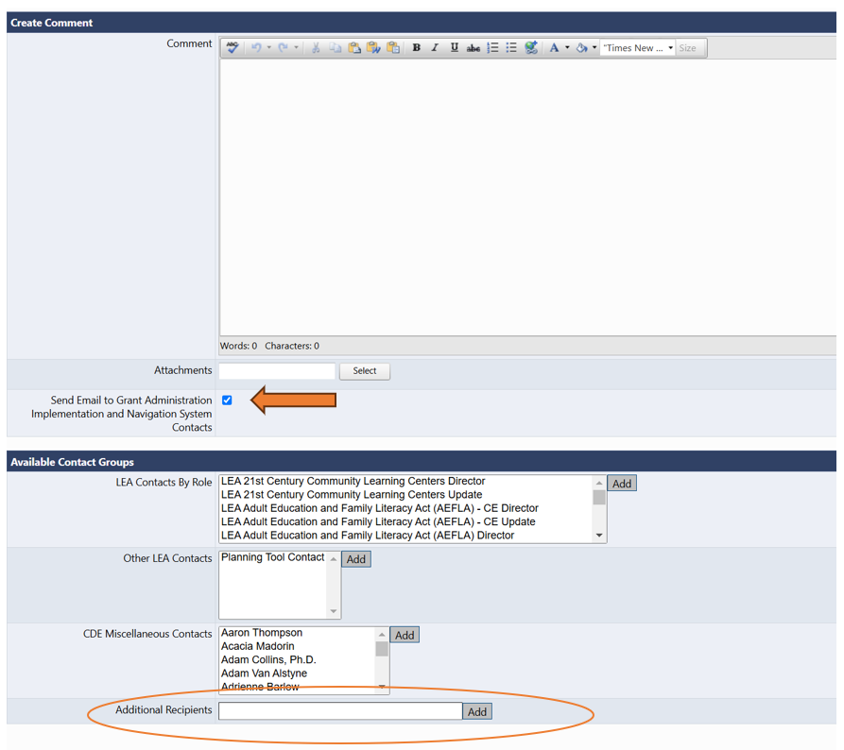
Creating Comments
After selecting Create a Comment, applicants will add the note to the text box indicating all responses have been made, click on the box “Send Email to Grant Implementation and Navigation System Contacts”, then add eans@cde.state.co.us to the “Additional Recipients” box.
Clicking “Save And Go To” will send the message. You can also ‘Go To’ the Sections page from here to return to the navigation screen.

Slide 34
GAINS Walk-through

Slide 35
Monitoring Timeline and Resources
Notes:
MVB Timeline and Resources

Slide 36
Timelines
February 26, 2025: Deadline for submitting Access Request
February 26, 2025: Initial Office Hours
March 5, 2025: Office Hours Q & A
April 25, 2025: Submission Deadline
April 26, 2025- May 30, 2025: CDE Monitoring Assessment period
30 days after CDE Reviewed – Deadline for 2nd submission of monitoring evidence
May 30, 2025: Final Review Complete

Slide 37
Resources
FAQ
Federal Poverty Guidelines
Planning and Evidence Preparation Tool
Instructions for Asset tagging
EANS I and II Disposition Form
EANS II Monitoring website
GAINS Training website
Logging into GAINS non-IdM Instructions

Slide 38
Questions?

Slide 39
Contacts
EANS Mailbox:
eansapplications@cde.state.co.us
Macie Van Bueren: EANS Consultant
van_bueren_m@cde.state.co.us
Phone: 720-648-1838
DeLilah Collins: Grants Program Administration Director
collins_d@cde.state.co.us
Phone: 720-537-9882

