Slide 1
ESSER Expanded Learning Opportunities (ELO) Grant Program
Pursuant to the American Rescue Plan of 2021
May 2022
Notes:
Introduce Speakers

Slide 2
Introduction
Significant interruptions to in-person learning due to the COVID-19 pandemic have led to potentially devastating and long-lasting negative impacts on student achievement, impacting every part of Colorado society. These negative impacts on student achievement are not equal; students furthest from privilege are at risk of the most opportunity loss. Research suggests that while all students may fall behind as much as seven months because of interruptions to in-person learning due to the COVID-19 pandemic, students who are identified as most in need may fall behind as much as ten months, exacerbating already entrenched inequities. Responding to learning opportunity loss and the widening of opportunity gaps could be the greatest challenge our state faces over the next few years, and the state has an urgent and immediate need to provide additional support to ensure students are well prepared for the future.
As Colorado students and families continue to recover from the impacts of the COVID-19 pandemic, the Colorado Department of Education seeks to support and empower students and families across the state through a coordinated, comprehensive, and consistent community approach. The pandemic has exposed and exacerbated the academic and personal challenges many students face. Helping them overcome those challenges requires not only the efforts of educators during the school day but also the efforts of student-centric afterschool and summer programming.
As such, the Colorado Department of Education (CDE) is creating a grant program that will support districts and community-based organizations (CBOs) in creating new or expanding existing expanded learning opportunities (ELOs). This program will be funded under the Elementary and Secondary School Emergency Relief (ESSER III) state reserve.
Notes:
Spencer

Slide 3
Purpose and Program Activities
This program exists to distribute funds to qualified applicants, pursuant to the American Rescue Plan requirements for the state education agency to reserve 1% of the state set aside to fund evidence-based comprehensive afterschool programs and an additional 1% to fund evidence-based summer enrichment programs, to create expanded learning opportunities that address students’ academic and personal needs, ensure families can continue to engage in and support their students’ learning, and ultimately continue to strengthen schools and communities during COVID-19 recovery.
This funding opportunity seeks to accelerate student learning and strengthen student engagement in that learning by:
Providing students with comprehensive out-of-school time programs, including after school and during the summer, that build upon a student’s school-day instruction to provide the continuity necessary to meet their academic, social, emotional, and mental health needs exacerbated by the COVID-19 pandemic.
Providing students a safe and healthy environment where additional educational enrichment services, programs, and activities are offered to students, particularly those who are disproportionately adversely affected by the COVID-19 pandemic.
Offering families of students served opportunities for active and meaningful engagement in their children’s education, to ultimately positively impact student academic outcomes.
Providing students and their families with a deeper connection to their school and community, allowing them to understand and take advantage of the full breadth of school and community supports and opportunities available to them.
The following are projected outcomes of this funding opportunity:
Expanded capacity for districts and community-based organizations to leverage after school and summer programming to accelerate the completion of lost or unfinished learning; and
Strengthened student engagement in learning–both in the traditional school day and out.

Slide 4
Eligible Applicants
Eligible entities may apply for this funding opportunity. The term “eligible entity” means:
A public local educational provider (LEP) including:
A school district on behalf of all or a subset of schools;
A Board of Cooperative Educational Services (BOCES);
A charter school or schools authorized by a School District or BOCES;
A charter school or schools authorized by the Charter School Institute;
A Facility School; and
The Colorado School for the Deaf & Blind.
A public library;
A Colorado community-based organization (CBO);
This includes nonprofit organizations.
An Indian tribe or tribal organization (as such terms are defined in section 4 of the Indian Self-Determination and Education Act (25 U.S.C. 450b)); and
Institutions of higher education or other public agencies/entities.
Note: A group of two or more such agencies, organizations, or entities (listed above) is eligible to apply as a consortium.
Applications will not be accepted from individual non-charter schools. Those schools must be included in an application submitted by their district. Only a single application per LEP will be accepted.
Charter schools may submit a stand-alone application but must receive sign-off from their authorizer. The authorizing district, BOCES, or CSI will be the fiscal agent, if funded.

Slide 5
Priority Consideration
This program is designed to support eligible applicants in creation and/or expansion of expanded learning opportunities through after school and summer programming. Available grant funding will be distributed to eligible applicants based on the application rubric described below in “Application Scoring”. Priority will be given to applications meeting the following priority considerations:
The application identifies one or more of the following student groups as the target student population for the programming and describes as an actionable plan for engaging those students in the program:
Students most impacted by the pandemic, including students from low-income families, children with disabilities, students with limited English proficiency, racial and ethnic minorities, migrant students, students experiencing homelessness, foster care youth, and highly mobile students;
Students who have become disengaged from school and/or dropped out of school (out-of-school youth);
Students who may be at risk for academic failure and/or at a high risk of dropping out; and/or
Other students disproportionately affected by COVID-19 (as demonstrated by description and evidence provided by applicant).
At least one district served by the application is identified as rural or small rural.
The application clearly identifies evidenced-based programmatic outcomes related to accelerating learning or increasing student achievement in the areas of English language arts, mathematics, and/or English language proficiency.
The application includes programs and activities for students and their families proposed in the application.

Slide 6
Available Funds
ARP ESSER requires that each SEA use 1% percent of the state set aside funds to fund evidence-based summer enrichment programs and 1% of the state set aside funds to fund evidence-based summer enrichment programs.
The Colorado Department of Education will be making up to a total of $10 million of ARP ESSER III funding available for this program for these two purposes. Eligible applicants are invited to submit applications that meet the needs of their program(s) with a maximum of $2 million per application (inclusive of all programs identified within the application). Additionally, program budgets should not exceed $2,000 per student served annually by the program, which takes into account all program costs (e.g., administrative, programming, and transportation costs).
Applicants will be notified of the award no later than September 1, 2022. Funds will be awarded for the performance period starting on July 1, 2022 and ending no later than September 30, 2024. Funding requests should include the entire performance period. Funded awardees are eligible to be reimbursed for allowable grant activities starting no later earlier than July 1, 2022. Please note that costs associated with grant writing and submission of grant application are unallowable.
Applications must adequately align the proposed use of funds in the budget and budget narrative. There will be no carryover of funds allowed past the performance period. The “supplement and not supplant” requirements do not apply to use of ESSER funds under this funding opportunity. However, while the supplement and not supplant requirements of ESEA do not apply to ESSER funds, an applicant that uses ESSER funds to pay for activities previously supported under a program that is subject to the supplement and not supplant requirements may be negatively impacted. Additionally, applicants using ESSER funds to address state or local revenue losses may have implications for Maintenance of Effort (under ESEA and IDEA) and Maintenance of Equity (under ARP ESSER III).
Grantees are not allowed to charge program participants membership or participation fees (weekly, annual, etc.). In addition, grantees are not allowed to generate program income from the program funded with this grant opportunity.

Slide 7
Allowable Uses of Funds
Program Types
Various program types are allowed under this application, depending on when grant-funded activities will occur and which program model applicants wish to include. Applicants may choose one or more of the following program types to include in their application.
After school programs (i.e., programs that occur within the traditional school year but outside of the traditional school day) including, but not limited to:
Extended school days;
5th-day academies;
Tutoring programs;
Saturday programs; and
Community-based afterschool academic and enrichment programs.
Summer programs (i.e., programs that occur outside of the traditional school year) including, but not limited to:
Summer camps;
9th grade academies;
Intersession programs;
Summer credit recovery programs;
Summer library literacy programs; and
Back to school academies (e.g. jump start programs).

Slide 8
Allowable Uses of Funds (Continued)
Program Focus
Applicants may choose one or more of the following academic or social, emotional, and mental health (SEMH) focus areas to include in their application.
Academic Needs: Mathematics - Accelerating learning or strengthening student achievement in mathematics.
Academic Needs: English language arts - Accelerating learning or strengthening student achievement in English language arts.
Academic Needs: English language proficiency- Accelerating learning or strengthening student achievement in English language proficiency.
Academic Needs: Other - Accelerating learning or strengthening student achievement in other academic areas including, but not limited to, STEM (Science, Technology, Engineering, and Mathematics) or STEAM (Science, Technology, Engineering, Arts, and Mathematics), social studies, civics, the arts, and physical education.
SEMH Needs: Engaging disengaged youth - Programs that seek to engage and/or re-engage youth that have dropped out of school, stopped attending school, or have otherwise become disengaged from the school and their learning.
SEMH Needs: Engaging families in learning - Programs that engage families in the learning of students.
SEMH Needs: Other - Any other evidence-based program that meets the social, emotional, and/or mental health needs of the students served by the program.

Slide 9
Allowable Uses of Funds (Continued)
Allowable Use of Funds
Each eligible entity that receives a grant award may use the award funds to carry out a broad array of activities through in-person (when health guidelines allow), virtual, remote or hybrid models of programming. Attachment A provides a non-exhaustive list of allowable programs/activities.
Examples of unallowable activities/costs include, but are not limited to:
Pre-award costs (those incurred before the grant effective date–indicated on the Grant Award Letter–including preparation of the initial grant application);
Services that duplicate or supplant those provided by the Colorado Talking Book Library;
Non-academic/entertainment programming;
Food for staff;
The purchase or rehabilitation of real estate and other real property.
These funds are specific to this program, the ESSER Expanded Learning Opportunities Grant Program, and uses of funds for any other purpose are not allowed. Please review the ESSER Allowable Uses document for further clarity. If you have any questions regarding allowable expenses, please reach out to Evan Davis (davis_e@cde.state.co.us) for assistance.

Slide 10
Duration of Grant
Funds awarded through this program are available as of the date of the Grant Award Letter (July 2022) and must be expended no later than September 30, 2024.

Slide 11
Evaluation and Reporting
Each applicant receiving funding through the ESSER Expanded Learning Opportunities Grant Program is required to report, at a minimum, the following information to the Department on or before July 31 following each school year for which an applicant has received funding:
A description of the status of planned activities (e.g., completed, in progress);
Any adjustments made to the LEP’s program plan and the reason adjustments were made;
The number of students served by the applicant’s program(s) (separated by program);
The staff and positions recruited, reassigned, hired, or provided professional development to support the program;
Any student outcomes (including, but not limited to, academic outcomes, student engagement outcomes, and school climate outcomes) identified through the implementation of the program(s) (separated by program); and
A description of the measurable student outcomes (including academic, social and/or emotional outcomes), disaggregated by student groups, and whether the expected result of the activities described in the plan were met.
Additionally, per H.B. 21-1259, CDE will be streamlining reporting requirements for this grant program and other expanded learning opportunities grants funded by state or ESSER funds. This single reporting system will require grant recipients to submit once annually for all students participating in any of these additional supports, along with information regarding their type and level of participation.
LEPs receiving funding will also be required to submit Interim Financial Reporting and Annual Financial Reporting. Details and formats for all reporting will be provided upon award and as part of the budget workbook and/or grant award letter (GAL).
Notes:
Spencer

Slide 12
Technical Assistance
Several types of technical assistance are offered to all potential applicants to encourage high-quality applications. All of these technical assistance opportunities are available at no cost to applicants. Resources include:
Office hours will occur during the regularly scheduled ESEA Office Hours which are held biweekly on Thursdays from 2:00 to 3:30pm. Dates of ELO Office Hours will be posted on the ESSER Expanded Learning Opportunities (ELO) Grant Program webpage.
CDE will, on the ESSER Expanded Learning Opportunities (ELO) Grant Program webpage, provide a regularly updated list of Frequently Asked Questions (FAQs) to support applicants in quickly addressing questions that might arise.
If interested in applying for this funding opportunity, submit the Intent to Apply by Friday, May 13, by 11:59 pm MDT. The Intent to Apply is encouraged, but not required to submit an application.
Notes:
Kim

Slide 13
Review Process and Timeline
Applications will be reviewed by CDE staff and peer reviewers to ensure they contain all required components. This review will be based on the specific criteria listed in this funding opportunity and detailed in the scoring rubric (starting on page 20 of the RFA). Applicants will be notified of final award status no later than Thursday, September 1, 2022, at 11:59 pm MDT.
Note: This is a competitive process – applicants must score at least 70 points out of the 100 possible points to be approved for funding. Additional points are awarded for prioritized high-need districts, schools, and student populations. Applications that score below 70 points may be asked to submit revisions that would bring the application up to a fundable level. There is no guarantee that submitting an application will result in funding or funding at the requested level. All award decisions are final. Applicants that do not meet the qualifications may reapply for future grant opportunities.
Notes:
Kim

Slide 14
Submission Process and Deadline
Applications must be completed (including all elements outlined below) and submitted through the online application form on the CDE Website by Friday, June 28, 2022, at 11:59 pm MDT. The Excel Budget Workbook and Program Assurances Form must also be uploaded to the online application form at the time of submission.
Application resources and required documents to include in the submission are available on CDE’s ESSER Expanded Learning Opportunities (ELO) Grant Program webpage. Incomplete or late applications will not be considered. Applicants should receive an automated confirmation email from the online system upon submission. If you do not, please email CompetitiveGrants@cde.state.co.us.
Notes:
Kim

Slide 15
Application Access – Districts and BOCES
The application access for most users, including LEAs and BOCES, is through the Identity Management (IdM) system. This is the same logon and password system used for the Consolidated Application, ESSER, Data Pipeline and UIP.
If you have used IdM before, please check with your district Local Access Management (LAM) and ask them to ensure you have permissions for the ESSERAPP application before attempting to log in.
If you haven't used IdM before or are having trouble logging in, please use this access assistance form to find your district's LAM. If you need a new password, please use this IdM password reset form.
If you continue to have trouble logging in after following the steps above, please contact us at esserelo@cde.state.co.us for additional technical assistance.
See also: LAM Quick Access Guide (DOCX) & IdM Quick Reference Guide (PDF)
Notes:
Kim

Slide 16
Application Access – CBOs, Libraries, Facility Schools, Indian Tribes or Tribal Organizations, Institutes for Higher Education, Other Entities
Application access for the users above begins when you complete the Application Access Form.
We will use the email address and organization name submitted to create an account for you in the ESSER ELO application within three (3) business days. You will receive an email at the address you provided with a link to set up your password. (Note that this is not the "forgot password" link that you see on this webpage but a special link custom to your account.)
If your forgot password link has expired, if you do not receive an email with your password link or if you have other trouble logging in, please contact us at esserelo@cde.state.co.us for additional technical assistance.
Notes:
Kim

Slide 17
Required Elements
The ESSER Expanded Learning Opportunities Grant Program online application form includes the following elements, all of which must be completed. Eligible applicants may submit a single application that includes multiple programs
Part IA: Applicant Information – Submitted once per application regardless of the number of programs included in the application.
Part IB: Financial Management Risk Assessment Form – Submitted once per application regardless of the number of programs included in the application.
This form is included in the application and must be completed by the Authorized Rep or Finance/Budget/Business Manager.
Part IIA: Program Information – Submitted for each program included in the application.
Part IIB: Program Narrative – Submitted for each program included in the application.
Part III: Program Assurances Form
The Approval and Transmittal form must be signed by the leaders of all organizations, districts, and/or schools involved in the implementation of the proposed program(s) and uploaded along with your application.
Funding will not be awarded until all signatures are in place. Applications may be submitted without signatures; however, please attempt to obtain all signatures before submitting the application.
If you have any questions on who needs to sign for your specific organization, please ask us! Submit questions to esserelo@cde.state.co.us.
Part IV: Budget – Submitted for each program included in the application.

Slide 18
Program Narrative Questions – Page 15 of RFA
To be completed for each program included in the application.
Applicants will be asked to complete the following questions in the ESSER Expanded Learning Opportunities (ELO) Grant Program webpage online application form. Applicants may find it useful to complete the application in the tables below and paste the responses into the online application.
Provide a detailed description of the after school/summer program including, but not limited to, the COVID-19 related student need(s) (academic, social, emotional, and/or mental health) that the program seeks to address, the academic subject(s) that will be focused on in the program, any curricula that will be used in the program’s implementation, and the timing of the program. Please see the Request for Applications for a description of allowable after school or summer programs. (no more than 1,000 words)
Describe any current related program(s) (school- or district-level) and identify what funds and resources (including ESSER funds and other grant funding) are currently allocated for expanded learning opportunities and programs. Additionally, describe how the proposed program activities will address gaps/unmet needs within the current program in order to drive academic acceleration or strengthen student engagement by expanding accessibility to high-quality expanded learning opportunities and programs to students (and, if applicable, their families). (no more than 500 words)
Describe how students will be identified for participation in the program. If the program is not available to all students in the applicant/partner district(s), also describe a clear and actionable plan for how students will be identified for participation in the program. Describe how students most impacted by the pandemic (including low-income families, children with disabilities, English learners, racial and ethnic minorities, students experiencing homelessness, and foster care youth) will be prioritized for outreach and participation in the program. (no more than 500 words)

Slide 19
Program Narrative Questions – Page 15 of RFA (Continued)
Describe the measurable student outcomes the applicant expects students to achieve as a result of the program (including, but not limited to, measures of academic achievement, student engagement, and school climate), a clear and reasonable description of how the proposed activities will lead to the identified outcomes, and how those outcomes will be measured and monitored. (no more than 1,000 words)
For each proposed activity, describe how the evidence base of the activity (based on the U.S. Department of Education’s definition of being an evidence-based intervention) demonstrates overall how the program will address students’ academic, social, emotional, and/or mental health (SEMH) needs identified for this program. Please note that all programs funded by this program must be evidence-based and programs unable to demonstrate such a basis will not be considered. (no more than 1,000 words)
Provide a description of the staff required to implement the program as well as any partner organizations and the role of each partner in the program implementation. If staff are to be hired, describe the strategies/timeline for recruiting required personnel. (no more than 500 words)
Describe how your program meets any or all of the priority criteria (see p.5) outlined in the RFA. (no more than 500 words)

Slide 20
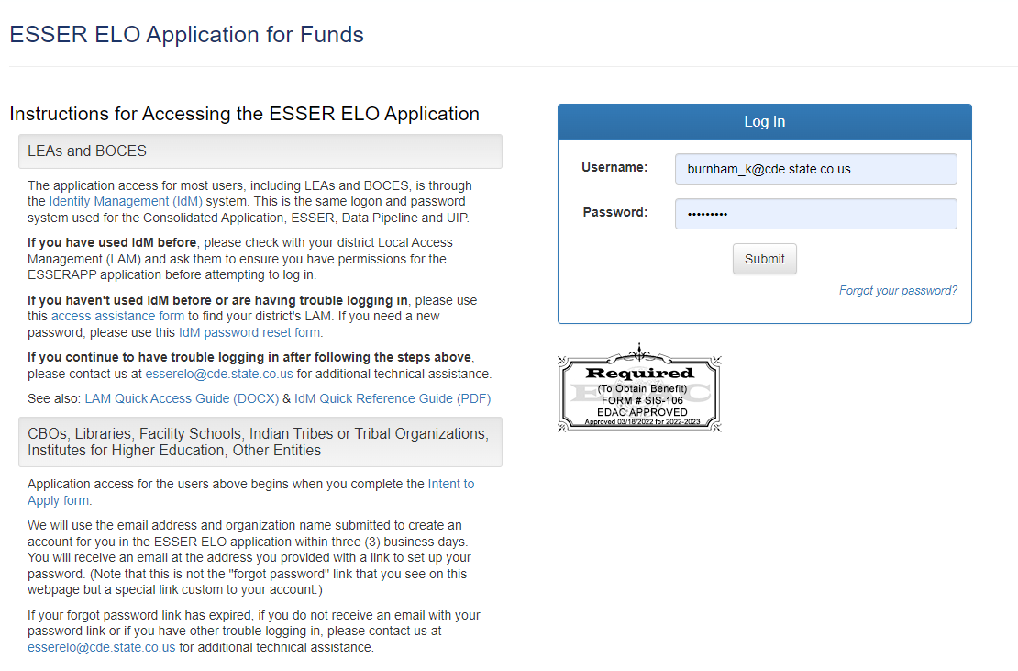
Online Application – Log In
Once you have reset your password, return to the Log In page and enter your username and new password.
Notes:
Kim

Slide 21
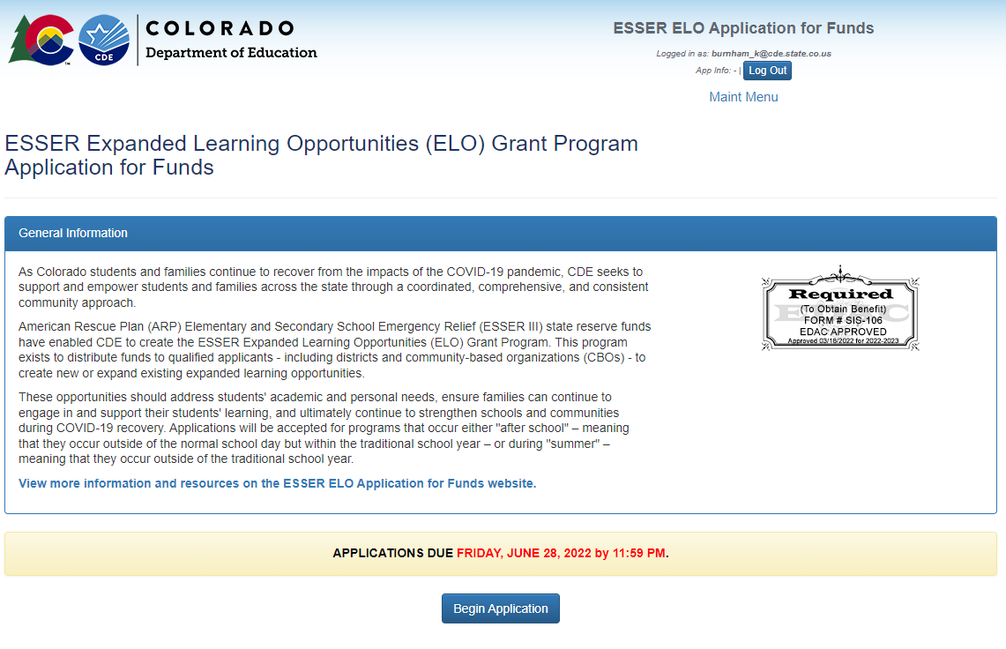
Online Application
Once logged in, click on 'Begin Application'
Notes:
Kim

Slide 22
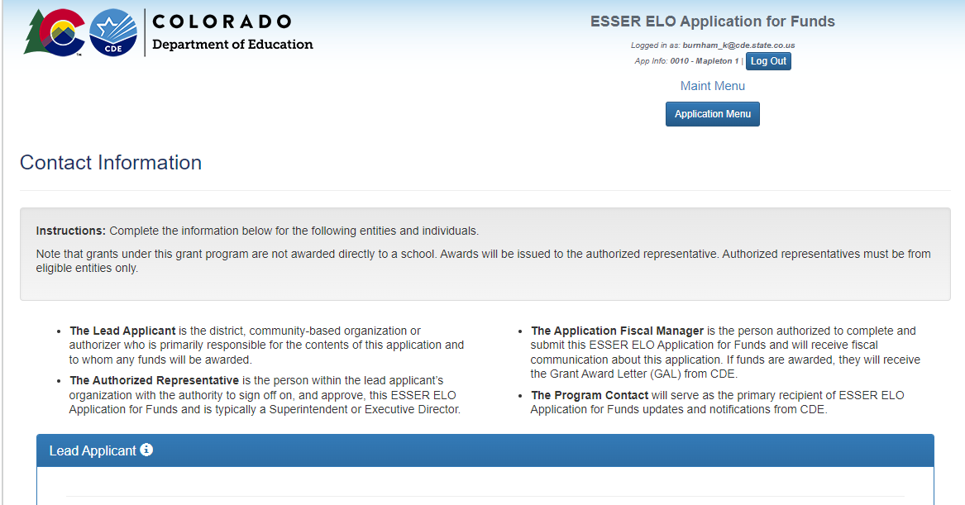
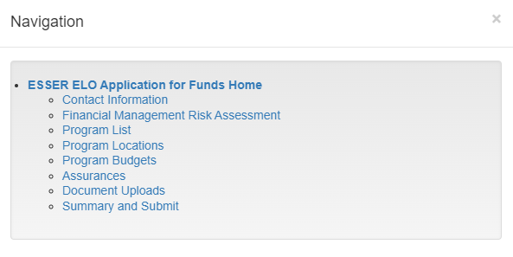
Online Application
After hitting 'Begin Application,' you will always start on the 'Contact Information' page.
You can navigate the different sections of the application by clicking on 'Application Menu'
Be sure to 'Save' at the bottom of each page before moving on.
Notes:
Kim

Slide 23
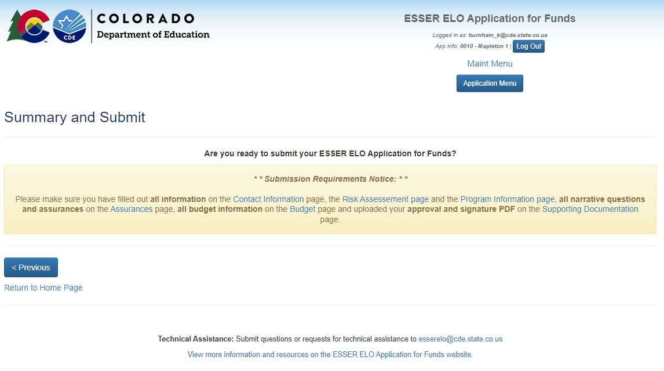
Online Application – Summary and Submit
Once you have completed each section of the application and uploaded the required Approval and Signature Form, the Submit button will appear on the 'Summary and Submit' page.
For technical assistance, please submit questions to esserelo@cde.state.co.us.
Notes:
Kim

Slide 24
Questions?

Slide 25
Application Contacts
Program Questions:
Spencer Ellis, High Impact Tutoring Program Manager
720-237-3306 | ESSERelo@cde.state.co.us
Budget/Fiscal Questions:
Evan Davis, Federal Fiscal Grants Supervisor davis_e@cde.state.co.us
Application Process Questions:
Kim Burnham, Grants Program Administration
(720) 607-1495 | CompetitiveGrants@cde.state.co.us

