Slide 1
Unique Accommodation Requests
2019-2020

Slide 2
Agenda
Laws and CDE Policy
Accommodations
Unique Accommodation Requests
Wrap-Up and Final Points

Slide 3
Laws and CDE Policy

Slide 4
Laws
Children’s Online Privacy Protection Act (COPPA, 1998)
Colorado Student Data Transparency and Security Act (2016)

Slide 5
COPPA
Personal Information means… a photograph, video, or audio file where such file contains a child’s image or voice…
(Federal Register Vol. 78 (No. 12), January 17, 2013; p. 4009)
Children's Online Privacy Protection Act of 1998, 15 U.S.C. 6501–6505
Children's Online Privacy Protection Rule: Final Rule Amendments To Clarify the Scope of the Rule and Strengthen Its Protections For Children's Personal Information; 16 C.F.R. Part 312

Slide 6
CO Student Data Transparency and Security Act
“Student personally identifiable information” means information that, alone or in combination, personally identifies an individual student or the student’s parent or family, and that is collected, maintained, generated, or inferred by a public education entity, either directly or through a school service, or by a school service contract provider or school service on-demand provider.

Slide 7
CDE Assessment Policy
Internet access has been restricted since CSAP/TCAP
“Additional considerations for test security apply when students are using assistive technology. Students must not be able to access any additional programs or the Internet while taking the assessment.” (Colorado Accommodations Manual 2011-2012, p. 75)
Current language
“Some students may require software that is not compatible with TestNav. These students may have a second device in the testing environment to provide access to that software. The second device may not have Internet access.” (CMAS and CoAlt Procedures Manual Spring 2020, Section 6)

Slide 8
Accommodations

Slide 9
Accommodations are…
Accommodations are practices and procedures that provide equitable access during instruction and assessment for students who have a documented need, including students with a disability.
The stipulations for providing an accommodation are:
the determination of need for a student must be made on an individual basis
accommodations are documented in a formal plan
accommodations are evaluated regularly for effectiveness
the accommodation is routinely used for both instruction and assessment according to the guidelines set forth by ESSU

Slide 10
UARs
Students must have an active ELP
Students must have an active IEP/504
Accommodations
May include students with active IEP/504/ELP (but not required)
Accessibility Features
Administration Considerations
All Students

Slide 11
New for 2019-2020

Slide 12
UARs for ACCESS
Students requiring Human Reader or Scribe must have a UAR for ACCESS
Federal requirement
Use the same form as CMAS
Use same process as CMAS UARs
Complete form
Complete spreadsheet
Different tabs for different grades
Load into Syncplicity
Email the UAR account
Due December 1, 2019 in order to have ready for January test window!

Slide 13
Unique Accommodations

Slide 14
Unique Accommodations
A very limited number of students who meet specific criteria may qualify for unique accommodations.
These accommodations might impact the construct being measured. For that reason, additional documentation is required.

Slide 15
Unique Accommodation Requests (UARs)
Accommodations requiring CDE approval:
Auditory presentation/reading/signing of the ELA (reading), including:
Text-to-speech (TTS) for ELA
Oral script for ELA (human signer, human reader)
Scribe for ELA/CSLA constructed responses
Calculator on non-calculator sections of math
Any accommodation that may impact the construct of the assessment

Slide 16
Use of Unapproved Accommodations
Use of unique accommodations without CDE approval may result in invalidation and/or suppression of student test scores
CDE will load UARs in 2020 to help minimize errors

Slide 17
Unique Accommodation Request Process
Deadline to submit ACCESS to CDE: December 1st
Deadline to submit CMAS to CDE: December 15th (annually)
Post in Syncplicity UAR folder
Submit all UARs for the district at once if possible
Must complete spreadsheet with student information
Notify the UAR account via email: Assessment_UAR@cde.state.co.us when posted in Syncplicity
Do not send UAR forms through email)
Use updated UAR forms – data is required upon submission
Must use 2019-20 form
Must include current data (from the current school year)
Forms without data will be rejected
Past CMAS scores, IEP eligibility data, and other scores from previous years cannot be used

Slide 18
Unique Accommodation Request Process
CDE will respond to each UAR
Written feedback re: approval or denial provided in UAR folder on Syncplicity
Unapproved requests will indicate the reason for rejection
CDE processes UARs in the order they are received
If possible submit early

Slide 19
Unique Accommodations Requests
All ACCESS UARs are due to CDE by December 1st
All CMAS UARs are due to CDE by December 15th for all students
UARs for students who arrive in district after January or are newly placed on IEPs are due by March 15th
UARs for “missed” students will not be accepted
UARs will not be accepted once your district has started testing

Slide 20
Follow directions on cover sheet for ACCESS and CMAS
Indicate whether it’s for ACCESS only or ACCESS and CMAS

Slide 21
Follow directions on cover sheet for ACCESS and CMAS
Indicate whether it’s for ACCESS only or ACCESS and CMAS

Slide 22
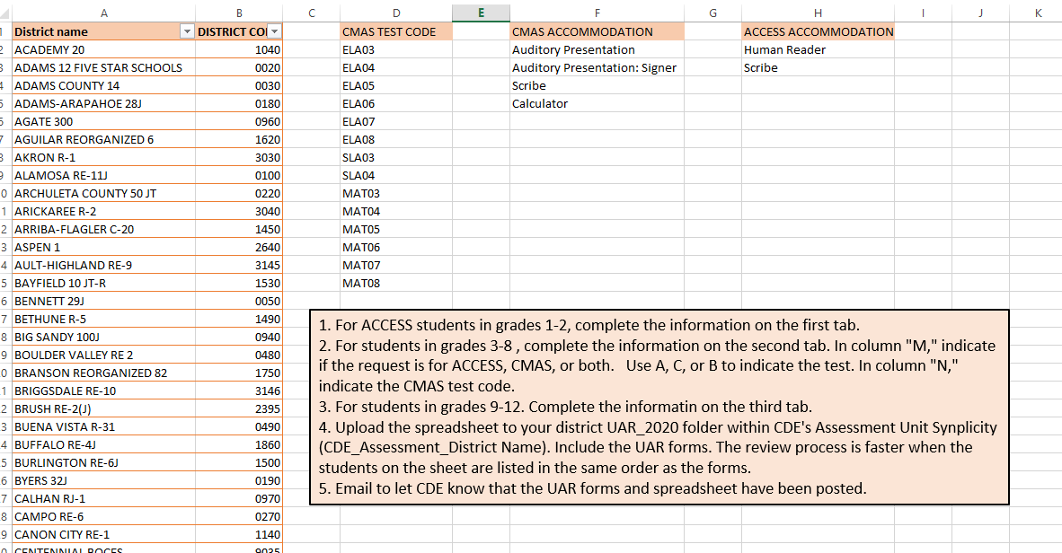

Slide 23
District Approval – Math Charts and Counters
Districts are responsible for approving the use of math charts and counters during the non-calculator sections of the assessment:
Arithmetic tables (+, -, x, /)
Two-color chips
Counters and counting chips
Square tiles
Base 10 blocks
100's chart
These will create an accommodation reminder
Reminder: Number lines are not allowed

Slide 24
Speech-to-Text and Word Prediction
Do NOT require a UAR
Cannot connect to internet
Place device in “test mode”
May need to use a separate computer/device
Train early and often

Slide 25
Reminders
Speech to text devices CANNOT connect to the internet
Train the device early and often
Repeated practice is necessary
Use extreme caution when assigning students to the AT form
AT form does not have the same tool bar
DO NOT assign students using STT to AT form
DO NOT assign students with hearing aids or FM systems to AT form
AT form is for students who utilize software/technology to access content (screen readers {JAWS}, adaptive mouse)
Math Charts and Counters are approved at the district level and do not come to CDE
Number lines are not an approved tool and cannot be used on the math assessment

Slide 26
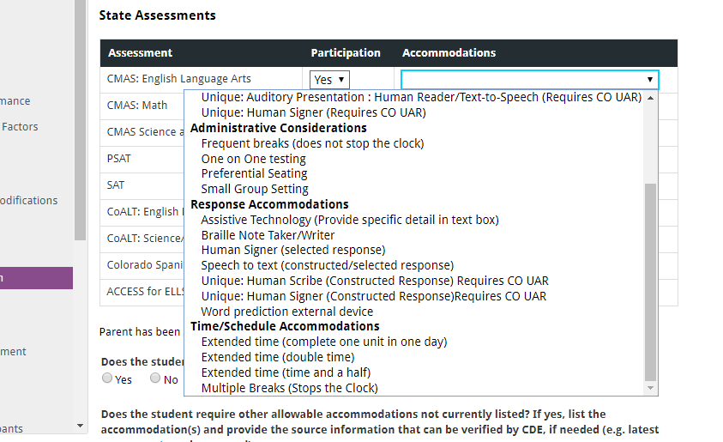
Unique Accommodations in Enrich (ELA)

Slide 27
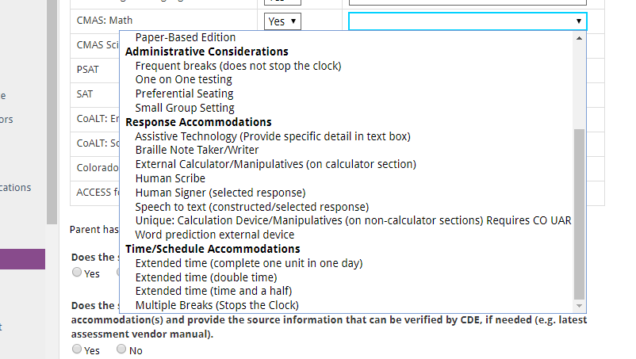
Unique Accommodations in Enrich (Math)

Slide 28
Wrap-Up and Final Points

Slide 29
Unique Accommodations
A very limited number of students who meet specific criteria may qualify for unique accommodations.
Reading access is for decoding
Calculators are for math fact fluency

Slide 30
Deadlines
ACCESS UARs are due DECEMBER 1
CMAS UARs are due DECEMBER 15
You may submit earlier
After DECEMBER 15
Students with a new IEP
Students whose IEP has been modified
Students new to the district MARCH 15

Slide 31
UARs by the numbers…
 | 2015 | 2016 | 2017 | 2018 | 2019
Auditory Presentation | 419 | 326 | 729 | 1249 | 2155
Calculator | 92 | 267 | 330 | 352 | 539
Scribe | 71 | 78 | 99 | 151 | 107
Other | NA | NA | 3 | 10 | 3
 | 2017 |  | 2018 |  | 2019*
 | TTS | Oral Script | TTS | Oral Script | TTS | Oral Script
ELA | 478 | 113 | 1034 | 167 | 1875 | 224
Math | 46,725 | 1,219 | 49,776 | 1,737 | 54,069 | 1,612

Slide 32
Resources
Assessment Accommodations Information
https://www.cde.state.co.us/assessment/training-accommodations
Accommodations Webinar
UAR webinar
Directions/guidance for UARs
Instructional information regarding accommodations
ESSU contacts by program
https://www.cde.state.co.us/cdesped/consultantresponsibilitylist_12-2018

Slide 33
Questions?
Assessment Accommodations Questions
Assessment Unit
303.866.6709
Instructional Accommodations Questions
Gina Herrera
Exceptional Student Services Unit (ESSU)
herrera_g@cde.state.co.us
303.866.6605

Slide 34
Thank You!

