Slide 1
CMAS TestNav Technical Site Readiness
Spring 2016

Slide 2
1. Online Testing Components 2. Network Preparation 3. Proctor Caching 4. Device Preparation 5. Infrastructure Trial 6. Support DuringTesting

Slide 3
Online Testing Components
1
2
3
4
5
6
SECTION 1
Online Resources
Components
TestNav
Proctor Caching
SystemCheck Tool
Student Responses
Best Practices and Recommendations for Device Configurations

Slide 4
Online Resources
DTC Site Readiness Support: http://www.cde.state.co.us/assessment/newassess-dtc
Technology Setup: http://parcc.pearson.com/technology-setup/
PearsonAccess^{next} : https://support.assessment.pearson.com/display/PAsup/PearsonAccess+Next+Online+User+Guide
TestNav Pearson Documentation: https://support.assessment.pearson.com/display/TN/TestNav+8+Online+Support
CMAS & PARCC System Check for TestNav8
CMAS: http://systemcheck.co.testnav.com/
PARCC: http://systemcheck.parcc.testnav.com/

Slide 5
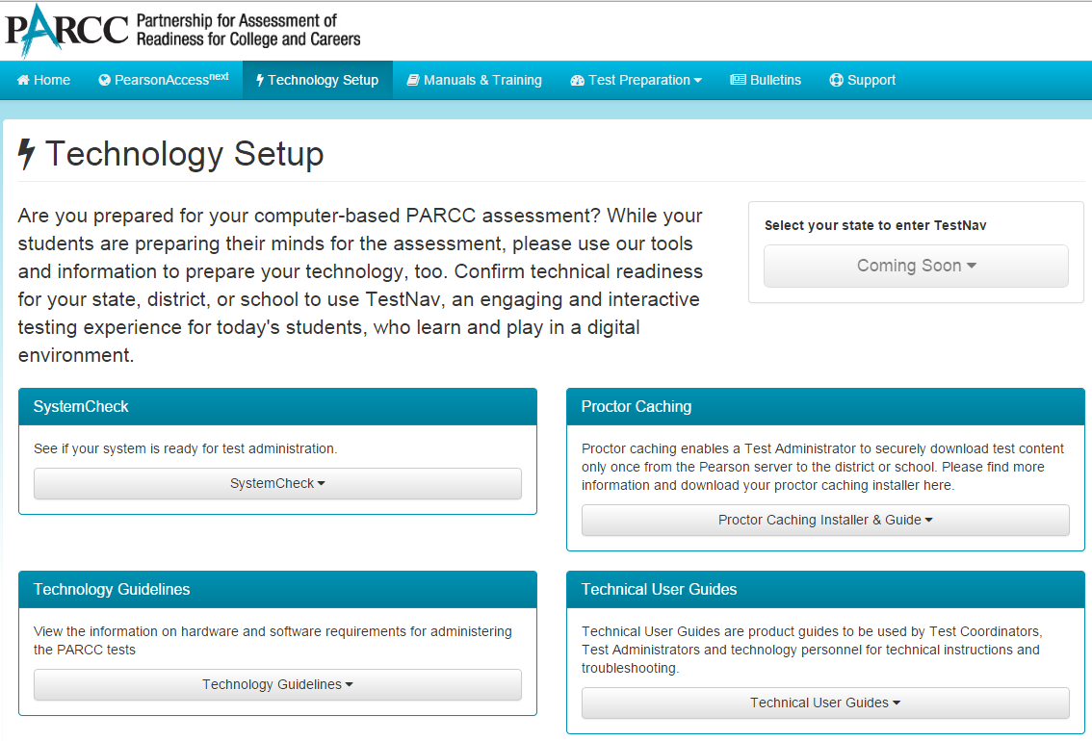
PARCC Online Resources
http://parcc.pearson.com/technology-setup/

Slide 6
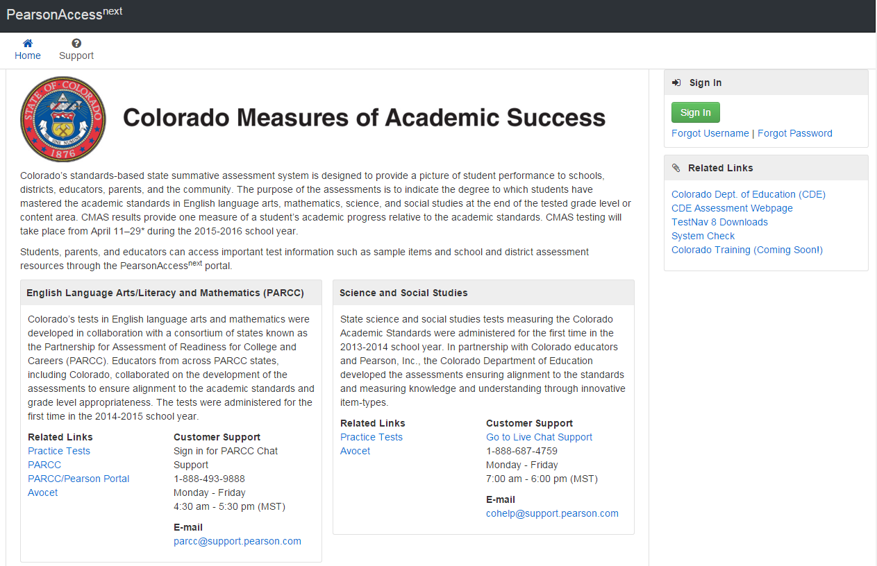
Sci. & SS Online Resources

Slide 7
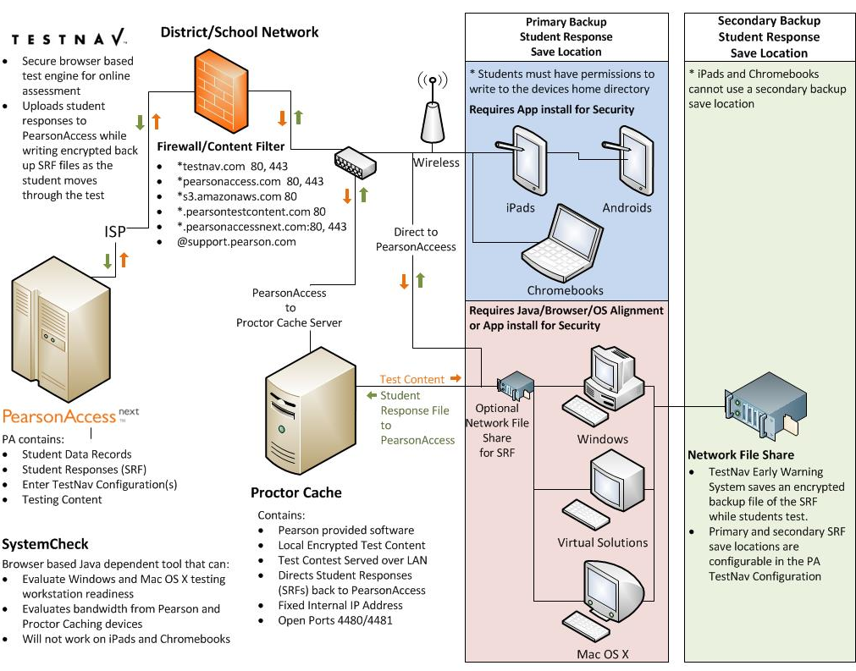
Online Testing Components Diagram

Slide 8
TestNav Components
Component | Current Software Version | Next Release date | Recommendations
Proctor Caching | v2015.1.21 | TBD | Upgrade proctor caching Servers to this version.
PearsonAccess^{next} | v3.1 | TBD
TestNav | v8.5 | TBD | Full Test of Assessment Environment using forms from training site. (infrastructure trial)
Desktop App | V1.4.1 | TBD | Quick Verification
iPad App | v1.4.7 | TBD | Quick Verification
Chromebook App | V1.4.68 | TBD | Quick Verification
Java | 8v25 | January 19th 2016 | Quick Verification

Slide 9
TestNav 8.5 no longer Supports
Operating Systems
iOS 7
MacOS 10.6
Windows Vista
Windows XP
Internet Browsers
Internet Explorer 9
Internet Explorer 10
Safari 5.x
Google Chrome – All versions
Java
Version 1.6
Version 1.7

Slide 10
TestNav 8.5 Options
Browser-based
Installable
Available for
Mac OS X
Windows
Runs in a browser
Requires that users install Java 1.8 or higher on the testing device.
Requires that users enable pop-ups
for TestNav.
Access your test by typing the
test-specific URL into browser
address bar.
Available for
Android
Chrome
iOS 8
Linux Fedora; Ubuntu
Mac OS X
Windows
Does not depend on other software, such as a browser or Java .
Access your test by starting the TestNav app and choosing your test.
Complete requirements can be found at https://support.assessment.pearson.com/display/TN/TestNav+8+Online+Support

Slide 11
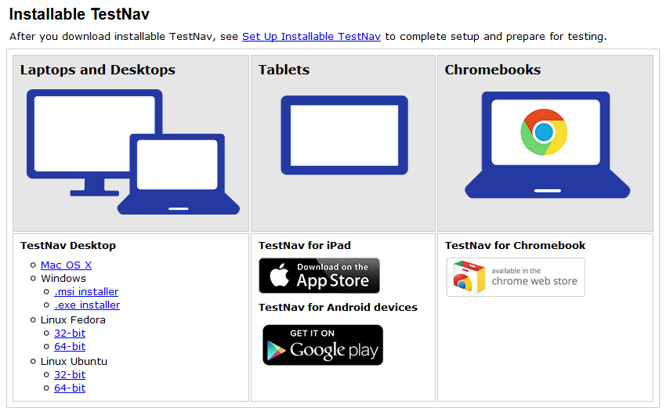
TestNav App Installers http://download.testnav.com
Notes:
If your school is downloading the TestNav 8 app, it is accessible at http://download.testnav.com.
If you are using a device that requires an application installation, or if you are planning to use the TestNav Desktop application for laptops and desktops, you can download the app or apps that you will need from this site, or you can go to the applicable device store for Chromebooks, iPads, and Android devices. We will talk more about these device types shortly.
For now, if you are installing TestNav Desktop, there are options for Mac, Windows, and Linux.
There are two options for Microsoft Window: .msi and .exe.
The .msi file is optimized for network installation as a group and pushing out to multiple computers.
The .exe file is for downloading onto individual computers.
The Desktop installation generally only takes a few minutes on an individual computer; network installations will vary depending on your environment.

Slide 12
Proctor Caching
Proctor Caching is Pearson-supplied software that is used in conjunction with TestNav to reduce bandwidth requirements and accelerate the delivery of test content.
Allows you to pre-cache test content to your local network before a test.
Reduces the burden on your ISP by eliminating redundancy in requests for test content.
Stores an encrypted local copy of all pre-cached tests
CanStock Photo
Notes:
What is Proctor Caching?
Proctor Caching is Pearson-supplied software that is used in conjunction with TestNav to reduce bandwidth requirements and accelerate the delivery of test content.
It allows you to pre-cache test content to your local network before testing.
It reduces the burden on your Internet service provider (ISP) by eliminating redundant requests for test content.
Cached content is encrypted and stored locally.
The Proctor Caching software is available on the non-secure support pages within PARCC PearsonAccess. The application is free and does not require a secure login access to download.

Slide 13
Device Preparation
Any software that would allow secure test content on student computers to be viewed on another computer must be turned off.
Any applications that may automatically launch on a computer are configured not to launch during testing sessions.
Allow local file access to home directory. <home dir>/Pearson/ and any alternative SRF save locations

Slide 14
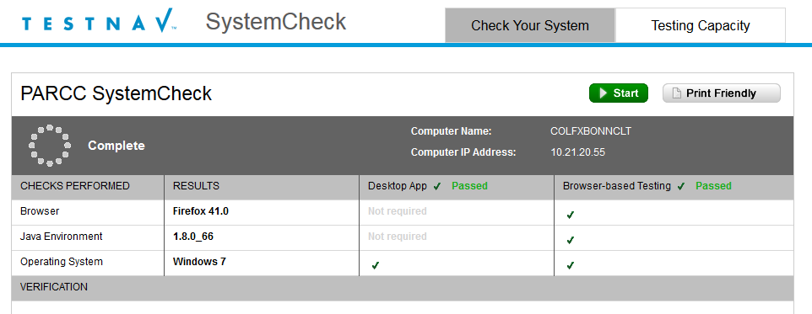
System Check for TestNav
System Check was developed as a tool for customers to use to validate their computers to ensure that TestNav software could run on their computers.
Support can also use System Check to validate the computer for any technical problems.
To gather realistic results System Check must be run from a student testing machine on the same day of week/time of day when you anticipate performing online testing.

Slide 15
Measure Testing Capacity PA^{next}
New
To measure your school's testing capacity for an online test, follow these steps:
From Setup > Organizations, search to find your organization(s) or click the down arrow next to the Search button to reveal and select the option to show all results. Select your school.
Open the task list and select Assess Testing Capacity and click Start.
Add details and click Calculate Capacity, and then click Save.

Slide 16
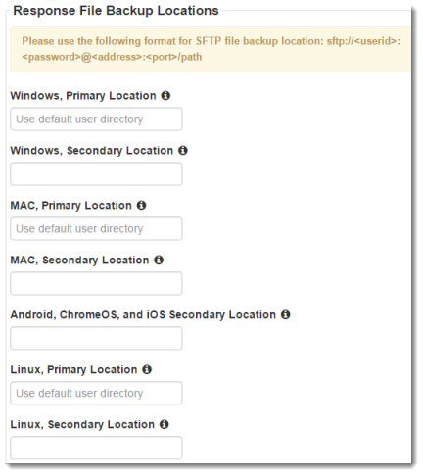
Student Responses
TestNav requires at least one working save location.
TestNav by default saves student response data to: <home dir>/Pearson/student/srf
Create a TestNav Config in PearsonAccess to specify custom Primary and Alternate file locations
Best Practice: Primary Response File Location should be on the student workstation. The alternate Response File Location should use a Secure File Transfer Protocol (SFTP) address to ensure that TestNav saves backup SRF files for all computers and devices. Designated in TestNav config in PearsonAccess.
Students must have full access to designated Response File Locations.
New
Notes:
When a student responds to a test question, TestNav saves the response in a saved response file (SRF) and sends these responses to the Pearson server. After the responses successfully save to the Pearson server, TestNav deletes the SRF.

Slide 17
Best Practices and Recommendations
Performance:
Use Proctor Caching for best network performance.
Use System Check extensively to test Proctor Caching and network environment before live testing.
Use System Check to test wireless network capacity if using wireless clients.
Testing Computers:
Create Device Image with only "bare minimum” OS, Browser, and Java for a clean environment.
Create “Kiosk” or GPO for standardized assessment environment.
Use System Check (TestNav Verification Test) to validate that TestNav will load on machines.
Freeze browser, operating system & Java environment if possible.

Slide 18
Network Preparation
1
2
3
4
5
6
Section 2
Online Resources
Configure Content Filter & Antivirus Software
Antivirus Software
Verify Bandwidth Capacity
ISP Notification

Slide 19
Online Resources
TestNav 8 Hardware and Software Requirements
https://support.assessment.pearson.com/display/TN/TestNav+8+Online+Support
CMAS System Check for TestNav8
CMAS: http://systemcheck.co.testnav.com/ PARRC: http://systemcheck.parcc.testnav.com/

Slide 20
Configure Content Filter & Antivirus Software
ALL Pearson domains and ports must be allowed to pass through your Internet firewalls, content filters or spam filters for inbound and outbound traffic.
*testnav.com: 80, 443
*pearsonaccess.com : 80,443
*.pearsonaccessnext.com:80, 443
*.pearsontestcontent.com: 80
google-analytics.com (optional)
*.thawte.com
Allow traffic on ports 4480 and 4481 to flow freely on the network. Proctor Caching uses these ports.

Slide 21
Content Filter & Antivirus Software
Some antivirus software can scan test content even if it has been whitelisted causing performance issues during testing. Additional configuration may be required.
CDE recommends using the CMAS Site Readiness form in a practice test in the PA training environment to be sure you have your Content Filter & Antivirus Software is configured correctly.
Work directly with your Content Filter & Antivirus Software provider to find an optimal configuration.

Slide 22
Verify Bandwidth Capacity
Use the Pearson tools to find estimated student testing capacity.
Identify network restraints or bottlenecks such as wireless access points using Pearson tools.

Slide 23
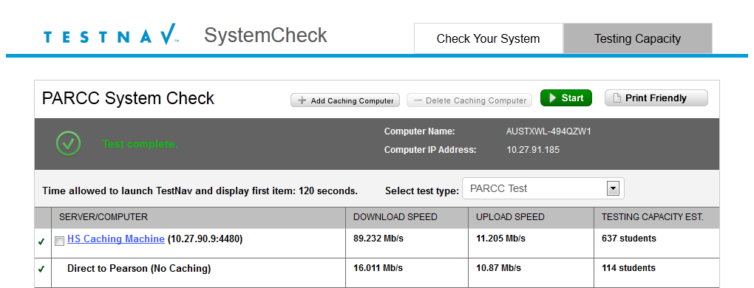
Verify Bandwidth Capacity
Based on the bandwidth test SystemCheck can provide the number of students that can test concurrently. It can be used to identify network restraints and plan the placement of Proctor Caching devices. Once PC devices are added use SystemCheck to verify student capacity.

Slide 24
Measure Testing Capacity PA^{next}
New
To measure your school's testing capacity for an online test, follow these steps:
From Setup > Organizations, search to find your organization(s) or click the down arrow next to the Search button to reveal and select the option to show all results. Select your school.
Open the task list and select Assess Testing Capacity and click Start.
Add details and click Calculate Capacity, and then click Save.

Slide 25
Yes, Proctor Caching can alleviate your network constraint
Install and configure the Proctor Caching device and re-run the SystemCheck testing capacity tab to verify results.
Communicate the estimated student testing capacity for each assessment environment to your DAC for session planning purposes.

Slide 26
No, Proctor Caching cannot alleviate your network constraint
Communicate the estimated student testing capacity for each assessment environment to your DAC for session planning purposes.
You may want to schedule fewer students than the SystemCheck estimated student testing capacity number. For example; If you have a wireless access point with an estimated student testing capacity 32 for the assessment environment, best practice would be to schedule no more than 29 per session for that assessment environment.

Slide 27
ISP Notification
Notify your Internet Service Provider of your online testing window.
Confirm that no scheduled maintenance or outages are planed during that time.

Slide 28
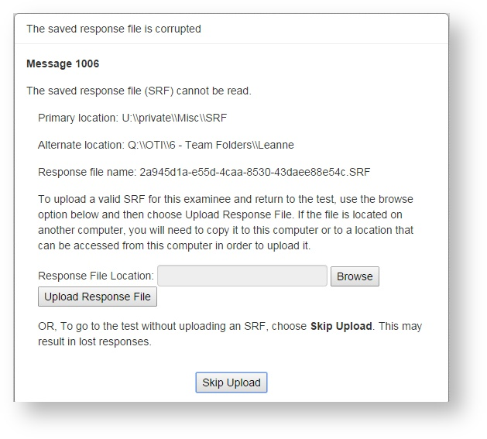
Troubleshooting
Error Messages 1001 and 1006
Aggressive content filters attempt to open and alter an SRF file before saving it.
Data manipulation corrupts the SRF and invalidates it from future use.
https://support.assessment.pearson.com/display/TN/Early+Warning+System+Triggers

Slide 29
Proctor Caching
1
2
3
4
5
6
SECTION 3
Online Resources
Pre-Installation Planning
Install & Device Requirements
Verify Proctor Caching Device
Proctor Caching Monitoring

Slide 30
Online Resources
Proctor Caching v2014.1.21 Hardware and Software Requirements:
https://support.assessment.pearson.com/display/TN/Set+Up+and+Use+ProctorCache
Software:
http://download.testnav.com/

Slide 31
What’s New v2015.1.21
ProctorCache Password
ProctorCache requires a password to refresh, reload, or purge content. You can use the default password, or you can change the default password at any time using the following instructions.
Connect to ProctorCache on your local host - http://localhost:4480/settings.jsp.
*If you access ProctorCache from a remote computer using an IP address (for example,http://10.25.99.142:4480/contents.jsp), you cannot view the Settings tab, which contains the option to change the default password.
Click the Settings tab
Enter the old password, and then enter the new password twice in the required fields.
Click Submit.
Notes:
What does the new Proctor Caching software offer?
The user interface has been redesigned to include the following enhancements:
renaming the Contents tab to Tests and the Client List tab to Clients for clarity,
simplifying use by consolidating information previously displayed on the Home page into the Clients and Tests tabs,
resolving issues with Internet Explorer 11 not displaying the list of cached content,
Enabling a more robust comparison between content on the caching computer and content on the Pearson server, to verify the cache has the most up-to-date content, and
renaming the “undefined” directory to “Was not Preloaded” to eliminate confusion.
PARCC recommends that all schools upgrade to the latest version to take advantage of these enhancements.

Slide 32
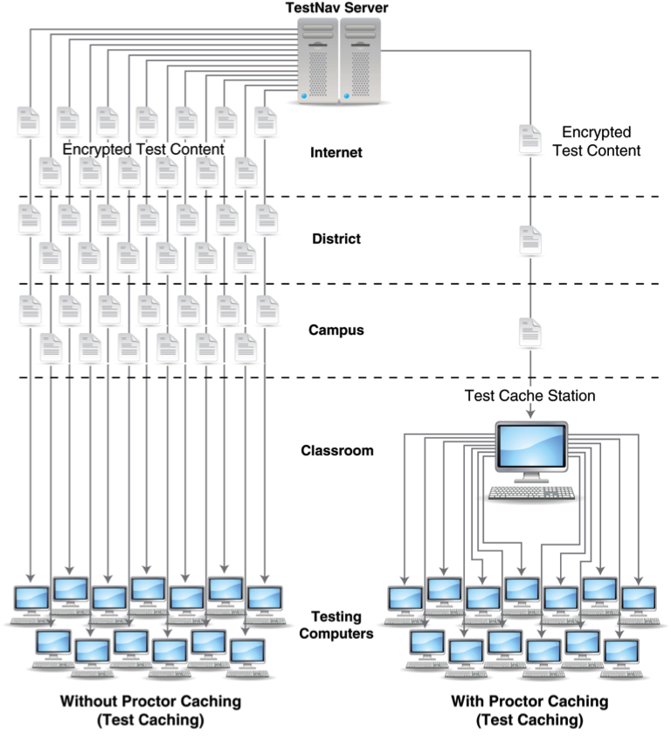
Proctor Caching – The Network
Notes:
This diagram illustrates the network traffic differences between using and not using Proctor Caching. Without Proctor Caching, as demonstrated on the left, multiple redundant copies of the same test are downloaded over the district’s ISP connection while students are waiting for the test to load. This heavy use of bandwidth not only affects how quickly tests load for students, but also the available bandwidth for all other Internet-related activities within the district.
With Proctor Caching, as seen on the right, districts will pre-cache one copy of each test and tests will be served to the students from the Proctor Caching machine. This minimizes redundant requests for test content over the district ISP connection, loads tests faster for students, and minimizes the effect of computer-based testing on district bandwidth utilization.
Districts have the flexibility to decide where to implement Proctor Caching in the network environment. Based on local network considerations, districts can implement Proctor Caching machines at the district, school, or classroom level.
Proctor Caching is highly recommended.

Slide 33
Pre-Installation Planning
Proctor caching computers must run on the same network as the students’ testing computers.
If proctor caching takes place at the district level, then you should configure any lower-level proctor caching computers to use the district-level computer as an upstream proxy.
If you need to update ProctorCache to a more recent version, uninstall the previous version. Then, reboot the computer and install the more recent version. You can uninstall ProctorCache using the software removal process for your operating system.
Must have full local administrator permissions on the PC device & working knowledge of your network.
Network connection 100 Mbps full-duplex or higher recommended.
Minimum network connection is 10/100.
Network is set to use IPv4 DNS (Domain Name System) servers.

Slide 34
Proctor Caching Requirements
Must have Fixed internal IP address.
Windows Firewall will need to be turned off on the proctor caching device.
Open traffic on TCP Ports include: 80 (Internet), 4480, and 4481 (Local Network).
Does not require an underlying server-based operating system.
For setting up an upstream proxy, refer to the Windows or Mac Upstream Proxy Configuration https://support.assessment.pearson.com/display/TN/Set+Up+and+Use+ProctorCache .
Notes:
Proctor Caching runs on Windows and Mac OS X.
It does not require an underlying server-based operating system. It can run on desktop class hardware and a desktop class operating system, which gives districts flexibility on what machines they use for Proctor Caching.
Complete Proctor Caching hardware requirements can be found on the parcc.pearson.com/technology-setup/ site.
Proctor Caching uses TCP Port 80 for communication between the Proctor Caching machine and the Pearson servers, and ports 4480 and 4481 for communication between testing workstations and the Proctor Caching machine.
Because testing workstations must know a predictable network location for the Proctor Caching machine, Proctor Caching requires a fixed internal IP address. Those districts that require Internet traffic to pass through an upstream proxy server will have to configure Proctor Caching to point to their proxy server. For details on setting up an upstream proxy, refer to the Windows or Mac “Tips on Proctor Caching” section in the TestNav 8 Proctor Caching User Guide.
Use the SystemCheck Testing Capacity tab for determining your network capacity during computer-based testing.

Slide 35
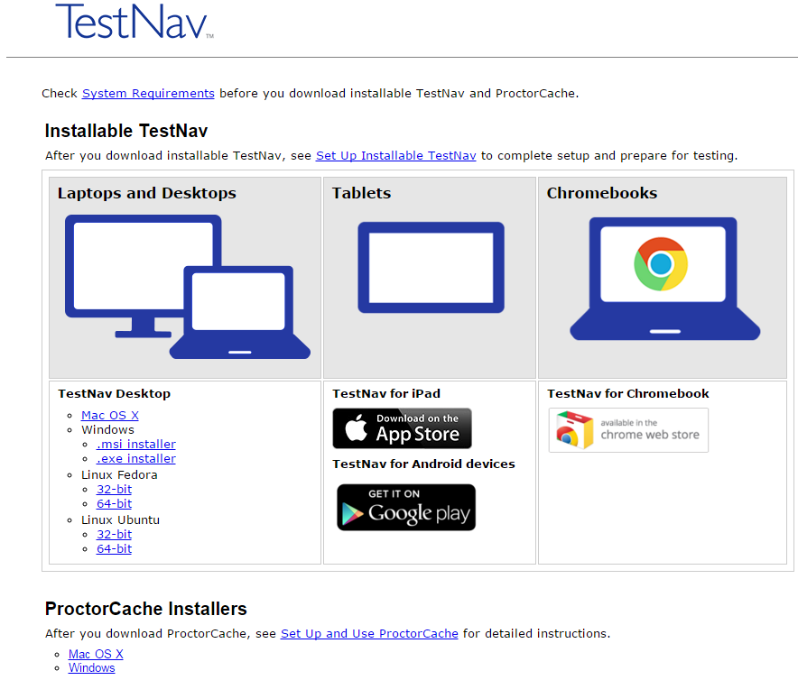
Install & Device Requirements
Download Proctor Caching installer from http://download.testnav.com/
Run the installer and Start Proctor Caching if not already started by the installer.
Use SystemCheck from client computer to verify that Proctor Caching is functional.

Slide 36
Proctor Caching Monitoring
URL: http://<Static IP Address>:4480
Tests:
Provides information about test content and caching status
Content Details displays status of individual test items
Clients:
Displays clients by IP address that have connected to TestNav
Client Details displays details by computer
Settings:
Allows you to set a custom password to refresh, reload, or purge cached content with access to http://localhost:4480/settings.jsp.

Slide 37
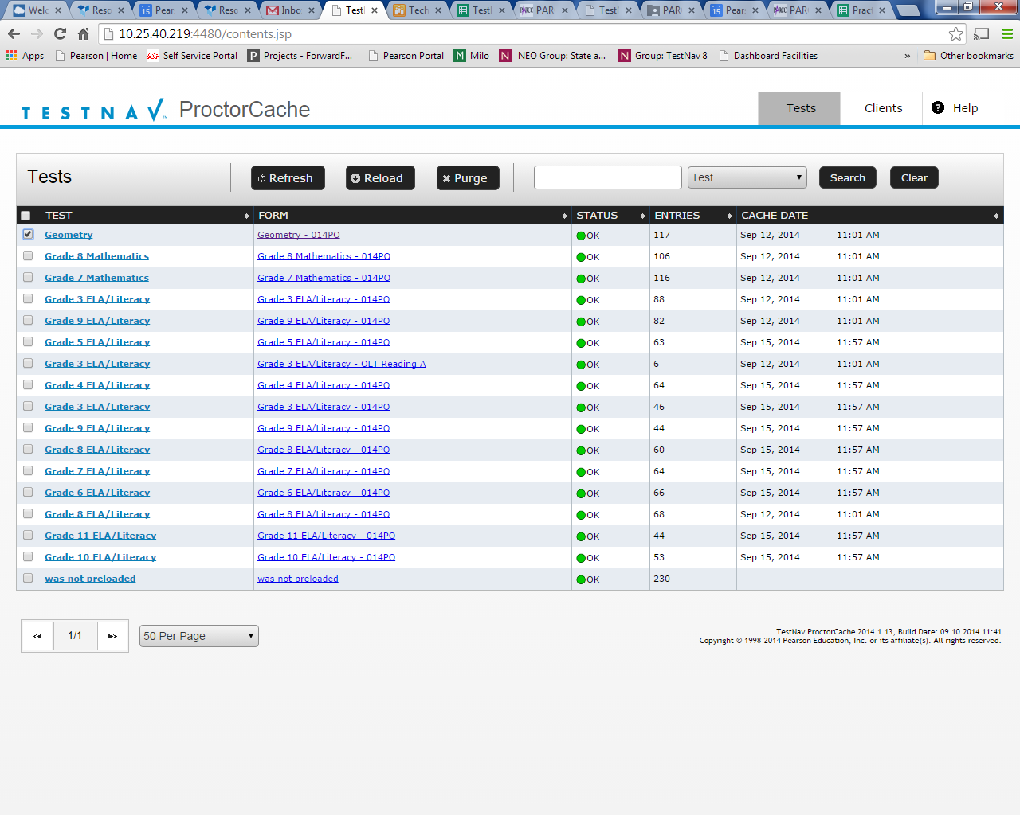
Tests Tab
Content is displayed at the Test and Form level.
Functionality is available to Refresh, Reload or Purge selected test content.
Clicking on a test name will display the Content Details screen which displays individual items in a test.
Notes:
On the Tests tab content is displayed at the Test and Form level.
Functionality is available to refresh, reload, or purge selected test content if necessary, and requires a password. The password is available in the Proctor Caching User Guide to protect against unauthorized deletion of cached content.
Clicking on a test name will display the Test Details screen which displays individual items in a test.

Slide 38
Tests Tab – Status
Ok – Content is successfully cached
Not Loaded – Content is not cached
Waiting… - Loading Content
Loading… - Loading Content
Failed to load content – There was a failure to load content
MD5 Check Invalid – MD5 comparison Failed
MD5 Mismatch – MD5 comparison was completed but files did not match
In general, any status in red is a critical problem. Any content with a red status should be checked and Reloaded. If the problem is not resolved contact Pearson Support
Notes:
The Tests tab provides status indicators for each item of cached test content.
An OK status means the content has successfully cached.
The yellow status indicators appear when the content is in the process of being cached.
Not Loaded means the content is not cached.
Waiting… means the content is in the queue, waiting to be loaded,
and Loading… means the content is currently loading.
Red status indicators indicate problems with cached content.
Failed to load content means there was a failure to download content .
Proctor Caching also performs an MD5 check once an item has been cached to compare the test content on the Pearson servers with the cached item. The MD5 check should show that the items are identical.
MD5 Check Invalid means the MD5 comparison could not be completed successfully.
MD5 Mismatch means the MD5 comparison was completed but the files did not match.
In general, any status in red is a critical problem. Any content with a red status should be checked and reloaded.
If the problem is not resolved, contact Pearson Support for technical assistance.

Slide 39
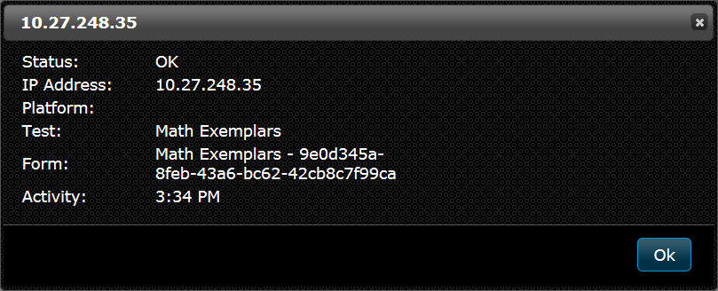
Client Tab
Clients which have connected to TestNav are listed by IP address
Clicking on a computer will display the Client Details screen which displays information regarding a particular computer connecting to Proctor Caching
Notes:
The Clients tab offers a quick view into client computer connections. Each computer can be clicked to bring up an individual Client Details screen. It provides visibility to which testing workstations have requested test content from the Proctor Caching server.

Slide 40
Client Tab – Status
Ok – Client is active
Idle – 5 to 30 minutes since client was active
Long Idle – 30 minutes to 12 hours since client was active
Clients are removed after 12 hours of inactivity
Notes:
The Client List tab also provides status indicators including:
Ok – meaning client is active
Idle – 5 to 30 minutes since client was last active
Long Idle – 30 minutes to 12 hours since client was last active
Clients are removed after 12 hours of inactivity.

Slide 41
Additional Technical Notes
Java runtime is included with Windows install.
Java runtime plugin is required for PearsonAccess pre-caching functionality.
If you must direct Proctor Caching to an upstream proxy server to access the Internet, Proctor Caching can be configured to use the proxy server.
Notes:
Note that Java runtime is included with Windows install and Java runtime plugin is required for PearsonAccess pre-caching functionality.
For additional help, refer to the Proctor Caching User Guide. The guide provides details for planning, installing, and monitoring, as well as “Tips on Proctor Caching.” The “Tips” section provides guidance on changing computer settings and how to edit the configuration file to point to an upstream proxy computer if needed.

Slide 42
Device Preparation
1
2
3
4
5
6
Section 4
Support Overview
Browser Based TN Setup
Installable TN Setup
TN on Chromebook
TN on iPad
App Features
Virtual Devices
Verify TestNav

Slide 43
CMAS Computer OS System Support
Windows
7, 8, 8.1, 10
Fire Fox v38+
Install Java 1.8
Turnoff popup blockers
Set trusted sites
Internet Explorer v11
TBD
Operating System
Platform
Additional Considerations
TN Desktop App
Install Java 1.8
Turnoff popup blockers
Set trusted sites

Slide 44
CMAS Computer OS System Support
Mac OS X 10.7, 10.8, 10.9, 10.1, 10.11
Fire Fox v38+
Install Java 1.8
Turnoff popup blockers
Set trusted sites
Safari Browser versions 6, 7, or 8
TBD
Operating System
Platform
Additional Considerations
TN Desktop App
Install Java 1.8
Turnoff popup blockers
Set trusted sites

Slide 45
CMAS Computer OS System Support
Linux
Fedora 19 & 20
Ubuntu 12.04 & 14.04
TBD
Operating System
Platform
Additional Considerations
TN Desktop App

Slide 46
CMAS Computer Tablet System Support
Chrome OS 43+
Install TN app
Set up Kiosk Mode
User Data Settings
Operating System
Platform
Additional Considerations
TN Desktop App
Chromebooks
iPads
Androids
iOS
7, 8, or 9
Install TN app
Set up Guided Access Mode
Operating System
Platform
Additional Considerations
TN Desktop App
Android 5.0
Install TN app
Set up User Access
Operating System
Platform
Additional Considerations
TN Desktop App

Slide 47
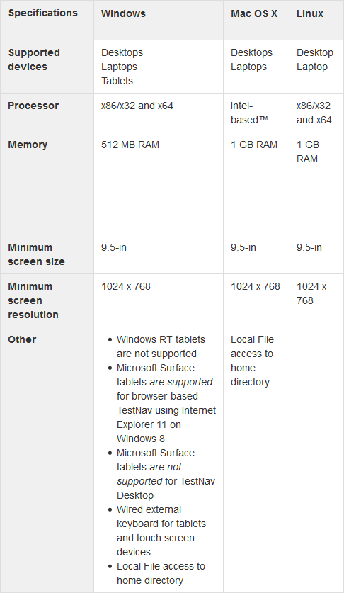
Windows, OS X, and Linux System Requirements
System requirements
Mac OS X 10.7–10.11
Windows 7–Windows 8.1, 10
Linux: Fedora 21–22 and Ubuntu 12.04 or 14.04
Notes:
Even though TestNav can be installed, the application still has a few minimum technology requirements. We will cover Windows, Mac OS X, and Linux now, and then discuss Chromebooks, iPads, and Android devices separately.
[CLICK] Mac OSX, Windows, and Linux are supported; Mac OS X 10.7–10.10 and Windows 7–Windows 8.1 and Windows 10. Linux is supported on Fedora 21–22 and Ubuntu (pronounced oo-boon-too) 12.04 or 14.04 for the TestNav Desktop app only. Linux is only supported using the TestNav Desktop app.

Slide 48
Browser-based Software Requirements
Browser | Operating systems | Other requirements
Firefox 38 and higher | Windows: 7, 8, 8.1 Mac OS X: 10.7, 10.8, 10.9, 10.10, 10.11 | Java 1.8 Enable pop-ups for TestNav Create javaw.exe exception in Windows Firewall Disable Skype plugins in Windows 7
IE 11 | Windows: 7, 8.1, 10 | Java 1.8 Enable pop-ups for TestNav Create javaw.exe exception in Windows firewall
Safari 6.x | Mac OS X: 10.7, 10.8 | Java 1.8 Enable pop-ups for TestNav
Safari 7.x | Mac OS X: 10.9 | Java 1.8 Enable pop-ups for TestNav
Safari 8.x | Mac OS X: 10.10 | Java 1.8 Enable pop-ups for TestNav
Notes:
[CLICK] For browser-based TestNav, most major browsers are supported; the exact browser version will depend on the operating system being used. Please note, the Chrome browser is not supported due to its lack of support for the Java plug in. As a result, corporations can choose to use the installable solution over browser-based if they do not want to use the alternative supported browsers available for browser-based TestNav. TestNav Desktop supports all item interaction types, tools, proctor caching, accessibility features, and accommodations as browser-based TestNav.

Slide 49
Windows & OSX Browser Based Device Preparation
Chrome browser no longer supported
Enable pop-ups for Pearson sites.
Grant students read write access on device.
1024 x 768 screen resolution
Firefox and IE: Create javaw.exe exception in Windows firewall
Firefox (Windows 7): Disable Skype plugins
Use SystemCheck to verify compliant OS/Browser/Java installed.
TestNav creates a Pearson directory in the home directory of the testing computer:
Windows XP C:\Documents and Settings\username\Pearson\...
Windows Vista and 7 C:\Users\username\Pearson\...
Mac //Users/username/pearson/...
Student Log files: Pearson/student/logs
SRF file default location: Pearson/student/srf
TestNav and test content is temporarily stored locally: Pearson/temp
Pearson recommends that the Pearson directory be excluded if desktop restoration tools such as DeepFreeze are used.

Slide 50
Installable TN on Windows & OSX
Install TestNav Desktop.
Start TestNav Desktop
Preform a TestNav Quick Verification to to ensure that it installed properly.
Set up Proctor Cache on your proctor caching computer(s).
Run SystemCheck to verify system readiness and capacity.
Set Up Response File Backups, and set up a Secondary Save Location.
Run an infrastructure trial.

Slide 51
TestNav Desktop Mass Install
Because TestNav installation does not add entries to the Windows registry, you can copy the TestNav application and push it to student computers for mass installation.
TestNav Desktop Patch Updates
TestNav program file updates are saved in {user_home}\AppData\Local\Pearson
Updates whenthe app opens or a student authenticates.
Can be pushed by using a snap shot of an updated Pearson folder pushed out to student devices.
Major TN updates that will require reinstallation will be scheduled in Winter and Summer student breaks.
TN Login Preferences
Exists in the update file folder, named with the update version number (for example, 1.4.1)
The default file, which stores the customer login preference for the next login can be pushed out as well.
Notes:
TestNav program file updates are saved in {user_home}\AppData\Local\Pearson. You must give students write access to the update directory.
Any necessary patch updates automatically install whenever TestNav starts or when a student attempts to log in.
You can also push the latest TestNav update, rather than waiting until each student opens TestNav.
To push an update, take a snapshot of the Pearson folder, and push that folder to all student computers.
Updates that require reinstallation of the TN app are scheduled for winter and summer breaks.
Pearson will communicate all updates with instructions in advance.
When you install TestNav Desktop, it creates the TestNav folder within the Pearson folder shown in the path above. The TestNav folder contains the following:
The default file, which stores the customer login preference for the next login

Slide 52
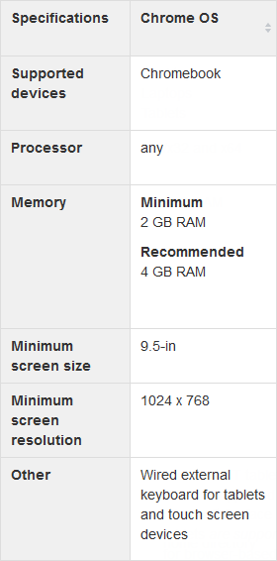
Chromebook System Requirements
Hardware and software requirements
Memory requirements
No Java or browser dependencies
Must use the Installable TestNav application for Chromebook and not a browser
Notes:
Before we go into the actual setup steps, let’s have a look at the system requirements. It’s important to note some highlights for the Chromebooks. Listed on the slide and also found on the TestNav 8 support pages are the minimum and recommended memory requirements. TesNav requires at least Chrome OS 44 or higher.
There are no Java or browser requirements for Chromebooks, as students will use the TestNav 8 App to access their test content. It is important to note that TestNav cannot be launched using a browser on a Chromebook.

Slide 53
Chromebooks – Setup Overview
Two Setup Methods
Managed Chromebooks
Unmanaged Chromebooks
Set each device settings to keep local data to avoid losing in-transit student response files
Before testing, enable Single App Kiosk mode by adjusting the Kiosk Settings
After testing, disable Single App Kiosk mode by adjusting Kiosk Settings.
Steps have to be performed on each Chromebook
Enable Single App Kiosk mode through Chrome browser
Requires access to the administrator/owner account for device
Device will be backed up to cloud storage and wiped if you do not have access to the administrator account for the device
Notes:
Now let’s move into the setup details. Chromebooks can either be managed or unmanaged, which presents us with two different setup methods.
[CLICK] For managed devices, all of the setup steps will be performed through the central administration, so all Chromebooks in a domain can be configured at once. When using managed devices, there are two main steps you will need to complete – install the TestNav 8 App and set it to run in Single App Kiosk mode, and preserve the local data on the Chromebook to retain Saved Response File (SRF) and log files on the device.
[CLICK] For unmanaged devices, the setup steps will have to be performed on each device individually. This requires access to the administrator account for the device. If you don’t have access to the administrator account, the Chromebook will need to be backed up to cloud storage and wiped clean before you can continue. After testing, it can be restored from the cloud. You will also need to enable the Single App Kiosk mode using the Chrome browser.

Slide 54
Chromebook Highlights
Requires TestNav App for security.
Chromebook must be set to Kiosk mode.
To locate SRF & Log files press <ctrl><shft>z and the File Viewer box appears.

Slide 55
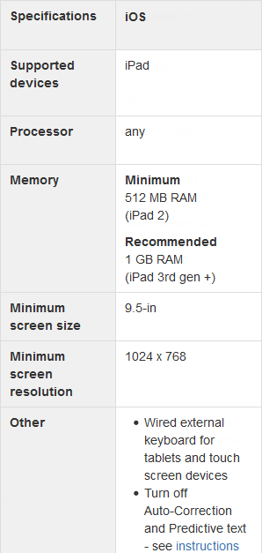
iPad System Requirements
Hardware and software requirements
Memory requirements
Operating system
No Java or browser dependencies
Must use the Installable TestNav application for iPad and not a browser
Notes:
Now let’s look at iPads. Before we go into the actual setup steps, let’s have a look at the system requirements. It’s important to note some highlights for the iPad. Listed on the slide and also found on the TestNav 8 support pages are the minimum and recommended memory requirements. TesNav requires at least iOS 9 and higher.
There are no Java or browser requirements for iPads, as students will use the TestNav 8 App to access their test content. Again, like Chromebooks, TestNav cannot be launched using a browser on an iPad.
For iPads, there is a requirement for a wired external keyboard for the ISTEP+ Part 1 assessment due to the nature of the items; however, the wired keyboard is optional and the onscreen keyboard can be used for IREAD-3 and ISTEP+ Part 2 assessments.

Slide 56
iPads – Setup Overview
Multiple Setup Methods
Apple Configurator
Apple Profile Manager
Install TestNav 8 app
Enable Supervised mode
Lock iPad to TestNav 8 app
Install TestNav 8 app
Create testing profile
Push testing profile to devices wirelessly
Guided Access
Autonomous Single App Mode - ASAM
Install TestNav 8 app
Configure each iPad for Guided Access
Lock iPad to TestNav 8 app
Install TestNav 8 app
Enable Supervised mode
Use MDM to enable ASAM mode
TestNav 8 initiates Single App mode
Notes:
Now let’s move into the setup details. As we talked about before, iPads have several setup options.
[CLICK] Administrators can use the Apple Configurator to manage multiple devices at once. Using this method, you will enable Supervised mode on the iPad and then lock the iPad to the TestNav 8 application for testing.
[CLICK] Profile Manager is Apple's Mobile Device Management or MDM solution for iOS devices. You can select the TestNav app from the Lock to App menu and push the profile to supervised devices.
[CLICK] Individual iPad devices can be configured using Guided Access. This set of steps will be done on each iPad to secure the device and lock it to the TestNav 8 app.
[CLICK] Autonomous Single App Mode allows the Single App mode to be turned on dynamically when the TestNav 8 application is launched. This method requires both a Mobile Device Manager (MDM) and an iPad that is in Supervised mode.

Slide 57
iPad Highlights
Requires TestNav App for security.
Must be set iPad to single app mode.
Must Turn Off Auto-Correction/Predictive Text.
Locate SRF & Log files using iPad’s Safari Browser: testnav://admin.

Slide 58
Virtual Devices and Online Assessment
There are many different types of virtualization technologies in use in school environments, many of which have broadly different implications on both test security as well as the potential for performance impacts to a student experience. The DTC must ensure virtualization solutions for online testing can both ensure appropriate test security during the assessment as well as provide a comparable student experience in order to prevent performance issues from impacting student performance on the assessments.
TestNav QualifiedTM Virtualization Solutions- Pearson’s TestNav QualifiedTM Program with a list of qualified virtualization solutions can be used in the implementation of CMAS.

Slide 59
TestNav Quick Verification
1. Start a Browser or App.
Select a URL: http://co.testnav.com
Enter the following credentials in the login screen:
Username: username
Password: password
4. Choose "Sign In".
5. Click the "Start Test Now" button.
6. If you see the "Congratulations" screen then your computer is correctly configured to run TestNav.
Notes:
Remember Chrome will not support Java

Slide 60
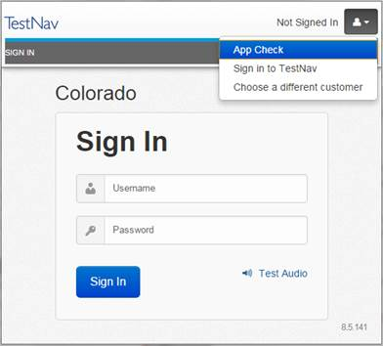
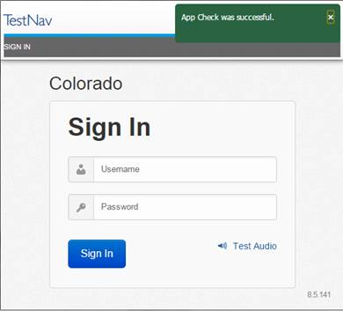
TestNav 8.5 Desktop App Check
New
Notes:
Replaces the TN quick verification.

Slide 61
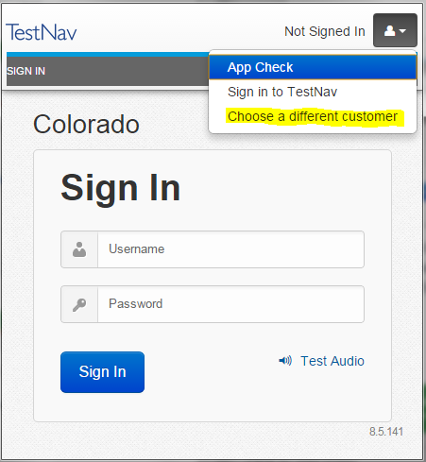
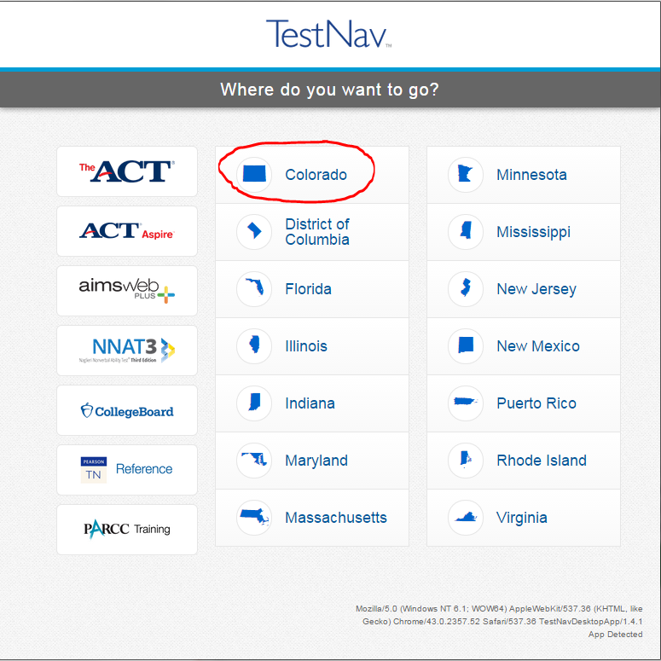
Point TestNav 8 App Toward TestNav URL
New
Choose the icon in the top right hand portion of the screen and select > Choose a different customer.
Select Colorado for all operational assessments Science, Social Studies as well as for PARCC ELA and Math assessments.

Slide 62
Infrastructure Trial
1
2
3
4
5
6
SECTION 5
Online Resources
Description
Create Students
Configure TestNav Create Testing Sessions
Pre-cache Test Content
Print Student Authorizations
Start Session

Slide 63
Online Resources
How-to Videos
Create a TestNav Configuration - https://www.youtube.com/watch?v=xT0Oo8zHKUs
Create an Online Test Session - https://www.youtube.com/watch?v=HnKXqPp-brg
Precache Test Content - https://www.youtube.com/watch?v=wbBjic1dHMA
TestNav Configuration
https://support.assessment.pearson.com/display/PAsup/Configure+TestNav+for+Proctor+Caching+and+Precache+Content
Configure Response File Backup Locations
https://support.assessment.pearson.com/display/PAsup/Configure+Response+File+Backup+Locations
Proctor Caching
https://support.assessment.pearson.com/display/TN/ProctorCache+Overview
PearsonAccess Next User Guide
https://support.assessment.pearson.com/display/PAsup/PearsonAccess+Next+Online+User+Guide

Slide 64
Description
An Infrastructure Trial is a full scale dress rehearsal a school can run to confirm that:
TestNav is configured correctly.
Devices can successfully run TestNav.
Network will bear the full load of simultaneous test-takers.
School personnel know what to do for computer-based assessments.
Students are familiar with the computer-based tools and formats.

Slide 65
Technology Setup
Complete Technology Setup prior to Infrastructure Trial:
Configure the Network
Proctor Caching
Capacity Check Tool
Proctor Caching Configuration
Notes:
Before conducting an Infrastructure Trial, it is important that the Technology Setup be completed and that technology coordinators, school personnel, and students are all equally prepared to participate in the Infrastructure Trial.
For the Technology Setup, it is recommended that these steps be completed:
Configure the network, so that network security devices such as content filters and firewalls allow connectivity with PearsonAccess^{next}, TestNav, Proctor Caching, and email communication with Pearson.
Proctor Caching software should be installed on selected computers with local static IP addresses.
The SystemCheck Tool should then be utilized to test bandwidth capacity of your environment, validate the Proctor Caching machine functionality, and SystemCheck - TestNav login credentials can be used to validate devices.
TestNav and Proctor Caching configurations will then need to be added to PearsonAccess^{next} for both the production site and the training site.
Practice tests available in the Training site, as well as sample items and student tutorials can be utilized to gain further experience with TestNav and the PARCC test administrations.
Once the Technology Setup is completed, schools can then conduct an Infrastructure Trial to collectively evaluate the test environment. This will allow schools to identify and resolve any remaining potential issues prior to the PARCC test administrations.
For detailed steps on Proctor Caching, SystemCheck Tool, and TestNav configuration please reference the “Proctor Caching & TestNav Configuration” training module.

Slide 66
PearsonAccess^{next} Setup
Schools or Districts will need to complete the following in PearsonAccess^{next} prior to the Infrastructure Trial:
Create Sample Students
Enter TestNav Configuration
Create Sessions
Print Student Testing Tickets
Notes:
Once TestNav and Proctor Caching configurations have been added to PearsonAccess^{next}, the next set of tasks can be completed by school personnel:
Sample Students can be created in the PearsonAccess^{next} Training site in order to administer an Infrastructure Trial.
Online Testing Sessions will then be created.
And from each session print Student Testing Tickets, Session Unlock Codes, and Rosters may be printed in preparation for the Infrastructure Trial.
We will now demonstrate each of these tasks.

Slide 67
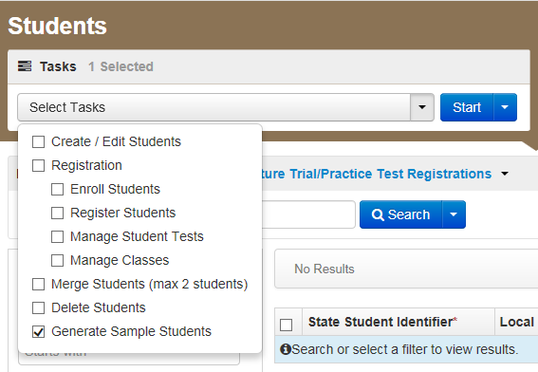
Create Sample Students
Log into the PearsonAccess^{next} Training Site
Choose the Colorado > 2015 - 2016 > CO CMAS: Science and Social Studies Spring 2016 Administration
Click Setup and select Students
Select Generate Sample Students from the Tasks menu
Click Start to continue
Notes:
To begin, we will log into the PearsonAccess^{next} Training Site. We will then choose the either the Spring PBA or EOY Administration. Infrastructure Trial testing is only available in either of these two administrations.
To Create Sample Students:
On the PearsonAccess^{next} home page, click Setup, select Students from the menu.
Next, select Generate Sample Students from Tasks menu; click Start to continue.

Slide 68
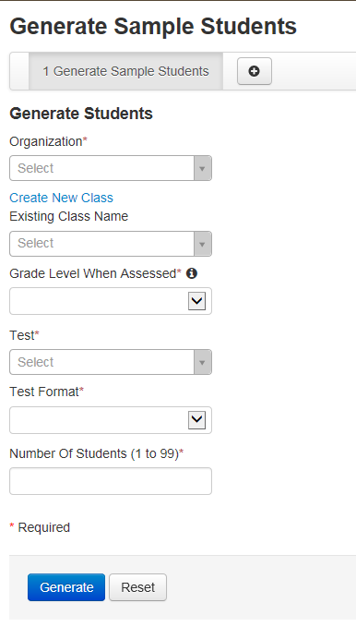
Create Sample Students
Complete the Generate Sample Students screen
Click Generate to complete the process
Notes:
You will need to complete these fields:
Organization: Select your school/organization
Class: Add an Existing Class Name or you may choose to create a new class
Grade Level When Assessed
Test: Choose one of the Practice Tests available from the pull down menu.
Test Format: Select Online for this option
Number Of Students: input a number between 1 through 99.
Click Generate
A confirmation screen will appear once the sample students have been created
Repeat the steps above until you have created sample students for the number of testing devices that will be tested concurrently, plus at least 10% additional sample students.

Slide 69
Create Sample Students- Demo

Slide 70
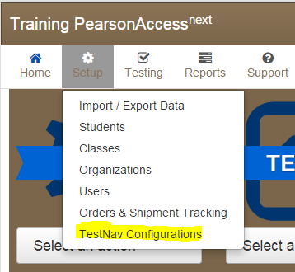
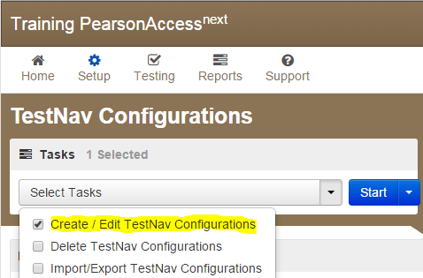
Configure TestNav Setup
Sign in to the CMAS PearsonAccess Next website at https://trng-co.pearsonaccessnext.com/customer/index.action
Select Setup > TestNav Configurations
Select Create/Edit Configurations; click Start to launch the configuration.
Notes:
Next you will need to create a TestNav configuration. Sign in to the PARCC PearsonAccess Next website. Technology staff will need to receive secure access from their district coordinator.
The Configuration screen can be accessed by selecting Setup and then TestNav Configurations from the drop-down menu. This will allow you to access the configurations settings to set primary and secondary temporary student response save locations for TestNav, and if applicable, set up a connection to your Proctor Caching machine(s).
Select Create/Edit Configurations from the tasks menu to launch the Configuration screen.

Slide 71
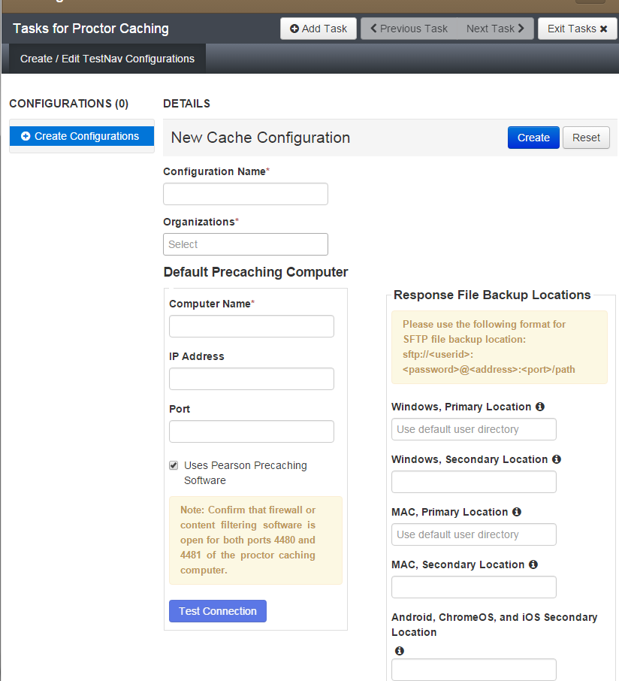
Configure TestNav Setup
Enter a Configuration Name.
Using the Organizations drop-down menu, select your school or district.
Notes:
You will be prompted to name your configuration. Configuration names must be unique within the PARCC PearsonAccess^{next} website for your state. Note that the Training site is shared by multiple states so configuration names must be unique across multiple states in the Training site. Pearson recommends using only letters and numbers in this field, as other characters may cause problems with test delivery. For example, Computer Lab 1 and Computer Lab 2, or High School and Middle School.
Next, using the Organizations drop-down menu, select the appropriate school or district from the menu. Regardless of the organization level, you will have the ability to add multiple settings (and Proctor Caching machines) to the configuration.

Slide 72
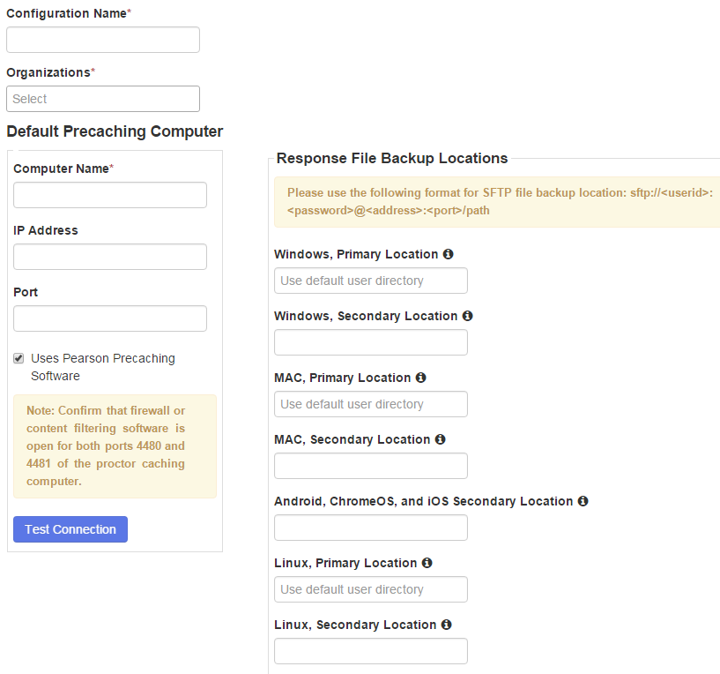
Configure TestNav Setup
Enter the Computer Name, IP Address, Port information, and check “Uses Pearson Precaching Software.”
Then specify student response file backup locations, and click Create.
New
SFTP file backup location format: sftp://<userid>:<password>@<address>:<port>/path
Notes:
Next, you can identify the Proctor Caching computer. In the “Default Precaching Computer” section, enter a computer name, the computer’s IP address, and port information.
The computer name will be the name that displays when selecting a Caching machine during test session creation. If you will be Proctor Caching, provide the internal network IP address of the caching machine and the port number, which unless modified is 4480 for Pearson-supplied Proctor Caching. The IP address should be a static address to ensure students can access content during testing. Also note, the computer selected for Proctor Caching should not be a student testing machine.
Check “Uses Pearson Precaching Software.”
If you will be using a non Pearson-supplied caching solution, you will uncheck the box next to “Uses Pearson Precaching software” and make sure the port is the correct port for the caching solution you will be using.
If you will not be Precaching, simply leave the IP Address and Port fields blank; you will still need to complete the next steps for TestNav.
For Response File Backup Locations, it is recommended that a Secondary Location be specified for Windows and Macintosh computers. The Secondary Location must be writeable by students and can be a network share on school network or a shared location on the local computer.

Slide 73
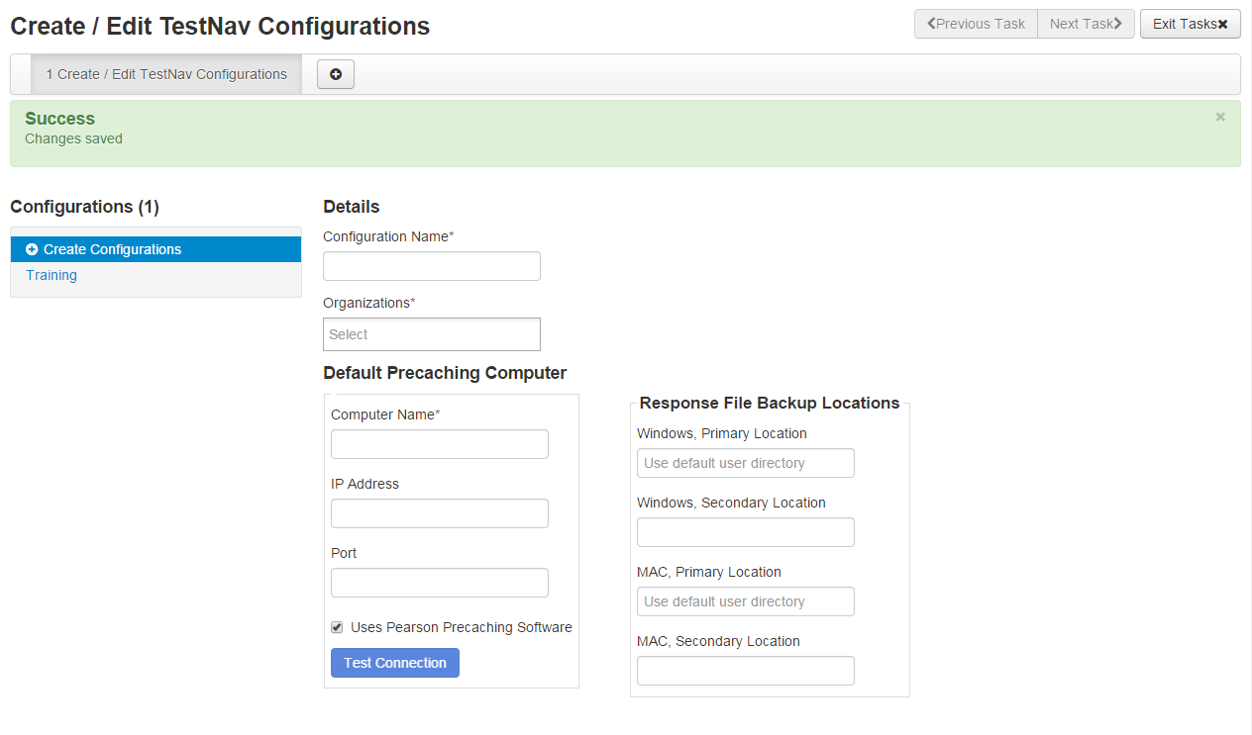
Completed TestNav Configurations
Notes:
A green Success! message will display after successful configuration. A red error will appear if there are issues.
To view, add, or make changes to an existing configuration, click on the configuration name under “Configurations.”

Slide 74
TestNav Configuration - Demo
Notes:
Demo TestNav Configuration.

Slide 75
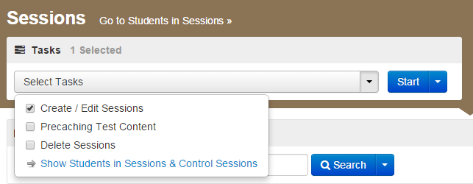
Create Sessions
Go to the Testing tab and click Sessions
From the Select Tasks pull-down menu select Create/Edit Sessions and click Start
A test session in PearsonAccess^{next} is an assessment containing certain units.
Notes:
In the Training site, go to the Testing tab and click Sessions.
From the Select Tasks pull-down menu select Create/Edit Sessions and click Start.
A test session in PearsonAccess^{next} is an assessment containing certain units.

Slide 76
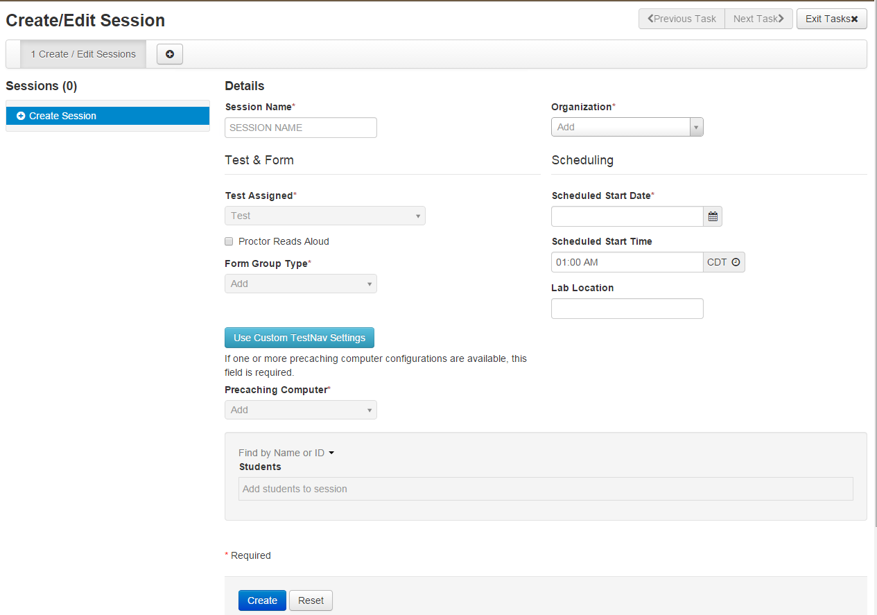
Create Sessions
Complete Test Details
Notes:
Complete the test session details by entering the Session Name and selecting the Organization (School or District) from dropdown menu.
Next, complete the Test & Form section. Select Test Assigned and choose the appropriate Practice Test from the dropdown.
Form Group Type to be set to “Main”.
If Precaching test content, select Precaching Computer from drop down menu.
Then, enter Scheduled Start Date in Scheduling section.
Scheduled Start Time and Lab Location are not required fields but it is recommended to complete both.
Note: The Scheduled Start Date and Scheduled Start Time for a session are intended primarily for planning purposes, it is not enforced. A test session will not be started until you click Start on the Session Details screen, regardless of the scheduled start date and time.

Slide 77
Create Sessions
Add students to session
Notes:
Finally add students assigned to this session.
Note: you can add individually by name or id association or in bulk using the class option. To add students by class, select the Find by Class button and select the class containing the sample students you would like to add to the session.
Click Create to create the session. A confirmation message will be displayed once the session has been successfully created. Exit tasks when finished.

Slide 78
Create Sessions - Demo

Slide 79
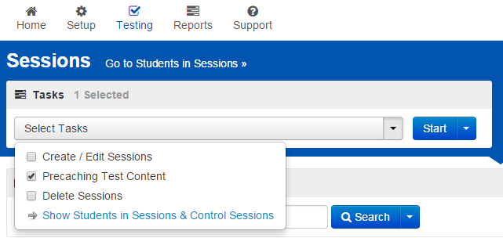
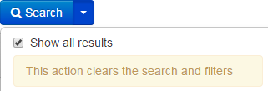
Precaching Content
Choose Sessions under the Testing tab
Select “Precaching Test Content” from the Tasks menu and click Start
Notes:
Precaching test sessions can be done by choosing Sessions under the Testing tab. On the Sessions screen, search for the sessions that you would like to Precache or use the Search arrow to select “Show all results” to bring up all sessions in your organization.

Slide 80
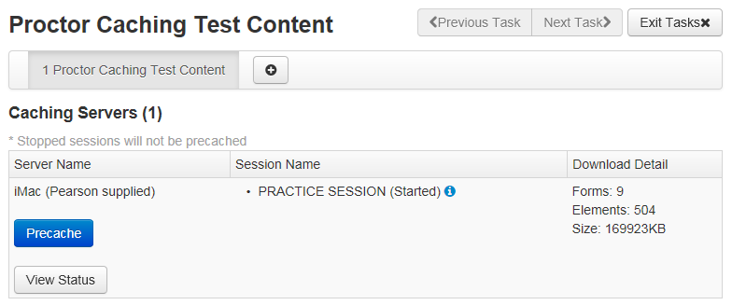
Precaching Content
Click the Precache button on the Proctor Caching Test Content screen
Notes:
This will bring up the “Proctor Caching Test Content” screen. On this screen you can click the Precache button to Proctor Cache the session. You can also click the “View Status” button to bring up the Proctor Caching Interface for the specified machine listed.

Slide 81
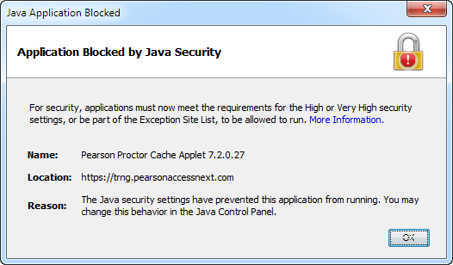
Precaching Content
Your Web Browser is not configured to run Java applet.
Notes:
Your web browser may not be configured to run Java applets. If this is the case, you might see an error message similar to this one pop-up on your screen. Please configure your web browser to run Java applets from https://*.pearsonaccessnext.com or go to http://java.com and click on the “Do I have Java?” link to verify that Java is enabled in your browser.
You may also need to configure your browser with an exception for the IP address of your Proctor Caching machine.

Slide 82
Precaching Content
Precaching is in progress…
Notes:
This message will appear once you have clicked the Precache button. You will need to click the Back button to return the “Precaching Test Content” screen.

Slide 83
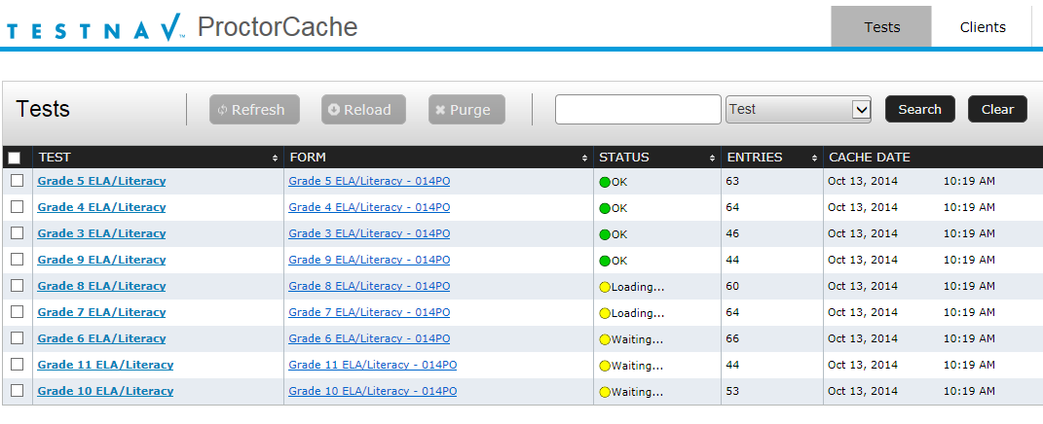
Precaching Content
Proctor Cache - Tests Screen will appear in a second window.
Notes:
Depending on your browser, a second tab or window will appear shortly. This window will display the Proctor Cache – Tests tab. It will detail each Test, Form, and status.

Slide 84
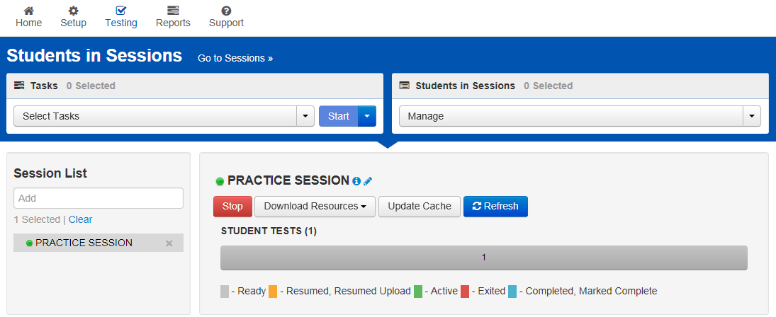
Precaching Content – Update Cache
Update Cache from the Students in Sessions screen under the Testing tab.
Notes:
You can also Precache sessions by using the “Students in Sessions” screen. You can bring this screen up by choosing Students in Sessions under the Testing tab. Selecting a session in the Session List to the right, will allow you to precache the session by then clicking the “Update Cache” button.

Slide 85
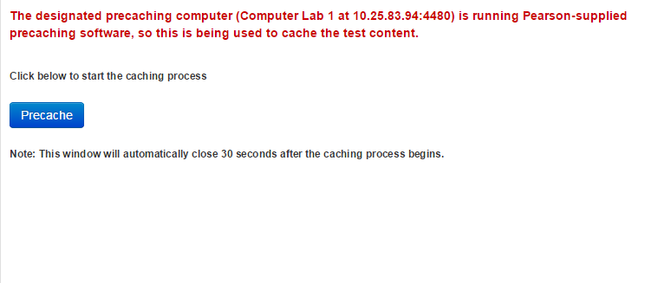
Precaching Content – Update Cache
Click Precache button to initiate the caching process.
Notes:
This will bring up a popup window with a similar Precache button, that will allow you to initiate the caching process. The popup window automatically closes after you click the Precache button. A second tab or window will appear shortly. This window will display the Proctor Caching – Tests tab.

Slide 86
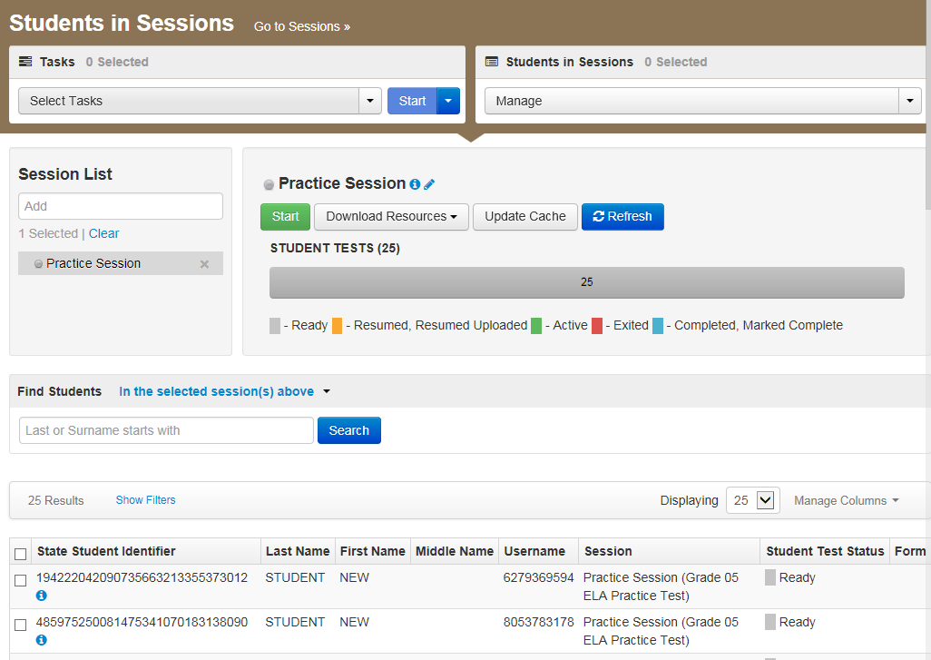
Session Management
Starting Session
Notes:
Now that we have created a session with sample students, we will now need to work with sessions.
To view sessions go to the Testing tab and click Students in Sessions.
Click the session name from the Session List. The Session Details screen will appear for the test session selected. If multiple sessions are selected, the option to Combine View appears.
Click the green Start in the Session Details screen. If multiple sessions are selected and are combined, there is an option to start all sessions.

Slide 87
Session Management
Print Student Authorizations & Session Unlock Codes
Notes:
Once the session is started, the Start button will change to a Stop button to allow you to Stop a session.
Use the Download Resources pull-down menu to view and print:
Session Unlock Codes
The Session Roster
and Student Testing Tickets
The Update Cache button may be used to update the Proctor Caching machine’s test content.
The Refresh button can be used to update the screen if needed.

Slide 88
Session Management
Student Test Status Key
Notes:
The Student Test Status will change individually for each student. The different color codes status are displayed in the Session window for your benefit. The individual students are displayed below along with their individual Student Test Status and other information.
Status key includes:
Ready - The student has not logged in to the session yet, but is ready to log in
Resumed, Resumed Upload - The student is ready to log back in to the session or the student is ready to log back in to the session and some responses were not sent to Pearson servers before exiting. Students will be prompted to have saved responses uploaded before resuming the test.
Active - The student is currently in the test.
Exited - The student has exited the session, but has not submitted his or her responses yet. Students in Exited status will need to be resumed by a Test Administrator to re-enter the test
Completed, Marked Complete - The student has completed the test and has successfully submitted his or her responses or the student’s test has been marked complete by the Test Administrator rather than being submitted through TestNav.

Slide 89
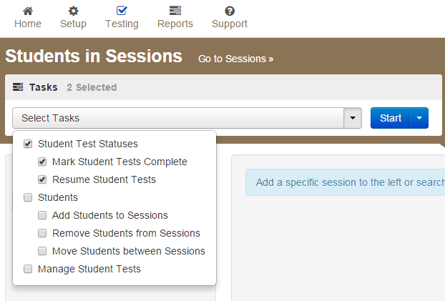
Session Management
Resuming, Marking Students Complete
Notes:
Once a session has been started, there are a number of actions that may need to be carried out in order to complete the Infrastructure Trial. These actions include resuming sample students, resuming sample students with saved responses, and marking tests complete. The Test Administrator should have their own device to perform these actions.
To mark test complete, resume student tests or undoing student test submissions, go to Testing tab, select Students in Session. Be sure the session name is selected within Session List. Check box next to student(s) name. Select from menu action you would like to complete.
To stop session, select the red stop button located on Student sessions. Please note, all students must be marked complete before stopping a session. You may also need to remove any students left in “Ready” status to successfully stop a session.

Slide 90
Support DuringTesting
1
2
3
4
5
6
Section 6
Online Resources
Early Warning System
Student Responses – SRF Files
Recovering from Problems
TestNav 8 Error Codes

Slide 91
Online Resources
Test Administration Support
https://support.assessment.pearson.com/display/TN/Troubleshooting
TestNav 8 Error Codes
https://support.assessment.pearson.com/display/TN/Error+Codes
EWS Potential Scenarios
https://support.assessment.pearson.com/display/TN/Early+Warning+System+Triggers

Slide 92
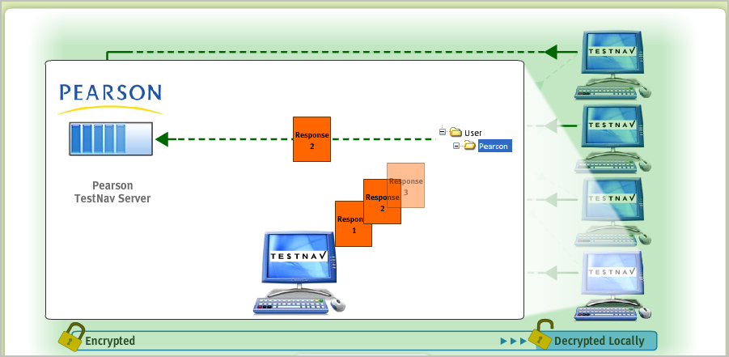
Early Warning System (EWS)
The Early Warning System (EWS) is integrated functionality that gives TestNav a high degree of fault tolerance and provides additional fail-safes in the event of unexpected network disruptions during online testing.

Slide 93
Early Warning System Design
Minimal interruptions for students.
Multiple physical file backups to safeguard against data loss.
Notification Screens designed for Test Proctors.
Early Warning System notifications often involve IT staff so an understanding is necessary to correct any issues during testing.

Slide 94
Student Responses – SRF Files
The EWS writes continuously in the background to the student response files. Both the Primary and Alternate files are written to at the same time.
The SRF file has a response data threshold that once reached will trigger TestNav to send response data to Pearson.
Uploading of response data is continuous. If an upload fails, TestNav will cycle and attempt another upload.
If the response data upload is successful, TestNav will create a new empty SRF file and begin the process again. TestNav will only delete an SRF file once it is successfully uploaded.

Slide 95
Student Responses - Identification
A combination of the test ticket ID combined with the session token is used to uniquely identify a Student Response File (SRF).
TestNav can identify the correct student response file if a test is successfully resumed.
The SRF can only be used the next time the student resumes a test.
You cannot upload a revalidated SRF to Android devices, iPads, or Chromebooks,
You can only upload this file and resume a student's test session on a computer running Windows or Mac OS X.
Notes:
Occasionally, after reviewing an SRF, Pearson Support revalidates the SRF and sends it back to a customer for re-upload so that the student can resume testing.

Slide 96
EWS Triggers
Response file save location is invalid.
During test start-up, TestNav cannot access a saved response file or files (SRF)or Pearson’s server.
After the test is in progress, TestNav cannot access both the SRF(s) and Pearson’s server.
TestNav cannot download test content after it attempts to download it three times:
TestNav cannot communicate with the proctor-caching computer.
TestNav cannot communicate with Pearson servers.

Slide 97
EWS Triggers
TestNav cannot locally save responses and/or upload student responses.
No response file locations are writeable when the student logs in, and test delivery cannot continue. TestNav requires at least one valid location at log in.
Responses cannot periodically save to the save location or if a student exits a test, and TestNav cannot send responses to Pearson.
TestNav cannot write or send responses (both fail at the same time) at any point during test delivery.
A student is resuming a test (in which TestNav requires a response file), and TestNav cannot find an SRF file.
TestNav may not locate this file if:
The student attempts to resume the test on a different device.
The device cannot access the network save location.
An administrator changes the SRF location before the student resumes a test.
Notes:
When a student resumes testing, TestNav requests a response file to resume the student's test at the correct item.

Slide 98
EWS Recovery - Resume a Test
When a student logs in to resume the test, TestNav checks the designated response file location(s) to determine whether a saved response file (SRF) exists.
When a student resumes the test on the same computer or device that he or she originally used, and TestNav finds one or more SRFs, the student can continue testing. TestNav uses the SRF with the newest time stamp.
If TestNav does not find an SRF, and the student is in Resume status in the system, he or she continues from the last item uploaded to Pearson.
If TestNav does not find an SRF, and the student is assigned Resume-Upload status in the system, EWS displays an error message.
Notes:
After you resolve an issue with a test, you can resume the student's test session in the assessment management system
These files have a .srf or.SRF extension.

Slide 99
EWS Recovery - Resume a Test
If the student must resume the test on a different device, and the EWS saved a student’s response file, you can use the SRF on the new device.
Save the SRF from the original device to a thumb drive or a shared location.
Transfer the SRF to the new device.
Mark the student Resume-Upload in the assessment management system.
When the student launches and signs in to TestNav on the new device, the system searches the default SRF location. When TestNav cannot locate the SRF in that location, it prompts you to browse to retrieve the file. After you direct TestNav to the file, it automatically uploads to the testing server.

Slide 100
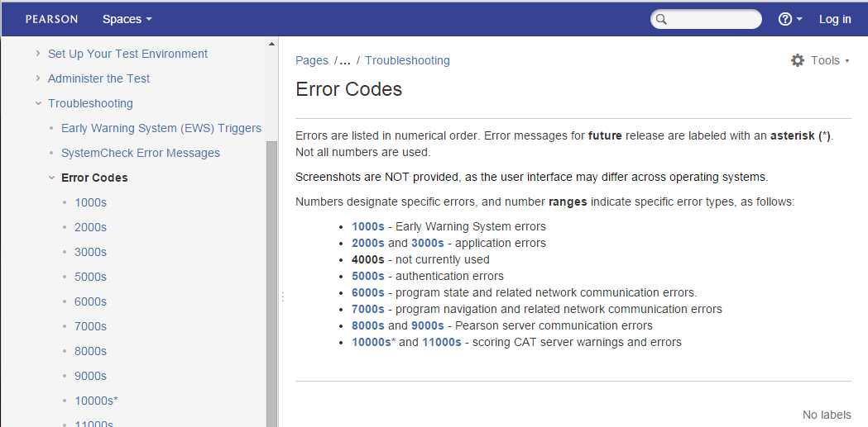
TestNav 8 Error Codes
The TestNav 8 Error Codes should be available to all test proctors to help support students as they test.
The Guide provides a list of all the warning messages that TestNav may show a student and how to resolve them.
Available through https://support.assessment.pearson.com/display/TN/Error+Codes

Slide 101
CMAS Support
English Language Arts/Literacy and Mathematics (PARCC)
Science and Social Studies
Customer Support Sign in PA^{next} for Chat Support 1-888-493-9888 Monday - Friday 4:30 am - 5:30 pm (MST)
E-mail parcc@support.pearson.com
Customer Support Sign in PA^{next} for Chat Support 1-888-687-4759 Monday - Friday 7:00 am - 6:00 pm (MST)
E-mail cohelp@support.pearson.com
Notes:
Many resources are available online. PARCC Support can be reached toll free Monday through Friday from 5:00 am through 7:00 pm, Central Time, at 888-493-9888. You may also send an email to PARCC@support.pearson.com. You can contact PARCC Support for assistance with:
Navigating PearsonAccess^{next}
Navigating the Training Center
Managing Student Registration Data
Setting up test sessions
Managing user IDs and passwords
Accessing resources
Setting up proctor caching
Submitting additional orders
Inquiring about shipments

Slide 102
Future Training Opportunities
Online Test Security
Reading TN log file
Infrastructure trial setup
https://www.surveymonkey.com/r/JZZMMG8

Slide 103
CDE Support Collin Bonner CDE Assessment Technology Specialist 303-866-6752 bonner_c@cde.state.co.us
Thank You for your Time!
Pearson Support 888-687-4759 COHelp@support.pearson.com
Districts/Schools should use Pearson as the first contact for support during testing

