Slide 1
Spring 2016
CoAlt: Science and Social Studies
Administration Training - DACs

Slide 2
CoAlt: Science and Social Studies Spring 2016
Agenda
Important Dates
Activities Before Testing
  Chain of Custody, Test Security, Annual Training, and PearsonAccess^{next}
Activities During Testing
  Administering the Assessment, Testing Procedures, and Examples of Administering the CoAlt: Science and Social Studies Assessment
Activities After Testing
  Online Score Entry, Status Reports, and Returning Materials
Support

Slide 3
CoAlt: Science and Social Studies Spring 2016
CoAlt PearsonAccess^{next} Important Dates
SR/PNP Update - Participation Counts for Initial Orders | January 11 – 29, 2016
Materials Arrive in Districts | March 28, 2016
Additional Orders - Secure Materials | March 29 - April 28, 2016
Additional Orders - Non-Secure Materials | March 29 - May 2, 2016
Testing Window | April 11 – 29, 2016
Score Entry Deadline | May 4, 2016
Schedule Pickup Deadline | May 2, 2016
Materials Pickup Deadline | May 4, 2016

Slide 4
CoAlt: Science and Social Studies Before Testing
Before
During
After

Slide 5
Security and the Chain of Custody page 54 of the Procedures Manual
  All CoAlt testing materials are secure.
  Each person in the chain is responsible for test security while the assessment is in their possession.
  Secure Storage
  Distribution of Materials

Slide 6
Test Security page 54 of the Procedures Manual
  Items are not to be reproduced
  Student responses are not reproduced
    Student responses are recorded in the test book or on the included score form
    After administering the CoAlt, the scores must be entered into PearsonAccess^{next}
  No digital cameras, video cameras, or recoding devices of any type are allowed in the testing environment

Slide 7
The Testing Environment page 46 of the Procedures Manual
  Separate testing space
  No distractions
    Turn off the phone (including cell phones)
    Not disrupted by other staff
    Not disrupted by other students
  Anyone in the testing room
    Must be trained on test security
    Must sign a Security Agreement/confidentiality form

Slide 8
Test Examiners page 36 of the Procedures Manual
  Must be a Certified Educator
    District Employee
    General Education/Special Education
    NOT Substitute License
  Should be the person who knows the student best – but not a relative
  Must be trained annually

Slide 9
Annual Training page 62 of the Procedures Manual
CoAlt Trainings
http://www.cde.state.co.us/assessment/trainings > 2015-2016 Trainings > CoAlt: Science and Social Studies Administration
Examiner’s Manual
http://www.cde.state.co.us/assessment/coaltem
Procedures Manual
http://www.cde.state.co.us/assessment/copromanual
Released Items
http://www.cde.state.co.us/assessment/CoAlt-Items.asp
DAC CoAlt Administration Training (Recorded Fall 2015)
https://enetlearning.adobeconnect.com/p78xxelh5bu/
  Should include:
  Available Resources
  Communication Protocols
  Security
  Administration Procedures
  Provide an opportunity to practice giving released items
  Provide an opportunity for immediate feedback
  Provide an opportunity to ask questions

Slide 10
Managing PearsonAccessNext
Create a Test Examiner
District Assessment Coordinators (DACs) and School Assessment Coordinators (SACs) can create Test Examiner accounts in PearsonAccess^{next}.
DACs and SACs can also add the Test Examiner role to existing PearsonAccess^{next} user accounts.
Accounts can be created or updated through the User Interface (UI) or through the User File import/export process.
Sign into PearsonAccess^{next} and select the CoAlt administration.

Slide 11
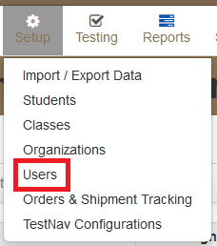
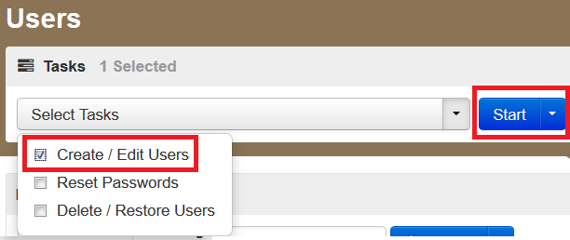
Managing PearsonAccessNext
Create a Test Examiner
Select Setup > Users.
Select Create/Edit Users from the Tasks drop-down and select Start.

Slide 12
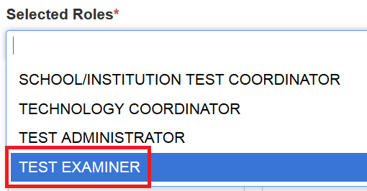

Managing PearsonAccessNext
Create a Test Examiner
Complete the necessary fields for the New User on the Details screen.
  In the Selected Roles field, select “Test Examiner” from the list of available roles.
Select Create.

Slide 13
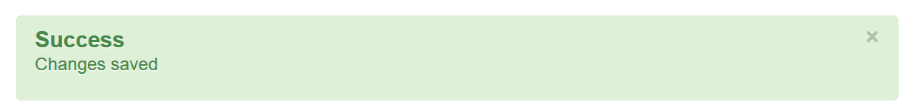
Managing PearsonAccessNext
Create a Test Examiner
Once the green “Success: Changes saved” message appears at the top of the screen, the new account has been created. Select the Exit Tasks button.

Slide 14
Managing PearsonAccessNext
Updating a Test Examiner
If the Test Examiner role needs to be added to an existing PearsonAccess^{next} account, the following steps should be taken:
Access the CoAlt: Science and Social Studies 2015-2016 Administration
Select Setup > Users
Use the Find Users search box to locate the account and select the checkbox next to the Username.
Select Create/Edit Users from the Tasks drop-down and select Start.
Select the username from the list of Users.
Select the white space next to the existing roles in the Selected Roles box. A list of available roles will appear. Select “Test Examiner”.
Select the Save button.
Once the green “Success: Changes saved” message appears at the top of the screen, the account has been updated. Select the Exit Tasks button.
The CoAlt PearsonAccess^{next} Guidance Document, which includes step-by-step screen shots of this process, is found on the CDE Training webpage, Avocet, and in PearsonAccess^{next} support.

Slide 15
Managing PearsonAccessNext
Create/ Update Account through a User File Import/Export
Directions for creating or updating user accounts through the file import/export process are found in the PearsonAccess^{next} Online User Guide at https://support.assessment.pearson.com/display/PAsup/PearsonAccess+Next+Online+User+Guide.
To create a new Test Examiner account or add the Test Examiner role to an existing account TEST_EXAMINER should be entered in Column Letter G in the user file.
Column Letter | Field Name | Expected Value
G | Roles | TEST_EXAMINER

Slide 16
Managing PearsonAccessNext
Assigning a Test Examiner to a Student Test
Sign into PearsonAccess^{next} and select the CoAlt administration.

Slide 17
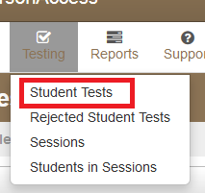
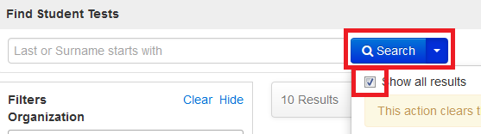
Managing PearsonAccessNext
Assigning a Test Examiner to a Student Test
Select Student Tests under Testing.
To locate students select the show all results under the search button.

Slide 18
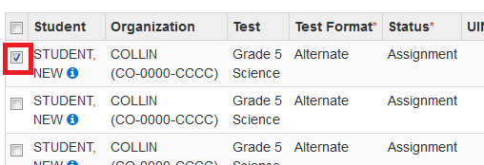
Managing PearsonAccessNext
Assigning a Test Examiner to a Student Test
Select the checkbox in line with the student’s name (additional students can also be selected at the same time if Test Examiners need to be assigned to multiple students).

Slide 19
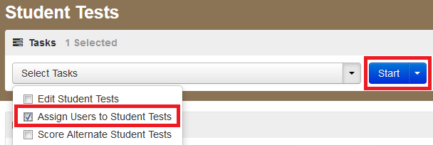
Managing PearsonAccessNext
Assigning a Test Examiner to a student
Select “Assign Users to Student Tests” and then select the Start button.

Slide 20
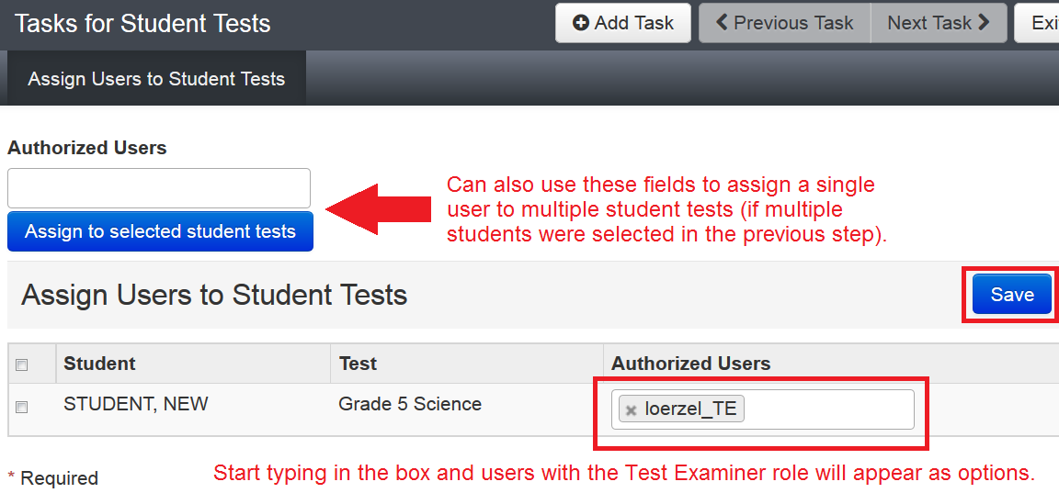
Managing PearsonAccessNext
Assigning a Test Examiner to a student
Enter the Test Examiner’s user name in the Authorized Users box in line with the student’s name.
  If a single Test Examiner will be assigned to multiple students and the students were selected in the previous step, the Authorized Users box at the top of the screen can be used instead to assign that user to multiple students at once.
Select the Save button and then select Exit Task once the green “Success: Changes saved” message appears.

Slide 21
CoAlt: Science and Social Studies Receiving and Distributing Materials
Page 87 of the Procedures Manual
  Timely distribution allows Test Examiners to:
    Review procedures
    Prepare materials
  Upon request, DACs may distribute PDF versions of task manipulatives for accommodations.

Slide 22
CoAlt: Science and Social Studies During Testing
Before
During
After

Slide 23
Administering the CoAlt: Science and Social Studies Assessment
Student is presented with three or four answer options
Student will work with item until the correct answer is received or maximum attempts is reached
CoAlt Test Examiners may NOT reword prompts
Re-present prompt at level four only when the student does not respond
An additional prompt is included to engage the student at level three
Only one data point is recorded

Slide 24
Administering the CoAlt: Science and Social Studies Assessment
Test book layout
Two item types
  Selected Response
  Supported Performance Tasks
Online Score Entry
  Should be completed the same day the assessment is administered.
  Must be completed by May 4th

Slide 25
Administering the CoAlt: Science and Social Studies Assessment
Test Materials
In grades 4, 5 & 7 there is one test form per grade level.
In grade 8 and HS there are two test forms.
  Form 016
  Form 026
Each student must be assessed with their own test book and corresponding task manipulatives.

Slide 26
Administering the CoAlt: Science and Social Studies Assessment
Task Manipulatives
Task manipulatives shrink-wrapped with each test book must be used with that specific test book.
Keep test materials that were shrink-wrapped together.

Slide 27
Administering the CoAlt: Science and Social Studies Assessment
Test Materials and Task Manipulatives
Each CoAlt Test Kit contains:
  Test book with form number on the front
  Task manipulatives
  Score entry form (with task manipulatives)
  Secure return envelope

Slide 28
Administering the CoAlt: Science and Social Studies Assessment
Test Materials and Task Manipulatives, continued
Write the student’s full name on the cover of the test book.
Write the student’s full name with a black marker on the secure return envelope.
Cut apart the task manipulatives for each performance task.
Paper clip the cut-apart task manipulatives to the corresponding student response page.
In between testing sessions, task manipulatives may be stored in the secure return envelope.
Keep all materials together throughout the test administration.

Slide 29
Administering the CoAlt: Science and Social Studies Assessment
Test Materials and Task Manipulatives, continued
Use the provided picture symbols, except when the student:
Needs to use objects rather than pictures
Needs pictures of real objects rather than drawings,
-OR-
The student has a personal lexicon with a specific representation for the concept or words in the student answer choices
  In this case, all answer choices must be from the student’s personal lexicon

Slide 30
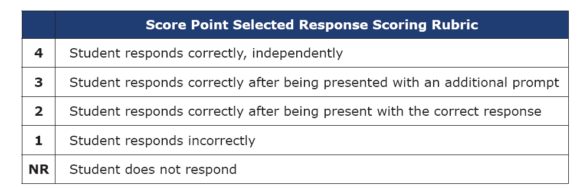
Selected Response Items
Selected Response items are identified as “Item ##” within the test book.
They contain both a primary prompt and an additional prompt.
Additional information in CoAlt S/SS Training PPT at http://www.cde.state.co.us/assessment/coaltadmintrg2015 on slides 12-38.

Slide 31
Selected Response Items
Test Examiner Flowchart
Present the Primary Prompt
Student Responds Correctly
Student Does Not Respond
4 Points
Repeat the Primary Prompt
Student Responds Correctly
4 Points
Student Responds Incorrectly OR Student Does Not Respond (after repeating the Primary Prompt)
Present the Additional Prompt and then present the Primary Prompt again
Student Responds Correctly
3 Points
Student Responds Incorrectly OR Student Does Not Respond
Present the Correct Answer and then present the Primary Prompt again
Student Responds Correctly
2 Points
Student Does Not Respond
Student Responds Incorrectly
“NR”
1 Point

Slide 32
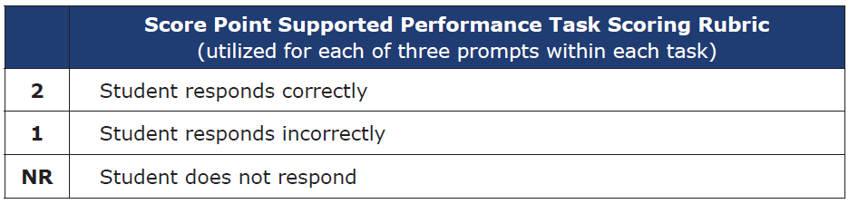
Supported Performance Tasks
Supported Performance Tasks are identified as “Task ##” within the test book.
They are made up of three prompts related to an overall task.
These items require the student to use the task manipulatives by placing them on the student response page (e.g., place task manipulative in designated boxes within a chart or diagram).
Additional information in CoAlt S/SS Training PPT at http://www.cde.state.co.us/assessment/coaltadmintrg2015 on slides 39-59.

Slide 33
Supported Performance Tasks
Test Examiner Flowchart
Present the Task
Student Responds Correctly
2 Points
Present the Prompt
Student Responds Incorrectly
1 Points
Student Does Not Respond
Student Responds Correctly
2 Points
Student Responds Incorrectly
1 Points
Student Does Not Respond
“NR”

Slide 34
CoAlt: Science and Social Studies After Testing
Before
During
After

Slide 35
Online Score Entry
Enter the students score in PearsonAccessNext
Sign into PearsonAccess^{next} and select the CoAlt administration.
Select the appropriate organization
Select Testing > Student Tests.

Slide 36
Online Score Entry
Locate the student by typing the student’s last name into the search box or by selecting the Search drop-down and “Show all results”.
Select the checkbox in line with the student’s name (additional students can also be selected at the same time if scores need to be entered for multiple students).

Slide 37
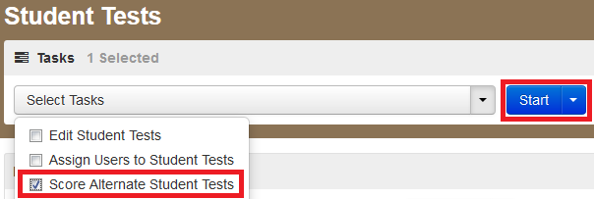
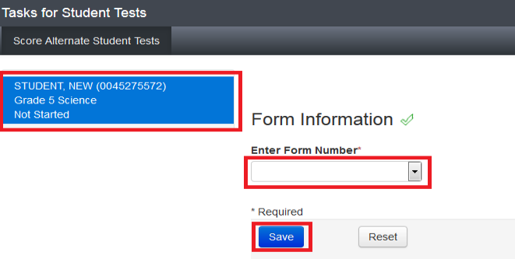
Online Score Entry
Select “Score Alternate Student Tests” and then select the Start button.
Select the student’s name on the left side of the screen, select the appropriate form number from the Enter Form Number drop-down, and select the Save button.

Slide 38
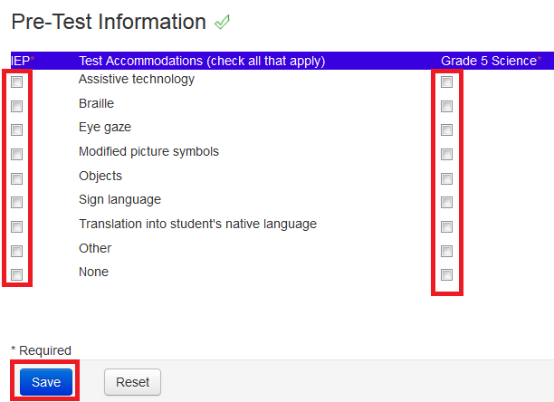
Online Score Entry
Enter IEP and assessment accommodations
Select Save.

Slide 39
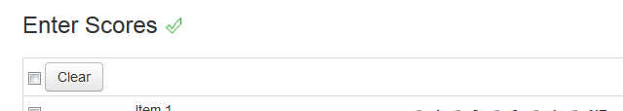
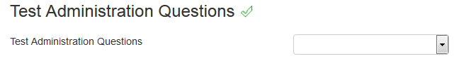
Online Score Entry
Enter the student’s scores
  Optional: Enter responses to the Test Administration Questions.

Slide 40

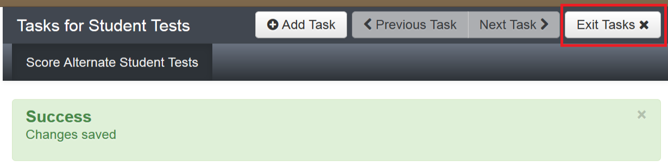
Online Score Entry
Select the Save button.
Once the green “Success: Changes saved” message appears at the top of the screen, select the Exit Tasks button.

Slide 41
Verify Completion of Score Entry
DACs and SACs can access Score Entry Reports through PearsonAccess^{next} to verify the status of student tests across the district or school.
Two types of reports are available:
  Summary Reports
    Contain Student Test status counts by test/grade across the district or school
  Status Reports
    Contain Student Test status by individual student across the district or school.
These reports can be displayed through the UI or downloaded as .csv files.

Slide 42
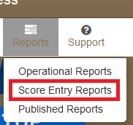
Verify Completion of Score Entry
Select the CoAlt administration and the appropriate organization.
Select Reports > Score Entry Reports.

Slide 43
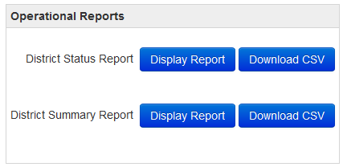
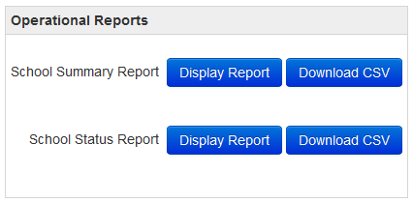
Verify Completion of Score Entry
  The Score Entry Reports screen will appear. Based on the selected organization, the report options will be either “District” or “School” level:
  District
  School

Slide 44
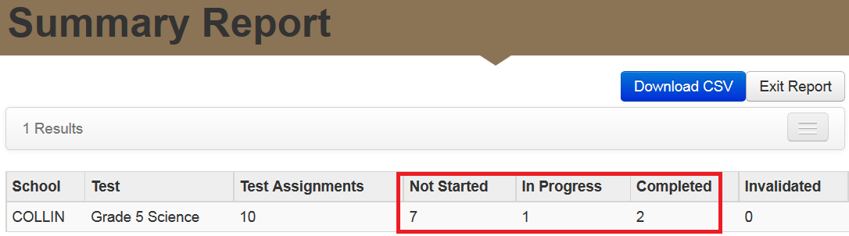
Verify Completion of Score Entry
Summary Report
Select “Display Report” or “Download CSV” for the Summary Report.
    Verify Student Test status counts by test/grade in the Not Started, In Progress, and Completed columns.

Slide 45
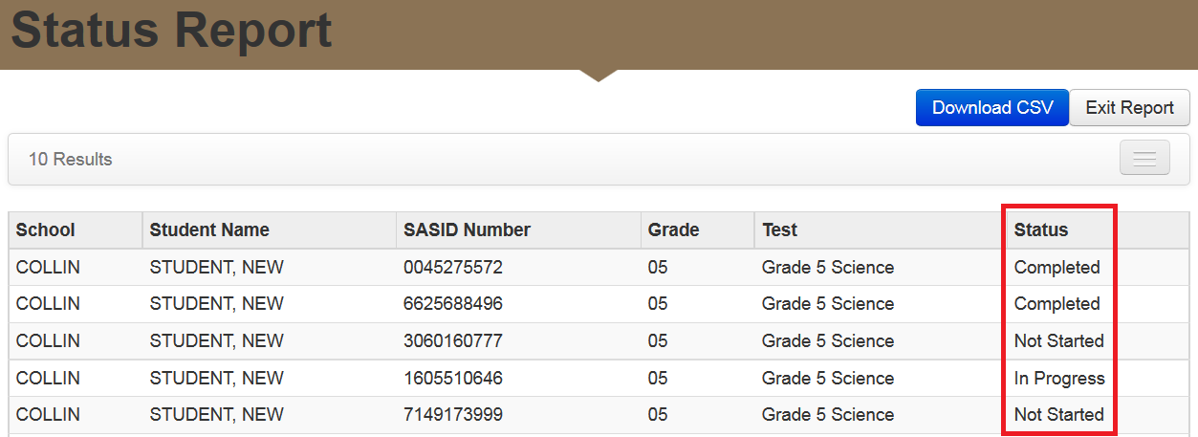
Verify Completion of Score Entry
Status Report
Select “Display Report” or “Download CSV” for the Status Report.
  Verify individual student test status in the Status column.

Slide 46
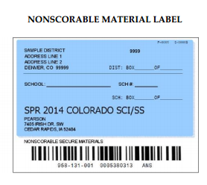
CoAlt: Science and Social Studies Return Materials
Page 94 in the Procedures Manual
Secure Return Envelope (1 per student)
  Task manipulatives
  Used score recording forms
    Verify student scores have been entered in PearsonAccess^{next}
  Security Agreement form (1 per Test Examiner)
Immediate Return
  Schools return all CoAlt materials to DAC once the last student has tested
  DACs return CoAlt materials to Pearson once all scores have been entered and the last school has tested
    Last day to schedule pick-up May 2, 2016
    Last day for material pick-up May 4, 2016

Slide 47
Support
Support Page on PearsonAccess^{next}
Toll Free Phone Support
    1-888-687-4759
Email Support*
    COHelp@support.Pearson.com
    *Student Personally Identifiable Information (PII), including names and SASIDs, must not be emailed.

