Slide 1
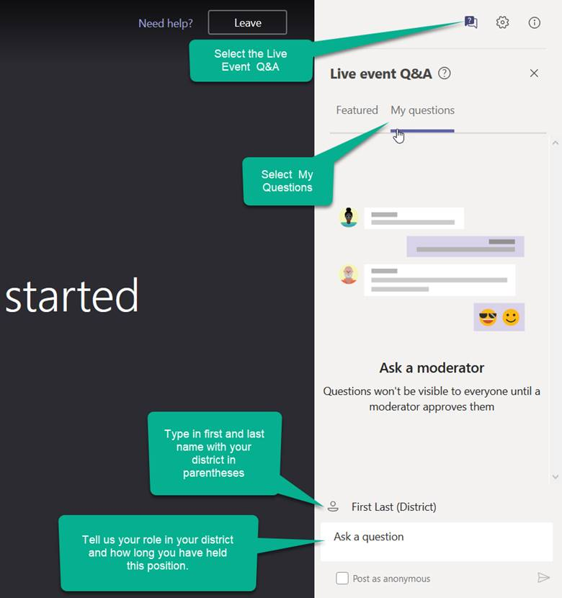
2020-2021 District Technology Coordinator Kickoff Meeting
Welcome!
Introduce Yourself
From the top of the right-hand navigation select the Live event Q&A
Below the Live event Q&A heading select My questions.
At the bottom of the Q&A box enter your name using this format: First Last (District)
In the Ask a question section tell us your district role and how long you have held your position.
Select the paper airplane icon in the bottom right corner of the window to send it.

Slide 2
2020-2021 District Technology Coordinator Kickoff Meeting
CDE Assessment Division
October 29, 2020

Slide 3
Welcome and Agenda
Current Circumstances
DTC responsibilities and privileges
DTC Listserv
Assessments and Platforms
State Assessment Schedule
Legislation
ACCESS for ELLs Insight
CMAS/TestNav
CoAlt/KITE

Slide 4
Current Circumstances

Slide 5
COVID-19 Policy Implications Stakeholder Group
2020 legislative session - Creation of a stakeholder group to address issues presented by the COVID-19 crisis School Finance Act (HB20-1418)
Review impact of the COVID-19 pandemic and the resulting disruption of the 2019-20 school year, including student transition to remote learning and the cancellation of the state assessments, accountability, accreditation, and educator evaluation systems.
Discuss how the cancellation of state assessments will impact accountability, accreditation, and educator evaluations during the 2020-21 school year and whether future modifications are needed for these areas in response to the pandemic.
Make recommendations regarding whether and how to proceed with state assessments, accountability, accreditation, and educator evaluations during 2020-21 school year and how the systems continue to effectively measure student achievement and growth and provide an accurate, credible, and comparable assessment of the public education system throughout the state following the COVID-19 pandemic.
19 committee members will work from fall 2020 through December 2020. By early January 2021, the findings and recommendations from the working group will be completed.

Slide 6
Sources of State Content Assessment Requirements
Colorado’s state (content) assessment system is guided by state law, state rule, federal law/regulations, and Colorado’s ESSA plan.
Mechanisms for change:
State law – executive order or legislative
State rule (limited for assessment) – Board adoption
Federal law/regulation – waiver (or legislative or federal department of education adoption)
ESSA plan – CDE revision or addendum, and federal department of education approval

Slide 7
Sources of State Content Assessment Requirements
Assessment | State Action | Federal Action
CMAS/CoAlt ELA/Math/Science SAT and CoAlt | Executive Order: suspended assessment requirements in C.R.S. § 22-7-1006.3 | Waiver: waived assessment requirements in ESSA Section 1111(b)(2)
CMAS/CoAlt Social Studies PSAT and CoAlt | Executive Order: suspended assessment requirements in C.R.S. § 22-7-1006.3 | Not applicable

Slide 8
DTC Responsibilities and Privileges

Slide 9
District Technology Coordinator (DTC)
DTC responsibilities and privileges
Primary technology contact for the district who works with CDE Assessment Division regarding online administration of state assessments
Receive critical, in-depth testing vendor communications directly from CDE during administrations
Communicate pertinent technology information to district stakeholders concerning the online administration of state assessments
DTC support for CMAS math, ELA, science and social studies
DTCs are escalated to Pearson’s Level 2 Technical Support when contacting the help desk with questions regarding the online assessment system
Note: Only the one officially identified DTC for each district is escalated
Request support directly from Collin Bonner in the CDE Assessment Division

Slide 10
District Technology Coordinator (DTC)
Check the CDE website to determine the appropriate person is listed as DTC
http://www.cde.state.co.us/assessment/DTC
It is important to identify a DTC for the district – make sure this position is updated if there is a change
Superintendent-appointed
DTC receives emails from CDE with information about training and technology updates throughout the year

Slide 11
New DTC Listserv

Slide 12
New DTC Listserv
DTC Listserv Notification sent via listserv October 7th.
Option to unsubscribe from this listserv reply to dtc-unsubscribe-request@cdelist.cde.state.co.us
Delivery errors automatically deleted from the list when:
errors have been reported for a period of 4 days or more or,
more than 100 delivery errors have been received
I will only reach out when active DTCs receive errors.
Contact me to request additional district subcriptions.

Slide 13
Supporting 3 Platforms

Slide 14
Colorado Assessments
Colorado Measures of
Academic Success
(CMAS)
Colorado Alternate Assessments
(CoAlt)
CO PSAT/SAT
SAT – grade 11*
PSAT – Grades 9 and 10**
Math*
Math (DLM)*
Math
ELA*
ELA (DLM)*
***Evidenced-based Reading and Writing
Science*
Science*
ACCESS
for ELLs
Social Studies**
Social Studies**
NAEP
& International Assessments
* Required by Colorado law and federal law
** Required by Colorado law
*** Allowed by Colorado law

Slide 15
Online Assessment Platforms
Assessment | Test Engine | Student Info System | Features
ACCESS for ELLs® |  | WIDA Assessment Management System (WIDA AMS) | Caching server Clients for Windows, Linux, Mac OSX, Chromebooks, iPads and Android
CMAS |  |  | Caching server available Installable apps for desktop, Chromebooks, Androids and iPads
CoAlt Science and Social Studies | N/A
CoAlt ELA and Math (Dynamic Learning Maps (DLM)) | Student Portal | Educator Portal | KITE client install for each device

Slide 16
2020-21 State Assessment Schedule (subject to change)

Slide 17
Tentative 2020-21 State Assessment Calendar (subject to change)
Assessment | Grade(s) | Tentative Windows
ACCESS for ELLs® | K-12 | January 11 - February 12, 2021
CMAS and CoAlt: Social Studies¹ | 4, 7 | April 12 - 30, 2021
CMAS and CoAlt: Science | 5, 8, 11²
CMAS: Math and ELA (CSLA³) | 3-8²
CoAlt: DLM ELA and Math | 3-8 | Aligned to CMAS: Math and ELA schedule
CO PSAT | 9, 10 | April 13, 14 or 15, 2021⁴ April 27 or 28, 2021: Make-up date April 13 - 20, 2021: Accommodations window
CO SAT | 11 | April 13, 2021 April 27, 2021: Make-up test date April 13 - 16, 2021: Accommodations window
CoAlt: DLM ELA and Math | 9-11 | Aligned to PSAT and SAT schedules
¹Social Studies are administered on a sampling basis
²See next two slides for early window options
³CSLA is for eligible English learners in grades 3 and 4 only
⁴District choice for initial test date

Slide 18
CMAS Assessment Window (subject to change)
Official window: April 12 - 30, 2021
All elementary and middle school science and social studies administrations must be completed within this window
All school-wide paper-based administrations for math and ELA must be completed within this window
Students taking CoAlt ELA and math (DLM) and those requiring paper accommodations should test at the same time as their peers (this includes CSLA)

Slide 19
CMAS Early Window Options (subject to change)
Online math and ELA
To compensate for technology capacity, the math and ELA window can open early for online administrations only
Students taking CoAlt ELA and Math (DLM) and those requiring paper accommodations should test at the same time as their peers (includes CSLA)
Earliest start date for online math and ELA: March 22, 2021
This is an extended window – total of 5 testing weeks
High school science
To accommodate high school assessment schedules including SAT, AP and IB exams, the high school science window can open and close early
Early window options:
March 29 – April 16, 2021
April 5 – April 23, 2021
This is an early window – total of 3 testing weeks
Districts are asked at fall administration trainings to notify CDE of intent to participate in early windows by December 15, 2020

Slide 20
Social Studies
High school social studies will no longer be administered
Fourth and seventh grade administration options are being considered by the Department and the stakeholder group
Individual elementary and middle schools are expected to be sampled once every three years
We will keep you posted on how those conversations progress

Slide 21
Legislation

Slide 22
Charter Schools
Charter Schools are considered their own LEP (Local Education Provider) for purposes of the following state laws:
Paper-based testing options: §22-7-1013(6), §22-7-1006.3(1)(d-e)
Assessment information for parents: §22-7-1013(7)(a)
Parent excuse information: §22-7-1013(8)(a-c)
DTCs are responsible for:
Communicating technology requirements and issues to district charter schools.

Slide 23
Requirements & District Responsibilities Paper §22-7-1013(6), §22-7-1006.3(1)(d-e)
Each LEP must adopt and implement a written policy by which it decides whether to request the paper form of the state assessments for its students
Decision must be made in consultation with schools and parents
Copy of policy must be shared with parents and posted on LEP website
LEP may make the decision by school or class (i.e., grade level and content area)
LEP will report to CDE the number of students who will take the paper form (indicated prior to initial order deadline)
Considerations
Technology capacity
Logistics
Must have the grade appropriate calculators for math (grades 6-8)
Paper and online form always available to individual students as an accommodation
Must commit to meeting security requirements and accounting for all secure materials
Chain-of-custody documentation and reports for missing materials

Slide 24
WIDA ACCESS for ELLs®

Slide 25
ACCESS for ELLs® Key Dates (subject to change)
ACCESS Testing Window
Monday, January 11 – Friday, February 12, 2021
WIDA AMS Test Setup Available
November 20, 2020 – February 18, 2021

Slide 26
DRC WIDA AMS Updates
The Device Toolkit renamed Central Office Services (COS):
Central Office Services (COS) is an web application in WIDA AMS that allows users to install, configure, and manage ACCESS online testing environment from a central location.
COS includes a number of functional components including the COS Service Device (COS-SD) Software for Content Management and Content Hosting.
COS was updated to improve usability and accessibility as well as include all of the steps for creating a New COS configuration in one window.
These changes have no impact on the pre-existing configurations and testing devices within the site.

Slide 27
DRC Device and OS Support Updates
WIDA Screener: 2020-21 OS Support beginning:
Phase 1 Best Effort Support The operating systems listed below:
Ubuntu 20.04 LTS version with Gnome Shell – Released April 23, 2020
iPadOS 14.x – anticipated September 2020 release
macOS 10.16 – anticipated September 2020 release
Windows 10 fall update – anticipated September 2020 release
WIDA Screener: 2020-21 OS Support ended or ending
iPad Air devices: The iPad Air device supports only iOS 12.x. DRC anticipates with the launch of iOS 14 in the fall Apple will drop support for iOS 12.x resulting in this device no longer being supported by Apple and therefore DRC.

Slide 28
DRC Chrome Updates
DRC offers the following levels of support for Chrome OS:
Full Support for the current stable channel level.
Best Effort Support for stable channel levels between level 83 and current stable channel level. Note: DRC also offers Best Effort Support for unmanaged Chrome devices (the DRC INSIGHT Secure App for Chrome OS was manually installed) that meet the system device and supported operating system requirements.
End of Support (no support) for stable channel levels before 83.
DRC recommends not using any Chrome devices that have reached, or will reach, Auto Update Expiration (AUE) within the 2020-2021 school year for testing. For reference, use the following link to help determine the AUE of a specific Chrome device: https://support.google.com/chrome/a/answer/6220366

Slide 29
DRC Technology Reminders
Automatic Operating System Updates and Other Background Processes:
Impacts Google, Microsoft and Apple
Update processes running in the background on testing devices consume CPU and memory
Can affect the testing experience
Audio playback may be choppy
Speaking test responses may be distorted
Verify devices have the most current version of the operating system before the test session starts to avoid issues.

Slide 30
CMAS Mathematics, English Language Arts/Literacy, Colorado Spanish Language Arts (CSLA), Science and Social Studies

Slide 31
CMAS Grades and Content Areas
Science and Social Studies
Elementary, middle and high school assessments
Science: grades 5, 8 and 11
Social Studies: grades 4 and 7
Administered on a sampling basis
Individual schools sampled once in three years
Math and ELA
Elementary and middle school assessments
Math: grades 3-8
ELA: grades 3-8
CSLA: ELA accommodation only for eligible English learners in grades 3-4

Slide 32
TestNav Requirements Policy
OS: | Based on manufacturer support Pearson will support: | Resources:
OS X and macOS | The two past releases as of July 15. | N/A
iOS | The two past releases as of July 15. | iOS Life Cycle Management
ChromeOS | Releases Google supports as of July 15 of the current calendar school year. | Chrome Update Policy
Windows | Releases Microsoft supports as of July 15 of the current calendar school year. | Windows lifecycle fact sheet
Ubuntu | The last two long-term releases. | N/A
Android | The last two releases. | Android website
Notes:
aligning TestNav system requirements with manufacturer-supported operating systems (OSs), devices, and browsers.

Slide 33
TestNav Software Requirements 2020-21
OS | Estimated Version Support 2020-21
Android (pending resolution with Google) | 9, 10
Chrome OS | 83, 84, 85, 86
iOS | 12, 13, 14
Linux | Fedora 28 (64-bit); Ubuntu 18.04 (64-bit)
OS X/macOS | 10.13, 10.14, 10.15
Windows | 7, 8.1, 10* (includes Windows Store app) *Build version 17763.107 or higher

Slide 34
TestNav Loss of Support 2020-21
Updated TestNav System to drop support for:
Android 7 and 8 (newer versions also not currently supported)
Chrome OS 74-82
macOS 10.12
Internet Explorer (IE) 11 (Practice tests)
Notes:
Pearson has temporarily delayed dropping support for Windows 7 and 8.1

Slide 35
TestNav Components 2020-21
Component | Current Software Version | Next Release Date | Installation
Proctor Caching | V2020.1 | TBD | Uninstall and reinstall newest version
TestNav Server side software | v8.15 | TBD | No install required apps are automatically updated
Desktop Client App | V1.9.7 | TBD | The new app can be pushed out to Mac OS or Windows OS devices without the need to uninstall the old version
iPad Client App | v1.9.1 | TBD | Auto updates are supported
Chromebook Client App | v1.9.107 | TBD | Auto updates are supported

Slide 36
Site Readiness Activities 2020-21
CDE recommends:
Conduct CMAS Infrastructure Trial through the PearsonAccess^{next} Training Site
Provides a way to test the local online assessment environment to verify the network, proctor caching devices and student testing devices are configured correctly using CMAS items
Highly recommended for districts and schools using virtualized device solutions

Slide 37
Proctor Caching
Windows
v2020.1
Processor
x86/x32 and x64
Minimum
2 GHz
Memory
Recommended: 4 GB RAM
Minimum: 2 GB RAM
MacOS
Pearson is no longer developing Proctor Caching software for MacOS.
Contact Pearson Level 2 support, 1-888-687-4759, and request the installation file for the legacy version of ProctorCache for OSX.

Slide 38
Proctor Caching in CMAS 2019
CMAS 2019
Over 889,000 Tests Completed
95% Proctor Cache Usage
Proctor caching was bypassed over 59,000 times or nearly 6.98% of students.
44% of Tests Completed with a Secondary Save Location
Average Load Time
With proctor caching 1.3 seconds
Without proctor caching: 1.1 seconds.

Slide 39
Proctor Caching History
ProctorCache was originally developed in 2001 to support testing environments with:
Very low network and or internet bandwidth.
Tests with large media files like Colorado Science and Social Studies simulations and Text to Speech forms.
Early TestNav versions that attempted to download the entire test at sign in.

Slide 40
Proctor Caching Considerations
Districts with increased network and or internet capacity may conduct an infrastructure trial to determine if the capacity exists to test without caching ELA or Math content.
District may explore having either schools or grade levels administer an assessment without ELA or Math content cached.
CDE recommends caching Science and Social Studies as well as Text to Speech forms due to the large file sizes for these assessments.
Contact CDE and Pearson if you would like to explore administering ELA or Math assessments with out proctor caching.

Slide 41
CDE CMAS Support
Technical Training Slide Decks – Detailed Training
Follow the structure of documentation
Detailed instructions with links to documentation
Webinars
Trainings - Cover Technical Training Slide Decks
Q & A Sessions to answer specific questions
Check http://www.cde.state.co.us/assessment/newassess-dtc for details.
Site Readiness Support Request
Pearson Field Engineering Services meetings 15, 30, or 60 minutes
Request a Technical Site Visit

Slide 42
CMAS Accommodations

Slide 43
District Use of Computer Based Speech to Text
CDE Requires:
Evidence that the vendor providing STT technology service as well as the vendor providing the application or plug-in adhere to Colorado data privacy statutes and are approved for student use by your district.
Specialized policies and procedures that assure students can access STT tools only and do not have unrestricted internet access during the assessment administration.
Guarantee electronic student answers follow all chain of custody requirements documented in the CMAS and CoAlt Procedures Manual and are deleted after they have been transcribed

Slide 44
CoAlt Science and Social Studies English Language Arts and Mathematics (DLM)

Slide 45
CoAlt Assessment Administration
CoAlt Science and Social Studies
Paper-based assessment
Individually administered
Scored locally by the Test Examiner
Scores are entered into PearsonAccess^{next} by Test Examiner, DAC or SAC
CoAlt ELA and Math (DLM)
Computer-based assessment
Individually administered
Test Administrators/DACs use Educator Portal for student management
Students test using KITE Client
Same window as CMAS math and ELA (3rd through 8th grades)
If using the 3 week window (paper-based or online), have the same 3 week window for DLM
If using the extended window for the CMAS math and ELA online assessments, have the same window for DLM

Slide 46
DLM Admin System: KITE Components
Component | Current Software Version | New Software Version | Next Release Date | Recommendations
KITE Local Caching Server |  |  |  | Not Available
KITE Student Portal | 7.0 | 7.0 | TBD | Must uninstall and reinstall on all student devices

Slide 47
DLM Supported Devices and OS for 2020-21
The following devices and operating systems are supported for the 2020-21 school year:
Desktops and laptops running Windows 8.1, or 10
Desktops and laptops running macOS 10.13–10.15
Chromebooks running ChromeOS 74+
iPads running iOS 12 – iPadOS 13.3.1
Notes:
Pearson has temporarily delayed dropping support for Windows 7 and 8.1

Slide 48
CoAlt Training
Train teachers in all parts of the CoAlt assessment
One combined module that contains all content areas
Two quizzes
One quiz for educators administering all content areas
One quiz for educators only administering ELA/math
Hosted on DLM Training Courses site
Auto enrollment from Educator Portal
DAC-specific training
Posted on CDE Training page at http://www.cde.state.co.us/assessment/training-coalt

Slide 49
Thank you!

