Slide 1
DTC Kick-Off
Meeting One conference number: 1 866 783-5479
Dial *# to mute and unmute your phones.
Please type your Name and District in the Chat box to check in!
October 10th 2018

Slide 2
Introductions
CDE - Collin Bonner- Bonner_C@cde.state.co.us
Technology Specialist Assessment Unit of CDE.

Slide 3
Colorado Assessments Breakdown
Colorado Measures of Academic Success (CMAS)
CO PSAT
& SAT
WIDA: ACCESS 2.0 for ELLs**
National Assessment of Educational Progress (NAEP)
& International Assessments
ELA (including CSLA***) and CoAlt ELA (DLM)**
SAT
(11th Grade)**
Math and CoAlt Math (DLM)**
PSAT 10
(10th Grade)*
Science and CoAlt Science**
PSAT 8/9
(9th Grade)*
Social Studies and CoAlt Social Studies*
* Required by Colorado law
** Required by Colorado and federal law
*** Allowed by Colorado law

Slide 4
Online Assessments
ACCESS for ELLs®
Online test option for districts
CMAS
English language arts and math
Including Colorado Spanish Language Arts
Science and social studies
Social studies assessments will be administered on a sampling basis to one‐third of the schools each year.
CoAlt
science and social studies
CoAlt DLM
English language arts and math

Slide 5
2018-19 State Assessment Calendar
Assessment | Grade(s) | Tentative Windows
ACCESS for ELLs® | K-12 | January 14 - February 15, 2019
CMAS and CoAlt: Social Studies¹ | 4, 7, 11² | April 8 - 26, 2019
CMAS and CoAlt: Science | 5, 8, 11²
CMAS: Math and ELA (CSLA³⁾ | 3-8²
CoAlt: DLM ELA and Math | 3-11 | Aligned to CMAS: Math and ELA schedule
CO PSAT | 9, 10 | April 9, 10 or 11, 2019 April 10 - 19, 2019: Make-up window April 9 - 16, 2019: Accommodations window
CO SAT | 11 | April 9, 2019 April 23, 2019: Make-up test date April 9 - 12, 2019: Accommodations window
¹Social Studies will be administered on a sampling basis
²See next two slides for early window options
³CSLA is for eligible English learners in grades 3 and 4 only

Slide 6
CMAS Assessment Window
Official Assessment Window: April 8 – 26, 2019
All elementary and middle school science and social studies administrations must be completed within this window
All school-wide paper-based administrations for math and ELA must be completed within this window
Students requiring paper accommodations in schools utilizing the extended online window options may test at the same time as their peers (this includes CSLA)

Slide 7
CMAS Early Window Options
Online math and ELA
To compensate for technology capacity, the math and ELA window can open early for online administrations only
Earliest start date for online math and ELA: March 18, 2019
This is an extended window – total of 5 testing weeks
High school science and social studies
To accommodate high school assessment schedules including SAT, AP and IB exams, the high school science and social studies window can open and close early
Early window options high school:
March 25 – April 12, 2019
April 1 – 19, 2019
This is an early window – total of 3 testing weeks
Districts will be asked at fall administration trainings to notify CDE of intent to participate in early windows by December 15

Slide 8
Social Studies
Individual schools will be sampled once in three years
2018-19 is Year 1 of the second social studies assessment cycle
High school social studies was not administered in the first cycle
High schools are currently scheduled for social studies assessment sampling in grade 11 in spring 2019
Sampling plan priorities:
Reduce testing burden
Avoid creating cohorts of social studies students
Minimize the number of students who will test in grades 4 and 7
Provide state level results that can be compared from administration to administration
Notes:
Work with your DAC to see if SS is Administered in your district.

Slide 9
Charter Schools
Charter Schools are considered their own LEP (Local Education Provider) for purposes of the following state laws:
Paper-based testing options: §22-7-1013(6), §22-7-1006.3(1)(d-e)
Assessment information for parents: §22-7-1013(7)(a)
Parent excuse information: §22-7-1013(8)(a-c)
DACs are responsible for:
Training SACs at charter schools in the district
Communicating charter school PBT selections to CDE

Slide 10
Requirements & District Responsibilities §22-7-1013(6), §22-7-1006.3(1)(d-e)
Each LEP must adopt and implement a written policy by which it decides whether to request the paper form of the state assessments for its students.
Decision must be made in consultation with schools and parents.
Copy of policy must be shared with parents and posted on LEP website before the start of the fall semester.
LEP may make the decision by school or class (i.e., by grade level and content area)
LEP will report to CDE the number of students who will take the paper form. (Indicated prior to initial order deadline.)
Considerations
Technology capacity
Logistics
Must have the grade appropriate calculators for math (grades 6-8)
Paper form always available to individual students as an accommodation.
Online form is also available as an accommodation.
Must commit to meeting the security requirements and accounting for all secure materials
Chain-of-custody documentation and reports/documentation for missing materials

Slide 11
Supporting 3 Platforms

Slide 12
Online Assessment Platforms
Assessment | Test Engine | Student Info System | Features
ACCESS for ELLs® |  | WIDA Assessment Management System (WIDA AMS) | Caching server Clients for Windows, Linux, Mac OSX, Chromebooks, iPads and Android
CMAS |  |  | Caching server available Installable apps for desktop, Chromebooks, Androids and iPads
CoAlt Science and Social Studies | N/A
CoAlt ELA and Math (Dynamic Learning Maps (DLM)) |  | Educator Portal | KITE client install for each device

Slide 13
ACCESS for ELLs 2.0 WIDA Consortium
Data Recognition Corporation’s
Testing Site Manager and Insight Test Engine

Slide 14
ACCESS for ELLs® Key Dates
ACCESS Testing Window
Monday, January 14 – Friday, February 15, 2019
WIDA AMS Test Setup Available
November 27, 2018 – February 15, 2019
Districts Receive Test Materials (on or before)
December 13, 2018

Slide 15
ACCESS for ELLs 2.0 Components
Component | Current Software Version | Next Release date | Notes
WIDA Assessment Management System (WIDA AMS) | NA | Available
Testing Site Manager (TSM) Caching Software | v9.2 | 9/10/2018 | Auto Update if the option is selected in the web interface during install.
INSIGHT Test Engine | v9.0 | 9/10/2018 | Auto Update if auto update is selected in the Device Tool Kit
Notes:
The INSIGHT Secure Browser has been updated to 9.0 and will need to be installed/updated on every student testing device. If INSIGHT is already installed on the device, Macs and Windows will prompt for an update upon launch and Apps for Chromebooks and iPads will update automatically. Please note, they will only auto update if they are marked to do so in the Device Toolkit.
The latest version 9.2 of Testing Site Manager (TSM) is strongly recommended for WIDA ACCESS for ELLs testing for content caching. Response Caching is optional. TSM Version 9.2 is the same version of the TSM used last year so its functionality and capabilities are unchanged.
In the device toolkit, ensure the TSM you are using for ACCESS for ELLs is TSM v9.2. Also, ensure you are copying/pasting the TSM Server Domain string for both the TSM Content Caching line and the Response Caching line in the Device Toolkit. IP Addresses or Machine names will no longer work.

Slide 16
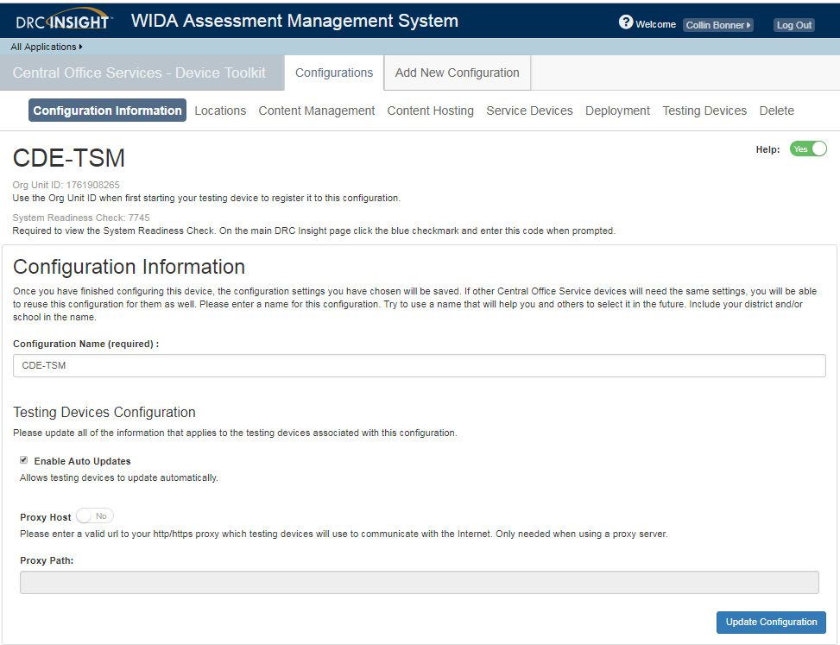
ACCESS for ELLs 2.0 Components
INSIGHT Test Engine Auto Update in Device Toolkit
Notes:
The INSIGHT Secure Browser has been updated to 9.0 and will need to be installed/updated on every student testing device. If INSIGHT is already installed on the device, Macs and Windows will prompt for an update upon launch and Apps for Chromebooks and iPads will update automatically. Please note, they will only auto update if they are marked to do so in the Device Toolkit.
The latest version 9.2 of Testing Site Manager (TSM) is strongly recommended for WIDA ACCESS for ELLs testing for content caching. Response Caching is optional. TSM Version 9.2 is the same version of the TSM used last year so its functionality and capabilities are unchanged.
In the device toolkit, ensure the TSM you are using for ACCESS for ELLs is TSM v9.2. Also, ensure you are copying/pasting the TSM Server Domain string for both the TSM Content Caching line and the Response Caching line in the Device Toolkit. IP Addresses or Machine names will no longer work.

Slide 17
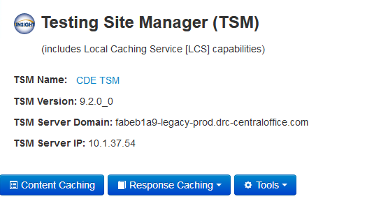
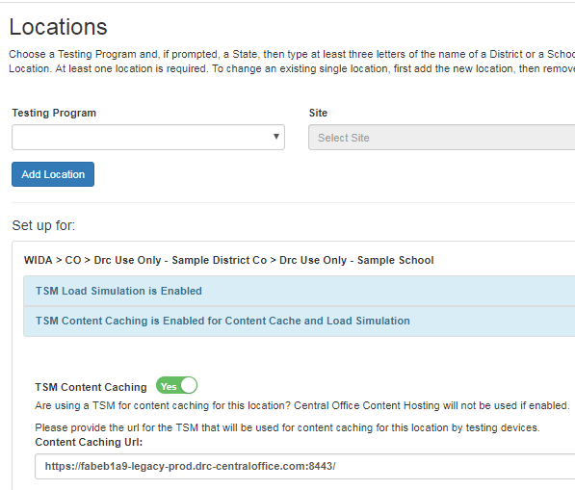
WIDA AMS Updates
Device Toolkit
In the device toolkit, ensure the TSM you are using for ACCESS for ELLs is TSM v9.2. Also, ensure you are copying/pasting the TSM Server Domain string for both the TSM Content Caching line and the Response Caching line in the Device Toolkit. IP Addresses or Machine names will no longer work. https://Content Caching line:8443/

Slide 18
New Whitelisting Information
Address | Ports
http://wida-insight-client.drcedirect.com/ | 80, 443
https://wida-insight.drcedirect.com/ | 80, 443
https://wbte.drcedirect.com/ | 80, 443
https://www.wida-ams.us/ | 80, 443
https://wida.drcedirect.com/ | 80, 443
https://dtk.drcedirect.com/ | 80, 443
https://api-gateway-cloud.drcedirect.com/ | 80, 443
https://api-gateway.drcedirect.com/ | 80, 443
https://cdn-content-prod.drcedirect.com/ | 80, 443
https://cdn-download-prod.drcedirect.com/ | 80, 443
https://drc-centraloffice.com/ | 80, 443
https://drc-wbte-prod.s3.amazonaws.com/ | 80, 443
https://www.drcdirect.com/ | 80, 443

Slide 19
DRC Component Updates
Chrome OS Support and Chrome Devices
DRC offers the following levels of support for Chrome OS:
Full Support for the current stable channel level
Automatic Operating System Updates and Other Background Processes
Impacts Google, Microsoft, and Apple
Update processes running in the background on testing devices consume CPU and memory
Can affect the testing experience
Audio playback may be choppy
Speaking test responses may be distorted
Verify devices have the most current version of the operating system before the test session starts to avoid issues.
Notes:
Operating system vendors such as Google, Microsoft, and Apple are moving to a model where operating system updates occur automatically in the background. Update processes running in the background on testing devices consume CPU and memory, and can affect the testing experience—audio playback may be choppy and Speaking test responses may be distorted. To avoid this situation, verify that no background processes are running on testing devices during testing. Also, if a testing device is set to accept operating system updates automatically, verify that it has the most current version of the operating system before the test session starts.

Slide 20
DRC Configuration Updates
Tablet/Netbook/Chromebook Devices
DRC recommends that these devices be streamlined for the DRC INSIGHT App
All applications and features that are unnecessary for testing should be disabled, removed, or turned off to ensure that the maximum amount of device memory is available for testing.
This includes services such as Bluetooth (unless a Bluetooth keyboard or mouse is needed), GPS, and power saving modes that reduce performance to maximize battery life.
DRC recommends rebooting devices before testing.
IPA Software
Intelligent personal assistant (IPA) software, such as Siri for iOS and MacOS, or Cortana for Windows 10, should be disabled during testing for the appropriate devices
If IPA software is not disabled, the testing site is responsible for ensuring the security and integrity of the test by actively monitoring that students are not using these applications
Notes:
These activities help free available memory. Devices that lack sufficient memory during testing may experience issues.

Slide 21
ACCESS for ELLs 2.0 Technology Webinars
Welcome Back: What’s New This Year?
Tuesday, September 18 from 12:00pm-1:00pm MT
Pre-Testing: Software Updates & Technology Readiness Checklist
Thursday, September 27 from 12:00pm-1:00pm MT
Pre-Testing: Technology Installations
Thursday, October 4 from 12:00pm-1:00pm MT
Pre-Testing: Technology Coordinator Support for Test Administrators
Tuesday, November 13 from 12:00pm-1:00pm MT
During Testing: Technology Troubleshooting
Thursday, January 10 from 12:00pm-1:00pm MT
The full List of ACCESS for ELLs 2.0 Webinars can be viewed here: http://www.cde.state.co.us/assessment/newassess-dtc

Slide 22
DRC Configuration Updates
Software Support Beginning
Mac OS X 10.14 (anticipated October 2018)
iOS 12.x (anticipated October 2018)
Windows 10 S (pending final testing)
Software Support Ending (July 2019)
Mac OS X 10.11
Ubuntu 14.04
Device & Software Support Ended (July 2018)
iPad 4th Generation
Mac OS X 10.10
iOS 10.3.x

Slide 23
Access 2.0 Questions?

Slide 24
CMAS (ELA, Math, Science, and Social Studies) and CoAlt (Science and Social Studies)
Pearson’s
PearsonAccess^{next} and TestNav

Slide 25
2018-2019 TestNav Components
Component | Current Software Version | Next Release Date | Installation
Proctor Caching | v2018.11 | TBD | Uninstall and reinstall newest version
TestNav Server side software | v8.11 | v8.12 anticipated January | No Install required apps are automatically updated
Desktop Client App | V1.7.3 | TBD | The new app can be pushed out to Mac OS or Windows OS devices without the need to uninstall the old version.
iPad Client App | v1.7.0 | TBD | Auto updates are supported
Chromebook Client App | v1.7.96 | TBD | Auto updates are supported
Notes:
Note: If any district upgraded to Windows 10S Anniversary update - version 1607 or later they can install the app from the Windows app store and this version supports auto updates!!

Slide 26
TestNav Requirements 2018-19
Support ending for:
Android 5, 6, and 7
Chrome OS 58-65
Firefox ESR browser based testing.
MacOS/OS X support for Proctor Caching
2019-2020 support ending for iOS 10.3 (iPad 4)
Added support for the following:
Chrome OS 69
iOS 12
macOS 10.14
Testing in progress for:
Windows 10 RS5
Notes:
Mozilla will end support of the Netscape Plugin Application Programming Interface (NPAPI)/Java plugin in its Firefox ESR browser before the start of the 2018-19 school year.
Pearson has released a TestNav 8.10 patch to block the TestNav Android app on Android devices and on Chrome OS due to a potential security issue. Pearson has notified Google of the security issue and will re-enable the app once the issue is resolved.

Slide 27
Site Readiness Activities 2018-19
TestNav 8.12 – Desktop app will be available January
CDE recommends:
Conduct CMAS Infrastructure Trial through the PAnext Training Site
Provides a way to test the local online assessment environment to verify that the network, proctor caching devices and student testing devices are configured correctly using CMAS-specific item types
Highly recommended for districts and schools using a virtualized device solutions to see how CMAS-specific item types will preform during testing

Slide 28
TestNav Questions?

Slide 29
CoAlt (Science and Social Studies)
Dynamic Learning Maps’
KITE System

Slide 30
CoAlt: ELA and Math (DLM)
Computer-based assessment
Individually administered
Test Administrators/DACs use Educator Portal for student management
Students test using KITE Client
Same window as CMAS ELA and Math
If using the 3-week window (paper-based or online), have the same 3 week window for DLM.
If using the extended window for the CMAS math and ELA online assessments, have the same window for DLM.

Slide 31
DLM Admin System: KITE Components
Component | Current Software Version | New Software Version | Next Release Date | Recommendations
KITE Local Caching Server |  |  |  | Not Available
KITE Student Portal | 5.0 | 6.0 | August 1 | Must uninstall and reinstall on all student devices

Slide 32
New Supported Platforms for KITE
Supported Platforms for KITE Client 2018-19
Desktops and laptops running Windows 7, 8.1, or 10
Desktops and laptops running macOS 10.12–10.13
All Chromebooks
iPads running iOS 10-11
Educator Portal Supported Browsers
Mozilla Firefox
Internet Explorer
Google Chrome

Slide 33
KITE Client Whitelist Settings
Whitelist by domain or IP Address
Domain
*.kiteaai.org
Files that Need Access Through the Firewall
kitestudentportal.exe
kite.exe

Slide 34
KITE Events
DLM Technology Specifications Training
Available now!
Recorded Webinar https://kiteassessments.org/sites/default/files/KITE_files/KITE_Client_Bandwidth_DLM.pdf

Slide 35
KITE Questions?

Slide 36
CDE Support
Technical Training Slide Decks – Detailed Training
Follow the structure of documentation
Detailed instructions with links to documentation
Deeper dives into real time testing support
Reading log files
Configuring and retrieving SRFs
Case studies involving common testing scenarios.
Webinars
Trainings - Cover Technical Training Slide Decks
Pearson Field Engineering Services meetings 15, 30, or 60 minutes
Q & A Sessions to answer specific questions
Check http://www.cde.state.co.us/assessment/newassess-dtc for details.

Slide 37
Thanks for Your Time

