Slide 1
CoAlt: ELA and Math (DLM)
DAC Activities
2019

Slide 2
Introduction (CoAlt)
Science & Social Studies
Paper based
Registrations are through PAnext
SS: 4 & 7 if peers are taking
SC: 5,8, & 11
Test window: April 9-27
High School Science may start earlier with CDE approval (as early as March 26)

Slide 3
Introduction
ELA & Math
Computer based
Registration is through Educator Portal
Students test using KITE
3-8 alternate to CMAS ELA and Math
9-11 alternate to College Board PSAT/SAT
Test window: April 8-26
*Note: If a district applies for an early window for ELA and Math, then the early window also applies to CoAlt.

Slide 4
DAC Activities
Upload/Input users
Enroll students
Verify enrollment from CDE
Verify student grade
Train teachers
Email CDE names of teachers
Create Rosters
Monitor testing progress

Slide 5
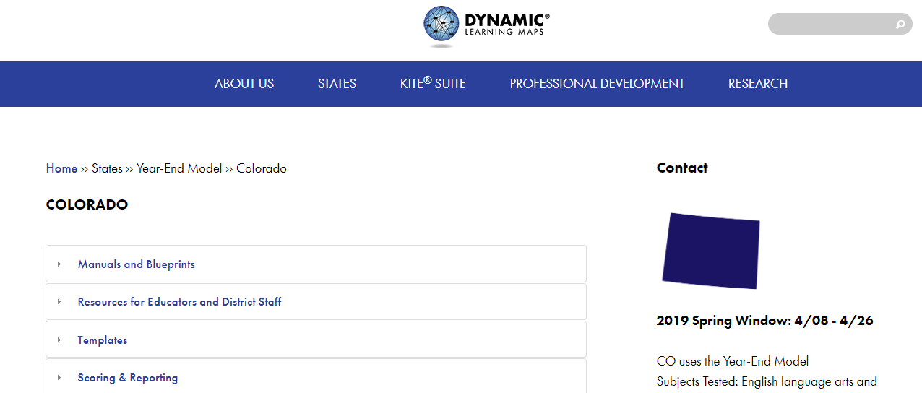
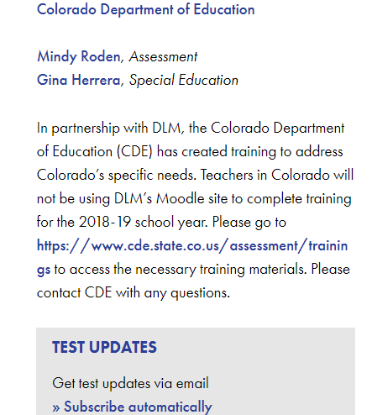
http://dynamiclearningmaps.org/colorado
Updated language regarding training

Slide 6
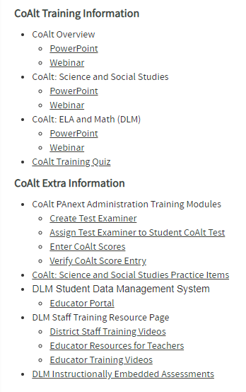
Teachers must take, at minimum, the CoAlt Overview and ELA & Math (DLM) Modules. Teachers who are administering SC or SS, must take the CoAlt Science and Social Studies Module. Districts may choose to have their teachers take all three modules. All teachers must complete the Google quiz before being allowed access to the DLM Educator Portal.
https://www.cde.state.co.us/assessment/trainings

Slide 7
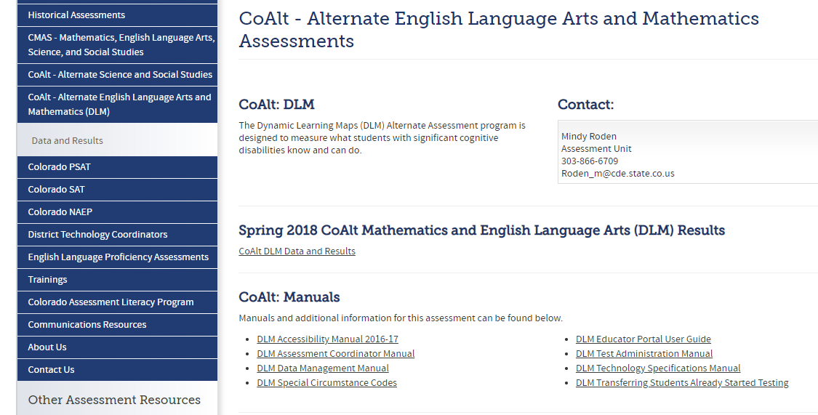
http://www.cde.state.co.us/assessment/newassess-coaltelam

Slide 8
Adding Users

Slide 9
Adding Users
Two ways to add users:
User Upload template
User Interface
Edit user information instead of creating new account:
Name change
Email change
School change
Always assign teacher role
CDE can only assign DAC role (DTC in DLM system)
Building principal role can be assigned to principal
Other roles are unneccessary

Slide 10
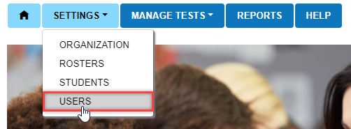
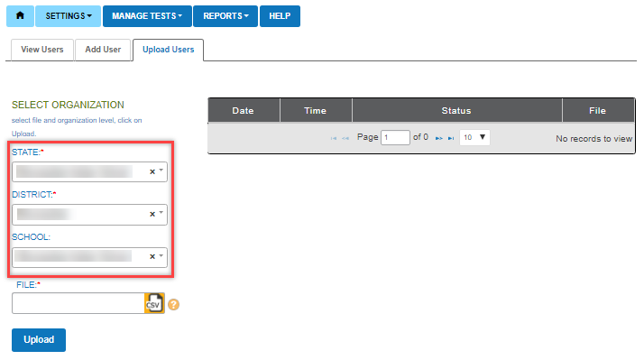

Slide 11
User Upload Template
http://dynamiclearningmaps.org/sites/default/files/User_Upload_Template.csv

Slide 12
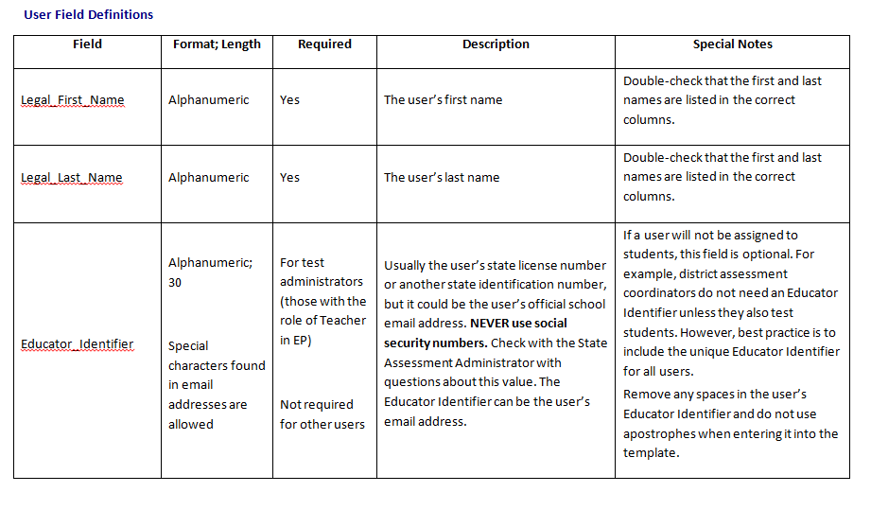
Use the assigned district email address at the Educator Identifier,
DO NOT use teacher employee or license number (it’s PII)
https://dynamiclearningmaps.org/sites/default/files/documents/Manuals_Blueprints/Data_Management_Manual.pdf

Slide 13
If a file is rejected, the error file will indicate the line(s) where the error occurred and
the reason(s) the line was not valid. Correct the data and upload again.
Attempting to upload the file with the incorrect template will cause an error.
Use the most recent version of the template. Each row in the CSV file is one record.

Slide 14
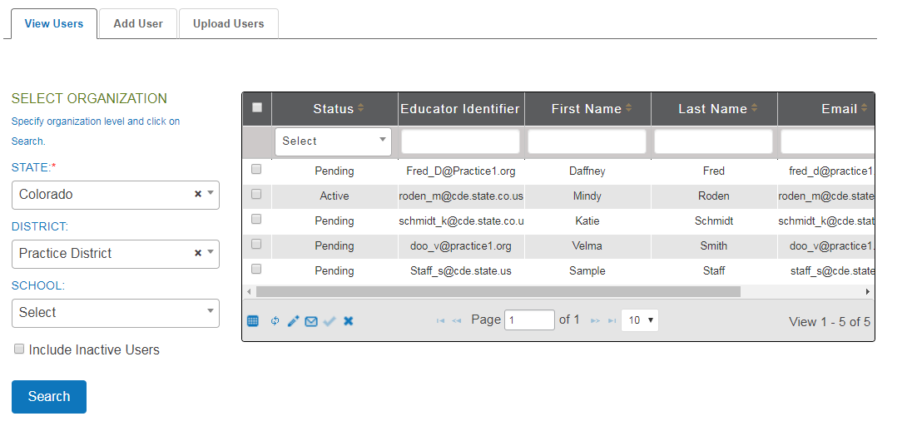

Slide 15
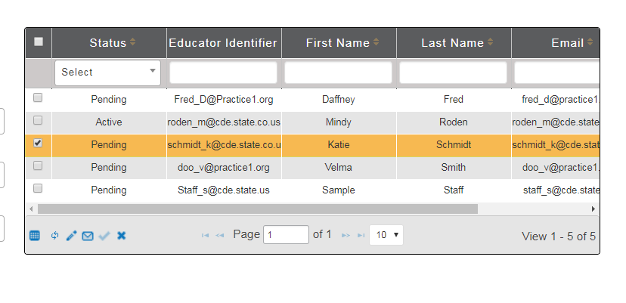
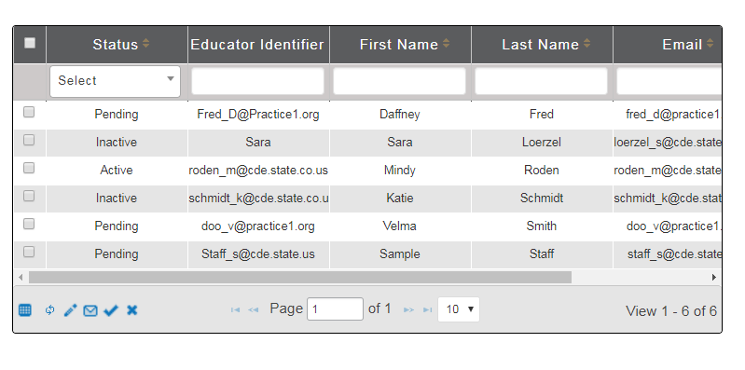
Inactivate any staff no longer employed with your district

Slide 16
Reminder: Use district assigned email

Slide 17
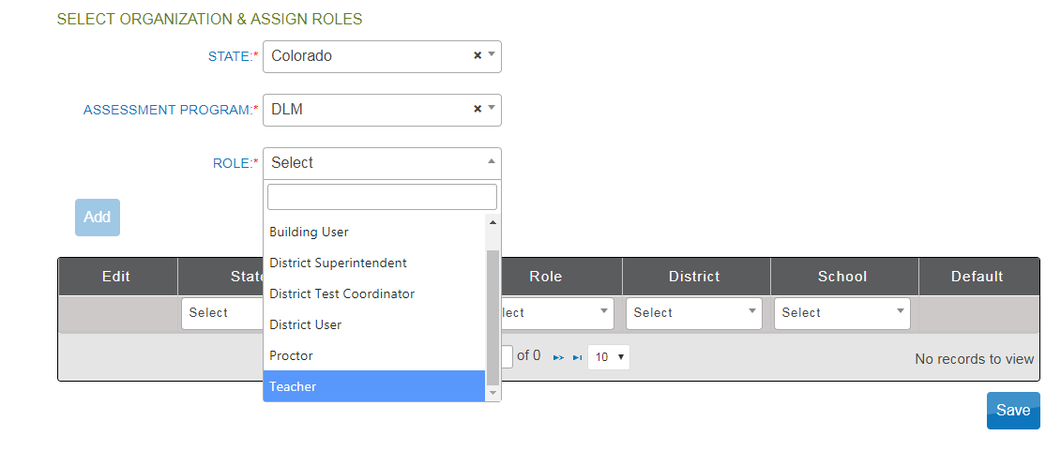

Slide 18
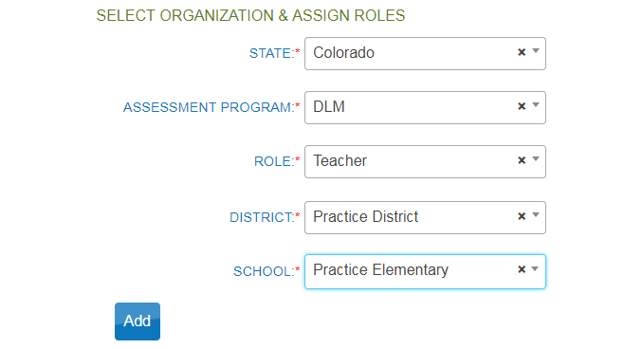

Slide 19
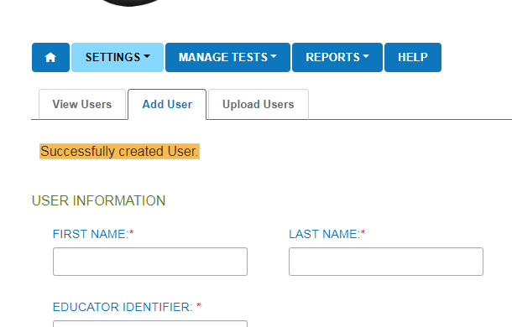

Slide 20
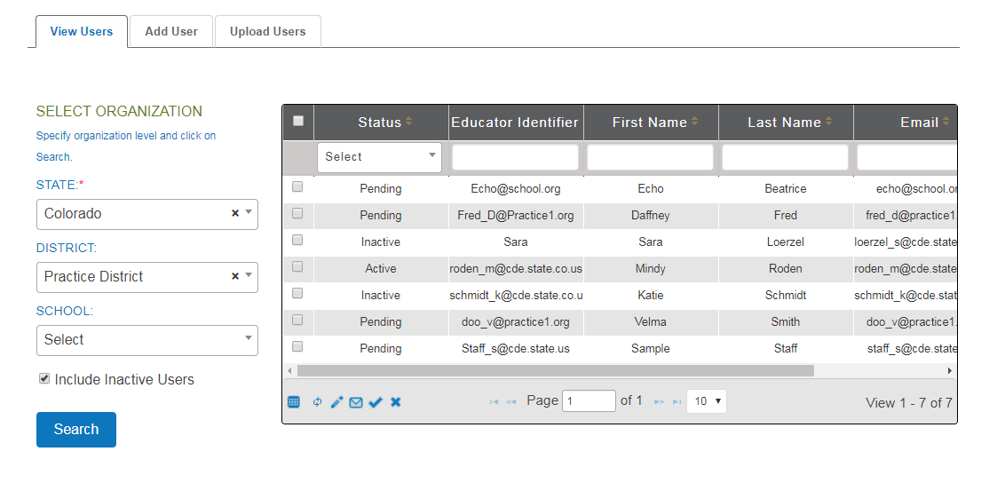
Activation email comes from “kite-support@ku.edu”

Slide 21
Enrolling Students

Slide 22
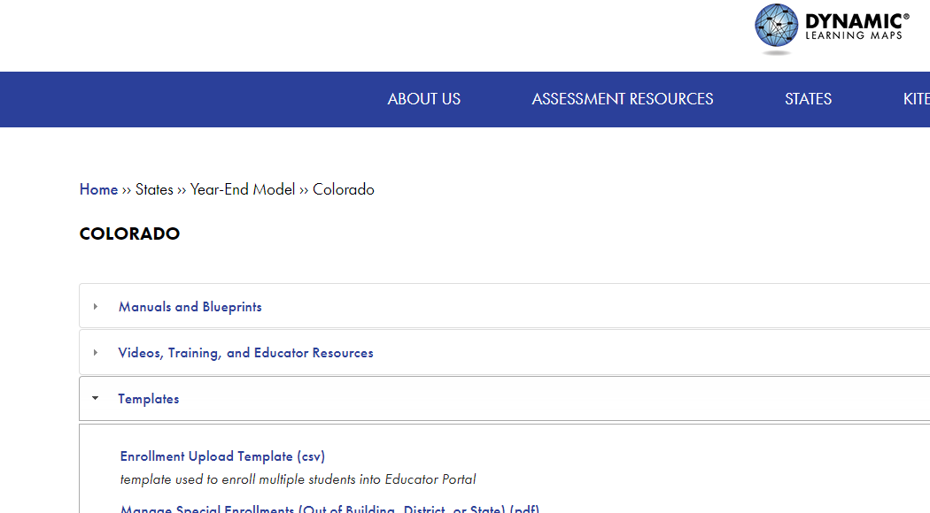
Enroll Students
2 ways to enroll
User Interface
CSV file upload

Slide 23
Enrollment Upload Template
http://dynamiclearningmaps.org/sites/default/files/Enrollment_Upload_Template.csv
Use the Data Management Manual to find the field definitions
https://dynamiclearningmaps.org/sites/default/files/documents/Manuals_Blueprints/Data_Management_Manual.pdf

Slide 24
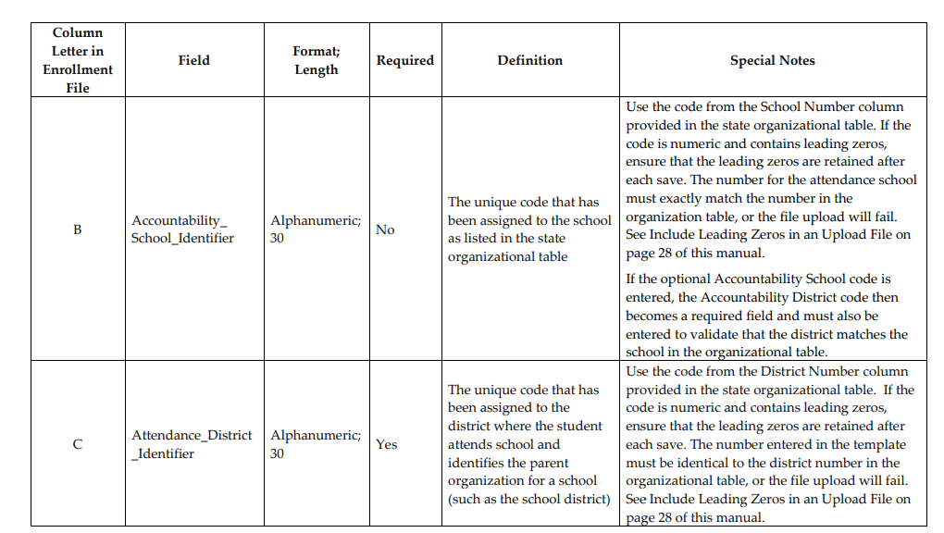
https://dynamiclearningmaps.org/sites/default/files/documents/Manuals_Blueprints/Data_Management_Manual.pdf

Slide 25
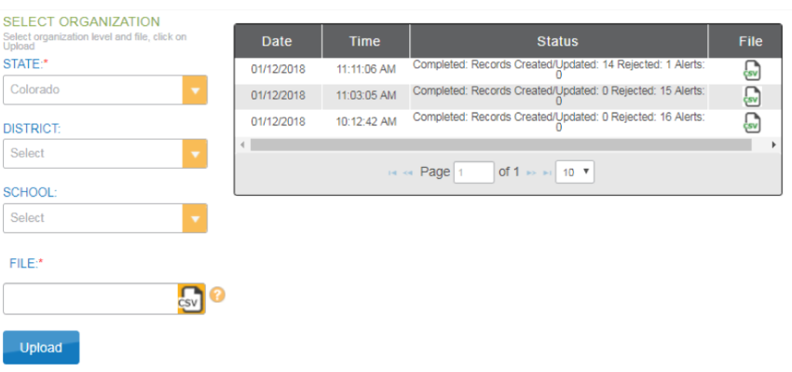

Slide 26
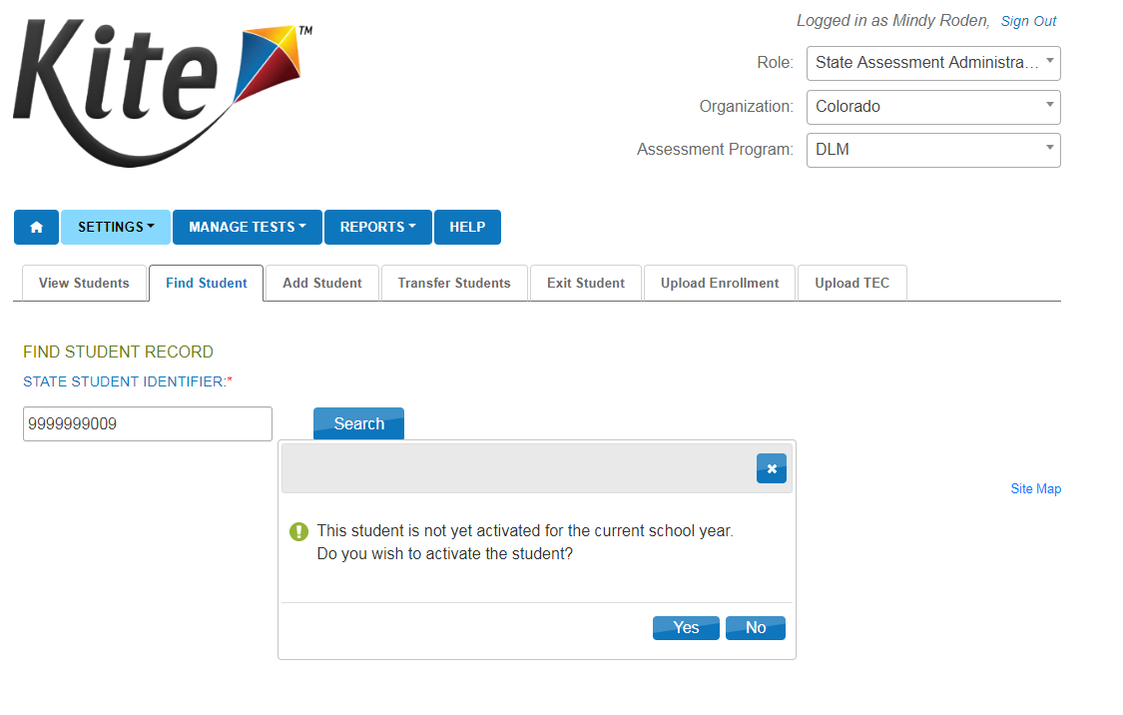

Slide 27
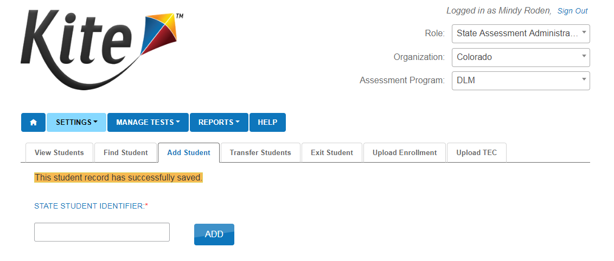

Slide 28
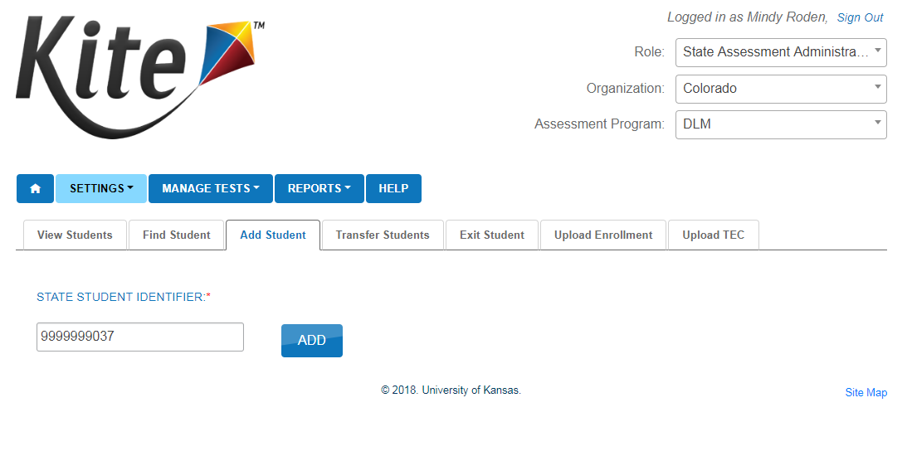

Slide 29
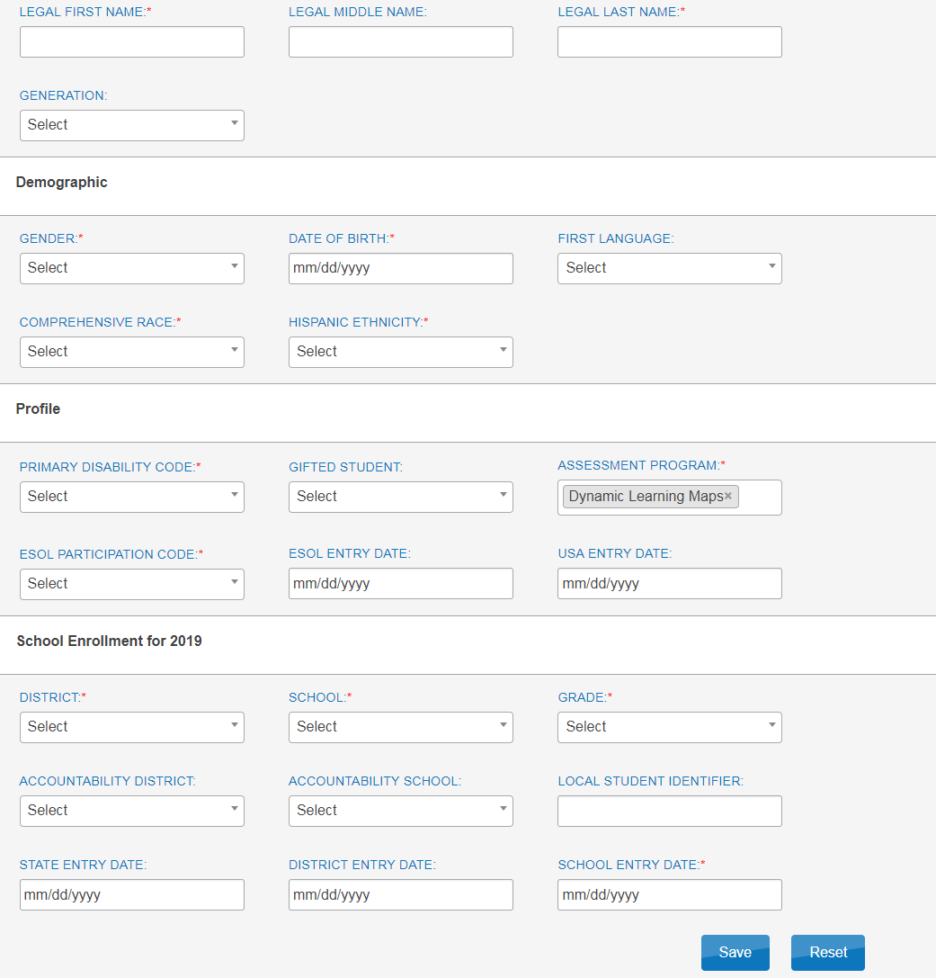

Slide 30
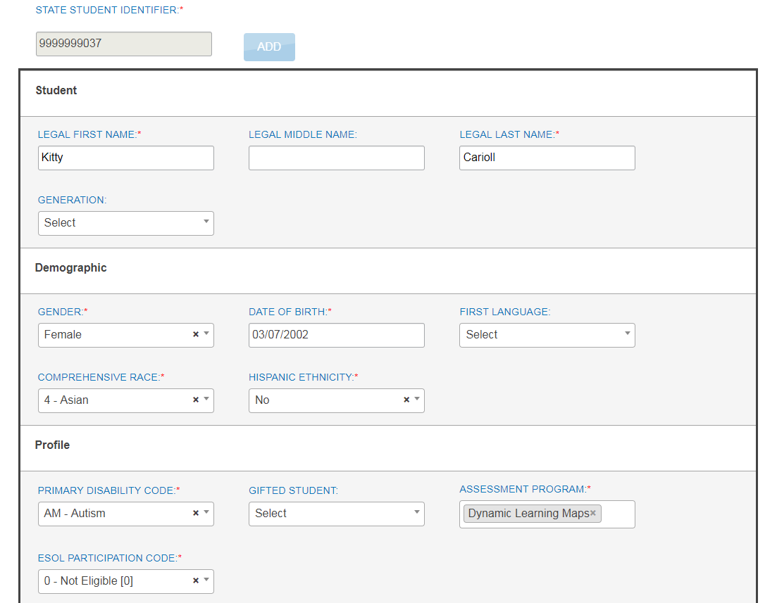

Slide 31
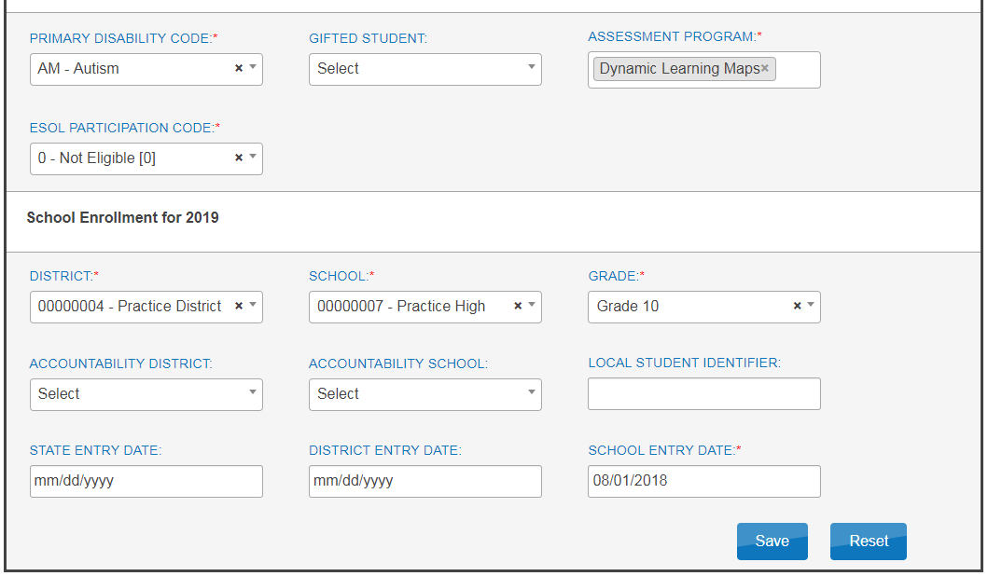

Slide 32
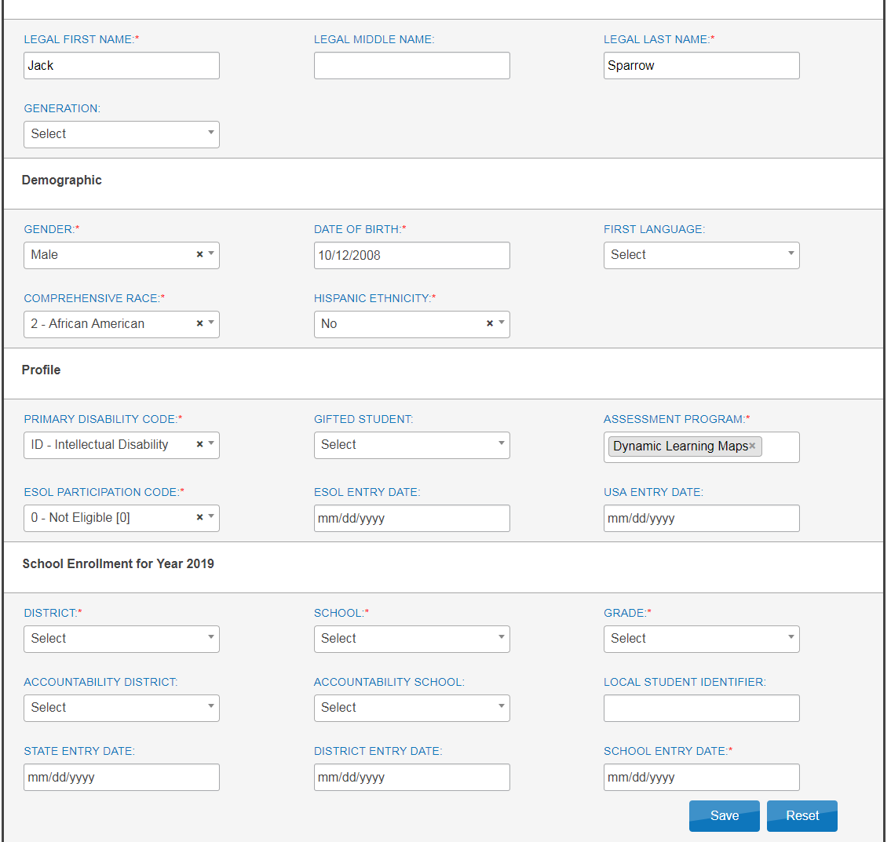

Slide 33
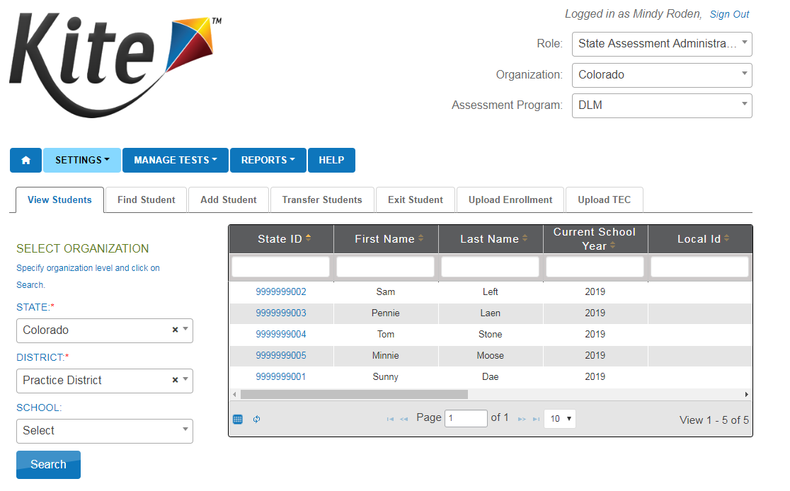
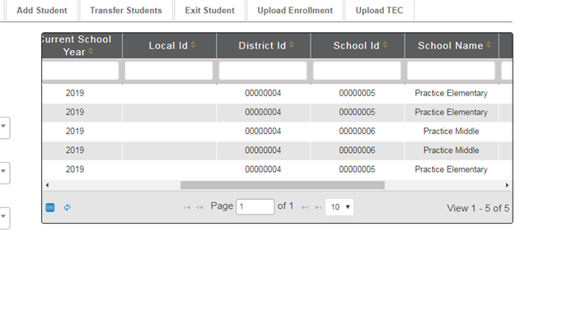

Slide 34
Exit Students

Slide 35
Exit Students
CDE will upload students in January
Verify students
Add new students
Exit any students who have left
If you know to what district the student moved, CDE can transfer them
If you do not know where the student is, exit him/her

Slide 36
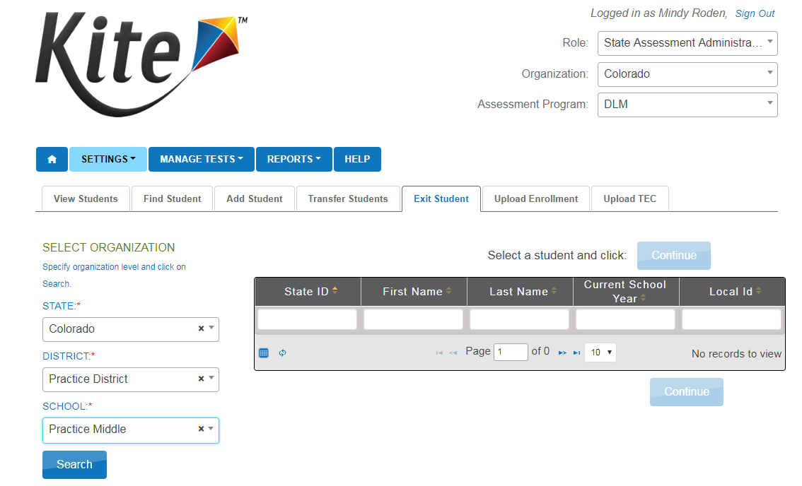

Slide 37
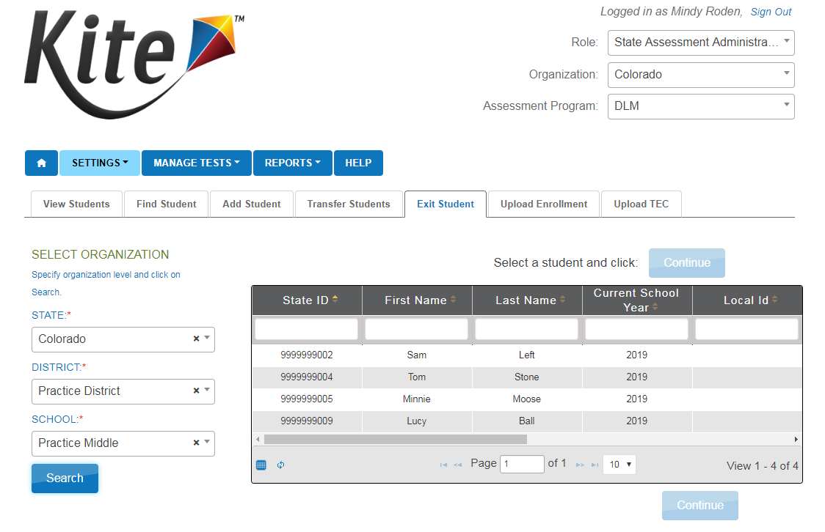

Slide 38
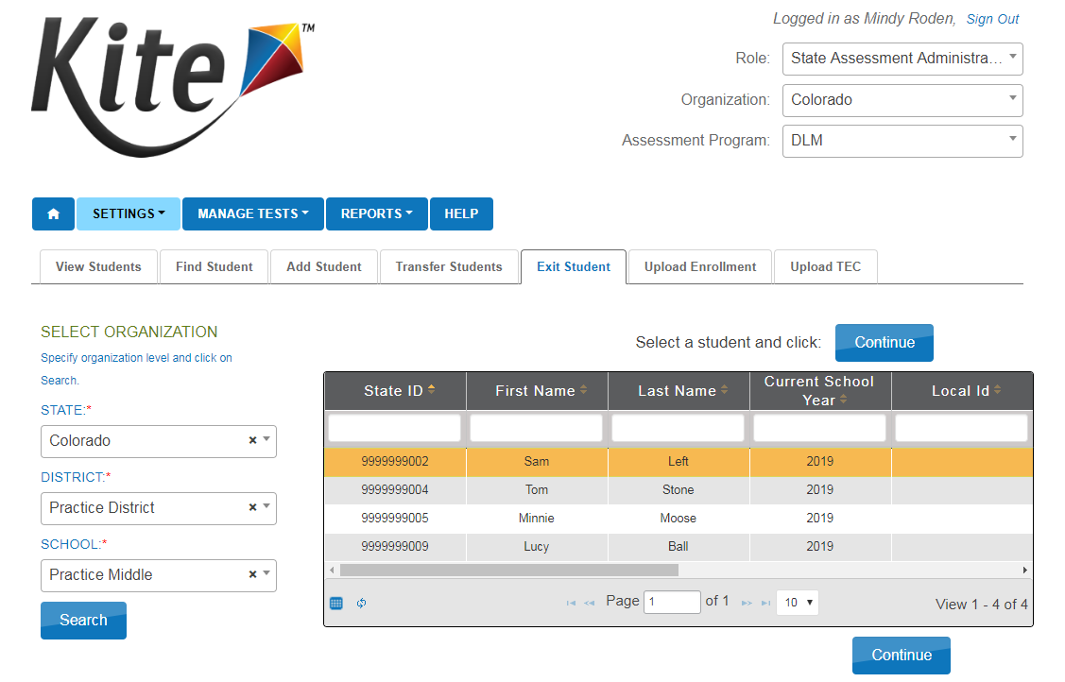

Slide 39
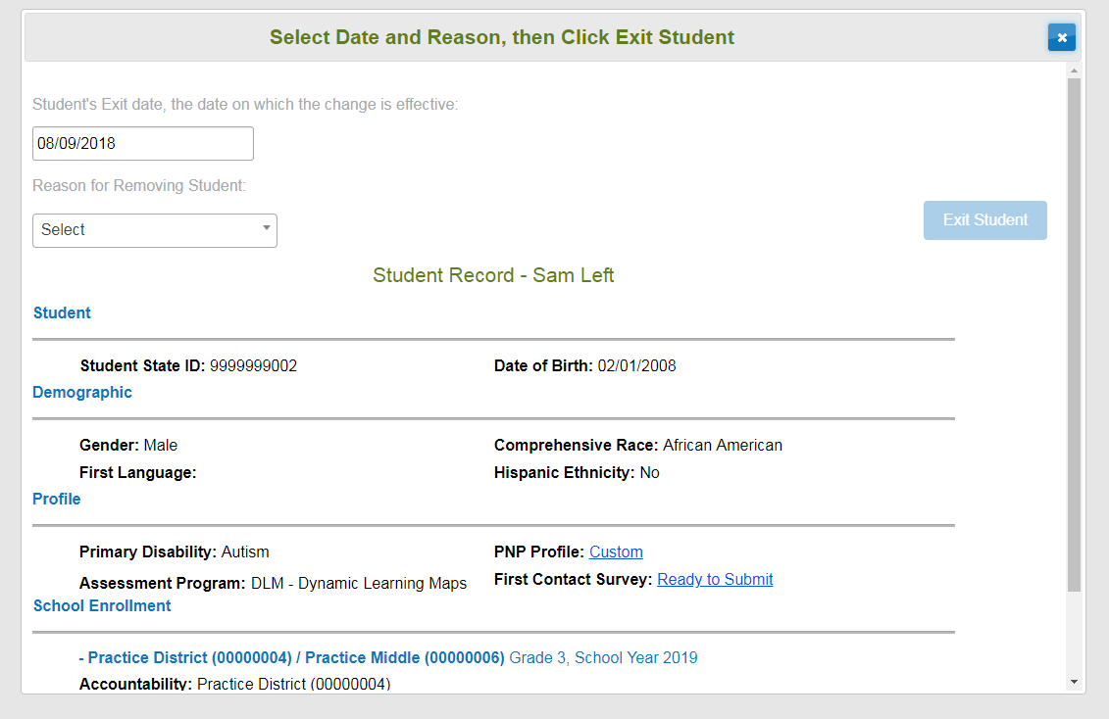

Slide 40
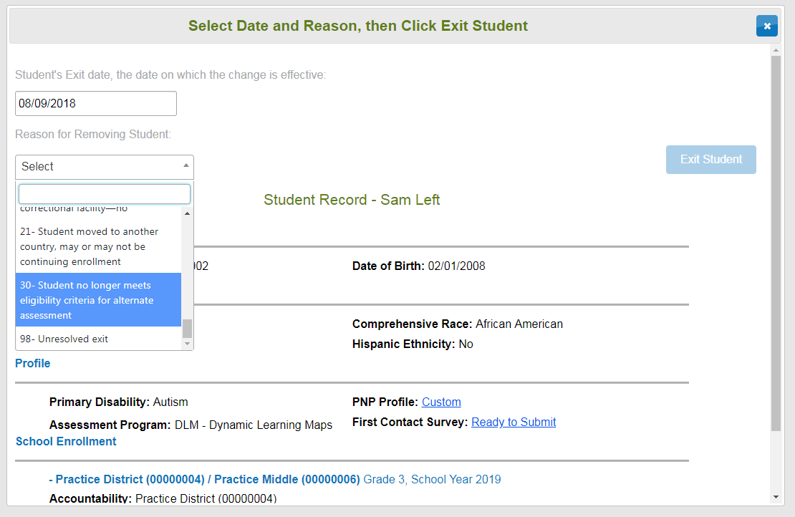

Slide 42
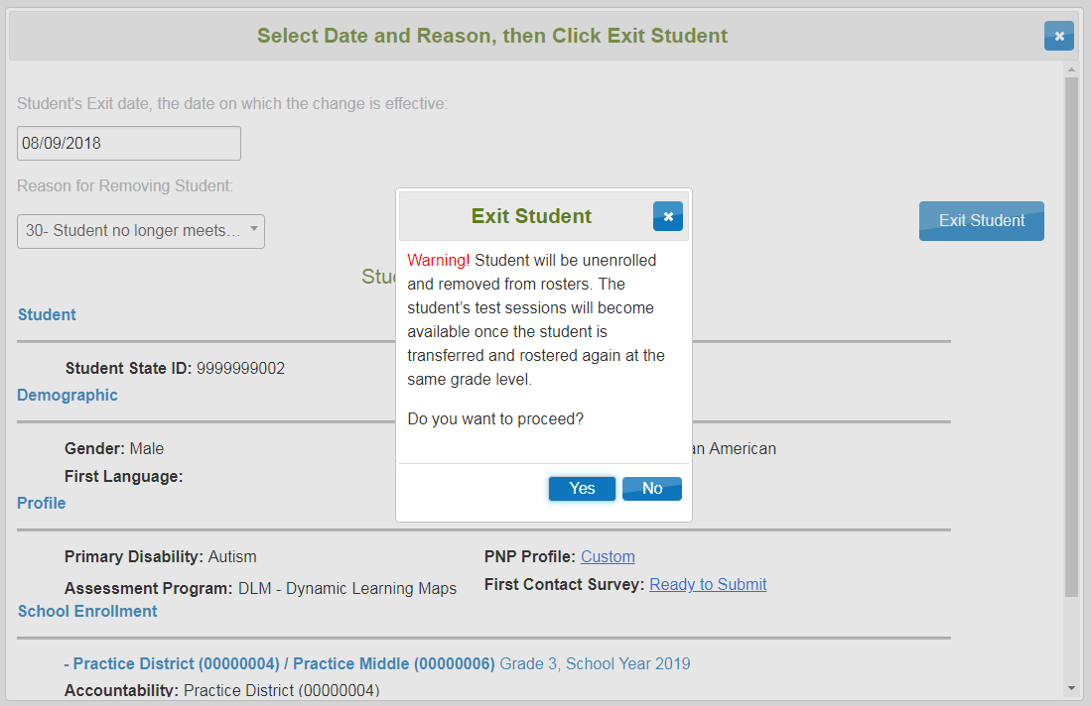

Slide 43
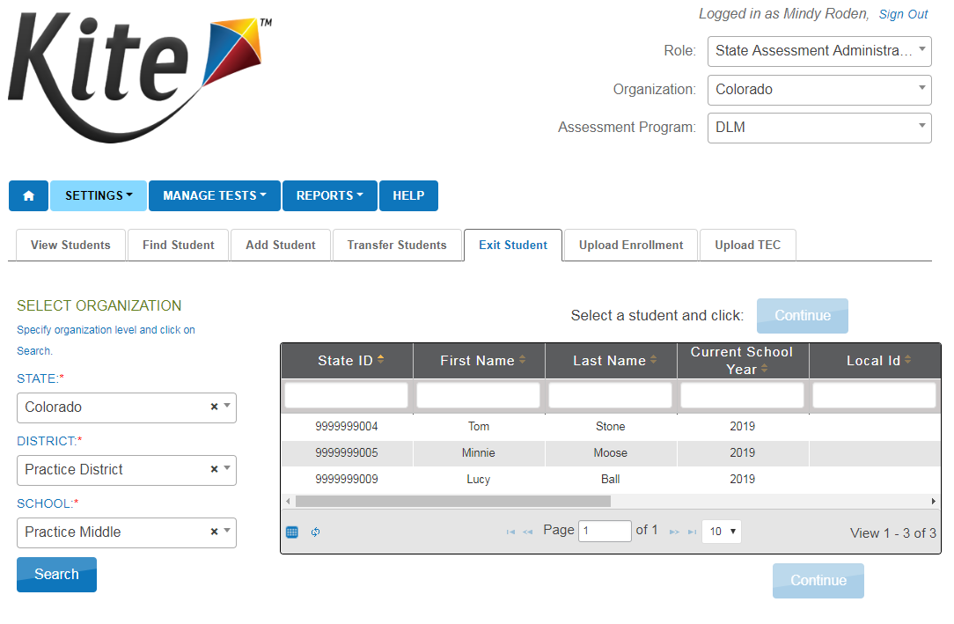

Slide 44
Creating Rosters

Slide 45
Creating Rosters
Two ways to create rosters:
Roster Upload template
User Interface

Slide 46
Rostering
All students are rostered to 2 separate rosters
Math
ELA
Do not create a roster for Science or Social Studies (PAnext)
Recommended naming conventions
Last name_subject

Slide 47
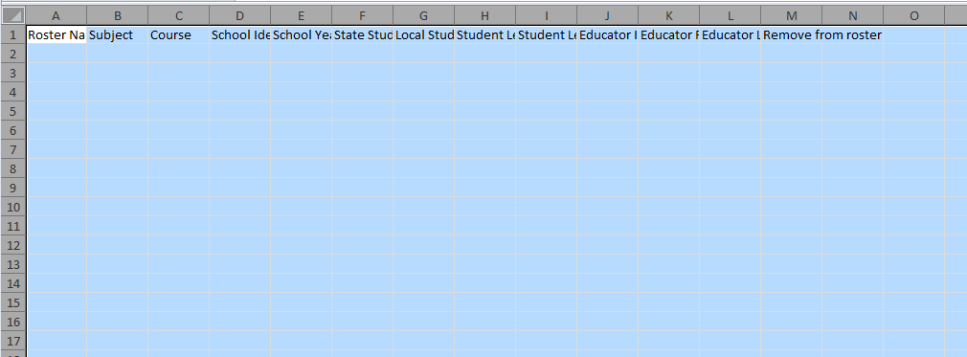
https://dynamiclearningmaps.org/colorado
Use the Data Management Manual for file layout information
https://dynamiclearningmaps.org/sites/default/files/documents/Manuals_Blueprints/Data_Management_Manual.pdf

Slide 48
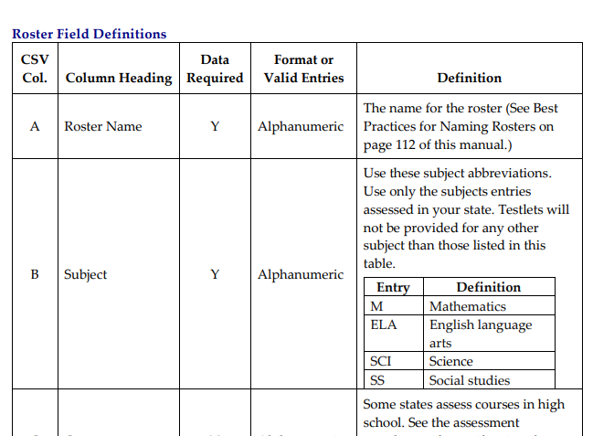
https://dynamiclearningmaps.org/sites/default/files/documents/Manuals_Blueprints/Data_Management_Manual.pdf

Slide 49
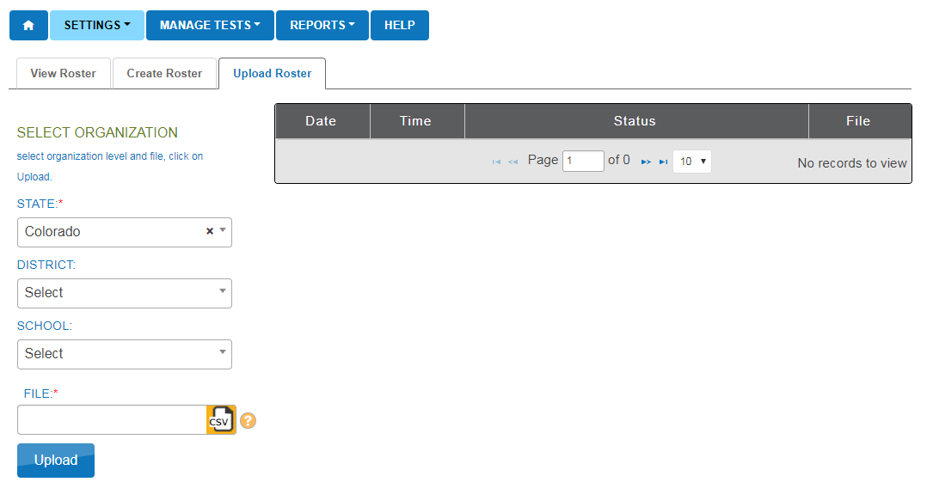

Slide 50
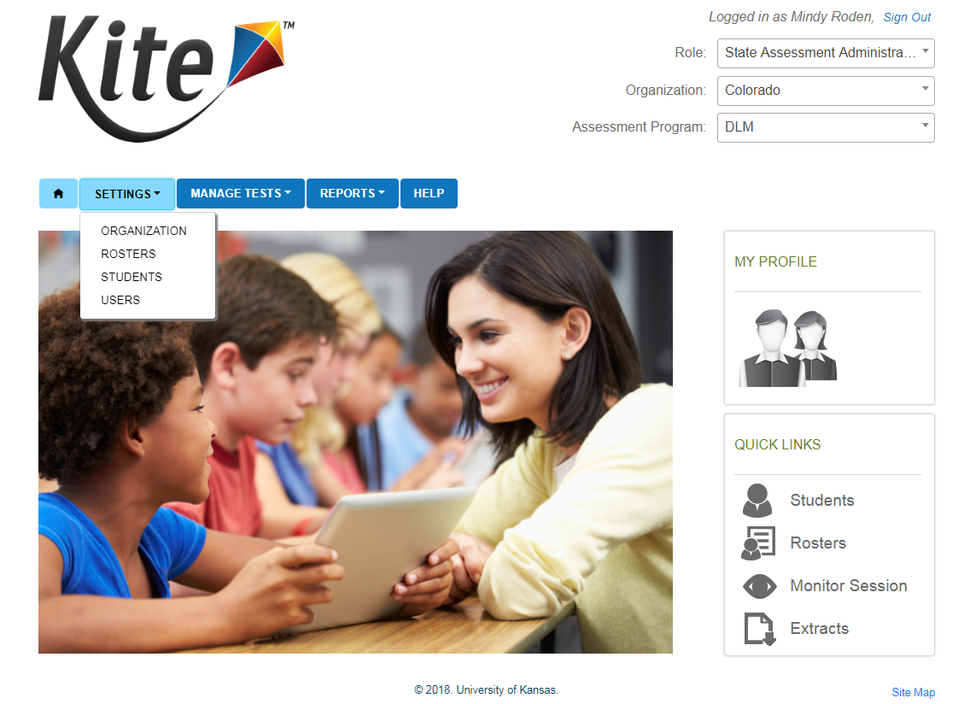

Slide 51
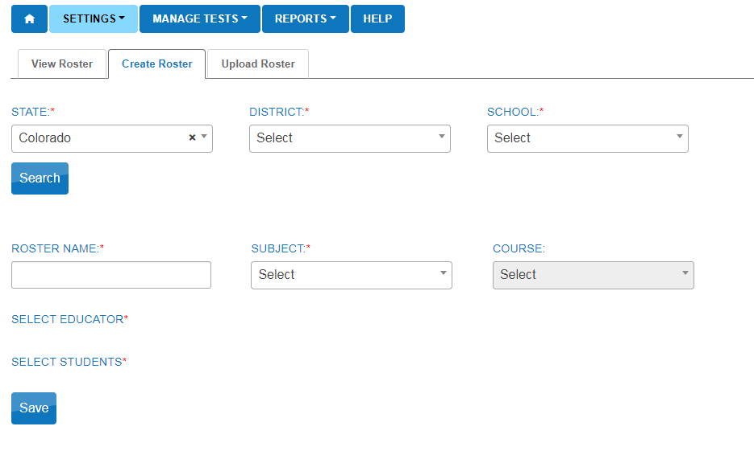

Slide 52
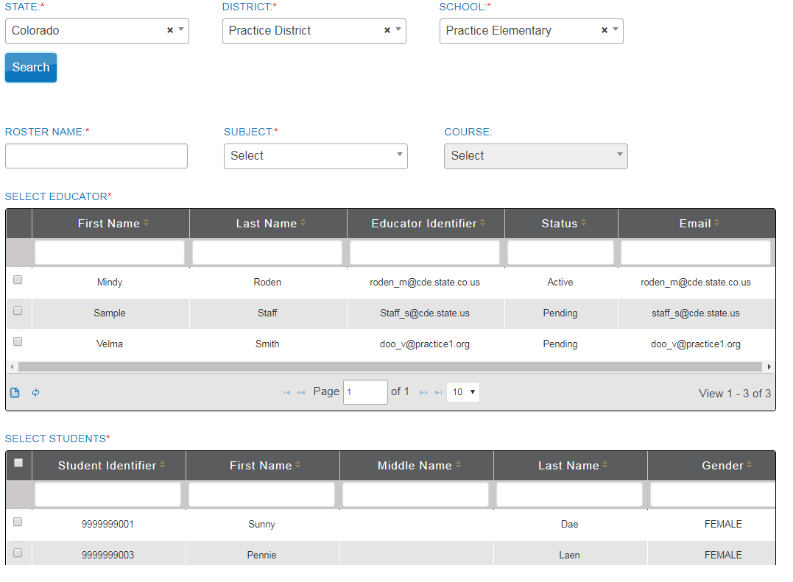

Slide 53
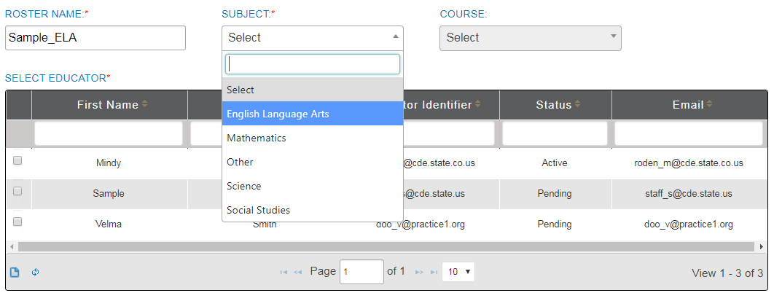

Slide 54
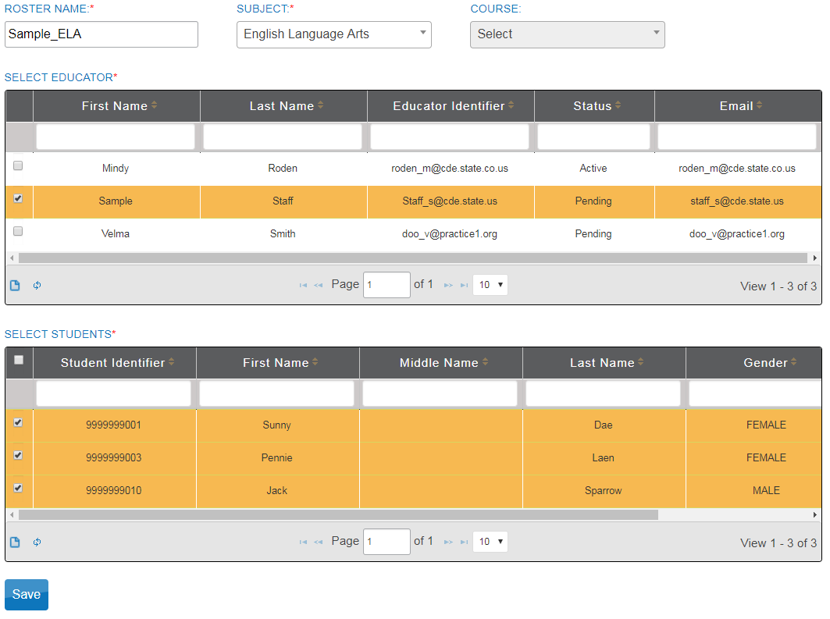

Slide 55
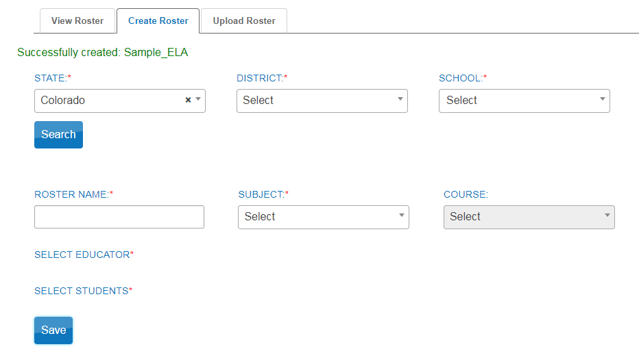

Slide 56
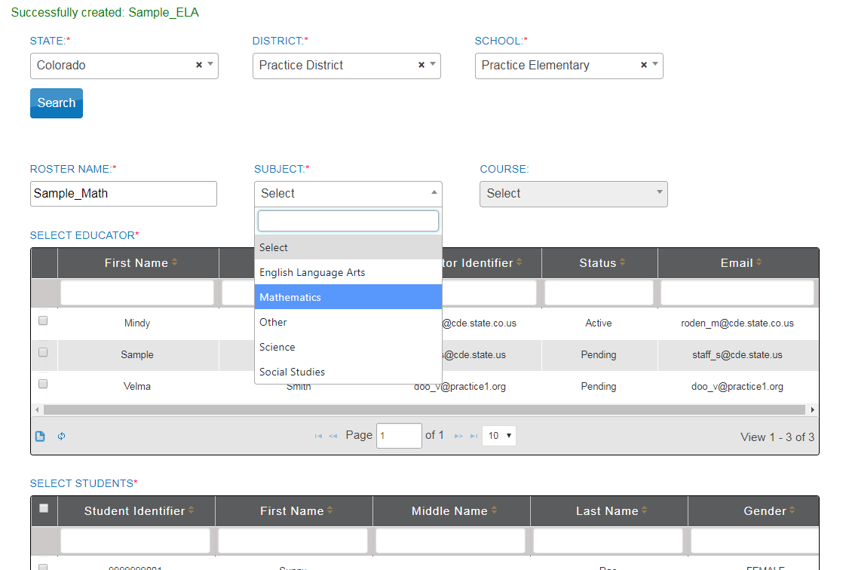

Slide 57
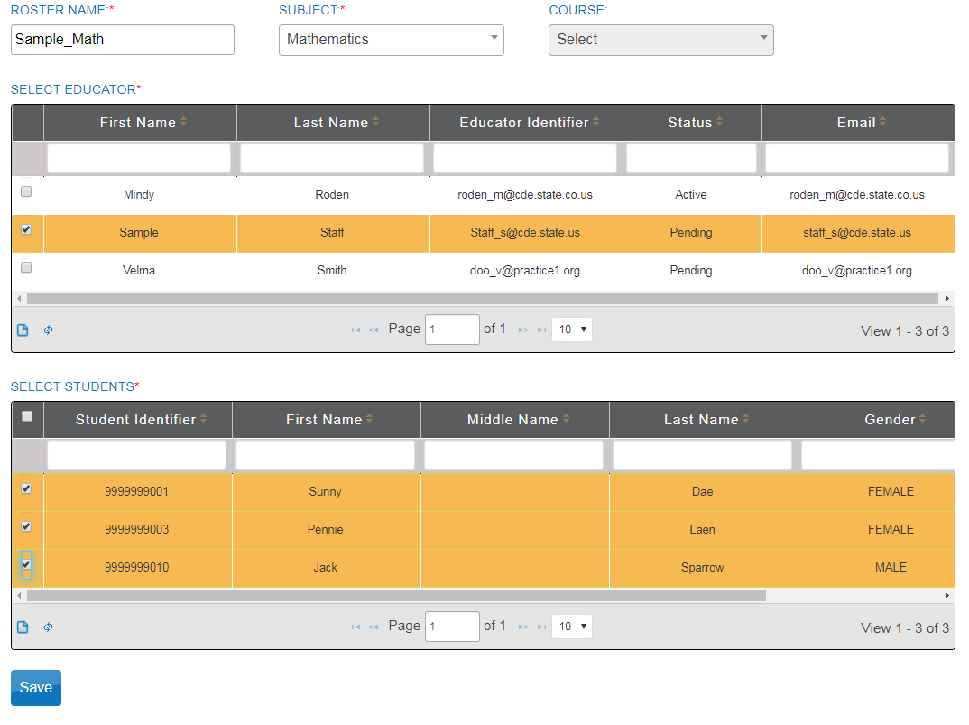

Slide 58
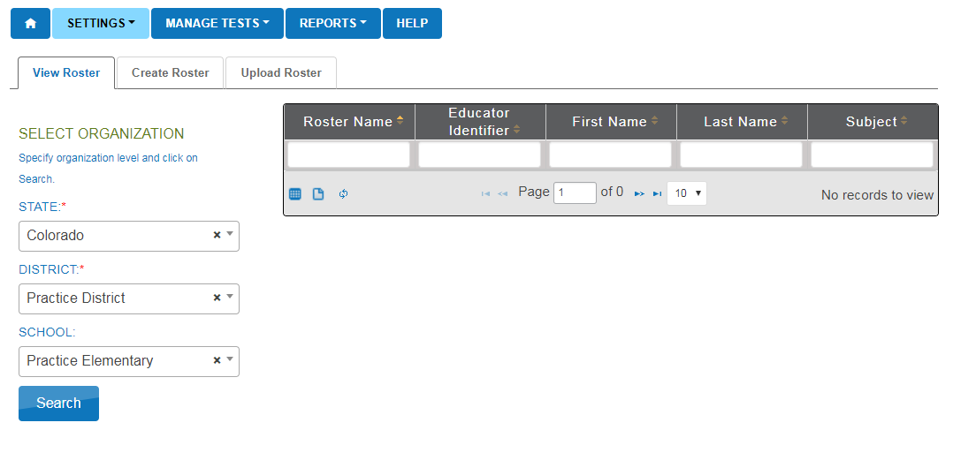

Slide 59
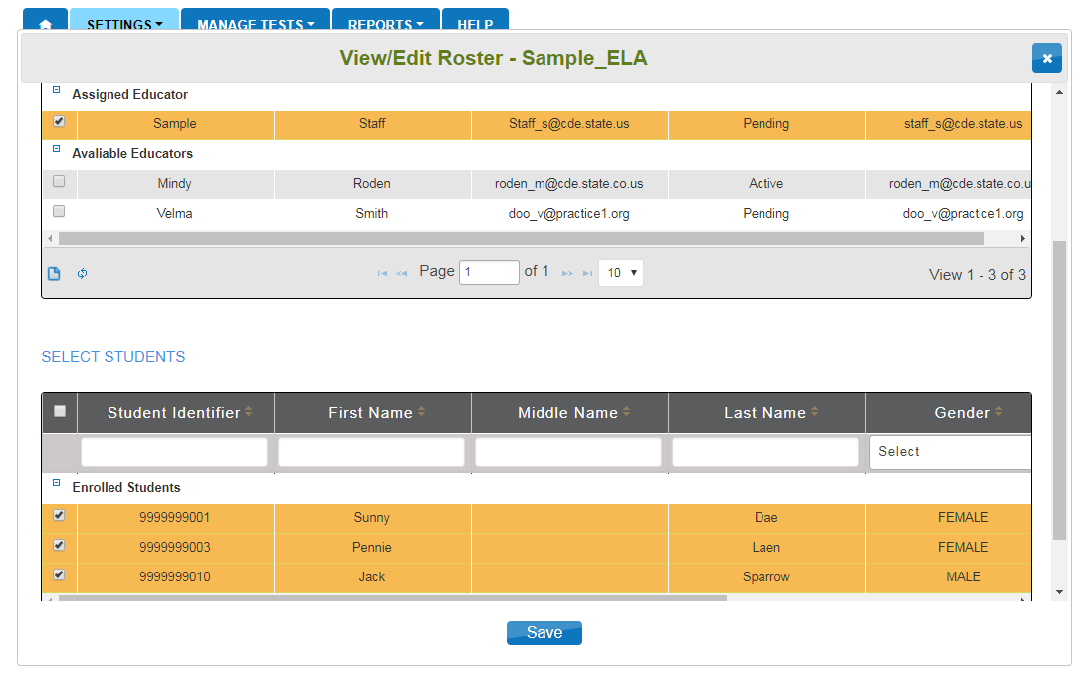

Slide 60
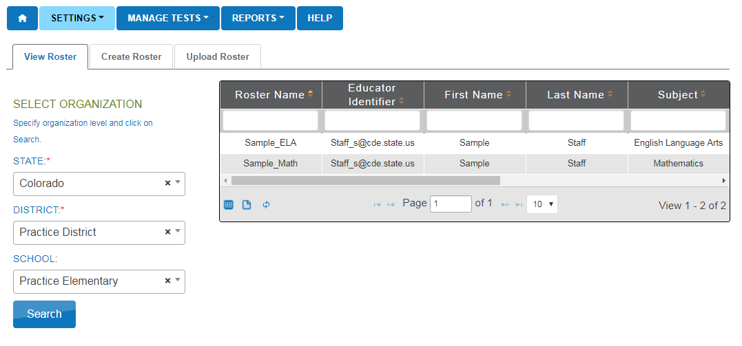

Slide 61
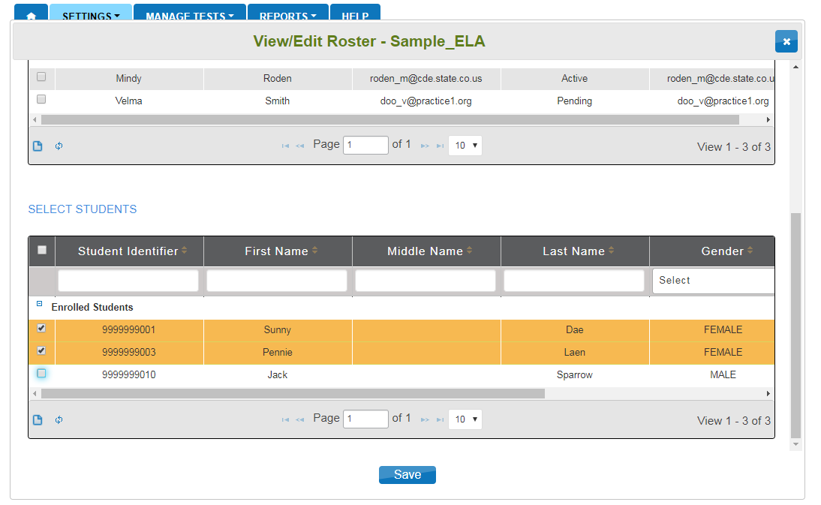

Slide 62
Student transfers

Slide 63
Between district transfers
Contact Mindy or Jasmine
If the student is not rostered, CDE will move the student
If the student is rostered, CDE needs confirmation from the sending district
DAC from receiving district should reach out to sending district
Email confirmation from sending DAC is needed

Slide 64
In-district transfers

Slide 65
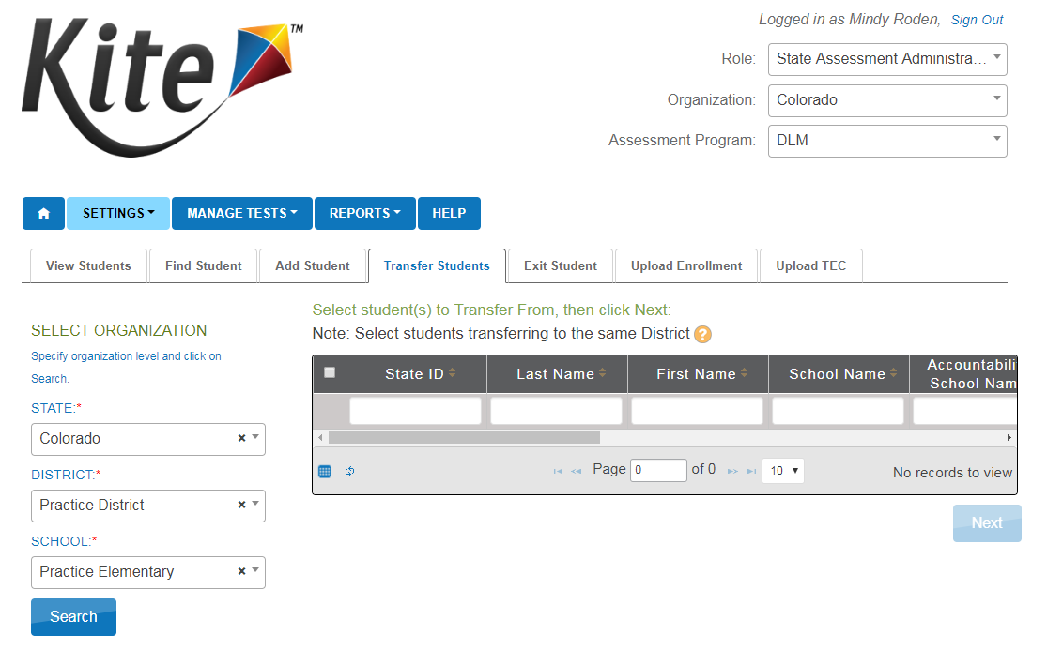

Slide 66
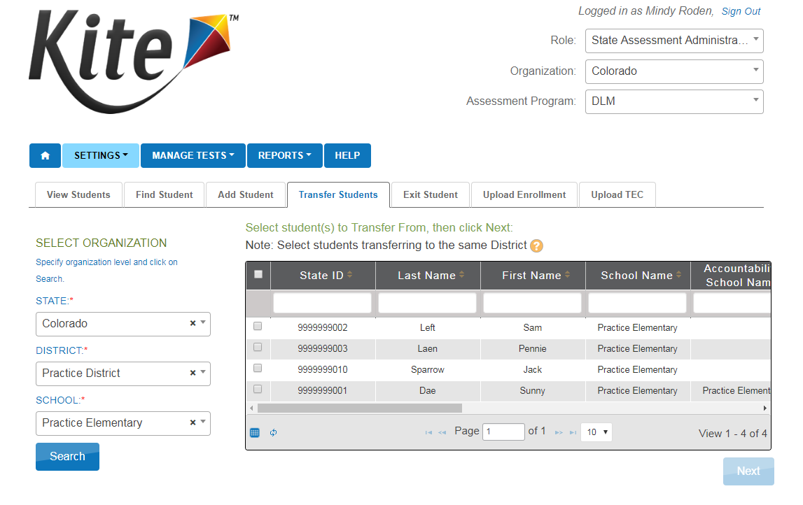

Slide 74
Reports and Monitoring

Slide 75
Teacher Activities

Slide 76
Teacher Activities
Complete PNP/First Contact Survey for each student
Create testing schedule
Download TIP and gather materials
Download student login and passwords
Test students
Securely destroy TIP, logins, and passwords

Slide 85
Accessing Tests

Slide 87
Testlet Information Page

Slide 89
Wrap Up

Slide 90
Remember!
Data management happens in Educator Portal
Student testing happens in KITE
Only for ELA and Math (grades 3-11)
KITE system scores the testlets
There are no materials to be returned
Everything is securely destroyed locally
CoAlt Science and Social Studies is a paper test registered through Pearson Access Next
Paper materials are returned to Pearson
Scores are manually entered into PAnext

Slide 91
SBD
Student Biographical Data (SBD) Clean-up
Late May
BEST method for coding invalidations
Special Circumstance Codes (will cover during office hours)

Slide 92
Questions?
Assessment Questions
Mindy Roden (EP, training, testing)
Roden_m@cde.state.co.us
303.866.6709
Jasmine Carey (EP, data)
Carey_j@cde.state.co.us
303.866.6634
Instruction Questions
Gina Hererra
Hererra_g@cde.state.co.us
303.866.6605

