Slide 1
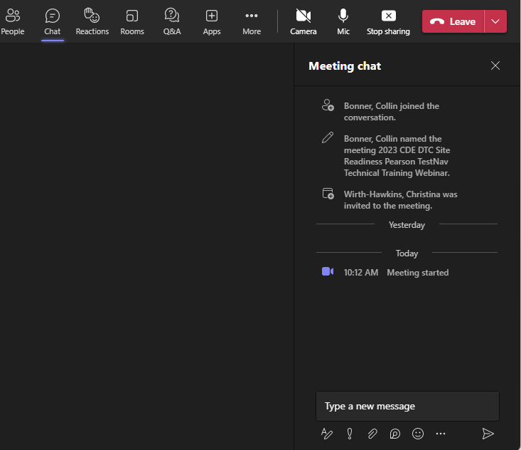
2023-2024 PSAT/SAT Technical Site Readiness Training
Welcome!
Introduce Yourself
From the top of the navigation select the Chat icon
In the Type a new message section tell us your district role and how long you have held your position
Select the paper airplane icon in the bottom right corner of the window to send
Use the Q &A to ask questions specific to the webinar.
Note: Select the three dots (…) and click “Turn on live captions” to access closed captioning
Select the Chat icon
Use the Q &A to ask questions specific to the webinar.
Tell us your district role and how long you have held your position.
Send your message
A recording of this meeting will be available at http://www.cde.state.co.us/assessment/newassess-dtc after December 20th This presentation will also be posted in the Colorado Resource Repository
Notes:
Collin Bonner Technology Specialist Assessment Division
Paulo Garcia Sanchez, Deina (day-nuh) Enoch, and Garrett McFarland, from College Board Technology Team will join us on the call today to address Questions in the Q & A section
A recording of this meeting will be available at http://www.cde.state.co.us/assessment/newassess-dtc after December 20

Slide 2
2024 CDE DTC College Board Bluebook Technical Training Webinar
December 14, 2023

Slide 3
Todays Topics
Bluebook Overview
Testing Windows and Deadlines
The Tech Coordinator Role
Network Preparation
Device Preparation
Ensure Devices Meet Requirements
Installing & Updating Bluebook
Digital Readiness Check Overview
Using Accommodations on Digital Tests
Support During Testing

Slide 4
Bluebook Overview

Slide 5
Colorado PSAT and SAT Window
Assessment | Grade | Administration Dates
PSAT 8/9 PSAT 10 | 9 10 | April 15 - April 26, 2024 Primary and make-up dates may be selected based on school preference within this window
SAT | 11 | April 15 - April 26, 2024 Primary and make-up dates may be selected based on school preference within this window
Notes:
Colorado schools will participate in testing for students in grades 9-11:
Grade 11 – SAT (or SAT with Optional Essay)
Grade 10– PSAT 10
Grade 9 – PSAT 8/9
The testing window is April 15 through April 26.
We recommend that schools plan to test all students during the week of April 15.
We recommend that schools reserve the week of April 22 to test students who were absent and students who experienced testing irregularities.
With permission from CDE, districts that have spring break conflicts and/or technology limitations may be allowed to use an extended testing window starting on April 8. DACs were provided the opportunity to request this prior to November 10th.
The March 9 SAT Weekend administration is available for virtual schools to use, as well as students who have curricular or religious conflicts with the SAT School Day testing window.

Slide 6
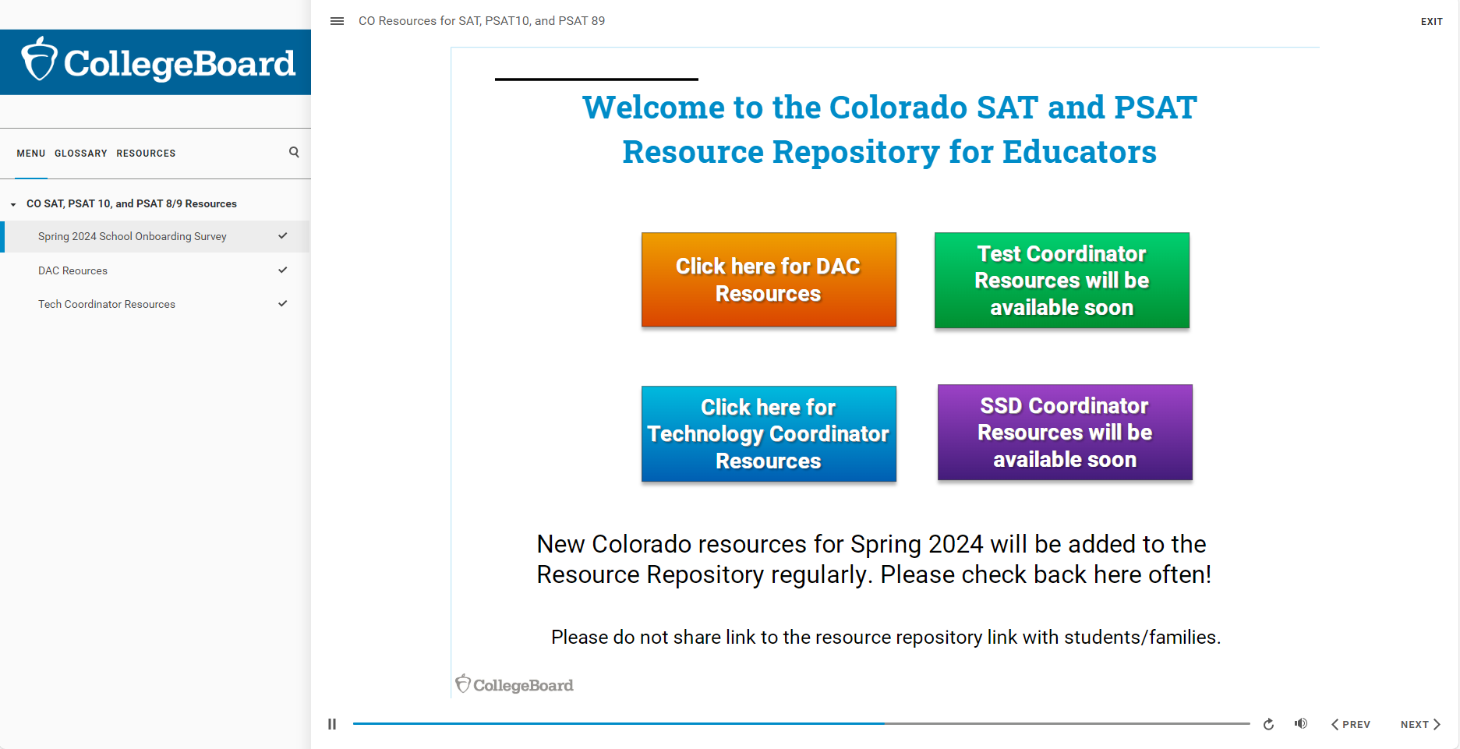
Colorado Resource Repository
Access resources to support Spring 2024 SAT and PSAT testing in the Colorado Resource Repository, including recorded webinars, presentation decks, manuals and other publications, and an archive of email communications.

Slide 7
About Bluebook Digital Testing
Content is downloaded at the form level and not the item level
All student test content will be downloaded when the student authenticates.
Adaptive assessment means three forms will be downloaded: Initial, form A, and form B.
Once content has been downloaded, testing can continue without internet connectivity.
Student must have internet connectivity to upload answer files and submit the assessment.
Answer files are continually uploaded to College Board.
Answer files are transferred to College Board on periodic intervals or “heartbeats” with continued internet connectivity.
This allows a student to switch devices in the event of a device failure or power loss.
The student’s process is tracked and can be viewed by the test administrator.
Bluebook requires operating system (OS) accessibility features for some accommodations
This may require additional device configuration. i.e., Chromebook floating accessibility menu or third-party accessibility software.

Slide 8
Digital Testing Preview
Test Form: PSAT 9, PSAT 10 and SAT tests will be presented in a digital format through the Bluebook app
Paper-based testing will be reserved for accommodated students only
Digital testing platforms
Test Day Toolkit – Test administration site used by testing staff
Bluebook – Testing application used by students
Test Structure
Test Section | Number of Questions | Time Limit | Assessment
Reading & Writing | 54 questions | 64 minutes | PSAT 9, PSAT 10 & SAT
Math | 44 questions | 70 minutes | PSAT 9, PSAT 10 & SAT
Essay (optional) | 1 prompt | 50 minutes | SAT only

Slide 9
Network Preparation

Slide 10
Network Requirements
All students and testing staff (coordinators, proctors, and monitors) must connect to your Wi-Fi on test day. This includes:
Students and testing staff who are
unaffiliated with your institution.
Students and testing staff who are
using personal devices.
You may need to set up guest access.
Be sure to share the network password with staff so they can share it with students.
Bandwidth Requirements
Test | Bandwidth
SAT School Day & PSAT-related Tests | 200 Kbps
https://bluebook.collegeboard.org/technology/networks

Slide 11
Network Configuration
To avoid test day disruptions that could prevent testing, take these steps:
Let traffic to and from the domains listed below bypass your security appliances and software.
Remember to exempt them from all SSL/TLS decryption rules if you’re certificate pinning.
Open the 443/TCP port and protocol for traffic to and from those domains.
Important: Students won’t be able to take the test if your network doesn’t meet these configuration requirements.
Bypass List
Let traffic to and from these domains bypass firewalls, content filters, proxy servers, and any other security appliances or software:
College Board: Use a wildcard at the root level to make Bluebook testing possible: *.collegeboard.org
Apple App Store: Enable Bluebook updates if students are testing on Macs or iPads Sentry: Use a wildcard at the root level to help us troubleshoot test day issues: *.sentry.io

Slide 12
Device Specifications

Slide 13



Device Requirements
Laptop,
Tablet,
School Managed Device (Chromebook or Desktop)
Device should be plugged into a power source or be able to hold a charge for 3 hours for SAT and PSAT, 4 hours if student is taking SAT with Optional Essay.
If student is testing with extended time, make sure they have access to power for the duration of their testing time.
Device must be able to connect to the school network via ethernet or
Wi-Fi

Slide 14
School-Managed Chromebook Specifications
You can only run Bluebook™ on a school-managed Chromebook—NOT personal Chromebooks.
To confirm a Chromebook is school managed: (1) click on the clock at the bottom right of the screen; (2) if it is school managed the managed device icon will appear.
Chrome OS 114 (or above) is recommended. Bluebook™ won't run below Chrome OS 102.
150 MB of available disk space is required for 1 exam, plus an additional 50 MB for each additional exam.
External mice are permitted.
External keyboards are not permitted.

Slide 15
Windows Lap/Desktop or Tablet Specifications
Windows 10 and 11 (Home, Pro, Education, and Enterprise). Not supported: Windows 10 in S mode and Windows 11 SE.
250 MB of available disk space is required for 1 exam, plus an additional 50 MB for each additional exam.
External mice are permitted (and recommended for Tablets).
External keyboards:
Laptops – not permitted
Tablet – permitted and recommended (required for students taking the essay).

Slide 16
MacOS For Lap/Desktop Specifications
MacOS 11.4 or later.
150 MB of available disk space is required for 1 exam, plus an additional 50 MB for each additional exam.
External mice are permitted.
External keyboards are not permitted for Laptops.

Slide 17
iPads Specifications
iPadOS 14—16 and 17.1+. Students should not test on iPads running version 17.0.0–17.0.3.
150 MB of available disk space is required for 1 exam, plus an additional 50 MB for each additional exam.
External mice AND keyboards are permitted AND recommended (required for students taking the essay).
Cannot test on iPad mini.

Slide 18
Device Preparation

Slide 19
General Device Preparation
Any software that would allow secure test content on student computers to be viewed on another computer must be turned off.
Any applications that may automatically launch on a computer are configured not to launch during testing sessions.
Turn off notifications for software that cannot be disabled.
Allow local file writable access to student testing device
Notes:
Install to user-level profiles
Save Data on chromebook

Slide 20

Install Bluebook™ On Student Devices
Bluebook™ can be installed on devices that are school managed or student owned (except for student owned Chromebooks). Bluebook™ should be installed on whatever device the student will use during test day.
For more information on device readiness visit: https://bluebook.collegeboard.org/technology/devices

Slide 21
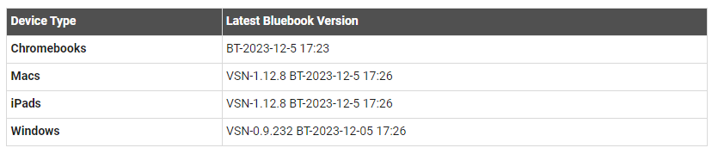
Update Bluebook™ On Student Devices
There are no planned Bluebook releases before the test administration window.
However, College Board reserves the right to push an update in case there’s a critical issue.
When properly configured, Bluebook’s auto-update functionality ensures that students are testing with the latest version of the application.
Above information current as of 12/7/2023
For more information on Bluebook™ updates visit: https://bluebook.collegeboard.org/technology/updates

Slide 22
Device Specific Installation Instructions
Chromebook Installation – Bluebook Technology | College Board
Windows Installation – Bluebook Technology | College Board
Mac Installation – Bluebook Technology | College Board
iPad Installation – Bluebook Technology | College Board
Notes:
Chrome 113 enable do not erase data
In MDM enable forced updates
No Guest accounts in macOS

Slide 23
Digital Readiness Check Overview

Slide 24
Digital Readiness Check
The Digital Readiness Check is scheduled 1-2 weeks prior to the test date by the Test Coordinator to ensure student and staff technical readiness.
Students will sign into Bluebook™ using the device they will test with complete exam set up and may also take a test preview or full-length practice.
To enable the digital readiness check:
Bluebook™ must be installed on all devices that students will use during test day (whether school-managed or student-provided)
The network must be configured to allow all necessary traffic.
The password to any necessary guest network must have been shared with administrating staff.
Digital Readiness Check – SAT Suite | College Board

Slide 25
Using Accommodations on Digital Tests

Slide 26
Review Accommodations Needs
The School SSD Coordinator will have a list of students approved for test day accommodations. Some of these accommodations may require the use of assistive technology, which the student should already be using during regular classroom instruction or assessments. Check with the SSD Coordinator to determine if there are any specific needs to support this technology.
Some accommodations are administered differently on digital exams than on paper and pencil exams. For example, a student who is approved to use a human reader on paper and pencil exams may use a screen reader for digital exams. Also, some accommodations may not be needed for a digital exam. For example, a student who is approved for large print may use the zoom tool that's available to all test takers.
All Bluebook™ exams are configured to work for students who test with accommodations or assistive technology. Students should open Bluebook on the type of device they’ll test with and try a test preview or full-length practice test to see how their accommodations and assistive technology will work on test day.

Slide 27


Paper Accommodations & Digital Testing Equivalents
Approved Accommodation | Digital Testing Equivalent
Human Reader | Screen Reader (Text-to-Speech)
Prerecorded Audio (MP3 via Streaming) | Screen Reader (Text-to-Speech)
Braille with Raised Line Drawings, Contracted | Screen Reader, Refreshable Braille Display
Braille, contracted UEB Technical | Screen Reader, Refreshable Braille Display
Raised Line Drawings | Raised Line Drawings (Screen Reader/ Text-to-Speech)
Writer/Scribe to Record Responses | Dictation (Speech-to-Text)
Large Print | Zoom (Universal Tool)

Slide 28
Assistive Technology
Any approved assistive technology a student uses when they’re online should still work during the digital exam.
If a student uses assistive technology, such as a screen reader (e.g., JAWS, NVDA, VoiceOver, or ChromeVox), magnification software (e.g., ZoomText Fusion), or dictation software (e.g., Dragon NaturallySpeaking) to interact with a standard web browser, the same commands can be used to navigate through content in the digital exam.
The exception to this would be if a student uses web-based assistive technology or a browser extension (e.g., add-ons, plug-ins, etc.) as they are not supported for use with the Bluebook application.

Slide 29
Configuring & Using Assistive Technology
Configuration steps need to be taken each time a student uses Bluebook, both for answering preview questions and for exam day.
In some cases, your school’s technology staff may need to complete the configuration steps on the student’s testing device (for instance, if the device is school managed and settings cannot be adjusted by the student).
If any settings need to be adjusted on exam day, configuration steps should be completed before beginning the check-in process in Bluebook. Once a student enters the start code at the end of the check-in process, they won’t be able to adjust settings because Bluebook locks their device.

Slide 30
Important: Chromebook Kiosk Accessibility
Students testing with approved accommodations on a school-managed Chromebook need the Chromebook floating accessibility menu to use the built-in screen reader and other accessibility features.
School technology professionals who manage Chromebooks need to use their Admin console to enable the feature
Once enabled, the menu appears in the bottom right of the screen when students open Bluebook. Students can move it to another corner of the screen if they need to.
How do I enable accessibility features on Chromebooks? – Bluebook | College Board

Slide 31
For More Information on Accommodations & AT
For more information on digital accommodations visit: https://satsuite.collegeboard.org/digital/accommodations-digital-testing/using-accommodations-digital-tests
For more information on assistive technology visit: https://satsuite.collegeboard.org/digital/accommodations-digital-testing/assistive-technology

Slide 32
Support During Testing

Slide 33
College Board Support
To support schools leading up to and through testing, College Board will have additional field staff support on the ground in Colorado.
If you contact customer service with an inquiry that cannot be resolved easily, customer service will share your contact information and issue summary with our field staff.
Someone from our field staff team will then reach out to you to provide additional support and, if needed, come out to your district/school to get the issue resolved.

Slide 34
Q & A

Slide 35
PSAT/SAT Customer Support
College Board’s Colorado Customers Service 866-917-9030 ColoradoSchoolDaySupport@collegeboard.org |  | Visit the Colorado Resource Repository Visit the Colorado Website www.collegeboard.org/colorado
Contact your DAC
Contact College Board’s Colorado Field Team
Noah Hurianek 720-582-6735 nhurianek@collegeboard.org | Sarah Orlowski 720-470-2343 sorlowski@collegeboard.org

Slide 36
Thank you for your Time!

