Slide 1
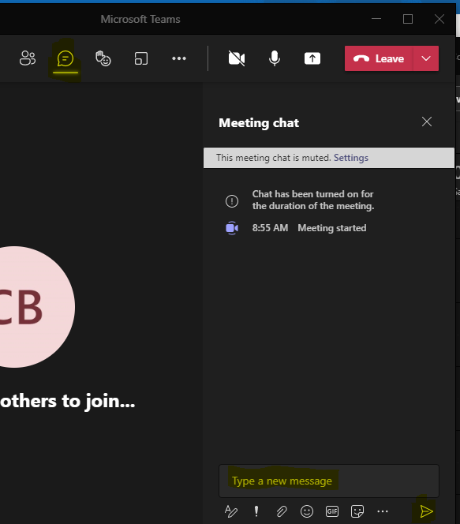
CoAlt Science Assessment Administration Training for Test Administrators
Welcome!
Introduce Yourself
From the top of the navigation select the Chat icon
In the Type a new message section tell us your district role and how long you have held your position
Select the paper airplane icon in the bottom right corner of the window to send
Note: Select the three dots (…) and click “Turn on live captions” to access closed captioning
Select the Chat icon
Tell us your name, district role, how long you have held your position, and your favorite kind of soup.
Send your message

Slide 2
CoAlt Science Assessment Administration Training for Test Administrators
Spring Administration 2022

Slide 3
Agenda
Lesson 1 – What are the CoAlt Assessments?
Lesson 2 – Security Standards
Lesson 3 – CoAlt: Science
Lesson 4 – Planning, Scheduling, and Resources

Slide 4
Lesson 1 What are the CoAlt Assessments?

Slide 5
Lesson 1 of 4
What are the CoAlt Assessments?
Questions

Slide 6
Lesson 2 Security Standards

Slide 7
Lesson 2 of 4
Security Standards
Questions

Slide 8
Lesson 3 CoAlt: Science

Slide 9
Lesson 3 of 4
CoAlt Science
Questions

Slide 10
Lesson 4 Planning, Scheduling, and Resources

Slide 11
Lesson 4 of 4
Planning, Scheduling, and Resources
Questions
Administrative trainings for CoAlt DLM will be found through the DLM Training Courses.

Slide 12
Reminders
Remember to take your quizzes
CoAlt Science Assessment
https://docs.google.com/forms/d/1-pWiHpeeTIGrHsXlpK2xWLEw6ysQd2hjVuIqahK9erY/edit
CoAlt ELA/Math
https://training.dynamiclearningmaps.org/login/index.php

Slide 13
Thank you

