Slide 1
CoAlt: DLM
Colorado Specific
Information

Slide 2
Testing window
Same as CMAS: PARCC
Varies by District
Cannot begin prior to March 16

Slide 3
Testlets
Approximately 9 testlets per content area
Varies by grade
Varies by linkage level
Includes embedded field test testlets
“Break” in between testlets
Dynamic Learning Maps says 15 minutes
I recommend planning on 30 minutes
The student is not expected to sit and wait
They can return to testing later

Slide 4
Required Training
Self directed in Moodle
Facilitated by District
New Test Examiners 4 modules
Returning Test Examiners 1 module
2 attempts at the quiz for 80% or higher

Slide 5
Test Examiner Qualifications
Computer based testing
- Trained
Teacher Administered Testlets
- Certified Educator

Slide 6
Students in KITE:
CDE uploaded the July file from KITE.
SBD updates were not applied
Grade promotion is not applied
Districts must go into KITE, download their student file, make corrects and upload the corrections
If a student is not longer in the district, use the TEC form to remove them

Slide 7
If test examiners cannot “see students in KITE:
Did the teacher complete training, including passing the associated quizzes?
Did the teacher agree to the security agreement?
Is the teacher rostered to their students?
If both are yes, then contact CDE.

Slide 8
Moodle
http://training.dynamiclearningmaps.org/login/index.php
User Name: email address used in KITE
Password: email address up to @

Slide 9
Eligibility Criteria
– Training Module 2, slide 7
Colorado participation guidelines can be found at:
http://www.cde.state.co.us/cdesped/AssessmentDisability
Questions should be directed to:
Linda Lamirande
303-866-6863

Slide 10
Eligibility Criteria
– Training Module 2, slide 18
Colorado does not have an appendix to the Accessibility Manual
The expectation is supports are similar to those which have been used during instruction.

Slide 11
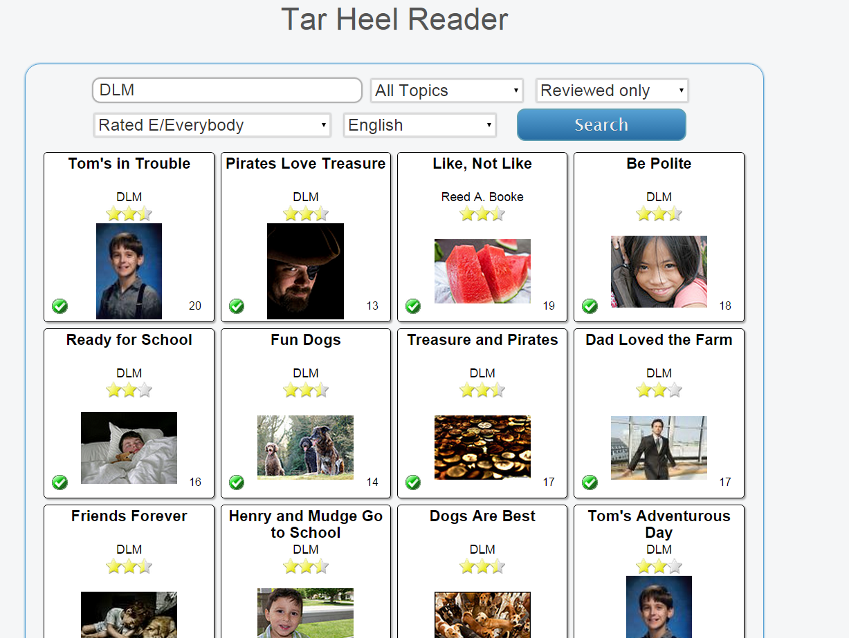
Training Module 3
http://tarheelreader.org/
Search “DLM”

Slide 12
Braille – Training Module 4, slide 18
The braille ready file (BRF) comes in uncontracted EBAE*
In Colorado:
DACs will be sent a link to the BRF
- this link can be emailed to TVI
DACs will be called with the password (this is secure)
this must be shared via voice only
*TVIs with the appropriate skills and software may adapt the code to uncontracted UEB if appropriate for their student

Slide 13
Training Module 4, Slide 24
Instructional Tools Interface Video
http://dynamiclearningmaps.org/content/educator-resource-videos-beta#ITIVideo
This is for districts using the optional instructionally embedded assessments

Slide 14
Training Module 4, slide 25
Optional Professional Development Modules:
http://dlmpd.com
Questions related to optional professional development modules can be directed to:
Linda Lamirande, 303-866-6863 lamirande_l@cde.state.co.us
Gina Quintana, 303-866-6605 quintana_g@cde.state.co.us

Slide 15
CDE Contacts for CoAlt
Administration of YE Assessments, Required Trainings and KITE System:
Mira Monroe, 303-866-6709 monroe_m@cde.state.co.us
KITE System and Data:
Jasmine Carey, 303-866-6634 carey_j@cde.state.co.us
Instructionally Embedded assessment, Professional Development, Participation Guidance, IEP Questions:
Linda Lamirande, 303-866-6863 lamirande_l@cde.state.co.us
Gina Quintana, 303-866-6605 quintana_g@cde.state.co.us

