Slide 1
Spring 2020 CMAS Administration Training for DACs
Science, Social Studies, Math, and ELA including CSLA
October 2019

Slide 2
Good Morning
We will use the PearsonAccess^{next} Training Center for demonstrations
Please log in to confirm access so you can follow along
http://trng-co.pearsonaccessnext.com
If your account credentials do not work or you need assistance, please notify Pearson or CDE staff before the training begins
On your phone or computer, please go to the following address: www.menti.com
Use this code:

Slide 3
Welcome & Agenda
General Info & Call-drivers
Timeline & Assessment Structure
PearsonAccess^{next}
Before Testing
Registering Students, Ordering Materials & Setting Up PAnext Test Sessions
Technology Overview
Administrative Considerations, Accessibility Features & Accommodations
Testing Environment
Receiving Materials & Test Security
During Testing
Administering Tests
Basic Technical Troubleshooting
Make-up Testing
After Testing
Returning Materials
PAnext Clean-up
Additional Information
Resources & Support

Slide 4
General Information

Slide 5
What is CMAS?
Colorado Measures of Academic Success (CMAS)
Colorado’s standards-based assessments designed to measure the Colorado Academic Standards (CAS)
English language arts/literacy (ELA)
Mathematics
Science
Social Studies
Purposes
Indicate the degree to which students have mastered the expectations of the CAS in each content area at the end of the tested grade level
Results provide one measure of a student’s academic progress relative to the CAS
Districts and schools may use aggregated scores to monitor their programs’ effectiveness
Administrations
Science and social studies: 2013-14 was the 1st year; 2020 is the 7th year
Math and ELA: 2014-15 was the 1st year; 2020 is the 6th year

Slide 6
Handouts
Handout
CMAS Overview
Technology Overview
Common Questions
Before Testing Checklist
Unit Testing Times and Testing Multiple Groups Guidance
Assessment Acronyms
Creating Sample Students in the PAnext Training Center
CMAS and CoAlt Security Agreement
DAC - sign and return during this training
Training Evaluation
District Contact Information

Slide 7
Assessment Acronyms*
Handout
AO: Additional Order
CBT: Computer-Based Test
CMAS: Colorado Measures of Academic Success
CoAlt: Colorado Alternate
CSLA: Colorado Spanish Language Arts
CPR: Colorado Practice Resource
DAC: District Assessment Coordinator
DTC: District Technology Coordinator
EL: English Learner
ELA: English Language Arts/Literacy
ET: Extended Time
HS: High School
PAnext: PearsonAccess^{next}
PBT: Paper-Based Test
PII: Personally Identifiable Information
PM: Procedures Manual
SAC: School Assessment Coordinator
SR/PNP: Student Registration/ Personal Needs Profile
S/SS: Science and Social Studies
SWD: Students with Disabilities
TAM: Test Administrator Manual
TTS: Text-to-Speech
UAR: Unique Accommodation Request
UI: User Interface
*See handout for additional acronyms and definitions

Slide 8
Overview of What’s New this Year
CMAS and CoAlt resource portal: http://coassessments.com
SR/PNP updates
Administrative considerations – fields removed
Accommodation type – new field used for certain validations
Visual accommodations field – previously “braille”
Spanish text-to-speech – entry updated
Response accommodations fields – previously “scribe”
Auditory presentation (i.e., text-to-speech and oral scripts)
Unit Timing Tables in Test Administrator Manuals
Updated materials return process
Additional Syncplicity contact option

Slide 9
Paper-based Testing §22-7-1013(6), §22-7-1006.3(1)(d-e)
Each LEP must adopt and implement a written policy by which it decides whether to request the paper form of the state assessments for its students
Decision must be made in consultation with schools and parents
Copy of policy must be shared with parents and posted on LEP website
LEP may make the decision by school or class (i.e., grade level and content area)
LEP will report to CDE the number of students who will take the paper form (indicated prior to initial order deadline)
Considerations
Technology capacity
Logistics
Must have the grade appropriate calculators for math (grades 6-8)
Paper form always available to individual students as an accommodation
Online form is also available as an accommodation
Must commit to meeting security requirements and accounting for all secure materials
Chain-of-custody documentation and reports for missing materials

Slide 10
Assessment Information and Calendar §22-7-1013(7)(a)
LEP will annually distribute to parents and post on its website, as early in the school year as possible, written information regarding its assessments, including:
The state and local assessments that the LEP will administer
Identify whether it is required by federal law, required by state law or selected by the LEP
Assessment calendar:
Estimated hours of testing each testing day for specific classes/grades for each assessment
Identify whether the assessment is required by state law, federal law or locally selected
The purposes of the assessments
The manner in which assessment results will be used

Slide 11
Parent Excusals §22-7-1013(8)(a-c)
A student’s parent may excuse the student from participating in a state assessment
Each LEP will adopt and implement a written policy and procedure by which a student’s parent may excuse the student from participating in one or more of the state assessments.
If a parent excuses his or her student, the LEP shall not impose negative consequence on the student or parent including:
Prohibiting school attendance; imposing an unexcused absence; or prohibiting participation in extracurricular activities.
Prohibiting the student from participating in an activity, or receiving any other form of reward that the LEP provides to students who participate in the state assessment.
LEP shall not impose an unreasonable burden or requirement on a student that would:
Discourage the student from taking a state assessment or
Encourage the student’s parent to excuse the student from taking the state assessment.

Slide 12
Personally Identifiable Information (PII)
State and Federal laws require protection of student PII
PII is any information that, alone or in combination, could identify an individual student (e.g., name, SASID, detailed demographics)
Emails can be intercepted, forwarded, and misrouted and are not secure methods for transmitting PII
It is CDE policy that any email with PII sent to, from, and within CDE must be encrypted
CDE strongly recommends that you encrypt emails with PII that are sent to other parties (other districts, within the district, vendors, etc.)
Additional Resources: http://www.cde.state.co.us/dataprivacyandsecurity

Slide 13
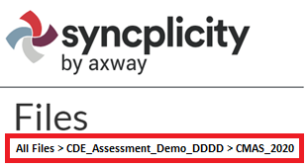
Syncplicity
The official DAC uses Syncplicity to transfer secure information and PII to CDE
User Guide available at http://www.cde.state.co.us/assessment/ausyncug
CDE Assessment folders and CDE Accountability folders are managed by different groups at CDE - CDE Assessment controls ONLY the CDE Assessment folders
All documents from 2019 were removed and archived by CDE
When posting
Ensure documents are placed in correct folders
Provide notice of uploaded files to the appropriate contact at CDE
Email file path and include the file name
Recommended: Use the browser version (unsync local devices from desktop app)
Optional: Each district may add one additional user who can access all CDE Assessment folders
Confirm the district allows the individual to access student PII, including assessment files and reports
Complete the form at https://forms.gle/5bR1p9BdBue5bKm86
It is the DAC’s responsibility to re-submit this form if the additional user should no longer have access to the CDE Assessment folders
New
Notes:
Files loaded through the browser are shared/updated faster than those loaded through the desktop app
Continuous syncing of desktop app devices sometimes causes reappearance of old documents and duplication of folders

Slide 14
Top Call-drivers 2019

Slide 15
Top Call-drivers 2019
Common Question
Students testing on paper who continued testing into the next unit early
Student who wasn’t assigned TTS but it’s in his/her IEP/504
Where is speech-to-text indicated?
PAnext password reset
Returning paper materials early (You CAN do this!)
Requests for return materials
Can materials from multiple schools be shipped back in the same box?

Slide 16
Timeline & Assessment Structure

Slide 17
Spring 2020 CMAS Window
Assessment | Grade(s) | Official Window
CMAS and CoAlt: Social Studies | 4¹, 7¹ | April 6-24, 2020
CMAS and CoAlt: Science | 5, 8, 11²
CMAS: Math and ELA (CSLA³) | 3-8²
CoAlt: DLM ELA and Math | 3-11 | Aligned to CMAS: Math and ELA schedule
¹Grades 4 and 7 Social Studies are administered on a sampling basis
²See following slides for early and extended window options
³CSLA is for eligible English learners in grades 3 and 4 only

Slide 18
Spring 2020 CMAS Window
Official window: April 6 – 24, 2020
All elementary and middle school science and social studies administrations must be completed within this window
All school-wide paper-based administrations for math and ELA must be completed within this window
Students requiring paper accommodations in schools utilizing the extended online window options may test at the same time as their peers (this includes CSLA)

Slide 19
CMAS Early/Extended Window Options
Handout
Math and ELA
To compensate for technology capacity, the math and ELA window can open early for online administrations only
Earliest start date for online math and ELA: March 16, 2020
This is an extended window – total of 5 testing weeks
High school science
To accommodate high school assessment schedules including SAT, AP, and IB exams, the high school window can open and close early
Early window options for high school:
March 23 – April 10, 2020
March 30 – April 17, 2020
This is an early window – total of 3 testing weeks
Notify CDE of intent to participate in early/extended windows by December 15

Slide 20
Spring 2020 Critical Dates – Tentative
Activity | Extended Math and ELA (CBT) | Early High School Science | Elementary/Middle School S/SS and Math/ELA (PBT)
Submit updates through UI or SR/PNP for initial orders | January 6 – 24
Online test session set-up begins | February 3
Materials scheduled to arrive in districts* | March 3 Student materials, student ID labels | March 3 Student materials, student ID labels | March 24 Student materials, student ID labels
Proctor caching test content begins | March 2 | March 2 | March 23
Prepare Test Sessions | March 13 | March 20 | April 3
* Materials arrive in two waves based on selected testing windows - Assessment Coordinator Kits and TAMs are sent in Wave 1 (March 3)

Slide 21
Spring 2020 Critical Dates – Tentative
Activity | Extended Math and ELA (CBT) | Early High School Science | Elementary/Middle School S/SS and Math/ELA (PBT)
Additional Orders – Secure Materials | March 4* – April 21 |  | March 25* – April 21
Additional Orders – Non-secure Materials | March 4* – April 29
Deadline for UPS scorable pickups** | April 29 Schedule pickup by April 28
Deadline for UPS nonscorable pickups | May 1 Schedule pickup by April 29
*Additional orders placed prior to receiving Wave 1 materials will not be reviewed or approved (i.e., if only the regular window will be used, do not place additional orders until March 25).
**If scorable materials are not picked up by April 29, 2020 there is no guarantee that records for these PBT students will be included in SBD or scored.

Slide 22
Spring 2020 Critical Dates – Tentative
Description | Post Testing Clean-up Tasks | Window Dates
Initial PAnext Clean-up (School and District) | Confirm Student Registrations Update Used Accommodations Mark Complete Units Stop Sessions Indicate Not Test and Void Test Score Reasons/Codes Resolve Rejected Student Tests | Prior to May 8
Final PAnext Clean-up (District) | Demographics and invalidations cleaned in PAnext | May 11 – 13
Student Biographical Data (SBD) Review (District) | Demographics and invalidations cleaned in CDE’s Data Pipeline | May 18 – 28

Slide 23
Social Studies
Individual schools are sampled once in three years
2019-20 is Year 2 of the second social studies assessment cycle
Sampling plan priorities:
Reduce testing burden
Avoid creating cohorts of social studies students
Minimize the number of students who will test as 4th and 7th graders
Provide state level results that can be compared from administration to administration
Notification emailed to DACs on August 23rd, 2019
List posted in CDE Assessment Syncplicity > CMAS_2020
Common Question

Slide 24
Colorado Spanish Language Arts (CSLA)
CSLA is a paper-based accommodated version of ELA
Follows the design, guidelines, and scheduling of ELA
Assign Test Code SLA03 or SLA04 instead of ELA03 or ELA04
Because CSLA is an EL accommodation, other EL accommodations are not allowed on CSLA
Qualifying students
English Learners (NEP, LEP)
Grades 3 and 4
Language arts instruction in Spanish within the past 9 months
Students in an English language development program for less than five years
Connect with the district’s EL coordinator
CMAS Spanish Assessments Decision Making Flowchart
http://www.cde.state.co.us/assessment/cmas_spaassessflowchart

Slide 25
First Year in US English Learners – ELA Only
Districts determine whether to administer the CMAS ELA assessment to their ELs who enrolled in a US school for the first time on or after April 9, 2019 (first year in the US) based on the following guidance:
Students who are NEP, based on WIDA Screener and a local body of evidence, are exempt from the ELA assessment
3rd and 4th grade NEP students whose native language is Spanish and who have received language arts instruction in Spanish during the current school year are required to take CSLA
Students identified as NEP whose native language is not Spanish, or whose native language is Spanish but who have not received Spanish language arts instruction in the current school year, are exempt
A parent/guardian of a student who meets exemption guidelines may choose to have their child participate in ELA testing. Results for these students will be included in accountability and growth calculations for the following year.
Students who are LEP, based on WIDA Screener and a local body of evidence, must take the state language arts assessment that best matches their instruction: CMAS ELA, CSLA (if eligible), or CoAlt (if eligible)

Slide 26
Guidelines for Administration Time
Task | Time to be Allotted for an Administration
Prepare for testing (includes reading SAY directions script from TAM and answering student questions) | 10 minutes (recommended)
Distribute test materials | 5 minutes (recommended)
ELA/CSLA unit testing time Math unit testing time ES/MS Science/Social Studies unit testing time HS Science/Social Studies unit testing time | 90-110 minutes* 65 minutes 80 minutes 50 minutes
Complete end-of-unit activities, including closing units and collecting test materials | 5–15 minutes (recommended)
*Testing time depends on grade level/course — refer to Unit Testing Times and Testing Multiple Groups handout

Slide 27
Guidelines for Administration Time
Schedule the entire amount of unit testing time
Once the unit testing time is met, the unit must end
A student is only allowed an extended time accommodation if listed in his or her IEP, 504, or EL plan
If all students complete testing before the unit testing time is met, the Test Administrator may end the unit (no minimum testing time)

Slide 28
Unit Testing Times: Grades 3-5
Handout
Assessment | # of Units | Section | Minutes
Math Grades 3-5 | Unit 1 | Non-calculator | 65
 | Unit 2 | Non-calculator | 65
 | Unit 3 | Non-calculator | 65
ELA Grades 3-5, incl. CSLA Grades 3-4 | Unit 1 |  | 90
 | Unit 2 |  | 90
 | Unit 3 |  | 90
Social Studies Grade 4 | Unit 1 |  | 80
 | Unit 2 |  | 80
 | Unit 3 |  | 80
Science Grade 5 | Unit 1 |  | 80
 | Unit 2 |  | 80
 | Unit 3 |  | 80

Slide 29
Unit Testing Times: Grades 6-8
Handout
Assessment | # of Units | Section | Minutes
ELA Grades 6-8 | Unit 1 |  | 110
 | Unit 2 |  | 110
 | Unit 3 |  | 110
Social Studies Grade 7 | Unit 1 |  | 80
 | Unit 2 |  | 80
 | Unit 3 |  | 80
Science Grade 8 | Unit 1 |  | 80
 | Unit 2 |  | 80
 | Unit 3 |  | 80

Slide 30
Unit Testing Times: Grades 6-8 Math
Handout
Assessment | # of Units | Section | Minutes
Math Grades 6-8 | Unit 1 | Non-calculator | 65
 |  | Calculator
 | Unit 2 | Calculator | 65
 | Unit 3 | Calculator | 65
Refer to the Calculator Policy at http://www.cde.state.co.us/assessment/cmas_calculator_policy

Slide 31
Unit Testing Times: Grade 11
Handout
Assessment | # of Units | Section | Minutes
High School Science | Unit 1 |  | 50
 | Unit 2 |  | 50
 | Unit 3 |  | 50

Slide 32
Calculating Unit Testing Times
NEW!
Unit timing box added to each set of SAY directions in the TAM
Example: Grades 6-8 Math
¹Refer to the Unit Timing Guide in Appendix B for assistance calculating the stop time.
Reminder: Adjust warning and stop times by 3 minutes if a stretch break is taken during the unit.
Unit Timing Guide included in TAM Appendix B
Unit Timing (65 Minutes)
 | Unit 1 | Unit 2 | Unit 3
Start
20 Minute Warning
10 Minute Warning |  | N/A | N/A
Stop¹
 | Math |  |  | ELA 3-5 CSLA 3-4 |  |  | ELA 6-8 |  |  | Social Studies 4 & 7 Science 5 & 8 |  | High School Science
Timing Type | Standard | Extended (1.5x) | Extended (2x) | Standard | Extended (1.5x) | Extended (2x) | Standard | Extended (1.5x) | Extended (2x) | Standard - Extended (1.5x) incl. | Extended (2x) | Standard - Extended (1.5x) incl. | Extended (2x)
Unit (minutes) | 65 minutes | 100 minutes | 130 minutes | 90 minutes | 135 minutes | 180 minutes | 110 minutes | 165 minutes | 220 minutes | 80 minutes | 110 minutes | 50 minutes | 70 minutes
Unit (hour(s) w/minutes) | 1 hour 5 minutes | 1 hour 40 minutes | 2 hours 10 minutes | 1 hour 30 minutes | 2 hours 15 minutes | 3 hours | 1 hour 50 minutes | 2 hours 45 minutes | 3 hours 40 minutes | 1 hour 20 minutes | 1 hour 50 minutes |  | 1 hour 10 minutes
Start Time | End Time |  |  | End Time |  |  | End Time |  |  | End Time |  | End Time
:00 | :05 | :40 | :10 | :30 | :15 | :00 | :50 | :45 | :40 | :20 | :50 | :50 | :10
:01 | :06 | :41 | :11 | :31 | :16 | :01 | :51 | :46 | :41 | :21 | :51 | :51 | :11
:02 | :07 | :42 | :12 | :32 | :17 | :02 | :52 | :47 | :42 | :22 | :52 | :52 | :12
:03 | :08 | :43 | :13 | :33 | :18 | :03 | :53 | :48 | :43 | :23 | :53 | :53 | :13

Slide 33
Guidelines for Breaks
Scheduled breaks may occur between units
Students may not have access to cell phones during scheduled breaks
During each unit, a short “stand-and-stretch” break is permitted at the discretion of the Test Administrator
Time stops for the unit, but only for up to 3 minutes
Activity | Time
Unit 1 | 8:00 a.m. – 10:00 a.m.
Scheduled Break | 10:00 a.m. – 10:15 a.m.
Unit 2 | 10:15 a.m. – 12:15 p.m.

Slide 34
Scheduling Considerations
Administer all test units in consecutive order
All content areas
Includes make-up testing
Excluding make-ups, determine
Whether one content area will be completed before beginning the next, or if testing will alternate between the content areas
Whether the district will condense testing or spread throughout the testing window
How many units students will take per day
Complete all tests by April 24, 2020
Plan extra days at the end of the window to account for cancellations due to snow or other unexpected closures
Plan time for make-up testing

Slide 35
Scheduling Considerations
Paper-based testing
PBT window does not open until April 6, 2020
Exception: Three week high school window can open as early as March 23
A school must administer the same unit to all PBT students within the same day (e.g., all Grade 4 Math Unit 1 on Tuesday)
Schools must have the grade level appropriate calculator (grades 6-8) if administering math on paper
Administer CBT accommodations on the paper schedule
Computer-based testing
Math and ELA CBT window can open as early as March 16, 2020
Three week high school window can open as early as March 23
Elementary and middle school science and social studies CBT window cannot open until April 6
To the extent possible, assess all students within the school at the same time
If not possible, assess all students within the shortest timeframe practicable
Administer PBT accommodations on the online schedule

Slide 36
Scheduling Considerations
To the extent possible, a student taking CoAlt in a content area for which the student is participating in a general education class should be assessed at the same time as their peers to avoid missed instruction
Ensure students taking these assessments do not miss instruction from their general education class

Slide 37
Scheduling Sessions
Handout
If the unit testing time and directions are the same, different grades can test in the same room
A separate testing environment is needed for:
Paper-based and computer-based (administration SAY directions and materials are different)
ELA and mathematics (unit testing times and administration SAY directions are different)
Directions read aloud in a language other than English
English tests and Spanish accommodated forms
Science/social studies and ELA/math (unit testing times and administration SAY directions are different)
Paper-based science and social studies (materials and administration SAY directions are different)
High school science and elementary/middle school science/social studies (different unit times)
Math grades 3-5 and math grades 6-8 (different administration SAY directions)
Math grades 6-8 unit 1 and math grades 6-8 units 2 and 3 (different administration SAY directions)

Slide 38
Afternoon Testing
If the school is having technology issues, do not start a unit unless there is enough time left in the day to complete the unit
It is a misadministration for a testing group to start the test and then stop and complete it the next day
This is only allowed for illnesses and unforeseen situations (e.g., school power outage)

Slide 39
After-hours Testing
If a school will start a test session after 4:30 p.m.
Email the following to CDE (loerzel_s@cde.state.co.us) ASAP
School name
Online test session name (not just the name of the test)
CDE will grant the test session(s) permission to test after hours
District or school must “start” the test session first

Slide 40
PearsonAccess^{next}

Slide 41
User Accounts
User Roles – assigned to PAnext users
Permissions - each user role contains permissions that determine which tasks the user can perform in PAnext
Once a user has a specific role, they can grant that role to another user account
Reference the User Role Matrix (Appendix H in the Procedures Manual) for additional information on role assignment and permissions

Slide 42
User Accounts
CMAS | PearsonAccess^{next} Role
District Assessment Coordinator (DAC) | LEA/District Test Coordinator
School Assessment Coordinator (SAC) | School Test Coordinator
District Technology Coordinator (DTC) | Technology Coordinator
CMAS Test Administrator | Test Administrator
CoAlt S/SS Test Examiner | Test Examiner

Slide 43
User Account Add-on Roles
Add-on Roles Assigned to DACs
Sensitive Data Role – View and edit sensitive student data
Users with this PAnext role have access to PII
Must have this role to import SR/PNP files
Delete Student – Delete registrations/students
CDE checks October Count numbers against final test registrations in PAnext
Student Test Update – Allows export/import of STU file to batch update Void and Not Tested codes/reasons
OnDemand Admin Report Access – Provides access to post-test on-demand individual student reports – these reports do not include comparative data
Published Reports – Provides access to post-test reports (i.e., results) and data files
Note: Roles are added/removed from accounts throughout the year

Slide 44
User Roles
Common Question
Why can’t I see all of my students?
The following user roles limit permissions and should not be assigned to users with other roles
Test Examiner
OnDemand Teacher Report Access Role
Users with these roles can only see students/data to which they are assigned
Example: A SAC who is assigned the School Test Coordinator and Test Examiner roles cannot function as a SAC
Can only see CoAlt students to whom they are assigned
If the school has 250 students and the SAC is assigned to 2 students taking CoAlt, they cannot see the other 248 student test records

Slide 45
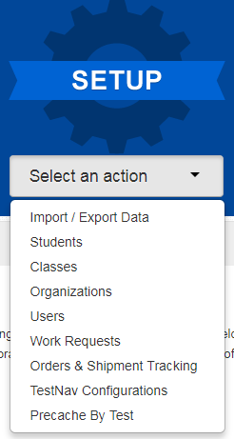
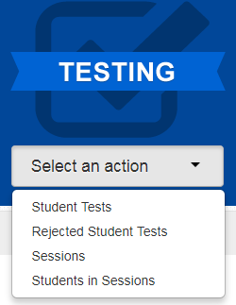
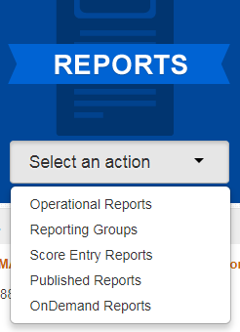
PAnext
Demo
CMAS or CoAlt
Administration
(back to 2013-2014)
Change your view
Menus
Organization
2019-2020
2020

Slide 46
PAnext – Setup Actions
Import/Export Data
Student Registrations (SR/PNP), Enrollment Transfers, Student Test Updates (STU), Users
Students
Create and edit student records
Register students for the current test administration - indicate demographic information
Manage student tests – add test assignments and update PNP
Classes
Create and edit classes to assign groups of students to online test sessions
Organizations
Check contact information
Verify enrollment counts before January 24, 2020 initial orders pull (determines material quantities for shipments)

Slide 47
PAnext – Setup Actions (continued)
Users
Create and edit user accounts
Work Requests
Submit student record transfer requests to other districts
Review, approve, and reject student record transfer requests received from other districts
Orders & Shipment Tracking
Order additional materials
Track material shipments
TestNav Configurations
Configure TestNav settings
Precache By Test
Proctor cache test content

Slide 48
PAnext – Testing Actions
Student Tests
All tests assigned to students in the selected organization
Edit student tests (PNP)
CoAlt only – enter CoAlt scores
Rejected Student Tests
After testing for PBT only
Resolve demographic mismatches for scanned test books
Sessions
Create and edit online test sessions
Add students to sessions
Lock all units for all tests in the selected organization
Students in Sessions
Print Student Testing Tickets and Session Rosters
Verify special form assignment
Manage live testing – start sessions, resume and unlock units, mark tests complete, move students between sessions

Slide 49
PAnext – Reports Actions
Operational Reports
Run live reports on student data, online testing, orders, etc.
Reporting Groups
For OnDemand Reports
Create and manage reporting groups of students
Assign and remove users from reporting groups
Score Entry Reports
CoAlt administration
Monitor completion of score entry for CoAlt assessments
Published Reports
After testing
Results – data files and reports
OnDemand Reports
After testing
Preliminary student performance results
Comparative data not included (state-, district-, school-level)

Slide 50
Before Testing
Handout

Slide 51
Annual Training Requirement
Everyone involved in CMAS math, ELA/CSLA, science, and social studies administration must complete training each year
Includes DACs, SACs, Test Administrators, Test Examiners, technology personnel, and any other school or district staff involved in administration
DACs and SACs are responsible for ensuring all individuals involved in test administration and/or handling secure materials receive training and sign the CMAS and CoAlt Security Agreement
Refer to the State Assessment Training Requirements at http://www.cde.state.co.us/assessment/annual_trng_requirements

Slide 52
Training
Comprehensive training must include:
Test Security
Standardized Test Environment
Test Administration
Test Session Management (for appropriate personnel)
Test Administrator Role vs. Teacher Role
Opportunity for personnel to ask questions
CDE provides a basic PPT that districts may update and use for Test Administrator trainings
Available in January
There are separate PPTs for CBT and PBT
Districts need to add district-specific instructions

Slide 53
Who Can Administer a Test?
Common Question
School and district employees who are trained on this year’s procedures and security
Long term subs may be Test Administrators
Student Teachers are NOT allowed to be the only person in the room or responsible for the administration of the assessment
Student teachers may be an additional person (proctor) in the room during testing

Slide 54
Student Readiness
Student practice resources are available on http://coassessments.com
Colorado Practice Resources (CPRs)
Computer-based testing
Paper-based testing
CPR Guides - include scoring information (e.g., answer keys and rubrics)
Updated TestNav tutorial with a walk through of various item types
During testing, Test Administrators cannot help students with TestNav navigation and answering questions in test books
May not help with how to answer a question
May not show how to go to the next question or use the review screen
May not assist with drag and drop or other technology enhanced items
Strongly recommend students are provided access to CPRs prior to testing
Includes forms with accessibility features and accommodations

Slide 55
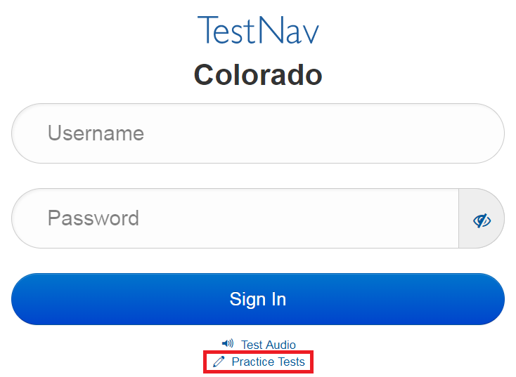
Student Readiness
Demo
Additional ways to access CBT CPRs:
TestNav App
Navigate to “Colorado” sign in page
Select “Practice Tests” link
PAnext Training Center
Requires login from student testing ticket
Secure practice sessions must be setup in advance

Slide 56
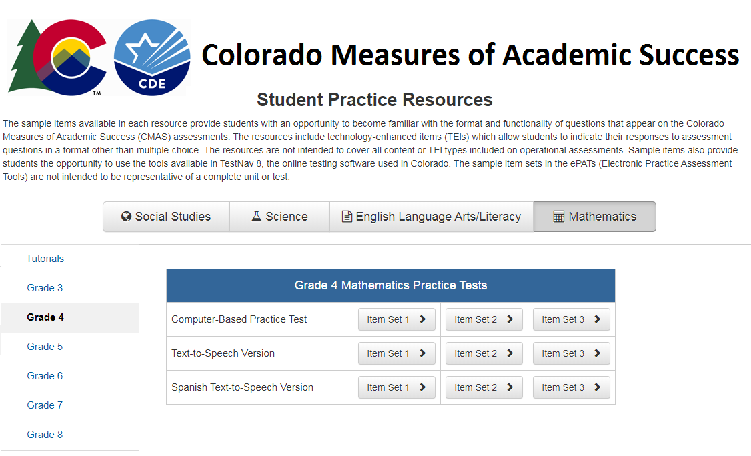
Student Readiness
Demo
App based CBT CPRs:

Slide 57
Registering Students, Ordering Materials & Setting Up PAnext Test Sessions

Slide 58
Student Registration Reminders
CDE initially registers students for districts using October Count data
Add new students into PAnext prior to testing, including for PBT
Do NOT use temporary SASIDs
Contact Sara Loerzel at CDE for help with SASIDs
There are several fields in the SR/PNP that are used to validate selected accommodations
If an error is received upon import, check cross-validation fields
These fields are only seen by PAnext users with the Sensitive Data role
Middle name field can be blank

Slide 59
Registering for PBT
Initial orders for PBT materials are generated using information indicated for students in the SR/PNP as of January 24, 2020
PBT for district/school/grade/content area
Paper format will be indicated for you if intent to use PBT is submitted to CDE by December 15
If PBT selection is not provided to CDE by December 15, district/school needs to indicate
Additional orders for whole districts/schools/grades/content areas will not be approved (including when tests are not updated from English to Spanish)
Ensure charter school selections are indicated
Individual students using PBT accommodated forms
Indicate Spanish Transadaptation and other accommodations prior to January 24
CDE adds UEB with Nemeth registrations into the initial upload for students who were assigned to braille last year (district/school adds grades 3 and 11)
Update math and science to UEB Technical, if needed

Slide 60
Accommodated Forms Ordering by January 24*
Ensure all large print and braille registrations are in PAnext
Oral scripts must be indicated
CSLA and other Spanish forms must be identified
CDE indicates UAR-dependent accommodations
Must meet December 15 UAR deadline
* Exception for new students who arrive after January deadline – DACs need to place an additional order for PBT or accommodated materials after updating student registrations

Slide 61
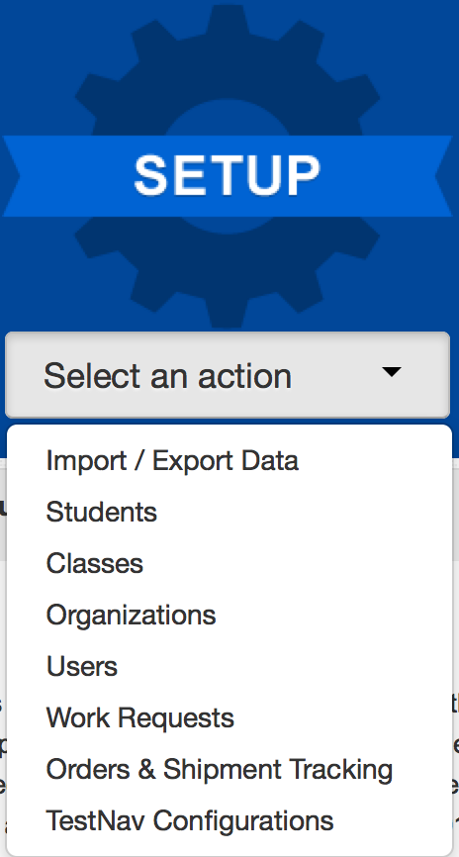
Registering a Student in PAnext through a File Upload
Demo
Select the Setup menu and choose Import/Export Data
Choose Import/Export Data and click Start

Slide 62
Registering a Student in PAnext through a File Upload
Demo
DURING the January 6-24 registration window:
Under Type, select Student Registration Import (Initial)
This file will allow edits to the UAR field
This is the only option during the initial registration window
AFTER the January 6-24 registration window:
Under Type, select Student Registration Import
This file will NOT allow edits to the UAR field
This is the only option after the initial registration window
Select Process

Slide 63
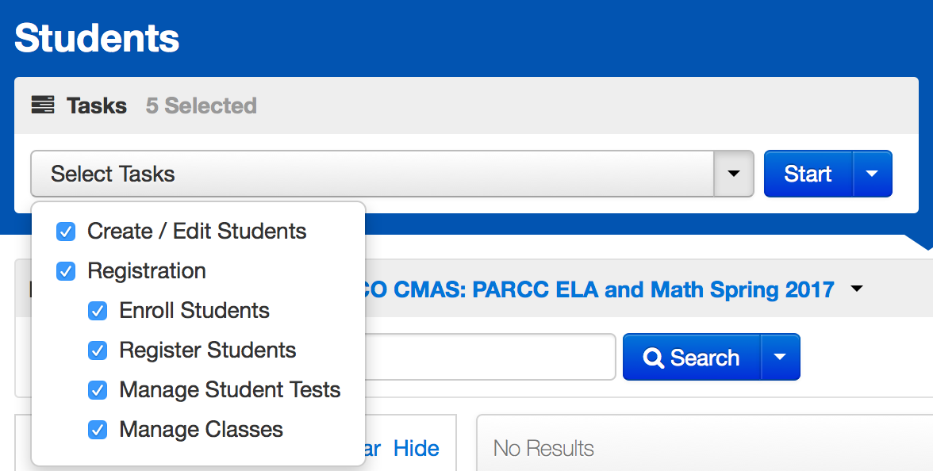
Registering a Student in PAnext Through the User Interface
Demo
Select the Setup menu and choose Students
Choose the Tasks and click Start

Slide 64
Operational Reports within PAnext – Help with Registration
Recommended reports
PNP Report – accessibility features and accommodations for student tests
Students where responsible district/school is different from testing district/school – use for transfer students
Students registered but not assigned to a test
Students with online test but not assigned to session
Students with multiple tests of same subject area

Slide 65
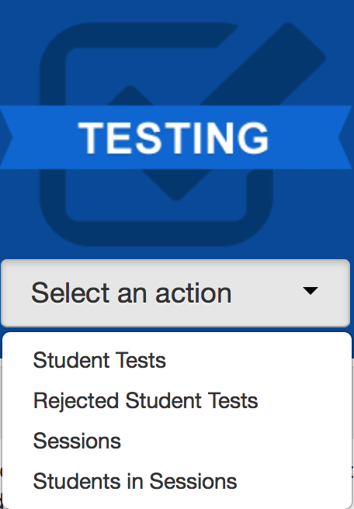
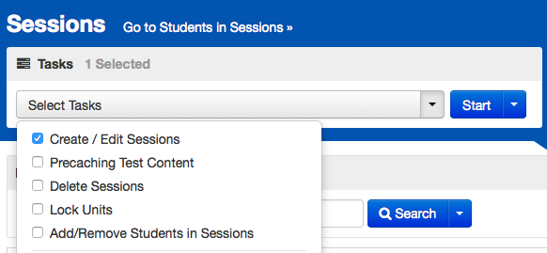
Online Testing Management
Demo
Select the Testing menu and choose Sessions
Choose the Tasks and click Start

Slide 66
New Students
Student arrives during… | Action | Example: ELA initial testing window is April 6-10
Initial testing window (by each content area)
Student needs to test
Student arrives on April 7th and needs to test ELA
Make-up testing window (by each content area)
District decides if student will test
Student arrives April 11th, district has the option of testing to receive data
Note: Registrations and online test assignments for students who transfer from another school district (did not complete testing before transfer) are transferred using the Work Request process

Slide 67
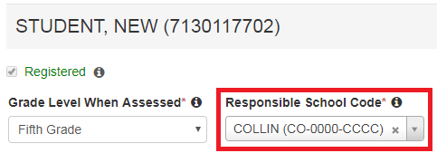
Work Request – Student Transfer Process
Student transfers from District A to District B prior to beginning testing:
District B attempts to register student in PAnext, but receives an error stating, “The student can only be enrolled in 1 organization.”
District B completes a Work Request to transfer the student to District B (through UI or file import)
An email is sent to District A’s Work Request contact and a red bell appears at the top of District A’s home screen
District A confirms that student transferred and approves the request (through UI or file import)
The student’s record is moved to District B
District B must go into the student registration screen and make necessary changes to the Responsible School Code field
If District A does not approve the transfer – the student’s record remains with District A
Don’t forget!

Slide 68
Work Request – Student Transfer Process (CBT) During Testing
The student started an online test:
District B completes a work request within PAnext
District A approves the work request
The online tests assigned to the student are automatically transferred to District B
The tests are placed in test sessions named “Transferred [Grade - Subject]” at the new school
Required action: Move these tests into another test session
DO NOT add fake or temporary SASIDs into PAnext unless CDE approves their use; use the transfer process
If you cannot find the student in PAnext, contact CDE for assistance. Typical errors involve hyphenated names, nicknames instead of birth names (e.g., Liz instead of Elizabeth), and DOB format (yyyy-mm-dd)

Slide 69
Work Request – PBT Student Transfer
Complete a Work Request in PAnext
For a non-started test, no physical material transfers are necessary
The new school can provide a test book or can assign the student to an online assessment
If the transferred student started testing on paper:
Contact the other district and arrange for secure transfer of the test book
In-person DAC to DAC hand-off
Fed Ex or UPS – signature required – track shipment
Students may not retest a unit that they took in a previous school
Provide a chain of custody for the transferred test materials
Both districts must keep a copy of chain of custody documents

Slide 70
Work Request – Releasing District
Check email and PAnext regularly
Look for the red bell at the top of the PAnext home screen
Click on the bell to go to the pending requests
Verify the student listed in the Work Request moved away from your district
Approve the transfer
If the student did not move away from your district
Reject the transfer
Provide reason (e.g., student did not move)
The other district may have requested the wrong student
If there is an error in the school field upon opening the work request, reject the request (the student was previously removed from your district)

Slide 71
Work Request – Receiving District
Review the student registration and update the responsible school and district (if needed – BOCES might not need to update this field)
Updates to a responsible school that is not within your district – completed via file upload or by CDE (call Sara Loerzel)
Updates to schools within your district – completed through the UI or via file upload
Use the Operational Report “Students Where Responsible District/School is different from Testing District/School”
If your district should be the responsible district, change this in the student’s registration via the UI or through a SR/PNP file upload

Slide 72
Assessment in Special Circumstances
Expelled students
It is the district’s responsibility to ensure every effort is made to test expelled students receiving educational services
Identify students as expelled in PAnext
Results are included in district results; they are not included in aggregated school results
Foreign exchange students
All students enrolled in Colorado schools, including foreign exchange students, are required to take state assessments
Medical exemption
Students who are unable to complete or participate due to a documented, significant, and fully incapacitating medical condition or emergency (e.g., student is in the hospital after a car crash) that extends across the entire (or remaining) test window
The incident or condition must be so severe that it prevents the student from participating in instruction
Note: This does not apply to students who are absent during testing due to typical illnesses
Identify as “Medical Exemption” in the appropriate PAnext invalidation field

Slide 73
Assessment in Special Circumstances
Common Question
Home school students
Do not have to test (CRS, 22-7-1006.3 (3) (b))
Includes students who may also attend a public school for a portion of the school day and are therefore included in the enrollment of the LEP
However, a parent/guardian of a child in a home-based educational program may request that the child tests
Students must meet participant criteria for the requested assessment(s)
The parent/guardian must pay all costs associated with administration and providing assessment results, as determined by the district
If registered in PAnext and…
Will not test, code as Not Tested Reason 08
Will test, set the Responsible School to CO-DDDD-HHHH (where DDDD = district’s code - available in each district)
Refer to Section 2.5 in the Procedures Manual for more information

Slide 74
Technology Overview

Slide 75
Technology Updates
Handout
Testing
Use TestNav app for student testing
Desktop/laptop computer
Chromebook
iPad
If you are proctor caching on a MAC, please have your DTC call Pearson Support to request the MAC Proctor Cache Installer
Verify the correct person is identified as the District Technology Coordinator for your district on the CDE website
http://www.cde.state.co.us/assessment/dtc
DTC receives technology updates and invitations to trainings via email
2019-2020 DTC Kick-off Webinar in mid-October
DAC should connect with DTC regularly to ensure CBT readiness for spring 2020

Slide 76
Administrative Considerations, Accessibility Features & Accommodations

Slide 77
Accessibility Features and Accommodations
Resources
Accommodations webinars posted on http://www.cde.state.co.us/assessment/trainings
Accommodations Crosswalk
CMAS and CoAlt Procedures Manual Section 6.0

Slide 78
For Unique Accommodation Requests, students must have an active IEP or 504 and receive CDE approval
UARs
Students must have an active IEP/504/ELP
Accommodations
May include students with active IEP/504/ELP (but not required)
Accessibility Features
Administrative Considerations
All Students

Slide 79
Administrative Considerations
Available to any student:
Adaptive and specialized equipment or furniture
Frequent breaks (do not stop the clock)
Noise buffers/headphones
Small group testing
Specified, separate, or alternate area or seating
Time of day
Administrative considerations are not captured on the SR/PNP for Spring 2020
New

Slide 80
Accessibility Features Identified in Advance
Available to any student and must be marked in the SR/PNP:
Auditory Presentation:
Text-To-Speech (CBT) Math, Science, Social Studies
Oral Script (PBT) Math, Science, Social Studies
Color Contrast
Note: Auditory Presentation of ELA is a unique accommodation that requires a CDE Assessment Division-approved UAR
While accessibility features are available to any student, they may not be appropriate for all students. Students should use similar access strategies during instruction.

Slide 81
Accommodation Type
New
New field in SR/PNP
Used to validate assignment of accommodations for which a student qualifies due to IEP/504 status and/or EL status
Auditory Presentation: Text-to-Speech
Auditory Presentation: Oral Script
Response Accommodation
Word Prediction

Slide 82
Extended Time
Administer extended time accommodations in a separate room from standard unit testing time administrations
CDE does not recommend providing more than double time
Complete a unit on the same day it was started
Science and social studies
Time-and-a-half built into unit time
Double time as an accommodation
Elementary and middle school – 110 minutes
High school – 70 minutes
Math and ELA
Extended time is not included in unit time
Note: Use the Unit Timing chart in the TAMs to accurately time extended time accommodations

Slide 83
Visual Accommodation Materials
Students with visual impairments have several options for visual accommodations:
Large print
Braille
UEB with Nemeth
UEB Technical (math and science only)
Visual descriptions
PBT
CBT
Tactile graphics for CBT
UEB with Nemeth
UEB Technical (math and science only)
Assistive Technology CBT form
Math and ELA only
For use with screen readers
Students can use visual descriptions and tactile graphics with this form
All except large print are indicated in the “Visual Accommodations” field on the PNP

Slide 84
Response Accommodation
Common Question
“Response Accommodation” fields in PNP
Replace “Scribe” fields
Used to indicate responses captured by a scribe, signer, speech-to-text, or other external AT device
Indicate use of speech-to-text under “Response Accommodation” fields, NOT “Assistive Technology”
Use of internet-based speech-to-text (STT) devices/software is not allowed
Privacy and security issues
A student’s voice is PII
Exposure of test content to STT provider
Embedded operating system accessibility features are not allowed
Contact CDE Assessment Division with questions about using STT

Slide 85
Auditory Presentation
Text-to-speech and oral script both provide auditory presentation of the assessment
Auditory Presentation: Text-to-Speech (TTS) – TestNav reads the assessment content via the embedded TTS functionality
Computer-based testing
This form is not for blind or low-vision students
TTS is an accessibility feature for math, science, and social studies
TTS is a unique accommodation for ELA
Auditory Presentation: Oral Script – Assessment content is read aloud by Test Administrator
Typically paper-based testing
Oral script is an accessibility feature for PBT math, science, and social studies only
Oral script is a unique accommodation for ELA and CSLA

Slide 86
Auditory Presentation
Computer-based testing
Students use Text-to-Speech in English or Spanish
ELA TTS use requires CDE Assessment Division-approved UAR
Math, science, and social studies oral scripts available for:
Translation into language other than Eng/Spa, including sign language
Student responses translated and transcribed into TestNav
Paper-based testing
Math, science, and social studies oral scripts available for:
English
Spanish
Translation into language other than Eng/Spa, including sign language
Student responses translated and transcribed into test book
ELA and CSLA
Must be approved for UAR
Sign language, English for ELA, Spanish for CSLA
No script – follow audio guidelines

Slide 87
Auditory Presentation – Oral Script
Oral script guidelines
A trained Test Administrator may be provided to read the entire test orally to a student who is unable to decode text
Individual words must not be read to students
Oral scripts should be provided to students on an individual basis
A student should have the option of asking a reader to slow down or repeat text
Math, science, and social studies: the Test Administrator must follow the script and not read from a test book or device screen
Scripts are secure and must be returned to Pearson
CBT with oral script
Must be in a separate test session in PAnext (cannot be in same online test session as non-oral script tests)
Test session Form Group Type must be set to Oral Script or student’s test will not match the oral script

Slide 88
Technology for Medical Monitoring
Students who use a phone, tablet, or other device to monitor a medical condition may have the device in the testing room
Documentation of medical necessity must be kept at the school and district
District plan for use of these devices must include:
Where the device is located and who has control of the device
If the student has control, the device must be visible at all times and may not be used for any other purpose
Procedures for if/when the device alerts and what action is necessary
If student has to leave the testing environment, follow procedures for students who become ill

Slide 89
Accommodations for ELs
The following accommodations are available to students learning English as documented on English learner plans (student-, school-, or district-level)
Extended Time
Admin (SAY) Directions Read Aloud, Clarified, and Repeated in Native Language
Spanish Transadaptation - Math, Science, Social Studies
CSLA in Grades 3 and 4 - ELA
Oral Script in Native Language - Math, Science, Social Studies
Non-English Response
Speech-to-Text
Word-to-Word Dictionary
Word Prediction
Note: EL accommodations are not available on CSLA or other Spanish forms as the student is testing in his or her native language

Slide 90
Administering Language Accommodations
Spanish forms - CSLA, Math, Science, Social Studies
Test Administrators must be bilingual to administer assessments in Spanish
Assigning Spanish forms
Without TTS – indicate in PNP “Spanish Transadaptation” field
With TTS – indicate in PNP “Auditory Presentation: Text-to-Speech” field
ELA
Only SAY directions can be provided in languages other than English
Auditory presentation of ELA in other languages is not allowed
Math, Science, and Social Studies may be translated into other languages using the provided oral script (CBT or PBT)
CBT oral script is ONLY for translation
SAY directions are available in English and Spanish
Spanish is found at http://coassessments.com
All other languages require local translation
Change

Slide 91
Non-English Responses
Math, Science, and Social Studies
If Spanish responses are identified, they are scored by a scorer proficient in Spanish
If student responds in a language other than English or Spanish, local translation and transcription are required for scoring
ELA and CSLA
On ELA, only English responses are scored
On CSLA, only Spanish responses are scored
Translation of student responses on ELA and CSLA is not allowed

Slide 92
Transcription Guidelines
Common Question
PBT and CBT Transcription
Requires presence of at least two individuals during transcription of student responses
One person to transcribe
One person to verify the transcription
Transcribe the student’s responses verbatim into the test book or TestNav
Note for braille transcription: Only a braille certified Test Administrator may transcribe student responses
After transcription, shred any responses printed from an assistive technology device
Complete the Secure Data Removal form
Refer to the Transcription Guidelines in Section 6.1.5 in the Procedures Manual

Slide 93
Transcription Guidelines
CBT Transcription
Student:
Responds to constructed response (CR) questions on their assistive device
Student may respond to selected response items in TestNav
Device with saved responses is secure until student responses are removed
Exits the unit, but the student should not submit the unit
Test Administrators transcribe student responses to CR questions into TestNav before the next unit
Transcriber:
Resumes the student’s test in PAnext
Logs-in as the student and transcribes the CR responses
Submits responses for the transcribed unit
Student continues testing in the next unit
Note: Because units cannot be administered out of order, transcription must take place before the student can take the next unit

Slide 94
Prior Access to Secure Test Materials
Prior access must be supervised by the SAC
Access to test questions and test materials prior to testing is limited to the following:
4 days for Auditory Presentation: Oral script for translation into language other than English/Spanish, including sign language
24 hours for Auditory Presentation: Oral script in English or Spanish
Paper-based testing only
24 hours for braille
TVIs may review Teacher Notes 24 hours prior to testing
TVIs may NOT review test content
Test materials must be secure at all times – follow chain of custody protocols
Test items may not be copied or discussed

Slide 95
Unique Accommodation Requests (UARs)
A very limited number of students who meet specific criteria may qualify for unique accommodations
These accommodations might impact the construct measured by the assessment; additional documentation is required
CDE Assessment Division approval is required for use of unique accommodations
UARs are due to the CDE Assessment Division by December 15
Notify CDE once posted on Syncplicity
Post together if submitting for multiple students
Do not email the UARs, just that UARs are posted for review
An approved UAR is required for:
Auditory presentation of the ELA or CSLA assessment (i.e., text-to-speech, oral script, signed presentation)
Calculation device on the non-calculator portions of the math assessment
Scribe on constructed response questions of the ELA or CSLA assessment
Any accommodations not listed in the Procedures Manual
UAR Guidance Documents - http://www.cde.state.co.us/assessment/trainings
Common Question

Slide 96
UARs
Only use the 2020 forms
Complete all criteria on each form
Include data/test results from the current school year
CDE updates PAnext with approved Unique Accommodations
This field is editable through the Student Registration Import (Initial) file from January 6 - 24 only
If approved:
Student is able to use the accommodation during the state assessment and will receive a valid score
If not approved:
If student uses the accommodation during the state assessment the results will not be considered valid
The score will be invalidated as a misadministration or suppressed
This counts against participation
Reminder: Number lines are not allowed

Slide 97
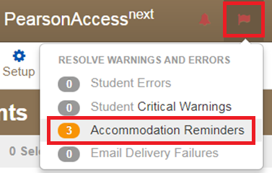
Accommodation Reminders
PAnext displays reminders for all students identified with the following accommodations:
TTS for ELA
Scribe for CRs on ELA/CSLA
Oral Script/Signer for ELA/CSLA
Calculation Devices and/or Math Charts and/or Counters
Reminders cannot be removed unless the accommodation is removed
If these reminders appear, check the students with reminders against the list(s) of students with:
CDE-approved UARs
District-approved UARs for math charts and counters

Slide 98
Form Assignment Markers in PAnext
A marker appears next to a SASID on the Students in Session screen if a form-dependent accommodation/accessibility feature was identified for the student on the Manage Student Tests screen or through an SR/PNP import
Indicator | Accommodation/Accessibility Feature
 | Text-to-Speech
 | Spanish
 | Spanish Text-to-Speech
 | Assistive Technology (Math and ELA)
TTS
SPA
SPA
TTS
AT

Slide 99
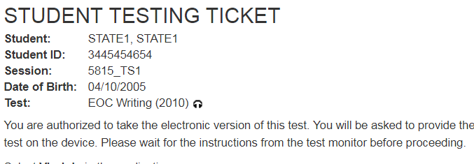
Form Assignment Markers on Testing Ticket
A marker appears next to a SASID on a student’s testing ticket if they were assigned a TTS or Oral Script form
Indicator | Accommodation/ Accessibility Feature
 | Text-to-Speech
 | Oral Script

Slide 100
Emergency Accommodation
Common Question
A student needs a new accommodation immediately due to unforeseen circumstances
Cases could include students who have a recently-fractured limb (e.g., arm, wrist, or shoulder); whose only pair of eyeglasses have broken; or a student returning from a serious or prolonged illness or injury
Permission is not needed from CDE
Complete the Emergency Accommodation Form (Appendix G) and maintain in the district
Do not send this form to CDE unless it is requested
Emergency Accommodations are identified in PAnext on the Manage Student Tests screen (through the UI or SR/PNP file upload)
Scribe
Other

Slide 101
Testing Environment

Slide 102
Student-to-Test Administrator Ratio
Student-to-Test Administrator ratio must not exceed 30 to 1
Test Administrator must be able to actively monitor the space within the physical testing environment
Consider room configuration
Make special considerations for large testing environments or environments with complicated configurations
Test Administrators must:
Actively proctor
Remain attentive and in the room during the entire testing unit
Circulate throughout the room during the test
Should be able to see students working, not student work

Slide 103
Test Environment
The testing environment must:
Be adequately lit, quiet, free of distractions, and heated or cooled
Provide an adequate writing surface (paper-based)
Be free of electronic devices and music
“Do Not Disturb/Only Authorized Personnel Allowed” sign must be placed on the door during test sessions
Note: Food and drinks are not allowed on desks or near test materials

Slide 104
Test Environment
Do not display/allow any content related posters or aids that suggest possible answers to students in the testing environment:
Word walls
Steps for solving math equations
Any resource that defines, explains, or illustrates terminology or concepts
General rule: When in doubt, cover it.
Do display unit testing time for students
Posters that do not include content specific definitions, content related processes or solutions may remain on the wall
Unit Name: | Grade 8 Science, Unit 1
Unit Testing Time: | 80 Minutes
Start Time: | 9:00
Stop Time: | 10:20

Slide 105
Room Configuration
Students should not be able to see each other’s work from a normal testing position
Consider the following seating configurations to maintain test security:
Seat students in every other seat (useful in a computer lab setup)
Arrange monitors back-to-back
Seat students back-to-back
Seat students in a semicircle (useful for schools using laptops)
Seat students in widely spaced rows or in every other row (appropriate for a classroom setup)
Dividing screens or other privacy materials may be used if students cannot be placed far enough away from each other

Slide 106
Headphones
Text-to-Speech (TTS)
Students must wear headphones if they are in a room with other students
Test students separately if they are unable to wear headphones
Note: CMAS assessments do not contain audio unless TTS is assigned

Slide 107
Unauthorized Visitors and the Media
Only students, Test Administrators/Examiners, and authorized school, district, state personnel, or state-sanctioned test monitors are allowed in testing areas during administration
Media are not allowed to have access to the tests before, during, or after test administration, or take pictures or video of testing materials or testing students
Parents are not allowed in the testing room with their child

Slide 108
Receiving Materials & Test Security

Slide 109
Test Security Protocols
Protection of student information and data
Protecting the validity of the state assessments
Financial considerations
State law: Maintain the integrity of the assessment

Slide 110
Security Plan
Successful Security Plan requirements:
All personnel have appropriate annual training
All involved personnel understand security protocols
All involved personnel have signed security agreements
Think about anyone who may be in/enter the testing environment
Test environments are secured against unauthorized personnel
Establish a documented/physical chain of custody form process
Materials are kept in a central, secure, and locked location with limited access
If materials are missing, follow up will be needed
Ensure that barcodes are identified

Slide 111
Test Materials Security
Secure
Student Testing Tickets
Paper-based test books
Social Studies source books
Periodic table (PBT HS science)
Oral scripts
Visual description documents
Used scratch paper
Any student work/responses
Math reference sheets just prior to testing
If written on, cannot be reused
Non-Secure
Test Administrator Manuals (TAM)
Procedures Manual
Unused scratch paper
Math reference sheets if not written on

Slide 112
Maintaining Security of the Assessments
All secure test materials must be secured while in the Test Administrator’s possession
No duplication of secure CMAS materials is permissible
No cell phones or other communication, reproduction, or recording devices are allowed during test sessions unless required for accessibility
Students should be aware that cell phones or other electronic devices are prohibited. Having these devices during testing (including if a student finishes testing but other students have not) or during a break may lead to the invalidation of not only that student’s test, but to the invalidation of others’ tests as well.
All individuals are strictly prohibited from taking photos or video of TestNav screens and paper test materials. Ensure all individuals in your district are aware of this critical instruction.

Slide 113
Receiving Test Materials
Initial materials are received in two waves based on the selected district start date(s)
Wave 1
Assessment Coordinator Kits
Test Administrator Manuals (used for all content areas)
Extended CBT math and ELA window – accommodated materials and corresponding student ID labels
Early high school window – student materials and corresponding student ID labels
Wave 2
Regular PBT math and ELA window – student materials and corresponding student ID labels
Elementary and middle school science and social studies window - student materials and corresponding student ID labels
Materials are packaged by school and shipped to the district
No overages are sent

Slide 114
Contents of Shipments
Labels are used to return all secure materials. DACs may want to take labels out of the school kits.
Wave 1
Assessment Coordinator Kit
Re-sealable plastic bag (holds all materials)
Paper bands
Pearson orange scorable and blue nonscorable shipping return labels
UPS return labels for scorable and nonscorable materials
Test Administrator Manuals
Waves 1 and 2 (as applicable)
Packing list and chain of custody form
Student test materials (if indicated by January 24 in PAnext)
Test books
Math reference sheets, rulers, and protractors, if applicable
Accommodated test books: large print, braille, Spanish including CSLA
Oral scripts
Student ID labels and rosters (with corresponding student materials)

Slide 115
DAC – Receipt of Test Materials
Upon Receipt of Test Materials, DACs:
Remove packing list, chain of custody form, and DAC Kit from Box 1
Inventory materials immediately to verify all were received and that there is an adequate number for administration
Official DAC may order additional material, if necessary
Keep all test materials in a centrally locked storage area with limited access until distributing to schools
Ensure chain of custody procedures are followed at all times
Deliver materials to schools no more than one week in advance of school testing window

Slide 116
SAC – Receive Materials & Chain of Custody
Receive materials from DAC no more than one week in advance of school testing window
Document any movement of secure materials before, during, and after testing
Schools inventory materials using the provided security checklist
Deliver test materials to Test Administrators only on the day of testing
Must use a chain of custody process
Distribute only the content area being assessed
As close to testing time as possible
Store materials in a designated secure location
As soon as possible after the unit is complete
Materials must not be stored in classrooms
Return secure materials to DAC after testing is completed
Includes oral scripts
Includes CoAlt test kits and task manipulatives in the CoAlt envelope

Slide 117
Chain of Custody Form
Districts may use the forms that are shipped with the materials or create their own to track all secure materials
If creating a district/school chain of custody form, for each day of testing the form must include:
Security barcode/number
Test Administrator signature
Date and time checked out
SAC (or designee) signature
Date and time returned
Chain of custody forms are kept on file for three years
If materials are missing, these will be sent to CDE

Slide 118
Documenting and Storing Test Materials
Keep all boxes in which the test materials were delivered and use them to return scorable and nonscorable materials after testing is completed
Report the following occurrences immediately to Pearson Customer Service using the Form to Report Contaminated, Damaged, or Missing Materials (Appendix E):
Non-receipt of any materials listed on the School Packing List
Discovery of damaged test material
Discovery of missing or duplicate sequence numbers on any test books

Slide 119
Steps to Order Additional Materials
Only the official DAC can submit additional orders
Quick Reference Guide to Additional Orders (Appendix H: PAnext)
PAnext Additional Orders Training Module
Note: CDE only reviews/approves AOs for materials if:
Placed no more than two weeks before the district’s selected test window (by test)
The ordered materials match a student registration in PAnext
The registration/accommodation information must be entered on the student’s PNP before placing the AO

Slide 120
Key Information to Order Additional Materials
Keep in mind when ordering additional material:
Do not submit AOs prior to receiving the initial shipment of test materials
All test materials must be inventoried prior to placing an AO
Ancillary materials for return shipping are not automatically included in the AO
Shipping labels
Extra boxes
You can edit submitted AOs that are not yet approved
Add on to submitted orders, do not create new, separate orders
Once an AO is approved, allow 4-5 business days for shipment delivery
AOs are packaged by district and shipped to the district
Notes:
Check for return labels prior to the end of the testing window as these will not have expedited shipping

Slide 121
During Testing (Administering Tests)

Slide 122
CBT Task “Prepare” Test Sessions
This step assigns forms to each student in the test session
Prior to completing this step, ensure students are assigned to the appropriate form-dependent accommodations and accessibility features (e.g., TTS)
If not indicated prior to this step, remove student from the test session, update PNP, then add back to the test session
“Prepare” sessions at least one school-day prior to starting a test session
Allows for the starting of multiple test sessions at one time
Only users with LEA or STC roles (DAC, SAC) can “prepare”
Once the session is “prepared” and the window is open, “start” the test session

Slide 123
Incorrect Form Assignment
Check form assignments before students log in
Incorrect forms must be identified before students log in to test
If errors are identified after students log in to test, the options are:
Continue with the test and suppress the score
Student receives SPR, but the scores are not aggregated
Counts against participation for the school and district
Stop the test and invalidate with Void 06
Misadministration = the student does not receive SPR
Counts against participation for the school and district

Slide 124
PAnext Online Test Session Life Cycle
Create
Session Form Group Type can be set to Oral Script if the session is not in prepared status
Prepare
Test forms are assigned when session is prepared
Start
Must be started prior to student being able to test
Can be started on the day the state window opens
Stop
Students’ PNPs can be updated if session is not in prepared status
DAC or SAC can prepare sessions (TA cannot prepare)
Students can be added to a prepared session through the UI only
Students can be added through the UI only
Stop sessions once all students complete testing
All units for all students in the session must be in “complete” or “marked complete” status to stop the session
Remove and code students with all units in “ready” status

Slide 125
PAnext “Prepare” Test Session
Checklist Prior to Preparing a Session
 | All students’ PNP attributes are correct
 | Students requiring auditory presentation of tests in languages other than English or Spanish, including sign language, are added to separate sessions and those sessions are set to Oral Script
 | Test content is proctor cached

Slide 126
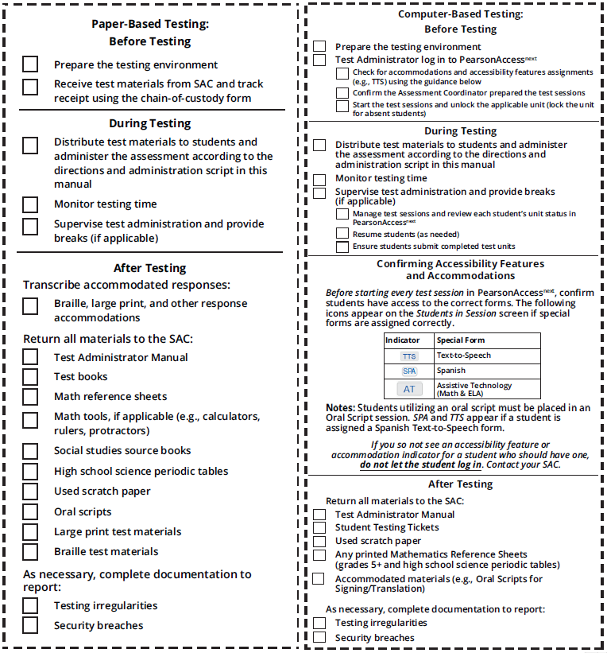
TAM Reminders
DRAFT

Slide 127
Tasks to Complete During Testing
On the Day of Testing (CBT):
Distribute test materials
Ensure TAMs have 2020 on the cover
Ensure Test Administrators have a computer or tablet available
Check form assignment
Ensure accessibility features and accommodated forms are assigned to appropriate students
Monitor test activity
Be available to Test Administrators and Proctors
Investigate security breaches and testing irregularities
Follow protocol for contaminated or damaged test materials, safety threats, and severe weather
Respond to all technology related issues
Collect materials from Test Administrators after each test unit

Slide 128
During Testing – Security Breaches and Irregularities
Monitor and Report Security Breaches and Testing Irregularities
Immediately report all instances of security breaches and testing irregularities to the SAC, and subsequently the DAC
DAC must immediately contact CDE upon receiving notification of a security breach
Testing Irregularity or Security Breach
SAC completes the Testing Irregularity or Security Breach Form (Appendix E)
SAC adds incident to the TIR spreadsheet (found in Syncplicity)
DAC submits completed form and updated spreadsheet through CDE Assessment Syncplicity in the Assessment Forms folder
Notify Sara Loerzel of posted form (loerzel_s@cde.state.co.us)

Slide 129
During Testing – Security Breaches and Irregularities
When to submit TIR form and spreadsheet to CDE via Syncplicity:
Students were grouped incorrectly – not same directions or time
Students were given an incorrect amount of time (more or less)
Students were cheating or using a unapproved electronic device
Students used an unapproved accommodation or were not provided an accommodation according to IEP, 504, or EL plan
Math, science, or social studies test read aloud to students without the oral script
Test Administrator did not follow procedures
PBT student goes past stop sign at the end of the unit
Large number of students involved in a technology related irregularity
If technology issues cause testing to not be completed on one day
Student goes back into a unit on a different day and changes answers
Test security breach – contact CDE immediately

Slide 130
During Testing – Contaminated & Damaged Materials
If necessary, replace contaminated or damaged materials
Place student ID label on replacement document or complete demographic data grid
Record security barcode number of the damaged and new documents
Submit the Form to Report Contaminated, Damaged, or Missing Materials through CMAS folder on Syncplicity
Notify Sara Loerzel of posted form (loerzel_s@cde.state.co.us)
If possible, transcribe responses from contaminated test material into the replacement
If not, contact Sara Loerzel
Destroy contaminated material according to local biohazards protocols

Slide 131
During Testing – Safety Threats and Severe Weather
Create a plan and train staff for safety threats and severe weather
Test Administrators and Proctors must:
Note the time of the disruption
Secure test materials as specified in the School Security Plan
Prepare students for the continuation of the unit and resume tests
Document the situation in writing
If the disruption caused the unit to be carried over into the next day, notify CDE

Slide 132
Test Administration Materials
2020 Test Administrator Manual (TAM)
Select district/school options for after the test session
Read SAY directions exactly as written (may clarify after)
Practice in advance
Each unit is submitted independently
Student Testing Tickets (CBT) and Test Books (PBT)
Hand out and collect in the test environment
Have a master list of students including accommodations
Like test books, Student Testing Tickets are secure
The same ticket is used for all three units

Slide 133
District Decisions – After Students Finish Unit
District Decisions:
Are students able to leave the test environment when they finish testing? (no minimum time)
Should students sit quietly?
Are students allowed to read?
Cannot use any electronic reading devices
Cannot read material related to the assessed content area
What to do when all students have completed the unit?
School Site Considerations:
Where do students go if they are released?
To whom are students released?

Slide 134
Active Administration
Active Test Administrators:
Ensure students have all necessary materials for each unit
Ensure a standardized testing environment
Read SAY directions exactly as written
Move throughout the room during testing
Re-read/clarify SAY directions to students when asked
Use proximity to keep students on task
Use “continue working” script
Test Administrations May Not:
Provide feedback
Clarify test questions
Answer content related questions
Interfere with students’ demonstration of skills
Interact with students in any way that would impact student responses
Engage in other tasks during test sessions
Read sources, passages, questions, or student responses
Help with TestNav navigation

Slide 135
Administration Steps for CBT
Prepare the test environment and situate students
Start test session (SAC must “prepare” first)
Unlock the unit through PAnext
Follow directions and read SAY script from TAM
Distribute Student Testing Tickets and scratch paper when directed
Assist students with logging into TestNav 8
Actively administer each test unit
Collect Student Testing Tickets and scratch paper
Confirm students submitted the unit
Lock the unit – each day
Stop test session in PAnext after last unit only

Slide 136
Basic Technical Troubleshooting

Slide 137
Common Error Codes
1001: “Your test has been saved. Please notify your test administrator.”
Early Warning System initial message, does not indicate the issue, another error code will follow
1009: “Unable to download test content”
Network connection issue between the testing device and Pearson servers
3005: “TestNav has detected that another application attempted to become the active window…”
Could be caused by pop-ups in the background or power saving features
TestNav exits the test and displays the following errors when a student types certain key combinations while testing – the test must be resumed before the student can sign in again:
3020: “TestNav has detected that Command+Option+Esc has been typed...”
3022: “TestNav has detected that Ctrl+Alt+Del has been typed...”
8026: “Unable to connect to the proctor caching computer. Please contact your administrator.”
Network connection issue between the testing device and the local proctor caching device

Slide 138
Common Error Codes – Next Steps
Resume the student’s test in PAnext
Have the student log in again on the same testing device
Do not move the student to another testing device unless the student safely exits the test using the “sign out” feature
If the same error occurs repeatedly, or if the same error is affecting multiple students, contact the Technology Coordinator

Slide 139
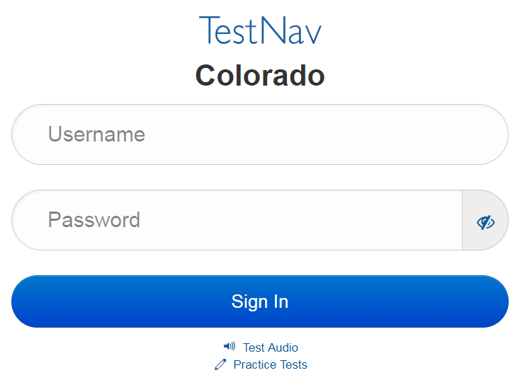
Common Errors – 9059
9059: “The username or password you entered is incorrect.”
If the username/password being used is accurate, the student may be on the incorrect login page
“Colorado”

Slide 140
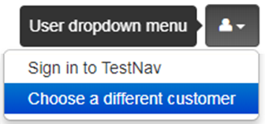
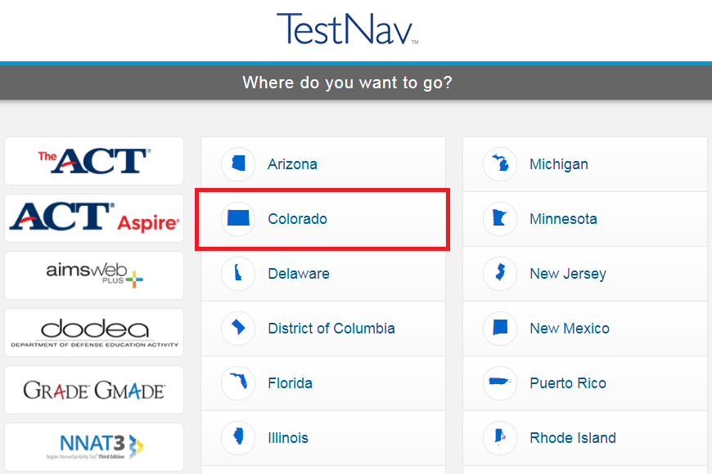
TestNav
Note: The Sign In page should say “Colorado” above the Username and Password fields. If it doesn’t, click the User Icon and select “Choose a different customer”.

Slide 141
“Early Submission” of Test
There are no confirmed cases of a student getting “kicked out” of TestNav and the test submitting itself
In all cases where a student’s test was submitted and the log files were sent to Pearson, the student followed the on-screen logout procedures and hit the submit button
CDE unsubmits tests for:
3rd graders one time only
Transcription
Other grades: If log files sent to Pearson show the student did not submit the test

Slide 142
Student Logs into Another Student’s Test
Student A logs into Student B’s test
Immediately exit the test
Do not have Student A or Student B continue/ start testing
School immediately contacts DAC
DAC immediately contacts CDE
If Student B hasn’t touched the test, CDE may be able to move the test into Student A’s name
Moves the whole test
Individual units cannot be moved
If Student B has taken one unit or more, CDE may have to void the unit taken by Student A to allow Student B to complete his or her test
Responses cannot be transferred to Student A’s test
Student A’s test may need to be invalidated as a misadministration
Not allowed to access test questions more than once
For PBT, if a student uses another student’s test book, the SAC immediately contact the DAC who contacts CDE.

Slide 143
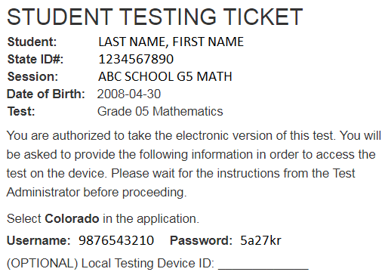
Technology Tip
Document the specific device on which each student tests for each unit
There is a space for this on the Student Testing Ticket
This aids in response recovery if it becomes necessary (SRF)
If not identified, may not be able to recover responses
If a student receives an error do not immediately move them to a new device
Sign in using the same device again, then click the User icon in the top right screen corner to “Sign out”
This sends all responses saved on the device to the testing server
Always have the student “sign out” if they are not submitting their test
Never just power-off

Slide 144
Student Response Files (SRF)
If the device cannot send a response to Pearson, it saves the response on the device and in a secondary save location (if set up by Technology Coordinator)
Test Administrator should check item progress/response receipt in PAnext
If there is a discrepancy, call Pearson
May need to manually move the SRF
Additional SRF documentation
https://support.assessment.pearson.com/display/TN/Find+SRF+and+Log+Files

Slide 145
Make-up Testing

Slide 146
Make-up Testing
Common Question
Students who are absent, become ill, or can no longer test because of classroom, school, or technical interruptions during originally scheduled units, may utilize make-up testing
This includes students who had to leave unexpectedly in the middle of a unit (e.g., parent picks up for appointment)
Students may not return to previously answered questions
Test security and administration protocols apply
SACs establish make-up testing schedules for their schools
Units may not be taken out of order for any test
Priority: Minimize risk of prior exposure to test content that could result in an invalidation

Slide 147
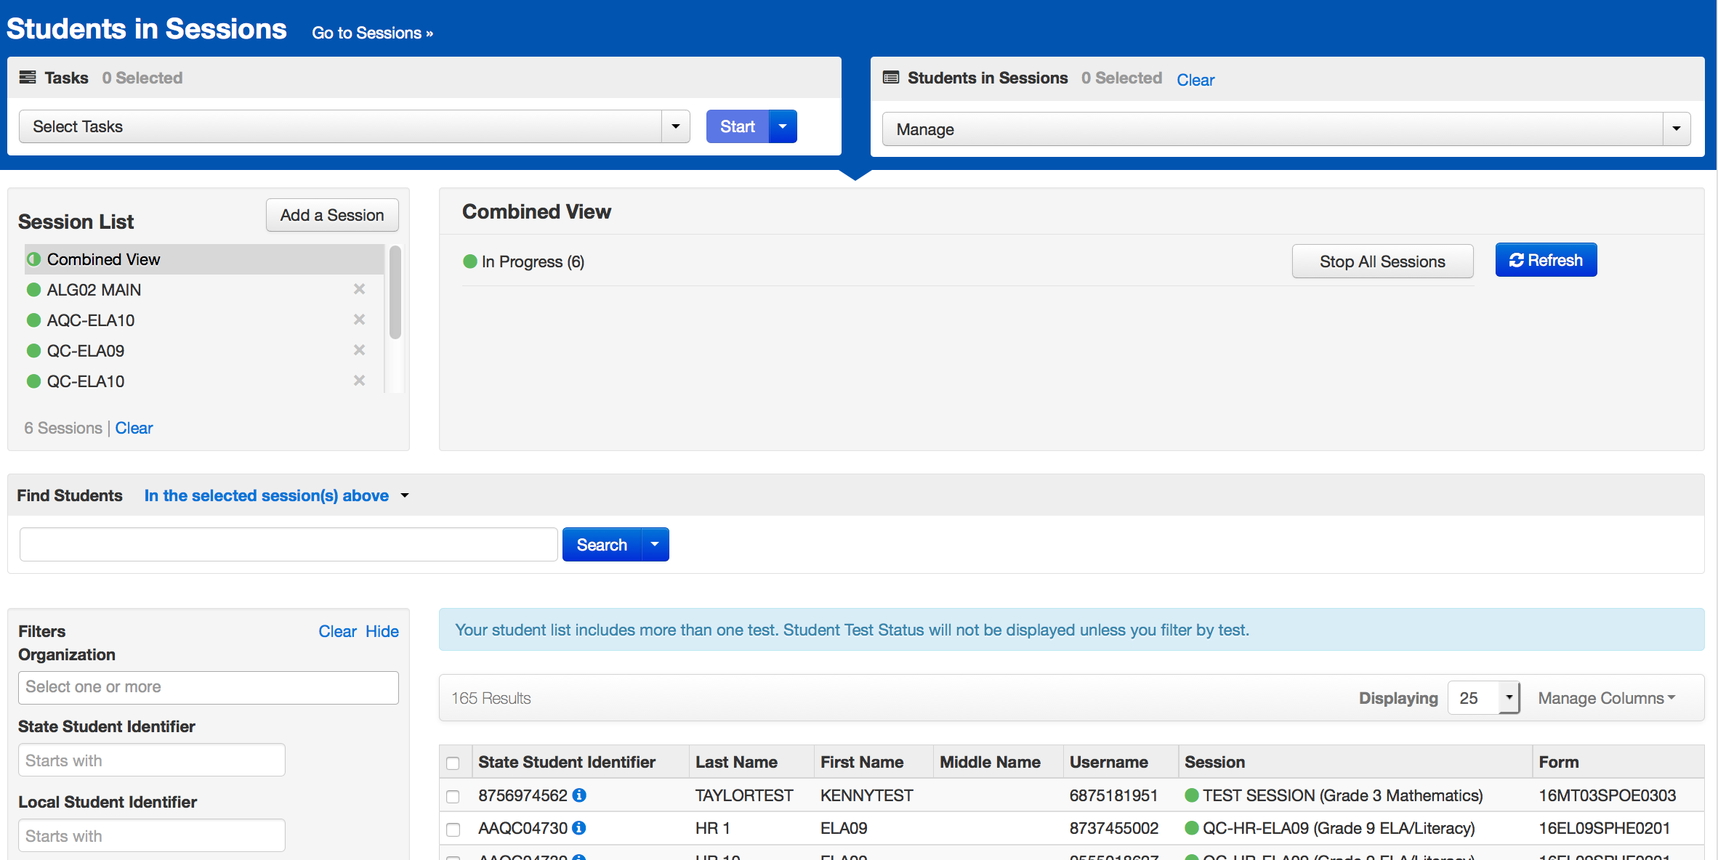
Online Test Management
PAnext users can manage multiple sessions at the same time

Slide 148
After Testing

Slide 149
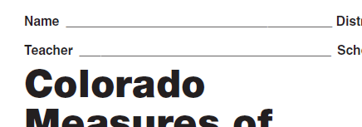
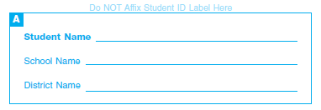
Tasks to Complete After Each Testing Session
CBT – After Testing
The day of testing:
Collect materials (Student Testing Tickets, scratch paper, etc.)
Ensure students logged out of TestNav correctly
Return materials to SAC using chain of custody form
Notify SAC of absent students and/or needed transcriptions
PBT – After Testing
The day of testing:
Collect materials (test books, scratch paper, etc.)
Ensure names are on test materials
Return materials to SAC using chain of custody form
Notify SAC of absent students and/or needed transcriptions
Front and/or back

Slide 150
Final Day – Tasks to Complete After Testing
CBT – After Testing
The final day of testing:
Collect materials (Student Testing Tickets, scratch paper, etc.)
Ensure all student test units are submitted/completed
Ensure all test sessions are stopped
Purge the cached test content
Securely destroy/recycle used scratch paper and AT printouts
PBT – After Testing
The final day of testing:
Collect materials (test books, scratch paper, etc.)
Ensure labels are affixed or demographic data grids are completed
Return scorable PBT materials to Pearson as soon as possible (by 4/29)
Securely destroy/recycle used scratch paper and AT printouts

Slide 151
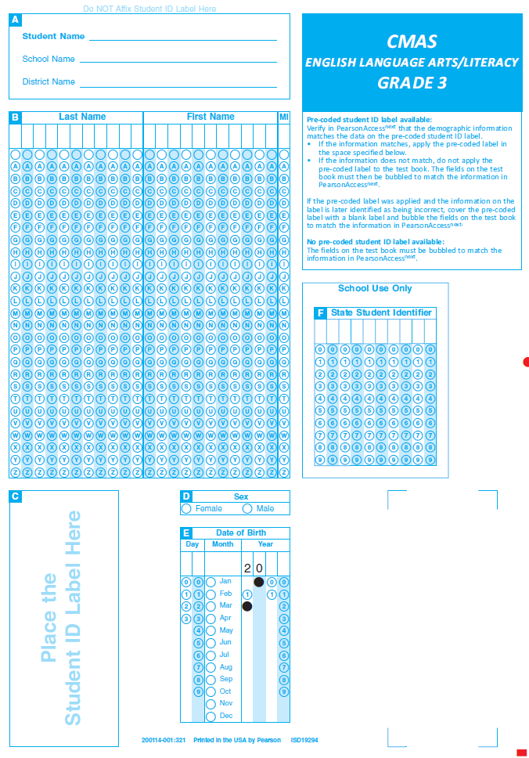
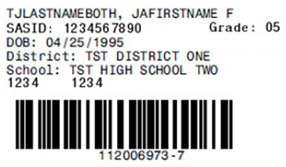
Student ID Labels
The student ID label overrides any bubbled demographic information on the test
Set aside unused student ID labels for secure destruction/recycling
May need to code these tests in PAnext (e.g., student left district, parent excuse)
If an ID label is not available, complete all fields on the demographic data grid
ID label goes here
Barcode and security number printed here

Slide 152
Demographic Data Grid
Common Question
Back of the paper test book
Complete all fields if a pre-printed ID label is unavailable
Must match data in PAnext
Incomplete or incorrect bubbling leads to rejected student tests that must be resolved by the district
There is no area to indicate invalidation coding on a test book
Indicate in PAnext
Barcode and security number printed here

Slide 153
Packing Scorables
Scorable materials
Used test books
Organized by grade and subject
Lowest grade on bottom, highest grade on top
Tests books do not need to be in alphabetical order by student name
NEW! No header sheets
Paper Band
Used Test Book Grade 8 Math
Paper Band
Used Test Book Grade 8 ELA
Paper Band
Used Test Book Grade 7 Math
Paper Band
Used Test Book Grade 7 ELA

Slide 154
Packing Nonscorables
Nonscorable materials
Organize by material type
Unused test books (e.g., absent students, parent excuse)
Used test books marked “Do Not Score” including:
Large print test books (student responses transcribed into regular print (scorable) test book included in kit)
Braille test books (student responses transcribed into regular print (scorable) test book included in kit)
Other used test books that should not go through scoring (e.g., parent excusal received after the student started testing)
Oral scripts
CoAlt science and social studies materials
Optional: used scratch paper
Order of nonscorable materials in the box does not matter

Slide 155
Packing Materials Checklist
Science, social studies, math, ELA, and CSLA materials are returned together
Confirm each scorable test book has a student ID label or hand-gridded student demographic data
Do not mix scorable and nonscorable materials in the same box
One school per box – do not combine materials from multiple schools in one box
Do not overfill boxes (pack under-filled boxes with crumpled paper)
DAC receives materials from the SAC
Confirm packing
Verify presence of all secure materials (i.e., materials with barcodes/security numbers)

Slide 156
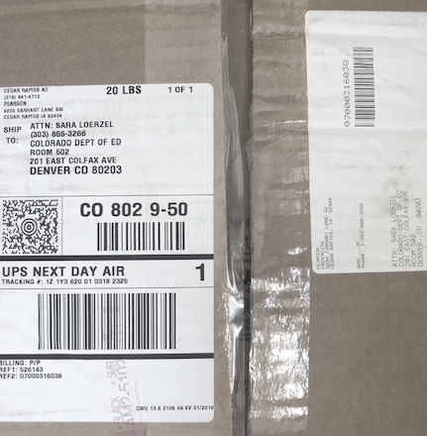
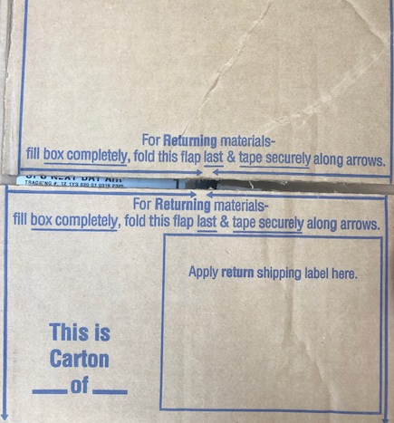
Packing Materials Checklist
Use appropriate shipping labels
One return shipping label (orange scorable or blue nonscorable) and one corresponding UPS label is placed on the top of each box
Once all materials are in boxes, indicate the sequence of boxes for each school (e.g., Box 1 of 3, Box 2 of 3, and Box 3 of 3) on each return label
Tape along arrows printed on box
Inbound to district
Outbound from district
Apply UPS label
Reverse box flaps
Apply orange/blue label

Slide 157
Arrange for Pickup
Scorable materials must be picked up by April 29, 2020*
Nonscorable materials must be picked up by May 1, 2020
Contact UPS at 800-823-7459 to schedule pickup:
Pickups must be scheduled at least 24 hours in advance
UPS customer service is available 24/7 - tell UPS you are calling about a pickup request for Pearson and will be using their “Return Service”
Once pickup is confirmed, you will get a confirmation number from UPS that can be referenced if questions or changes arise
Reminder: Verify labels are received in the initial shipment
Included in DAC and SAC kits
Additional orders for return materials are not overnighted
*If scorable materials are not picked up by April 29, 2020 there is no guarantee that records for these PBT students will be included in SBD or scored.

Slide 158
Tasks to Complete After Testing
After returning materials:
Resolve critical warning/alerts, including PBT Rejected Student Tests, in PAnext
Confirm all testing irregularities and security breaches were reported and posted on Syncplicity by May 8, 2020
Testing Irregularity or Security Breach Form and corresponding TIR spreadsheet
Complete post-testing forms, as applicable, and post on Syncplicity:
Scratch Paper Verification
Secure Data Removal Verification
Post-test Certification Form for all CMAS and CoAlt content areas
Keep records for three years

Slide 159
PBT Rejected Student Tests
Rejected student tests are paper tests that were returned for scoring but were not matched to a student registration in PAnext
Notification received through PAnext (est. mid-May)
Tests are not scored if left unresolved
Created when:
All student fields on the paper test demographic grid do not match data in PAnext
First name, last name, SASID, sex, date of birth
Organization code does not match
If student is registered for a CBT test but took the PBT version
Remove any form-dependent CBT accommodations and change the test to PBT

Slide 160
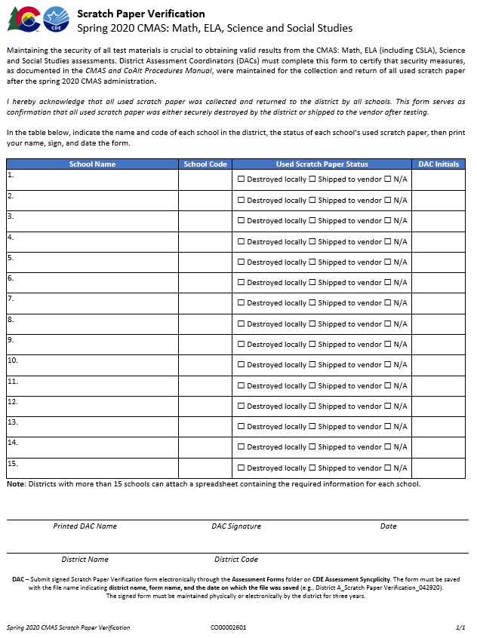
Scratch Paper Verification
Administration may require CMAS students to use scratch paper
Scratch paper is secure and must be treated as such
If used scratch paper is not returned to Pearson secure destruction/recycling is required
It is the DAC’s responsibility to ensure all used scratch paper is handled appropriately after CMAS testing
Complete the Scratch Paper Verification form (Appendix G)
NEW!

Slide 161
Secure Data Removal Verification
Administration may require temporary storage of CMAS student responses on local devices
These materials are secure and must be treated as such
Transcribe student responses saved on secondary devices into online or paper test forms for scoring
Remove all student responses from the secondary device or flash drive immediately following transcription or printing for transcription purposes
It is the DAC’s responsibility to ensure all secure electronic content is deleted in a secure manner after CMAS transcription
Secure Data Removal Verification form (Appendix G)

Slide 162
Additional Documentation - Missing Materials
If secure materials are not returned/missing after testing, CDE requires the following documentation for each item that is missing :
Signed statement by the DAC
Signed statement by the SAC
Signed statements by any other involved personnel
Chain of custody documentation
Search documentation
Copies of signed Security Agreement forms for all involved persons
Form to Report Contaminated, Damaged, or Missing Materials (Appendix E)
Training materials relating to test security may also be requested
CDE maintains records of missing materials to identify patterns across individual organizations
PBT reminder: Must commit to meeting security requirements, accounting for, and returning all secure materials

Slide 163
Remember - Secure Materials Must be Returned
Make sure all materials are accounted for and returned
Every test book and oral script has a secure barcode and is tracked by Pearson and CDE
Every secure test item must be returned
If any material is destroyed locally (e.g., due to contamination), complete Form to Report Contaminated, Damaged, or Missing Materials (Appendix E) and notify CDE
Keep track of UPS tracking numbers when returning materials to Pearson

Slide 164
CMAS Forms
Handout
Return all district level forms through CDE Assessment Division Syncplicity – Assessment Forms folder, then notify the appropriate CDE contact:
Sara Loerzel (loerzel_s@cde.state.co.us)
The following forms are found in the Procedures Manual:
Prior to testing
SAC, DTC, Sensitive Data, TA, TE Security Agreements - maintained locally
Security Agreement (DAC only)
Verification of District Training
During Testing
School Chain of Custody - maintained locally
Testing Irregularity or Security Breach
Test Incident Report spreadsheet
Contaminated, Damaged, or Missing Materials
After Testing
Post-test Compliance
Scratch Paper Verification
Secure Data Removal Verification - maintained locally
Only use spring 2020 forms with CDE logo

Slide 165
PAnext Clean-up

Slide 166
PAnext Clean-up Activities – CBT and PBT
Student demographic data in PAnext is used for reporting (i.e., individual student performance reports, school/district-level reports, data files)
Use Operational Reports to ensure data accuracy:
Reports > Operational Reports > Students & Registrations >
Not Tested Student Tests (students with a NT Code/Reason applied)
Void Score Tests (students with a Void Code/Reason applied)
Students Registered but not Assigned to a Test
Student Tests that have been Assigned but Not Yet Completed
Students where Responsible District/School is Different from Testing District/School
Students with Multiple Tests of Same Subject Area
Reports > Operational Reports > Online Testing >
Online Student Tests Marked Test Complete
For School/District records only – Mark Test Complete Reason does not invalidate
Must enter Void Code/Reason separately

Slide 167
Coding Invalidations
There are two categories of invalidation codes:
Not Tested Reasons/Codes
Void Test Score Reasons/Codes
Indicate coding in PAnext in two ways:
Student-by-student through User Interface (Sensitive Data role)
- or -
Batch loaded through Student Test Update process (STU role)
Coding is unique to each test
Does not transfer across math, ELA, science, and social studies tests
Entered for each test as appropriate
“Marked Complete” does not invalidate tests
“Mark Test Complete Reasons” are for district/school use only
They do not “flow” into scoring/reporting

Slide 168
Not Tested Students
Students who were absent or not tested (did not access any part of the test):
PBT: Return test materials in nonscorable boxes with unused materials
ACTION: Indicate the Not Tested Reason/Code in PAnext
CBT: DO NOT mark complete students who did not start testing
ACTION: Remove students from prepared/started test sessions
To find these tests:
Go to PAnext > Reports > Operational Reports > Online Testing
Select Session Roster
Request the report
Download Report
Filter Test Status column and look for tests in Testing status
Remove students from sessions if all three units are Ready
If test session is not prepared/started, do not have to remove students (on Session Roster report, Test Status = Assigned)
ACTION: Indicate the Not Tested Reason/Code in PAnext
Common Question
Not Tested Reason/Codes are in PM Appendix K: Data Section 3

Slide 169
Stop Test Sessions
By May 8, 2020, stop any test sessions that were started
Started test sessions cannot be stopped unless all units for all students are either “Completed” or “Marked Complete”

Slide 170
Combined Unit Statuses
Started sessions:
ACTION: SACs/DACs “mark complete” units for students who started, but did not complete testing
To find these tests:
Go to PAnext > Reports > Operational Reports > Online Testing
Select Session Roster
Request the report
Download Report
Filter Test Status column and look for tests in Testing
“Mark complete” tests with varying unit statuses
“Marked Complete Reasons” do not invalidate student tests
ACTION: If invalidation is needed, apply Void Reasons/Codes in PAnext
Common Question
Void Reason/Codes are in PM Appendix K: Data Section 3

Slide 171
Void Test Score and Not Tested Coding
 | Void Test Score Reason/Code | Not Tested Reason/Code
For tests that were NOT started… | Not allowed | Use Not Tested coding
For tests that were started but should NOT be scored… | Use Void coding | Do not apply as this coding type is ignored on started/completed tests
When can I apply this type of code? | CBT: Once all test units are in completed/marked complete status PBT: Once tests are scanned into PAnext* | CBT: As long as test is not in started/stopped session PBT: Any time unless scanned into PAnext*
*If a PBT test was started/completed but should not be scored, write “Do Not Score” on material, return in nonscorable box, and indicate Not Tested coding in PAnext.
Note: “Marked Complete Reasons” do not invalidate tests or flow into scoring/report. MCRs are only for internal district/school use. Enter Voids separately.

Slide 172
Coding Parent Excusals
Common Question
Districts/schools must maintain documentation of parent excusals
Never code parent excusals unless documentation was received from a parent/guardian
In order for schools and districts to have parent excusals not count against participation, apply the following coding in PAnext or during SBD:
Students who never started the test:
Not Tested Code of 09
Students who started but did not complete the test, or were “Marked Complete” by the school:
Void Test Score Code of 09
Reminder: “Marked complete” text box “reason” does not indicate parent excusal for accountability purposes.
Can a parent submit an excusal in the middle of a test?

Slide 173
Suppressions
CDE adds suppression codes and actions
Individual student performance reports (SPRs) are produced
Suppressions exclude individual student test scores from school and district aggregations
Used in the following instances:
Home school students – students with CO-DDDD-HHHH indicated as their Responsible School in PAnext
Misadministrations – students included on the district-submitted TIR spreadsheet for whom a testing irregularity was documented
Suppression Reason | Receives Student Report | Impact to Participation
Home School | Yes | Does not impact participation
Misadministration | Yes | Impacts school and district

Slide 174
Additional Information

Slide 175
Student Biographical Data – Tentative Dates
Early 2020
SBD Manual
Training
Clean-up in PAnext
Initial: Through May 8
Final: May 11 - 13 (District level only)
SBD via Data Pipeline
CMAS and CoAlt SBDs are together
May 18 - 28

Slide 176
2020 Reporting Timeline – Tentative
Common Question
Student data files expected in June
OnDemand student reports available at this time (no comparative data)
Individual student performance reports and summary data files
District- and school-level reports
All state assessment results will be embargoed and must not be publicly disseminated, distributed, or published by any means until they are publicly released by the state; however, districts and schools may:
Share confidential individual student performance reports with parents
Use aggregated and individual student level results internally for informational and planning purposes before results are publicly released
Ensure any data you release after the embargo lifts includes appropriate suppressions to meet federal and state data privacy requirements
Reminder: Colorado statute requires that LEPs ensure appropriate personnel provide and explain assessment results to the parent/guardian of each student enrolled in the district or charter school (C.R.S. §22-7-1006.3 (8)(a))

Slide 177
Reporting Information
Looking for information about reports?
http://www.cde.state.co.us/assessment/cmas-dataandresults
CMAS and CoAlt Interpretive Guide to Assessment Reports
Interpreting Assessment Results Training PPT
Publicly posted data and results
http://www.cde.state.co.us/assessment/resources
Parent’s Guide to Understand the Score Reports
How to Use the Test Results to Support Your Student

Slide 178
Accountability Questions
Participation:
District and School Overall Results
http://www.cde.state.co.us/assessment/cmas-dataandresults
All students included in participation calculations
State accountability purposes
Parent excusals removed from participation calculations
The Assessment Division does not produce growth data or performance frameworks
Contact the Accountability and Data Analysis Unit with questions about how participation is calculated, growth, performance frameworks, or where these are found:
Dan Jorgensen - jorgensen_d@cde.state.co.us
Jessica Watson - watson_j@cde.state.co.us

Slide 179
Upcoming CMAS Due Dates
December 15
UARs due to CDE Assessment for approval
Submit
Notification for use of extended/early testing windows
Notification of schools/grades/subjects that will test on paper to have CDE load student registrations as PBT for the initial load into PAnext
Transfer/Work Request contact information
Complete by January 24
All test assignments requiring physical materials in PAnext
School/grade/subject PBT selections
PBT accommodated forms
Large print
Braille, visual descriptions, tactile graphics
CSLA
Spanish math, science, and social studies
Oral scripts

Slide 180
CMAS Checklists
Manuals contain checklists in each section:
Before Testing – Section 3
During Testing – Section 4
After Testing – Section 5

Slide 181
Complete Security Agreement
Each year, each DAC must submit a signed Security Agreement to CDE
If not handed in at training, please post your signed CMAS and CoAlt Security Agreement in the Assessment Forms folder on CDE Assessment Syncplicity
Notify Sara Loerzel (loerzel_s@cde.state.co.us)

Slide 182
Student Surveys
Student surveys are not embedded in any assessment, online or paper
If student surveys are used this year, participation is determined by the district and/or school
Surveys are accessed through a link the school can provide to students

Slide 183
2020 Colorado Academic Standards
Common Question
Full implementation of the new science standards will take place in the 2021-22 school year
CMAS science assessments will cover the new standards no sooner than full implementation
Administration of the revised CMAS based on 2020 science CAS expected in 2021-22
Accountability: hold harmless – participation only
Assessment should follow instruction, not the other way around
CDE is waiting to see how the standards are implemented instructionally across Colorado before starting heavy development work on new CMAS science assessments
Refer to *DAC* email sent September 18, 2019 for additional information

Slide 184
CoAlt Assessments
Colorado Alternate (CoAlt) assessments are for students with significant cognitive disabilities
CoAlt Science and Social Studies
CoAlt ELA and Math (Dynamic Learning Maps (DLM))
Corresponding assessment to CMAS math and ELA for grades 3-8 and PSAT/SAT for grades 9-11
Same window as CMAS
DLM for grades 9-11 in same window as PSAT/SAT
Recorded trainings available through the Assessment Division Training webpage
http://www.cde.state.co.us/assessment/trainings
Annual training is required

Slide 185
Colorado PSAT and SAT
All 9th graders take PSAT 8-9
All 10th graders take PSAT 10
All 11th graders take SAT
Webinar trainings are presented by College Board

Slide 186
Test Monitoring
US DOE Peer Review Requirement
Monitoring is to take place for state assessments
DACs need to know their schools’ testing schedules
CMAS
DACs are notified prior to school visits
CoAlt Science and Social Studies
Districts are contacted in advance to schedule score monitor visits when testing will take place
Part of the validity research on CoAlt

Slide 187
Get Involved!
Educator participation is critical to Colorado's state assessment development and validation process
Educators may sign up to serve on committees related to the following state assessments:
CMAS: Science, Social Studies, Mathematics and English Language Arts/Literacy (ELA), including Colorado Spanish Language Arts (CSLA)
CoAlt: Science and Social Studies
Join the Colorado Educator Pool for assessment development committee selection
http://coassessments.com > Educator Involvement

Slide 188
Resources and Support

Slide 189
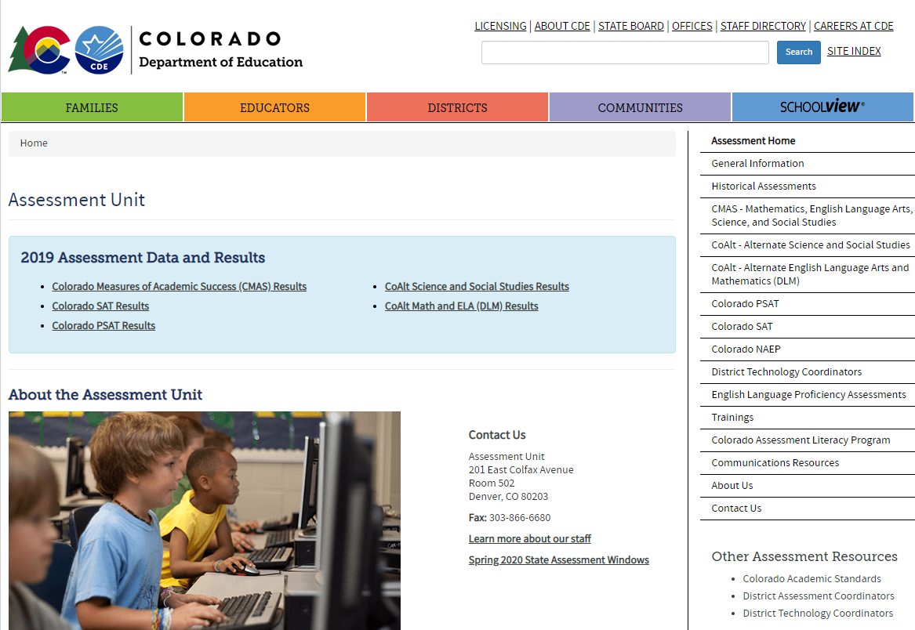
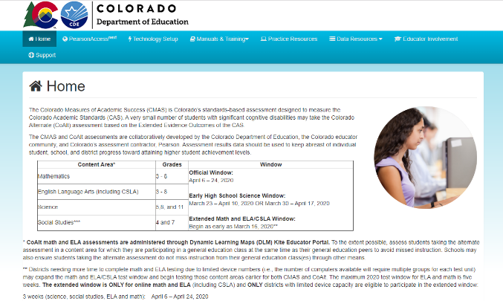
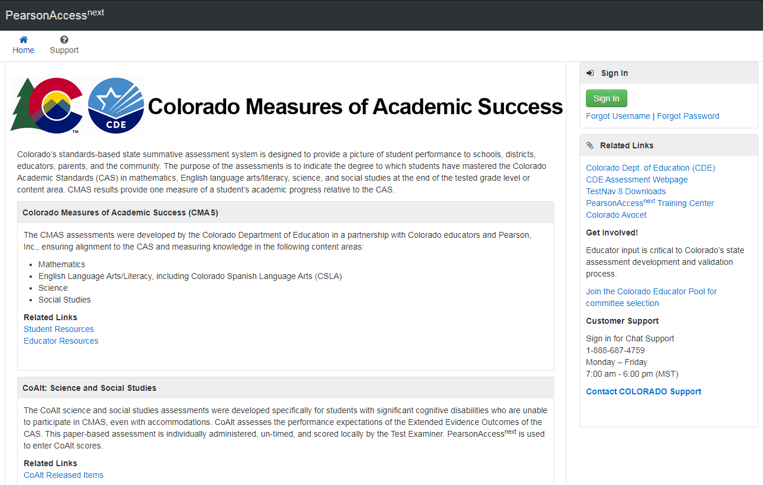
Resources - Websites
Colorado Department of Education - Assessment
http://www.cde.state.co.us/assessment
Colorado Assessments Portal
http://coassessments.com
PearsonAccess^{next}
Live Site: https://co.pearsonaccessnext.com
Training: http://trng-co.pearsonaccessnext.com/
Note: Avocet is being retired

Slide 190
Resources – Portal
Demo
PearsonAccess^{next}
Links to the live and training site
Technology Setup
Technology Guidelines
Manuals and Training
CMAS and CoAlt Procedures Manual
CMAS Test Administrator Manuals
Computer-based Testing
Paper-based Testing
Spanish SAY Directions
CoAlt Test Examiner’s Manual
Training Videos
Additional Documentation
Practice Resources
TestNav 8 Tutorial
Computer-based Testing CPR
Paper-based Testing CPR
Scoring Guides and Rubrics
Data Resources
File Layouts
Reporting Resources
Interpretive Guide
Spanish Report Shells and PLDs
Educator Involvement
Register for educator committee development meetings
Historical information

Slide 191
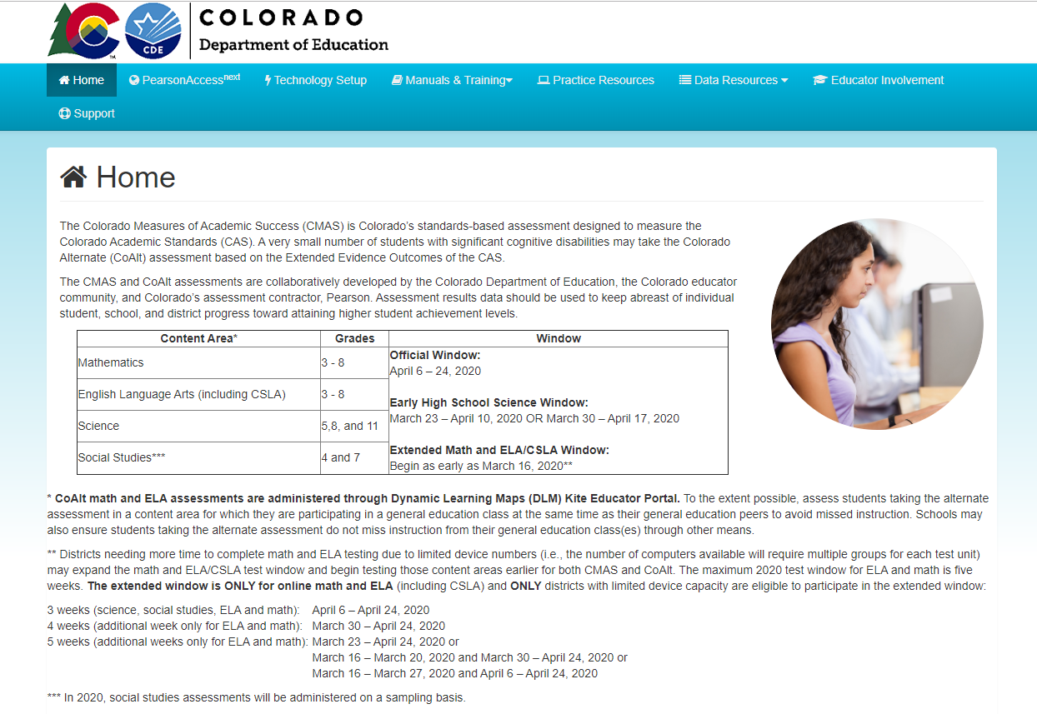
Resources – Portal
Demo
http://coassessments.com
DRAFT

Slide 192
Resources – PAnext Training Modules
The following modules are suggested for use by districts:
Welcome to PearsonAccess^{next}
User Accounts
Student Registration/Personal Needs Profile
Materials Management for DACs and SACs
Assessment Coordinator Session Management
Test Administrator Session Management
Additional Orders
Not Tested and Void Test Score Codes
Rejected Student Tests (PBT only)
Expected to be available beginning mid-January (rolling release)

Slide 193
Customer Support
Contact Support for assistance with:
Navigating PearsonAccess^{next}
Navigating the Training Center
Managing student registration data
Setting up test sessions
Managing user IDs and passwords
Accessing resources
Setting up proctor caching
Submitting additional orders
Inquiring about shipments
CMAS Support
Call Toll Free: 1-888-687-4759
Monday – Friday
7:00 am - 6:00 pm (MST)
https://co.pearsonaccessnext.com > Contact COLORADO Support
Chat is available

Slide 194
Resources
CMAS Administration Call-in Office Hours
Thursdays from 3-4
https://enetlearning.adobeconnect.com/assmtofficehrs/
866-783-5479
Office hours dates:
November 7
December 12
January 9 and 23
February 13 and 27
Weekly beginning March 12
Topics include
PearsonAccess^{next}
Policies and procedures
Updates
Packaging materials for return
Invalidation coding
*DAC* Emails
Assessment Division updates and information emailed to DACs, as needed (typically weekly in the spring)
Some districts set up auto-forwarding rule based on *DAC* in subject line
Office hours are not recorded. Any “new” information discussed during office hours is included in *DAC* emails. If you have a question and cannot attend, email or call CDE.

Slide 195
CDE Assessment Division Contacts
Questions | Contact | 303-866- | Email
CMAS & PAnext | Sara Loerzel | 3266 | loerzel_s@cde.state.co.us
CoAlt & Accommodations for Students with Disabilities | TBD
ACCESS & Accommodations for English Learners | Heather Villalobos Pavia | 6118 | villalobospavia_h@cde.state.co.us
Technology & PAnext | Collin Bonner | 6752 | bonner_b@cde.state.co.us
CO PSAT & SAT | Jared Anthony | 6932 | anthony_j@cde.state.co.us
NAEP & International Assessments Coordinator | Collin Bonner | 6752 | bonner_c@cde.state.co.us

Slide 196
CDE Assessment Division Data Contacts
Staff | Contact | 303-866- | Email
Jasmine Carey (Psychometrician) | Psychometrics | 6634 | carey_j@cde.state.co.us
Pam Amato | Data Support | 6281 | amato_p@cde.state.co.us
Shangte Shen | Data Support | 6877 | shen_s@cde.state.co.us

Slide 197
Thank you!

