Slide 1
ATTENTION
Please review slides before local use.
Update information in red font with local assessment administration policies.

Slide 2

Spring 2026 CMAS
Test Administrator Training
Science, Social Studies, Math, and ELA

Slide 3
Welcome
Information presented in this training is current as of January 2026
These plans are subject to change
Any changes will be communicated to Superintendents and DACs as soon as possible
Use the PearsonAccess^{next} Training Site to practice different functions within the assessment data management system
Log in to confirm access
  http://trng-co.pearsonaccessnext.com
If your account credentials do not work or you need assistance, notify the School Assessment Coordinator (SAC)

Slide 4
Topics
CMAS Administration Overview
Testing Schedule
Administration Policies
Test Security
Accessibility Features and Accommodations Overview
Student and Test Administrator Materials
Testing Environment
PearsonAccess^{next}
Before Testing
During Testing
After Testing
Reporting, Resources, and Support

Slide 5
CMAS Administration Overview

Slide 6
What is CMAS?
* Social studies assessments only administered at schools identified in the spring 2026 social studies sample. LEAs/districts received notice of participating schools in September 2025.
Colorado Measures of Academic Success (CMAS)
  Colorado’s standards-based assessments designed to measure the Colorado Academic Standards (CAS)
    English language arts (ELA)
    Mathematics
    Science
    Social studies*
Purposes
  Indicate the degree to which students have mastered the expectations of the CAS in each content area at the end of the tested grade level
    Results provide one measure of a student’s academic progress relative to the CAS
  Districts and schools may use aggregated scores to monitor their programs’ effectiveness
CMAS Administrations
  Science and social studies: 2013-14 was the first administration year
  Math and ELA: 2014-15 was the first administration year

Slide 7
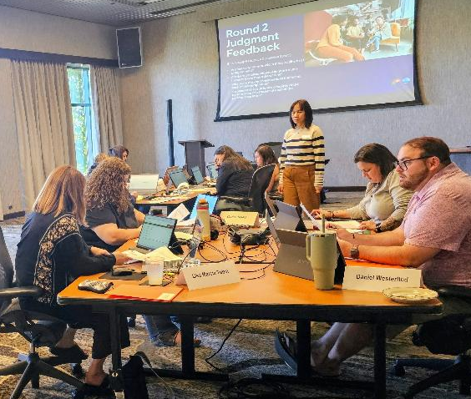
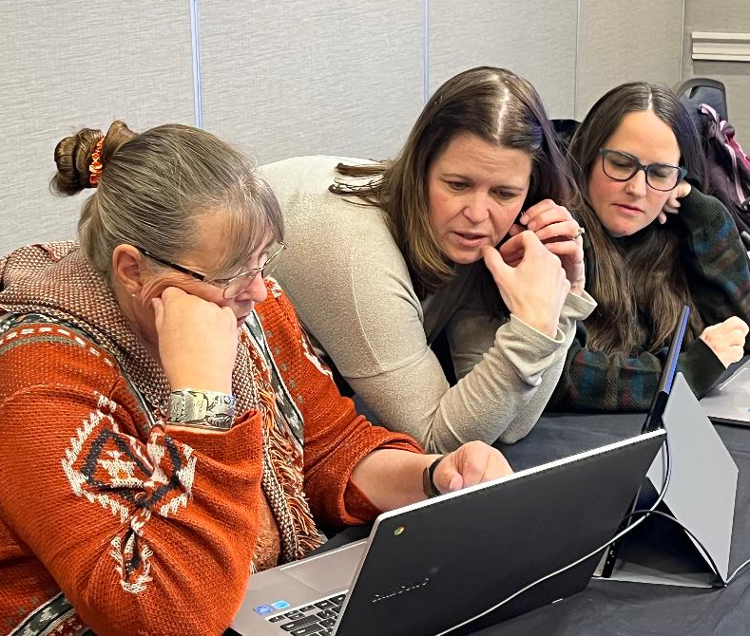


Do you know about educator involvement?
CMAS assessments are developed by Colorado educators
Colorado educators:
  Write questions that appear on the CMAS tests
  Review every question, passage, and simulation to ensure
    Alignment to the CAS
    Freedom from bias and sensitivity issues
  Review student responses to determine how test questions are scored
  Review student performance data associated with questions
Sign up to receive invites to meetings!
https://coassessments.com/educatordatabase
300 Colorado educators participated in 2025 alone!

Slide 8
Districts with Recent CMAS Development/Review Participation
Academy 20 | Custer County SD C-1 | Garfield RE-2 | Monte Vista C-8 | School District 27J
Adams 12 Schools | Delta County 50(J) | Gilpin County RE-1 | Montrose County RE-1J | St Vrain Valley RE 1J
Adams County 14 | Denver County 1 | Harrison 2 | Otis R-3 | Steamboat Springs RE-2
Adams-Arapahoe 28J | District 49 | Hinsdale County RE-1 | Peyton 23 JT | Summit RE-1
Aguilar RE-6 | Dolores RE-4A | Holly RE-3 | Plateau Valley 50 | Thompson R2-J
Archuleta County 50 JT | Douglas County RE-1 | Jefferson County R-1 | Platte Valley RE-7 | Weld County 4 (Windsor)
Arriba-Flagler C-20 | Durango 9-R | Julesburg RE-1 | Poudre R-1 | Weld County 6 (Greeley)
Boulder Valley RE 2 | Eagle County RE-50J | Lamar RE-2 | Pritchett RE-3 | Weld County RE-1
Branson RE-82 | East Otero R-1 | Lewis-Palmer 38 | Pueblo City 60 | Weld County RE-3(J)
Centennial R-1 | Ed reEnvisioned BOCES | Littleton 6 | Pueblo County 70 | Weld RE-5J
Charter School Institute | Ellicott 22 | Manitou Springs 14 | Ridgway R-2 | Westminster Schools
Cherry Creek 5 | Estes Park R-3 | Mapleton 1 | Roaring Fork RE-1 | Widefield 3
Cheyenne Mountain 12 | Fountain 8 | Mesa County Valley 51 | Salida R-32-J | Wiley RE-13 JT
Colorado Springs 11 | Fremont RE-2 | Moffat County RE-1 | Sangre De Cristo RE-22J | Yuma 1

Slide 9

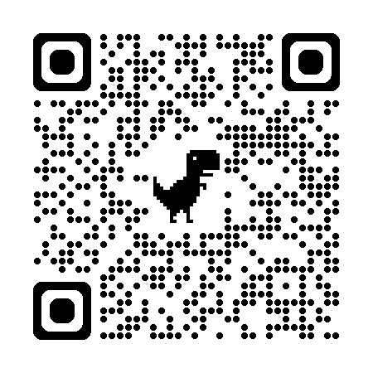
Do you know practice resources are available?
Hover over video box then click play in bar that appears at the bottom.
Practice resources that include released items are available publicly on the Colorado Assessments Portal
TestNav Tutorials – for students new to online testing, use tutorials to become familiar with navigation, using online tools and supports, and working with different types of online test questions
Sample/released items (practice forms)
  Online and accommodated paper
  English and Spanish
    With and without text-to-speech for online
Scoring guides with answer keys, performance data, scoring rubrics, and sample student responses
  ELA/CSLA include student writing samples with scoring annotations at varying score points at the end of each guide
Note: The Portal display has been refreshed since creation of this video, but the same resources remain available.

Slide 10
CMAS Test Design – available resources
Frameworks and high-level blueprints
  Include assessed standards and evidence statements
  Content representation, as seen on the blueprints, is determined by the breadth of the Colorado Academic Standards (CAS)
    Educators were involved in the development of the CAS
Performance Level Descriptors (PLDs)
  Provide details about the specific grade-level content area concepts and skills typically demonstrated by students within a CMAS performance level
  The met and exceeded expectations levels are considered on track to being college and career ready
  Educators were involved in the development of PLDs
Performance levels and cut scores
  Determined by educators through the standard setting process
  These do not change from year to year

Slide 11
Annual Training Requirement
Refer to the State Assessment Training Requirements
Training Requirement
Throughout the training, click this icon to view resources relevant to the info on a slide.
Everyone involved in CMAS math, ELA/CSLA, science, and social studies administration must complete training each year
Includes DACs, SACs, Test Administrators (TAs), technology personnel, and any other school or district staff involved in administration
DACs and SACs are responsible for ensuring all individuals involved in test administration and/or handling secure materials receive training and sign the CMAS and CoAlt Security Agreement

Slide 12
Assessment Acronyms*
*See Assessment Acronyms resource for additional acronyms and definitions
Acronyms Guide
CBT – Computer-Based Testing
CDE – Colorado Department of Education - Assessment Unit
CMAS – Colorado Measures of Academic Success
CoAlt – Colorado Alternate Assessment
CSLA – Colorado Spanish Language Arts
DAC – District Assessment Coordinator
ELA – English Language Arts
ML – Multilingual Learner
PBT – Paper-Based Testing
SAC – School Assessment Coordinator
TA – Test Administrator
TAM – Test Administrator Manual
TTS – Text-to-Speech
UAR – Unique Accommodation Request

Slide 13

Test Administrator Manuals (TAMs)
Test Administrators use TAMs for detailed instructions and general administration scripts to prepare for testing and administer tests in a standardized manner.
  Printed copies received in initial shipment from Pearson (March 24)
  Include SAY instructions in English and Spanish
  SAY instructions for accommodated paper CMAS tests are included in test book kits (do not use online SAY instructions in TAM)
Information in this presentation is found in the Spring 2026 CMAS Test Administrator Manual.
  Security measures, administration policies, and procedures identified in the TAM must be maintained
  Refer to checklists in TAM for before, during, and after testing tasks
Available online! https://www.cde.state.co.us/assessment/cmas_tam

Slide 14




Spring 2026 CMAS Window
April 6 through 24, 2026
Science
Grades 5, 8 and 11
Math
Grades 3 through 8
ELA
CSLA: ELA accommodation for eligible multilingual learners in grades 3 and 4
Social Studies
Grades 4 and 7
Grades 3 through 8
Administered only at selected schools

Slide 15
Testing Schedule

Slide 16
District/School CMAS Window
Insert district testing window information
All testing in all districts must end on or before April 24, 2026
Returning materials
  All materials (i.e., used/unused test books, auditory/signed presentation scripts, visual description documents, braille test kits, CoAlt test books/manipulatives, etc.) must be shipped back to Pearson with pick up by May 1, 2026
  Districts need to create an internal return schedule to meet materials return deadlines

Slide 17
Administration Time Allotments
*Testing time depends on grade level — refer to Unit Testing Times and Testing Multiple Groups resource
**Because of the “pause” feature available to any student, allow for an additional 3 minutes for each unit in the event students utilize the feature
Unit Testing Times
Task | Time to Allot for an Administration
Prepare for testing (includes reading SAY instructions script from TAM and answering student questions) | 10 minutes (recommended)
Distribute test materials | 5 minutes (recommended)
ELA/CSLA unit testing time** Math unit testing time** Science unit testing time** Social Studies unit testing time** | 90 minutes 65 minutes 50 to 65 minutes* 65 minutes
Complete end-of-unit activities, including closing units and collecting test materials | 5 to 15 minutes (recommended)

Slide 18
Guidelines for Administration Time
*If a student’s test requires transcription, they must not submit their answers. See TAM, page 24 for instructions.
Schedule the entire amount of unit testing time
Once the unit testing time is met, the unit must end
  A student is only allowed an extended time accommodation if listed in their IEP, 504, or ML plan
  Students will see a “Time Expired” pop-up with a button prompting to “Submit Final Answers” *
If all students complete testing before the unit testing time is met, the Test Administrator may end the unit (no minimum testing time)
  Test Administrators may not encourage students to finish any unit early

Slide 19
Unit Testing Times: ELA and Math - Grades 3 through 8
Unit Testing Times
Grades | Unit | Testing Time (minutes)
 | 1 | 90
ELA 3 through 8 CSLA 3 and 4 | 2 | 90
 | 3 | 90
 | 1 | 65
Math 3 through 8 | 2 | 65
 | 3 | 65

Slide 20
Unit Testing Times: Science – Grades 5, 8 and 11
Unit Testing Times
Grades | Unit | Testing Time (minutes)
 | 1 | 65
Science Grades 5 and 8 | 2 | 65
 | 3 | 65
 | 1 | 50
Science Grade 11 | 2 | 50

Slide 21
Unit Testing Times: Social Studies – Grades 4 and 7 (selected schools only)
Unit Testing Times
Grade | Unit | Testing Time (minutes)
Social Studies Grades 4 and 7 (selected schools only) | 1 | 65

Slide 22
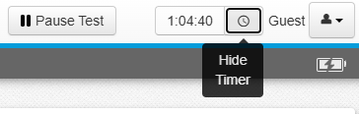
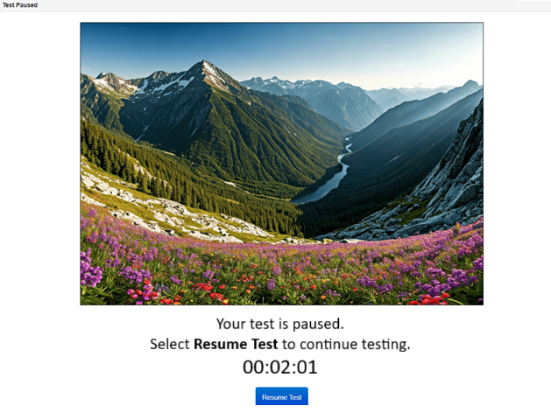
Unit Testing Times – Calculated in PearsonAccess^{next}
**New in Spring 2026: Test timing is built-in to online forms. Test Administrators are no longer responsible for timing!
**New in Spring 2026: Students can pause the test using a pause button. Pause button may be used more than once, but only for a total of 3 minutes.* After 3 minutes, the pause button is disabled and the test returns to the last item being worked on. See TAM, page 12. See TAM, page 23 for SAY instructions regarding use of 3-minute pause feature.
If all students in a physical testing group complete the test unit before the maximum unit testing time is reached, the Test Administrator may end the test unit.
*For accommodated paper testing, students may request to pause testing time for up to 3 minutes. Test Administrator tracks the 3-minute pause and adjusts the end time accordingly.

Slide 23
Administration Policies

Slide 24
Active Administration
Active Test Administrators:
Ensure students have all necessary materials for each unit
Ensure a standardized testing environment
Read SAY instructions exactly as written
Move throughout the room during testing
Re-read/clarify SAY instructions when asked by students
Use proximity to keep students on task
Use “continue working” script

Slide 25

Prohibited Activities
Test Administrators May Not:
Provide feedback or coach students
Clarify test questions
Answer content related questions
Interfere with students’ demonstration of skills
Interact with students in any way that would impact student responses
Engage in other tasks during test sessions
Leave test materials unsecured
Read sources, passages, questions, or student responses to self or students* before, during or after testing
View,* score (formally or informally), or comment on student responses
Allow students to communicate with each other in any way, or use prohibited materials
Discuss or disclose test content through verbal exchange, email, social media, or any form of communication
Download any part of the assessments*
*Except as part of specific accommodations

Slide 26
Guidelines for Breaks
Scheduled breaks may occur between units
Students may not have access to cell phones during scheduled breaks
During each unit, students have access to a “pause” feature which allows them up to 3 minutes of time
  Pause feature stops testing time for the unit, but only for up to 3 minutes
  The 3 minutes need not be used consecutively (e.g., a student may pause their test twice, once for 1 minute and again for 2 minutes)
  For accommodated paper testing, the test administrator tracks student break time, up to a total of 3 minutes
Restroom breaks during testing do not stop the clock unless the pause feature is utilized
Example: Grade 11 Science
Activity | Time
Unit 1 | 8:00 a.m. to 8:50 a.m.
Scheduled Break | 8:50 a.m. to 9:05 a.m.
Unit 2 | 9:05 a.m. to 9:55 a.m.

Slide 27
Make-up Testing
Students who are absent, become ill, or can no longer test because of classroom, school, or technical interruptions during originally scheduled units may utilize make-up testing
  This includes students who had to leave unexpectedly in the middle of a unit (e.g., parent picks up for appointment)
  Students may not return to previously answered questions
Test security and administration protocols apply
Units may not be taken out of order for any test
  Administering units out of order is a misadministration

Slide 28
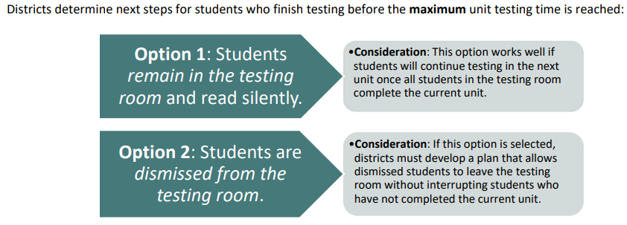
Guidelines for Administration – After A Unit
After students finish each unit, individual students are to…
  District selects one option for Test Administrators to follow
When releasing students after a unit, consider:
  Where will they go?
  To whom will students be released?

Slide 29
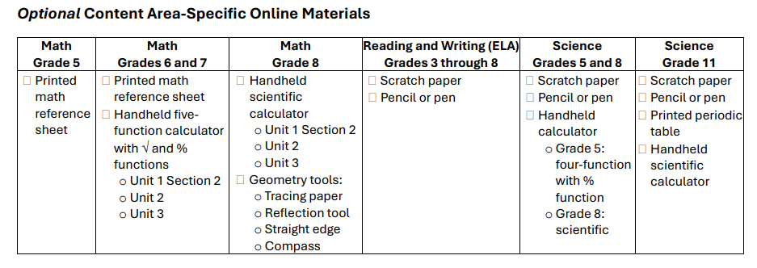
Guidelines for Administration - Materials
Required online materials:
Testing device
Student testing ticket
Headphones (only for math, science or social studies if using text-to-speech)
Scratch paper and pencil/pen (required for math; insert district policy for other content areas)

Slide 30
Safety Threats and Severe Weather
Know the plan for safety threats and severe weather
  Note the time of the disruption and time remaining in the unit
  Secure test materials as specified in the School Security Plan
  When testing can continue, prepare students for the continuation of the unit and resume tests
  Document the situation in writing
    Report the testing irregularity or security breach to the SAC

Slide 31
Test Security

Slide 32
Importance of Assessment Security
The security of the assessments is essential for the following reasons:
Protecting student information and data
Protecting the validity of the state assessments
Financial considerations (replacement of compromised test content and materials)
It is in state law that the integrity of the assessments must be maintained – this is done through security measures detailed in this training
Reporting Testing Irregularities and Security Breaches:
All instances of testing irregularities and security breaches must be immediately reported to the SAC, and subsequently, the DAC
Should a testing irregularity or security breach occur, be prepared to provide a written statement of the incident to the SAC

Slide 33
Chain of Custody Form
Document any movement of secure materials before, during, and after testing
Sign/complete the chain-of-custody form when checking materials out/in
Receive materials (e.g., student testing tickets, scratch paper, auditory/signed presentation scripts) from SAC only on the day of testing
Receive only the content area and grade level being assessed at that time
At the end of the testing session, return all materials to the designated secure location
Materials must not be stored in classrooms

Slide 34
Maintaining Security of the Assessments
All individuals are strictly prohibited from taking photos of online test screens, paper test materials, and all other secure material.
All secure test materials must be secured while in the Test Administrator’s possession
No duplication of secure CMAS materials is permissible
No cell phones or other communication, reproduction, or recording devices are allowed during test sessions unless required for accessibility
  Students should be aware that cell phones or other electronic devices are prohibited (e.g., smart watches, smart glasses). Having these devices during testing (including if a student finishes testing but other students have not) or during a break may lead to the invalidation of not only that student’s test, but to the invalidation of others’ tests as well.

Slide 35
Test Materials Security
Secure
Student testing tickets
Rosters printed from PAnext with student information
Auditory/signed presentation scripts
Visual description documents
Used scratch paper
Any student work/responses (e.g., printed from AT device)
Printed math reference sheets and grade 11 science periodic tables just prior to testing
  If written on, cannot be reused
Non-Secure
Test Administrator Manuals (TAMs)
Procedures Manual
Unused scratch paper
Math reference sheets and grade 11 science periodic tables if not written on
Copies of the following materials can be printed:
Math reference sheets
Periodic tables

Slide 36
Accessibility Features and Accommodations Overview

Slide 37
Accommodations Pyramid
For Unique Accommodation Requests, students must have an active IEP or 504 and receive CDE approval
UARs
Students must have an active IEP/504/MLP
Accommodations
May include students with active IEP/504/MLP (but not required)
Accessibility Features
Administrative Considerations
All Students
Refer to
Procedures Manual Section 6.0

Slide 38
Administrative Considerations
Changes to the conditions of testing are available to any student who may benefit:
Adaptive and specialized equipment or furniture
Frequent breaks (do not stop the clock)
Noise buffers/headphones
Small group testing
Specified, separate, or alternate area or seating
Time of day
Administrative considerations are available as long as test security is not compromised and testing environment requirements are met.

Slide 39
Accessibility Features
While accessibility features are available to any student, they may not be appropriate for all students. Students should use similar access strategies during instruction.
Accessibility features are available to all students to increase access to the assessments
The following accessibility features must be identified in the SR/PNP in advance by an assessment coordinator or sensitive data personnel, otherwise they will not be available to a student during testing:
  Auditory Presentation: Text-To-Speech for Math, Science, and Social Studies
  Enlarged Pointer
The following accessibility features can be identified in the SR/PNP in advance, but a student can still access them during testing if they are not:
  Color Contrast
  Zoom Percentage
Note: Embedded operating system accessibility features are not allowed

Slide 40
Accommodations
Assessment accommodations are changes made to assessment procedures that provide a student with access to comprehensible information and an equal opportunity to demonstrate knowledge and skills without affecting the reliability or validity of the assessment
  Available to students who have IEP, 504, or Multilingual Learner (ML) plans, based on the plan’s documented need for the accommodation(s)
Accommodations should not provide an unfair advantage to any student
Providing an accommodation for the sole purpose of increasing test scores is not ethical

Slide 41
Unique Accommodation Requests (UARs)
A very limited number of students who meet specific criteria may qualify for unique accommodations
  These accommodations might impact the construct measured by the assessment; additional documentation is required
  CDE Assessment approval is required for use of unique accommodations
    There must be a direct connection between the student’s disability and the ability to access the assessment, which is used to determine qualification for use of a unique accommodation
An approved UAR is required for:
  Calculation device on non-calculator portions of math
  Scribe on constructed response questions of ELA/CSLA
  Any accommodation not listed in the Procedures Manual
If approved:
  And used during the assessment, the student receives a valid score
If not approved:
  And used during the assessment, the results are not considered valid
    The score is invalidated as a misadministration or suppressed
    This counts against participation
Reminder: Number lines are not allowed

Slide 42
Reminders
ELA/CSLA A/S Presentation FAQs
Auditory/signed presentation
of the ELA or CSLA assessment
(i.e., text-to-speech, oral script,
signed presentation) is a modification
The 2020 Colorado Academic Standards (CAS) expect students to read (decode a printed or tactile code) and comprehend (make meaning of) literary and informational texts independently and proficiently. In accordance with the full implementation of the 2020 Reading, Writing, and Communicating CAS, CMAS mirrors the standards’ expectation that students combine their phonemic awareness, phonics, vocabulary, and text comprehension reading skills to demonstrate mastery of the 2020 CAS independent reading expectations.
Providing an auditory or signed presentation of printed or brailled text changes the ELA’s assessment’s focus from reading and comprehension of text to listening and comprehension of text. As such, both presentations are considered modifications.
Any modification of the assessment fundamentally changes the assessment’s intended measure and, therefore, is a misadministration resulting in an invalid score

Slide 43
Accessibility Features and Accommodations Training
Accommodations Training Resources
Administering assessments to students requiring the use of certain accessibility features and accommodations requires training each school year.
Presentation
  Alternate format (i.e., standard print, large print, braille)
  Auditory/signed presentation: script
Response
  Spoken response: scribe and speech-to-text
  Accommodations requiring transcription (including translation)
Timing
  Extended Time
  Stop-the-Clock Breaks

Slide 44
Transcription Guidelines
Transcription Guidelines
Transcription Steps
Student:
  Respond to questions on their assistive device
    Student may respond to selected response items in TestNav or their accommodated paper test
    Device with saved responses is secure until student responses are removed
  If testing online, Exit but do not submit the unit
    Test Administrators must transcribe student responses into TestNav between units
Transcriber:
  If the student is testing online, Resume the student’s test in PAnext
  Log in to TestNav as the student and transcribe the responses verbatim
  Submit responses for the transcribed unit
  After transcription, SAC shreds any responses printed from an assistive technology device
    Complete the Secure Data Removal form (Procedures Manual page 130)
  Student:
  Continue with the next unit if testing online or if testing on paper and transcription is
  completed between units
Must be completed by April 24, 2026 (close of testing window)
Requires presence of at least two individuals during transcription of student responses
One person to transcribe
One person to verify the transcription
Note for CBT: Because units cannot be administered out of order, transcription must take place before the student can take the next unit

Slide 45
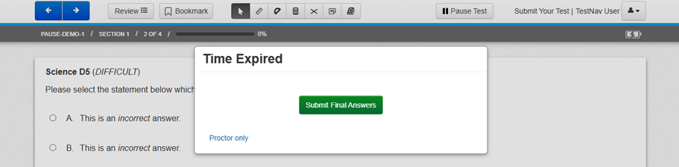
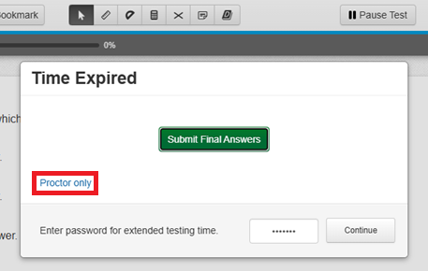
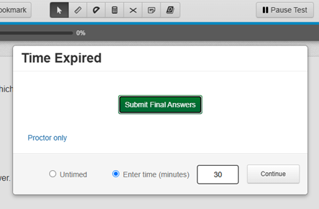
Transcription – Time Expired
If transcription is required and the testing time expires before transcription is completed, the following message is displayed in TestNav:
Select Proctor only, enter the password provided by the SAC, then click Continue.
Select either Untimed or Enter time (minutes) with the amount, then click Continue.

Slide 46
Extended Time Accommodations
Adjustments to the unit testing time may only be made for students with a documented need for the accommodation in their IEP, 504, or ML plans
Administer extended time accommodations in a separate room from standard unit testing time administrations
Extended time is not included in unit time for any content area
**New in Spring 2026: Because a timer is now built-in to CMAS tests, an assessment coordinator or sensitive data personnel must assign extended time in advance of testing

Slide 47
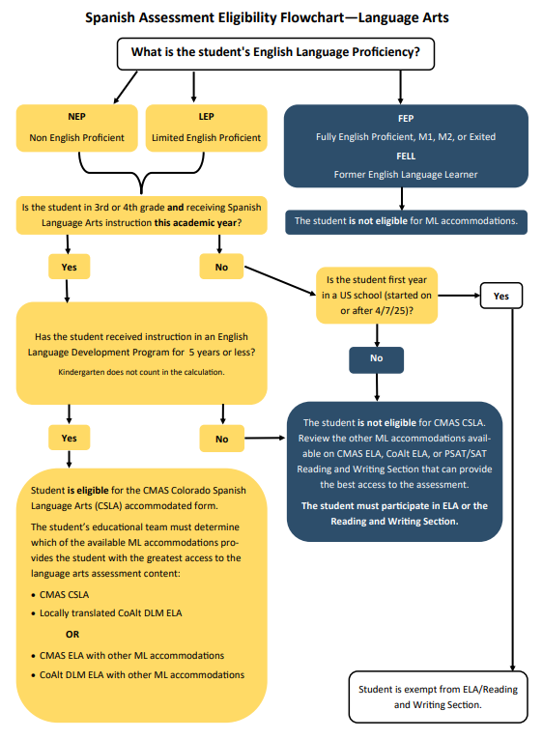
Colorado Spanish Language Arts (CSLA)
Qualifying students may need to take math and/or social studies assessments in Spanish (other ML accommodations are also available). Refer to Math/Science/Social Studies Spanish Assessments Flowchart
LA Spanish Assessments Flowchart
CSLA is an accommodated version of ELA
  Follows the design, guidelines, and scheduling of ELA
  Administered in place of ELA
  Because CSLA is a ML accommodation, other ML accommodations are not allowed on CSLA
Qualifying students
  Multilingual Learners (NEP, LEP)
  Grades 3 and 4
  Language arts instruction in Spanish this academic year
  Students in an English language development program for less than 5 years
Qualifying students may need to take math and/or social studies assessments in Spanish (other ML accommodations are available)

Slide 48
Emergency Accommodations
Emergency Accommodation Information
A case in which a student needs a new accommodation immediately due to unforeseen circumstances
  Cases could include students who have a recently-fractured limb (e.g., arm, wrist, or shoulder), whose only pair of eyeglasses have broken, a student returning from a serious or prolonged illness or injury, etc.
Contact the SAC to complete the Emergency Accommodation Form (CMAS Procedures Manual, Appendix G) so steps can be taken to provide the accommodation

Slide 49
Technology for Medical Monitoring
Students who use a phone, tablet, or other device to monitor a medical condition may have the device in the testing room
  Documentation of medical necessity must be kept at the school and district
  Follow the district’s plan for use of these devices:
    Where the device is located and who has control of the device
      If the student has control, the device must be visible at all times and may not be used for any other purpose
    Procedures for if/when the device alerts and what action is necessary
  If student must leave the testing environment, follow procedures in the TAM for students who become ill

Slide 50
Student and Test Administrator Materials

Slide 51

Test Administrator Manual (TAM)
Ensure the TAM has 2026 on the cover.
Indicate selected district/school option for after the test session
Read SAY instructions exactly as written (may clarify after)
Practice in advance
Each unit is submitted independently

Slide 52

Devices
Student Testing Devices
Students cannot use browsers to test online
Use the TestNav app for student testing on the following device types:
  Desktop/laptop computer
  Chromebook
  iPad
Test Administrator Device
Used to manage the online test session through PAnext

Slide 53
Calculators
Calculator Policy
Calculators by grade
  Math
    Grades 6 and 7 – Five function with square root and percentage functions
    Grade 8 – Scientific
  Science
    Grade 5 – Four function with percentage function
    Grades 8 and 11 – Scientific
  For computer-based testing, the correct calculators are automatically provided to students within TestNav.
  The school must supply students requiring specialty or handheld calculators with the appropriate grade-level calculator.

Slide 54
Additional Mathematics Materials
Student Materials
Rulers and Protractors
  Rulers and protractors are available to all students automatically through TestNav, as appropriate by assessment
  Handheld rulers are not allowed on CBT
Mathematics Reference Sheets
Automatically available to all students taking mathematics tests in grades 5 through 8 through TestNav
Optional: Schools can provide printed copies to students for use during testing
Optional Geometry Tools:
Schools may provide the following tools to students for Grade 8 Math:
  Tracing paper
  Reflection tools
  Straight edges
  Compasses
  Protractors
Accommodated paper tests: Math reference sheets, protractors, and rulers (as appropriate by assessment) are included in test kits.

Slide 55
Additional Science Materials
Student Materials
Grade 11 Science Periodic Table
Automatically available to all students taking grade 11 science through TestNav
Optional: Schools can provide printed copies to students for use during testing
Accommodated paper tests: Periodic tables are included in test kits.

Slide 56

Headphones
Note: CMAS assessments do not contain audio unless TTS is assigned.
Required for use with Text-to-Speech (TTS) forms
  Students must wear headphones if they are in a room with other students
  Test students separately if they are unable to wear headphones
  Bluetooth headphones are not allowed for CMAS
Also available for use as noise buffers

Slide 57
Testing Environment

Slide 58

Test Environments Must
Be adequately lit, quiet, free of distractions, and heated or cooled
Provide an adequate writing surface (for scratch paper)
Be free of electronic devices and music
Have a “Do Not Disturb/Only Authorized Personnel Allowed” sign placed on the door during test sessions

Slide 59
Prohibited Materials
Note: Food and drinks are not allowed on desks or near test materials.
All cell phones
  Exception: Test Administrator may have a cell phone for emergency use ONLY, but the ringer must be turned off
  Exception: Student medical monitoring devices
Electronic devices including, but not limited to:
  E-readers
  Personal document scanners
  Electronic pens
  Smartwatches
  Smart glasses
  Bluetooth earbuds
  iPods, MP3 players, or other music players
  Instructional aids relevant to content being assessed
  Reference books (exception: word-to-word dictionaries for ML)

Slide 60
Prohibited Displays and Visual Aids
General rule: When in doubt, cover it.
Do not display/allow any content related posters or aids that suggest possible answers to students in the testing environment
  Posters that do not include content specific definitions, content related processes or solutions may remain on the wall
Prohibited visual aids in the test environment must be removed or covered
    Number lines
    Word walls
    Steps for solving math equations
    Maps
    Charts
    Models
    Any content related materials
    Any resource that defines, explains, or illustrates terminology or concepts

Slide 61
Student-to-Test Administrator Ratio
Test Administrators must:
Actively proctor
Remain attentive and in the room during the entire testing unit
Circulate throughout the room during the test
  Should be able to see students working, not student work
Student-to-Test Administrator ratio must not exceed 30-to-1
  Test Administrator must be able to actively monitor the space within the physical testing environment
Consider room configuration
  Make special considerations for large testing environments or environments with complicated configurations

Slide 62
Room Configuration
Students should not be able to see each other’s work from a normal testing position
Consider the following seating configurations to maintain test security:
  Seat students in every other seat (useful in a computer lab setup)
  Arrange monitors back-to-back
  Seat students back-to-back
  Seat students in a semicircle (useful for schools using laptops)
  Seat students in widely spaced rows or in every other row (appropriate for a classroom setup)
Dividing screens or other privacy materials may be used if students cannot be placed far enough away from each other

Slide 63
Testing Different Grades Together
Unit Testing Times
If the unit testing time and directions are the same, different grades can be administered in the same room
A separate testing environment is needed for:
  Accommodated paper testing (administration SAY instructions and materials are different)
  Different content areas (testing times and SAY instructions are different)
  Directions read aloud in a language other than English
  English tests and Spanish accommodated forms
  Grade 11 science and grade 5/8 science (different unit times)
  Math grades 3 through 5 and math grades 6 through 8 (different SAY instructions)
  Math grades 6 through 8 unit 1 and math grades 6 through 8 units 2 and 3 (different SAY intructions)

Slide 64
Unauthorized Visitors and the Media
Only students, Test Administrators, and authorized school, district, state personnel, or state-sanctioned test monitors are allowed in testing areas during administration
  Official DACs are notified in March if the district is selected for test monitoring
Media are not allowed to have access to the tests before, during, or after test administration, or take pictures or video of testing materials or testing students
Parents are not allowed in the testing room with their child

Slide 65
PearsonAccess^{next}

Slide 66
PearsonAccess^{next} Use
PAnext User Guide
PAnext is used for student test data management (and accessing results) for both computer-based and accommodated paper-based testing
Short training modules are available for different PAnext activities

Slide 67
User Accounts
User Accounts Module
User Roles – assigned to PAnext users
Permissions - each user role contains permissions that determine which tasks the user can perform in PAnext
  CMAS Test Administrators have the Test Administrator role which allows them to take the necessary actions in PAnext to administer CMAS tests

Slide 68


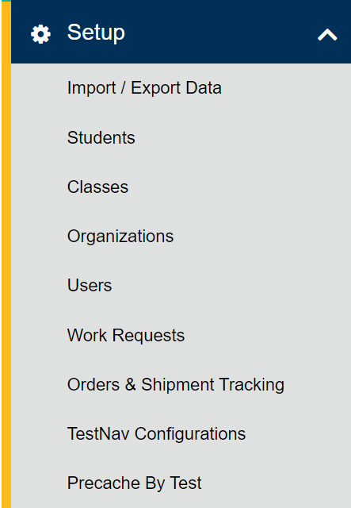
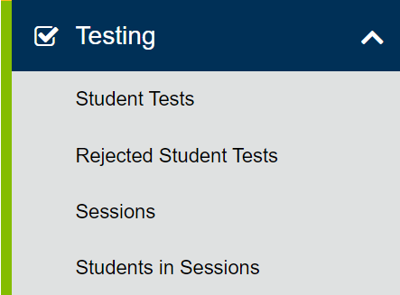
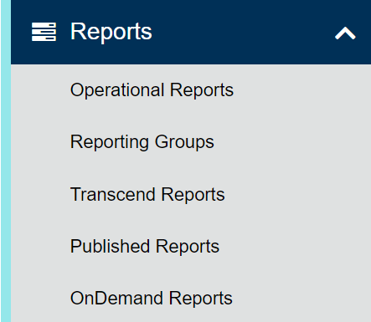
PAnext Basics
Welcome to PAnext Module
Administration:
CMAS or CoAlt
(back to 2013-2014)
Change your view
Colorado > 2025 – 2026 > CMAS Spring 2026 COLORADO (CO)
Menus
Organization:

Slide 69
PAnext – Testing Actions
As a Test Administrator, you will work with the following actions under the Testing menu:
Sessions
  Locate and select the session(s) you will administer
Students in Sessions
  Print Student Testing Tickets and Session Rosters
  Verify special form assignment
  Manage live testing
    Start sessions
    Unlock units
    Resume units

Slide 70
Before Testing

Slide 71
Student Readiness
CPRs
Student practice resources are available on the Colorado Assessments Portal
  Practice/released questions, passages, simulations
  TestNav tutorial with a walk through of various item types and embedded tools
During testing, Test Administrators cannot help students with TestNav navigation and answering questions in test books
  May not help with how to answer a question
  May not show how to go to the next question or use the review screen
  May not assist with drag and drop or other technology enhanced items
Strongly recommend students are provided access to CPRs prior to testing
  Includes forms with accessibility features and accommodations

Slide 72

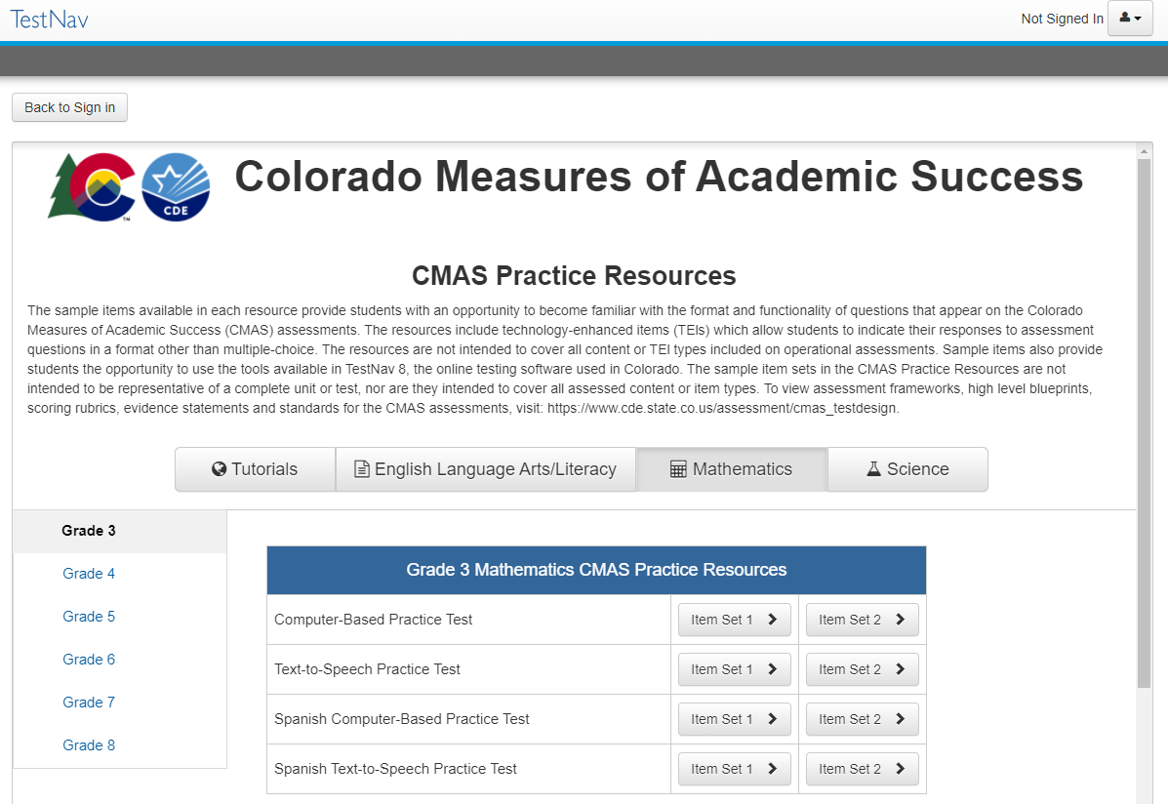
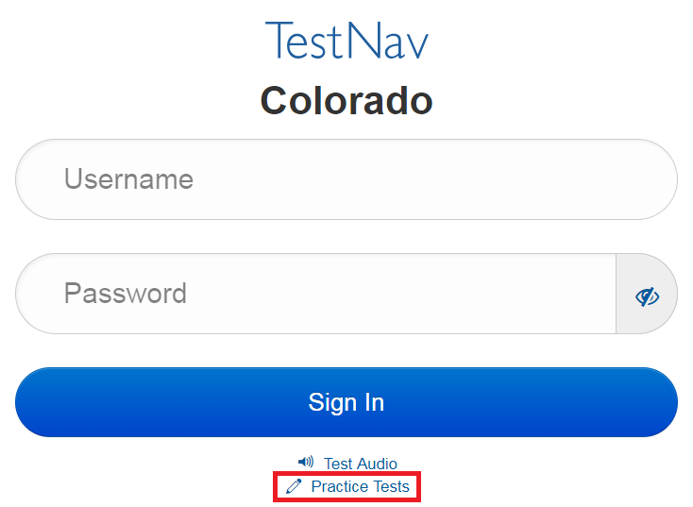
Student Readiness Using the App
Additional ways to access CBT CPRs:
  Open the TestNav App
    Navigate to “Colorado” sign in page
    Select “Practice Tests” link
OR
    Login to TestNav using a student testing ticket printed from the PAnext Training Site
    Secure practice sessions must be setup in advance by a District/School Assessment Coordinator

Slide 73
Accessibility Features and Accommodations
Accommodations Training
To prepare for providing accommodations:
Administer student practice resources to students
Review resources:
    Section 6.0 in the Spring 2026 CMAS and CoAlt Procedures Manual
    CMAS Accessibility Features and Accommodations Trainings
Auditory/signed presentation scripts – supervised early access to script for rehearsal, if applicable
Confirm students with accommodations are testing in an appropriate environment
On the “Students in Session” screen in PA^{next}, confirm the student has the correct form marker displayed on the screen (e.g., TTS, SPA TTS, AT)

Slide 74
Test Administrator Access to Materials
Test Administrator access to test materials is only available on the day of testing
  Check materials out using school chain-of-custody form
  Administer assessment
  Check materials in using school chain-of-custody form
There are early access exceptions for some accommodations
  See accommodations training information
Secure test materials must:
  Not be removed from the school’s campus
  Never be left unattended
  Be secure while in the Test Administrator’s possession

Slide 75
Tasks: One Week Before Testing
At least one week before testing:
Review the Test Administrator Manual and attend training to understand policies and instructions for the spring 2026 test administration
Sign the CMAS and CoAlt Security Agreement form
Prepare to administer accommodated tests, if necessary
Ensure PAnext can be accessed
Optional: Administer the Colorado Practice Resources (CPRs)

Slide 76
Tasks: One Day Before Testing
One day before testing:
Prepare the testing environment
Ensure the spring 2026 administration instructions (TAM) are available
Know when, where and how testing will take place
Arrange for school-supplied materials (e.g., scratch paper, calculators)

Slide 77
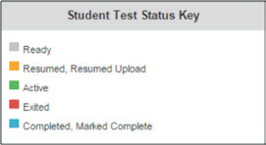
Session Management in PearsonAccess^{next}
Overview of Managing and Monitoring Test Sessions in PA^{next}
  Log into PA^{next}
  Locate and start test session(s)
  Confirm special forms assignments
  Unlock/lock unit
  Students log in to TestNav
  Understand the testing status indicators
  Manage test interruptions and Resume student tests, as needed
  Verify units are in Completed status
  Stop test sessions only after all units are completed
Information on how to complete these activities is found in the PA^{next} Online User Guide

Slide 78
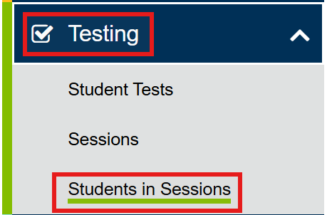
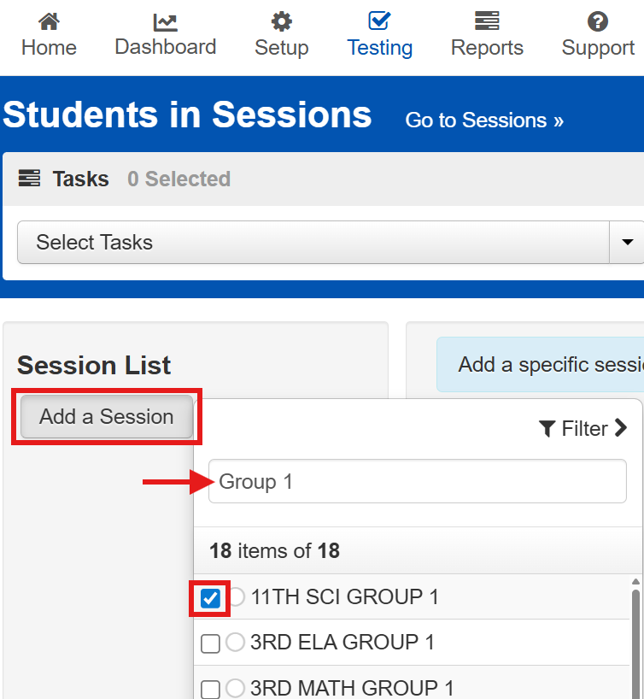
Start a Session – Locate Session
Start a Session
From Testing, select Students in Sessions.
Select Add a Session, type the name of the session provided by the SAC, then select the session.

Slide 79
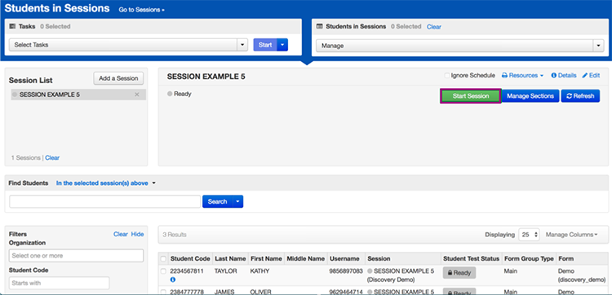
Start a Session
Start a Session
At the top of the Students in Sessions screen, with the session selected, click Start Session.
If the Start button is not available, contact the SAC to have the test session Prepared (only SACs and DACs can prepare test sessions)

Slide 80
Form Assignment Markers in PAnext
Confirm Special Form Assignments
A marker appears next to a SASID on the Students in Session screen if a form-dependent accommodation/ accessibility feature was identified for the student
Indicator | Accommodation/Accessibility Feature
 | Text-to-Speech
 | Spanish
 | Spanish Text-to-Speech
 | Assistive Technology
If a student should have one of these forms and the marker is not seen, do not let the student sign into TestNav! Immediately contact the SAC.
TTS
SPA
SPA
TTS
AT

Slide 81
Incorrect Form Assignment
Check form assignments before students log in
Incorrect forms must be identified before students log in to test
  Immediately contact the SAC if the form indicator is not seen in PAnext
If errors are identified after students log in to test, the options are:
  Continue with the test and suppress the score
    Student receives a report, but the scores are not aggregated
    Counts against participation for the school and district
  Stop the test and invalidate
    Misadministration = the student does not receive a report
    Counts against participation for the school and district

Slide 82
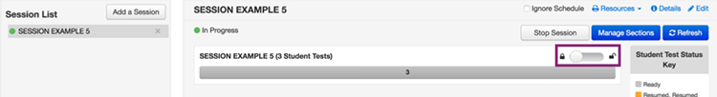
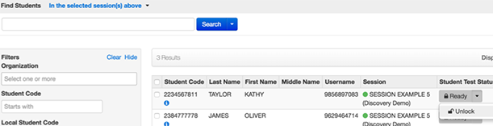

Unlock a Unit
Unlock a Unit
Before reading aloud the SAY instructions, at the top of the Students in Sessions screen, with the session selected:
  At the unit level, unlock the unit for all students in the session
  At the student level,
    Lock ($$) the unit for any absent students
    Unlock () appropriate units for any make-up students
  Students who are taking make-up units can be unlocked individually
  A student can only have one unit unlocked at a given time
  Administer all units in sequential order

Slide 83
During Testing

Slide 84

Maintain Test Security
Administer test sessions properly and securely according to protocol
  Refer to training and TAM
Administer all tests
Focus full attention on the testing environment at all times during testing
  Ensure students do not participate in any prohibited activities
Do not provide students assistance that could impact answers
Follow proper test security procedures for providing accessibility features or accommodations
Follow chain-of-custody requirements to return all test materials after testing
Reporting Testing Irregularities and Security Breaches:
Immediately repot all instances of testing irregularities and security breaches to the SAC, and subsequently, the DAC
  Be prepared to provide a written statement of the incident to the SAC

Slide 85

Tasks: Complete on the Day of Testing
The following icon appears with “SAY” instructions that indicate materials are to be distributed:
Receive test materials
    E.g., student testing tickets, headphones for students using TTS, scratch paper, and pencils
    Required materials for each test are listed in the TAM
Manage test session in PAnext
  Ensure a computer or tablet is available
Check students on the Students in Sessions screen in PAnext
    Ensure accessibility features and accommodated forms are assigned to appropriate students
Read aloud the SAY instructions from the TAM
Distribute test materials to students
    Ensure testing tickets are provided to the correct students
Help students log in to TestNav
Monitor time (accommodated paper testing only)
Supervise and monitor test activity
    Unit 1: Start test session
    All units: Unlock at the unit or individual student level
    Resume test units, as needed
Monitor students as they use 3-minute break time, as needed
Report testing irregularities or security breaches to SAC

Slide 86
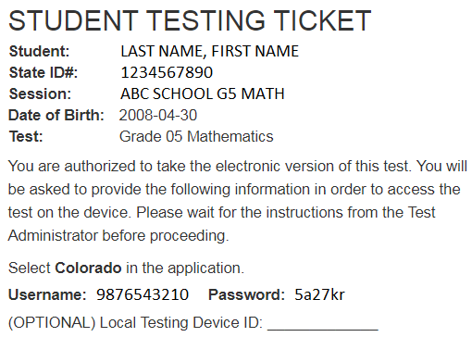
Distributing Test Tickets to Students
Distribute as directed in the SAY instructions
When distributing testing tickets to students at the start of each testing session, ensure each student is provided the testing ticket on which their name appears

Slide 87
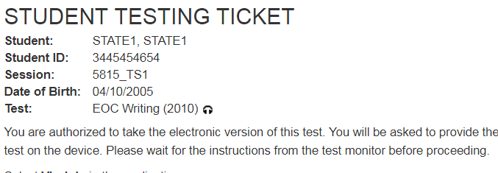
Form Assignment Markers on Student Testing Ticket
Confirm Special Form Assignments
A marker appears next to a SASID on a student’s testing ticket if they were assigned a TTS or Auditory/Signer Script form
If a student should have one of these forms and the marker is not seen, do not let the student sign into TestNav! Immediately contact the SAC.
Indicator | Accommodation/ Accessibility Feature
 | Text-to-Speech
 | Auditory/Signer Script

Slide 88
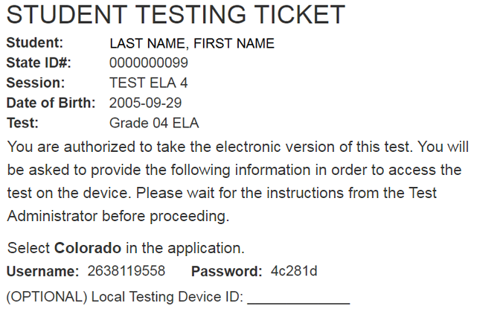
Identify Student Testing Device on Student Testing Ticket
Strongly suggest identifying the device on which the student tests. Use the same device each day of testing for a content area. For example, the student tests all ELA units on device #11, but math could be taken on a different device.

Slide 89
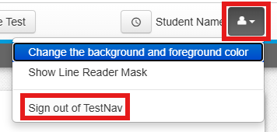
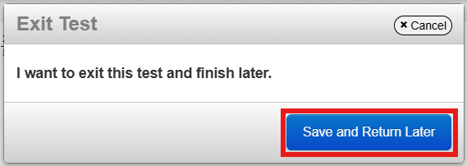
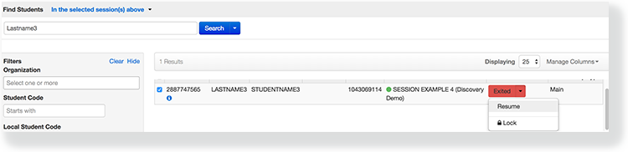
Interruptions During Testing
Student View in TestNav:
If there is an interruption to testing, including if a student becomes ill, the student should:
  Select the button next to their name displayed in the top right corner of the screen
  Choose the option Sign out of TestNav; then select Save and Return Later on the Exit Test screen
The test will close on the student’s device, and the student will be listed in Exited status on the Students in Sessions screen
A Test Administrator must Resume the student’s test before the student can continue with the same test
If a student exits TestNav (either unintentionally or intentionally) before completing a test unit:
  Verify TestNav shut down on the student’s device
  Resume the student’s test in PAnext
    The student’s test will resume from the point at which the test was interrupted
    The system will upload any test responses that the student entered after the interruption if resumed on the same testing device
Test Administrator View in PAnext:

Slide 90
Resume a Test
Note: A unit cannot be resumed if it is Resumed, Marked Complete, or Completed.
Resume a Test
Locate the student’s test that needs to be resumed.
Click the arrow next to the student's status and select either Resume or Resume Upload (only displayed if the student’s status is still Active but they are not still in TestNav)

Slide 91
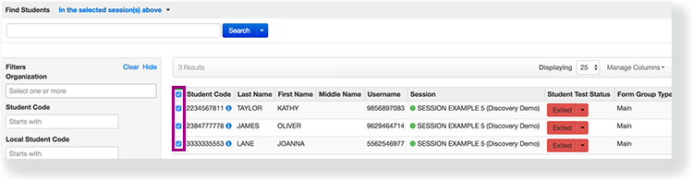
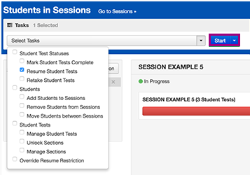
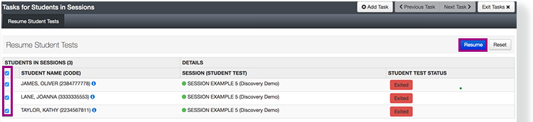
Resume Multiple Tests at Once
To resume units for multiple students in PA^{next}, take the following steps on the Test Administrator’s device:
Select the checkbox next to the student(s) whose unit status needs to be updated
Open the task list, select Resume Student Tests, and click Start
Select the checkbox next to the unit that is to be resumed for the student(s); click Resume

Slide 92
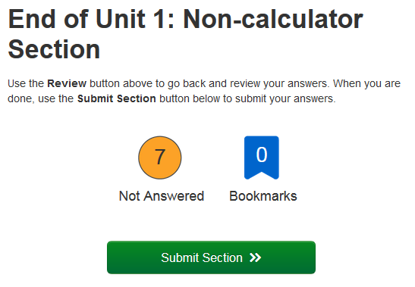

Math Units with Two Sections
Unit 1 for Math Grades 6, 7, and 8 contains two sections:
  Unit 1 Section 1 = non-calculator
  Unit 1 Section 2 = calculator
Both sections must be completed during Unit 1 testing time
  Math Grades 6 through 8 – 65-minute unit testing time
When 20 minutes remain in the Unit, students see a reminder in their tests to move on to Section 2
  At the end of the first section, the student sees the above screen instructing them to submit the section, and then confirms that action
    Students will see a similar screen at the end of the second section, which must be submitted in order to submit Unit 1
  Distribute handheld calculators to students who require them when notified
    The calculator icon appears by calculator references in the TAM

Slide 93
Student Submits Test
Units only go into Completed status if the student selects the green Yes, Submit Final Answers button on the Test Submit Warning screen.
Once a student goes through the multi-step process to submit their answers for a unit, that unit is complete and will not be re-opened.
Steps the student must take to move a unit into Completed status:
  Use navigation arrows through the last question or select the Review button and scroll to the bottom of the drop-down menu and select the End of Section option
  Select Submit Final Answers on the End of Section screen
  Confirm Yes, Submit Final Answers on the Test Submit Warning screen
    A message appears on the screen: Sign out complete. Thank you for using TestNav.

Slide 94

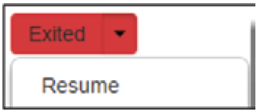
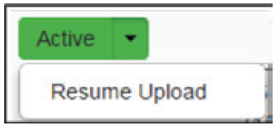
Verify Answers are Submitted
At the end of each unit, verify in PA^{next} that all students who just completed testing show a unit status of Completed in the unit column on the Students in Session screen
If any students are in Exited status, they did not submit their final answers before signing out of TestNav
  Resume the student’s test through PA^{next}
  Have the student use their Student Testing Ticket to sign into TestNav on the same device they used to test
  The student should then go through the proper steps to submit their final answers
  Confirm that the student’s unit status changes to Completed in PA^{next}
If any students are in Active status, but are no longer signed into TestNav, they are not properly logged out of the test (e.g., the student closed the Chromebook lid, the computer froze, or the device crashed during testing or submitting answers)
  Select Resume Upload, then follow the previous steps

Slide 95


Lock Unit at the End of Each Testing Session
Lock the tested unit at the session level
  The unit status for students who just completed testing should now be locked and Completed
  The unit status for students who were absent should be locked and Ready
Sign out of PA^{next}
  Do not stop the test session in PA^{next} until all units are completed by all students
Collect Student Testing Tickets, any accommodated test materials, and used scratch paper
Return the materials to the SAC
Document the return of all secure test materials (used and unused) on the school’s chain of custody form

Slide 96
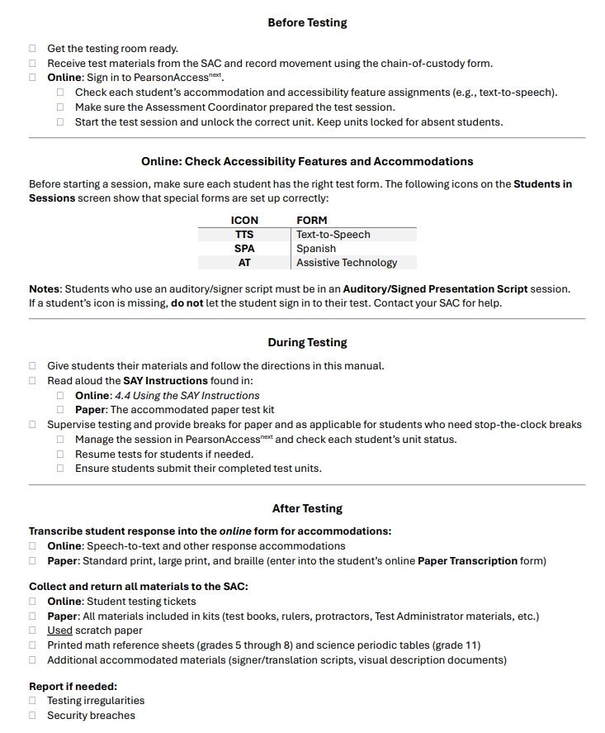
TAM Reminders
This checklist appears on the back of the TAM for quick reference

Slide 97
Basic Technical Troubleshooting

Slide 98
Troubleshooting Guidance
When a technology disruption occurs, Test Administrators take the following steps:
  Follow local procedures for troubleshooting and technology support
    Single student:
      Resume the student’s test once resolved
      Only move the student to another testing device if the issue persists
    Multiple students:
      Resume the students’ tests once resolved
      If issues persist, the session may need to be paused until local tech support can resolve – contact the SAC and document the situation in writing

Slide 99
Error Codes
Error codes are received on a student’s device when TestNav identifies an issue. Examples:
1001: “Your test has been saved. Please notify your test administrator.”
  This is an Early Warning System initial message, which does not indicate the issue, so another error code will follow
1009: “Unable to download test content”
  Network connection issue between the testing device and Pearson servers
3005: “TestNav has detected that another application attempted to become the active window…”
  Could be caused by pop-ups in the background or power saving features
TestNav exits the test and displays the following errors when a student types certain key combinations while testing – the test must be resumed before the student can sign in again:
  3020: “TestNav has detected that Command+Option+Esc has been typed...”
  3022: “TestNav has detected that Ctrl+Alt+Del has been typed...”
8026: “Unable to connect to the proctor caching computer. Please contact your administrator.”
  Network connection issue between the testing device and the local proctor caching device

Slide 100
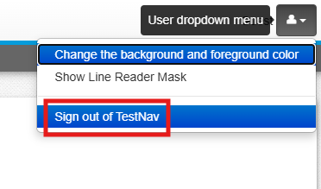
Error Codes – Next Steps
Error Code Directory
Resume the student’s test in PAnext
Have the student log in again on the same testing device
  Do not move the student to another testing device unless the student safely exits the test using the “sign out” feature in TestNav
If the same error occurs repeatedly, or if the same error is affecting multiple students, contact the Technology Coordinator

Slide 101
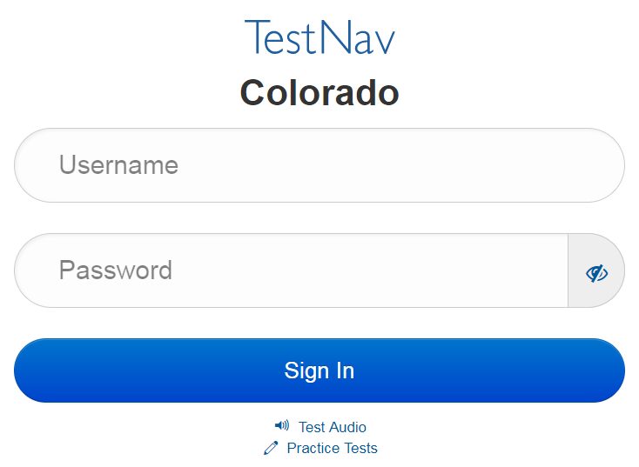
Common Errors – 9059
9059: “The username or password you entered is incorrect.”
If the username and password being used are accurate, the student may be on the incorrect login page
  “Colorado”

Slide 102
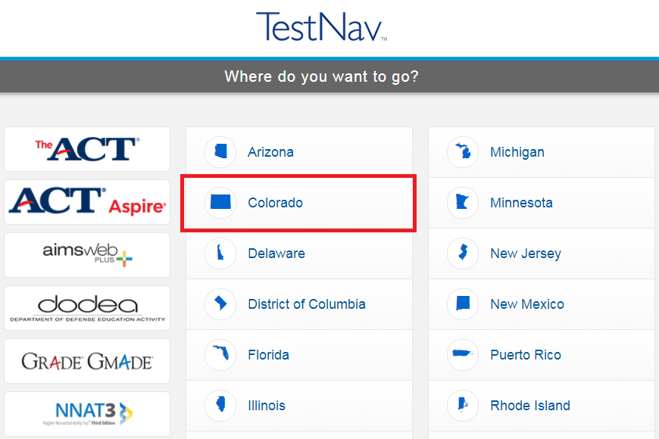
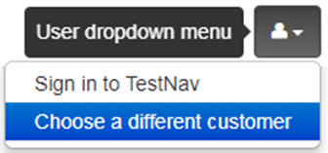
TestNav
Note: The Sign In page should say “Colorado” above the Username and Password fields. If it doesn’t, click the User Icon and select “Choose a different customer”.

Slide 103
Student Logs into Another Student’s Test
Student A logs into Student B’s test
  Immediately exit the test
    Do not have Student A or Student B continue/start testing
  School immediately contacts DAC
  DAC immediately contacts CDE
    If Student B hasn’t touched the test, CDE may be able to move the test into Student A’s name
      Moves the whole test
      Individual units cannot be moved
    If Student B has taken one unit or more, CDE may have to void the unit taken by Student A to allow Student B to complete their test
      Responses cannot be transferred to Student A’s test
      Student A’s test may need to be invalidated as a misadministration
        Not allowed to access test questions more than once

Slide 104
Technology Tip
Document the device on which each student tests
  There is a space for this on the Student Testing Ticket
  This aids in response recovery if it becomes necessary (SRF)
  If not identified, may not be able to recover responses, if needed
If a student receives an error do not immediately move them to a new device
  Sign in using the same device again, then click the User icon in the top right screen corner to “sign out”
  This sends all responses saved on the device to the testing server
Always have the student “sign out” if they are not submitting their test
  Never just power-off a device

Slide 105
Issues with Individual Items
If a student reports an item is not functioning or does not have an answer space:
DO NOT read the item
Note:
  Content area
  Grade level
  Form number
  Unit number
  Item number
  Test format
Provide information to the SAC
  Wording and/or photos from the test must NEVER be included verbally or in writing
The SAC will contact the DAC and Pearson

Slide 106
After Testing

Slide 107
Tasks: After Each Testing Session
Collect materials (see below)
Ensure students logged out of TestNav correctly
Return materials to the SAC using chain of custody form
  Student testing tickets
  Test Administrator Manual
  If applicable
    Printed periodic tables (science grade 11 only)
    Printed mathematics reference sheets (math grades 5 through 8 only)
    Calculators
    Headphones
  Used and unused scratch paper
Notify the SAC of absent students and/or needed transcriptions
Report any testing irregularities or security breaches to the SAC, including missing materials
After all units of a test are completed, stop test sessions in PA^{next}

Slide 108
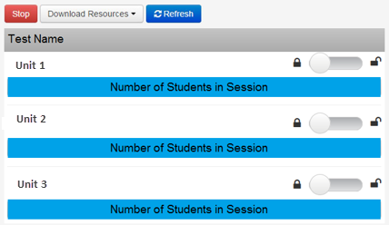
Stop a Session
Stop a Session
Once all students are in Completed or Marked Complete status for all units, the test session can be stopped
If any units for any students need to be Marked Complete, inform the SAC. A reason for marking complete must be provided to the SAC; however, this does not automatically invalidate a test.

Slide 109
Reporting, Resources, and Support

Slide 110
Typical Reporting Timeline
Families also get access to results at this time!
Student data files are expected to be available by June 1, 2026
  OnDemand student reports available at this time (no comparative data)
  Followed by…
Individual student performance reports (with comparative data) and
summary data files
District- and school-level reports
  All state assessment results will be embargoed and must not be publicly
  disseminated, distributed, or published by any means until they are
  publicly released by the state; however, districts and schools may:
    Share confidential individual student performance reports with parents/guardians
    Use aggregated and individual student level results internally for informational and planning purposes before results are publicly released
  Districts/schools must ensure any data shared after the embargo lifts includes appropriate suppressions to meet federal and state data privacy requirements
Reminder: Colorado statute requires that LEPs ensure appropriate personnel provide and explain assessment results to the parent/guardian of each student enrolled in the district or charter school (C.R.S. §22-7-1006.3 (8)(a))

Slide 111
Reporting Information
Procedures Manual Section 7.0 Reporting
  7.1 PearsonAccess^{next} Reports
    Operational Reports
    OnDemand Reports
    Published Reports
  7.2 Public Assessment Reports
    State Level Results
    District and School Level Results
    District and School Disaggregated Summary Results
  7.3 Accountability Reports
    Growth
    Performance Frameworks
CMAS Data and Results Resources
  CMAS and CoAlt Interpretive Guide to Assessment Reports
  Publicly posted data and results
Communication Resources
  Understanding CMAS Score Reports
  Using CMAS Score Reports to
  Support Your Student’s Success
Looking for information about CMAS reports?

Slide 112
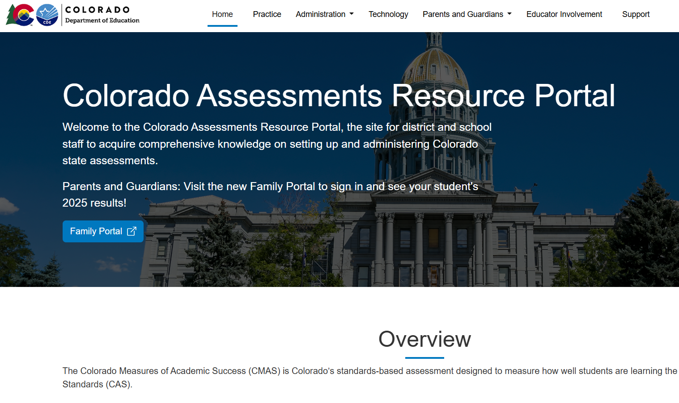
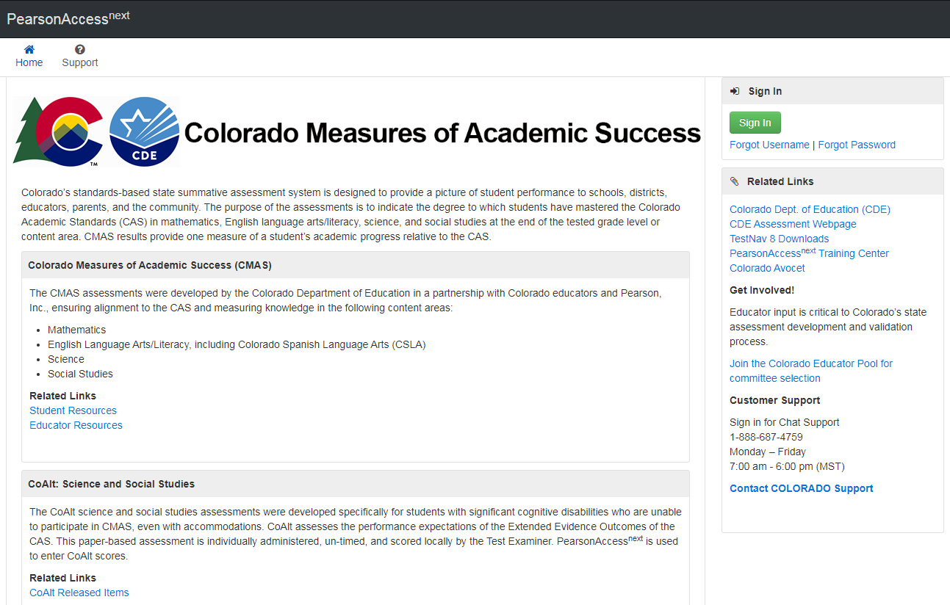
CMAS Websites
Tip: PearsonAccess^{next} sites can be accessed through the Colorado Assessments Portal (bookmark the portal!)
Colorado Assessments Portal
Access Student and Educator Resources (practice tests)
PearsonAccess^{next}
  Live Site
    Sign in to manage online test sessions
  Training Site

Slide 113
Resources – Portal
Portal
Practice
  TestNav 8 Tutorials
  Computer-based Testing CPRs
  Accommodated Paper-based Testing CPRs
  CPR Scoring Guides and Rubrics
Technology
  Setup
  Training
Parents and Guardians
  Resources
  Family Portal (Student Score Reports)
Educator Involvement
  Register to participate in CMAS and CoAlt development activities
Administration
  Assessment Management System
    PA^{next} Live and Training Site Links
    User Accounts Info
    File Layouts
  Training Modules
  Test Administration Resources
    Manuals
    Policy Documents
    Forms
  Results
    Interpretation Video
    Reporting File Layouts
    Interpretive Guides
    Spanish Report Shells

Slide 114
Customer Support
Contact support for assistance with:
Navigating PearsonAccess^{next} and the Training Site
Managing test sessions
Troubleshooting error codes
Managing user IDs and passwords
Accessing resources
CMAS Support
Call Toll Free: 1-888-687-4759
Monday – Friday
7:00 am - 6:00 pm (MST)
PearsonAccess^{next} > Contact COLORADO Support
Chat is available

Slide 115
Communication
In addition to state policies and procedures, each LEP determines their own local policies and procedures
To ensure communication is as efficient as possible, refer to the follow communication structure:
  Test Administrator contacts SAC
  SAC contacts DAC
  DAC contacts CDE
SAC Contact Information
  Name
  Phone
  Email
DAC Contact Information
  Name
  Phone
  Email

Slide 116
Security Agreement Form
Return the signed form to the SAC.
Sign the Security Agreement form for
Spring 2026 CMAS and CoAlt: Math, ELA, Science, and Social Studies

Slide 117
Thank you!

