Slide 1

CMAS Student Biographical Data Review
Date
Presenter: Director of Assessment Data and Psychometrics, Jasmine Carey

Slide 2
Goals for this training
Explain the new CMAS SBD process
Get familiar with the PearsonAccess^{Next} (PAN) system
Review the STU File layout
Understand the data upload process and error messages in PAN
Understand the options for manually editing student records
Become familiar with PAN reports and learn some data validation techniques
Review the data approval process

Slide 3
CMAS Student Biographical Data Process

Slide 4
New CMAS SBD Review Process
Previously, CMAS data clean up was completed both in PAN for data that was needed for testing and again through a CDE Data Pipeline collection
Why Change?
Some changes made in Data Pipeline were not compatible with PAN and caused a disconnect between district submitted data and what was in the final score files (grade changes, accommodation status, Not Tested/Void Codes)
Errors were introduced from the Student Interchange because the Data Pipeline collection uses information from the interchange that was not approved and often uploaded by a different data team
The lag between testing and clean up caused issues with determining the correct data at the time of testing
Legislation (HB 25 - 1278) now requires results release by June 1st and a second review period prevented meeting that goal

Slide 5

Advantages to using PAN - Timeline
Timeline
The STU is active starting April 12th - student demographics can be updated at any time during the window
Final district review can take place from April 27th to May 8th which is more time than was available in the Data Pipeline system
  CDE automatically locks schools out of PAN on May 1st, but districts can disable access as soon as the test window ends
Finished before the end of the school year
  Some districts do not maintain staff for the summer
  Districts that have to work directly with schools to get data could not reach them in some cases

Slide 6
Advantages to using PAN - Data consistency
Some data fields are tied directly to test administration and should be fixed during the window
IEP and Language Proficiency Status are required for accommodations
  Updates to these fields should be made during the assessment window before students test so that they have the appropriate test settings
Grade changes may excuse a student from testing or require a change to the assigned test to avoid a misadministration
Not Tested Codes and Void Score codes should be applied in conjunction with test administration information
  The STU includes details on test administration status that can inform the use of these codes
  Rules around the appropriate uses of Not Test and Void Codes are coded into PAN

Slide 7
CMAS Data Process Overview
The new process builds on functionality that has been available in PAN. Steps 1-3 are part of the standard DAC duties during administration. Steps 4 and 5 have been available but not all districts chose to use them for data clean up.
CDE uploads student data from October Count to PAN using the Student Registration and Personal Needs Profile (SR/PNP)
Districts make updates for students who have entered their district since October count and any other changes that were not captured but are required for testing (IEP Status, Language Proficiency, Grade updates) using the SR/PNP file
Ongoing - handle transfer requests and updating the Responsible District/School and Continuous fields
(optional) Starting on April 12th districts can make batch updates to student data using the Student Test Update (STU) file or manual edits for individual students
  Schools can make updates as allowed as well
Starting on May 1st schools are locked out of the system and districts can make their final updates using the STU or manual edits, districts can lock schools out earlier if they choose
Once any necessary changes have been made, district data respondents sign off on the data in PAN

Slide 8
Get to know PearsonAccess^{Next}

Slide 9
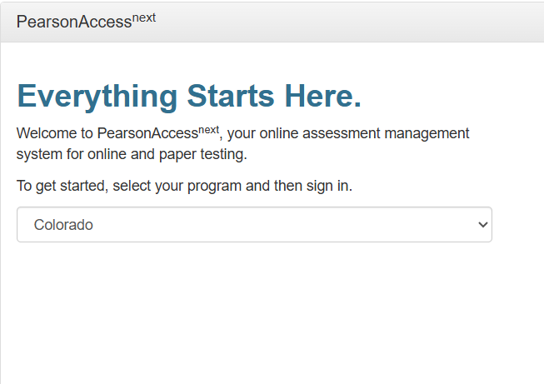
What is PearsonAccess^{Next} (PAN)
PAN is the test registration and administration platform used for the CMAS assessments: https://co.pearsonaccessnext.com
Official District Assessment Coordinators (DACs) are given automatic access to the system and can add access for Data Respondents and other district level users

Slide 10
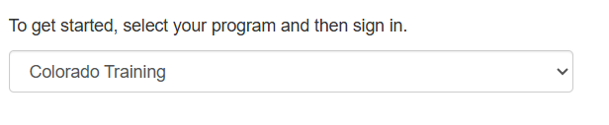
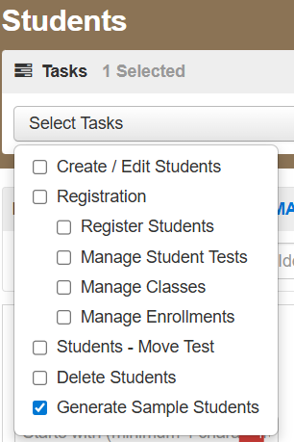
Follow along with the training
You can use the Colorado Training site to access a version of PAN where you can practice downloading and uploading files and editing records without impacting your real data. The screenshots in this training are from the real site, but the functionality is the same
If no one in your district has used the site yet you can use this guide to generate test data to use to practice downloading and uploading files

Slide 11
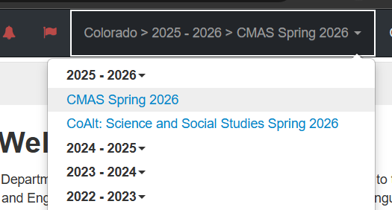
Navigating in PAN - Administration
Check that you are in the correct administration in the top right of the screen:
CMAS and CoAlt are separate administrations and need to be reviewed in separate files

Slide 12
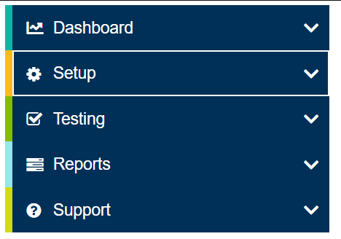
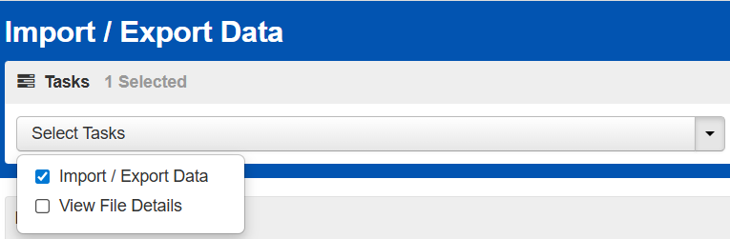
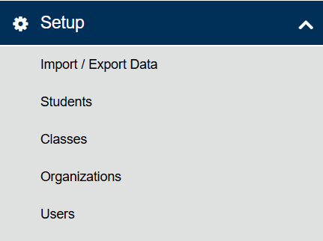
Downloading a Student Test Update file

Slide 13
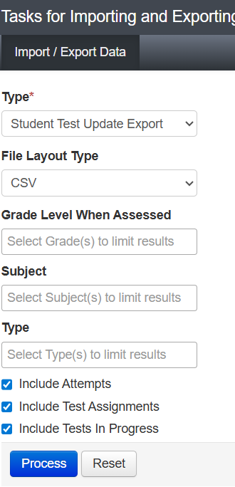
Downloading a Student Test Update file - File options
Select parameters on which to run the file export, then select Process.
  File Layout Type – options are CSV and fixed – CSV is recommended if no option is preferred
  Grade Level When Assessed – options are third, fourth, fifth, sixth, seventh, eighth, and eleventh grades – leave blank (default) to export all grade levels
  Subject – options are CSLA, ELA, math, science, and social studies (CoAlt - only science and social studies) – leave blank (default) to export all content area assessments
  Test status inclusions – select all boxes to include attempts, test assignments, and tests in progress or limit to the records of interest

Slide 14
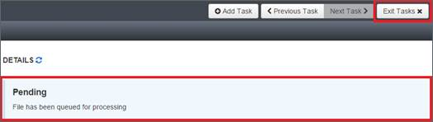
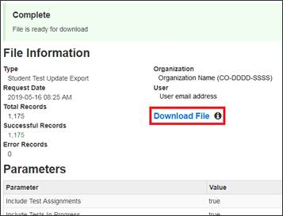
Downloading a Student Test Update file - Generating the file
You can use the refresh button to check the status or log out and wait for an email when the file is finished processing
Once the file is complete select Download File to save it locally for editing

Slide 15

Check In
Was everyone able to get logged in?
Questions about the process so far?

Slide 16
The Student Test Update File Layout

Slide 17
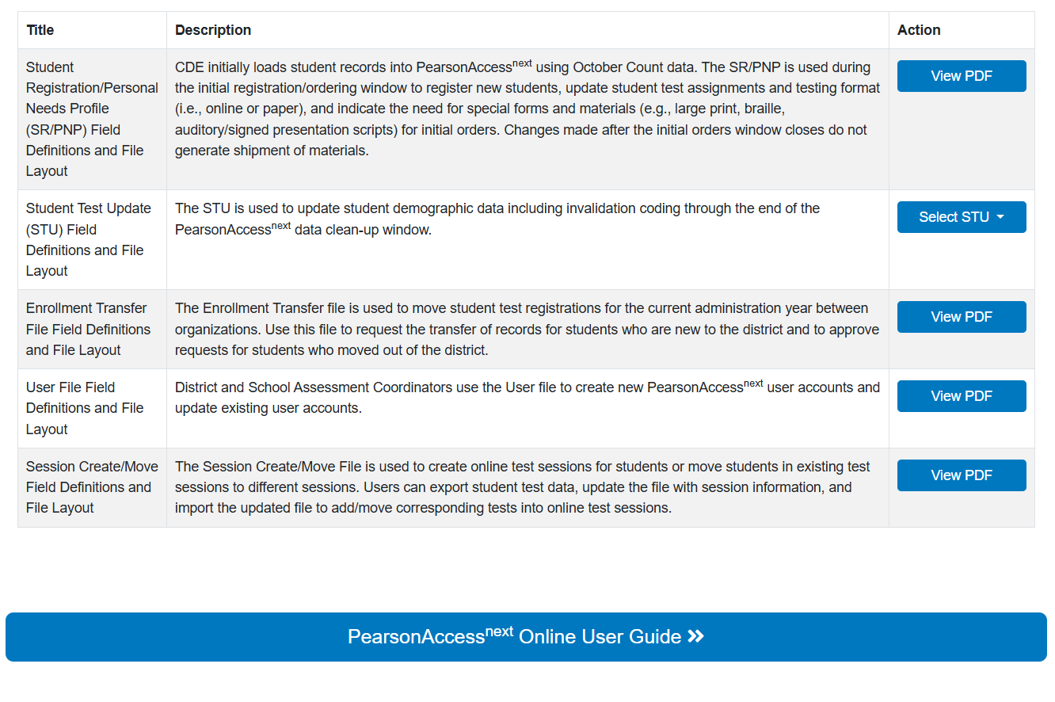
Accessing the STU file layout
File layouts are posted on the Pearson Colorado Resources page under Administration > Assessment Management System
https://coassessments.com/assessment-mananagement-system/
Scroll to the bottom of the page to access the file layouts as well as a general user guide for Pan

Slide 18
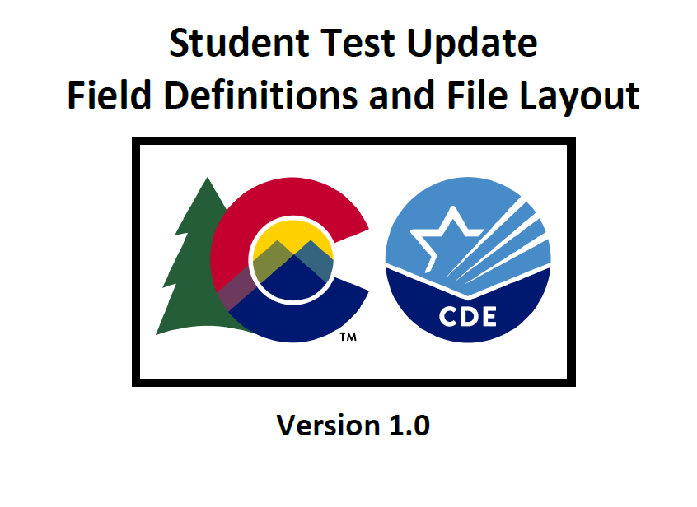
Walk through the STU Layout
We now will go through the fields on the layout and highlight which ones are critical for the SBD review process

Slide 19
STU Layout Structure
Beginning of the file explains the record matching rules and gives instructions for downloading the file and editing in Excel
The file layout includes
  Column
  Field Name
  Required Y/N (can the uploaded file be blank for this field)
  Field Length
  Field Definition
  Notes & Validations (error checks)
  Expected Values
  Updateable (some fields cannot be edited through the STU)

Slide 20
Core Student Data and Student Registration
The fields through Column AK “Preferred First Name” are at the Student Level
  Updates to these fields change all records for the student within the same administration (CMAS vs. CoAlt)
Most SBD relevant fields are in this section
  Student Identifiers: Name, SASID, Birthdate, Gender
  Responsible District and School – must be updated for students who transfer in
  Race/Ethnicity
  Reporting Fields: Gifted – Title I
  Accountability Fields: Continuous in District/School, Expelled
  Accommodation Type: should reflect the IEP and Language Proficiency status
  Preferred First Name may be used if the student would like a name other than their legal name to appear on their Student Performance Reports

Slide 21
Test Data and Reporting Data
The Test Data section includes information specific to the test being taken and most cannot be changed after the test has been taken without CDE assistance
  Test Code
  Accommodations
Reporting Data has information on the status of the test
  Test Status
  Attemptedness and Total Items Attempted
  Not Tested Reason
  Void Score Reason
  Report Suppression Codes (must be entered by CDE, but they can be reviewed in the STU)

Slide 22
Opening the file for editing
The file layout includes instructions for opening a .csv file in Excel while preserving the formatting of the fields. If you are using Excel then a .csv is the most appropriate file format.
If you are using data software other than Excel, you will need to read in the file as appropriate. Both .csv and fixed form files are available.
Edits can be made directly in the .csv file in Excel. Make sure to save updated files with names that help identify which file is the most recent so you don’t have version issues.

Slide 23
Check In – Working with the STU File
Questions about the layout
Issues opening the file

Slide 24
Uploading an STU and reviewing errors

Slide 25
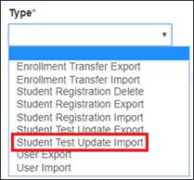
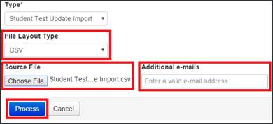
Uploading an edited STU
Start the same way as downloading (follow menus on Slide 13) but select Student Test Update Import in the Type dropdown
Select the layout type and choose the file you would like to import

Slide 26
Tips for uploading edits
Student records will be updated based on the matching rules in the layout
If you update data in the Student Data section, that will update all records for that student within the administration
  Basic demographics updates can be made in just one content area
    When uploading files with multiple content areas the last processed record will win, make sure that all records in your file for the same student are matching
    Grade 11 students only have data for Science
  IMPORTANT: A student may have accommodations on one content area but not another so check all content areas for a student before removing data from IEP or ML Fields

Slide 27
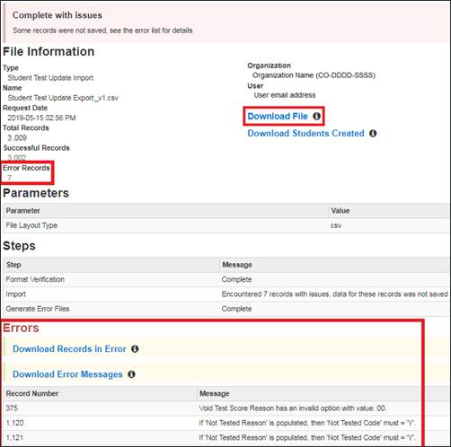
Reviewing upload errors
After the file processes, the View File Details screen will show the number of successful records and error records.
Download the error messages will appear on this screen and can be downloaded for review.
Download Records in Error will pull the records that did not load in the STU layout

Slide 28
Fixing errors using the data file
Option 1:
Download the records in error and error messages and use the messages to identify what fields require editing for each record. The records and error messages are in order of processing so they correspond across the files (unless there are multiple errors on one record).
  TIP: If you get a large number of the same error message this usually indicates a universal error (like using an invalid code). You can filter the records in error file on this code to update all of those errors at once rather than going through individually
Use the error messages to edit your full file and reload all records. This will process as an update even for the records that were not changed but it will not cause any issues - This might be easier if there are a lot of records with similar errors that can be batch updated

Slide 29
Common errors - Accommodations
IEP and ML (Language Proficiency, Background, Program) are used to validate student used accommodations and impact a large number of cross validations
  If you are removing or adding these statuses you will need to update the Accommodation Type Field
  If the student has already tested with an accommodation these cannot be removed and the record may need to be marked a misadministration which will count against participation
  If the student has not tested yet and will not be receiving accommodations then the accommodation fields will also need to be updated
    If the student is flagged for a Unique Accommodation you will need to contact CDE before removing
CDE suggests that these fields should be maintained as part of the test administration work rather than the post administration clean up

Slide 30
Common errors - Not Tested and Void Score Codes
Which code to use depends on the testing status
  Assign = Not Tested
  Attempt = Void Score
Codes that do not match the testing status will cause errors
If Not Test Codes and Reasons are entered but then a student tests, those codes will be ignored and the Calculated Invalidation will be “Valid Score”
  See this document for specific guidance on Parent Excuse coding:
    https://www.cde.state.co.us/assessment/parentexcusalcoding
  Some Not Tested Codes may need to be removed and others may need to be changed to a Void Score code depending on the circumstances, do not automatically update Void Codes if a student tested

Slide 31
Editing records in the UI
Data respondents can also edit records in the UI if you are down to only a few records or are not sure what to do to clear the error
UI includes dropdowns with valid values and shows critical warnings on relevant fields
This guide walks through how to edit student records in the UI:
  https://support.assessment.pearson.com/PAsup/setup/manage-students/edit-a-student-record

Slide 32
Check In – File upload and errors
Questions about the upload process
Questions about reviewing errors/accessing the error report

Slide 33
Data Validation Tips

Slide 34
No errors? Wait, you’re not done!
Some data issues cannot be detected as errors
Errors require a comparison such as a list of valid values or other fields that can be checked against (e.g. IEP and Primary disability)
Data fields such as the Race Ethnicity fields cannot be validated automatically in the system since they can be any valid value for any student
Reports are available in PAN to assist in validating data for some fields

Slide 35
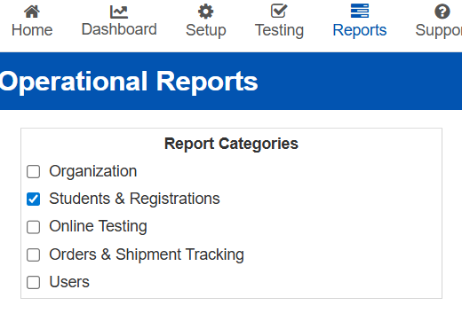
PAN Operational Reports
Several useful reports are under Students & Registrations
Student Org Enrollment Report
  Can be used to identify new students who may need data updates
Students where Responsible Org is Different from Testing Org
  Responsible org and Continuous fields need to be updated when students transfer between districts or schools
Students with Multiple Tests of the Same Subject Area
  Identifies potential duplicate records that may need to be invalidated
Parent Excusals Student List/Count

Slide 36
Review data using Pivot Tables
Some errors can only be detected by looking at the counts of students in different groups
In Excel, pivot tables are the simplest way to check counts
  If you have never used pivot tables you can start with this Microsoft Tutorial
Other data software can produce counts and crosstabs
A simple count check will identify major errors such as not reporting any students as Economic Disadvantage or Gifted
An deeper analysis would compare against previous year’s data to detect smaller but still concerning deviations
  CDE will conduct this type of review on the final data and will notify districts if we find anything

Slide 37
Check In – Data Validation
Questions about the Data Validation process
Break out rooms
  5 minutes to discuss how you check your data for accuracy or share ideas/questions about the process
  Google Sheet for capturing ideas you’d like to share or questions for CDE

Slide 38
Data Validation Sign-off Process

Slide 39

Data Validation Sign-off
To indicate that you have completed the SBD Review there is a sign-off process in PAN
Only the designated Data Respondent can complete the sign off
This serves the same purpose as submitting the SBD file in Data Pipeline indicating that the district has reviewed the data

Slide 40
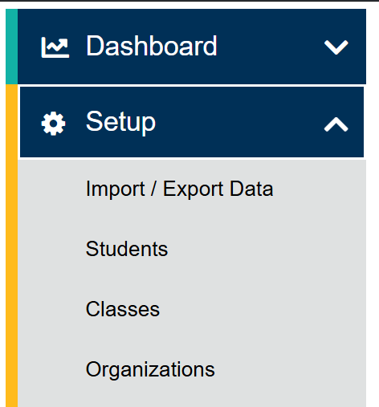
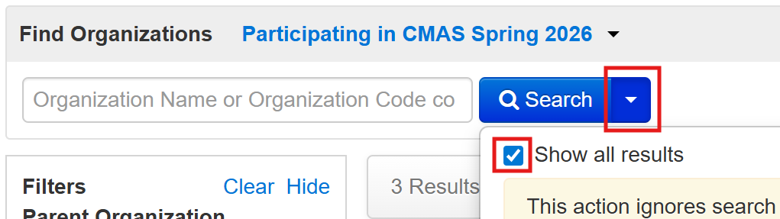
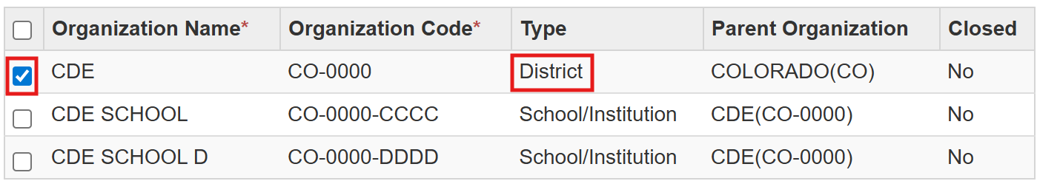
Data Validation sign-off directions in PAN
Navigate to Setup and then Organizations
Show all results to and select the district level
Or search for your district level organization

Slide 41
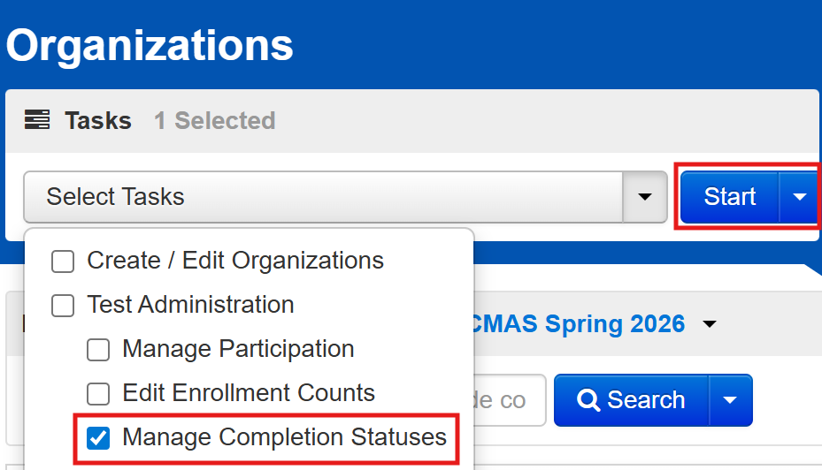
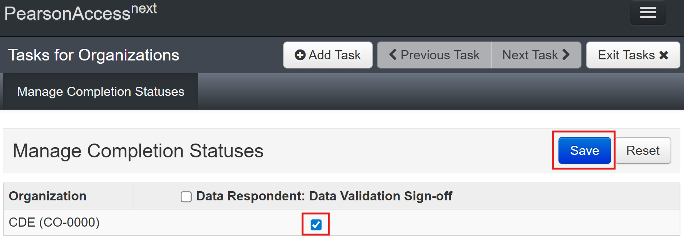
Data Validation sign-off directions in PAN - continued
Under the Select Tasks menu check “Manage Completion Statuses” then Start
Check the box and then select the Save button

Slide 42
CDE Data Review Window
CDE will review the STU from May 11th - May 15th
This will allow us to run analyses on the data looking for issues that may have been missed
  Accountability analytics will provide support for this review
If errors are found that need to be corrected we will reach out to the DAC to arrange to provide any needed updates
  This will likely be done using Syncplicity
This new review process is intended to catch any errors that may impact accountability calculations before the data is saved in the warehouse

Slide 43
Accountability

Slide 44
Reasons to Participate in SBD
Student test records used to calculate school plan types and district accreditation ratings
The request to reconsider (R2R) process cannot be used to address district reporting errors that should have been corrected during SBD
Student test Records are used to identify schools under Every Student Succeeds Act (ESSA)

Slide 45
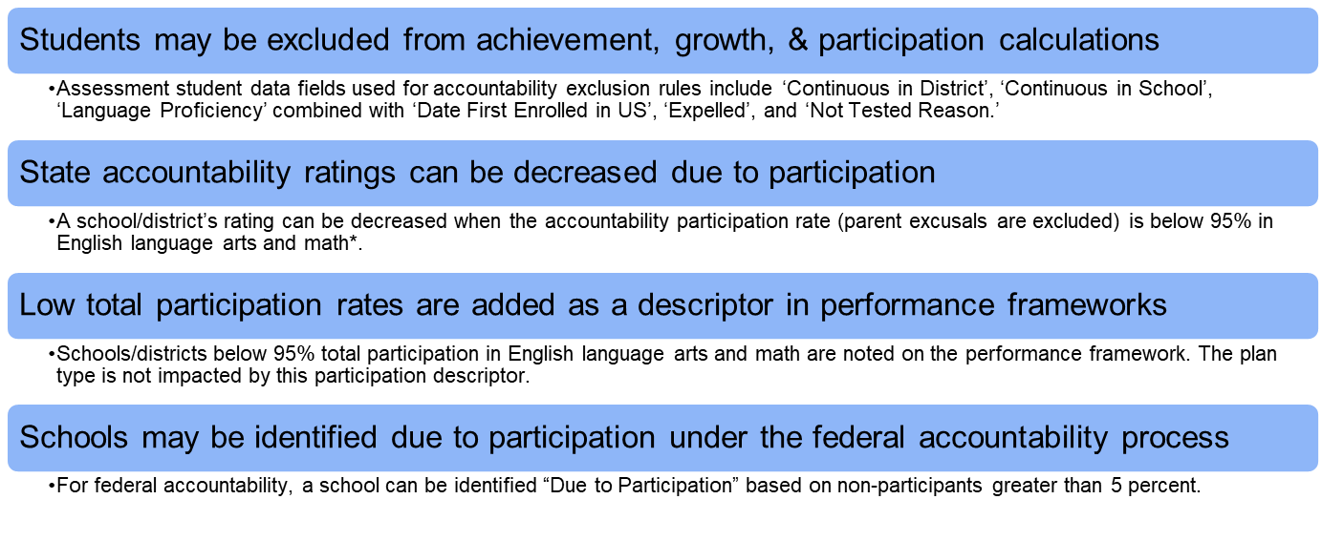
Participation Calculations

Slide 46
Clarification about Request to Reconsider (R2R)
The R2R process cannot be used to change underlying data, especially inclusions/exclusions for growth calculations
Growth is calculated for the entire state using all students to create cohorts and cannot be rerun
Fields that are used for inclusion/exclusion to growth will be carefully reviewed by CDE, but should be a priority for districts to make sure the data is accurate (Continuous in District/School, Expelled)
Accountability Participation Impact condition can be used as an option if invalidation coding errors cause a rating to be lowered due to participation

Slide 47
Check In – Accountability, Final Questions
Questions about accountability data in the collection?
Any final questions about the process?

Slide 48
Resources
PearsonACCESS^{Next} resources and user guides
SBD and Accountability Factsheet
Please contact SBD Support with any technical SBD questions:
Email: sbdsupport@cde.state.co.us
Phone: 720.696.0185
For state accountability questions, Email: accountability@cde.state.co.us
For federal accountability questions, Email: ESSAquestions@cde.state.co.us

