Slide 1
ATTENTION
Any text in this presentation that appears in red font will need to be updated with local assessment administration policies.

Slide 2
Welcome
CMAS Computer-Based Testing Administration Training for
Test Administrators
Spring 2016

Slide 3
Topics
Go to: Topics
CMAS Administration Overview
Testing Schedule
Administration Policies and Testing Security
Tasks to Complete Before Testing
Tasks to Complete During Testing
Tasks to Complete After Testing
Resources and Support

Slide 4
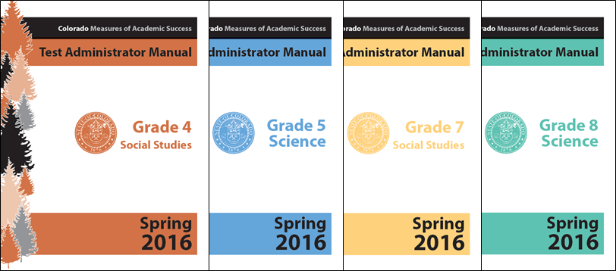
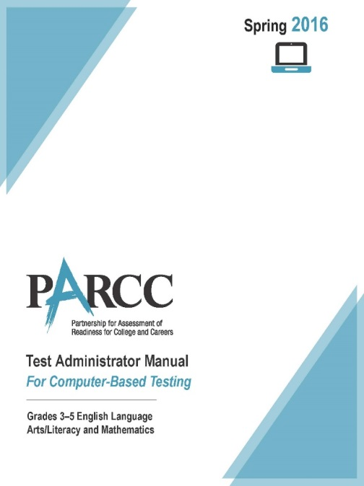
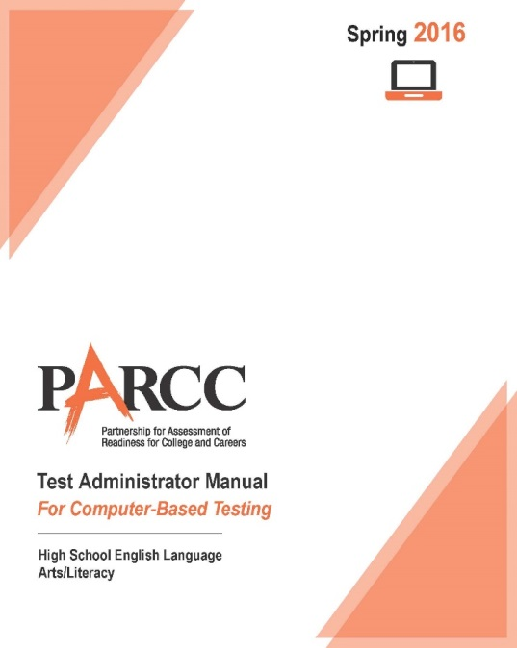
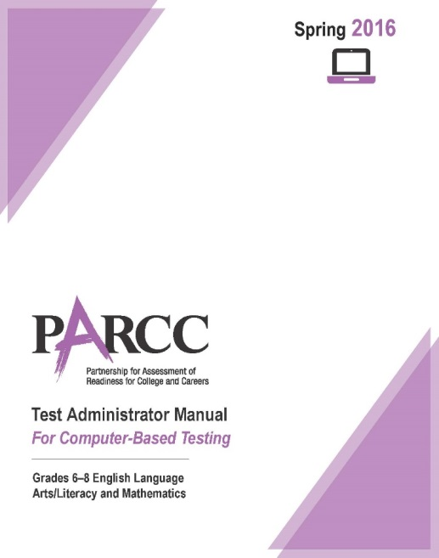
Test Administrator Manual (TAM)
Go to: Topics
Information in this presentation is found in the:
PARCC Test Administrator Manuals for computer-based testing
CMAS: Science and Social Studies Test Administrator Manuals
Security measures and administration policies and procedures identified in the TAMs must be maintained.

Slide 5
Acronyms
CBT – Computer-Based Testing
CDE – Colorado Department of Education - Assessment Unit
EL – English Learner
ELA/Math – English Language Arts and Mathematics
PAnext - PearsonAccess^{next}
PBT – Paper-Based Testing
SAC/STC – School Assessment Coordinator/School Test Coordinator
S/SS – Science and Social Studies
TA – Test Administrator
TAM – Test Administrator Manual
TTS – Text-to-Speech

Slide 6
Note about this Training
Throughout this PPT purple text is used for information that only pertains to PARCC ELA and math, and green text is used for S/SS content.
If information appears in black text, it applies to both PARCC and S/SS.

Slide 7
Accessibility Features & Accommodations
If administering the following accessibility features or accommodations, ensure you are trained on them this school year.
Oral Presentation: Human Reader/Signer, Oral Script for Translation
ELA Accommodation
Math Accessibility Feature
Science Accommodation
Social Studies Accommodation
Human Scribe

Slide 8
Access to Materials
Access to test materials is only available on the day of testing
Check materials out using school chain-of-custody form
Administer assessment
Check materials in using school chain-of-custody form
There are early access exceptions for some accommodations
See accommodations training information
Secure test materials must not be removed from the school’s campus.
Test materials must never be left unattended.
Test materials must be secure while in the TA’s possession.

Slide 9
Field Testing ELA in 2016
Go to: Topics
The primary purpose is to evaluate test questions and tasks. This allows us to determine if the item can be used operationally (as part of a student’s score) on future administrations.
A sample of students will participate in an English language arts/literacy (ELA/L) field test. If a grade in your school is participating in the field test, for more information, please refer to:
Appendix D in the TAM
Appendix G in the TCM
Unit 3 has two parts, which are treated at independent units, and have separate unit timing. All standardized procedures must be followed for all units.
Grades 3-5 – unit 3a and 3b are each 90 minutes
Grades 6-9 – unit 3a 90 minutes and 3b is 110 minutes

Slide 10
Comparisons between PARCC ELA/Math and CMAS S&SS
Comparisons between
CMAS: ELA/Math and S/SS
PARCC English Language Arts and Mathematics: Purple | Science and Social Studies: Green
Unit (may have Sections within a Unit) | Section
Scratch Paper (locally provided) Provide for CBT Math District decision for ELA CBT Sending back is optional | Scratch Paper (locally provided) District decision for CBT Must return used scratch paper to SAC
Spanish Versions (Math Only) CBT Spanish Text CBT Spanish Text w/Text-to-Speech | Spanish Versions CBT Spanish Text w/Text-to-Speech
Make-up Testing Units cannot be tested out of order, except for make-up testing | Make-up Testing Sections cannot be tested out of order

Slide 11
What’s New this Year?
PARCC ELA and Math: | Science and Social Studies:
One Window (no PBA/EOY) | Increased alignment to PARCC procedures and systems
CSLA can replace grades 3 and 4 ELA for eligible students | Spanish Versions
PAnext One login for all CMAS assessments No seal codes – use lock/unlock feature instead
TestNav Updates TestNav Desktop App Text-Extractor and Hot-Text Update (no longer appears as highlighting) Highlighter and Text-to-Speech compatibility with Color Contrast Increased size of Text Editor response box Google Chrome not supported Spell check included in Text Editor (PARCC only)

Slide 12
CMAS Administration Overview
Content Area | Grades
English Language Arts | 3-9 (CSLA available for grades 3 & 4)
Mathematics | 3-8, Grade 9 will take one of the following assessments: Pathway 1: Algebra I, Geometry, Algebra II; Pathway 2: Integrated/Math I, Integrated/Math II, Integrated/Math III
Science | 5, 8, and HS (Grade 11)
Social Studies | 4 and 7 (sampled schools only)

Slide 13
Go to: Topics
Topics
Test Overview
Testing Schedule
Administration Policies and Test Security
Tasks to Complete Before Testing
Tasks to Complete During Testing
Tasks to Complete After Testing
Resources and Support

Slide 14
Spring 2016 CMAS Window
Insert your district testing window
All testing in all districts must end on or before April 29, 2016
All materials must be shipped back to Pearson with a pick up by May 2, 2016

Slide 15
Guidelines for Administration Time
Task | Time to be Allotted for an Administration
Preparing for testing (includes reading instructions to students and answering questions) | 10 minutes (recommended)
Distributing test materials | 5 minutes (recommended)
PARCC ELA unit testing times PARCC Math unit testing time | 75-110 minutes* 60-90 minutes*
ES/MS Science and Social Studies section testing time HS Science section testing time (this is a change) | 80 minutes 60 minutes
Completing end-of-unit activities, including closing units/sections, and collecting test materials | 5–15 minutes (recommended)
*Testing time depends on unit and subject. Refer to Unit Testing Time Table in the Test Administrator Manual for each unit time.

Slide 16
Unit Testing Times: PARCC ELA/L & Math Grades 3-5
Subject and Grade | Unit | Section | Unit Testing Time (Minutes)
Mathematics Grade 3 Mathematics Grade 4 Mathematics Grade 5 | Unit 1 | Non-calculator | 60
 | Unit 2 | Non-calculator | 60
 | Unit 3 | Non-calculator | 60
 | Unit 4 | Non-calculator | 60
English language arts/literacy (ELA/L) Grade 3* | Unit 1 |  | 90
 | Unit 2 |  | 75
 | Unit 3 |  | 90
ELA/L Grade 4* ELA/L Grade 5* | Unit 1 |  | 90
 | Unit 2 |  | 90
 | Unit 3 |  | 90
*Grades selected to participate in the ELA field test will have an additional unit of 90 minutes.

Slide 17
Unit Testing Times: PARCC ELA/L & Math Grades 6-8
Subject and Grade | Unit | Section | Unit Testing Time (Minutes)
Mathematics Grade 6 Mathematics Grade 8 | Unit 1 | Non-calculator | 80
 | Unit 2 | Calculator | 80
 | Unit 3 | Calculator | 80
Mathematics Grade 7 | Unit 1 | Non-calculator | 80
 |  | Calculator
 | Unit 2 | Calculator | 80
 | Unit 3 | Calculator | 80
ELA/L Grade 6* ELA/L Grade 7* ELA/L Grade 8* | Unit 1 |  | 110
 | Unit 2 |  | 110
 | Unit 3 |  | 90
*Grades selected to participate in the ELA field test will have an additional unit of 110 minutes.

Slide 18
Unit Testing Times: PARCC ELA/L & Math Grade 9
Subject and Grade | Unit | Section | Unit Testing Time (Minutes)
Algebra I, Geometry, Algebra II; Integrated I, II, and III | Unit 1 | Non-calculator | 90
 |  | Calculator
 | Unit 2 | Calculator | 90
 | Unit 3 | Calculator | 90
English language arts/literacy (ELA/L) Grade 9* | Unit 1 |  | 110
 | Unit 2 |  | 110
 | Unit 3 |  | 90
*If selected to participate in the ELA field test, students will have an additional unit of 110 min.

Slide 19
Section Testing Times: Science and Social Studies
Subject and Grade | Section | Section Testing Time (Minutes)
Elementary School Science and Social Studies | 1 | 80
 | 2 | 80
 | 3 | 80
Middle School Science and Social Studies | 1 | 80
 | 2 | 80
 | 3 | 80
High School Science | 1 | 60
 | 2 | 60
 | 3 | 60

Slide 20
Guidelines for Administration Time
Guidelines for Administration Time
Provide the entire amount of Unit/Section Testing Time.
Once the Unit/Section Testing Time has elapsed, the unit/section must end.
If all students have completed the unit/section prior to meeting the maximum testing time, the unit/section may be ended (no minimum testing time).
Test Administrators may not encourage students to finish any unit/section early.
A student may be allowed an extended time accommodation only if listed in his or her IEP, 504 Plan, or EL Plan.
PARCC: time-and-a-half is not included in Unit Testing Time.
Science and Social Studies: time-and-a-half is included in the Section Testing Time

Slide 21
Go to: Topics
Topics
Test Overview
Testing Schedule
Administration Policies and Test Security
Tasks to Complete Before Testing
Tasks to Complete During Testing
Tasks to Complete After Testing
Resources and Support

Slide 22
Active Administrators: (maintain standardization of the assessments)
Ensure students have all necessary materials for each unit/section
Ensure a standardized testing environment
Follow all directions and scripts exactly as written
Move throughout the room during testing
Re-read TAM directions to students when asked and clarify the SAY directions as needed
Use proximity to keep students on task
Use “continue working” script for off-task students

Slide 23
Test Administrators May Not: (engage in activities that impact validity, reliability, or fairness of the tests)
Provide feedback or coach students
Clarify test questions including reading sources or test items to students*
Answer content related questions
Interfere with the students’ demonstration of skills
Interact with students in any way that would impact student responses
Allow students to communicate with each other in any way, or use prohibited materials
Engage in other tasks during test sessions
Actively read or view the assessment items or content before, during, or after testing*
Actively read, view, score (formally or informally), or comment on student responses*
Leave test materials unsecured
Discuss or disclose test content through verbal exchange, email, social media, or any form of communication
Download any part of the assessments*
*Except as part of specific accommodations.

Slide 24
Guidelines for Breaks
Breaks
Between units/sections, scheduled breaks may occur.
During a unit/section, one short “stand-and-stretch” break may be permitted at your discretion.
Testing time stops for the unit, but only for up to 3 minutes.
If you know you will take the “stand-and-stretch” break, add 3 minutes to the ending time when beginning the unit/section.
Restroom breaks do not stop the clock.
8:00 a.m. – 10:00 a.m. | Unit 1 / Section 1
10:00 a.m. – 10:15 a.m. | Scheduled Break
10:15 a.m. – 12:15 p.m. | Unit 2 / Section 2

Slide 25
Make-Up Testing
Go to: Topics
Make-Up Testing
Students who are absent, become ill, or who can no longer test because of classroom or school interruptions during originally scheduled units/sections should participate in make-up testing.
Students are not allowed to return to any portion of the unit/section they have already completed.
Test security and administration protocols apply.
ELA/Math ONLY: Units may be taken out of order for make-up testing only. For regularly scheduled testing, units must be administered in sequential order.
All S/SS sections must be administered in sequential order. NOTE: It is a misadministration to administer S/SS sections out of order.

Slide 26
Guidelines for Administration
Optional Text in SAY Directions
For ELA/Math and S/SS, read the following script option regarding allowable activities if students finish early. (Identify which of these options your district will allow.)
Scratch paper option in S/SS SAY Directions
Option A Students are to sit quietly when they are done testing.
Option B Students will be dismissed when they are done testing.
Option C Students may read when they are done testing.
If no scratch paper is to be provided, | Skip ahead to the “SAY” directions that appear after this option box.
If scratch paper is to be provided, | SAY If you would prefer to use scratch paper for taking notes, raise your hand. Distribute blank scratch paper, as requested…

Slide 27
Guidelines for Administration
After Students Finish Unit/Section…
District Decisions:
Will students be able to leave when they have finished testing? (no minimum time)
Sit quietly?
Read? (cannot use any electronic reading devices)
Are students to be released to a location outside of the testing area when?
What are TAs to do when all students have completed a unit/section?
School Site Considerations:
Where will released students go?
To whom will students be released?

Slide 28
Administrative Considerations
Administrative Considerations are changes to the conditions of testing that may benefit a student. Administrative considerations are available to any student as long as test security is not compromised and test environment requirements are met.
Adaptive and specialized equipment or furniture
Frequent breaks (do not stop the clock)
Noise buffers/headphones
Small group testing
Specified, separate, or alternate area or seating

Slide 29
Emergency Accommodation
A case where a student needs a new accommodation immediately due to unforeseen circumstances.
Cases could include students who have a recently-fractured limb (e.g., arm, wrist, or shoulder); whose only pair of eyeglasses have broken; or a student returning from a serious or prolonged illness or injury.
Contact your SAC so that the Emergency Accommodation form can be completed and the appropriate steps can be taken to provide the accommodation.

Slide 30
Colorado Spanish Language Arts Accommodated Form
The CSLA is a paper/pencil Language Arts accommodated form available for eligible 3rd and 4th grade students. This Spanish form is administered in place of PARCC ELA.
Large print available
These students will still take PARCC Math, which is also available in Spanish.

Slide 31
PARCC: Student Accommodation Refusal
If a student refuses an accommodation, the school should document in writing that the student refused the accommodation.
Contact your SAC if a student refuses an accommodation.
This does not apply to students with extended time who do not use the extended time.
The accommodation must be offered and remain available to the student during testing.

Slide 32
Chain of Custody
Document before, during, and after testing.
Any movement of secure materials must be documented.
Sign/complete the chain-of-custody form when checking materials out/in.
Receive materials (e.g., scratch paper, human reader kit, oral script, Student Testing Tickets) from SAC only on the day of testing.
Receive only the content area and grade level being assessed at that time.
At end of the testing session, return materials to a designated secure location.
Not stored in classrooms
Includes scratch paper, human reader kit, oral scripts, and Student Testing Tickets.

Slide 33
Maintaining Security of the Assessments
All secure test materials must be secured while in your possession.
No duplication of secure materials is permissible.
No cell phones or other communication, reproduction or recording devices are allowed during test sessions unless required for accessibility.
Students should be aware that cell phones or other electronic devices are prohibited. Students who are found with these electronic devices in their possession during testing (including if they have finished testing but other students have not) or during a break may lead to the invalidation of not only their test, but to the invalidation of others’ tests as well.
All individuals are strictly prohibited from taking photos of TestNav screens and all secure test materials.

Slide 34
Test Materials Security
Secure
Non-Secure
Paper-based test booklets
Answer documents
Social Studies source books
Periodic table (HS Science)
Human Reader/Oral scripts
Used scratch paper
Any student work/responses
Printed Mathematics Reference Sheets prior to and after given to students
Test Administrator Manual (TAM)
Test Coordinator Manual (TCM)
Unused scratch paper
Procedures Manual
Test Examiner Manual (TEM)
Notes:
Math reference sheets are available online. Teachers may use the online version, printed, in classrooms. However, for testing, the math reference sheet is secure before and after testing to ensure, that no additional/unapproved content is on the sheet.

Slide 35
Headphones
PARCC
ELA all students must have headphones for all Units.
Not every unit has audio, typically one unit for each student will
Need to be prepared and adjust volume prior to logging in to each unit (SAY directions include this step)
Text-to-Speech
If students using TTS are to be in a testing room with other students, headphones must be worn.
Students may be tested separately if they are not able to wear headphones.
Device volume must be adjusted prior to logging in (SAY directions include this step)
Math, S/SS questions with video files do not contain audio, unless TTS is assigned.

Slide 36
Testing Different Grades/Courses Together
If the unit/section testing time and directions are the same, different grades can be administered in the same room.
Algebra I and Geometry can be administered in the same room.
ELA and math cannot be administered in the same room because the directions are different.
Ensure that all calculator/non-calculator sections are the same (Grade 7).
Elementary and middle school science and social studies:
CBT can be administered in the same room.
PBT cannot be administered in the same room as materials and directions are different.
High school science cannot be administered with elementary or middle school science.
PBT and CBT cannot be administered in the same environment.
Students from different grade levels taking the same assessment (e.g., Algebra I for grades 8-9) can be combined in a testing environment.
http://www.cde.state.co.us/assessment/cmas_testing_multiple_grades

Slide 37
Test Environment
Room Configuration
Students should not be able to see each other’s work from a normal testing position.
Dividing screens or other privacy materials may be used if students cannot be placed far enough away from each other.

Slide 38
Test Environment
The testing environment must:
Be adequately lit, quiet, free of distractions, and heated or cooled.
Provide an adequate writing surface.
Students will need room for the following:
Scratch paper
Math reference sheet if printed locally
Be free of electronic devices and music.
“Do Not Disturb/Only Authorized Personnel Allowed” sign must be placed on the door during test sessions.

Slide 39
Test Environment
A Timing Box (optional box around; other information required) must be visible to students
Unit Name: Math Unit 1
Unit Testing Time: 90 Min
Starting Time: 9:00
Stopping time: 10:30

Slide 40
Test Environment
Prohibited Materials
All cell phones (TA may have one ONLY for emergency use, but the ringer must be turned off)
Electronic devices including
E-readers
Personal document scanners
Electronic pens
Smartwatches
iPod, MP3 players or other music players
Instructional aids relevant to content being assessed
Reference books (exception: word-to-word dictionaries for EL)
No food or drinks are allowed on desks or near test materials.

Slide 41
Test Environment
The testing environment must be free of any content related posters or aids that suggest possible answers to students.
Prohibited visual aids in the test environment must be removed or covered.
Number lines
Word walls
Steps for solving math equations
Maps
Charts
Models
Any content related materials
Any resource that defines, explains, or illustrates terminology or concepts
Generally, posters that do not include content specific definitions, content related processes or solutions may remain on the wall.
General rule: when in doubt, cover it.

Slide 42
Student-to-Test Administrator Ratio
Student-to-Test Administrator ratio must not exceed 30 to 1
Test Administrator must be able to actively monitor the space within the physical testing environment.
May use additional trained staff to help maintain an appropriate ratio for the group (not exceeding 30:1).
Consider room configuration
Make special considerations for large testing environments or environments with complicated configurations.

Slide 43
Unauthorized Visitors and the Media
Only students, Test Administrators/Examiners, and authorized school, district, state personnel, or state-sanctioned test monitors may be in testing areas during administration.
Media are not allowed to have access to the tests before, during, or after test administration, or take pictures or video of testing materials or testing students.
Parents are not allowed in the testing room with their child.

Slide 44
Security Breaches
Go to: Topics
Monitoring and Reporting Testing Irregularities and Security Breaches
All instances of testing irregularities and security breaches must be immediately reported to the School Test Coordinator, and subsequently, the District Assessment Coordinator/LEA Test Coordinator.
Should a testing irregularity or security breach occur, be prepared to provide a written statement of the incident to your School Test Coordinator.

Slide 45
Safety Threats and Severe Weather
Go to: Topics
Know the Plan for Safety Threats and Severe Weather
Test Administrators and Proctors must:
Note the time of the disruption and time remaining in unit/section.
If time permits, students should log out of TestNav and/or Test Administrators should lock the unit/section.
Upon return, unlock unit/section if necessary, resume students, and prepare students for the continuation of the unit/section.
Report a testing irregularity or security breach to your SAC.

Slide 46
Topics
Go to: Topics
CMAS Administration Overview
Testing Schedule
Administration Policies and Testing Security
Tasks to Complete Before Testing
Tasks to Complete During Testing
Tasks to Complete After Testing
Resources and Support

Slide 47
Go to: Topics
Tasks to Complete Before Testing:
Prepare to Administer Accommodations
TAs administering accommodated versions of the assessments need annual training in the administration of those accommodations.
To prepare students for testing with accommodated materials:
Administer the accommodated practice tests.
Review:
Accessibility Features and Accommodations Manual
Science and Social Studies Accommodations Supplement
Colorado Accessibility Features and Accommodations Training
Rehearse with Oral Scripts/Human Reader scripts, if applicable.
Confirm that students with accommodations are testing in an appropriate environment.
On the “Students in Session” page in PearsonAccess^{next}, confirm that your student has the correct form name displayed on the screen (e.g., ASL, TTS).

Slide 48
Go to: Topics
Tasks to Complete Before Testing
At least one week before testing:
Review the Test Administrator Manual and attend training to understand policies and instructions for this test administration.
Sign the CO Security Agreement form.
Prepare to administer accommodated tests, if necessary.
Ensure you can access PearsonAccess^{next}.
Optional: Administer the computer-based testing sample items and tutorials.

Slide 49
Go to: Topics
Tasks to Complete Before Testing
One day before testing:
Ensure you can access PearsonAccess^{next}.
Prepare the testing environment.
Know what and when you will be testing.
Arrange for school-supplied materials (e.g., scratch paper, calculators).
Ensure that the administration instructions (TAM) are available.

Slide 50
Tasks to Complete Before Testing
Go to: Topics
High School Math
Changing the embedded TestNav TI calculator from radians to degrees:
Instructions may be provided to students prior to reading the TAM SAY directions before beginning the unit.
Located on p. 14 of the High School MathCBT TAM

Slide 51
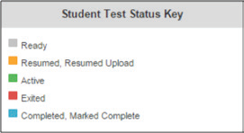
Understand Session Management in PearsonAccess^{next}
Go to: Topics
Overview of Managing and Monitoring Test Sessions in PearsonAccess^{next}
Log into PearsonAccess^{next}
Start test sessions
Unlock/lock unit/section
Students log in to TestNav
Understand the active testing status indicators
Manage test interruptions and Resume student tests, as needed
Verify that units/sections are in Completed status
Stop test sessions only units/sections after all are completed
Information on how to complete these activities can be found in the PearsonAccess^{next} Training Modules.
The PAnext modules apply to both PARCC and S/SS.
Notes:
https://parcc.tms.pearson.com/

Slide 52
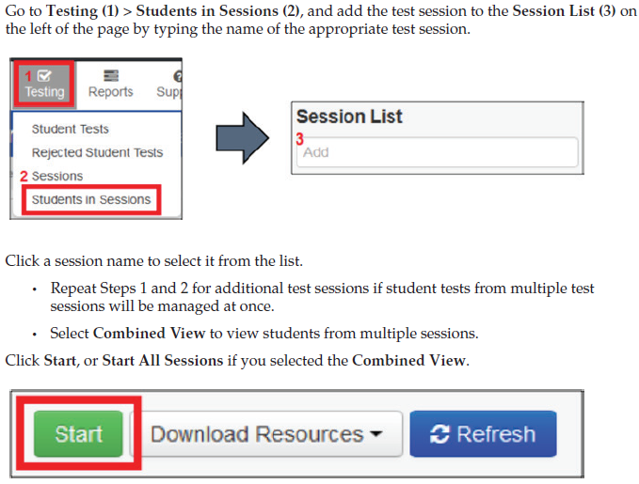
Tasks to Complete Before Testing: Starting Test Sessions
Go to: Topics
Start Test Session in PearsonAccessnext

Slide 53
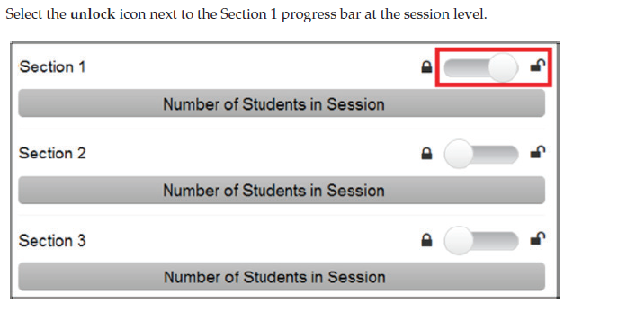
Tasks to Complete Before Testing: Unlocking Test Units/Sections
Go to: Topics
Only one unit/section can be unlocked at one time for a student.
Students that are taking make-up units can be unlocked individually.
S/SS assessments may not be administered out of order, ensure that section 1 directions are read to students testing with students taking other sections.
PARCC units may be taken out of order for make-up testing only.

Slide 54
Go to: Topics
Topics
CMAS Administration Overview
Testing Schedule
Administration Policies and Testing Security
Tasks to Complete Before Testing
Tasks to Complete During Testing
Tasks to Complete After Testing
Resources and Support

Slide 55
Go to: Topics
Maintain Test Security
Receive training in administering test sessions properly and securely.
Administer all tests according to appropriate protocols.
Focus full attention on the testing environment at all times during testing.
Ensure that students do not participate in any form of cheating.
Do not provide assistance to a student that could impact his/her answers.
Follow proper test security procedures for providing accessibility features or accommodations.
Follow chain-of-custody requirements to return all test materials after testing.

Slide 56
Go to: Topics
Tasks to Complete the Day of Testing
On the Day of Testing:
Receive test materials.
Note: ELA requires headphones for all students, all units
Manage test sessions in PearsonAccess^{next}
Read the appropriate SAY directions from the TAM.
Distribute test materials to students.
Help students log in to TestNav.
Keep/monitor time.
Supervise and monitor test activity.
Provide break, if applicable.
Report testing irregularity or security breaches to SAC.

Slide 57
Go to: Topics
Supported Browsers/Apps
The following browsers and apps can be used for testing:
Firefox
Internet Explorer
TestNav App for
Desktop
Chromebook
iPad
Android
Chrome is not a supported browser.

Slide 58
Optional: Identify Student Testing Device
on Student Testing Ticket
Suggest identifying the device identifier on which the student tests. Suggest using the same device each day of testing for a content. For example, the student tests all ELA on device 111, but math could be taken on a different machine.

Slide 59
Go to: Topics
Interruptions During Testing
If there is an interruption to testing, including if a student becomes ill,
The student should:
Select the button next to his or her name displayed in the top right corner of the screen
Choose the option “Sign out of TestNav”; then select “Save and Return Later” on the Exit Test screen.
The test will be closed on the student’s device and the student will be listed in “Exited” status on the Students in Sessions screen.
A Test Administrator must “Resume” the student’s test before the student can continue with the same test.
If a student exits TestNav (either unintentionally or intentionally) before completing a test section:
Verify that TestNav is shut down on the student’s device.
Resume the student’s test in PearsonAccess^{next}.
The student’s test will resume from the point at which the test was interrupted.
The system will upload any test responses that the student entered after the interruption if resuming on the same testing device.

Slide 60
s
Go to: Topics
Interruptions During Testing
To resume* units/sections in PearsonAccess^{next}, the following steps should be take on the TA’s device.
From the Students in Session screen, use one of two options:
Resume a small number of students:
Select the drop-down arrow next to the student’s unit/section status; select Resume or Resume Upload.
If the unit/section status is Exited and TestNav is shut down on the student device, select Resume.
If the unit/section status is Active and TestNav is shut down on the student device, select Resume Upload to force TestNav to check for a saved response file (SRF) when the student logs in to continue.
Resume several student tests at the same time:
Select the checkbox next to the student(s) whose unit/section status needs to be updated.
Open the task list, select Resume Student Tests, and click Start.
Select the checkbox next to the unit/section that is to be resumed for the student(s); click Resume.
When a test is resumed using this option, the test is set to Resumed Upload. This forces TestNav to check for an SRF when a student logs in to continue.
NOTE: Units/Sections will only go into Completed status if the student has selected the green Yes, Submit Final Answers button on the Test Submit Warning screen.
*A unit/section cannot be resumed if it is in Resumed, Marked Complete, or Completed status.

Slide 61
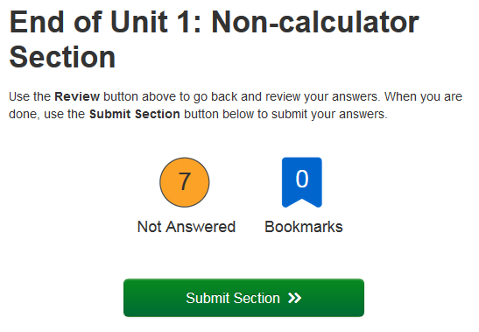
PARCC Units with Two Sections
Some PARCC math tests Unit 1 contain two sections:
When 20 minutes remain in the unit, there is a reminder script
7th Grade Math – Unit 1 contains Non-calculator and Calculator sections
Both sections must be completed within the 80 minute unit testing time
High School Math – Unit 1 contains Non-calculator and Calculator sections
Both sections must be completed within the 90 minute unit testing time
If needed, distribute calculators after students have submitted the first section
Multi-section units only:
At the end of the first section, the following screen appears:
TAs may look at this screen and tell the student to submit this section to continue into the Calculator section of this unit.
The second End of Unit screen reads “End of Unit 1: Calculator Section.” Students will submit final answers from this screen.

Slide 62
Student Submits Test
Units/sections will only go into “Completed” status if the student has selected the green “Yes, Submit Final Answers” button on the “Test Submit Warning” screen.
Once a student goes through the multi-step process to submit their answers for a unit/section, that unit/section is complete and will not be re-opened.
Select the Review button.
Scroll to the bottom of the drop-down menu and select the End of Section option.
Select Submit Final Answers on the End of Section screen.
Select Yes, Submit Final Answers on the Test Submit Warning screen.
Select the user menu in the top right corner of the screen.
Select Sign out of TestNav from the drop-down
Select the Save and Return Later button.
A message will appear on the screen that says, “Sign out complete. Thank you for using TestNav.”

Slide 63
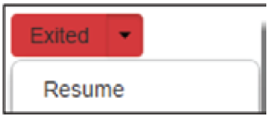
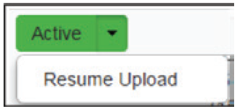
Verify that Answers have been Submitted
At the end of each unit/section, verify in PearsonAccessnext that all students who just completed testing show a unit/section status of “Completed” ( ) in the unit/section column on the Students in Session screen.
If any students are in “Exited” status, they did not submit their final answers before signing out of TestNav.
Resume the student’s test and have the student sign in to TestNav using their Student Testing Ticket.
The student should then go through the proper steps to submit their final answers.
Confirm that the student’s unit/section status changes to “Completed” in PearsonAccessnext.
If any students are in “Active” status, but they are no longer signed in to TestNav, they are not properly logged out of the test (e.g., the computer froze or the browser crashed during testing or while the student was submitting their answers).
Change the student’s status to “Resume Upload” and have the student sign in to TestNav using their Student Testing Ticket.
The student should then go through the proper steps to submit their final answers again.
Confirm that the student’s unit/section status changes to “Completed” in PearsonAccessnext.

Slide 64
Lock Unit/Section
at the End of Each Testing Session
Lock the tested section at the session level.
The unit/section status for students who just completed testing should now be locked and “Completed” ( ).
The unit/section status for students who were absent should be locked and “Ready” ( ).
Sign out of PearsonAccess^{next}. Do not stop the test session in PearsonAccessnext until all units/sections have been completed by all students.
Collect Student Testing Tickets, any accommodated test materials, and used scratch paper and place in an unsealed secure return envelope.
Return the secure return envelope to the SAC.
Document the return of all secure test materials (used and unused) on your school’s chain of custody form.

Slide 65
Go to: Topics
Troubleshooting Guidance
When a technology disruption affecting a single student occurs, Test Administrators should follow these steps:
Note the time of the disruption.
Follow procedures on troubleshooting and support.
If issue persists, move the student to another testing device.
Document the situation in writing.
When a technology disruption affecting multiple students occurs, Test Administrators should follow these steps:
Pause testing.
Note the time of the disruption.
Follow procedures on troubleshooting and support.
Resume testing.
Document the situation in writing.

Slide 66
Go to: Topics
Troubleshooting Resources
Test Administrator Manual:
Guidance for Troubleshooting Computer-Based Testing
TestNav 8 Online Support Guide:
Early Warning System (EWS) Triggers - https://support.assessment.pearson.com/display/TN/Early+Warning+System+%28EWS%29+Triggers
Error Codes - https://support.assessment.pearson.com/display/TN/Error+Codes
Saved Response File (SRF) and Log File Locations - https://support.assessment.pearson.com/display/TN/Saved+Response+File+%28SRF%29+and+Log+File+Locations
EWS Recovery – Resume a Test - https://support.assessment.pearson.com/display/TN/EWS+Recovery+-+Resume+a+Test

Slide 67
Issues with Individual Items
If a student reports that an item is not functioning or does not have an answer:
DO NOT read or review the item.
For items not displaying properly, instruct the student to go to the next item and then return to the item.
Instruct the student to do their best on the item.
Note the content area, course/grade level, form number, item number, and test format and provide this to the SAC/STC.
Wording from the test must NEVER be included verbally or in writing
The SAC will contact the DAC and Pearson.

Slide 68
Go to: Topics
Topics
Test Overview
Test Security and Administration Policies
Testing Schedule
Tasks to Complete Before Testing
Tasks to Complete During Testing
Tasks to Complete After Testing
Resources and Support

Slide 69
Go to: Topics
Tasks to Complete after Testing
After each unit/section has been administered:
Ensure all materials have been returned to the SAC.
Test Administrator Manual
Student Testing Tickets
School-supplied mathematics reference sheets
Calculators (if applicable)
Used and unused scratch paper
Headphones
Report accommodations usage and missing materials to the SAC.
After all units/sections are completed, stop test sessions in PearsonAccess^{next}.
Report any testing irregularities or security breaches to SAC.

Slide 70
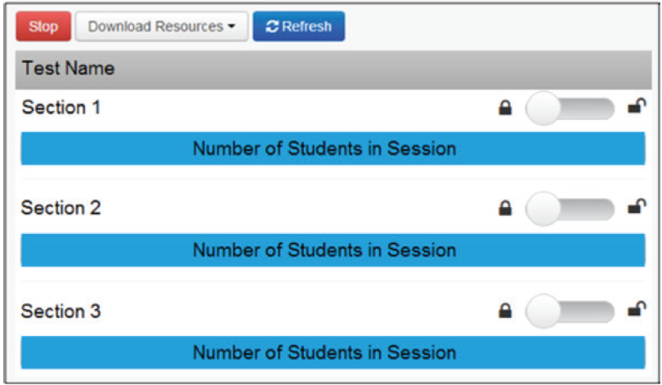
Stop Test Session after Last Unit/Section
Once all students are in “Completed” or “Marked Complete” status for all units/sections, the test session should be stopped.
If any units/sections for any students need to be “Marked Complete”, inform the SAC. A reason for marking complete must be provided to the SAC as this does not invalidate a test.

Slide 71
Go to: Topics
Topics
Test Overview
Test Administrations
Testing Schedules
Tasks to Complete Before Testing
Tasks to Complete During Testing
Tasks to Complete After Testing
Resources and Support

Slide 72
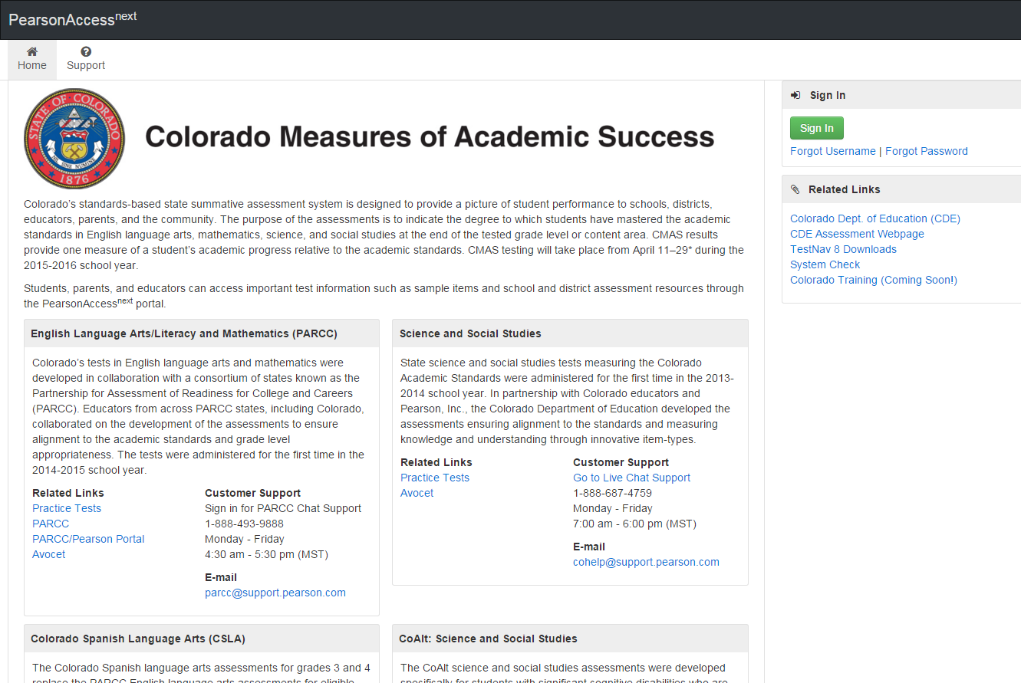
PearsonAccess^{next} Landing Page
Go to: Topics
co.pearsonaccessnext.com
Resources for all CMAS administrations
Includes links to:
All practice tests
PARCC.pearson.com
Avocet - online index
for assessment manuals
and materials
Customer Service
Contact Information

Slide 73
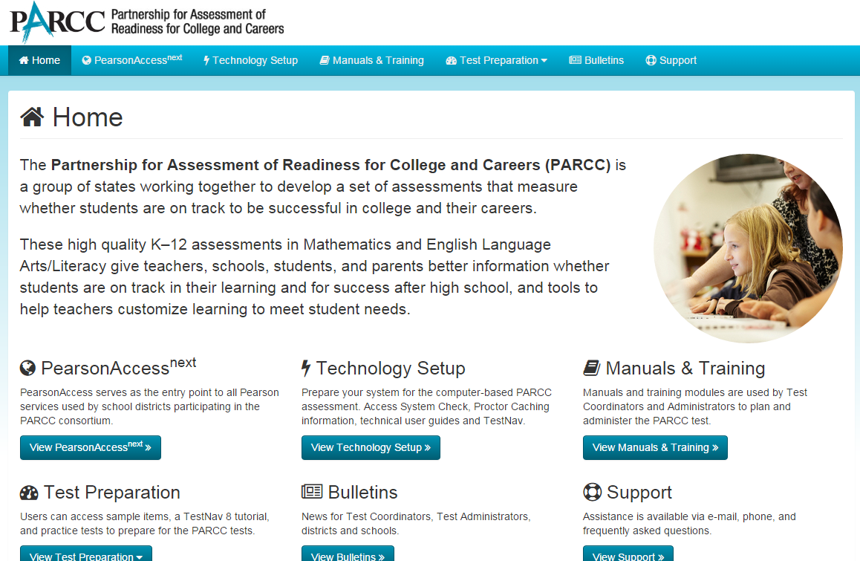
Go to: Topics
PARCC Portal
http://parcc.pearson.com

Slide 74
Resources – TAM
Go to: Topics
Test Administrator Manuals
PARCC Test Administrator Manuals (TAMs) for computer-based testing
http://avocet.pearson.com/PARCC/home (under category “Test Administration Manuals)
CMAS: Science and Social Studies Test Administrator Manuals (TAMs)
http://avocet.pearson.com/CO/Home

Slide 75
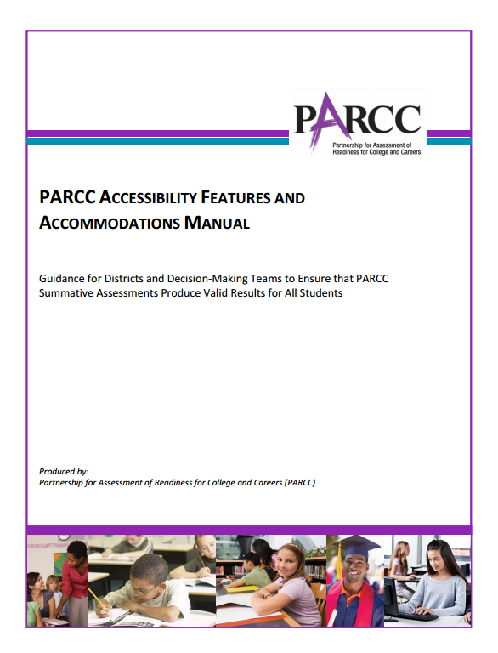
Go to: Topics
Accessibility Features and Accommodations
Accessibility Features and Accommodations Manual
http://avocet.pearson.com/PARCC/home
Accessibility Features and Accommodations Training Module:
https://parcc.tms.pearson.com
Science and Social Studies Accommodations Supplement
http://www.cde.state.co.us/assessment/spring2016_cmas_sss_accommodationssupplement

Slide 76
Go to: Topics
PearsonAccess^{next} Training Modules
Training Modules to Support Next Steps:
Go to: https://parcc.tms.pearson.com
Enter your email and register, including selecting your school.
The following module are suggested:
Student Readiness Resources for PARCC
PearsonAccess^{next} training Modules
Students in Session Screen
Monitor Student Test Status
These modules can be used to support session management for both PARCC and S/SS.

Slide 77
Customer Support
Contact Customer Support for assistance with:
Navigating PearsonAccess^{next}
Navigating the Training Center
Managing test sessions
Managing user IDs and passwords
Accessing resources
TestNav
PARCC Online Support and Resources http://PARCC.Pearson.com/Support | CMAS Science and Social Studies and CSLA Support
Hours: 4:30 am – 5:30 pm MT, Mon.–Fri. | Hours: 7:00 am - 6:00 pm, MT Mon.-Fri.
Call Toll Free: 1-888-493-9888 | Call Toll Free: 1-888-687-4759
Email: PARCC@support.pearson.com | Email: cohelp@support.pearson.com
Chat is available | Chat is available

Slide 78
Communication
TA – Contacts School Assessment Coordinator (SAC)
SAC – Contacts District Assessment Coordinator (DAC)
DAC contacts CDE
If you have are experiencing an issue or require guidance or support, go through the proper channels.
This includes when students exits out of tests quickly
NOTE: Submitted units/sections will not be re-opened as students have to go through multiple steps and confirmations before their status changes to “Completed”.

Slide 79
Security Agreement Form
Sign the CO Security Agreement form for
Spring 2016 CMAS and CoAlt: ELA, Math, Science and Social Studies
and return it to your SAC/STC.
http://www.cde.state.co.us/assessment/cmas_security_agreement

Slide 80
Go to: Topics
Thank you

