Slide 1
Disclaimer Meeting Recording and Transcription Notice Please be aware that the meeting will be recorded and transcribed for training and reference purposes. By participating in this meeting, you consent to the recording and the use of the transcript for training and accommodation purposes. Disclaimer Artificial Intelligence This online training event is offered by the CDE Assessment Division to support the District Assessment Coordinator prepare for the 2025-2026 Colorado WIDA ACCESS administration window. By participating in this event attendees agree that they will not record, capture, share, or publicly post its contents without expressed permission. Attendees may not use artificial intelligence (AI) software or services to capture the content of the event. CDE reserves the right to remove any attendee employing such services.

Slide 2


2025-26 District Assessment Coordinator ACCESS Training
Heather Villalobos Pavia, EdD
villalobospavia_h@cde.state.co.us
Fall 2025

Slide 3
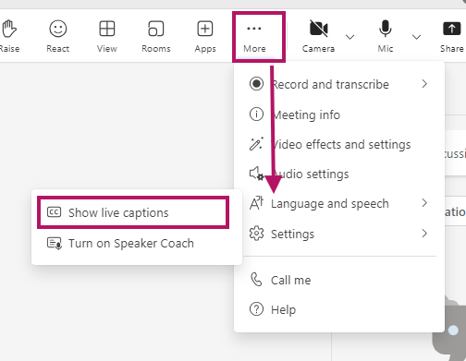
Teams Meeting Logistics
Enable closed captioning
Above More select the 3 dots (…) → Settings → Language and speech → Show live captions

Slide 4
This training is to support District Assessment Coordinators prepare their district for the annual administration of the ACCESS suite of assessments including WIDA ACCESS, WIDA ACCESS for Kindergarten, and Alternate ACCESS.

Slide 5
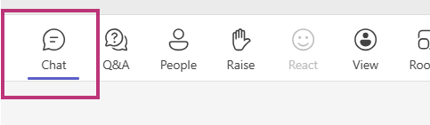
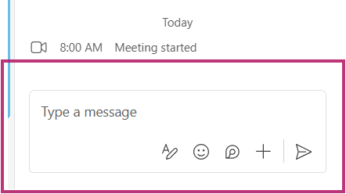
Please confirm your chat is working
Enter your name
District
Role
Something you are looking forward to this fall.

Slide 6
Agenda
ACCESS District Assessment Coordinator Training 2025-2026
About ACCESS
Key Players
Important Dates
New for 2025-2026
Communication and Resources
Student Participation
Security and Training Requirements
Materials
Assessment Development Opportunities

Slide 7
What are the WIDA ACCESS Assessments?
The WIDA ACCESS suite of assessments are standards-referenced assessments that measures English language proficiency. Student performance is compared to the WIDA ELD Standards Framework. Students are not ranked against each other or against the expected performance of monolingual English speakers.
Purpose:
Helps educators make decisions about students' English language development.
Assists in appropriate program and instructional planning.
Meets state (Colorado Senate Bill 109, House Bill 14-1298) and federal requirements (Civil Rights Act, Every Student Succeeds Act).

Slide 8
Assessment Format
WIDA ACCESS* (Grades 1-12): Primarily computer-based; Writing for grades 1-3 is on paper.
WIDA ACCESS for Kindergarten: Paper-based, interactive format.
Alternate ACCESS: For students with significant cognitive disabilities; large-print and paper-based.
*Paper available, when a student has a documented disability that directly impacts their access to computerized technology and therefore prevents their access to the digital assessment
E.g., epilepsy, other seizure disorder, neurological disorders that prevent access computerized technology, etc.
A hearing impairment that requires visual phonics to access computer presented audio

Slide 9
Key Players

Slide 10
Colorado Department of Education
ACCESS Logistics and Administration Policy
Heather Villalobos Pavia
Accommodations for students with an IEP or 504
Arti Sachdeva
ACCESS Technology
Collin Bonner
ML Identification/WIDA Screener
Doris Brock-Nguyen
Data Pipeline/Coding
Collin Slutzky

Slide 11
Vendors
WIDA
U.S.-based collaborative group of 41 member states, territories and federal agencies
Comprehensive, research-based system of language standards, assessments, professional learning and educator support
Data Recognition Corporation (DRC)
DRC is a long-standing WIDA partner responsible for the administration, scoring, and reporting for the ACCESS, Alternate ACCESS, and online WIDA Screener assessments
WIDA and DRC administer the ACCESS assessments to 2.5 million students each year.

Slide 12
District
District Assessment Coordinator (DAC): Oversees district-wide assessment processes.
Data Respondent: Ensures an accurate data file of NEP and LEP students in data pipeline
School Assessment Coordinator (SAC): Manages school-level logistics and training.
Sensitive Data: Works with student data including sending, viewing, adding, and editing student data in WIDA AMS
District Technology Coordinator (DTC): Prepares and maintains testing technology.
Test Administrators (TAs): Administer the tests and ensure security.
ACCESS Test Takers: ACCESS test takers are students who are identified as language learners with a language proficiency code of NEP (1) or LEP (2).

Slide 13
Ensuring a Smooth Testing Process
Before Testing:
Authentic training and engagement
Secure materials
Review accommodations
Prepare test environment
During Testing
Standardized administration
Proper use of materials
Active monitoring
Appropriate use of scratch paper
No additional devices
Report any incidents
After Testing
Return materials correctly and on time

Slide 14
Student Participation

Slide 15
Student Participation
Students who are Multilingual Learners, including students with disabilities, with a language proficiency designation of:
1, Non English Proficient (NEP)
2, Limited English Proficient (LEP)
Students whose parent/guardian opted them out of an LIEP program are still required to participate in ACCESS testing.

Slide 16
Participation Options
Three participation options exist:
The student participates in WIDA ACCESS or WIDA ACCESS for Kindergarten.
The student participates in WIDA ACCESS or Kindergarten for ACCESS with accommodation(s).
The student participates in Alternate ACCESS* only for students with the most significant cognitive disabilities.
*It is not appropriate or ethical to give the Alternate ACCESS to students who do not qualify for the assessment. Student with a primary disability code of DD, SLD, SED, or SLI are not eligible for alternate assessments.

Slide 17
Testing students who have an IEP or 504 Plan
The educational team (ML and IEP or 504 as applicable), which must include the family, determines whether the student will take:
ACCESS 1-12 or Kindergarten with or without accommodations
Alternate ACCESS for a student with the most significant cognitive disability who meets the participation requirements for the alternate assessment.
According to federal requirements, there must be evidence of alignment between a student’s educational plan, instruction, and the accommodations provided on any of the state assessments, as well as any determinations for students to participate in Alternate ACCESS.

Slide 18
Accommodations for Students
Accommodations are practices and procedures that provide equitable access during instruction and assessment for students with a documented need.
Who Qualifies for ACCESS Accommodations?
Students with IEP or 504 Plans documenting use of the accommodation
Examples of Accommodations: Manual control of audio, extended speaking time, repeat item audio, etc.
Unique Accommodation Requests (UAR) are due December 1

Slide 19
Dates

Slide 20
Important Dates 2025*
October 1st: Initial Paper Materials Orders Open(through Syncplicity/CDE)
October 15th: DAC Office Hours Begin
October 28th: DEADLINE for DAC Signed Security Agreement
October 31^{st:} DEADLINE for Initial Paper Materials
November 3rd: CDE sends DAC Verification of District Training form.
November 4th: Assessment Team pulls October Snapshot for WIDA AMS upload.
December 1st: DEADLINE for UAR (scribe) submission
December 2nd: WIDA AMS Opens
*Dates may change to accommodate unforeseen circumstances.

Slide 21
Important Dates 2026
January 6th: Additional Test Material Ordering Available Window
January 9th: DEADLINE for Verification of District Training Form
January 12th: Test Window Opens
January 31st: Enrollment Cutoff for New Students
February 6th: Last day to Order Additional Test Materials
February 13th: Last day of Test Window
February 18th: DEADLINE for Shipping Completed Test Materials to DRC
February 20th: LAST DAY to make updates in WIDA AMS
March 6th: CDE sends Post-Test Compliance form
March 13th: DEADLINE Post-Test Compliance form
April 30th: Reports and Data Files Available in WIDA AMS
*Dates may change to accommodate unforeseen circumstances.

Slide 22
Office Hours Invitation
The ACCESS Office hours invitation will be sent directly to all DAC calendars.
ACCESS Office hours are optional
Office Hours will be on Wednesdays at 3:30 p.m.
Monthly October - December
October 15th
November 19th
December 17th
Weekly January – February
January 7th – February 11th

Slide 23
New for 2025-2026

Slide 24
New Test!
WIDA removed “for ELLs” from the ACCESS name. The new names are:
WIDA ACCESS
WIDA ACCESS for Kindergarten
WIDA Alternate ACCESS
Why did WIDA make changes to ACCESS?
With the release of the WIDA English Language Development (ELD) Standards Framework, 2020 Edition a few years ago, test developers have been incorporating those new standards into ACCESS test content.

Slide 25
New Test!
Complete redesign of Kindergarten
incorporated new test content that reflects input from many experienced educators.
Changes to ACCESS (grades 1-12)
test administration experience is the same
Release ACCESS score reports according to our regular reporting timeline.
WIDA will hold a standard setting event in July 2026
Standard setting ensures that student scores give an accurate picture of a student’s English language development
Colorado will have 5 district/school representatives participate
Learn more about the behind-the-scenes changes to ACCESS on the WIDA ACCESS in 2025-2026 webpage.

Slide 26
What is different about Kindergarten ACCESS?
Fewer test materials to manage (no more activity board and fewer cards!)
All 4 domains connect to a single new storyline
Each language domain is administered once, with no starting or skipping rules
New task types that reflect everyday classroom practices
Separate score sheet to mark student scores for Listening and Speaking, Writing and Reading
Revised scoring protocols and rubrics for Speaking and Writing tasks

Slide 27
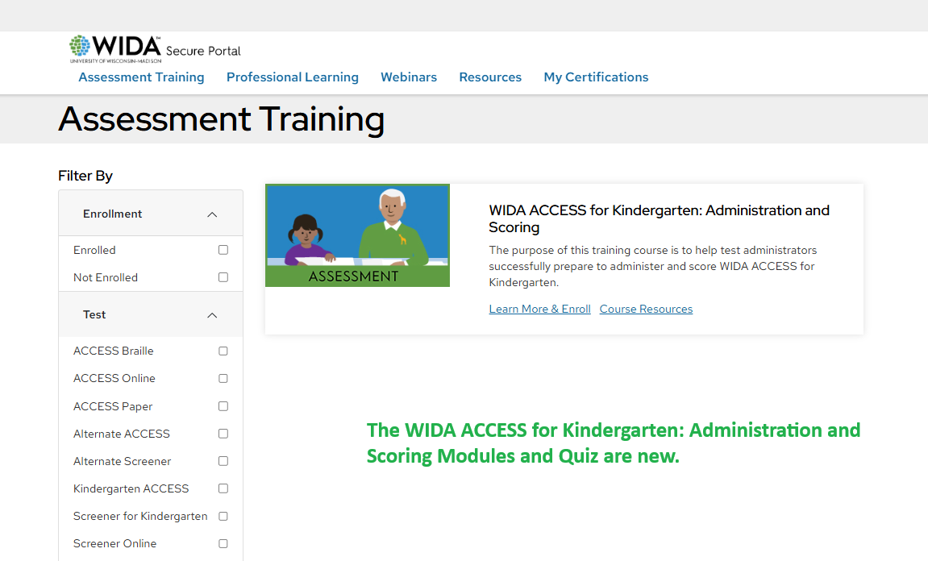
New Modules and Quiz

Slide 28
Kindergarten Low Vision Accommodation
A new accommodation is available for Kindergarten students with low vision needs.
The accommodation:
Low Vision Test Administrator Script
Addresses the unique needs of students with low vision and promotes a standardization of the testing experience.
Scripts are ordered by the DAC during the additional materials order window through DRC Customer Service.
The accommodation LV- Low Vision Test Administrator Script (WIDA ACCESS for Kindergarten Only) will be added to the Student Import File Layout, Student Management Accommodations tab, and student test booklets.

Slide 29
Initial Materials Orders
Online, Kindergarten and Alternate (with correct indicator in the October snapshot) are ordered automatically through the PreID file.
Paper (standard print), large print, and Braille require an IEP or 504 and require active ordering.
UPDATED Paper (standard print) requirement
The student has a documented disability that directly impacts their access to computerized technology preventing access to a computer-based assessment
e.g., epilepsy, other seizure disorder, neurological disorders that prevent access computerized technology, etc.
A hearing impairment that requires visual phonics to access computer presented audio

Slide 30
Additional Materials Ordering
The permission to order additional materials is being returned to District Assessment Coordinators!
Returned with conditions:
DACs need to collect orders from schools and submit orders sparingly.
If more than 2 orders are placed in a week, ordering permission will be removed, and future orders must be placed through CDE
Additional materials must be placed through _District-Level Additional Orders Only Site – WWWW not school specific
If you believe you have a scenario where a student qualifies for Hand Writing response connect with CDE for approval.

Slide 31
CD and Audio Streaming for ACCESS Paper
For students utilizing ACCESS paper per IEP/504 Plan documentation
Speaking and Listening can be played through the CD (provided with initial materials) or audio streaming within WIDA AMS
Audio streaming permission in WIDA AMS is titled Media Player - Registration View
Do not order CDs with additional materials, use the audio streaming in WIDA AMS.
Contact Heather Villalobos Pavia to activate Media Player - Registration View.

Slide 32
Scratch Paper Update
CHANGE Colorado DOES NOT allow scratch paper for the Speaking domain.
Scratch paper is allowed upon student request for the Listening, Reading, and Writing domain. When requested, blank scratch paper is passed out by the test administrator. All scratch paper is collected at the end of the test session and securely destroyed.

Slide 33
WIDA AMS
Test Management
The Test Management application now includes the Unregistered Student Export feature, which helps identify students who are not assigned to a registration.
WIDA ACCESS Paper Audio
WIDA ACCESS Paper Audio is a new application for the 2025-2026 administration.
Allow users with the appropriate permissions to play the Listening and Speaking audio tracks through WIDA AMS, rather than playing the audio on a CD.
Import Management
The Registration Import File was added in the 2024-2025 assessment year to Import Management for WIDA ACCESS. This will now be available for the WIDA Screener.
Contact DRC Customer Service at (855) 787-9615 or wida@datarecognitioncorp.com

Slide 34
Communication and Resources

Slide 35
Communication
CDE Assessment works with the official superintendent-appointed DAC and DTC
School-level staff, including Test Administrators and school leadership, refer questions to the SAC
SACs and district-level staff refer questions to the DAC and DTC
Official DACs and DTCs refer questions to CDE Assessment
DACs and DTCs share information from CDE with district and school-level staff, as appropriate
Using this communication structure ensures local policies and procedures are communicated
Note: CDE Assessment and CDE Accountability are separate groups. The District Accountability Contact list is maintained by CDE Accountability. Direct questions about ACCESS Growth to CDE Accountability

Slide 36
District and School Communication to Parents
Requirements & District Responsibilities Assessment Information
§22-7-1013(7)(a)
LEP (Local Education Provider) will annually distribute to parents and post on its website, as early in the school year as possible, written information regarding its assessments, including:
The state and local assessments that the LEP will administer
Identify whether it is required by federal law, required by state law, or selected by the LEP
Assessment calendar:
Estimated hours of testing each testing day for specific classes/grades for each assessment
Identify whether the assessment is required by state law, federal law or locally selected
The purposes of the assessments
The manner in which assessment results will be used

Slide 37
District and School Communication to Parents
Results
ISRs (Individual Student Reports) are to be shared with parents/guardians as soon as practicable, before the end of the school year.
Reports are confidential and distribution of both electronic and/or hard copy reports must be in accordance with state and federal privacy laws, and local school board policy

Slide 38
Colorado Specific Documents
CDE Assessment Division
Colorado WIDA ACCESS Training Information
Colorado Accommodations Training
Colorado ACCESS Checklist
CDE Office of Culturally and Linguistically Diverse Education
Identification
Language Proficiency Coding
Redesignation

Slide 39
WIDA and DRC Resources
WIDA (require login)
District and School Coordinator Manual
Test Administrator Manual
Test Administrator Essentials
Accessibility and Accommodations Manual
DRC
WIDA AMS User Guide

Slide 40
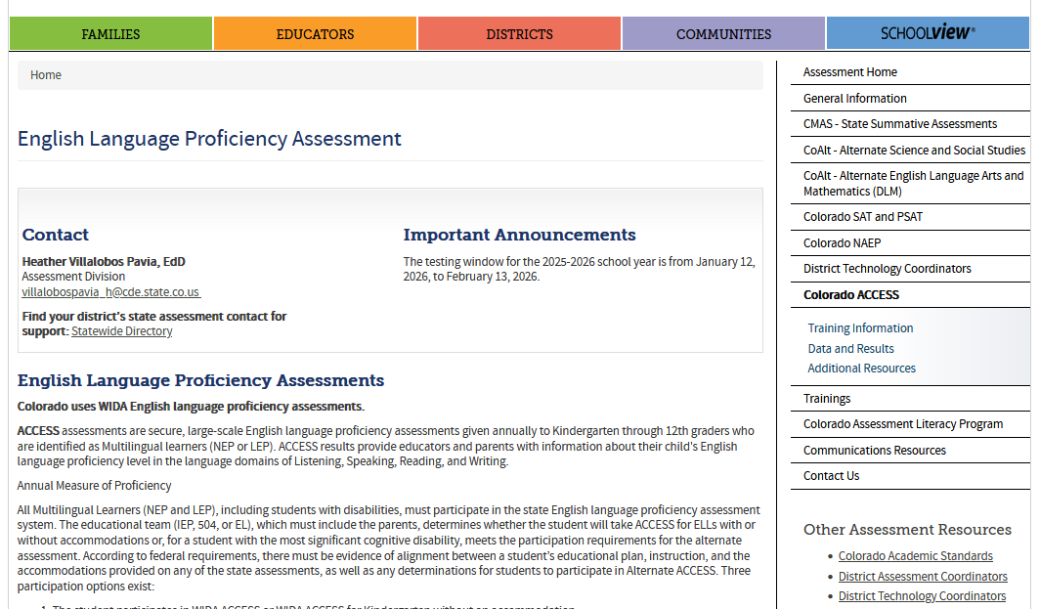

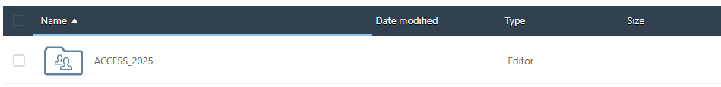
CDE webpage/resources
ACCESS (https://www.cde.state.co.us/assessment/ela)
Syncplicity

Slide 41

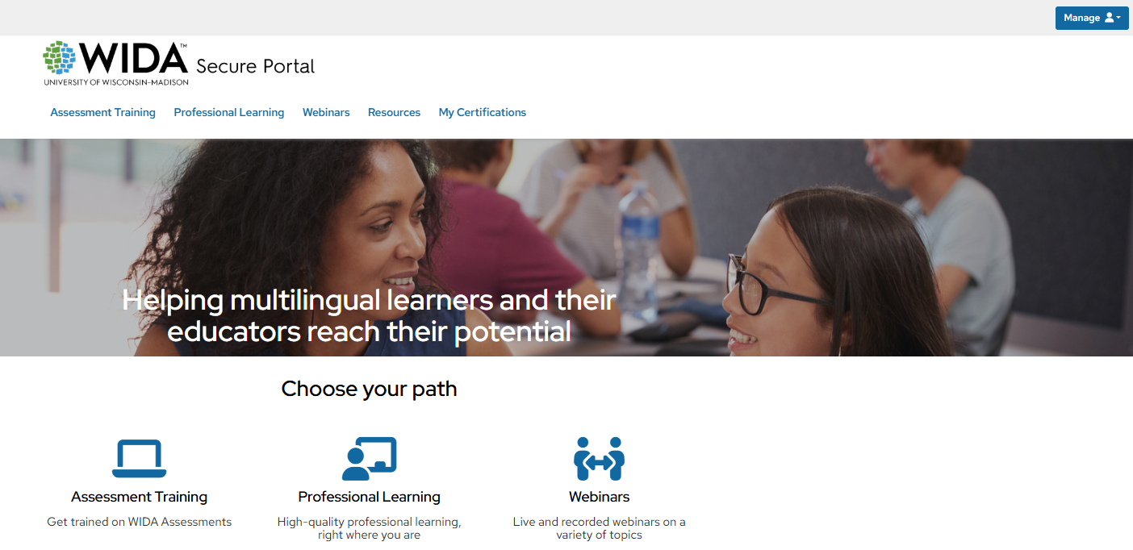
WIDA Secure Portal https://wida.wisc.edu/
Accounts must use District/School email address.

Slide 42
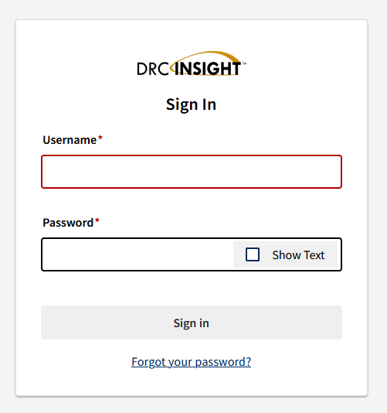
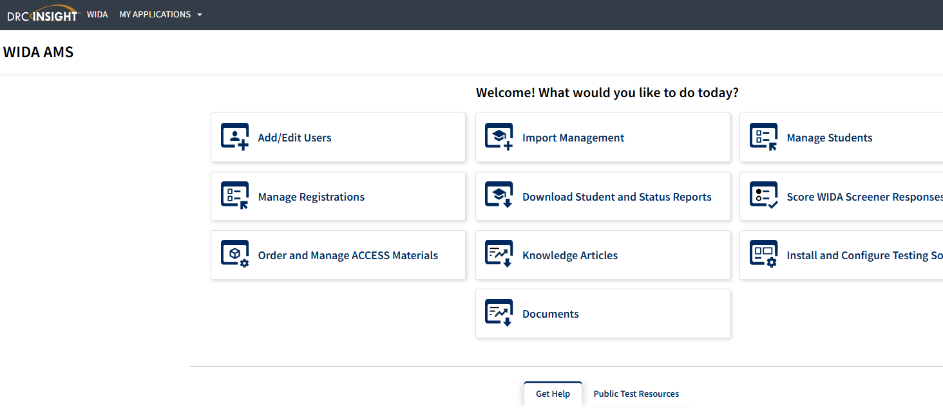
WIDA AMS https://www.drcedirect.com
Accounts must use District/School email address.

Slide 43
Security and Training Requirements

Slide 44

WIDA ACCESS Security
ACCESS Assessments are secure tests
Colorado Security Agreement

Slide 45


Intellectual Property
All WIDA assessments and related materials are the copyright of the Board of Regents of the University of Wisconsin System. Should an egregious security incident occur compromising WIDA’s intellectual property remedies for violations will be governed by Wisconsin State Statutes.

Slide 46
Training
DACs are to hold annual trainings ensuring SACs are aware of all local assessment policies and deadlines.
Test Administrators need to complete modules and quizzes provided through the WIDA Secure Portal. Passing the quiz counts as certification for test administration.
Certification must be completed annually.
DACs and SACs need to ensure TAs of sessions using test accommodations are trained on proper accommodation use.

Slide 47
Test Administrators Training Requirements
Be trained annually
Complete the requirements of the district/school annual ACCESS training.
Complete the WIDA Training Module(s) and Certificate
Oct 1, 2025 – January 9, 2026
Submit a signed Security Agreement to their SAC
Read the Colorado Resource Document, the WIDA TAM, and familiarize themselves with test administration procedures before administering the test to students.
Actively proctor the test administration in its entirety
If administering assessments in which students are provided accommodations, be trained appropriately.

Slide 48
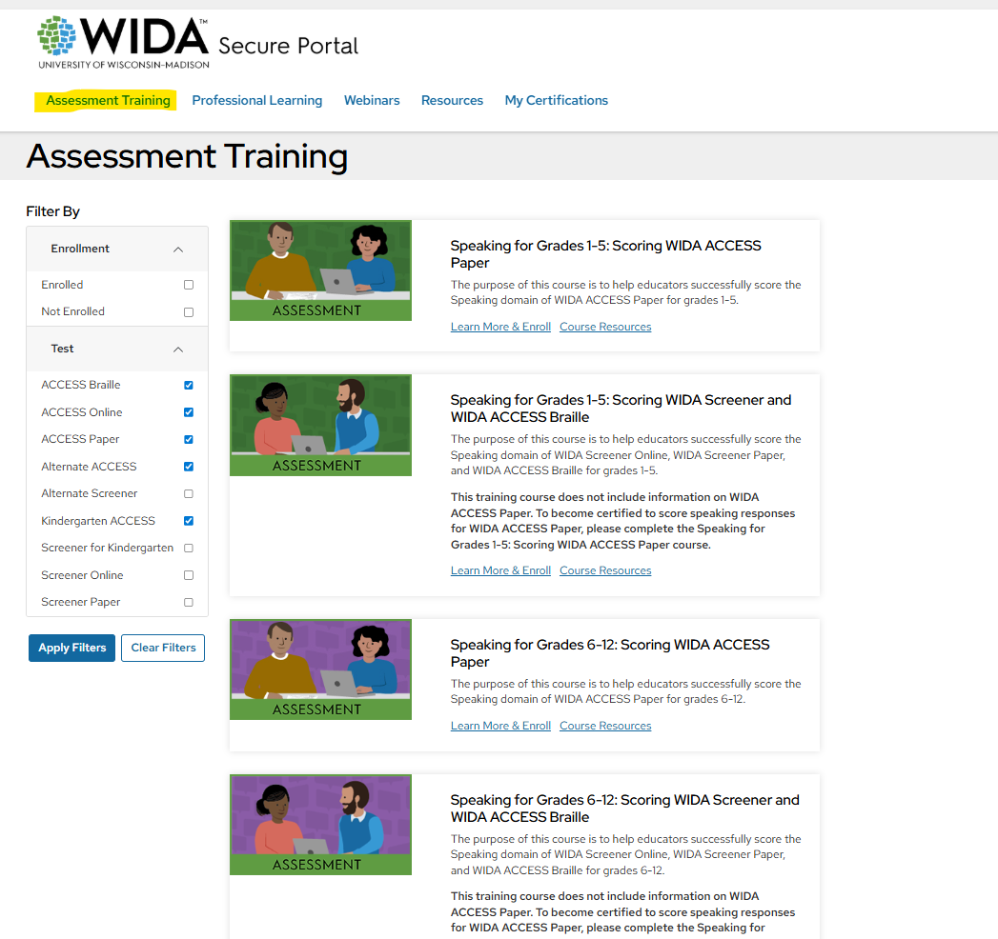
Assessment Training in the WIDA Secure Portal

Slide 49
Kindergarten eLearning Webinar
Assessment will host a special WIDA eLearning webinar
Exploring WIDA ACCESS for Kindergarten
Live virtual webinar
Must register in advance
Registration email directly to DAC November 12th
One registration per district
Access to recorded version and all materials
Option 1: Exploring WIDA ACCESS for Kindergarten
December 9, 3:00 – 4:30 p.m.
Option 2: Exploring WIDA ACCESS for Kindergarten
December 10, 8:30 – 10:00 a.m.

Slide 50
Test Security and Integrity
Maintaining the security of test materials and student data is essential.
Key Actions:
Secure storage and handling of materials
Signed security agreements
Clear chain of custody for test materials
Active Proctoring
Use of Test Monitoring Application and Waiting Room
Secure transmission of student data to CDE
Protection of logins and student test tickets/rosters

Slide 51
Training
All involved in assessment be it through
Administration
Receiving, distributing or storing materials
Managing student data
Must be trained on best practices of standardized assessment administration, security, and student privacy.

Slide 52
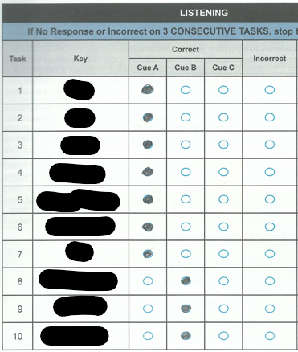
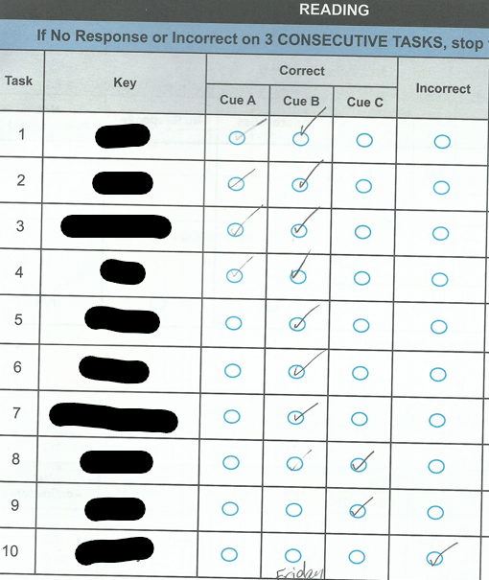
Marking student responses
CORRECT
INCORRECT
TAs for Kindergarten and Alternate
must use a #2 pencil and completely fill the answer choice.

Slide 53

Transmitting Secure Information
Use Syncplicity to send secure information to CDE
Two users per district can access the CDE_Assessment folder
The official DAC
One additional individual, if requested (submit request to Collin Bonner)
CDE will email a list of users to each district
Respond with updates
New users must create/access their accounts within 90 days
Reminder: Do not send personally identifiable information (e.g., SASID, name, free and reduced lunch status, disability status, test scores, etc.) through email
CDE Assessment will not respond to emails containing PII
The email will be deleted
Remind all staff who may communicate with CDE

Slide 54
CDE Assessment Monitoring
Consistent with all state assessments, The Colorado Department of Education (CDE) uses test monitoring as a tool to monitor and reinforce statewide administration of the ACCESS assessments CDE will notify districts that are selected for assessment monitoring.
3 options for ACCESS monitoring
virtual before testing
on-site during testing
virtual post testing
The district does not choose which monitoring they participate in.
Approximately 15 districts will be selected

Slide 55
Materials

Slide 56
Initial Materials
Materials ordered automatically through October Snapshot:
WIDA ACCESS
WIDA ACCESS for Kindergarten
Alternate ACCESS (Alternate Assessment Participation must be marked in Student Interchange*)
Materials that require order placement via Syncplicity:
WIDA ACCESS Paper
WIDA ACCESS Large Print Paper
WIDA ACCESS Braille
DACs email Heather Villalobos to request order form (orders due 10/31).
Paper available, when a student has a documented disability that directly impacts their access to computerized technology and therefore prevents their access to the digital assessment
e.g., epilepsy, other seizure disorder, neurological disorders that prevent access computerized technology, etc.
A hearing impairment that requires visual phonics to access computer presented audio
*Students with a primary disability code of DD, SLD, SED, or SLI are not eligible for alternate assessments.

Slide 57
Additional Materials January 6 – February 6, 2025
NEW The permission to order additional materials is being returned to District Assessment Coordinators!
DACs need to collect orders from schools and submit orders sparingly
If more than two orders are placed in a week, ordering permission will be removed
Future orders must be placed through CDE.
DACs place the additional materials order in WIDA AMS. Additional materials must be placed through _District-Level Additional Orders Only Site – WWWW not school specific.
Very few students will use Human Reader scripts follow the guidelines in the Colorado Accommodations Crosswalk

Slide 58
Materials Return
Return scorable materials as early as possible
Colorado has about 40,000 scoreable materials
Timely scanning and scoring is essential to results timeline
Keep DRC Boxes for Returning Materials
Easily identifiable
Stronger
Water resistant coating
Not waterproof, put all scoreable materials in the provided plastic bags

Slide 59
Assessment Development Opportunities

Slide 60
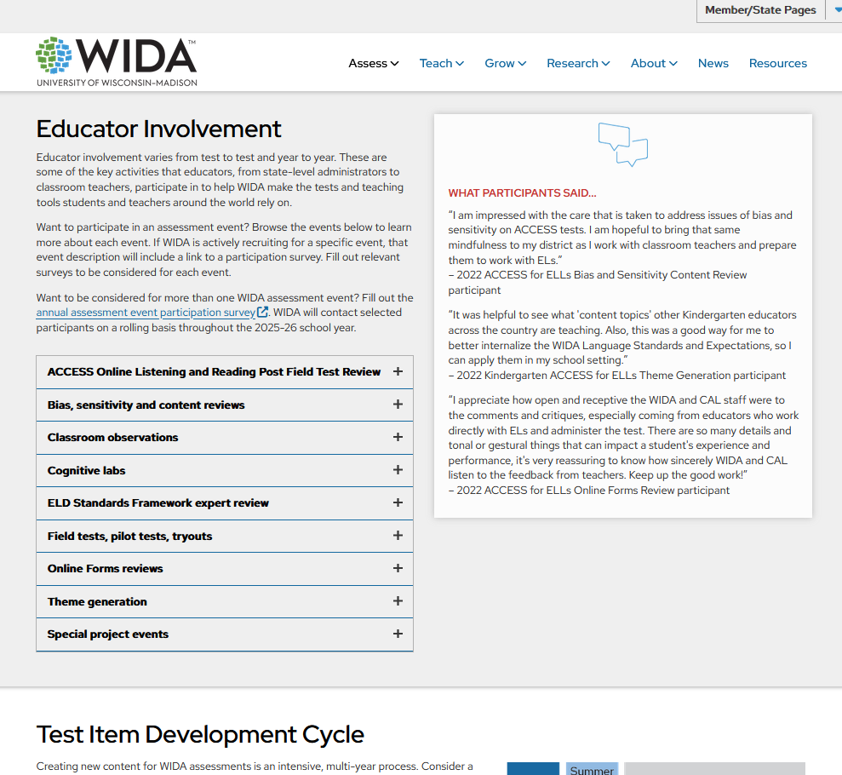
WIDA Assessments

Slide 61
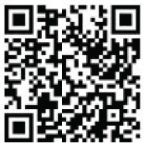


CMAS
Educator input is critical to Colorado's state assessment development and validation process. Educators may participate in committees related to the following state assessments:
Colorado Measures of Academic Success (CMAS): Science, Social Studies, Mathematics and English Language Arts/Literacy (ELA)
Colorado Spanish Language Arts (CSLA)
Colorado Alternate (CoAlt) Assessment: Science and Social Studies
State Assessment Development Flyer
Join the Colorado Educator Pool for assessment development committee selection:
CDE Assessment Educator Database
Scan Here!

Slide 62
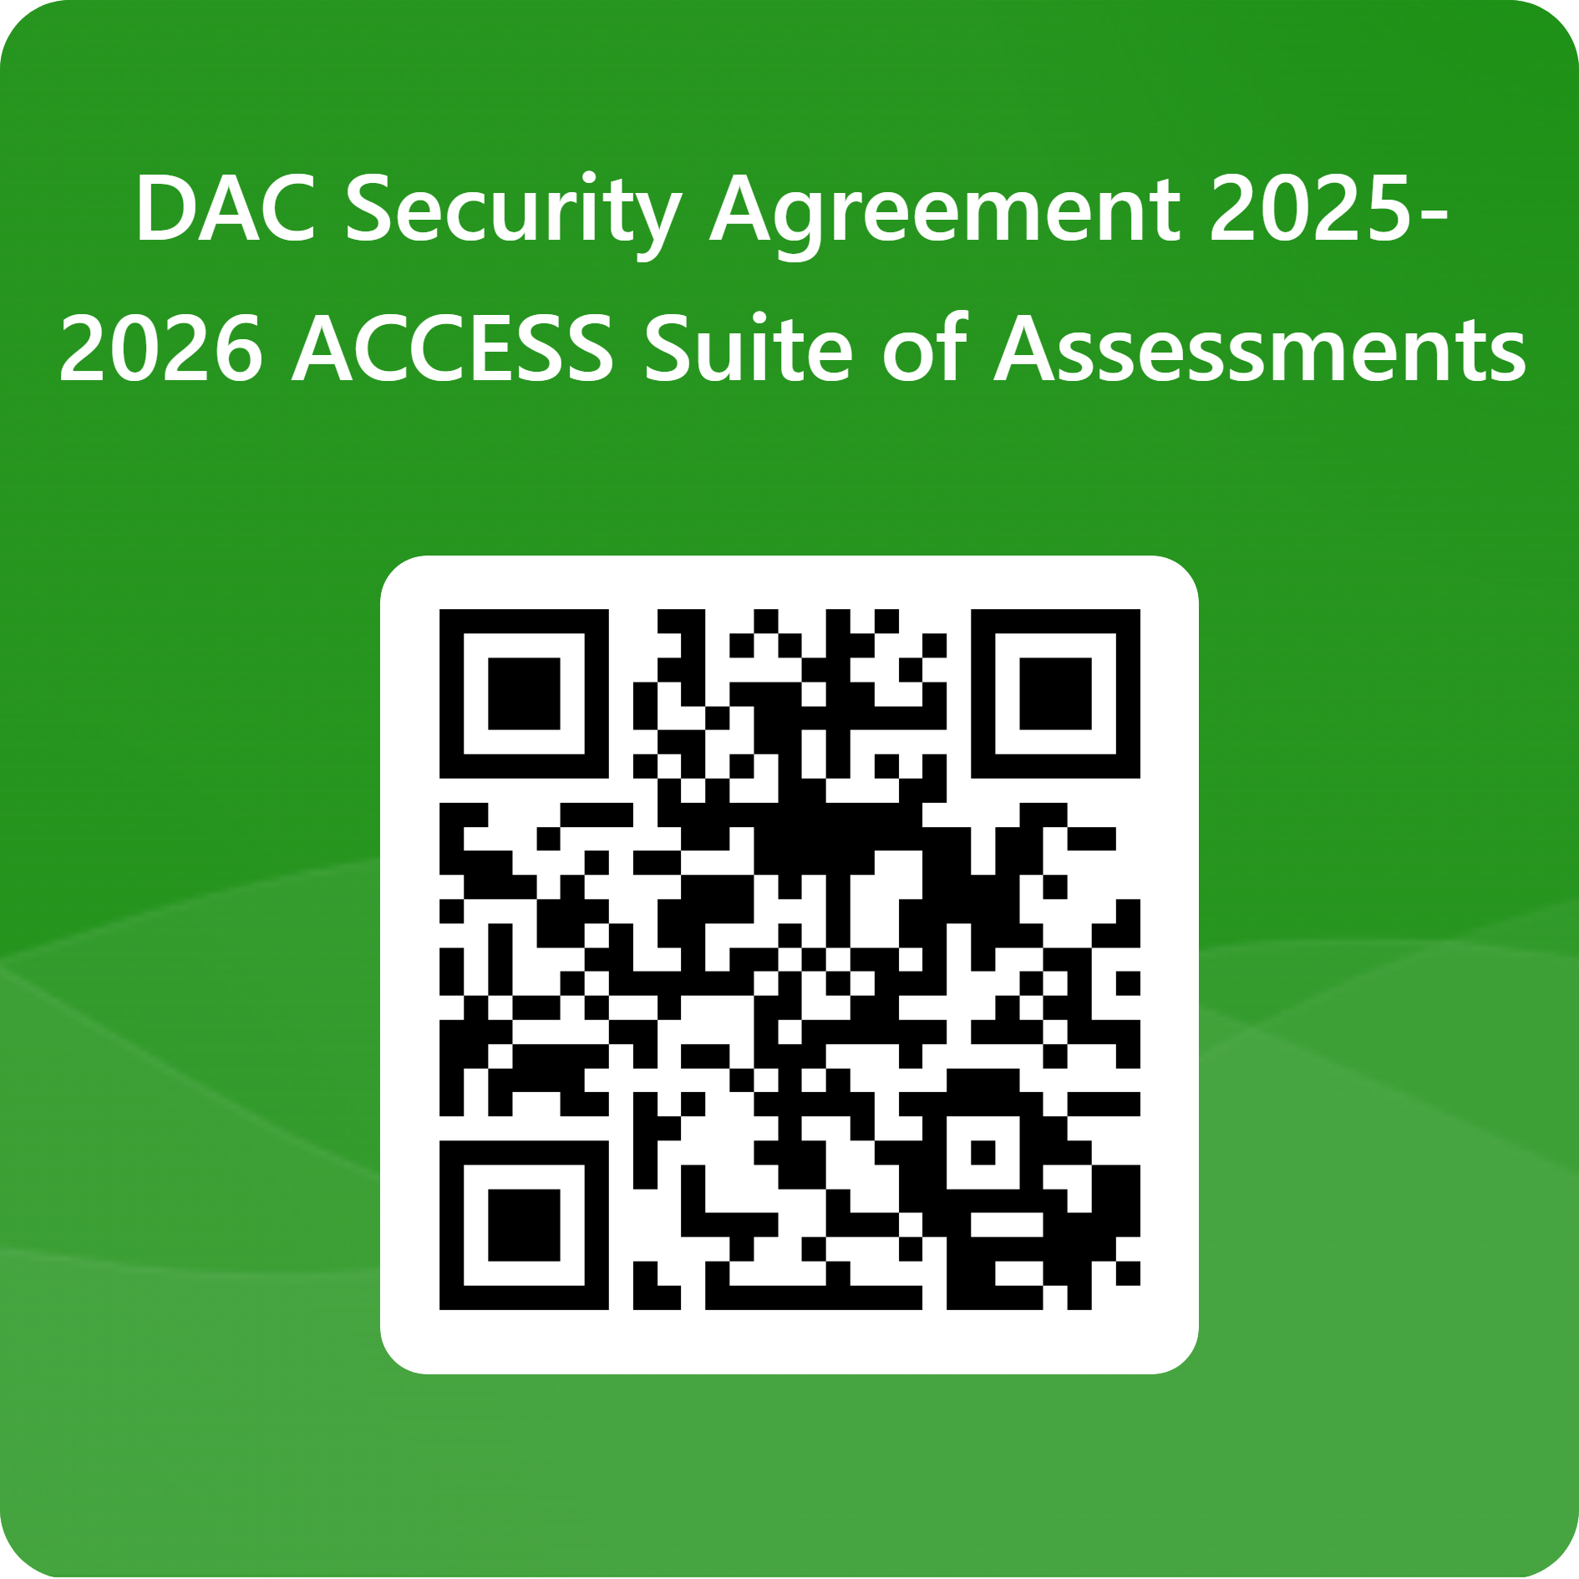
Thank you for attending the 2025-26 DAC Training.
DAC Security Agreement (to be completed ONLY by the official DAC)
https://forms.office.com/r/ym0JUhM3E4

