Slide 1
DTC Troubleshooting and Support Webinar
February2018

Slide 2
Agenda Topics
2017 Statistics
Common Early Warning System Triggers
Student Log Files
Using the ProctorCache Administration Page
Example Troubleshooting Scenarios

Slide 3
2017 Statistics

Slide 4
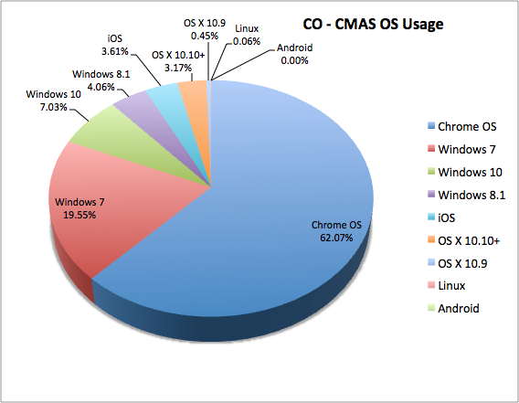
Operating System Breakdown
OS Breakdown
ChromeOS – 62%
Windows – 31%
iOS – 4%
OS X – 3%
565,375 Successful Logins
12,523 Errors logged
2.21% student login attempts received error code

Slide 5
Top 5 Error Messages
EWS Message Received
3005 – 58%
“TestNav has detected another application ...”
Background applications
1009 - 29%
“Unable to download test content”
Connectivity issues
1014 – 7%
“Unable to download test content”
Issues retrieving custom stylesheet
3044 – 4%
“You cannot lock the device”
Unable to lock device
3016 – 2%
“Your login information is no longer valid”
Login information invalid

Slide 6
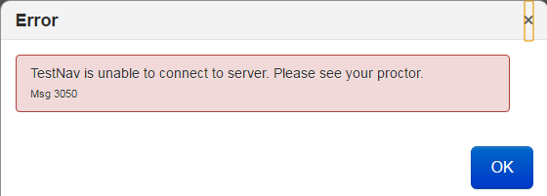
Other Error Messages
EWS Message Received
3029– 145
Test window has exited fullscreen mode
TestNav exited fullscreen
5030 – 129
Unable to communicate with the testing server
Connectivity – unable to communicate with testing server
3050 – 113
TestNav is unable to connect to server
Connectivity – unable to communicate with update server
1010 – 107
The test content is corrupted
Content checksum mismatch (aggressive content filter)
3055 – 97
The TestNav app needs to be restarted
TestNav needs to restart

Slide 7
Common 3005 Errors
Common 3005 Errors
Sethc.exe – 1099
Windows acessibility options
Explorer.exe – 837
Taskbar, explorer window, Windows shell
Ease of access dialog – 632
Windows accessibility options
Ctrl+Alt+Del – 623
Windows escape chord
Firefox.exe – 450
Firefox browser
Unknown system process – 300
Process could not be trapped

Slide 8
Common Early Warning System Triggers

Slide 9
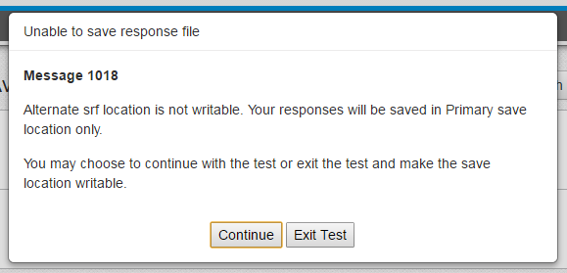
Common Early Warning System Triggers
Save File Location Invalid
Save file locations are tested during login, while the test is in progress, and during AppCheck
Requires read, write, and delete access
Specific error codes
1017 (primary) – Testing will be interrupted
1018 (secondary) – Message can be bypassed
Potential Causes
Network issues
Path issues
Read/write/delete access issues

Slide 10
Common Early Warning System Triggers
Unable to Download Test Content
ProctorCache Bypass is OFF
ProctorCache connection checked on login
Connection successful - Content gathered from ProctorCache machine
Connection unsuccessful – EWS message displayed
ProctorCache Bypass is ON
ProctorCache connection checked on login
Connection successful - Content gathered from ProctorCache machine
Connection unsuccessful – Content gathered from remote Pearson servers
If TestNav cannot retrieve content – EWS message displayed
TestNav will make multiple attempts to download content
Potential Causes
Network security is preventing access / blocking content
Connectivity issues

Slide 11
Common Early Warning System Triggers
Unable to submit responses
TestNav periodically attempts to submit SRF files to Pearson.
If transmission is unsuccessful during the test
SRF will be maintained locally until next transmission attempt
Testing continues uninterrupted
If transmission is unsuccessful during final submission
SRF will be retained locally
Error message is displayed and testing halts
Potential Causes
Connectivity issues
Network security is preventing the transmission

Slide 12
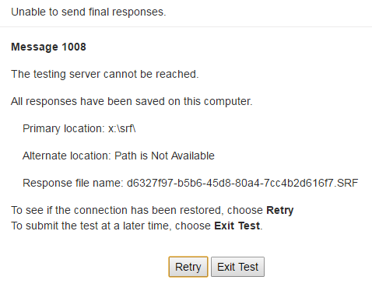
Common Early Warning System Triggers

Slide 13
Common Early Warning System Triggers
SRF File Cannot be Found
When a student is resumed and TestNav cannot find the previous login attempts SRF file
A message will be displayed giving the option to search for the SRF or continue
Potential Causes
Student was set to ‘Resume-Upload’ in the assessment portal
Student resumed on different device
Network SRF location cannot be reached
Local SRF file has been manually moved / removed

Slide 14
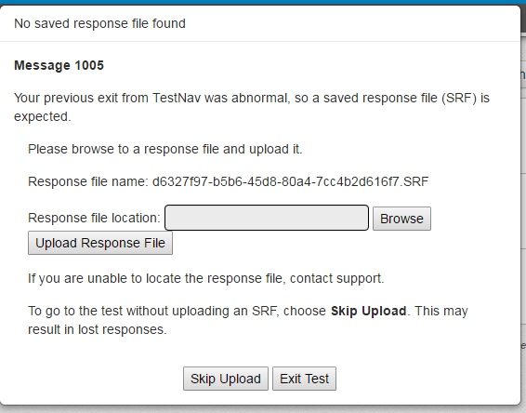
Common Early Warning System Triggers

Slide 15
TestNav Log Files

Slide 16
Student Log Files
Three Parts
[ timestamp]-Started.log
Created when TestNav is launched
Records initialization, device specifications, and client information
Logging moves to student specific logging on login
[timestamp]-[ Student Identifier ].log
Records all test and student interactions
Retrieving content, navigating, interaction (not item specific), SRF saves, error messages
Logging moves to *NotSignedIn.log after successful logout interaction
[ timestamp]-NotSignedIn.log
Records shutdown and cleanup functions

Slide 17
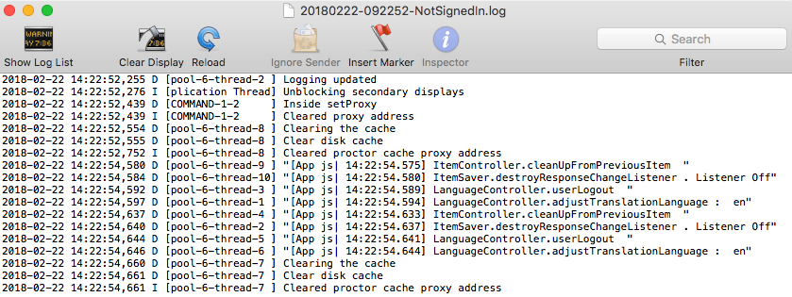
Student Log Files
Finding log files
https://support.assessment.pearson.com/x/DAACAQ
Linux / Mac / Windows
Log files will be located in the test computers home directory
Android / Chromebook / iPad
Log files are written to the device
Each device has specific retrieval instructions

Slide 18
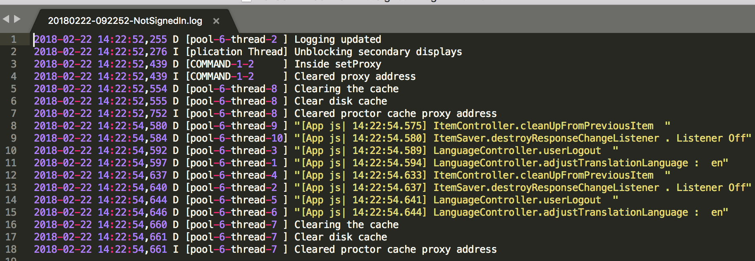
Student Log Files
Opening Log Files
Open with a text editor
Notepad
TextEdit
Vim
SublimeText
Etc.
Some advanced editors may allow you to create highlighting and formatting rules

Slide 19
Student Log Files
Interpreting Log Files
Bulk of useful information is located in the student log file
Each entry is timestamped
Follow all interactions student made while logged in
Search for key terms
Error, navigate, submit, logout, save, SRF, write
Useful entries
Beginning and ending interactions
Log files that end suddenly or without being passed to shutdown log

Slide 20
Using The ProctorCache Administration Page

Slide 21
Using The ProctorCache Administration Page
ProctorCache Administration Page
Simple administration site
View cached content and connected clients
Can be used for troubleshooting
When to Use
Pre-test
Verify cached content status
Test Time
Verify cached content status
Verify cached content is being used
Verify client connections
Troubleshoot issues
Post-test
Purge cached content

Slide 22
Example Troubleshooting Scenarios

Slide 23
Example Troubleshooting Scenario
Unable to connect to testing server
Potential Causes
Network / ProctorCache down
Network security blocking item assets
Content not cached successfully
Infrastructure configuration
Things to check
Verify ProctorCache service is running
Verify content was cached successfully
Verify whitelisted URLs and ports – has anything changed on your network since infrastructure was configured?
Bypass ProctorCache service
Connect via hotspot

Slide 24
Example Troubleshooting Scenario
Student unable to stay logged in
Potential Causes
Student intervention
Device configuration
Things to check
Test examiner should report any abnormal testing situations or observations (hand placement over power button, kicking power strip)
Look at the student log files for abnormalities
Look at the device log files for abnormalities
Note:
We are working with secure tests – monitoring the student directly may not be appropriate

Slide 25
Example Troubleshooting Scenario
Orphaned SRF files after testing is complete
Potential Causes
SRF file moved
Student receives additional error message before SRF can be consumed
SRF file is skipped when asked to browse / upload
Things to check
Verify that all students are in complete status

Slide 26
Example Troubleshooting Scenario
Students are not logged in but still showing active
Potential Causes
TestNav exited ungracefully
Things to check
If necessary – investigate the reasons why TestNav exited unexpectedly

Slide 27
Thank You!

