Slide 1
2016-2017 DAC Kick-Off Meeting
August 25, 2016
Assessment Unit

Slide 2
Welcome and Agenda
2015-16 Results
2016-17 General Information
WIDA: ACCESS for English Language Learners
CMAS:
Science and Social Studies; PARCC English Language Arts and Mathematics
CoAlt:
Science and Social Studies; DLM English Language Arts and Mathematics
PSAT 10 and SAT
Data
NAEP and International Assessments
Communication
Supplemental Information

Slide 3
2016-2017 Assessment Calendar
Assessment | Grade | Tentative Windows
ACCESS for ELLs® - Reading, Writing, Speaking and Listening | K-12 | January 9 - February 10, 2017
CMAS and CoAlt: Social Studies¹ | 4, 7 | April 10 - April 28, 2017
CMAS and CoAlt: Science | 5, 8, 11 | April 10 - April 28, 2017²
CMAS: PARCC ELA and Math | 3-9 | April 10 - April 28, 2017²
CoAlt: DLM ELA and Math | 3-11 | Aligned to CMAS: ELA and Math schedule
PSAT 10 | 10 | April 11th or April 12th, 2017 April 25th or April 26th, 2017 make-up
SAT | 11 | April 11th, 2017 April 25th, 2017: Make-up testing date April 11th – 14th, 2017: Accommodations window April 17th – 21st, 2017: Accommodations make-up testing
¹Social Studies will be on a sampling basis.
²See next two slides for optional extended window options for online testing.

Slide 4
Early CMAS: PARCC ELA and Math Online Administration
Standard window: April 10 - April 28
All elementary and middle school science and social studies administrations must be completed within this window
All school-wide paper-based administrations for ELA and math must be completed within this window
Students requiring paper accommodations in schools administering online assessments may test at the same time as their peers.
The window can start earlier only for online ELA and math for a total of 6 weeks to compensate for technology capacity
March 13th for PARCC
March 15th for DLM
Notification to CDE at the November trainings

Slide 5
Early CMAS: HS Science Administration
Standard window: April 10 - April 28
All elementary and middle school science and social studies administrations must be completed within this window
We are investigating if the high school science window can start earlier
We will update districts via email and office hours when this is finalized
Process for notifying CDE of intent to participate in early HS science window will be similar to the process for early online ELA/math

Slide 6
Scheduling Considerations
The Colorado Spanish Language Arts (CSLA) assessment should be administered in the same window as CMAS: PARCC ELA.
To the extent possible, a student taking CoAlt, CSLA or CMAS with accommodations in a content area for which the student is participating in a general education class should be assessed at the same time as their peers to avoid missed instruction.
Ensure the students taking these assessments do not miss instruction from their general education class.

Slide 7
2015-16 Reporting

Slide 8
2015-16 Reporting
CDE reviews CMAS data files and reports before they are released to districts.
CMAS and CoAlt Science and Social Studies Reporting:
Impacted by paper-based testing
Unanticipated back-and-forth review rounds with the vendor
Vendor system interactions across content areas limited access to posted reports
CMAS: PARCC ELA and Math Reporting:
Significantly impacted by paper-based testing
Vendor system interactions limited access to rolling files
CoAlt: DLM ELA and Math Reporting:
Vendor reporting errors

Slide 9
2015-16 Reporting Timeline
Schools and Districts have:
All science and social studies reports and files
CMAS: PARCC ELA and math individual student level files, electronic individual student reports, summary files, student rosters, district summary of schools
CoAlt (DLM): ELA and math individual student level files
CO ACT reports and files
PSAT10 reports and files via College Board website

Slide 10
2015-16 Reporting Timeline
Remaining reports/files:
Next week (expected): CMAS: PARCC ELA and Math unique to Colorado reports (Performance Level Summaries (disaggregated), Evidence Statement Analysis Reports, and Content Standards Rosters) and hard copy individual student reports
Next week (expected): CSLA reports and files
TBD: DLM individual student reports
TBD: DLM aggregated reports

Slide 11
2015-16 Reporting Timeline
Publicly released:
CMAS and CoAlt: Science and social studies state overall and disaggregated results
CMAS science school and district overall results
CMAS: PARCC and DLM ELA/math state overall and disaggregated results
Embargoed until September 1st:
CMAS: PARCC ELA/math school and district overall results
Mid- to end-September
CMAS: PARCC ELA and Math Growth
School and district CMAS disaggregated results

Slide 12
Data Privacy
Reminder: The data in school and district files and reports is confidential
Includes state level disaggregations
Public state data reported
http://www.cde.state.co.us/assessment/cmas-sciencesocial-dataandresults
http://www.cde.state.co.us/assessment/cmas-englishmath-dataandresults
Prior to making district and school data public, make sure you are in compliance with state and federal law
Reminder: The state will have posted school and district overall results with state suppression rules applied
Mean scale score
Percent met and exceeded

Slide 13
General Information

Slide 14
Meet the CDE Assessment Team
Joyce Zurkowski
Executive Director of Assessment
Margo Allen
Business Process Manager
303-866-6929
Will Morton
Director of Assessment Administration
Christina Wirth-Hawkins
Director of Assessment Development
Open – PSAT 10/SAT
Stephanie Boyd
CMAS: PARCC Coordinator
Pam A. Sandoval
NAEP & TIMSS
Sara Loerzel
CMAS Administration & PearsonAccess
Heather
Villalobos Pavia
ACCESS, CSLA, Linguistic Accommodations
Open
CMAS Content Development
Mindy Roden
CoAlt, DLM, SPED Accommodations
Collin Bonner
Technology Support
Jasmine Carey
Psychometrics, Data: College Entrance & DLM
Shangte Shen
Data: CMAS, incl. PARCC
Melissa Mincic
Data: ACCESS and SBDs

Slide 15
Colorado State Assessments
Colorado Measures of Academic Success (CMAS)
WIDA: ACCESS 2.0 for ELLs
ELA/L & Math
(PARCC)
Science & Social Studies
PSAT 10
CoAlt: ELA/L & Math (DLM)
CoAlt: Science & Social Studies
Colorado Spanish Language Arts (CSLA)
SAT
Federal Assessment: National Assessment of Educational Progress (NAEP)

Slide 16
State Content Assessments: Grades 3-9 School Year 2016-2017
Grade | ELA | Math | Science | Social Studies*
3 | X | X
4 | X | X |  | X
5 | X | X | X
6 | X | X
7 | X | X Grade 7 or Algebra I or Integrated/Math I |  | X
8 | X | X Grade 8 or Algebra I or Integrated/Math I or Geometry or Integrated Math II | X
9 | X | X Algebra I or Integrated/Math I or Geometry or Integrated Math II or Algebra II or Integrated/Math III
* Social studies will be assessed on a sampling basis.

Slide 17
State Content Assessments: Grades 10 and 11 School Year 2016-2017
Grade | PSAT 10 | SAT | Science | Social Studies*
10 | X
11 |  | X | X (all)
The DLM assessment is the corresponding assessment to the PSAT 10/SAT for students with the most significant cognitive disabilities.
* Social studies will not be assessed at the high school level this year.
The student-selected writing portion of the SAT will be administered during the school day.
- Details about ordering process will be shared later this fall. Registrations will be required in December.

Slide 18
Social Studies
Individual schools will be sampled once in three years
Priorities:
Reduce testing burden
Avoid creating cohorts of social studies students
Ex., minimize the number of students who will test as 4th graders and as 7th graders
Provide state level results that can be compared from administration to administration
Notification has been placed in Syncplicity

Slide 19
Annual Training Requirement
http://www.cde.state.co.us/assessment/annual_trng_requirements
Assessment specific training for all district and school personnel involved in any aspect of Colorado’s state assessments is required on an annual basis.
DACs must meet with School Assessment Coordinators (SACs) to ensure that a training plan is in place for training Test Administrators, Test Examiners, Technology Coordinators, and any other school staff handling secure materials.
Districts are required to collect signed documentation that demonstrates an understanding of the policies and procedures set forth by the State of Colorado and the district.

Slide 20
Paper-based Testing
Determined by Local Education Provider (LEP)
Charter schools are their own LEP
Considerations
Instructional match
Grade level variation
Test design
Technology capacity
Logistics
Must have the grade appropriate calculators for math (grades 6-9)
Must commit to meeting the security requirements and accounting for all secure materials
Includes chain-of-custody documentation and reports for missing materials

Slide 21
Online Assessment Platforms
Assessment | Test Engine | SIS | Notes
ACCESS for ELLs® Reading, Writing, Speaking and Listening |  | WIDA Assessment Management System (WIDA AMS) | Caching server. Clients for Windows, Linux, Mac OSX, Chromebooks, iPads, and Android.
CMAS and CoAlt: Science and Social Studies |  |  | Caching server available. Installable apps for desktop Apps for Chromebooks , Androids, and iPads.
CMAS-ELA and Mathematics (PARCC )
Dynamic Learning Maps (DLM) CoAlt |  | Educator Portal | KITE client install for each device.

Slide 22
WIDA ACCESS for ELLs® ^{WIDA Screener}
Heather Villalobos Pavia

Slide 23
ACCESS for ELLs®
These English language proficiency assessments for grades 1-12 are available via online or paper.
Kindergarten and alternate ACCESS remain as a paper-based kit.
All Test Administrators will need to participate in WIDA’s checklists or quizzes and have an opportunity to ask questions to their school or district assessment leaders.

Slide 24
ACCESS for ELLs® Key Dates
ACCESS Testing Window
Monday, January 9 - Friday, February 10, 2017
Test Order Window
October 3 – November 11, 2016
If you do not need tests, still login to Data Recognition Corporation (DRC) and indicate zero
WIDA AMS Test Setup Available
November 29, 2016 – February 10, 2017
Districts Receive Test Materials (on or before)
December 15, 2016

Slide 25
WIDA Training
Registration for trainings will be sent at the end of September.
Trainings will be all day; lunch will be provided by CDE.
October 17, 2016 – Denver (Golden)
October 18, 2016 – Greeley
October 20, 2016 – Limon
October 21, 2016 – Pueblo
October 24 2016 – Montrose
WIDA will also offer a variety of pre-testing, during testing, and post-testing webinar trainings. Topics and dates will be communicated via DAC email.

Slide 26
WIDA Screener
WIDA has created a new screener for grades 1-12 that aligns with ACCESS for ELLs 2.0
The Assessment Unit will provide WIDA Screener paper kits to districts in the fall.
Included in the kit: Student Test Booklets, audio files for Listening and Speaking domains on USB or CD, Test Administrator’s Script, Student Response Booklets, and Recording Script.
The preparation and training for WIDA Screener Paper can be found here: https://www.wida.us/assessment/Screener/screener-paper.aspx#prep

Slide 27
WIDA Screener Continued
WIDA Screener Online will become available after completion of the standard setting work, anticipated in October, 2016.
Eligibility cut scores for the new WIDA Screener (both paper and online) will be provided at the time of training.

Slide 28
WIDA Screener Continued
CDE has determined that districts may use either the existing W-APT or the new WIDA Screener as they like throughout the 2016-2017 school year.
Full implementation of the new WIDA Screener must be in place by July 1, 2017 for the 2017-2018 school year.
As a reminder, the Kindergarten W-APT has not been updated and will remain the same.
For questions regarding the process of identifying EL students, please contact the Office of Culturally and Linguistically Diverse Education (CLDE) at www.cde.state.co.us/cde_english/contactus

Slide 29
DRC Component Updates
TSM Version 9.1
Enhanced content verification of increased content download retries
On demand content verification with auto-corrections
Limited log information sent to DRC at regular intervals
64-bit TSM
Enhanced Load balancing options
Removed response caching from TSM (all domains)
Still need the Device Tool Kit to configure client devices.

Slide 30
DRC Component Updates
Test Engine & Secure Browser
Test Responses will go directly from test client to DRC, bypassing the TSM
Slicing Speaking Test responses into pieces, compress, encrypt and sending separately
Error messaging
Student friendly so they don’t feel they did something wrong
Clearer Speaking Test end-of-test message
More specific messages on the problem encountered with more information
Improved troubleshooting information for site and DRC Customer Support
Resiliency - more retries. Applies to both content retrieval and response processing

Slide 31
DRC Component Updates
AMS
Data Validation export > 500
Enhanced District progress report
AMS Menu changes
4 Tickets per page from current 8 tickets per page
Student Transfer
AMS Student Management
Domain Termination (role based)
AMS Test Management
Manage Student Export All Fields/>3000Export/Import

Slide 32
DRC Component Updates
September 1, 2016
Updated TSM Specifications
Final Site Technology Readiness Checklist

Slide 33
CMAS PARCC English Language Arts and Mathematics Colorado Spanish Language Arts (CSLA) Science and Social Studies
Stephanie Boyd and Sara Loerzel

Slide 34
CMAS Assessments – Administration Grades and Content Areas
Science and Social Studies
Elementary, Middle, and High School Assessments
Science: grades 5, 8, and 11
Social studies: grades 4, 7
A sample of schools will administer the social studies assessments
ELA/Literacy and Math
Grades 3-9 all students test:
ELA/L and Mathematics
CSLA for grades 3-4 ELA/L only

Slide 35
ELA & Math Testing Times
Math units have similar testing times
Math grades 3-5: four 60 min. units
Math grades 6-8: three 80 min. units
Math high school: three 90 min. units
ELA all grades have 3 units*
Grade 3: 2 units of 90 min. and one unit of 75 min.
Grades 4-5: 3 units of 90 min.
Grades 6-9: 2 units of 110 min. and one unit of 90 min
*4 units for grades within a school that are selected for the ELA field test

Slide 36
Science & Social Studies
Grades
Social Studies* – 4 and 7
Science – 5, 8, and 11
S/SS assessments have 3 units
Current unit timing:
80 minutes per unit – elementary and middle school
60 minutes per unit – high school
Social Studies
Sampling at the school level
Individual schools will be sampled once in three years
Selected schools list is in Syncplicity

Slide 37
CMAS: PARCC ELA Field Testing
Sampling only one grade per school
Not schools sampled for social studies
Students in sampled grade will have an additional unit. PAnext will have 4 units.
Grade 3: 3 units of 90 min. and one unit of 75 min.
Grades 4-5: 4 units of 90 min.
Grades 6-9: 3 units of 110 min. and one unit of 90 min.

Slide 38
CMAS: PARCC Paper-based Test (PBT) Format
PBT Grade 3
Consumable booklet
ELA and Math PBT Grades 4 and above
Will have test books and answer documents
Students will need space for the following:
Test booklet
Answer document
Scratch paper
Math reference sheet
Calculator (if allowable)
Provided tools (ruler, protractor)

Slide 39
CMAS: PARCC Note
The PARCC Test Coordinator Manual (TCM) will be posted in October.
Some PARCC states offer fall testing for high school, but Colorado does not participate
Do not use the fall Test Administration Manuals (TAMs) or training modules, as they do not reflect any changes in vendor systems (PAnext and TestNav).

Slide 40
Accommodations References
AF&A – Accessibility Features & Accommodations Manual
Check for current school year’s version
http://www.cde.state.co.us/assessment/201617parccafamanual
CMAS Accommodations Supplement will be in the Procedures Manual
Assessment Accommodations Webinar
Monday , August 29th 1:00-3:00
Tuesday, August 30th 10:00-12:00

Slide 41
Braille for Spring 2017
Historical system: English Braille American Edition (EBAE)
January 4, 2016: Implementation of Unified English Braille (UEB)
What does that mean?
New materials will be brailled in UEB
Previously brailled materials will continue to be available in EBAE
Colorado TVIs and most school braillists have been trained in UEB. The vast majority of veteran TVIs and school braillists have now demonstrated braille competency in UEB (literary). New TVIs to the field are expected to demonstrate UEB (literary) braille competency within their first year of employment.
CMAS: PARCC grades 3-5: UEB for ELA and UEB with Nemeth code for math
CMAS: PARCC grades 6-9: EBAE for ELA and EBAE with Nemeth code for math
Science & Social Studies grades 4-5: UEB for SS and UEB with Nemeth code for sci
Science & Social Studies grades 7-8, HS: EBAE

Slide 42
Unique Accommodations (UAR)
Unique accommodations that could invalidate the test must be approved by CDE. Guidance documents and the Unique Accommodations Requests (UAR) form will be available here http://www.cde.state.co.us/assessment/trainings for:
Reading of the ELA/L (reading) test (oral script, TTS, ASL video)
Scribing for ELA/L constructed responses
Calculator for the non-calculator section of Mathematics (different forms for grades 3-7 and 8-9)
Deadline to submit unique accommodations requests to CDE: December 15th
Requests after December 15th are only for new students.
Documentation of accommodations that do not threaten the validity of the assessment should be kept locally (ex. providing primary reinforcers)

Slide 43
Native Language Accommodations
Native language accommodations may be used for up to 5 years, when appropriate
Online Spanish text version (with or without TTS)
The Colorado Spanish Language Arts (CSLA) is available for English learners (NEP/LEP) in grades 3 and 4

Slide 44
First Year in US for ELA English Learners Only
There are two options available for these students
Year 1: Students test in ELA but scores do not count for status or growth
Year 2: Students test and scores are included in growth calculations
Year 3: Students test and scores are included in status and growth calculations
OR
Year 1: Students don’t test in ELA (Participation in ACCESS is required to count as a participant in ELA)
Year 2: Students test and scores are included in status calculations
Year 3: Students test and scores are included in status and growth calculations

Slide 45
First Year in US for ELA English Learners Only
Reminder: For first year in U.S. English learners who have a home language of Spanish, the Colorado Spanish Language Arts assessment is available in place of the CMAS: PARCC ELA assessment.
If the student enrolled in their first U.S. school on or before April 10th, 2016, they should test in English Language Arts. (April 10th, 2017 would be their 366th day.)
*For students who transfer from one U.S. school to another U.S. school, their date of enrollment from the first U.S. school should be used.

Slide 46
Colorado Spanish Language Arts (CSLA)
Qualifying students
English Learners (NEP, LEP)
Grades 3 and 4
Language arts instruction in Spanish
Students can now participate up to five years
Updated eligibility flowchart coming soon
Students taking CSLA will not take CMAS: PARCC ELA
They will take CMAS: PARCC Math (Spanish accommodations available)
Connect with your EL coordinator

Slide 47
PearsonAccess^{next}
Updates will occur several times this year.
Final version will be available in January/February
Training in November will cover the final version.
Additional webinar training will be provided as needed during office hours.
Any training will be recorded and posted

Slide 48
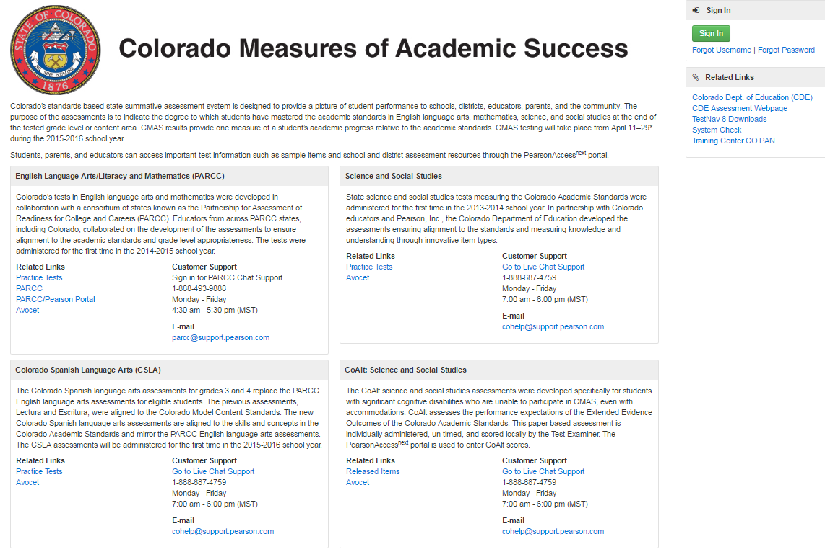
https://co.pearsonaccessnext.com/

Slide 49
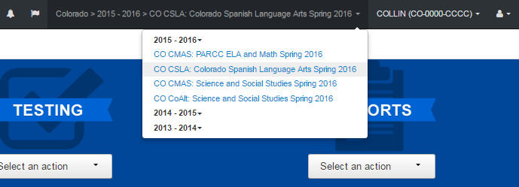
PearsonAccess^{next}
Updated dropdown list
Added previous administrations so that reports will be able to be accessed

Slide 50
PearsonAccess^{next} User Roles for DACs
The following user roles are given to DACs. CDE will determine when/if any newly created roles will be assigned to DACs
LEA/District Test Coordinator (i.e., DAC)
School Institutional Test Coordinator Coordinator (i.e., SAC)
Technology Coordinator
Sensitive Data Role (will have access to PII)
Request Additional Order Role* (do not give to schools)
Delete Student Role*
Published Reports Role (ability to see district, school, and student reports)
Student Test Update*
Rejected Student Test*
DACs/SACs will assign user roles to individuals in the district as appropriate
*Assigned during times when DACs can perform these tasks

Slide 51
Updates for 2016-17
PARCC Practice tests are being updated with current test design
TestNav 8.8 – Desktop app will be available December
PearsonAccessnext 4.0 will update in January/February.
We recommend running the Assess Testing Capacity task in PAnext
Located in PA next under Organizations>Test Administration task Dropdown menu.
CO site readiness form is being updated to include ELA audio items.
Strongly suggest that school test their equipment with this form once it is available
If using iPad 2, must use this form to ensure that audio will work

Slide 52
TestNav Updates
The keyboard was removed from Minimum Specifications, kept in Recommended Specifications for tablet devices.
iOS Automatic Assessment Configuration
Allow Microphone
Allow App Self-Lock prompt
Practice tests can be completed on Chrome and Edge Browsers
Added support for Windows and Chrome OS Touchscreen devices
The TN log file new filename is Date-Time-StudentName to make log files easier to find

Slide 53
TestNav Updates
Firefox Extended Support Release (ESR)
Firefox ESR 32-bit browser will be the only browser supported
Students using assistive technologies must test with the Firefox 45 ESR 32-bit browser, which is only available on Windows and Mac
Note: Oracle Corporation has posted notice that Java updates are scheduled on the following dates:
October 18, 2016
January 17, 2017
April 18, 2017

Slide 54
iPad 2
iPad 2s are supported this year with some caveats:
They have memory limitations (512 MB), which fall below the standard recommended memory for testing devices.
Do not use them for accommodated forms versions (TTS, ASL)
Science simulations may cause an issue
Have a plan in case there is an issue.

Slide 55
2016-2017 TestNav Components
Component | Current Software Version | Next Release date | Recommendations
Proctor Caching | v2016.9.0.0 | TBD | Eliminates the JAVA requirement for caching test content in PA next.
TestNav | v8.7 | Installable TestNav - v8.7 available now v8.8 anticipated release in December | Wait until TN 8.8 for spring testing then run full testing.
iPad App | v1.5.1 | TBD | Select App Check from the User dropdown menu
Chromebook App | v1.5.78 | TBD | Select App Check from the User dropdown menu

Slide 56
High Level PearsonAccess^{next} and Administration Activities
CDE pulls pre-ID mid-December (after December 16)
CMAS (ELA, Math, Science, Social Studies) SR/PNP upload (January)
Order paper-based materials
Create/update user accounts
Train STC/SACs and Test Administrators
Create test sessions
Verify proper form assignment (including form-dependent accommodations and accessibility features)
Distribute materials
Administer assessments
Return all scorable secure materials by May 3rd

Slide 57
CMAS Training and Office Hours
Training | Dates
CMAS: PARCC ELA/math, CSLA and S/SS Office Hours | September 15, 2016 October 20, 2016 December 1, 2016 Weekly Office hours begin January 12, 2017
CMAS: PARCC ELA/math, CSLA and S/SS Training | November 8 – Grand Junction November 9 – Carbondale November 11– Brush November 14 – Alamosa November 15 – La Junta November 16 – Colorado Springs November 17 – Limon November 18 – Metro (Golden)

Slide 58
CoAlt Science and Social Studies English Language Arts and Mathematics (DLM)
Mindy Roden

Slide 59
CoAlt Assessment Administration
Students with the most significant cognitive disabilities take the Colorado Alternate Assessments (CoAlt)
Science and Social Studies (Colorado-developed)
Elementary, Middle, and High School Assessments
Science: grades 5, 8, and 11
Social studies: grades 4 and 7 (high school will not be administered in spring 2017)
A sample of schools will administer the social studies assessments
English language arts and mathematics (DLM-developed)
Grades 3-9, 10-11
Alternate for PARCC ELA and math, PSAT 10 and SAT

Slide 60
CoAlt: Science and Social Studies
Paper-based assessment
Individually administered
Scored locally by the Test Examiner
Scores are entered into the PearsonAccess^{next} portal

Slide 61
CoAlt: ELA and Math (DLM)
Computer-based assessment
Individually administered
Test Administrators/DACs use Educator Portal for student management
Students test using KITE Client
Same window as CMAS (PARCC) ELA and Math
If using the 3-week window (paper-based or online), have the same 3 week window for DLM.
If using the 6-week extended window for the general online assessments, have the same 6-week window for DLM.

Slide 62
DLM’s Administration System: KITE Components
Component | Current Software Version | New Software Version | Next Release date | Recommendations
KITE Local Caching Server |  |  |  | DO NOT USE
KITE Client | 2.1 | 3.0 | Mid-September | Reinstall KITE Client on student computers.

Slide 63
CoAlt Training and Office Hours
Training Resource | Location
CoAlt Office Hours | September 26 October 17 November 14 December 12 Weekly January - mid-March Biweekly April - May
CoAlt Training | October 27 - Greeley October 28 - Denver November 2 – Alamosa November 3 – La Junta November 4 – CO Springs November 7 – Grand Junction November 8 – Glenwood Springs November 10 - Limon

Slide 64
PSAT 10 & SAT
Will Morton

Slide 65
PSAT 10 & SAT
The PSAT 10 will be administered to all* students in the 10th grade.
It is aligned to both the Colorado Academic Standards and the 11th grade college entrance exam
The SAT will be administered to all* students in the 11th grade.
The SAT is the state’s selected College Entrance Exam.
All Colorado state colleges accept the SAT
*Students who participate in CoAlt will take the DLM assessment instead of the PSAT 10/SAT. This means that all 10th and 11th grade students participate in an assessment.

Slide 66
PSAT 10 & SAT
Colorado PSAT 10¹ | April 11th or April 12th, 2017: District choice for initial test date ¹ April 25th or April 26th, 2017: Determined by initial test date
Colorado SAT | April 11th, 2017: Initial test date April 11th – 14th, 2017: Accommodations window April 17th – 21st, 2017: Accommodations make-up testing April 25th, 2017: Make-up testing date
¹ If Tuesday, April 11th is chosen as the initial test date for PSAT 10, the make-up date will be Tuesday, April 25th. If the district chooses Wednesday, April 12th as the initial test date, the make-up date will be Wednesday, April 26th

Slide 67
PSAT 10 & SAT
SAT with and without writing will be administered during the school day
Student choice will be collected in December
Online schools for PSAT 10
Will need to provide a testing center for students to test
Online schools for SAT
Can provide a testing center for students to test
May provide a voucher for students to test on the March national test date

Slide 68
PSAT 10 & SAT Accommodations
Students who tested using College Board approved accommodations for the PSAT 10 or AP exams last year continue to be approved for 2017.*
State allowed accommodations must be requested and approved each year.
College Board is working to adjust their accommodations request and approval process with the goal of providing a more streamlined process for educators and faster approval for certain populations of students.
*No changes to student situation

Slide 69
PSAT 10 & SAT Training
DAC kickoff webinar September 21st 2:30-4:30 PM
SAC kickoff webinar September 22nd 2:30-4:30 PM
Registration links for both webinars will be sent out in the DAC weekly email

Slide 70
Data
Jasmine Carey, Melissa Mincic, Shangte Shen

Slide 71
Assessment Data Collections
Assessment Collections have two Data Pipeline Activities
Pre-Coded/Pre-ID Labels
ACCESS for ELLs: November
All other assessments: December
Student Biographical Data Review
ACCESS for ELLs: April
All other assessments: May - July
Training Materials
Assessment Unit Data Pipeline Manual
Annual Webinar
Connect with Data Respondents

Slide 72
NAEP and International Assessments (selected schools)
Pam A. Sandoval

Slide 73
Colorado 2016-2017 NAEP
Assessment window: January 30, 2017, through March 10, 2017
Assessment Subjects | Test Mode | Approximate Test Time
Math & Reading^{1,2,3} | Tablets (80%) & Paper-pencil (20%) | Tablets = 120 minutes a session; Paper-pencil = 90 minutes a session
Math¹, Reading¹ & Writing³ | Tablets | 120 minutes a session
Civics, Geography, U.S. History³ | Tablets | 120 minutes a session
= grade 8 only
¹Math & Reading required by ESSA & tied to Title 1 funds.
²Separate locations are needed for the tablet & reading tests.
³Each student is tested in only one subject area & tests may be spiraled in same room at same time.

Slide 74
NAEP 2017 Program
 | Program 1 (Alpha) | Program 2 (Beta)
Civics |  |  Pilot
Geography |  |  Pilot
Mathematics |  State/TUDA Results |  Pilot
Reading |  State/TUDA results |  Pilot
U.S. history |  |  Pilot
Assessment Details
 = 2 sessions of about 25 students each, lasting approximately 120 minutes (Alpha & Beta)
= 1 session of up to 20 students, lasting approximately 90 minutes (Alpha)
If there is a significant change in the number of students enrolled in the grade after the Student October Count compared to previous years then there may be a change in the number of tablet sessions.
= grade 8 only

Slide 75
Communication

Slide 76
District Technology Coordinators (DTC)
Please check the website to determine that the appropriate person is listed as the District Technology Coordinator at http://www.cde.state.co.us/assessment/DTC
The DTC will receive emails with information about training and technology updates
It is important to identify a DTC for your district and to make sure this position is updated if there is a change
Superintendent-appointed

Slide 77
Office Hours Schedule
August – December:
CMAS monthly meetings
Can be more frequent as needed
Please let us know if you have topics or issues that you would like to have us address
CoAlt monthly meetings (Sept- Dec)
January – May: weekly meetings
CMAS weekly meetings
CoAlt monthly meetings
Weekly meetings in Jan-March
Bi-weekly meetings April - May

Slide 78
Weekly Bulletins
CDE will typically send out weekly bulletins
Bulletins will include information about:
Important updates for the week and coming weeks
Topics that will be covered during weekly office hours
Provide a recap of previous week’s office hours
May not specifically identify topics from office hours, but topics within the bulletins will be covered on office hours
If not needed, we will not send a bulletin.

Slide 79
Distribution of Secure Information
Syncplicity is the way to transmit secure information to/from CDE
Only the DAC has access to the assessment folder
During SBD, the Data respondent has access to the separate SBD folder
Reminder: Do not send Personally Identifiable Information (e.g., SASID, name, free and reduced lunch status, disability status, etc.) through email.

Slide 80
Fall To Do List (1 of 2)
Fulfill district policy requirements of HB 15-1323
Adopt and implement a policy by which the LEP decides whether to request the paper form of the state assessments for its students
Adopt and implement a written policy and procedure by which a student’s parent may excuse the student from participating in one or more of the state assessments
Distribute to parents and post on LEP’s website written information regarding assessments, including an assessment calendar
Determine mode of testing (computer or paper) for each school and each subject
If testing online, determine if technology capacity requires an extended window for ELA and math (4, 5, or 6 weeks)

Slide 81
Fall To Do List (2 of 2)
Gather accommodation information for assessments
Paper-based accommodations (braille, large print, oral scripts, etc.)
Computer-based accommodations (text-to-speech (TTS)*, Spanish, etc.)
Determine the need for and submit unique accommodations requests
Includes reading of the ELA/L assessment (oral script, TTS)
CMAS Student Registration files and Personal Needs Profiles loaded in January 2017
Start submitting College Board-approved accommodations requests
Attend trainings
Accommodations
ACCESS
CoAlt
CMAS
SAT and PSAT 10
Schedule and plan district trainings

Slide 82
2016-2017 Training Timeline
Assessment | Description | Dates (Tentative)
All | Accommodations | August 29 & 30
ACCESS for ELLs® | Administration | October 17 –October 24 (in-person)
CoAlt: English Language Arts and Math (DLM), Science and Social Studies | Administration | October 27 - November 10 (in-person)
CMAS: English Language Arts and Math (PARCC ), Science and Social Studies | Spring 2017 Administration Technology | November 7-18 (in-person)
PSAT 10 & SAT | DAC kickoff SAC kickoff Additional training | September 21 September 22 TBD
When possible, webinars will be recorded for those who cannot attend.

Slide 83
CDE Assessment Contacts
Questions | Contact | Email
General Questions | Margo Allen | allen_m@cde.state.co.us
CMAS: PARCC ELA and Math | Stephanie Boyd | boyd_s@cde.state.co.us
CMAS: Science and Social Studies | Sara Loerzel | loerzel_s@cde.state.co.us
CoAlt and accommodations for students with disabilities | Mindy Roden | roden_m@cde.state.co.us
ACCESS, CSLA and accommodations for English learners | Heather Villalobos Pavia | villalobospavia_h@cde.state.co.us
Technology | Collin Bonner | bonner_b@cde.state.co.us
PSAT 10 and SAT | Will Morton | morton_w@cde.state.co.us
NAEP & International Assessments Coordinator | Pam A. Sandoval | sandoval_p@cde.state.co.us

Slide 84
CDE Assessment Data Contacts
Staff | Programs | Email
Melissa Mincic | Data Support | mincic_m@cde.state.co.us
Jasmine Carey (Psychometrician) | Psychometrics | carey_j@cde.state.co.us
Shangte Shen | Data Support | shen_s@cde.state.co.us

Slide 85
Thank You!

Slide 86
Supplemental Information
ESSA
Formative Assessment Insights
Other Requirements Under HB 15-1323 and District Responsibilities

Slide 87
ESSA
State plan and innovative assessment demonstration authority
Hub and spoke configuration has been established
We will leverage the monthly CMAS Office Hours to solicit DAC input and provide updates

Slide 88
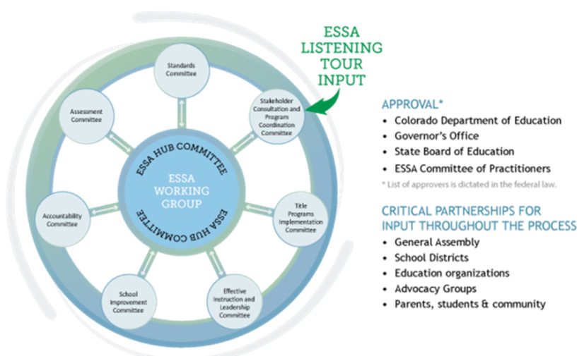
ESSA State Plan Development
44

Slide 89
ESSA… Continuing the Conversation
ESSA in Colorado Blog
http://www.cde.state.co.us/fedprograms/ESSABlog
ESSA Mailbox
essaquestions@cde.state.co.us
ESSA Webpage
http://www.cde.state.co.us/fedprograms/essa
45

Slide 90
Other Requirements Under HB 15-1323 and District Responsibilities
Each LEP must adopt and implement a written policy by which it decides whether to request the paper form of the state assessments for its students.
Decision must be made in consultation with schools and parents.
Copy of policy must be shared with parents and posted on LEP website before the start of the fall semester.
LEP may make the decision by school or classroom
LEP will report to CDE [through its vendors] the number of students who will take the paper form.
Charter schools are considered LEPs
Paper form still available as an accommodation.
Considerations

Slide 91
Other Requirements Under HB 15-1323 and District Responsibilities
LEP will annually distribute to parents and post on its website, as early in the school year as possible, written information regarding its assessments, including:
The state and local assessments that the LEP will administer
Identify whether it is required by federal law, required by state law or selected by the LEP
Assessment calendar:
Estimated hours of testing each testing day for specific classes/grades for each assessment
Identify whether the assessment is required by state law, federal law or locally selected
The purposes of the assessments
The manner in which assessment results will be used.

Slide 92
Other Requirements Under HB 15-1323 and District Responsibilities
A student’s parent may excuse the student from participating in a state assessment
Each LEP will adopt and implement a written policy and procedure by which a student’s parent may excuse the student from participating in one or more of the state assessments.
If a parent excuses his or her student, the LEP shall not impose negative consequence on the student or parent including:
Prohibiting school attendance; imposing an unexcused absence; or prohibiting participation in extracurricular activities.
LEP shall not impose an unreasonable burden or requirement on a student that would:
Discourage the student from taking a state assessment or
Encourage the student’s parent to excuse the student from taking the state assessment.

