Slide 1
2013- 2014
Assessment Logistics Training
For TCAP and CoAlt
(Reading, Writing and Math)
December 2013
Notes:
1
Welcome to the 2013-2014 TCAP and CoAlt Logistics training. This training will focus on what districts need to do with materials before and after the administration of the tests. This training is not required, but is strongly encouraged for all DACs, especially those who are new or feel they need a refresher on logistics. Please note that there are separate administration trainings for each assessment that are required. More information about required training is available on the Assessment Unit Website under the “Trainings” tab.
Also note that there is a separate logistics training for ACCESS for ELLs that can be found on the Assessment Unit website.
In this training you learn about how to receive, manage and return test materials.

Slide 2
What’s New for 2014?
Physical Disability and Language Proficiency updated to match values in Student Interchange.
Pre-Coded label process.
Notes:
There are two important changes to this year’s logistics. The first is that Physical Disability and Language Proficiency updated to match values in Student Interchange.
The second is Pre-Coded label process has changed with the implementation of the Data Pipeline and details regarding this change will be covered in this training.

Slide 3
The CTB Helpdesk
CTB Help Desk:
800-994-8557
Notes:
Before starting, I want to make sure that you have the most important phone number when it comes to logistics and test materials. That number is the CTB help desk at 800-994-8557.
The help desk can help you with any issues regarding materials such as ordering, requesting additional materials, or questions about packaging, shipping and scheduling materials drop offs and pick ups.
The Assessment Unit can answer some of these questions. But the helpdesk should be your first resource for these questions because they can tap directly into our test vendor’s ordering and information system and usually will be able to handle your logistics questions more efficiently than the Assessment Unit can.
If you ever lose this number, it can be easily found at the beginning of the DAC/SAC manual.

Slide 4
Assessment Logistics
Please read the DAC/SAC manuals carefully
  http://www.cde.state.co.us/assessment/coassess-additionalresources
4
Notes:
4
There is one DAC/SAC manual for TCAP and a separate one for CoAlt. All DACs and SACs should read each of them carefully. These are your primary go-to resources for how to handle logistics… a logistics instruction manual if you will. They can be located on both CTB Navigator, and on the Assessment unit website under TCAP/CSAP, and then under “Additional Resources”.

Slide 5
Assessment Logistics
TOPICS
Materials Review
Ordering Materials
Student Test Book Data
Packaging and Returning Test Materials
5
Notes:
5
Here are the topics that we will cover in this training.
We will start with a review of materials and how to order them. Then we will move on to some specific information you will need about how to mark test books. Finally, we will discuss how to package and return your materials to our test vendor, CTB/McGraw Hill for scoring.

Slide 6
Secure Materials
Three types of test materials
  Secure and may not be reproduced, transmitted, or recounted
    Test books and Examiner Protocols
    Student answers and Examiner’s Rating Forms
    Used draft books
  Secure and may be reproduced
    Teacher Read Directions and Translated Teacher Read Directions
    Oral Scripts and Translated Oral Scripts
  Not secure
    Test Proctors and Examiners manuals
    DAC/SAC manuals
    Procedures Manual
Student Confidential Information
Notes:
There are three types of test materials: Secure materials that may not be reproduced, secure materials that may be reproduced and materials that are not secure.
When we say that test materials may not be reproduced, this includes any imaginable means of reproduction such as memorization, writing down, paraphrasing, recalling, recounting or transmitting. It is important to note that student responses and used draft books are considered just as secure as the test books themselves.
Oral scripts and teacher read directions must be downloaded and reproduced by DACs, but they are still considered secure. Only the DAC may make these copies and only in sufficient quantities for accommodated test sessions. Once created, oral scripts and teacher read directions should be treated exactly as other secure materials and must be returned to CTB with “Not to be scored” materials.
Finally, some test materials are not secure and may be reproduced, transmitted and discussed. These include the Test Proctors and Test Examiner’s guide, the DAC/SAC manuals, and the Procedures Manual.
One last piece of information that should be kept secure and confidential is any student information. Confidential student information may be present on rosters, pre-coded labels, and test books when the student biographical data grid or front of the test book is completed. Please adhere to your own district’s confidentiality guidelines when handling private student information.

Slide 7
Handling Secure Test Materials
Chain of Custody must be maintained for all secure material
  Test books, Examiner’s Protocols, Examiner’s Rating Sheets
  Oral Scripts and Teacher Read Directions
  Used Draft Booklets
Return all secure materials to CTB as soon as possible.
  Do not wait for all materials to come back from schools before returning!
  Failure to return materials by the final pick up date is a breach of security and will likely result in the invalidation of student test scores.
Treat secure “Not to be Scored” materials just as you would other secure test materials.
Notes:
All secure materials should be handled in accordance with instructions from the Procedures Manual. This includes maintaining a chain of custody for all secure materials and secure storage of materials. It also means that all secure materials are returned to CTB, whether they are to be scored or not.
Be sure to return materials as soon as you are able to CTB. Do not wait to return materials that you have received from schools. You should ship materials back in multiple shipments as soon as you are able.
Failure to return materials by the final pick up date is considered a serious breach of security protocols and may result in test scores being invalidated.

Slide 8
TCAP Test Materials Review
 | TCAP Test Coordinator’s Kit (TCK) | Test Proctor’s Manual (TPM) | TCAP DAC/SAC Manual | Test Books
Secure? | Contains private student information | No | No | Yes
Location | Arrive in district 1/31 | In TCK, also on CTB Navigator | In TCK, also on CTB Navigator | Shipped to districts based on test window
Contents | Rosters, Student Labels, Paper bands, group information sheets (GIS), Shipping labels | Instructions for administration of test sessions, standardized conditions, security and ethics | Instructions for handling organizing and shipping test materials | Test books for students based on enrollment, plus 5% extra
Notes:
Here is a list of specific test materials for the TCAP. Each column shows you a different type of material, whether it is secure, where it can be obtained, and what it contains. An upcoming slide will provide you with specific dates for the arrival and return of test booklets. Take a moment to peruse this information.

Slide 9
CoAlt Test Materials Review
 | CoAlt Test Coordinator’s Kit (TCK) | Examiner’s Manual | CoAlt DAC/SAC Manual | “Pizza Boxes”
Secure? | Contains private student information | No | No | Yes
Location | Arrive in district 1/31/14 | CTB Navigator | CTB Navigator and shipped with TCKs | Shipped to Districts 1/17/14
Contents | Rosters, Student Labels, Paper bands, group information sheets (GIS), Shipping labels | Instructions on standardization, security and test administration. Required materials and expanded accommodations | Instructions for handling organizing and shipping test materials | Math manipulatives, Test Examiner Protocol, Rating forms, Supplemental Materials
Notes:
Here are the details on CoAlt test materials. Like the previous slide, this table shows you what materials you will need to test CoAlt, whether they are secure or not, where they can be obtained and what they contain. The next slide will include specific shipping dates for CoAlt and TCAP Materials. Take a moment to review this information. Also, keep in mind that if you would like to refer to this table again, you can download this PowerPoint in its non-webinar format on the trainings page of the Assessment Unit website.

Slide 10
TCAP and CoAlt Shipping Dates
 | Grade 3 Reading (Early) | Grade 3 Reading (Regular) | Grade 3-10 (Early) | Grade 3-10 (Regular) | CoAlt “Pizza Boxes”
Receive by | January 24, 2014 | February 7, 2014 | February 14, 2014 | February 21, 2014 | January 17, 2014
Schedule Return Pick Up by | February 26, 2014 | March 11, 2014 | April 9, 2014 | April 16, 2014 | March 25, 2014
Final Day to Pick Up | February 28, 2014 | March 13, 2014 | April 11, 2014 | April 18, 2014 | March 27, 2014
Note: Returning test materials after the final pick up date is a breach of test
security and will likely result in the invalidation of test scores.
Notes:
These are the dates for shipping of various TCAP and CoAlt Materials. This information can also be found in the Procedures Manual
The first row tells you the last day that you should expect to receive specific materials. If you do not receive your materials by this day, you should immediately call the CTB Helpdesk. Also, you should compare this date to your district calendar. If your district is on a four day week, or if you have planned office closures on these dates, you will need to special arrangements for delivery and pick up of materials. Please call the CTB Helpdesk to make such special arrangements.
The next row shows you the last day that you can schedule pick up of materials and the last row tells you the last day that materials can be picked up.
Again, you should not that returning test materials after the final day to pick up constitutes a major breach of test security. Any test booklets returned after the final pick up date will likely be invalidated and reported as a no-score in district and school data. Do not let a scheduling error invalidate your district’s data!

Slide 11
Ordering Materials
Pre-Coded Label Extract – NEW PROCESS
  No longer being pulled from October Count
  Clean up enrollment data in Data Pipeline Student Interchange files
  Data must be in untagged Student Interchange Files
  Work with district Student Interchange respondent
  See DAC Email for specific details
  Assessment pulling data on January 15
  Overage: Schools will be sent sufficient test booklets for all pre-coded labels, plus an overage of 5%. The overage can be used for late-enrollment students, for transcribing, and to replace damaged test books.
11/2/2011
Notes:
New pre-coded label process. No longer will data be pulled automatically from October Count. Districts must have current data in the untagged Student Interchange Student Demographic and School Association files. This is the data that will be used for the labels. The Assessment Unit will be extracting the data for TCAP and CoAlt eligble students on January 15. DACs should coordinate this data collection with their district Data Pipeline Student Interchange person.
Schools will also receive a 5% overage in test books in order to accommodate students who enroll after data has been collected, or for use in transcriptions, or to be used in case of a book being damaged.
In summary – Pre-coded labels is no longer an automatic data pull from Student October. Districts must have current data in the untagged Student Interchange files to get labels.

Slide 12
Teacher Read Directions and Oral Scripts
Teacher Read Directions and Oral Scripts
Available on Navigator February 12th
Security for Teacher Read Directions and Oral Scripts
  Documented Chain of Custody
  Return with “Not to be Scored Materials” to CTB
  Access
    Limited to only test proctors using them
    Preparation time must be done in a secure, supervised environment
Translated Teacher Read Directions and Oral Scripts
  Spanish
  Other Languages (Procedures Manual Section 6.8 Translator Access to Test Materials)
Notes:
The two major accommodations for which materials are provided are Teacher Read Directions and Oral Scripts. Teacher read directions only indicate the instructions for the items on the test. For example, they might say, “study the graph and select the correct answer” but they do not include item specific content.
Oral Scripts would be an accommodation for a student who cannot access the test by reading in English. Oral scripts include item content. Oral scripts are available for all content areas, except reading, because oral presentation of the reading test would violate the construct of the test.
Both Teacher Read Directions and Oral Scripts will be available from CTB Navigator on February 12th.
Test Materials for Accommodations are just as secure as test books. You must follow all of the of the Chain of Custody requirements as you would for student test books and they must be returned to CTB with “Not to be Scored” materials.
Test Proctors should be allowed access to these for review up to 24 hours prior to test administration, but this must be done in a secure location under the School Assessment Coordinator’s supervision. They should never be given to teachers to take back to their classroom on their own. The purpose of allowing this time is for test proctors to familiarize themselves with the scripts in order to ensure a smooth test administration.
Teacher Read Directions and Oral Scripts are available in Spanish translations if needed. If translation into a language besides Spanish or English is required, the district must arrange for the translation. See section 6.8 of the procedures manual for more information on translator access to Test Materials.

Slide 13
The Short Add Window
Use the short add window if your enrollment changes after the close of pre-coded label collection.
Note: An extra 5% of TCAP books and draft booklets are automatically sent to districts.
Information about the Short Add Window will be sent out in DAC Emails, starting in January
Notes:
The short add window is used when a district needs to order materials due to enrollment changes. Remember, that for TCAP test books, a 5% overage is already included with your test materials. Short add is done through CTB Navigator. Information about the Short Add Window will be sent out in DAC Emails, starting in January

Slide 14
Stop Sheets for Lectura/Escritura
“Stop Sheets” must be inserted into Lectura/Escritura test books
Stop Sheets must be photocopied from the Procedures Manual or DAC/SAC Manual
Stop Sheets must be removed from test books prior to returning to CTB
14
Notes:
<Stop Sheets>
The use of stop sheets for Lectura and Escritura is covered in both the Test Proctor’s Manuals and the DAC/SAC manual. These insterts are created by the DAC by photcopying the “stop page” from either the DAC/SAC or Procedures manuals. The stop page inserts apply to Spanish grade 3 reading, grade 3 writing, and grade 4 reading/writing test books ONLY. Never use a stop page with an English assessment.
It is extremely important that the ‘stop pages’ are removed from the test books before districts prepare their materials for scoring. These sheets will stop the scanners causing a slow down in CTB’s scanning and scoring process.

Slide 15
Distributing Materials to Schools
Step 1 Review Your Test Materials
  Make sure you have adequate quantities of all materials
  Review rosters of pre-coded information
  Gather information for new students
Step 2 Distribute Test Materials
  Establish Chain of Custody Documents
    Who, what, when, where
  Deliver materials to schools one week or less before testing
  Distribute test books to Proctors:
    One test book at a time
    Minimize time test books are in proctor’s possession
15
Notes:
15
Before you distribute materials to schools, you will want to ensure that you have all of the materials you will need for testing, that rosters match pre-coded labels, and you will want to gather information about students who are new to the district and do not have pre-coded labels, to ensure that these students are adequately supplied with materials and accounted for in the data.
Next, you will distribute materials to schools. You will need to create chain of custody documents that record who has custody of what documents, when they received them and when they returned them and additionally, where they will be kept. This document can be a simple, multi-column sheet. Be sure to have proctors sign test books in and out.
Also remember that test proctors only check out one content area of test books at a time. This requirement reduces the risk that tests will be invalidated due to the wrong session being administered and additionally reduces the potential exposure of the test.

Slide 16
Student Test Book Data

Slide 17


Use
Pencil
ONLY!
Student Name District Name
Procedures
Teacher Name School Name
68
DAC/SAC
5
Use only a standard, wooden, graphite-based, #2 pencil on any part of the test book….
including the front cover!
17
Notes:
The most important thing to remember is that only pencil should be used to mark in student test books. This is because the scanners used by our vendor, CTB McGraw Hill, track graphite levels on the page. This may seem old fashioned, but in fact, the graphite scanning equipment helps us to identify and score light marks and to tell the difference between intentional markings and unintentional markings, or markings which have only been partially erased.
Pencil should also be used to complete the front of the test book and the student biographical data grid. Districts should not use adhesive labels for the information on the front of the test book because commercially available labels cannot withstand the high heat and pressure of the scanning process. If these labels become detached in the scanners they will literally “gum up the works” and cause scanning and scoring delays and student information crucial to tracking the test books will be lost.

Slide 18
Verify Pre-coded Labels
Verify pre-coded labels with student rosters prior to testing
  No Free/Reduced Lunch (District Use C) and Homeless (District Use D) data printed on rosters, but data are included with label
If the wrong label is placed on a book:
  Place two blank labels over incorrect label and then complete the student data grid
18
Notes:
One of the first things you will want to do when you receive your materials is verify that your pre-coded labels match the rosters that you are provided. Note that the student data in the pre-coded label will match the information provided during enrollment and pre-coded label collection, but that not all of the same information will appear on the roster. For example, “free and reduced lunch” and “homeless” status are included in the pre-coded label, but are not printed on the label.
You will want to be careful that the correct student receives the correct book and that they are properly labeled. It can happen that students with similar names or siblings have the wrong label placed on their test book. If it is discovered that the wrong label was placed on the test book, then use two blank labels to cover the incorrect label and fill out the student biographical data grid by hand.
18

Slide 19
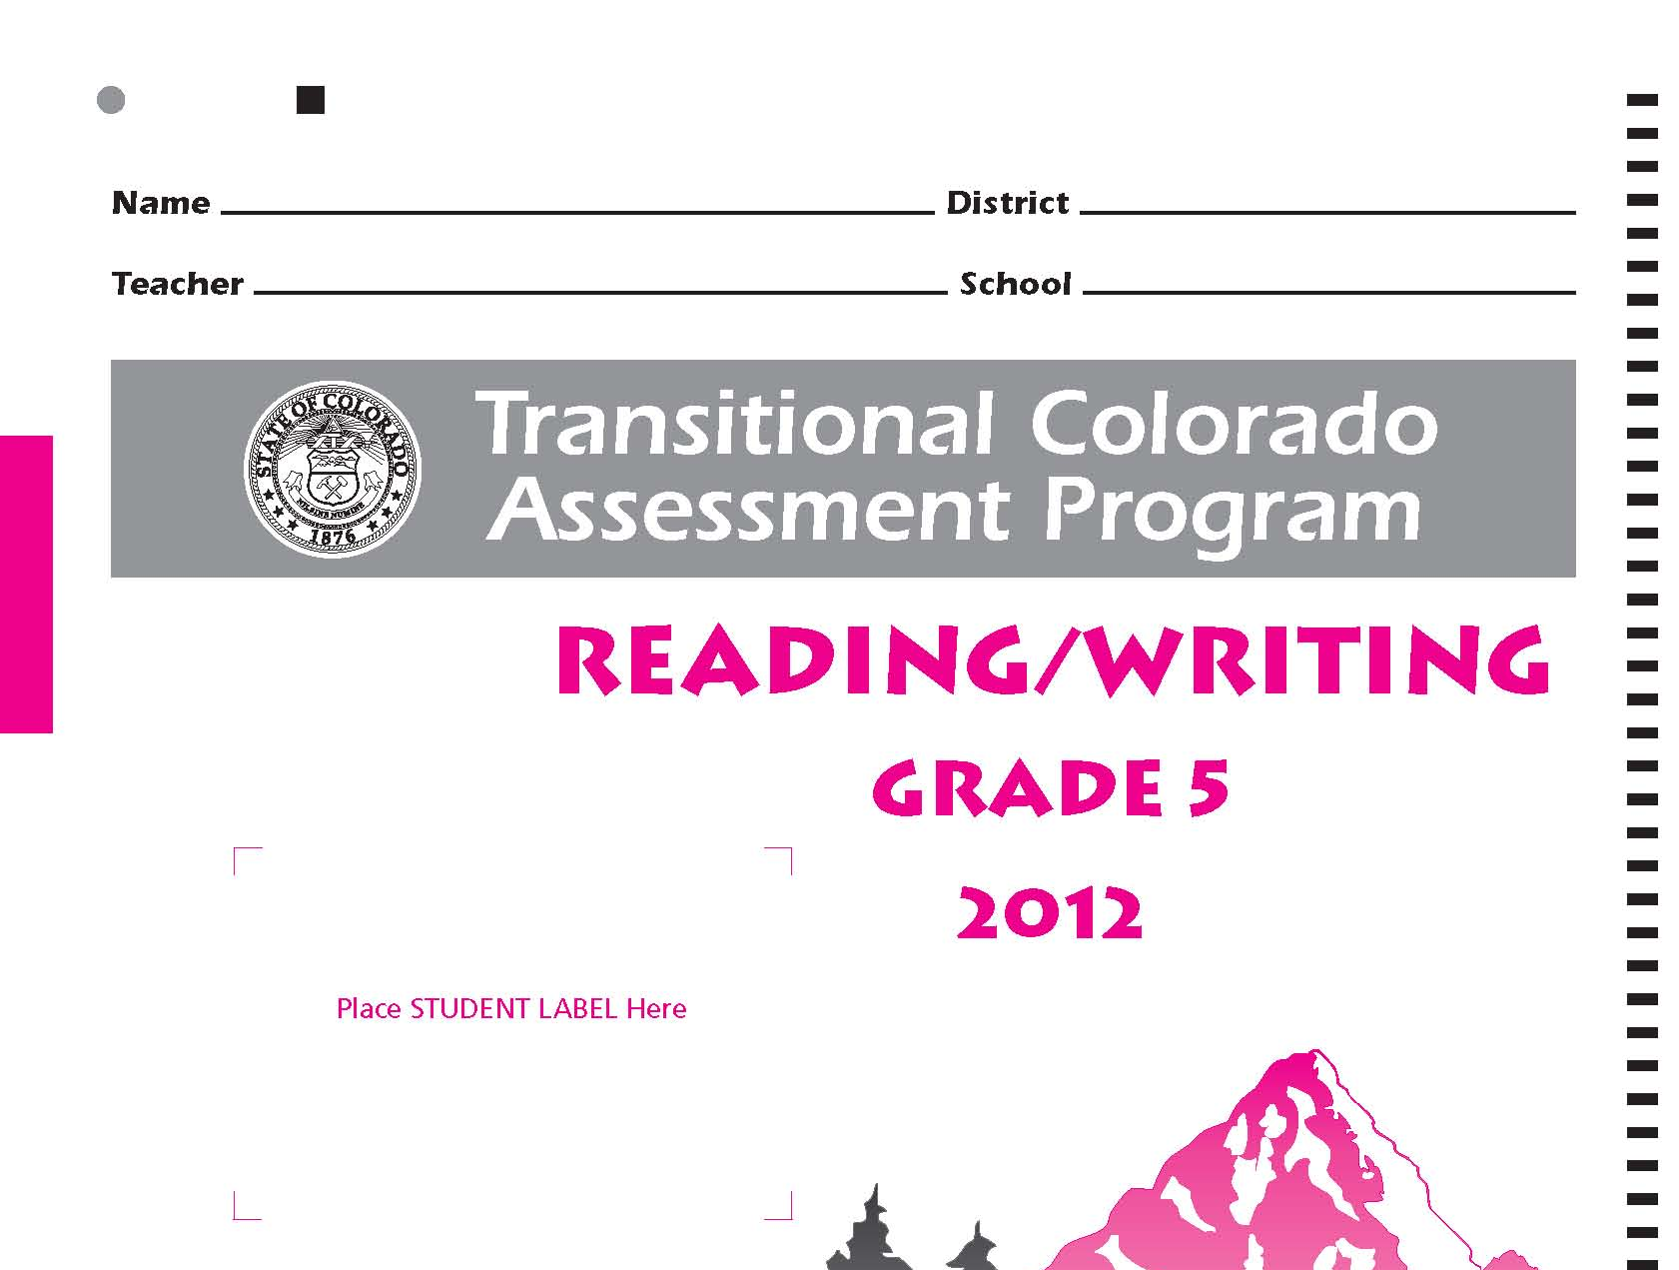
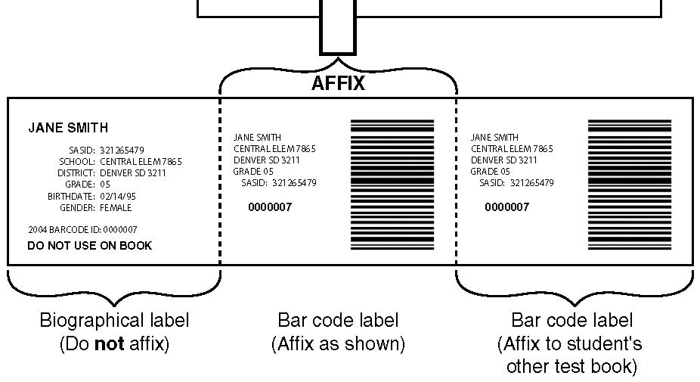
Pre-coded Labels
In order for the scoring process to move smoothly, it is ESSENTIAL that the labels are not placed crooked or outside the designated area on the front cover.
✓
Slightly off-center and tilted
or upside down
19
Notes:
Be sure that labels are properly affixed to the test book and that the label matches the information on the front of the test book. Improper placement of labels can result in scanning and scoring delays and in rare instances cause data to be lost.

Slide 20
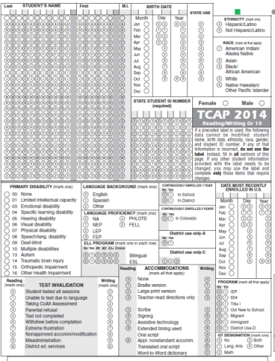
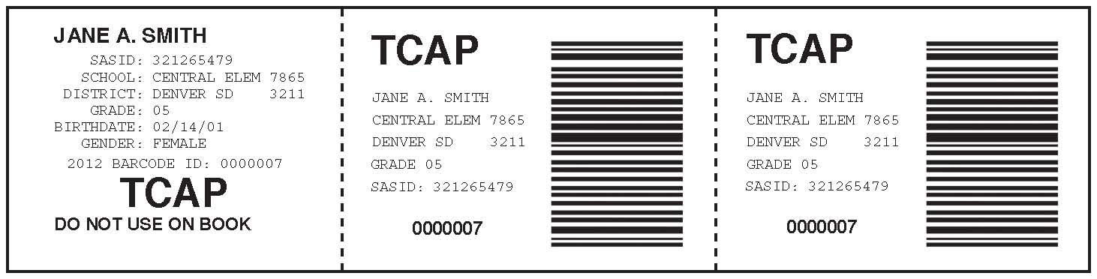
Pre-coded Labels
Do not use the label if an error exists above the line of Student Data Grid - complete all information.
If any data below the line is incorrect, use the label and fill in only the information that needs to be corrected.
TCAP label on TCAP book, etc.
20
Notes:
<When to use and not use a label>
Here is a graphic of the actual TCAP pre-coded labels. Note that not all pre-coded data is printed on the label. Again, it is essential that the pre-coded label information is verified with the student rosters before testing starts. The barcode links the student information with a database of all pre-coded data electronically.
Note the large “TCAP” on the TCAP pre-coded label – do not use the wrong label for the wrong assessment!
If label data are wrong, you may still be able to use the label and correct what data need to be corrected.
If any data on the TOP of the data grid are wrong “above the blue line”, DO NOT use the label. These fields are student name, DOB, Grade level, Gender, Ethnicity, Race, and SASID. In that case, complete the entire student data grid and discard the label.
If any data BELOW the middle line are incorrect, you can correct the specific data and still use the pre-coded label for other data fields.
Of course if the student does not have a label, the data grid must be completed. There are NO default values on the grid. CTB and CDE will not complete the data grid with any “default” values. It is the district’s responsibility to get the student biographical data completed accurately for every student taking the test.

Slide 21
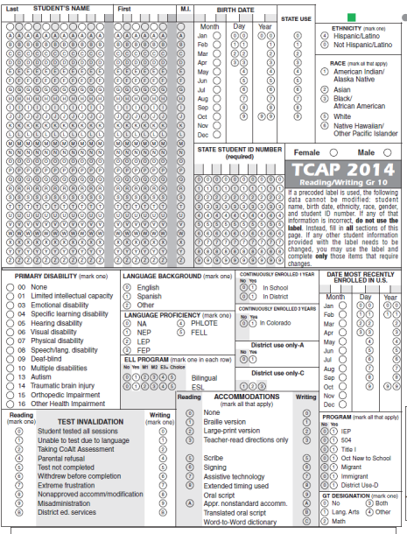
TCAP Student
Data Grid
21
Notes:
21
<TCAP Data Grid>
Here is the TCAP data grid. In the accommodations box, bubble either “None” or all that apply, for both reading and writing in this example.
If you are bubbling the ethnicity and race fields, bubble Hispanic “Yes” or “No” and at least one race field.
Also note, the Date most recently Enrolled in US field is collected for every student. If a student has never attended school outside the U.S., then the date is probably the date the student enrolled in kindergarten.
Additionally, there are two more bubbles that must filled in on every test book once testing is complete. I will cover these on the next slides.

Slide 22
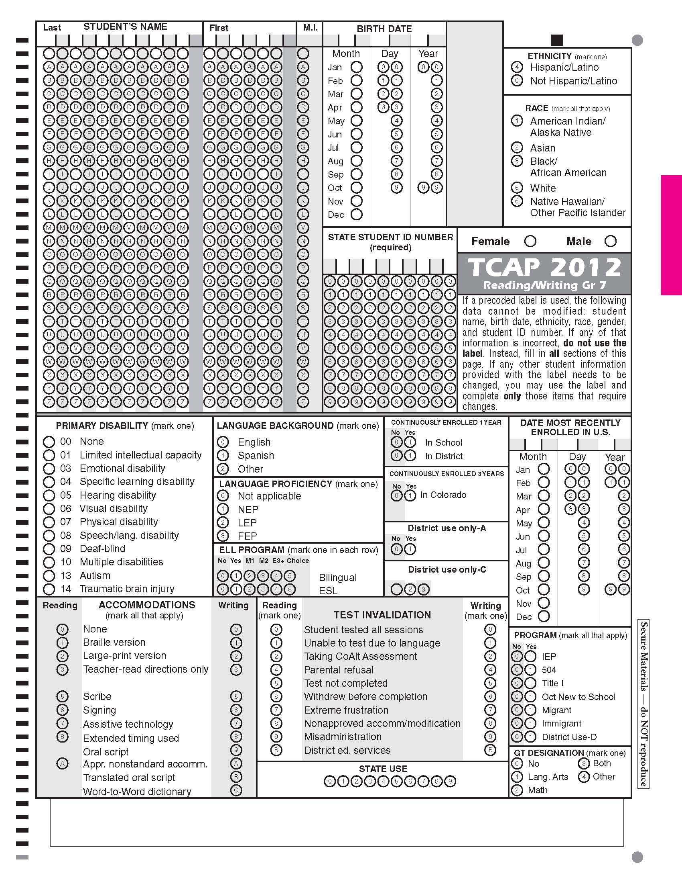
All tested subjects
Test Invalidation Codes
Check all test books:
All students are required to take the TCAP.
Most test booklets will have the “0” bubble(s) filled in!
All other Test Invalidation bubbles allow your district to account for missing data.
22
Notes:
<Test Invalidation Codes>
Let’s highlight the Test Invalidation field first – this crucial field that can impact whether the test is scored and how results are reported. When TP or SAC complete this field accurately, it insures the test is scored properly and reported properly.
The majority of your test books should have the “Student Tested all sessions” bubble filled. In past years, only around 1-2% of all state assessments have been invalidated in some way.
This example shows the TCAP invalidation choices “When “Student tested all sessions” is bubbled, the student will receive a scale score and a proficiency level – as long as the student has completed every session of the test. If any of the other invalidation options are bubbled, the student will receive a “no score” result.

Slide 23
All tested subjects
Accommodations Codes
Check all test books:
All students must have one or more accommodations code bubbled on the data grid.
Most test booklets will have the “0” bubble(s) filled in!
Marking all that apply allows you to record all accommodations used for a student.
23
Notes:
All test books must have an accommodations bubble filled in. If no accommodations were used on the test, mark “none”. Otherwise be sure to mark all accommodations that were used.
It is better to mark both the test invalidations and accommodations fields right after testing, so that you don’t forget what applies.

Slide 24
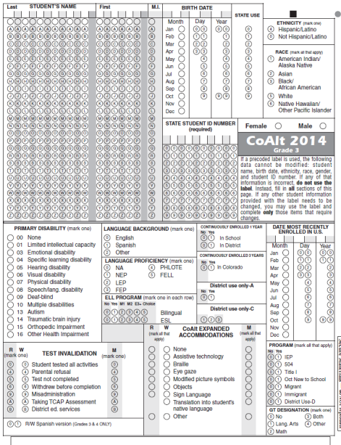
CoAlt Student
Data Grid
What is Unique about CoAlt data grid:
Multiple content areas on one data grid
No grade field to bubble
Expanded Accommodations
Test Invalidations and Accommodations for RWMS
R/W Spanish version (grades 3/4)
ALERT: Take care when
transferring responses from the protocol to the rating form!
24
Notes:
24
<CoAlt Data Grid>
Here is the CoAlt data grid.
The booklets are specific to each grade level, so grade does not need to be bubbled.
Please keep in mind when transferring complete test data from the test protocol to the Rating Form that the order for the Levels of Independence when giving the test go from 4, 3, 2, 1 – but the Rating Form uses the scanning convention of 1, 2, 3, 4. Teachers need to pay special attention to this when completing the Rating Form. Transferring these test responses incorrectly will result in students not receiving a score. More on transferring responses is covered in the CoAlt Admin training and Test Examiners guide – as well as in the Rating Form itself – there is an “Alert” page on the inside cover that details how to correctly bubble the form.
CoAlt has multiple content areas on the data grid. You must bubble the Test Invalidation and Expanded Accommodations for all content areas. Again, the “State Use” field is outlined in orange.

Slide 25
Returning Test Materials
Sort
Bundle
Ship
Notes:
Returning test materials should be as straight forward as sort, bundle, and ship.

Slide 26

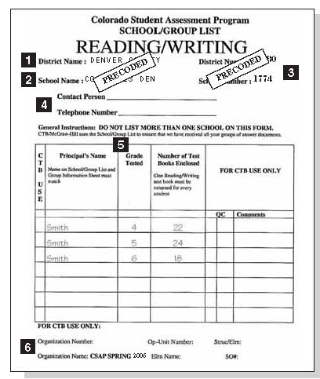
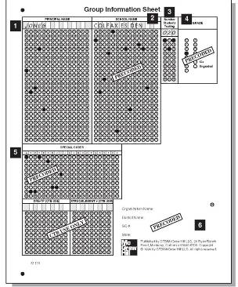
GIS and SGL Forms
SACs complete Group Information Sheets (GIS) and School Group Lists (SGL)
DACs and SACs check to make sure the GIS and SGL numbers match – critical
Scorable
Test Books
GIS
SGL
26
Notes:
After the booklets have been checked and the data grids have been checked and completed, Group information sheets and school group lists can be completed.
Group information sheets or GIS forms tell CTB how many completed test booklets are being returned for every grade and content area. School group lists or SGLs list all the GIS forms the district is returning for each school.
For TCAP, each content area has a separate SGL.
GIS counts must match SGL counts.
Obviously, this is critical information for SACs to fill in correctly and for DACs to review before shipping to CTB for scoring.
So, when completed materials to be scored are packed to be sent to CTB, a GIS will be placed on top of a group of student booklets within a school (i.e. for all grade 6 TCAP Math booklets), and the SGL will go on top of all the sets of student books with GIS forms (i.e. all grades 6, 7, and 8 TCAP math).
GIS forms work hand in hand with SGLs to provide a complete inventory of how many books should be scanned and scored. GIS and SGL also determine the school for which results are reported. All student test booklets for a school must be sent back to CTB to be scored under the GIS and SGL for the school where the results will be reported. In special circumstances when a student tests at a different school, the student’s completed test booklets still need to be returned to be scored under a GIS/SGL for the reporting school.
Always photocopy your GIS and SGL forms for your district records. These will provide documentation for you to check total counts later on – specifically during the Ncount processes and SBD review after books have been shipped to CTB and before the final results are reported. Do not send photocopied GIS or SGL forms to CTB. If you need more forms, you may get them from CTB.

Slide 27
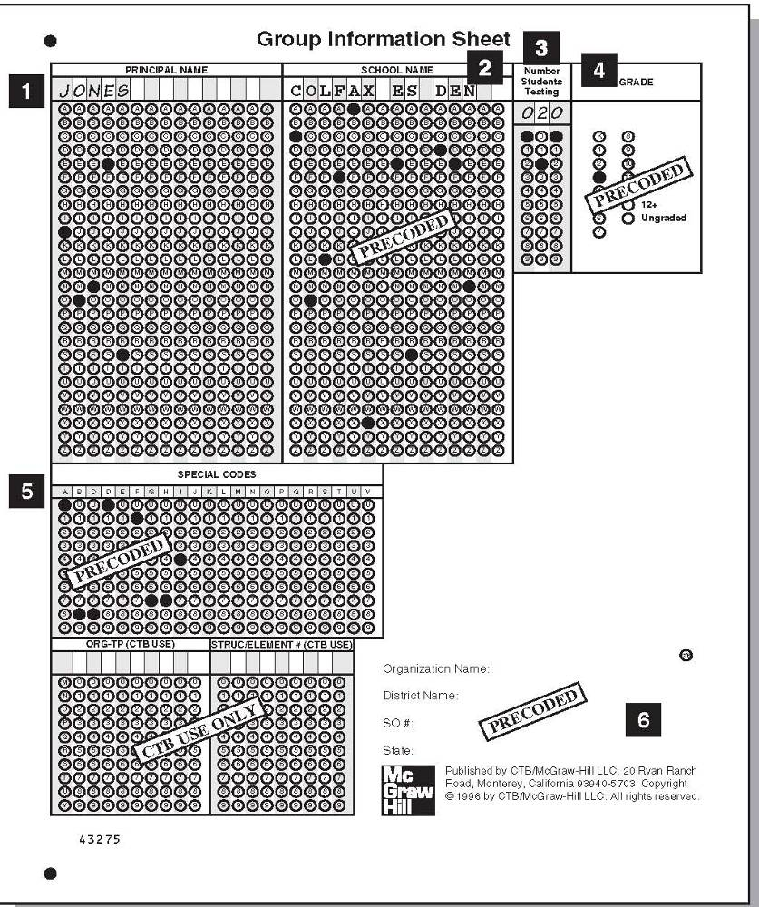
Group Information Sheets - GIS
Make a copy of each GIS
SACs complete the GIS | Must Complete and Bubble | Pre-coded
1. Principal’s name | X
2. School name |  | X
3. Number of Students Testing | X
4. Grade | For CELApro and CoAlt | For TCAP
5. Special Codes |  | X
6. Organization name, District name, etc. |  | X
For CoAlt
27
Notes:
This is the Group information sheet, or GIS. This is the TCAP GIS, the CoAlt GIS differs slightly
For both TCAP and CoAlt, complete the Principal name, number of students tested. Additionally, the Grade must be bubbled for CoAlt. Grade will be pre-coded for TCAP.
Here’s what is pre-coded: school name, district name, and other CTB special codes and grade for TCAP.
Completing the Principal name correctly on the GIS form best identifies the school and helps CTB if further contact with the district is needed for total student count questions.
Again: for CoAlt, the SAC will complete a GIS for every grade within their school.
For TCAP, the SAC will complete a GIS for every grade and content area within their school.
Never mix grades or TCAP content areas under a GIS when packing your completed test books. Step 5 of the SAC/DAC manual describes how to complete the GIS and includes a larger picture of the form.

Slide 28
Different Colors of GIS Forms
CoAlt: Red
TCAP: Blue
  Homeschooled students for TCAP: Green
28
Notes:
GIS Sheets come in different colors. Be sure that you are using the correct one for the correct assessment. CoAlt GIS forms are red while TCAP GIS are blue. Also note that a green GIS will be included for home-school students taking the TCAP. It is important to separate home school student forms so that they are not included in your school or district data.

Slide 29
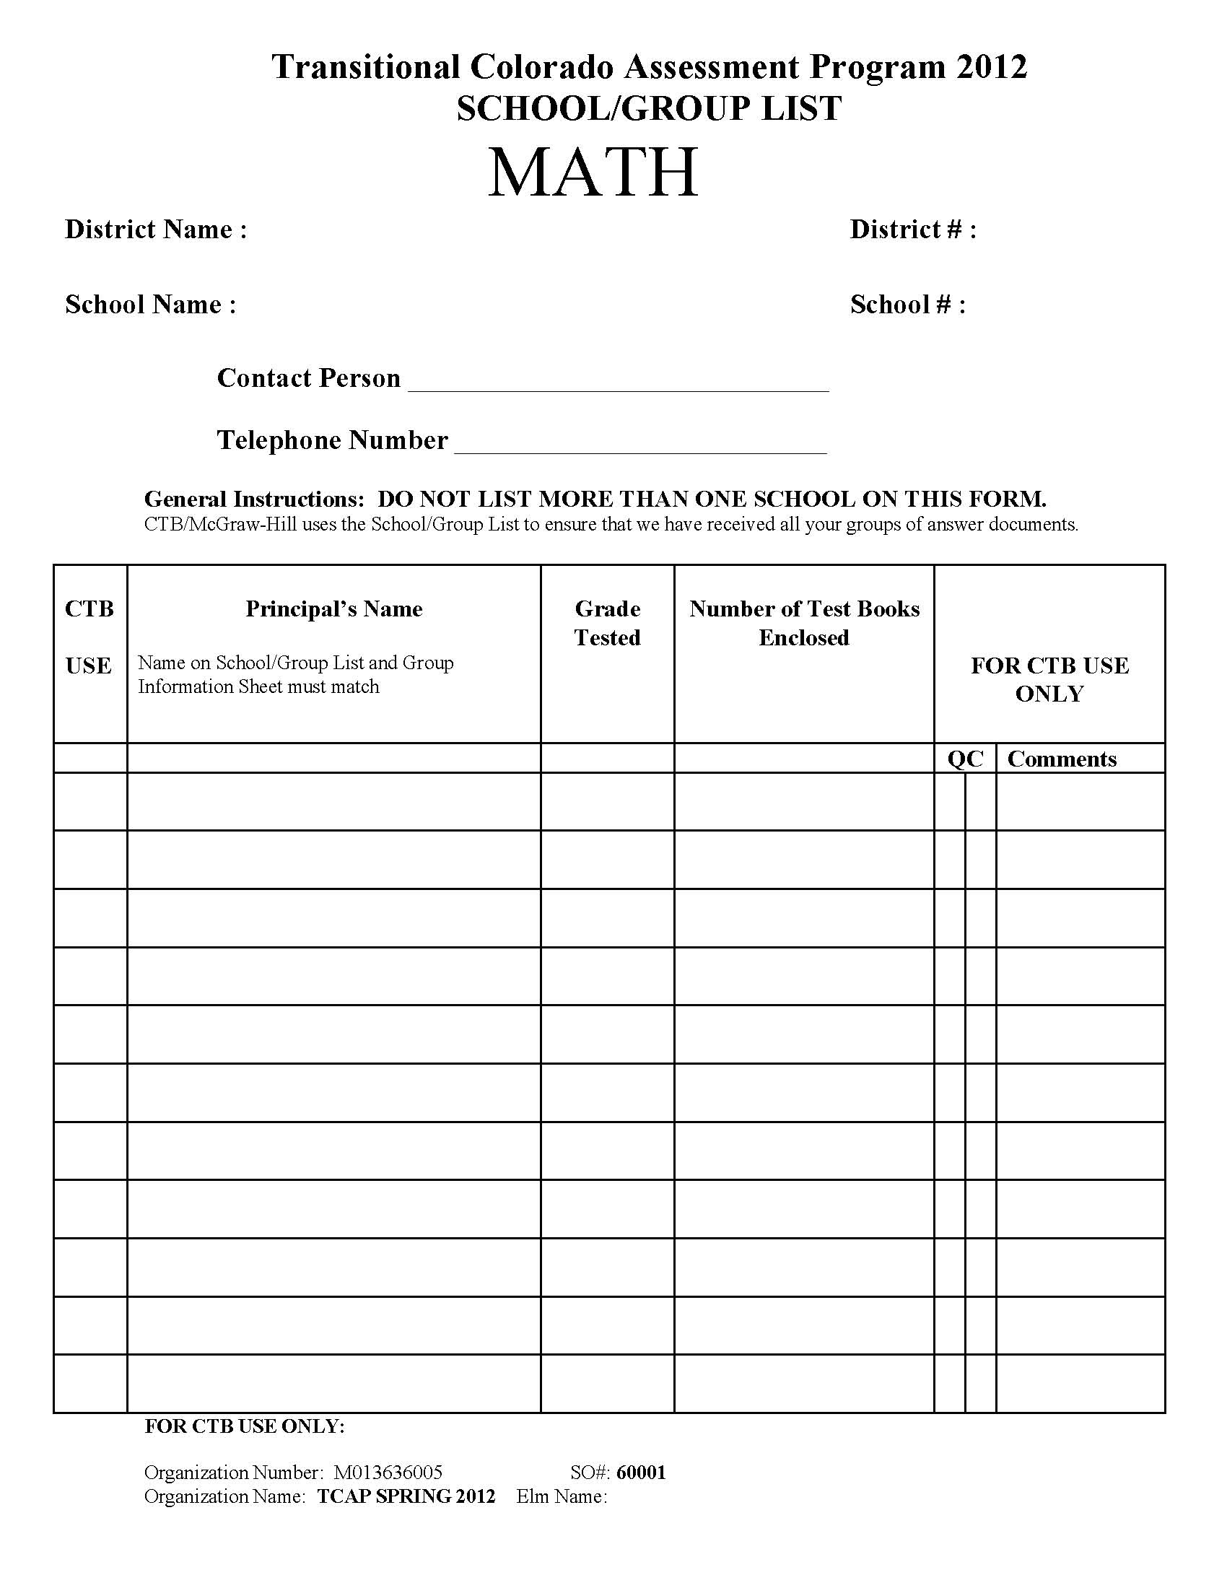
School/Group Lists - SGL
Make a copy of each SGL
Pre-Coded
Pre-Coded
SGLs list ALL GIS forms with test books by content area sent in to CTB.
SGLs arrive Pre-Coded.
You must complete:
Contact Person and
Telephone number.
Principal Name
Grade Tested
Number of test books
1
2
3
4
29
Notes:
<School/Group List form>
This is the SGL form. The picture shown is again for TCAP specifically. CoAlt will not have a content area listed at the top. There are some fields pre-coded on the SGL and some that require SACs to complete.
What must be filled in:
Contact Person and Telephone number.
Principal Name
Grade Tested
Number of tests books
What is pre-coded: school name and number and district name and number.
SGLs confirm that all your groups of test books have been received, so you should be listing all the GIS forms by grade and numbers of books on the SGL in your shipment.
There will only be one SGL per school for CoAlt. There will only be one SGL per school for each TCAP content area.
Again, make a copy of SGLs for district records – but never send photocopied forms to CTB!!

Slide 30
Shipping Materials
Do Not Mix Assessments in Shipments!
Use only Green Boxes for shipping back to CTB
Use paper bands and stack cards for TCAP test books
Use envelopes for returning CoAlt
“To be Scored” and “Not to be Scored”
  Ship “To be Scored” and “Not to be Scored” materials in separate boxes.
  “To Be Scored”
      Purple for Grade 3 Reading, Orange for CoAlt, and White for TCAP
  “Not To Be Scored”
      Yellow for all assessments
Follow DAC/SAC Manual instructions on how to package materials
30
Notes:
30
It is important to Ship TCAP CoAlt assessments separately:. Also please note: CoAlt procedures are slightly different from TCAP. Please refer to the SAC/DAC manuals for each assessment as necessary.
First, all materials are returned to CTB in the green striped boxes in which your materials were shipped to you initially.
CoAlt will continue to use envelopes for return shipping.
I will explain how to use paper bands and stack cards for TCAP materials on the next slides. CoAlt does not use paper bands or stack cards.
Remember to package to be scored and not to be scored materials in separate boxes and use the correct labels for each. Refer to the DAC/SAC Manual for specific instructions on how to pack boxes.

Slide 31
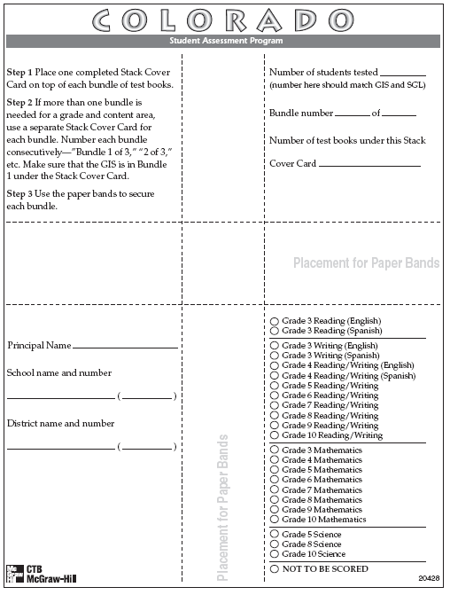
Paper Bands and Stack Cards
Materials
For TCAP test materials
Complete a stack cover card for each bundle of test books.
Note: CoAlt Rating Forms to be scored will use an envelope, not paper bands/stack cards.
31
Notes:
Here is what paper bands and stack cards look like for the TCAP. Be sure to complete all of the information on the stack card. If you need additional stack cards, these may be photcopied, or you may request more from CTB Navigator.
Two paper bands are used for each bundle of test books. One is wrapped horizontally and the other vertically, so that they form a cross on the front, back and sides of each bundle.
When you pack your boxes, please be sure that you comply with instructions in the DAC/SAC manual about the order in which stack cards, bundles, and GIS or SGLs should be placed.

Slide 32
Booklets Per Bundle
TCAP Grade 3: 30
TCAP Grades 4-10 Math: 25
TCAP Grades 4-10 Reading/Writing: 15
32
Notes:
When bundling booklets, you want to aim for these approximate numbers. If you are a couple test books over or under, that is ok. For example, you can go one or two over instead of creating a new bundle for just a couple of books. But don’t go over too much because these bundles must still be small enough to be handled by the scanning and processing equipment and we don’t want to jam up the works.

Slide 33
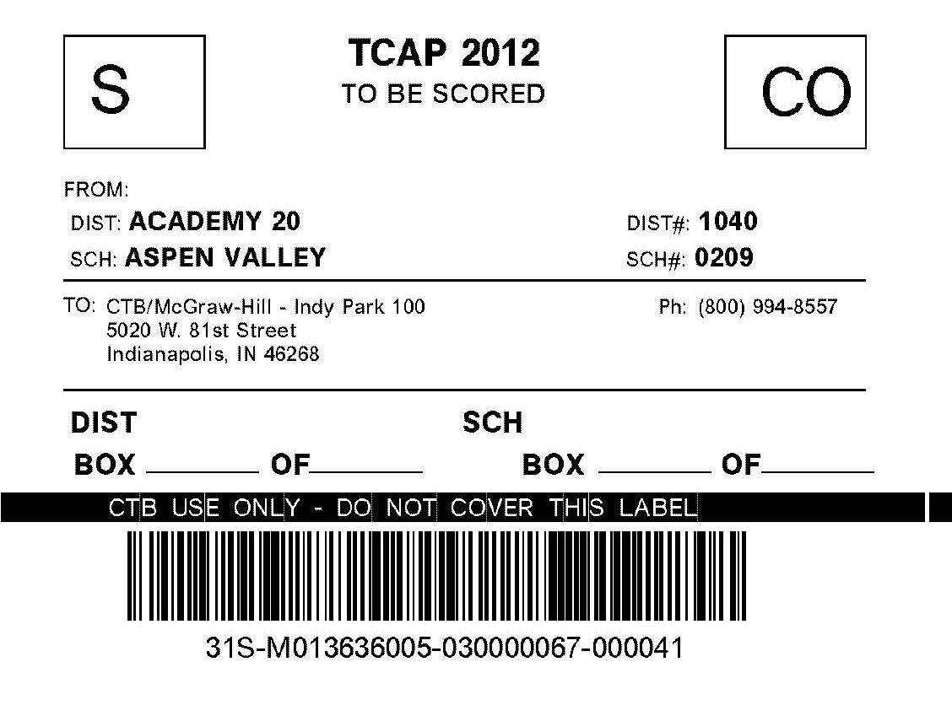
TO BE SCORED materials
Include:
TCAP Test Booklets to be scored
CoAlt Rating Forms to be scored
Shipping Labels
  Purple for 3rd Grade reading
  Orange for CoAlt
  White for TCAP
Do not create your own shipping labels
33
Notes:
TO BE SCORED boxes can only contain TCAP test booklets or CoAlt Rating Forms
Once boxes are packed, use the right To Be Scored shipping label for the right assessment. School names are on the labels. Make sure the test books are returned under the school name and number that is on the label.
You will need to specify how many boxes are in this particular shipment. Complete the shipping label by entering the District box number blank of blank and school box blank of blank
DO NOT reproduce or create your own shipping labels. If you run out of labels, please order more through CTB Navigator. CTB scans the bar codes of all shipping labels when the boxes are received. Duplicated shipping labels slow the scanning process.
Step 9 of the TCAP SAC/DAC manuals details shipping boxes to CTB. (This is step 8 in the CoAlt SAC/DAC manual.)

Slide 34
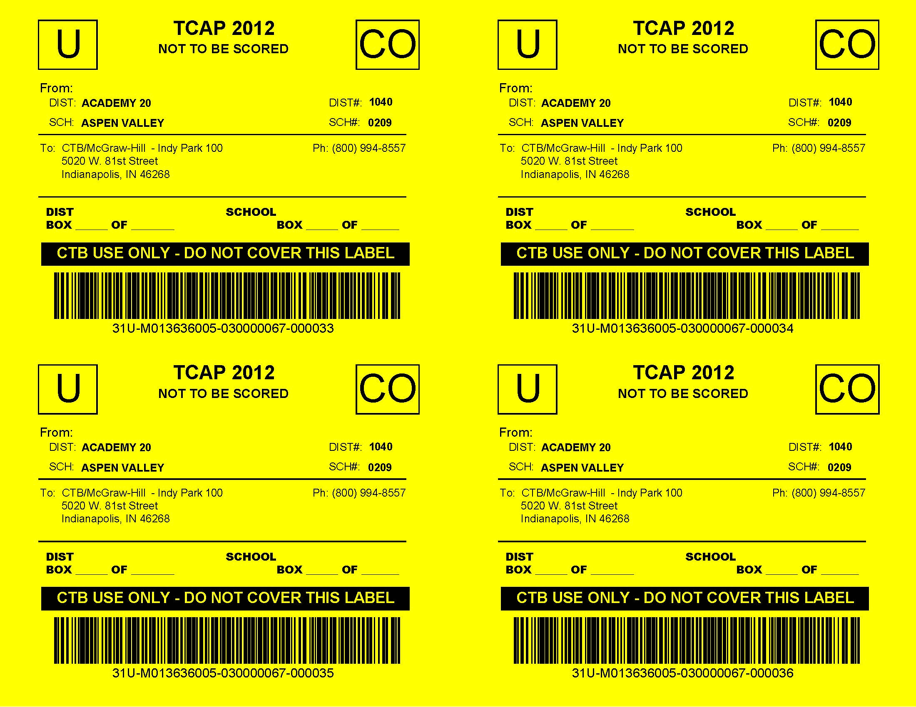
NOT TO BE SCORED materials
Include:
Unused test books
Used test books that are not to be scored
Braille and Large Print books
Oral scripts
Teacher-read directions
All used and unused draft booklets
CoAlt Test Protocols
Examiner Guides, etc.
34
Notes:
NOT TO BE SCORED materials must be boxed separately from TO BE SCORED materials. Both TCAP and CoAlt will have YELLOW Not To Be Scored labels with the assessment name on the top.
You should include Used test books that are not to be scored such as:
Student wrote answers in Spanish and then the book was transcribed
Damaged test books (answers have been copied into another book)
Anything that was completed by student but was transcribed – like Braille and large print
But please note that an “invalidated” test book does not fall in the not to be scored category. In other words, if a student was absent and the test is invalidated as “test not completed” that book should still be shipped with to be scored materials.
Other types of Test Materials that are Not To Be Scored include:
Oral scripts, translated oral scripts, and teacher read directions. Remember that these are all are all secure materials
CoAlt Test Protocols
Examiners Guides and Test Proctor’s Manuals
Some test materials have specific considerations
Math manipulatives should not be returned to CTB– these can be kept by districts or destroyed.
TCAP punch-out tools may be returned with Not to be scored materials, destroyed by the district, or retained by the district for instructional use. Never use prior year’s punch out tools on the assessment. Always use the new punch out tools provided.
CoAlt pizza box options: If the box is still sealed, send the entire box back with the NTBS materials. If the box is opened, you can recycle the box and return the unused materials with the NTBS materials.
Note: CTB will open and review NTBS materials. It is helpful to write “DNS” or “DO NOT SCORE” across any used booklets included in the NTBS materials.

Slide 35
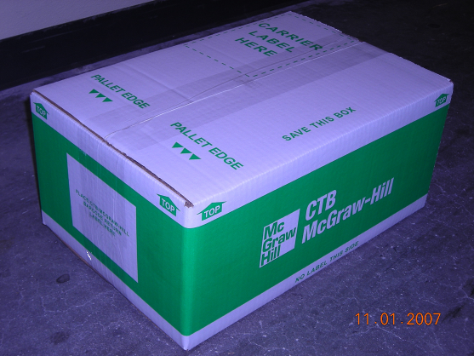
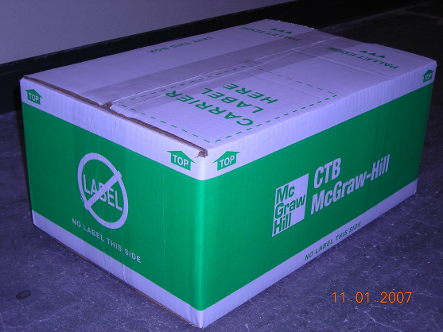
The Green Box
Place Label Here
Do Not Place Label Here
35
Notes:
These are the green boxes with which you will return to be scored and not to be scored materials. Remember that you should never put to be scored and not to be scored materials in the same box.
When returning materials, make sure your district name and number and school name and number are on the labels correctly and number the District box number x or x and school box x of x for this shipment you will be scheduling for CTB to pick up. Place the label in the specified location on the end of the striped green boxes. Again, if you do not have adequate shipping labels, you should order extras from CTB through CTB Navigator. Do not make your own labels if you run out.
Please note the “Place CTB Barcode Return Label here” text on the side of the box. This is where shipping labels must be placed. Also, if you are shipping multiple boxes, be sure that the labels are facing outwards. This improves processing speed when they are received.
Please also note the other side of the box has a graphic that says: “no label.” Obviously, no label should be placed here.

Slide 36
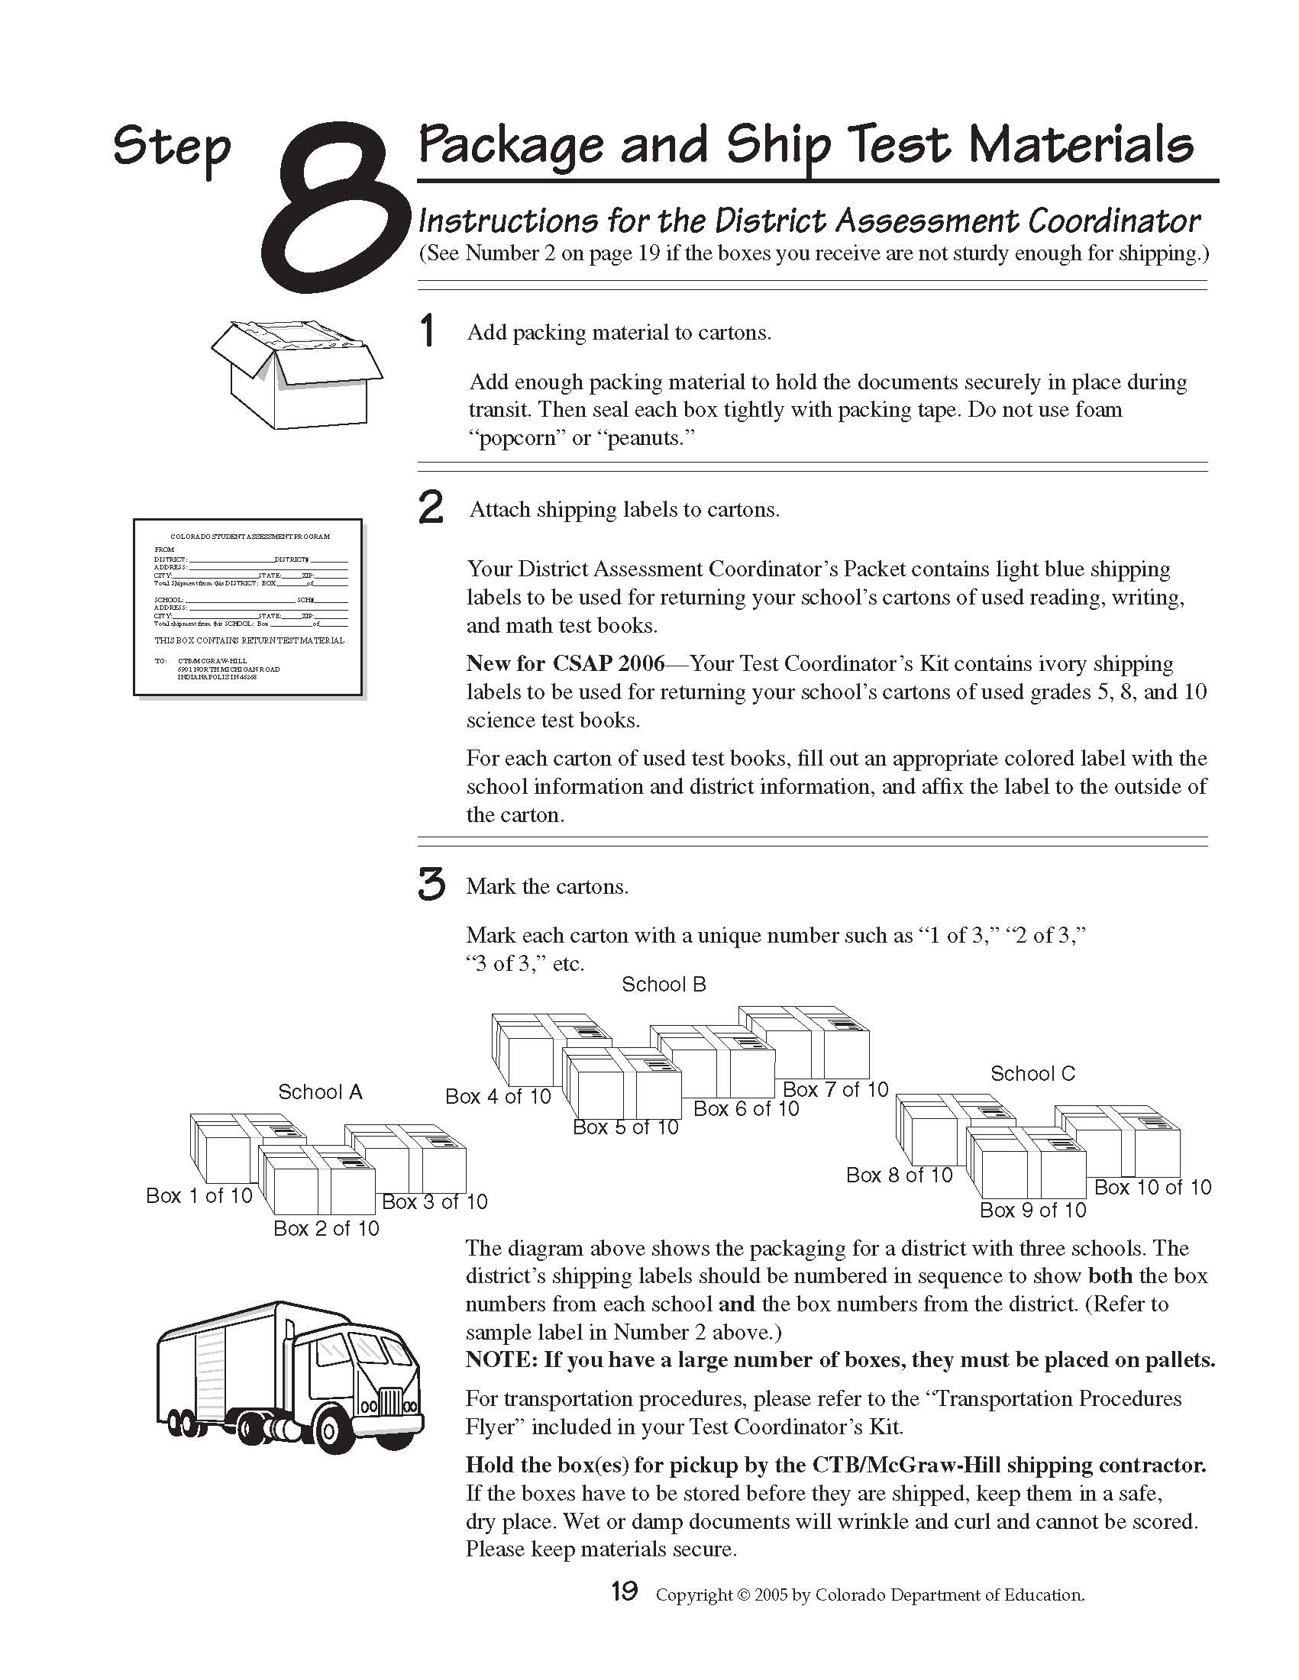
Final Packing and Shipping - DAC
“TO BE SCORED” Materials
SGL
SGL
SGL
“NOT TO BE SCORED” Materials
36
Notes:
Here is a graphic example of how to ship back to CTB from the SAC/DAC manuals. When you are ready to ship, schedule the pickup online through CTB’s Navigator site. Be sure to select the correct assessment (TCAP or CoAlt) when scheduling pickup of test materials on Navigator.
Note again, To Be Scored and Not To Be Scored materials are completely separate, with separate box counts and labels by school. This example is for a district with three schools in this shipment. School A has three boxes of To Be Scored material, with the Student Group List in box 1 of the three, School B with four boxes, School Group List in the first box of the four, and School C with three boxes, School Group List in box 1 of 3. Placing the School Group List in the first box is key. The To Be Scored shipping labels are numbered district x of 10 – ten total boxes for this district shipment.
The district level-box counts should always reflect what you have scheduled for pickup on Navigator. Scheduling separate "stand alone" shipments for make-ups and "Not To Be Scored" materials on Navigator is always acceptable....as long as the box counts are accurate by district and school.

Slide 37
TCAP and CoAlt Shipping Dates
 | Grade 3 Reading (Early) | Grade 3 Reading (Regular) | Grade 3-10 (Early) | Grade 3-10 (Regular) | CoAlt “Pizza Boxes”
Receive by | January 24, 2014 | February 7, 2014 | February 14, 2014 | February 21, 2014 | January 17, 2014
Schedule Return Pick Up by | February 26, 2014 | March 11, 2014 | April 9, 2014 | April 16, 2014 | March 25, 2014
Final Day to Pick Up | February 28, 2014 | March 13, 2014 | April 11, 2014 | April 18, 2014 | March 27, 2014
Note: Returning test materials after the final pick up date is a breach of test
security and will likely result in the invalidation of test scores.
Notes:
Once again, here are the various shipping dates that you will need to be mindful of.

Slide 38
Call the CTB Help Desk
1.800.994.8557
for questions about your TCAP and CoAlt materials
38
Notes:
Thank you for your attention to the CO Logistics training. If you have any questions about logistics or test administration, call or email the Assessment Unit.
If you need any materials – boxes, labels, GIS forms, missing special pops materials you have ordered online – call CTB directly at the customer service line 1-800-994-8557.

