Slide 1
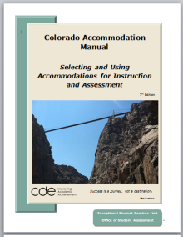
Overview of the 2013-14 Building Bridges for the Future Colorado Accommodation Manual Part II – Assessment Accommodations Section VII ACCESS for ELLs Section VIII CMAS Appendices
Welcome! Colorado Department of Education

Slide 2
Accessing State Assessments
WIDA, CMAS, Appendices

Slide 3
ACCESS for ELLs
Alternate ACCESS for ELLs
English Language Proficiency

Slide 4
ACCESS for ELLs
ACCESS for ELLs® is a secure large-scale English language proficiency assessment given annually to Kindergarten through 12th graders who have been identified as English language learners (ELLs). It provides educators and parents information about the English language proficiency level in the language domains of Listening, Speaking, Reading and Writing.

Slide 5
Participation
All students identified as English Language Learners (LEP and NEP).
Some students who are also identified with a disability (IEP or 504 plan) may need additional support to access the assessment.
A very small number of students may qualify to take the Alternate Access for ELLs. Must qualify for the CoAlt as their academic measure.

Slide 6
Who can have accommodations for accessing the assessment?
Students with an IEP
Students with a 504 plan

Slide 7
ACCESS
Noun
Verb
the right or privilege to approach, reach, enter, or make use of something
to gain access to
make accessible or available
Notes:
Not improved scores, but being able to interact with the assessment.

Slide 8
CONSTRUCT
Noun
Verb
an image, idea, or theory, especially a complex one formed from a number of simpler elements
a model devised on the basis of observation, designed to relate what is observed to some theoretical framework
to build or form by putting together parts
frame
to draw so that certain requirements are satisfied
Notes:
What is being tested

Slide 9
Listening
process, understand, interpret and evaluate spoken language in a variety of situations
Notes:
Domain/Construct as defined by WIDA

Slide 10
Speaking
engage in oral communication in a variety of situations for a variety of purposes and audiences
Notes:
Domain/Construct as defined by WIDA

Slide 11
Reading
process, understand, interpret, and evaluate written language, symbols and text with understanding and fluency
Notes:
Domain/Construct as defined by WIDA

Slide 12
Writing
engage in written communication in a variety of situation for a variety of purposes and audiences
Notes:
Domain/Construct as defined by WIDA

Slide 13
Test Directions
Text in the Test Administers Script in bold
Translation into student’s native language
Translation into sign system
Repeat
Not allowed
Explanation of directions in any language (English and/or native language)
Use directions that have been marked by teacher
Notes:
There is not a separate script for Teacher Read Directions.
Test directions for this accommodation consist of the words in Bold in the Test Administers Script.

Slide 14
Presentation Access
Test items – including introductory text and graphic supports
Translation into sign system (SEE or PSE)
Reading of test in English
Use of yellow highlighters
Use of place markers
Large print
Magnification devices
Audio amplification
Read-aloud to self
Not allowed
Translation into student’s native language
Bilingual dictionary

Slide 15
What about students with visual impairments including blindness?
WIDA is having a meeting on September 19 – 20 and we anticipate to have more information after that.

Slide 16
Setting Access
School personnel familiar to student
Non-school setting only in extenuating circumstances (public library)
CDE does not support the testing of grievously ill students
In a separate room
In a small group
Preferential seating
Individually
Study carrel
Special lighting
Special acoustics
Special furniture
Equipment/technology

Slide 17
Timing / Schedule Access
Flexibility with timing of test is permitted as documented on student’s IEP
More breaks as needed by student
Short-segment testing
Extended time within the same school day
Extended time over multiple days
Not allowed for Speaking

Slide 18
Response Access
Devices and practices used to facilitate testing for student who have difficulty with bubbling or writing in the correct area of the test book
Braille writers
Must be transcribed
Computer, word processer
Spell check – Off
Grammar check – Off
Dictionary/Thesaurus – Off
Points/Indicates answers
Scribe – for students who meet the criteria for all Colorado assessments
Not allowed
Tape recorders
Student’s native language

Slide 19
Colorado Measures of Academic Success (CMAS)
Social Studies
Grades 4 & 7
Science
Grades 5 & 8

Slide 20
Computer Based
The expectation is that most students will be taking the Colorado Science and Social Studies Assessments using an electronic platform (i.e., computer).
Paper-based assessments will be available for a small number of students who are unable to access the computer-based assessment for a specific reason (for example, seizures from using a computer, need to use braille, adaptive input does not work with test engine, etc.).
Additionally, some accommodations are not yet available in the computer-based testing environment and are only available via a paper-based assessment. (Assistive Technology)
Notes:
Multiple operational systems –

Slide 21
Vocabulary
Tools
Part of the test engine
Available for all students
Embedded Accommodations
Part of the test engine
Available to students with an IEP, 504 plan or identified as ELL
Identified and turned on prior to testing
Locally Provided
May be on the computer, or on a Paper/Pencil form
Notes:
Locally Provided usually includes a district/school personnel to deliver the accommodation

Slide 22
Tools
Embedded Tools for Computer-Based Testing in CMAS Operational Administration
 | Windows |  | Mac |  | iOS |  | Chrome OS
 | Spring 2014 | Fall 2014 | Spring 2014 | Fall 2014 | Spring 2014 | Fall 2014 | Spring 2014 | Fall 2014
TOOLS – Available for All Students
Eliminate Answer Choice | Yes | Yes | Yes | Yes | Yes | Yes | Yes | Yes
Flag Items for Review | Yes | Yes | Yes | Yes | Yes | Yes | Yes | Yes
Magnification/ Enlargement Device | Yes | Yes | Yes | Yes | Yes | Yes | Yes | Yes
Notepad | TBD | TBD | TBD | TBD | TBD | TBD | TBD | TBD
Calculator - Scientific | Yes | Yes | Yes | Yes | Yes | Yes | Yes | Yes
Calculator - Four function with square root | Yes | Yes | Yes | Yes | Yes | Yes | Yes | Yes
Pencil tool | TBD | TBD | TBD | TBD | TBD | TBD | TBD | TBD
Ruler Inches/Centimeters | Yes | Yes | Yes | Yes | Yes | Yes | Yes | Yes
Audio with Volume Control | Yes | Yes | Yes | Yes | Yes | Yes | Yes | Yes
Highlight tool | TBD | TBD | TBD | TBD | TBD | TBD | TBD | TBD
Spell Check | TBD | TBD | TBD | TBD | TBD | TBD | TBD | TBD
Writing Tools (Cut/Copy/Paste) | TBD | TBD | TBD | TBD | TBD | TBD | TBD | TBD
Line Guide | TBD | TBD | TBD | TBD | TBD | TBD | TBD | TBD
Tools – Can be selected locally in the online platform prior to administration based on students individual academic need
Text-to-Speech | Yes | Yes | Yes | Yes | Yes | Yes | Yes | Yes
Eliminate answer choice
Flag items for review
Magnification/Enlargement
Notepad
Calculator
Pencil tool
Ruler
Audio with Volume Control
Highlight
Spell Check
Writing Tools
Line Guide
Text-to-Speech
Notes:
Text to Speech – can be selected locally in the online platform prior to administration

Slide 23
Tools
Eliminate Answer Choice
Pencil Tool

Slide 24
Magnification / Enlargement
We do not know specifics of how it will work – only that it will be available.
It will use the screen size provided – thus a larger screen will be able to provide larger text and graphics with less scrolling.

Slide 25
Calculator
Older grades
Younger Grades

Slide 26
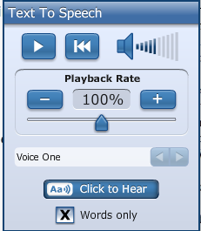
Text-to-Speech
Speed, volume, and voice options are available.
Word-by-word highlighting accompanies a continuous read of the item text.
Considerations
Bandwidth
Headphones
Screen real estate
Must be “turned on” locally prior to the assessment
Notes:
Not a reading test so it is available to all students
If your district is planning on using many accommodated forms, please check with your District Technology Coordinator that you have appropriate bandwidth.
We are not sure how it gets “turned on” = SDU, or individually in PearsonAccess

Slide 27
Embedded Accommodations
Color Contrast Settings
Spanish Audio
Spanish Written Responses
Accommodations for Computer-Based Testing in CMAS Operational Administration
 | Windows |  | Mac |  | iOS |  | Chrome OS
 | Spring 2014 | Fall 2014 | Spring 2014 | Fall 2014 | Spring 2014 | Fall 2014 | Spring 2014 | Fall 2014
Embedded Accommodations – Can be selected by locally in the online platform prior to administration according to a student’s 504, IEP, or English Learner Plan.
Color Contrast Settings | Yes | Yes | Yes | Yes | Yes | Yes | Yes | Yes
Spanish Audio | TBD | TBD | TBD | TBD | TBD | TBD | TBD | TBD
Embedded Accommodations – do not need preselected
Spanish written Responses | Yes | Yes | Yes | Yes | Yes | Yes | Yes | Yes
Notes:
IEP, 504, ELL
These color choices were based on research from the following websites: http://irlen.com/index.php and http://www.w3.org/WAI/RD/2012/text-customization/r11 and follow the same guidelines that drive web content accessibility.

Slide 28
Locally Provided
Teacher Read Directions
Word-to-Word dictionary
Translated Oral Script**
Spanish Provided
Other languages locally translated
As documented in the IEP, 504 plan or ELA plan
Small group
Extended time
Multiple breaks
Scribe*
Notes:
IEP, 504, ELLs
TRD – any student
Translated Oral Scripts – will need to be indicated in PearsonAccess so students in the same environment are on the same form.
Scribe has additional requirements.

Slide 29
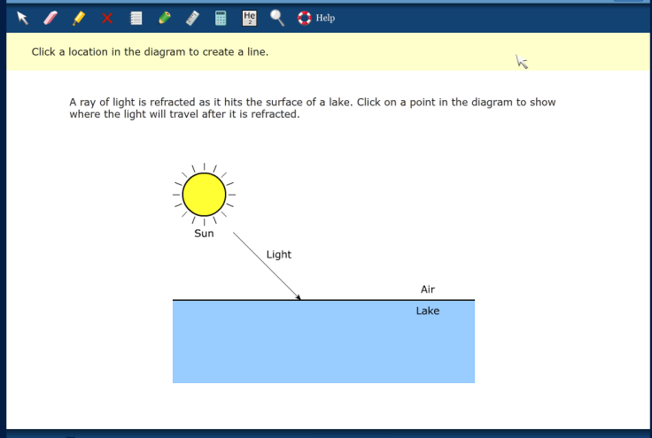
Teacher Read Directions
Teachers may read what is in the yellow band on the top of the screen.
Notes:
Available to any student and may be used to redirect a student to on the assessment.
There is no script.
Potential to be disruptive to the testing environment – earphones

Slide 30
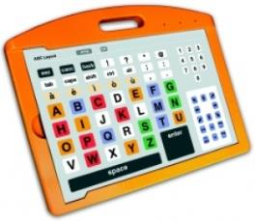
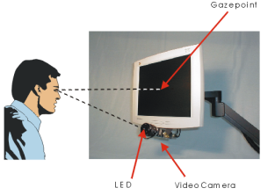
Scribe
We do not know specifics of how it will work – only that it will be available.
For students with a physical disability that prohibits them from accessing the computer-based assessment.
Extreme fatigue
Incompatible A.T.
Notes:
Please notice that in addition to the restrictions that have been used for Scribe on TCAP – a student’s disability must prohibit them from accessing the technology. There are multiple means of accessing a computer based assessment – including adapted keyboards, adapted mouse, switches and eye gaze.
If the student’s AT is not compatible with the test system, the student may qualify for a scribe for this assessment.

Slide 31
Assistive Technology
** A number of “plug and play” devices are being investigated for compatibility with the computer-based test engine. A list of compatible devices will be provided at a later time, once a determination is made that a device works without error.
Notes:
May be as late as March…
Working with AT project and SWAAAC teams
If you have a student that needs AT to access the computer the current recommendation is to plan on ordering a paper/pencil assessment for the student – if their technology is deemed compatible, the student should test on the computer and the paper/pencil assessment returned unused.

Slide 32
As Documented in IEP, 504 plan or ELA plan
Extended Time
Breaks
Generously allotted testing sessions
Separate environment
Does not stop the clock
Notes:
If it is not specified in the IEP, consider what is used during classroom instruction, and on instructional and district assessments.

Slide 33
Translated Oral Scripts
Computer-based
As long as the student is responding in English or Spanish
Indicated prior to testing in PearsonAccess will “force” onto one form.
Spanish
Provided
Other languages and sign language
a script will be provided for translation at the local level
Notes:
If you have a student that will be writing in their native language for local translation – this will force them onto the paper/pencil form

Slide 34
Small Group
PARCC Wording
Colorado Small Group
Principals may determine any student requires one or more of the following test administration considerations regardless of the student’s status as a student with a disability or who is an English learner:
Small group
Frequent breaks
Time of Day
Separate or alternate location
Specified area or seating
Adaptive or specialized equipment or furniture
As documented in the IEP, 504 plan or ELA plan
If the plan does not give a specific number consider:
What is the small group size used in instruction and on classroom and district assessments? data

Slide 35
Paper/Pencil Accommodations
Braille
Speech-to-Text
Word Prediction
Locally translated responses

Slide 36
Remember
There is no limit to what is used in the classroom to help students access instruction
Accommodations on the assessment it must maintain the construct of the assessment
When in doubt ask

Slide 37
Appendix
Letter to Superintendents
No Opt Out
Instruction for Signing of Oral Scripts
Instructions for Scribe
Verification of Removal of Saved Data
Nonstandard Accommodations
Dual assessment request form in section 3
SwDCLD
Monitoring and Documentation
Universal Design

Slide 38
Letter to the Superintendent

Slide 39
Nonstandard Accommodations December 13, 2013
Be specific
Be individualized
Include documentation of need – (IEP or 504)
Have SASID (10-digit)
Two signatures
All the questions answered
Notes:
A lot of the time people put these off until the last minutes. I recommend that this not be the case.
Please see the September 5 training for more information on the nonstandard accommodation process.
Secure information is contained in these documents, so please keep this in mind when submitting.
Requests may be submitted via Fax, PDF (secure server where we go down load, or password protected pdf emailed, and password sent), or Courier
Requests must be received by the deadline of December 13.

Slide 40
Thank you
Linda Lamirande – Instructional Accommodations
Lamirande_L@cde.state.co.us
303-866-6863
Mira Monroe – Accommodations for Assessment
monroe_m@cde.state.co.us
303-866-6709

