Slide 1
Technical Advisory Panel (TAP) Webinar
March 12, 2019

Slide 2
Technical Advisory Panel
Welcome!
Introductions

Slide 3
Growth to Standard: Indicator Weightings
Marie Huchton

Slide 4
Growth-to-Standard Requirement in SB18-1355
Required performance indicator for inclusion in annually-determined school and district rating calculations: “Student academic growth to standards, based on students progress toward meeting the state standards… or for students who meet grade-level expectations on the state standards, progress toward higher levels of achievement, if available, as measure by the statewide assessments.” 22-11-204(1)(a)(III)
Which means a growth to standard metric needs to measure a student’s progress towards meeting a target level of performance within a given timeframe. And this metric needs to update/incorporate observed progress over time.

Slide 5

CMAS ELA and Math Growth to Standard-
Proposed TAP Methodology
What target(s)?
  Increase 1 proficiency level
How long to achieve the target(s)?
  3 Years
How does the target update over time?
  Resets every year
Do we report students below proficient (Catch Up) and above proficient (Keep Up) separately? Or combined?
  Report combined On Track metric

Slide 6
Growth to Standard for Framework Reporting
Growth to standard will be added as a standalone indicator in the school and district performance frameworks.
A minimum N of 20 will be applied for public reporting
For points, report only the All Trajectories group- for both All Students and Disaggregated Groups.
For informational purposes, report the Catch Up and Keep Up results. If either the Catch Up or Keep Up group does not meet minimum N, both categories are suppressed (location still TBD).
Sub-indicator cuts set at the 15th-50th-85th percentiles of All Students distributions

Slide 7
Rolling up Growth to Standard Sub-indicators
Points Eligible for Growth to Standard will be the same as for the Achievement and Growth metrics? (All Disaggs combined = ½ All Students group weight)
The ELP On Track measure moved into growth to standard indicator for Elementary and Middle school-level results.
For high school-level results, ELP On Track will continue to be reported in Growth since there is no current Growth to Standard measure (Tableau tool needs to be updated, so ignore current results for schools serving high school students).
Thinking about renaming Growth to Standard as Growth On Track

Slide 8
Middle School Targets
CDE contemplated 2 possible scenarios:
  Targets stop at grade 8, so 7th graders only have 2 years and 8th graders only have 1 year to achieve their targets
  Targets extend to grade 9 PSAT (couldn’t go to grade 10 PSAT because do not yet have a single cohort of students testing on both PSAT 9 and PSAT 10) so 7th graders have 3 years and 8th graders have 2 years to achieve their targets
Internal CDE discussions around bridging the CMAS g8 results to PSAT g9 resulted in technical concerns:
  Lack of sufficient alignment between CMAS and anticipated PSAT/SAT performance levels
  Lack of sufficient standards alignment between CMAS ELA (Reading and Writing content) and PSAT/SAT EBRW (Reading content only)
  Lack of sufficient alignment between item type outcomes CMAS ELA (MC and CR items) and PSAT/SAT EBRW (MC items only)

Slide 9
Middle School Cut Scores
Given these technical concerns, CDE has decided not to pursue the extended targets scenario, and will set the current cap on Growth to Standard targets at grade 8.
Once PSAT and SAT state performance levels are established, we will investigate the potential to create Growth to Standard calculations at the high school level.

Slide 10
Growth to Standard Sub-indicator Cut Scores
The following table shows the cut-scores for Elementary and Middle school-levels by on track trajectory for 2018

Slide 11
Indicator Weighting Scenarios

Slide 12
Weighting Between Indicators
Results include only 1-Year framework data (not necessarily official) and cuts for overall rating categories stayed the same
Overall impact is fairly small- maximum of 6% of schools and 7% of districts move up or down one framework rating.
This is the result of how the measure has been constructed and the strong correlations seen with the existing Achievement and Growth indicator results.

Slide 13
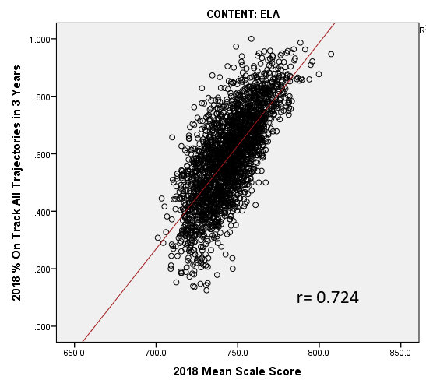
Correlation between Recommended On Track All Trajectories and Mean Scale Score
The correlation between the Elementary % On Track across All Trajectories and the Mean Scale Score is moderate at 0.724 for ELA and 0.704 for Math

Slide 14
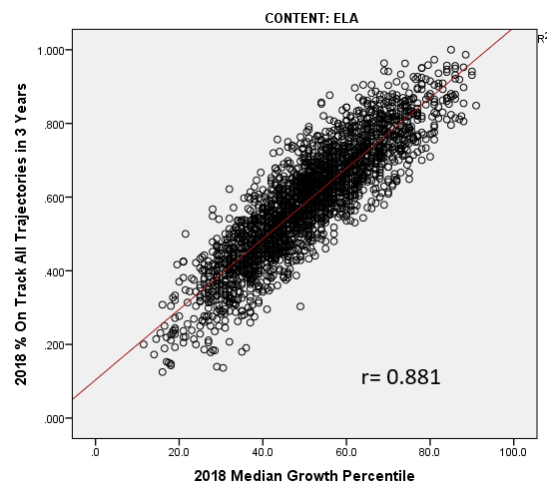
Correlation between Recommended On Track All Trajectories and Mean Scale Score
The correlation between the Elementary % On Track across All Trajectories and the Median Growth Percentile is very strong at 0.881 for ELA and 0.847 for Math

Slide 15
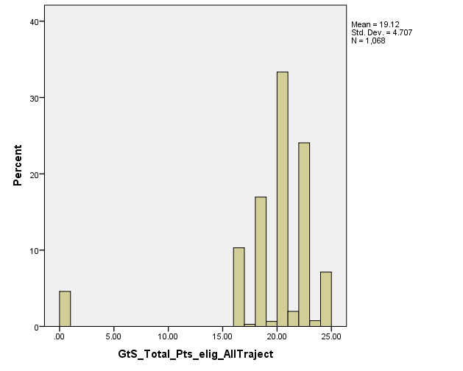
Summary of Growth to Standard Indicator
Roll-up Results
On average, Colorado Elementary schools had reportable Growth to Standard data for the All Students Groups in ELA and Math and 3 Disaggregated groups. The histogram to the left shows the total distribution of points eligible, and the table to the right gives the overall distribution of Growth to Standard Indicator ratings.

Slide 16
Interactive Tableau Tool with
Weighting Scenario Results
Josh is amazing and made an interactive tool where we can look at the outcomes of each of the weighting scenarios compared to the current results:
  Results for districts, schools serving high school students (ignore for now), and schools not serving high school students (E/M only)
  Hover overs with demographic and indicator results
  Hover overs on percent of points graphic with specific district/school info
  Sliders so you can filter results by concentration of at-risk students enrolled
Today we are going to focus on the Elementary/Middle school only and District results. The plan is for schools serving high school students to get the same weighting as the districts, as we have done in the past.

Slide 17
Framework Indicator Weighting Scenarios
2 Major Questions:
How many points should the new Growth to Standard indicator be worth?
  5, 10 or 15 points for elementary and middle school only schools?
  5 or 10 points for schools serving high school students and districts?
What proportion of points should be taken from existing indicators?
  All from growth, all from achievement, or a blend of the two?
  How should PWR play in at the high school and district levels?

Slide 18
Change in Framework Ratings by Weighting Scenario- Elementary and Middle Schools
The TAP handout provides a summary of each weighting scenario modeled, along with the average % FRL and associated FRL quartile for movers. Basic narratives comparing outcomes have also been included.

Slide 19
Change in Framework Ratings by Weighting Scenario- Elementary and Middle Schools
The TAP handout provides a summary of each weighting scenario modeled, along with the average % FRL and associated FRL quartile for movers. Basic narratives comparing outcomes have also been included.
If TAP is amenable, we will focus on the scenarios where GtS is weighted 10 points (middle ground and allows for 5 points at district)

Slide 20
Change in Framework Ratings by Weighting Scenario- Elementary and Middle Schools
District results are included in the handout as well, with weighting scenarios including PWR.

Slide 21
Change in Framework Ratings by Weighting Scenario- Elementary and Middle Schools
District results are included in the handout as well, with weighting scenarios including PWR.
If TAP is amenable, we will focus on the scenarios where GtS is weighted 10 points (middle ground and allows for 5 points at district)

Slide 22
Next Steps for April
CDE will be having 1 on 1 meetings with each of the Board members between March 14 and the April SBE meeting to explain the TAP recommended Growth to Standard Methodology and review performance framework impact data
CDE will publicly present TAP recommended Growth to Standard Methodology and review performance framework impact data at the April SBE meeting

Slide 23


Slide 24
Overview of March 1st State Board
Work Session
Ashley Piche

Slide 26
Technical Advisory Panel
Meeting Summary:
  Suggested future analysis
  TAP recommendations from this meeting
Public Comment
Close Meeting
  Next Scheduled Meeting, Tuesday, April 2nd, 1-4 (CDE)

