Slide 1
Technical Advisory Panel (TAP) Meeting
February 25, 2019

Slide 2
Technical Advisory Panel
Welcome!
Introductions

Slide 3
PWR Indicator:
Future Changes & Updates

Slide 4
Discussion Items
PWR Indicator: Future Changes*
SB18-012 Military Enlistment as part of the PWR Indicator
HB18-1019 Kindergarten Through Twelfth Grade Accreditation Weighted Factors
SB17-272 Measure relating to Demonstration of CCR
Other Updates
Industry Credential Submission
*Please note that all of the PWR indicator information is draft only and may change.

Slide 5
PWR Indicator: Future Changes
SB18-012 Military Enlistment as part of the PWR Indicator
Bill Sponsors: Senator Owen Hill & Rep. Brittany Pettersen
Description | Implementation | Required Data/Possible Source
Adds military enlistment within a year of graduation to matriculation rates. | An equally weighted matriculation option that would be factored into the overall matriculation rate calculations. Anticipated -2021 DPF/SPF reports. | Student level enlistment data; possible EOY ‘intent to enlist’ flag.

Slide 6
PWR Indicator: Future Changes
HB18-1019 Kindergarten Through Twelfth Grade Accreditation Weighted Factors
Bill Sponsors: Representative Mike Foote & Senator Kevin Priola
Description | Implementation | Required Data/Possible Source
Adds additional measures of the percentage of students who successfully complete: An advanced placement course in a subject other than English language arts or math and earn a score of 3 or higher on the end-of-course advanced placement exam; A concurrent enrollment course in a subject other than English language arts or math and earn a grade of 'B' or higher in the course; and an international baccalaureate course in a subject other than English language arts or math and earn a score of 4 or higher. | Possible overall % of students meeting criteria. Anticipated - 2022 DPF/SPF reports. | Course enrollment information, AP/IB/CE scores & (w/non-ELA and non-Math designation); College Board, IB, and CDHE

Slide 7
PWR Indicator: Future Changes
SB17-272 Measure relating to demonstration of CCR
Bill Sponsors: Rep Brittany Pettersen, Rep. Paul Lundeen, & Senator Kevin Priola
Description | Implementation | Required Data/Possible Source
Adds as an additional measure for determining attainment of the postsecondary and workforce indicator the percentage of students enrolled in high school who demonstrate college and career readiness, based on the demonstration options available to the students enrolled in each public high school, at a higher achievement level that indicates that the student is prepared to enroll in postsecondary general education core courses in reading, writing, and math without needing remediation. | PWR sub indicator reflecting the % of students enrolled in HS who demonstrate CCR (indicating a lack of need for remediation), based on the options available to the students enrolled in the public HS in math and ELA. Anticipated - 2021 DPF/SPF reports. | student level scores; EOY submission

Slide 8
Other Updates
Industry Credential Submission
Optional Submission of Approved Industry Credentials for 2018 HS Graduates.
  The submission will be open from April 1st to April 30th
  Related resources are available at: http://www.cde.state.co.us/accountability/performanceframeworksresources

Slide 9
Growth to Standard:
Incorporating into the Frameworks

Slide 10
Growth-to-Standard Requirement in SB18-1355
Required performance indicator for inclusion in annually-determined school and district rating calculations: “Student academic growth to standards, based on students progress toward meeting the state standards… or for students who meet grade-level expectations on the state standards, progress toward higher levels of achievement, if available, as measure by the statewide assessments.” 22-11-204(1)(a)(III)
Which means a growth to standard metric needs to measure a student’s progress towards meeting a target level of performance within a given timeframe. And this metric needs to update/incorporate observed progress over time.

Slide 11

CMAS ELA and Math Growth to Standard-
Initial Theoretical Decision Points
What target(s)?
  Should the target be set to “Meets State Expectations” or should interim targets be used for Catch Up trajectories?
How long to achieve the target(s)?
  How many years should students be given to attain their target performance level? Should that vary by grade, content area, and/or initial performance level?
How does the target update over time?
  Does the clock start over every year or should this be a set trajectory where we track student progress from the first test result? To be successfully on-track, do students have to maintain the gains made?
Do we report students below proficient (Catch Up) and above proficient (Keep Up) separately? Or combined?
TBD- February

Slide 12
CMAS ELA and Math Growth to Standard-
Proposed TAP Methodology
What target(s)?
  Increase 1 proficiency level
How long to achieve the target(s)?
  3 Years
How does the target update over time?
  Resets every year
Do we report students below proficient (Catch Up) and above proficient (Keep Up) separately? Or combined?
TBD- February

Slide 13
CMAS ELA and Math Growth to Standard-
Proposed TAP Methodology
What target(s)?
  Increase 1 proficiency level
How long to achieve the target(s)?
  3 Years
How does the target update over time?
  Resets every year
Do we report students below proficient (Catch Up) and above proficient (Keep Up) separately? Or combined?
TBD- February

Slide 14
Statutory Language
2-11-204(1)(a): "The department shall annually determine the level of attainment of each public school, each school district, the institute, and the state as a whole on each of the following performance indicators:
(I) Student longitudinal academic growth...
(II) Student academic achievement...and
(III) Student academic growth to standards"

Slide 15
Statutory Language
2-11-204(1)(a): "The department shall annually determine the level of attainment of each public school, each school district, the institute, and the state as a whole on each of the following performance indicators:
(I) Student longitudinal academic growth...
(II) Student academic achievement...and
(III) Student academic growth to standards"
Since the growth to standards metric is specifically labeled as an Indicator, we probably don’t have much flexibility in trying to incorporate the new On Track measure(s) as part of the existing Achievement or Growth indicators.

Slide 16
Growth to Standard Indicator
What does the TAP see as the pros/cons of including Growth to Standard as a standalone indicator on the performance frameworks?

Slide 17
Minimum N for Reporting GtS
Since Growth to Standard is a combination of two metrics, Achievement (minimum N=16) and Growth (minimum N=20), what should we choose as the minimum N for reporting?
Keep in mind that not all students included in achievement will have growth scores, but all students with growth scores will also have a growth-to-standard result.

Slide 18
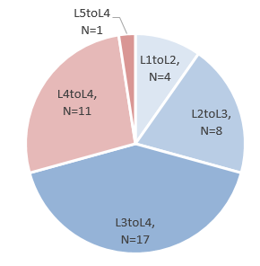
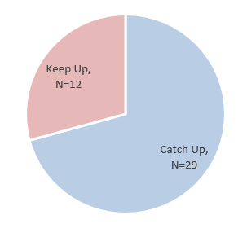
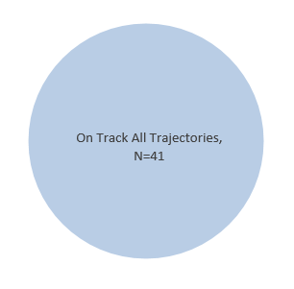
Catch Up, Keep Up and All Trajectories on Track
Assuming the minimum N is 20, most schools will not have enough students in the individual Catch Up L1 to L2, Keep Up L4 to L4, etc. categories to report, so it makes sense to roll up to aggregated Catch Up and Keep Up measures and to have a combined All Trajectories On Track metric.

Slide 19
Catch Up, Keep Up and All Trajectories on Track
However, since the Catch Up and Keep Up flags re-introduce performance level information, we might run into some student data privacy issues.
In the above example the Keep Up results would be excluded, which would mean you couldn’t report both the Catch Up and All Trajectories results because simple subtraction would show how many must be Keep Up.

Slide 20
Reporting Disaggregated Groups
To add to these small N roll-up reporting concerns, as a consequence of growth to standard as a standalone indicator is that we have to report by disaggregated groups for points (starting in 2020):
  22-11-204(5): "In measuring the performance of a public school, a school district, the institute, or the state on each of the performance indicators, the department shall disaggregate the measures for each indicator by student group. The department shall separately account for the performance of each student group in determining the overall performance on a performance indicator by a public school, a school district, the institute, or the state.“

Slide 21
Catch Up, Keep Up and All Trajectories on Track by Disaggregated Group
Considering the known relationship between school demographics and achievement mean scale scores, most of the students reported in the disaggregated groups will be scoring below proficient (Catch Up), meaning fewer schools will meet the minimum reporting N for Keep Up.

Slide 22
Catch Up, Keep Up and All Trajectories on Track by Disaggregated Group
Here is a table comparing the proportions of Elementary Schools with reportable data by measure for each disaggregated group:
What are the implications if schools don’t get credit for whether their already-proficient students are on track?

Slide 23
CDE Proposal and TAP Recommendation
CDE Proposal:
For points, report only the All Trajectories group- for both All Students and Disaggregated Groups
For informational purposes, report the Catch Up and Keep Up results- probably for the All Students group only
If either the Catch Up or Keep Up group does not meet minimum N, both categories are suppressed
TAP Recommendation:
What is the TAP’s recommendation for incorporating the new growth to standard sub-indicators on the performance frameworks?

Slide 24
TAP Recommendation
If the TAP recommends including the Catch Up and Keep Up results for informational purposes only (not for points), where should these data be reported? In the same line as the official All Trajectories results or as part of the addendum?

Slide 25
Rolling up Growth to Standard Sub-indicators
How should the points eligible for the All Students and Disaggregated groups be weighted? Same as for the Achievement and Growth metrics? (All Disaggs combined = ½ All Students group weight)
If the TAP recommended including individual Catch Up and Keep Up results for points, how should these be weighted? If minimum N isn’t met for one or more groups should we replace with All Trajectories results? How would CU/KU be weighted against All Trajectories?
Should the ELP On Track measure be moved into this new growth to standard indicator?

Slide 26
Rolling Up Across Indicators
This is what the indicator roll-ups section on the front page of the frameworks would look like:
Question: What should this indicator be labeled?
Growth to Standards, Adequate Growth, ELA/Math On Track, something else?

Slide 27
Break

Slide 28
Weighting Between Indicators
How should the new growth to standard indicator be weighted in relation to the existing Achievement and Growth indicators?
Note that we probably won’t be able to create a growth to standard metric at the high school level.

Slide 29
Assumptions for Today’s School Impact Data
Included only 1-Year Elementary-level data for schools (will discuss middle school options in March)
Sub-indicator cuts set at the 15th-50th-85th percentiles of All Students distribution
Only All Trajectories results included for points
Sub-indicator All Students and Disaggregated weightings mirror Achievement and Growth weightings
ELP growth stays in Growth Indicator
Weighting and Ratings scenarios only include schools that had reportable Growth to Standard indicator results
Cuts for overall rating categories stayed the same

Slide 30
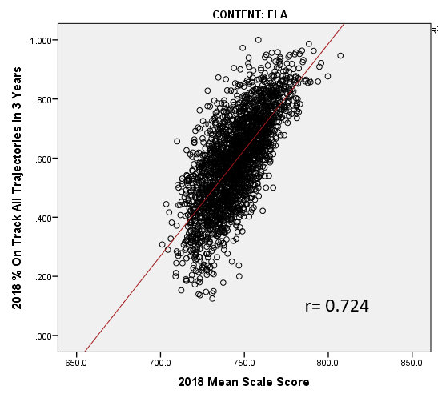
Correlation between Recommended On Track All Trajectories and Mean Scale Score
The correlation between the Elementary % On Track across All Trajectories and the Mean Scale Score is moderate at 0.724 for ELA and 0.704 for Math

Slide 31
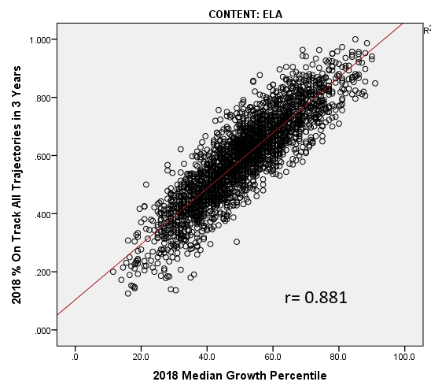
Correlation between Recommended On Track All Trajectories and Mean Scale Score
The correlation between the Elementary % On Track across All Trajectories and the Median Growth Percentile is very strong at 0.881 for ELA and 0.847 for Math

Slide 32
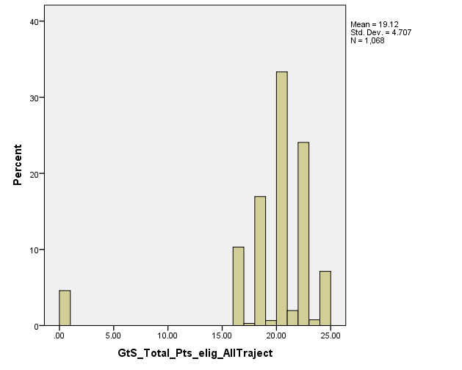
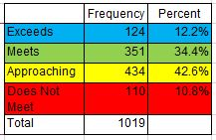
Summary of Growth to Standard Indicator
Roll-up Results
On average, Colorado Elementary schools had reportable Growth to Standard data for the All Students Groups in ELA and Math and 3 Disaggregated groups. The histogram to the left shows the total distribution of points eligible, and the table to the right gives the overall distribution of Growth to Standard Indicator ratings.

Slide 33
Weighting Options Included in Impact Data
There are a huge number of possible weighting combinations, but for today’s conversation, we’re limiting it down to the following 5 that represent both extremes and balance in terms of where points are taken from and how much weight should be given to the new indicator.
 | Pts from Growth | Pts from Ach | Balance Ach & Gro | Balance Less Wt | Balance More Wt
Achievement | 40 | 25 | 35 | 35 | 30
Growth | 45 | 60 | 50 | 55 | 50
Growth to Standard | 15 | 15 | 15 | 10 | 20

Slide 34
Discussion Questions
For each Weighting Scenario, consider the following:
To what extent does this weighting scenario align with Colorado’s values?
How different/similar would these results be from the current 2018 outcomes?
How would the changes in rating categories effect our inferences about schools’ performance?

Slide 35
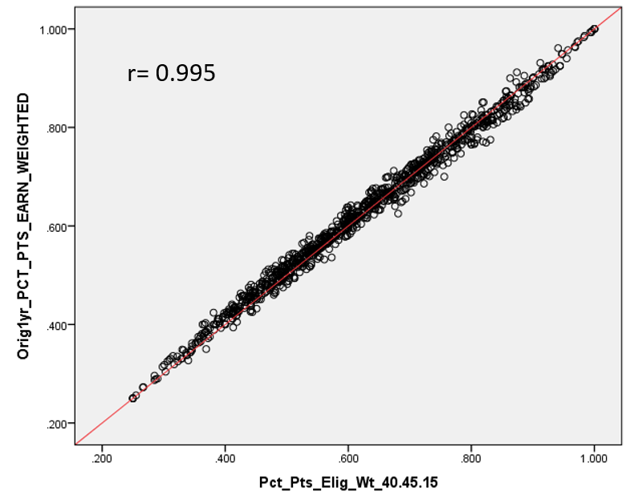
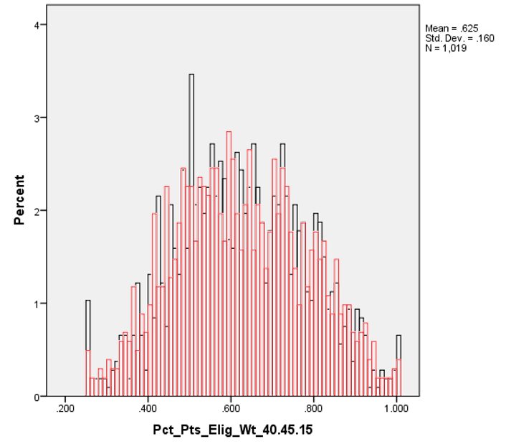
Weighting Scenario:
All points From Growth, 40-45-15

Slide 36
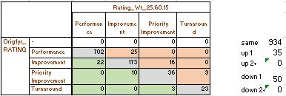
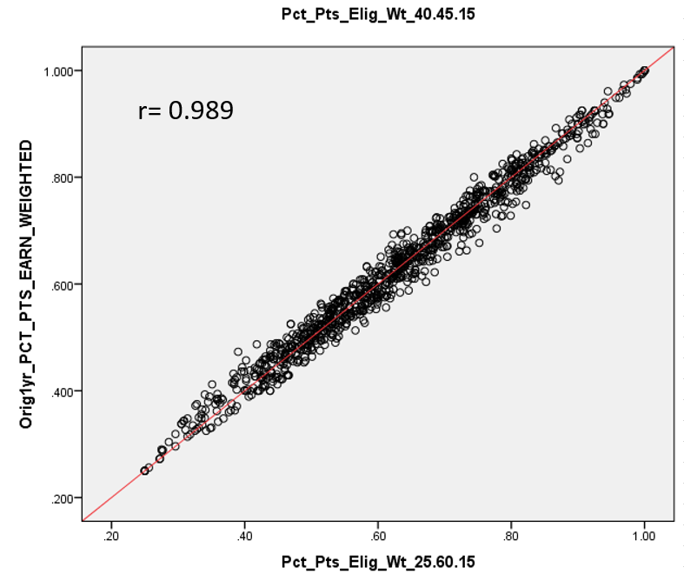
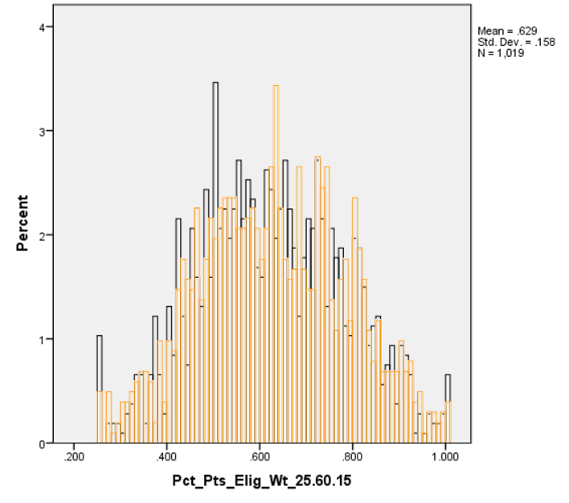
Weighting Scenario:
All points From Achievement, 25-60-15

Slide 37
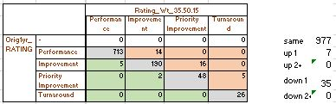
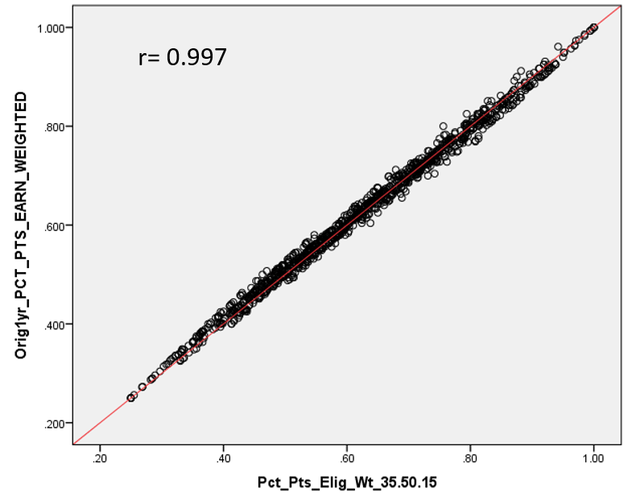
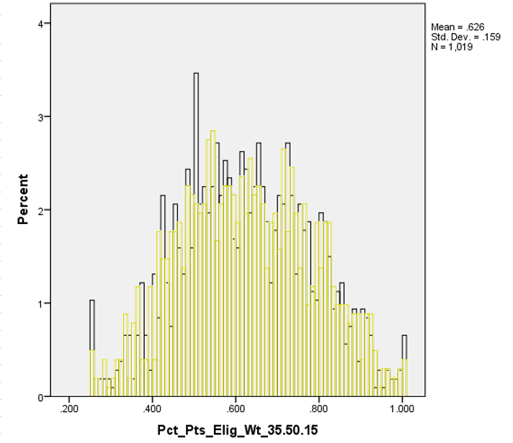
Weighting Scenario:
Balancing taking Points from Ach & Gro, 35-50-15

Slide 38
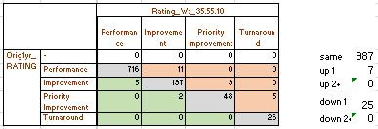
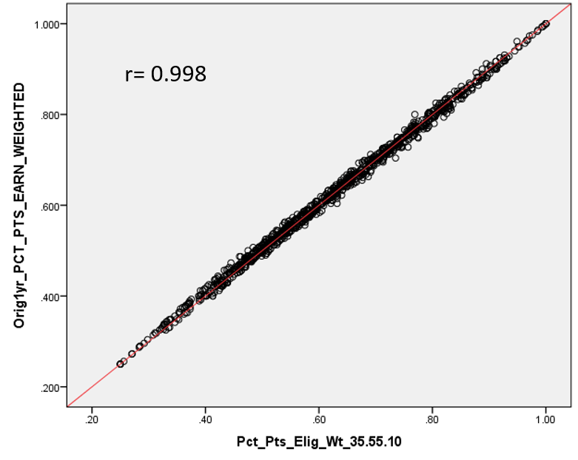
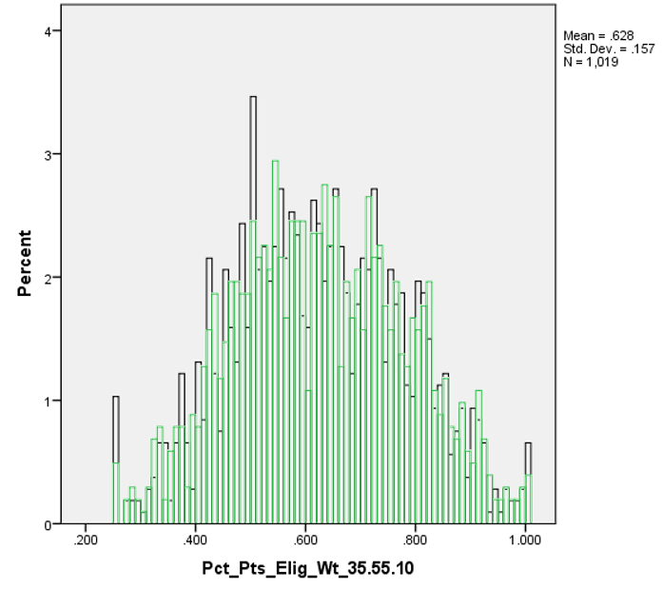
Weighting Scenario:
Balanced Points Less Weight for GtS, 35-55-10

Slide 39
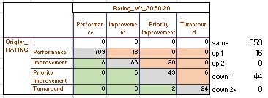
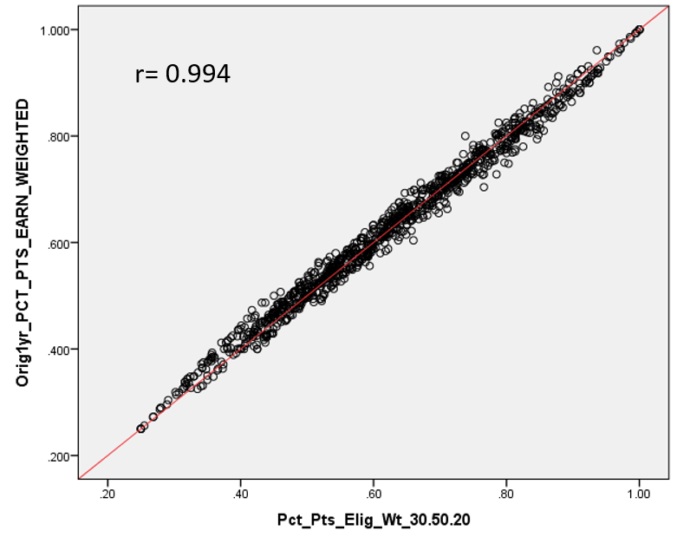
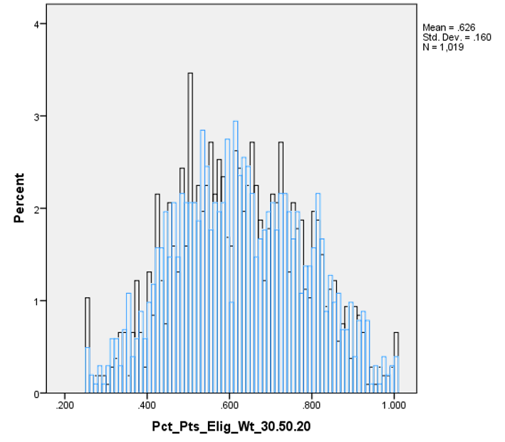
Weighting Scenario:
Balanced Points More Weight for GtS, 30-50-20

Slide 40
Next Steps for TAP Recommendation
What additional information or weighting scenarios would you need to see before making a recommendation?

Slide 41
Next Steps for March
CDE is having a working session with the State Board on Friday March 1st from 1:15 to 4:15 pm in the SBE Room. It is open to the public and will also be live streamed.
We will mostly be focusing on the upcoming Accountability rule hearings, but will also be giving a quick summary of the current TAP recommendations for the GtS metric. We anticipate the SBE will have thoughts that will influence our March TAP meeting agenda.

Slide 42


Slide 43
Technical Advisory Panel
Meeting Summary:
  Suggested future analysis
  TAP recommendations from this meeting
Public Comment
Close Meeting
  Next Scheduled Meeting, Tuesday, March 12th, 1-4 (webinar)

