Slide 1
Student-Centered Accountability: Impact on Learning and Systems
1241 Task Force
March 12, 2024

Slide 2
VISION
The Student-Centered Accountability Program seeks to promote and implement an accountability system that is timely, meaningful, considers the whole child and engages community stakeholders in a continuous cycle of improvement and innovation supported by a network of peers.
Since 2015
20 + Rural Colorado Districts

Slide 3
Rural Challenges
N Size: Students have a disproportionate weight in small schools (500 or less was the number stated as having high error of variability).
Single student has unreasonable overall impact on a rating (batting average)
High variability means caution in finding root cause
Magnified for sub groups in small schools
Opt out magnified in small schools
Insufficient Data: Districts/schools are left without ratings that can diminish the importance of administration
Opt Outs
Irrelevant, less value perception
Formulas to try to account for known errors corrupt reliability/value
Resources: Funding and access to resources is limited
Incentivizing practices through grants and accountability put smaller, remote districts at disadvantage (AP/IB vs Ag or Arts)
Local values are not face forward (beneath state report)

Slide 4
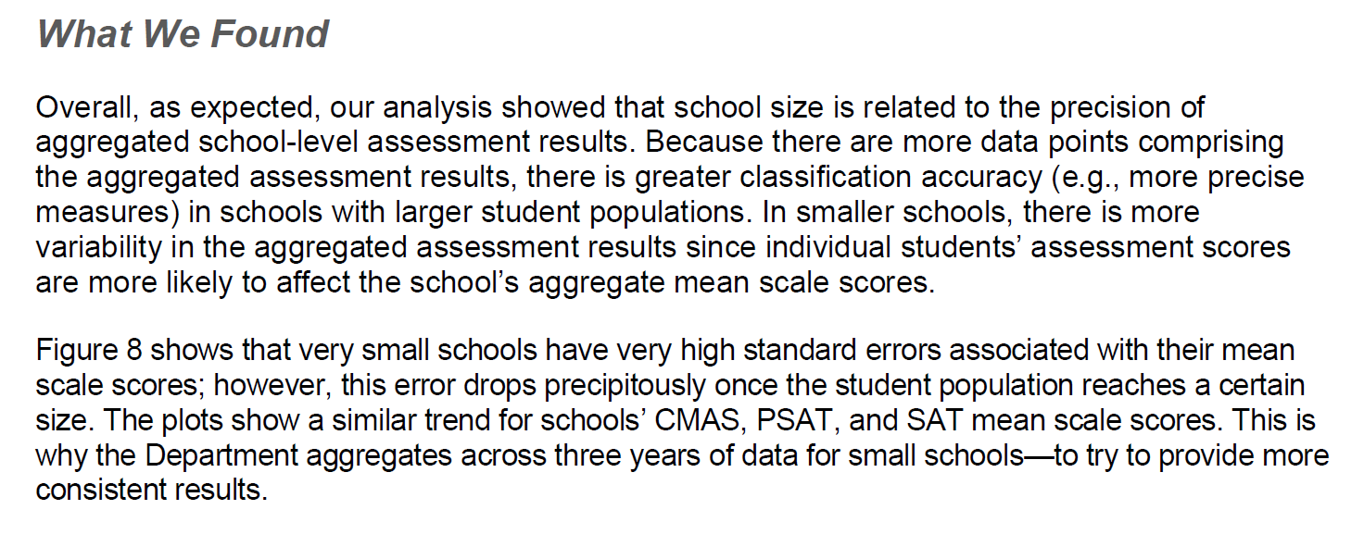
What we found
from Audit p. 47

Slide 5
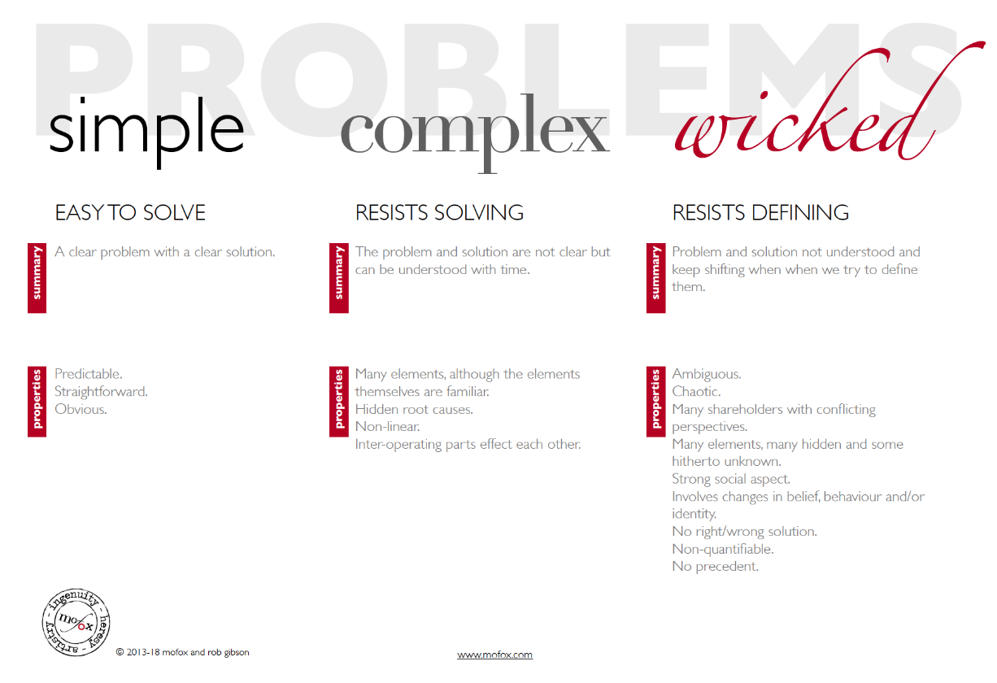
Problems

Slide 6
Guiding Principles:
Current state accountability has not sufficiently addressed N size in rating districts, and more, in providing information to local boards
Current state accountability measures over-simplify the complexities of systems whose outcome is human capital and so have put [rural] districts in binds.
Accountability of outcomes needs to be more directly connected to strategic actions of continuous improvement
Local Boards need to be empowered to guardian vision of student success through accountability
Notes:
Bree
Bullet 1 -We all have incomplete stories of systems and students being represented. What is NOT being told impacts student success).
Bullet 2 - (talk about resource allocation here)
Bullet 3 - We know mistakes are opportunities)
Bullet 4 - We can’t not do this work.

Slide 7
Possible Values
*
Comparability between districts? To state?
Critical thinking vs foundational knowledge
Directing resources
Improvement *
Incentivizing certain practices
Equity – all subgroups of students achieving at high levels
How well are we spending our money?
Comprehensive measures of student success *
Individual student achievement/growth of key academic areas
Accessibility of information to local families and communities*

Slide 8
SCAP Values
Aligning accountability, improvement, and instruction for deeper learning in rural schools
Core Values
1. Emphasize every student and the whole student
2. Accountability means continuous improvement
3. What gets measured and reported gets done
4. Accountability impact increases with local stakeholder investment

Slide 9
Key Features of S-CAP
Inputs: Implementation of System Support Reviews (SSRs) to support continuous improvement by examining root cause issues and small cycle changes
Expanded Success Measures: Use of Learning Dispositions Data: family, student, staff surveys administered annually and professional observations
Dashboards: Monitoring of multiple measures feasible by local boards with state base, standard benchmarks
Local Accountability: Investment of Boards of Education as stewards of student achievement and growth
Professional Growth and Respect: Participation in peer reviews advances teacher investment in system improvement
Integrate State Accountability: Advocate for adjusted weightings for students in small schools

Slide 10
Key Solutions to the Wicked Problem
Dashboards
Weight every student the same
Connect results with change improvements
On site evaluations
Support leadership transitions in Board and superintendents by focusing accountability on strategic priorities that lead rather than “people” turnovers

Slide 11
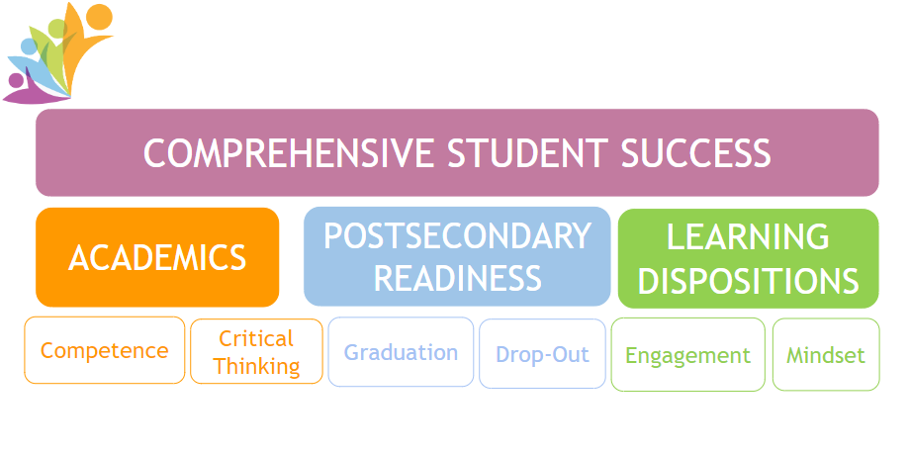
LOGO
Notes:
Bree
Bullet 1 -We all have incomplete stories of systems and students being represented. What is NOT being told impacts student success).
Bullet 2 - (talk about resource allocation here)
Bullet 3 - We know mistakes are opportunities)
Bullet 4 - We can’t not do this work.

Slide 12
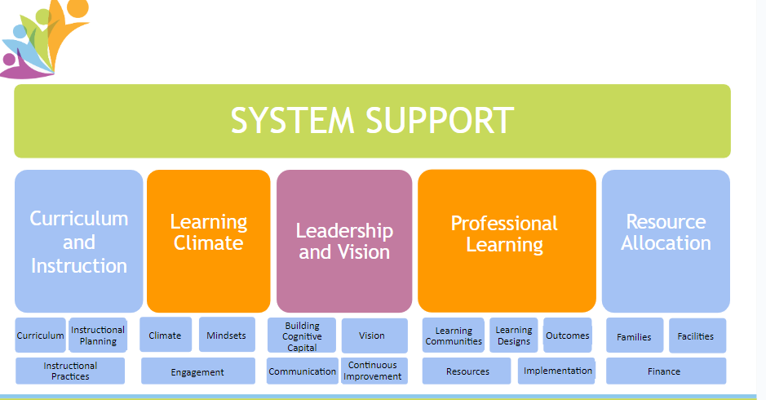
System support

Slide 13
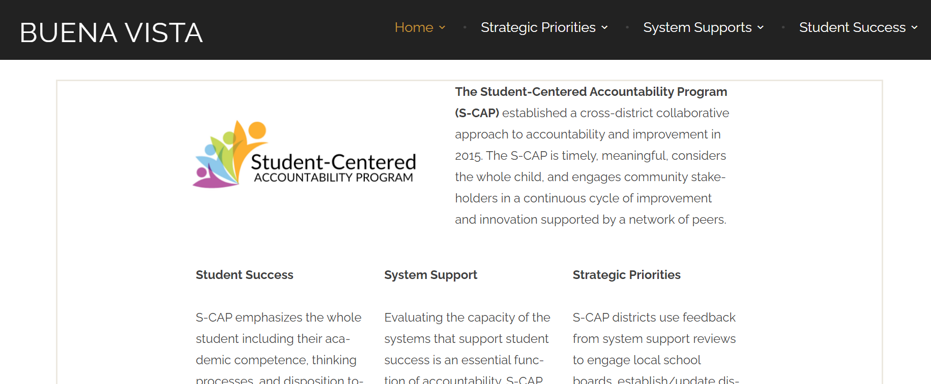
Student centered
https://scapbvschools.com/

Slide 14
Contacts
S-CAP Contacts:
Buena Vista - Lisa Yates
lyates@bvschools.org
Holyoke - Kyle Stumpf
stumpfky@hcosd.org
Kit Carson - Robert Framel
robert.framel@kcsdr1.org
La Veta -Bree Lessar
bree.lessar@lvk12.org
S-CAP Website
www.s-capcolorado.com

