Slide 1
My Site has a Priority Improvement or Turnaround Plan Type. Now What?
August 30, 2024 – 10:00-11:00 am
Notes:
Before we get started, We’d like to know who’s joining us.
In the chat, please introduce yourself providing…
Your name
Your District and School, if relevant, and
What are you looking forward with the long weekend ahead?
Let me also put a link to the Google slide deck in the chat for folks to follow along – https://docs.google.com/presentation/d/1huelzH5HqFuZ2S1Q2wrtvvKmoYhubyffGEuiBJssb2o/edit?usp=sharing
Here’s also a copy link to the webinar’s information packet to support planning – https://docs.google.com/document/d/1fu4U38xUazJNnuQPdV1z8s-7ODtGtzPhoAwRlnNueVY/copy
START recording, state webinar, introduce self and support / back channel

Slide 2

Agenda
Meeting Practices
Colorado’s Educational Accountability System
  State identification and performance watch
  Performance watch progressions
Requirements for State Identified Sites
  Year-specific process requirements
  Planning requirements and how to satisfy them
Support options and resources
Questions & Answers
This meeting is being recorded.
Use the Chat feature in Zoom to ask questions throughout the presentation.
Please mute your sound if you are not speaking.
All participants are encouraged to be on camera if tech allows.
Slides and the recording will be posted to the CDE website.
Notes:
We’ll first ground in the Colorado’s Educational Accountability system and the performance frameworks focused on performance watch and then shift to requirements for state identified schools and districts – how to satisfy them and learn about supports, fand wrapping up with a Q&A session when I’ll stop the recording.
Please take a moment to jot down questions you’ve brought with you today. We'll then return to these questions at the end of the webinar, to ensure we answer them. (pause)
We encourage you to use the chat feature in Zoom to ask questions. We’ve got _____ who will monitor the chat. We also love to see faces, so please consider being on camera if possible. After this webinar, we’ll post the slides and recording at our Accountability Resources webpage.

Slide 3
State Identification and Performance Watch

Slide 4
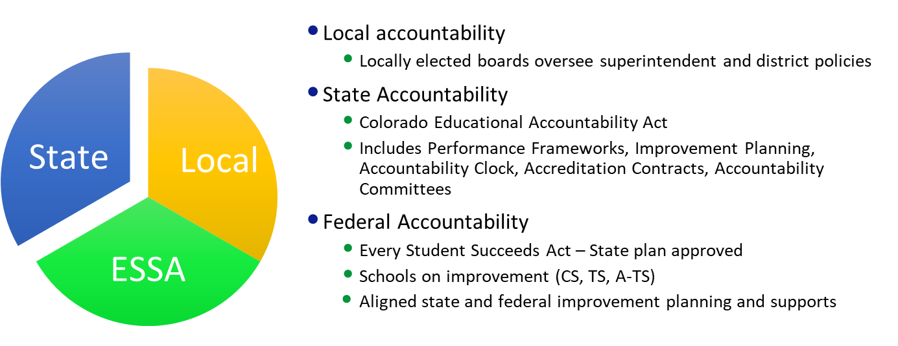
Colorado’s Educational Accountability System
Notes:
The state’s educational accountability system consists of local, state, and federal processes. In this webinar, we’ll focus on State Accountability and specifically how the ratings from district and school performance framework reports determine if a site is state identified on performance watch or the accountability clock. We’ll review associated requirements, interventions and supports, all of which are informed by the Education Accountability Act of 2009 and by rules set by the Colorado Board of Education.
(alternative script – not for this purpose)
Colorado’s education accountability system is based on the belief that every student should receive an excellent education and graduate ready to succeed. The accountability system consists of local, state, and federal processes:
Local accountability is driven by locally elected boards and reflects locally-held values. Boards oversee superintendent and district policies.
State accountability that this webinar focuses on, is informed by the Education Accountability Act of 2009 and by rules set by the Colorado Board of Education. This policy context drives the creation of performance frameworks, public reporting, improvement planning, performance watch including the accountability clock, accreditation contracts, accountability committees, supports and interventions, and several state award programs.
Federal accountability is informed by the Every Student Succeeds Act or ESSA and the approved Colorado state plan. The state plan establishes the criteria to identify schools on improvement.

Slide 5
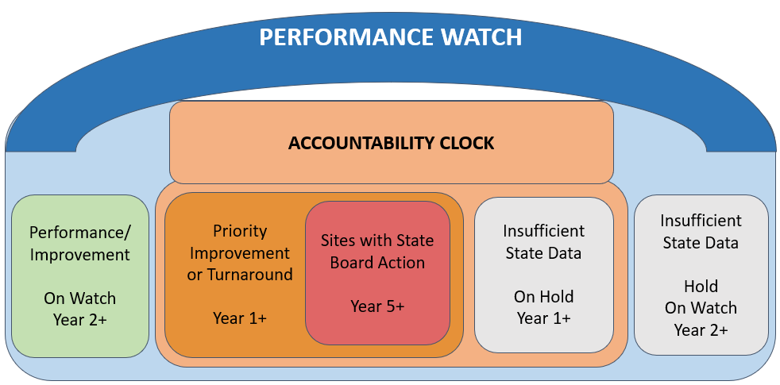
Performance Watch
Performance Watch Expectations, webpage
Notes:
Performance watch encompasses districts and schools identified as being on the Accountability clock, where the site’s Performance Framework indicates [CLICK] a priority improvement or turnaround plan type for one or more consistent years.
[CLICK] The red box identifies sites at the “end of the clock” reaching 5 or more consecutive years being “on the clock.” These sites move to state board action.
In this illustration of Performance Watch, [CLICK] a site with an Insufficient State Data or ISD rating that had their last Plan Type – Priority Improvement or Turnaround are On Hold, within the clock
In other words, they remain on the Accountability Clock, while their Year label will not advance.
[CLICK] There are also sites that may be identified On Watch – still under Performance Watch because they were previously on the Accountability Clock for two or more consecutive years and,
while they earned a performance or improvement rating this year, must achieve one of those ratings for two consecutive years before exiting Performance Watch.
[CLICK] And finally, the box on the far right, illustrates the scenario where a site has an ISD rating and are Hold On Watch with the same Year label they previously had.

Slide 6
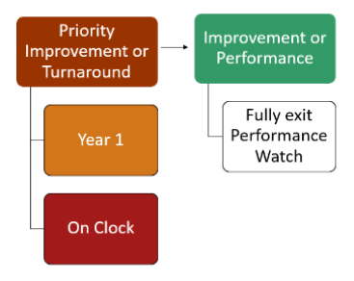
Example 1. Exit Performance Watch after One Year Identified
This is the most common progression since most schools tend to earn Improvement or Performance after Year 1 identified on the clock. ~ One Year On, One Year Off ~
Year 1 Year 2
Notes:
Now let’s review a couple clock progression examples, starting with a site that is identified on the clock, Year 1 based on its priority improvement or turnaround rating.
Then next year, the site receives an improvement or performance rating and fully exit performance watch because they were only on the clock for one year.
Think of it in terms of “one year on, one year off.”

Slide 7
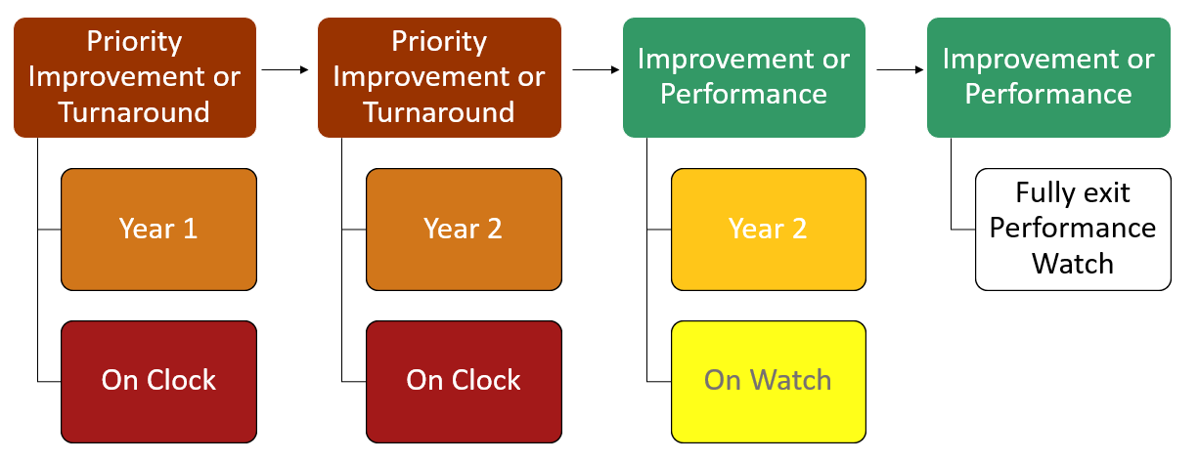
Example 2. Progression Fully Exiting Performance Watch
This example is most notable that after being on the clock for 2 years because of a PI/T rating for two consecutive years, the site then earned an Improvement/Performance rating for two consecutive years, allowing the site to fully exit in Year 4.
Year 1 Year 2 Year 3 Year 4
Notes:
Now let’s review an example that shows the progression of a site that exits Performance Watch over four years of Plan Type assignments.
After being on the clock for 2 consecutive years because of a priority improvement or turnaround rating, the site then has to earn an Improvement/Performance rating for two consecutive years, allowing it to fully exit in Year 4.
This example illustrates the idea of 2 years on, 2 years off. It’s really 2 or more years on, then 2 years off to fully exit.
Here’s a question for you. What would have happened in Year 4 if the site received a Performance Improvement or Turnaround Plan Type?
[wait for it — ANSWER: Priority Improvement or Turnaround Year 3, On Clock]

Slide 8
Accountability Clock Year-Specific Requirements with CDE supports

Slide 9
You’ve Been Assigned a Priority Improvement / Turnaround Plan Type
Now what?
Backwards Planning to submit your UIP by October 15 for review and posting; flexibility for newly identified sites.
Note: Sites with an Insufficient Data Rating (ISD) whose last plan type was Priority Improvement or Turnaround must respond to PI/T planning requirements.
Notes:
With the additional UIP process requirements for state identified sites, backward plan to ensure your completed UIP is submitted by October 15 for review and posting.

Slide 10
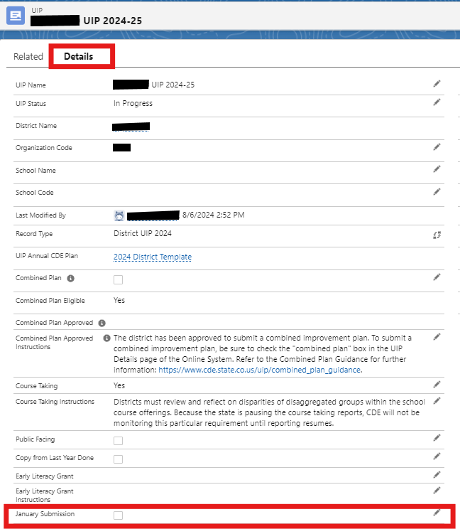
Newly Identified Sites
UIP Submission flexibility
Unified Improvement Plan (UIP) Submission Deadline
October 15
Flexibility is at the the district’s discretion
January 15
Newly identified (Year 1) as Priority Improvement or Turnaround based on the School/District Frameworks
Newly identified as Comprehensive Support based on federal ESSA identifications
Participating in the Request to Reconsider process
Eligible schools must seek approval from their district to submit in Jan.
Resource: January Submission Guidance for district UIP users, not school level users
Notes:
At each district’s discretion, sites newly identified under the state or federal system, may submit their UIP no later than January 15. Some districts may prefer that all schools submit their plans by October 15, but there is that flexibility for newly identified sites. If districts requested changed ratings through the Request to Reconsider process, the later submission date is available too, again if approved by district.
[CLICK] This snapshot shows where in the online UIP system, the district would select January submission for sites they use this flexibility.

Slide 11

Annual Stakeholder Engagement – Process Expectations
Parent Notification Letter
For each school with a plan type of Priority Improvement or Turnaround, the district must notify families in the school of the school’s plan type, the reason for identification, ways to provide input into the school’s plans (e.g., School Accountability Committee meeting) and notification of the local board’s hearing prior to adopting the school’s plan.
Target Date: within 30 calendar days of receiving initial plan type assignment
Public Hearing at Local School Board Meeting
Target Date: at least 30 calendar days after the date on which the district provides the written notice
Local School Board Adopts the Plan
Your local board must approve your UIP before it is publicly posted either October 15 or January 16; the latter is only available to newly identified schools and districts.
DUE: On or before the UIP is publicly posted (UIP submission date)
Schedule these two Board Meeting dates now.
UIP Assurances
Use the UIP assurance in the online UIP/ACI system to demonstrate compliance of these requirements related to Parent Notification and local board hearing and adoption.
Key Resource
Parent Notification and Public Hearing Requirements
(includes sample English/Spanish Parent Notification Letter)
Notes:
Being aware of the UIP submission due date and flexibility is helpful when considering the annual stakeholder engagement requirement for identified sites.
For schools with a plan type of Priority Improvement or Turnaround, the district must notify families in the school of the school’s plan type, the reason for identification, ways to provide input into the school’s plans, and notification of the local board’s hearing prior to adopting the school’s plan. This should be done within 30 calendar days of receiving the initial plan type rating. And the key resource in the green box provides more information including updated parent letters in English and Spanish to adapt for notification of state and/or federal identifications.
You’ll also need to have your board approve UIPs for state identified sites. This occurs in two steps. First, a public hearing should occur about 30 calendar days after the date the district provides the written notice to families.
During these public hearings, the local board would review the school’s progress in implementing its plan during the preceding year. At least one member of the School Accountability Committee is encouraged to attend the public hearing.
After, incorporating any feedback provided at the hearing, you will then return to your board for plan approval or adoption before it is publicly posted by the UIP submission date. This is in part, why first year identified sites have the flexibility to submit their UIP by January 15th instead of October.

Slide 12
Year 1+ | Annual Requirements, summary
Type | What | Improvement | Priority Improvement | Turnaround
Stakeholder Engagement | Parent Notification and Local Board Hearing & Adoption (Schools) |  | ✔ | ✔
Planning Requirements | Family, School, & Community Partnerships (Schools) |  | ✔ | ✔
 | Math Acceleration (Schools & Districts) | ✔ | ✔ | ✔
 | Early Learning Needs Assessment (K-3 Serving, Schools & Districts*) |  | ✔ | ✔
 | Turnaround Strategies (Schools & Districts) |  |  | ✔
*The Early Learning Needs Assessment applies to Districts accredited PI/T and with schools operating under a Priority Improvement or Turnaround plan.
Notes:
In addition to Stakeholder Engagement, other requirements are associated to planning and should be addressed in the UIP.
This table provides a quick overview of annual requirements starting at Year 1 On the Clock by plan type.
You’ll see that some requirements like stakeholder engagement and Family, School & Community Partnerships are required for identified schools, but not districts.
Whereas Math Acceleration and Turnaround Strategies are required for both identified schools and districts. In the case of the Early Learning Needs Assessment, this requirement applies to districts accredited PI/T and with schools operating under a PI/T plan.
It’s also noteworthy that Math Acceleration associated to more recent legislation – HB 23-1231 sets requirement for sites with an Improvement rating, not just those identified with Priority Improvement or Turnaround.
We’ll review each in greater detail to support your local improvement planning, but I’ll first walk through Year specific process requirements and related supports.

Slide 13
This training focuses on requirements associated to State Identification based on District & School Performance plan types.
There are other categories that have additional UIP requirements that are not covered in this session. Examples include
ESSA Identification (CS, TS, A-TS),
Comprehensive Early Literacy Grant (ELG),
EASI Grant and
Title I (if satisfying through UIP)
Notes:
Just as a reminder…

Slide 14
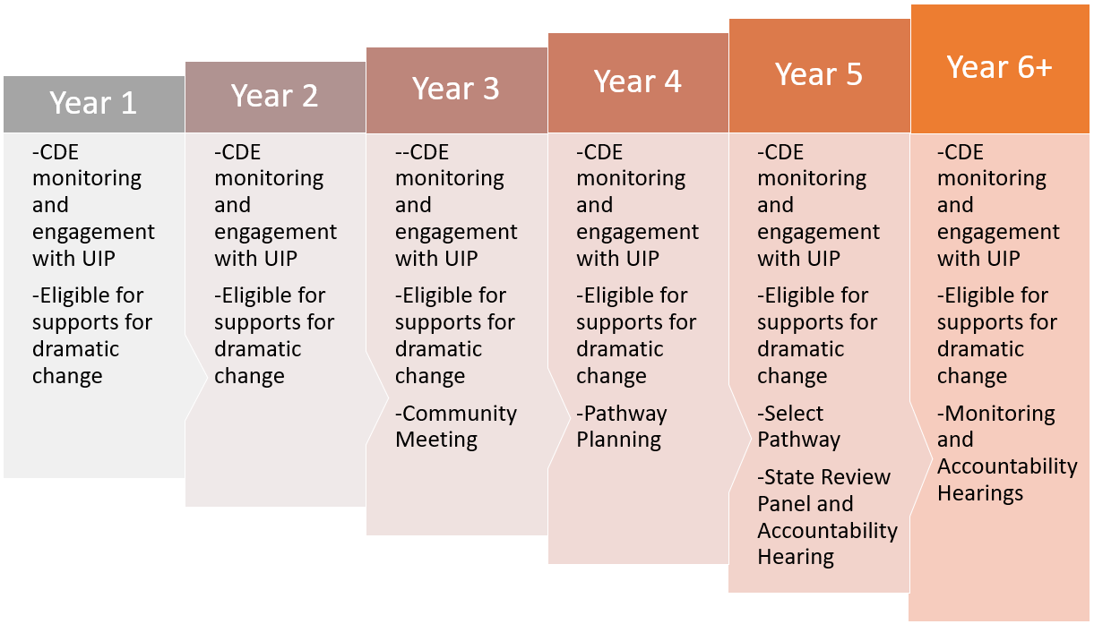




Progression of Monitoring and Support | By Clock Years
CDE Streamlined supports – CDE assigned technical Support Lead, EASI Pathways
Annual Requirement: Parent Notification & Local Board Hearing, then UIP Adoption
Notes:
Once a school or district is On the Clock, requirements change by year relating both to the UIP process and supports for dramatic change.
CDE streamlined supports increase as sites progress on the clock, while the requirement of Parent Notification & Local Board Hearings are continuous throughout the progression.
With department support, in year 1, most districts with schools identified on the clock will have a support lead assigned. As schools or districts advance on the clock and upon entering year 3, they are assigned a Transformation Specialist to provide more direct support with regards to accountability pathway options and anticipation of end-of-clock requirements in year 5.

Slide 15

Year 3 | Additional Community Engagement
Community Meeting - Districts must host a parent and community meeting to provide information and receive input on school’s accountability rating and next steps to improve.
  May be standalone meeting or connected to DAC / SAC
  Recommend holding in fall after third year rating is released
  Advertise meeting through regular communication channels to community
  Year 3 Community Meeting Supplement
CDE Support Lead transitions to a “Transformation Specialist”
  includes more intensive engagement from CDE
  helps with Community Meeting
  Provides technical assistance, may help present to local board, leadership, staff, etc.
Notes:
From Year 3 on the State Accountability Clock, in addition to the annual parent notification process, districts must host a parent and community meeting to provide information and receive input on the school’s accountability rating and next steps to improve. If your district has one or more schools that are Year 3 or more, CDE will reach out with more information about scheduling any required steps for these sites.
This more intensive engagement from CDE is coordinated by a “Transformation Specialist” mentioned on the previous slide.

Slide 16
Accountability Pathways | Supports & Interventions for Dramatic Change
Schools & Districts
Accountability Pathways
Associated to End-of-Clock / Year 5 Board Directed Action
Best suited to create dramatic change targeting root causes of identified performance priorities
Pathway Guidance Documents
  Pathways Overview
  Community School Conversion
  Conversion to a Charter School
  Innovation School or Innovation Zone
  Management by a Public or Private Entity
  School Closure
  District Reorganization
Accountability Pathways webpage
Transformation Specialist support role in:
Year 3 – Pathway Awareness
Year 4 – Identify Pathway Preference
Identify and communicate via UIP
  What to know at Year 4
State Review Panel Hearing
  In spring of Year 4, anticipating Year 5 end of clock
  State Review Panel Fact Sheet
Year 5 – State Board Hearing & Directed Action
Notes:
When sites move to year 3 on the clock, they’ll work with their CDE assigned Transformation Specialist to review accountability pathway options to identify the one that is best suited for a site to create dramatic change.
At this time, the transformation specialist will also consult regarding the State Review Panel that is organized by a 3rd party contracted with the department. More details about this are provided in the grey box, while we won’t go into these details.
If someone does have SRP or board order questions, please hold them to the end.

Slide 17
Satisfying Requirements for State Identified Sites
Notes:
We’ll now shift to plan type requirements and how to satisfy them. Before doing so, are there any questions about early on the clock vs. advancing to later and end of clock?
In the remainder of this webinar, you may want to follow along with the information packet that follows remaining slides. It may help with note taking or during application of some of the content we’ll review.
I’ll put a Google copy link in the CHAT now. https://docs.google.com/document/d/1fu4U38xUazJNnuQPdV1z8s-7ODtGtzPhoAwRlnNueVY/edit?usp=sharing

Slide 18

State & Federally Identified Sites – Document Review
UIPs are reviewed by the CDE
New consultation option before submission, depending on availability, or review after submission
both with written feedback provided
Questions, email uiphelp@cde.state.co.us
Quality Criteria
Available for the Streamlined & Traditional Templates
By School and District
UIP Quality Criteria & Requirements
Notes:
CDE reviews UIPs for all schools and districts state identified as well as schools federally identified – ensuring that plans meet the requirements based on each site’s plan type.
Traditionally, UIPs are reviewed after plans are submitted. New this year, we’re offering a consultation option that will occur before sites submit their plan. In this new model, the site will have a near completed plan that the CDE staff member will review before consultation focusing on the big elements of the plan. After the one-hour consultation, the staff member will provide written feedback. In most cases, sites that engage in the consultation model will not have their plan reviewed after submission. However, there may be exceptions for sites identified with comprehensive support through ESSA. If this is something of interest to you, please email uiphelp@cde.state.co.us.
I also want to stress that the Quality Criteria or QC is the best resource for understanding where in the UIP template to address each planning requirement, both for state and federal identification. The website in the last bullet takes you to the UIP resource webpage, with links to QCs for both the streamlined and traditional template, and differentiating for schools and districts.

Slide 19

Family Engagement Activities
Who: All schools with Priority Improvement or Turnaround plans
Requirement:
Where to include this in your UIP:
Action Steps – Implementation & Actions (streamlined template) / Action Plans (traditional template)
Includes high leverage action steps to increase parent engagement at the school that are aligned with Family, School and Community Partnership standards.
Resource: UIP Quality Criteria
Notes:
Now let’s shift back to Planning requirements for state identified sites. All schools with Priority Improvement or Turnaround plan types are required to include high leverage action steps to increase parent engagement at the school.
These action steps should be included in the Action Plan section of your UIP.

Slide 20
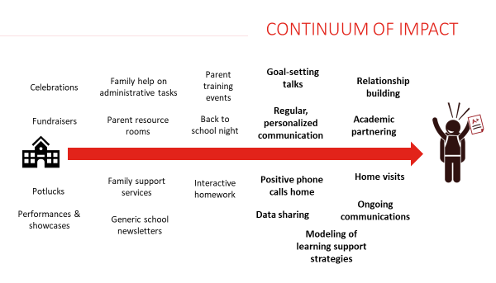
Family Engagement | Continuum of Impact
FSCP Resources
Family, School & Community Partnership Strategy Guide, CDE
Family-School-Community Partnership Framework, CDE
Promising Partnership Practices, CDE in collaboration with SACPIE
Six global lessons on how family, school, and community engagement can transform education, Brookings Institute
Notes:
This image depicts the continuum of impact for family engagement activities. These include, on the left, school or system-wide activities; and, on the right, more individualized touchpoints with specific students and families. Note that there is no “good” or “bad” end of this continuum. This image reflects the research findings that individualized activities have a stronger impact on student success than building-wide activities. However, a strong family engagement approach will incorporate a range of activities from across this spectrum.
[CLICK] This box on the right has key resources to support implementation of high leverage FSCP practices. The first link is a Strategy Guide that outlines the core components and key resources needed for a successful implementation. For schools and districts who are interested in strengthening their FSCP work, consider using the second link- or the FSCP Framework to audit the current state of systems and practices to determine priorities. The third link takes you to a website that curated promising practices. Finally, the fourth link is a research paper from the Brookings Institute.

Slide 21
Application | Family Engagement
If you don’t yet have family engagement activities in your UIP, using the “Continuum of Impact” graphic or one of the other Family Engagement resources, brainstorm 1-3 Action Steps to incorporate family engagement activities into your UIP.
If you’ve already included family engagement activities, use the Continuum of Impact graphic to audit the activities you’ve identified. Including a blend of school-wide and individualized activities can help build strong family-school partnerships.
Notes:
Let’s take a moment, referring back to the webinar information packet, to reflect on the Family Engagement practices in the context of your UIP.
(read off of the slide)
https://docs.google.com/document/d/1fu4U38xUazJNnuQPdV1z8s-7ODtGtzPhoAwRlnNueVY/copy

Slide 22

Math Acceleration | Planning Requirements (HB 23-1231)
Who: All schools and districts with Improvement, Priority Improvement or Turnaround plans
Requirements:
Math performance data has been analyzed over time by grade level, performance levels, and student demographics.
Rationale describes performance patterns that led to prioritizing math or explanation if not.
Set ambitious and attainable target(s) for reducing the number of students who are below grade level expectations or are struggling in math.
Evidence-based action steps that will likely have a meaningful impact for students identified as being below grade level or struggling in math.
Where to include this in your UIP:
Data Analysis through Assurances
Priorities & Targets (streamlined template) / Priority Performance Challenges (traditional template)
Action Steps – Implementation & Actions (streamlined template) / Action Plans (traditional template)
Target Setting (traditional template)
Resource: UIP Quality Criteria
Notes:
The newer Math Act from HB 23-1231, termed Math Acceleration seeks to improve outcomes in pre-k through twelfth grade math by putting in place supports to accelerate achievement.
Associated UIP requirements pertain to schools and districts with Improvement, Priority Improvement and Turnaround Plan Types.
Requirements are associated with multiple sections of the UIP. First, sites must conduct a data analysis of math performance data from two school years by grade level, performance levels and student demographics.
For the UIP, this requirement is satisfied through the Assurances section. Based on data analysis, sites then identify whether or not they have a math priority and either identify a math Student Performance Priority OR if the data analysis does not support prioritizing math, then an explanation must be included. The UIP must also include action steps that will likely have a meaningful impact for students identified as being below grade level or struggling in math.
Finally, targets must be set to reduce the number of students who are below grade level in math.

Slide 23

Math Acceleration | Resources
Implementation of HB 23-1231 (fact sheet)
Improving Mathematics Outcomes – Supporting Struggling Learners in Mathematics
Definition of “Below Grade Level” or “Struggling in Math” – School districts, schools and public charter schools must provide access to linguistic, instructional and behavioral scaffolds/supports to grade level math content/practices through core instruction.
Mathematics Intervention as a process, not just a product to be purchased, should focus on the specific needs of a student or group of students and working with that student or students and others in their support system to overcome their mathematical difficulties using the right tools
The Colorado English Language Proficiency Standards provides Colorado educators with resources to develop mathematical language in all students. The 'Can Do' descriptors are a particularly helpful entry point to the standards.
Notes:
With regards to implementation of HB 23-1231, department math content specialists in the Teaching & Learning Unit have curated a lot of resources for improving outcomes in math.
The home page is titled ‘Supporting Struggling Learners in Mathematics’, while I’ve also included a few key resources provides at that web page too.

Slide 24
Application | Math Acceleration
If you don’t yet have a math student performance priority and your site has an Improvement, Priority Improvement or Turnaround plan type, be sure to explain why math was not prioritized in the ‘Priority & Target’ (streamlined) or ‘Priority Performance Challenge’ (traditional) UIP tab.
If you’ve included a math student performance priority, ensure you set math targets, and identify action steps that will likely have a meaningful impact for students identified as being below grade level or struggling in math.
Notes:
Let’s take a moment, referring back to the webinar information packet, to reflect on Math Acceleration in the context of your UIP. (read off of the slides)
https://docs.google.com/document/d/1fu4U38xUazJNnuQPdV1z8s-7ODtGtzPhoAwRlnNueVY/copy

Slide 25

Early Learning Needs Assessment (ELNA)
Who: All K-3 schools with Priority Improvement or Turnaround plans & their districts if also identified PI/T
Requirements:
summarizes findings from an Early Learning Needs Assessment that meets the minimum requirements and commits to next steps based on those findings.
(turnaround only) plan identifies appropriate research-based next steps, based on the findings of an Early Learning Needs Assessment, to improve early childhood programs and partnerships.
Where to include this in your UIP:
Root Causes & Strategies (Streamlined Template) or Data Narrative–Root Causes (Traditional Template)
Resource: UIP Quality Criteria
Note: The ELNA is frequently conflated with the Early Literacy Grant – these are separate things.
Notes:
The Early Learning Needs Assessment supports schools and districts in analyzing the needs and learning of children from birth through age 8.
This requirement applies to schools with a Priority Improvement or Turnaround plan type that also serve students in K-3.
It also applies to Districts that have a school serving students in grades K-3 operating under a priority improvement or turnaround plan. This is unique statute requiring districts to act based on the school’s plan type.

Slide 26




Why is an Early Learning Needs Assessment Important?
Principles of an Early Learning Needs Assessment (ELNA)
Notes:
The analysis of ELNA, as a part of continuous improvement, facilitates four research-based principles by …
[CLICK] identifying quality and availability of programming,
[CLICK] collaborating within the community to create and strengthen partnerships to collectively support the early learning needs of children and families,
[CLICK] fostering effective transitions from a child’s early experiences into elementary school,
[CLICK] and providing continuity of learning as a child enters kindergarten, 1st grade and beyond.
An ELNA analysis can inform intentional local efforts to strengthen local policies, regulations, and governance that’s representative of the community and leads to continuity of learning and ready schools.

Slide 27
ELNA Plan Requirements for Priority Improvement & Turnaround
Indicate in your 2024-25 UIP any steps taken to assess the needs of and resources available for children eight and under across your community.
Use resources available on the Improvement Planning and Early Learning website to learn about and plan this year to conduct and report on an Early Learning Needs Assessment in your 2025-26 UIP.
Ideally, districts with identified schools will initiate the ELNA process to coordinate across sites, as needed.
Key resources:
The Early Learning Needs Assessment Handbook
For a deeper dive, the Early Learning Needs Assessment Data Sources Guide contains information on data sources that may be helpful in completing this assessment.
Notes:
For ELNA…
[CLICK] Indicate in your current UIP any steps you have taken to assess the (needs of) and (resources available for) children eight and under across your community.
[CLICK] Take advantage of the resources available on the Improvement Planning and Early Learning website to learn about and plan this year to conduct and report on an Early Learning Needs Assessment in your next year’s UIP.
[CLICK] Ideally, districts with identified schools will initiate the ELNA process to coordinate across sites, as needed.
[CLICK] If you’d like additional information on the ELNA, consult the Early Learning Needs Assessment Handbook. For a deeper dive, the Early Learning Needs Assessment Data Sources Guide contains information on data sources that may be helpful in completing this assessment. Links to these resources are available in your information packet on page 6.We won’t pause at this time like we did for FSCP and MATH.
Copy link of info packet – https://docs.google.com/document/d/1fu4U38xUazJNnuQPdV1z8s-7ODtGtzPhoAwRlnNueVY/copy

Slide 28

Turnaround Strategies
Who: Schools and Districts with Turnaround plan type are required to include a state-required turnaround strategy.
Requirements:
Where to include this in your UIP:
Major Improvement Strategy
The plan identifies a state-required turnaround strategy and articulates an action plan that is aligned to the needs identified in the data analysis. (Select from dropdown in the UIP Online System.)
Resource: UIP Quality Criteria
Notes:
One of the additional requirements for schools and districts with a Turnaround plan type is to include a state-required turnaround strategy, specifically that the plan identifies a state-required turnaround strategy and articulates an action plan that is aligned to the needs identified in the data analysis. If your site has a Turnaround plan type, than the online UIP system will include a drop down menu to select your strategy within the Major improvement strategy section.

Slide 29
State-required Turnaround Strategies
These strategies include:
Employing a lead turnaround partner
Reorganizing the oversight and management structure in the district
Converting to an innovation school or school zone
Converting to a charter school
Renegotiating or restructuring a charter contract
Research-based strategies focused on early learning and development
Other actions of comparable or greater significance or effect.
For additional information, refer to EASI grant application process that includes options aligned to these turnaround strategies.
Notes:
Turnaround strategies are included on this slide, while I won’t read them all.
For additional information, refer to EASI grant application process that includes options aligned to these turnaround strategies.
We’ll go over EASI briefly in the last portion of this session.

Slide 30
Reminder – All Schools serving K-3: READ Act
What are the Early Literacy Requirements in the UIP?
Data Analysis
Data and trends from a READ interim assessment for grades K-3.
UIP template: through Assurances
Strategies
Specific actions to support students who are identified as having a significant reading deficiency (SRD) and students who are not yet reaching grade level expectations.
UIP template: Root Causes & Strategies (streamlined) / Action Plans–Major Improvement Strategy (traditional)
Target Setting
Set targets to improve reading outcomes for students as measured by a READ interim assessment.
UIP template: Priorities & Targets (streamlined) / Action Plans-Target Setting (traditional)
Notes:
Finally, this is just a slide to remind you that in addition to plan type requirements, all schools serving K-3 grades must fulfill the READ Act or early literacy requirements in the UIP.
As an FYI, more details about this requirement is included in the webinar’s information packet too.

Slide 31
Supports for Continuous Improvement
Notes:
Now I’ll briefly walk through supports for improvement

Slide 32
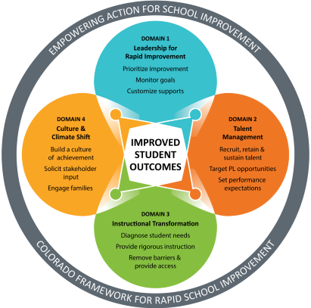
Four Domains for Rapid School & District Improvement
Resource: Four Domains Diagnostic Rubrics
School Diagnostic Rubric
District Diagnostic Rubric
Brings focus to get foundational elements in place in support of rapid school and district improvement.
Created and maintained by the Transformation Network, specifically for lower performing systems (e.g., state/federally identified).
Notes:
The Four Domain’s Rapid School Improvement Framework helps in understanding research based dimensions of school improvement.
Each domain includes steps – when all four domains come together, they collectively contribute to improved students outcomes, as shown in the middle of the graphic.
The department uses the Four Domains to increase supports alignment across the department.
If districts and schools are in a position to identify a domain or areas they need help with, that’s potentially a way to reduce the scope to focus on high leverage domains in improvement planning.
In the resources box, you’ll find school and district diagnostic rubrics provided by the Transformation network team. The rubrics are focused for lower performing systems and provide a great starting point to engage in a ‘needs assessment’ for where to focus improvement planning efforts first.

Slide 33
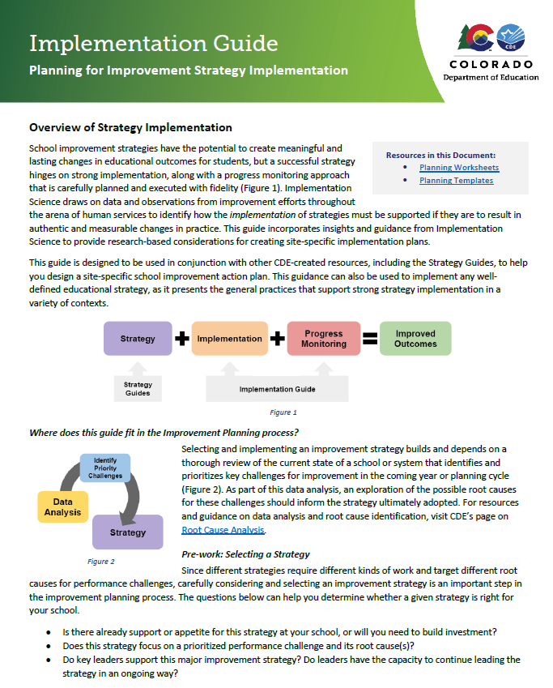
Improvement Planning Strategies & Implementation
UIP Implementation & Strategy Guides (CDE webpage)
Major Improvement Strategy (MIS) Guides
  Organized based on 4–domains for Rapid Improvement
  Use for MIS selection or determine areas of focus
  Provides content for UIP–Action Steps
(Qualifies as research-based evidence, UIP/ESSA)
Implementation Guide, supported with worksheets
  Provides research-based considerations for creating site-specific implementation plans
  Designed to be used with the Strategy Guides and other CDE resources for site-specific improvement action plan
  Presents general practices that support strong strategy implementation in a variety of contexts
Notes:
CDE has also created a number of strategy guides to help schools and districts better understand what research says about strategies that are commonly used in the UIP.
We have organized these strategy guides based on the 4 Domains of Rapid School Improvement.
These guides can be used for strategy selection or to inform action plans.
I’ll just take a moment to show you available strategy guides, perhaps you will make connections with current major improvement strategies you’ve already identified.
If you’d like stronger guidance on how to create action plans and progress monitoring plans for your identified strategies, use the Implementation Guide and its Planning Worksheets to pull together all the information you need to create these plans.

Slide 34
Explore Empowering Action for School Improvement (EASI)
EASI
Eligibility: Schools identified for improvement under ESSA (i.e., Comprehensive, Targeted, Additional Targeted) and/or schools or districts with a State identification of Priority Improvement, Turnaround, or On Watch
Multi-year Funding: Empowering Action for School Improvement (EASI) grant funded through state and federal funds
Routes: options aligned to acuity of need / years on the clock –
1) diagnosis and planning phase, 2) implementation phase, or 3) end-of-clock phase
Consultation: CDE offered services, approved external partners, selected program contractor (may also be district designed or led)
Notes:
Schools and districts with a Priority Improvement or Turnaround plan type and ESSA identified schools are eligible to apply for multi-year, school improvement funding through the Empowering Action for School Improvement – or EASI.
There are a number of different support models, or “routes,” within EASI, providing options for schools in the diagnosis and planning phase, implementation phase, or end-of-clock phase of school improvement.
Many EASI grant routes can provide funding to support partnerships with the external providers.
EASI is a one-stop shop for districts to apply for state and federal funds that are focused on improvement efforts.

Slide 35
Overview of EASI Routes and Services
EASI
Early on the Clock
On the Clock
End of Clock
School Transitions
Duration- 1 year Amount- Up to $50,000
Diagnostic & Planning
Facilitated Board Training for School Improvement
Duration- 1 year Amount- Up to $10,000
Exploration Supports
Duration- 1.5 year
Amount- Up to $42,000, $80,000, or $150,000 based on service
District Designed and Led
Duration- 2.5 years
DDL Major Improvement Strategy- Amount- Up to $20,000 in year 1 and Up to $80,000 for year 2 & 3
DDL Improvement Support- Amount Up to $20,000 in year 1 and up to $50,000 in year 2 & 3
Implementation
School Turnaround Leadership Development
Duration & Amount- Based on selected leadership development program and provider cost
Connect for Success, COMTSS, and School Transformation Network
Duration- 2.5 years
Amount- Up to $20,000 in year 1 and Up to $80,000 for year 2 & 3
Rigorous Action through Redesign
Duration- 2.5 years
Amount- Up to $20,000 in year 1 and Up to $100,000 for year 2 & 3
Accountability Pathways
Duration- Up to 2 years
Amount- Up to $100,000 per year
End of Clock
Notes:
Through EASI, you’ll ultimately choose your own adventure, considering how long your site has been on the Accountability Clock. Across the top, you’ll see the diagram moves from early on the clock to end of the clock.
For sites early on the clock, not sure where to start – consider Exploration Supports and working with an external provider. They’ll complete a needs assessment to inform a plan, providing scaffolding and supports for schools that know they have needs, but not sure how to get started.
District Designed and Led routes offer opportunities for district-led improvement efforts focused on one major improvement strategy. Two new options exist this year including an option for funding to support the implementation of one of CDE’s Major Improvement Strategy Guides and a second option for districts who have a specific improvement approach they are ready to put into action.
Other services are available through CDE such as Connect for Success, COMTSS, Rigorous Action through Redesign, and the School Transformation Network.
New this year, we are offering 1 year limited support for student, staff, and community transitions through a support called School Transitions. This is designed specifically for identified schools that are closing within the coming year or eligible schools receiving students from an upcoming school closure.
And, you’ll also note that as a site moves further on the clock, routes and services get more rigorous including Accountability Pathways associated to end of clock support.

Slide 36
EASI Application Process | Key Resources & Support
EASI
Key Resources:
Empowering Action for School Improvement (EASI)
EASI Menu of Supports
EASI Application Planning Document
GAINS - Online system to submit EASI application
Support Options:
Regular EASI eligible schools and LEA communications
EASI Kick-Off
District Support Leads (if applicable)
Route-specific office hours in November
Application Process:
Decide on the best fit route or service
Preview application questions using the EASI Application Planning Document
LEAs apply on behalf of eligible schools via an online application portal by December
EASI Timeline
Grant application opens | late September 2024
EASI Kick-Off | mid-October 2024
EASI office hours for specific routes- only COMTSS and DDL | early November
EASI application due | December 4, 2024 by 4 pm
Grant award notifications | by January 31, 2025
Notes:
If eligible, districts start getting communication following the release of state and federally identified notification letters. All districts with at least one eligible school will receive direct communications providing access to resources, timelines, and details to apply for funds. Interested schools and districts are encouraged to check out resources available on the EASI page of the CDE website.
The best “first look” resource to review is the Menu of Supports document that will highlight each available route and service, duration of each respective grant, award amount, and eligibility criteria. The 2024 Menu will posted at the EASI website mid-September. In October, CDE will host a short webinar referred to as the EASI Kick off. The EASI Kick off will walk through each route and service offering and details of the application process. Interested schools and districts must apply by December 4th and award notifications will occur by January 31st. It’s also noteworthy that this year, EASI applications will be submitted through the GAINS system.

Slide 37
Wrap-up: Resources & Support

Slide 38
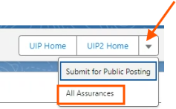
New Assurances Dashboard for District Users
Ensure the combined UIP plan covers district & school requirements based on identification
Login to online UIP system, open the district’s current UIP ‘Details’ tab
From the ‘Details’ tab, select the dropdown menu right of the ‘UIP2 home’ button
Notes:
To help districts monitor their schools’ completion of assurances, the online UIP system has a new dashboard where you can view “All Assurances” for schools via the District UIP.
I’ll login to the online UIP system and demo it quickly.

Slide 39
Performance Watch and Other Resources
Accountability & Performance Watch
  Performance Watch (webpage), outlines expectations w/ resources
  Identification Supplement (coming soon)
  Accountability Handbook and Fact Sheet
  Accountability Resources (webpage)
UIP Resource Webpages
  UIP 101 Videos
  UIP Quality Criteria & Requirements
  UIP General Resources – new resource: Streamlined UIP Workbook
Across Department Connections
2024 Improvement Planning Data Analysis Considerations provides tips on conducting data analysis on timely issues (e.g., On Track Growth, PSAT/SAT, TLCC).

Slide 40

Performance Watch | Contact Us
Your CDE Identified Support Lead
This will be in your Identification Letter (coming soon!)
General questions
uiphelp@cde.state.co.us
accountability@cde.state.co.us

Slide 41
Q & A ~ Please complete our feedback survey
https://tinyurl.com/ACIWebinarSurvey Thank you!!
Notes:
Thank you for participating in this webinar. I’ll stop the recording now for the Q & A session. Please refer back to any questions you jotted down at the beginning of the webinar to ensure we answer them.
We’d also appreciate it if you’ll complete our feedback survey at this URL that I’ll also put in the chat. Thank you!

Slide 42
Remaining slides are hidden, not part of the webinar, while providing extra content

Slide 43
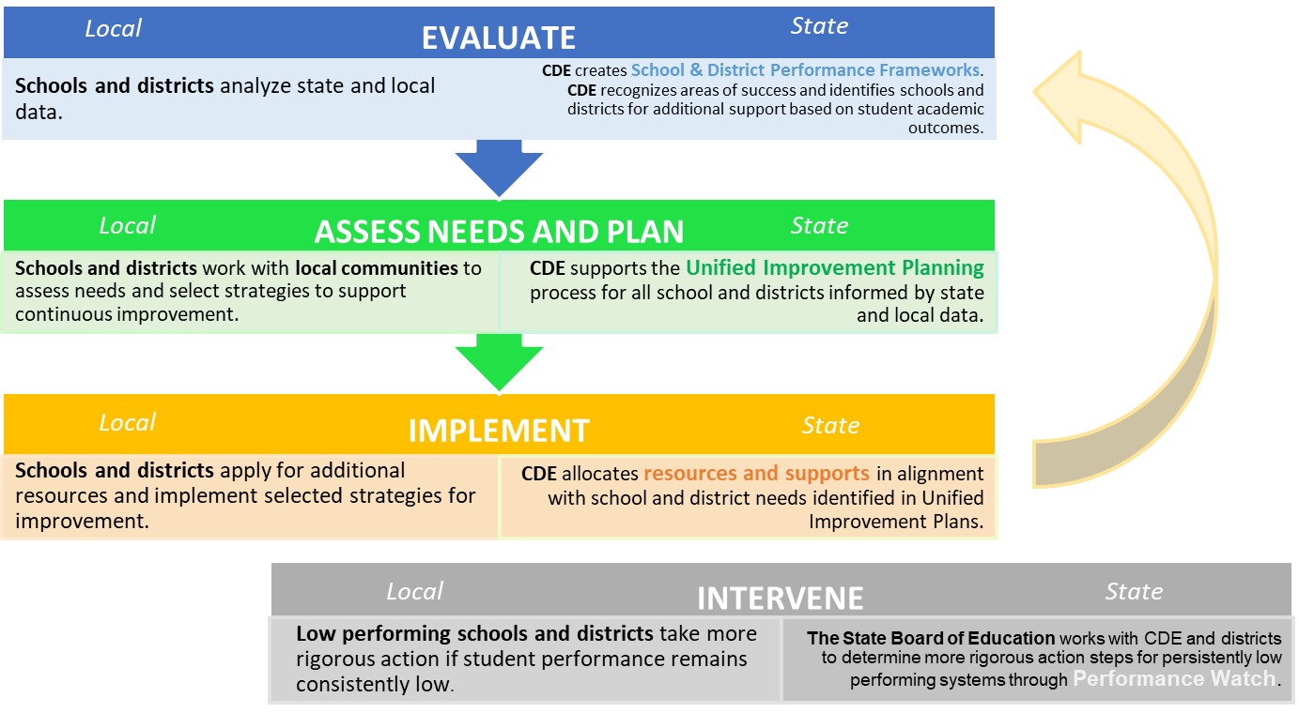
Accountability & Continuous Improvement Theory of Action
Accreditation
Notes:
This image summarizes the state’s theory of action for how elements of the state accountability system for schools and districts interact each year. The state is expected to evaluate school and district performance (e.g., performance frameworks), schools and districts engage with their data to assess needs, plan (e.g., improvement planning) and implement approaches to improvement. The state also provides supports and interventions to identified schools and districts. Stakeholder engagement is woven through each step.

Slide 44
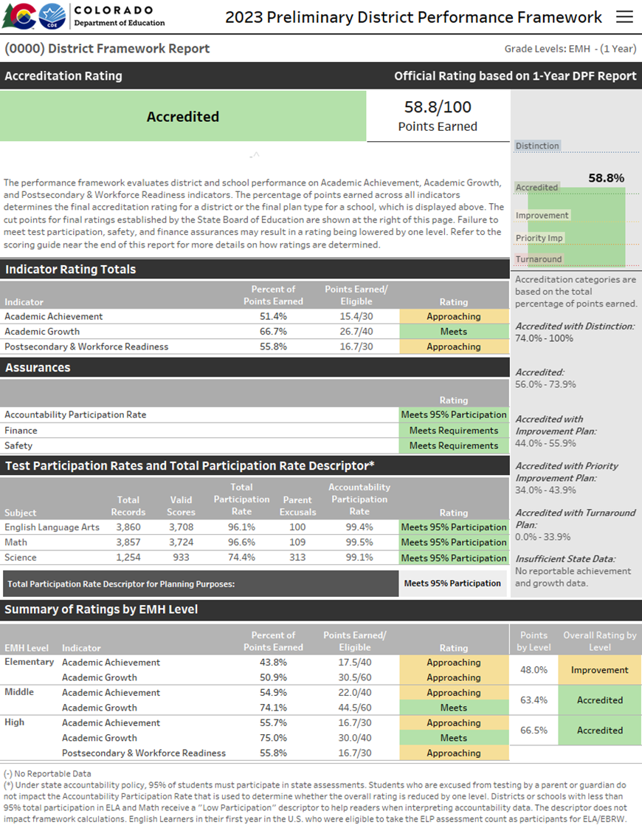
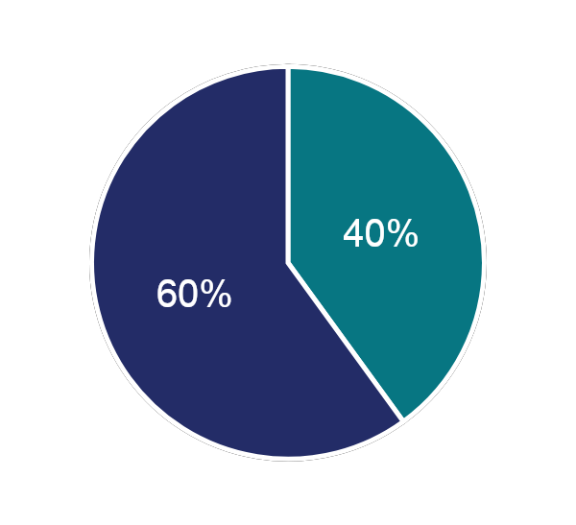
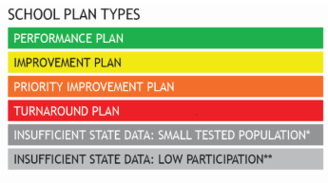
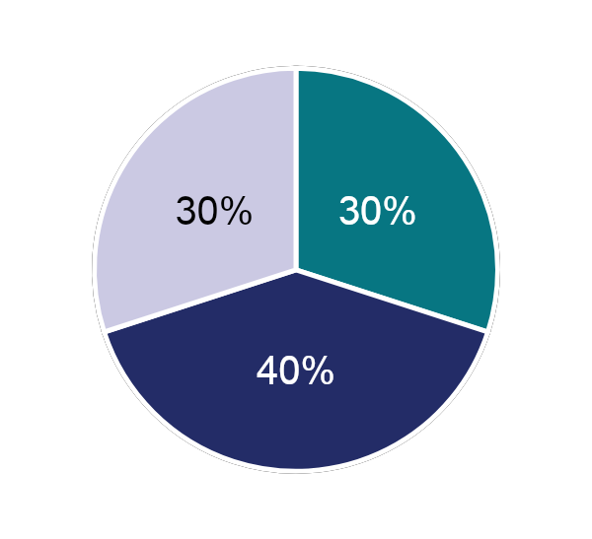
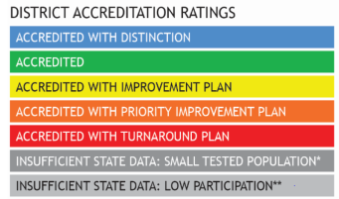
Performance Indicators | Weighted to Determine Ratings
Performance Indicators | Weight
Academic Achievement | 40% Elementary & Middle Schools 30% High Schools & Districts
Academic Growth | 60% Elementary & Middle Schools 40% High Schools & Districts
Postsecondary & Workforce Readiness | 30% High Schools & Districts
Elementary & Middle Schools
Ratings
High Schools & Districts
For information about framework calculations, go to
Guidance on the School and District Performance Frameworks.
Notes:
Performance Frameworks include three indicators of performance: Academic Achievement, Academic Growth and Postsecondary Readiness, the latter in districts and schools that serve high school grades 9-12.
These indicators are weighted to determine ratings assigned in district and school performance frameworks.
(alternative script – too long, not for this purpose)
Performance Frameworks include three indicators of performance: Academic Achievement, Academic Growth and Postsecondary Readiness, the latter in districts and schools that serve high school grades 9-12.
These indicators are weighted to determine ratings. For Elementary and middle schools, growth accounts for 60% of the overall rating and achievement is weighted 40%. At the high school level and for districts with the inclusion of all three indicators, growth accounts for 40% of the total rating while academic achievement and PWR each hold 30%.
While the weighing varies by grade level, the one constant is that Growth holds the highest weight because annual growth is a precursor to increasing achievement, all students can show growth, and the relationship between growth and student characteristics outside the control of schools (i.e., poverty) is weaker than with the other indicators.
For more information on how performance frameworks are calculated, please refer to the link provided as this training does not go into these details.

Slide 45
Performance Frameworks | Ratings and Explanatory Notes
Ratings
Descriptors
Meets Participation
Above 95% total participation rate in ELA and Math in 2024⁺
Low Participation
Below 95% total participation rate in ELA and Math in 2024⁺
Decreased Due to Participation
Below 95% accountability participation, once parent excuses are removed, in ELA and Math in 2024⁺
+
⁺ 2024 Science participation results are not included or factored into participation calculations for accountability purposes.
Note that Science achievement results are included for points in 2024 frameworks, the first time since the revised 2020 Colorado Science Academic Standards.
Notes:
Each school and district receive a rating in their performance framework. Schools receive Plan Types with the highest noted in green, a Performance Plan type.
Districts receive an Accreditation rating – the highest noted in blue, Accredited with distinction. Throughout this session, I’ll refer to a rating or plan type interchangeably.
[CLICK] Frameworks also identify if schools and districts meet the total participation rate of 95% to provide context for interpreting how representative results are likely to be of the entire population.
This is noted as either “meets participation” or with a “low participation,” which is included on page 1 of the performance framework unter “Test Participation Rates.” The footnote explains that Science participation results are still NOT factored into participation rates, while this year science achievement results are included for points in the 2024 frameworks, the first time since the revised 2020 Colorado Science Academic standards.
[CLICK] Only the “decreased due to participation” is included with the plan type at the top of page 1.
This flags that the School’s Plan Type or District Accreditation rating was“decreased due to participation” — meaning that the school or district’s accountability participation rate, rather than the total participation rate was below 95%
This participation rate does NOT include parental excusals.

Slide 46
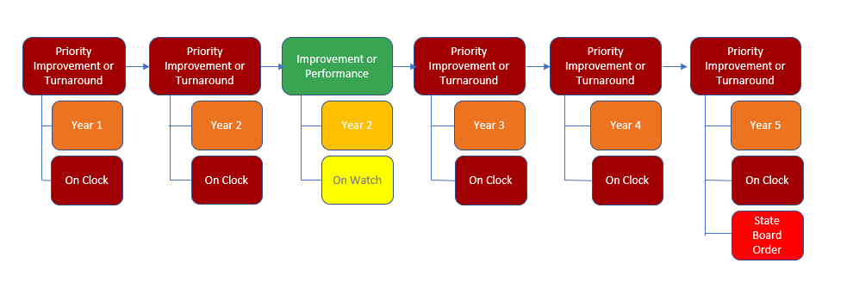
Example 3. Performance Watch Progression through End of Clock, Year 5
This diagram illustrates annual Performance Framework Plan Types over 6 years, with the associated year identified on the Clock below each year’s Plan Type.
Year 1 Year 2 Year 3 Year 4 Year 5 Year 6
Notes:
This example illustrates a Performance Watch Progression through the End of the Clock to Year 5.
Across the top of the diagram, you see annual Performance Framework Plan Types over 6 years, with the associated year identified On the Clock below each year’s Plan Type.
It’s noteworthy that in the third year of this example, this site received an Improvement or Performance plan type, which adjusted the performance watch label as “On Watch” retaining its Year 2 clock placement from the previous year.
In the subsequent year, the site received a performance improvement or turnaround plan type that moved it on to Year 3 of the clock.
The rest of the diagram shows the site advancing on the clock until reaching Year 5 or the end-of-the clock over a 6 year period.
At this time there would be directed action by the State Board of Education.
It’s important to know that there are supports and grant funding available as early as the first year a school or district is identified on the accountability clock
and those supports expand as a school or district advances on the clock.
We’ll go over these supports in the next part of the session.

Slide 47
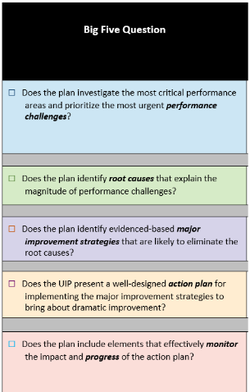
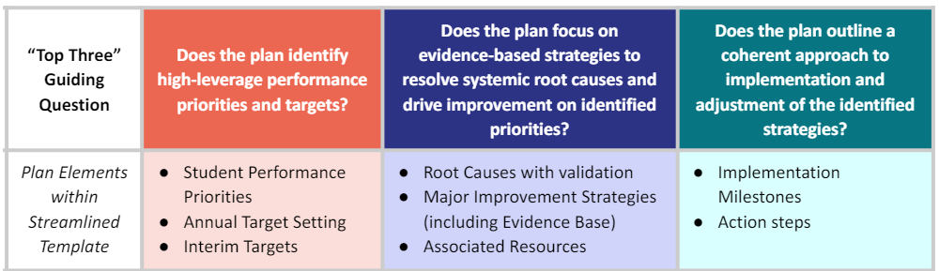
Streamlined UIP Template Organized into three sections instead of five.
The Streamlined UIP organized into three sections instead of five.
Traditional UIP Template
Streamlined UIP Template
Questions about UIP elements?
Check out the UIP 101 webinar series (webpage)
Notes:
This parallel slide shows how those elements vary by the traditional and streamlined template. In the traditional template, we use performance challenges, root causes, major improvement strategies, action plans and progress monitoring. You’ll now see that the new, streamlined template is organized into three sections instead of the traditional five. We’ll dig into the QC in a moment.
If you have questions about sections or elements for either of the templates, I highly recommend reviewing our UIP 101 webinar series that offers bite size on-demand recordings for each component. The webpage also includes associated slide decks for each webinar.

Slide 48
Capacity Building
Your concierge: Support Leads – Year 1 & 2; Transformation Specialists – Year 3+
Professional Learning Cohorts: Learning Cohorts, through the District Improvement Strategy Office
External Providers: Already vetted and approved by CDE, through an annual RFI process
District-Level Supports | School-Level Supports
District-level Strategic Planning (holistic or targeted at one or more key district systems) District Improvement Implementation Support (including STLD) District Managers | School Holistic Diagnostic Reviews and Improvement Planning School Improvement Implementation Support (including STLD) School Managers
Considerations: Guide to working with external partners
Notes:
To support Capacity Building, the Department provides different supports.
As I previously mentioned, districts have support leads with sites early on the clock and as sites move to year 3, a transformation specialist is assigned too.
From the District Improvement Strategy Office, there are different Professional Learning Communities, or Learning Cohorts to apply for. At the linked websites, there’s more information including that applications are being accepted until today. Be sure to reach out if you’re interested in any Learning Cohorts. If there are openings after the application window, there might still be an opportunity to join. .
Finally, the Department conducts an annual Request for Information process, where external providers may apply for approval by CDE. The current list of vetted providers offer services aligned to the Four Domains for Rapid Improvement will be posted by the end of September. Districts may use this list to identify external partners, and schools or districts identified through the state or federal system, may apply for funding through EASI to work with an approved external provider.

