Slide 1
Ensuring Access to Student Data
Building a Data Culture Webinar Series

Slide 2
Building a Data Culture Webinar Series: Themes
Access
Ensure data is easy to access in an interpretable format—educators can't use data if it's not readily available and actionable.
Skills
Provide additional professional learning to know how to interpret and use data.
Meaning
Dedicate time to meet and discuss data, collaborating to find meaningful and useful insights to inform action.
Use
Be clear about how the data will be used, by whom, and for what goal or purpose, so that educators know which teams use data in different scenarios.
Support
Nurture data use and provide the environment to develop the skills and comfort-level needed to meaningfully integrate data use into daily practice.
Adapted from: https://ies.ed.gov/ncee/wwc/PracticeGuide/12
Notes:
In this webinar series, we will be focusing on the five core components of building a data culture from the What Works Clearinghouse and the Institute of Education Sciences. The focus of this webinar is data access. In order to build a data culture, data must be accessible and in an interpretable format. Data cannot be used by educators if its not readily available and actionable.

Slide 3

Session Outcomes
This video will focus on the following topics:
Selecting data to report
Developing data systems and structures
Notes:
The two primary outcomes of this session focus on selecting the data to report and developing data systems and structures that promote accessibility and understandability [[“access to data and understanding of that data”?]]. In promoting accessibility, your school is empowering teachers with additional tools in their toolbox. The ultimate goal is to use this information to inspire changes for students and families.

Slide 4

Where to Begin?
“
District and school adoption of data-driven decision-making practices requires a focused coordination of elements of the larger education system, including such things as policy change, widespread professional development planning, and reliable and affordable support mechanisms. In other words, it is important to consider how the process will function across the entire district and will be used by participants at all levels of the system.
(Means, Padilla, & Gallagher, 2010)
How do you build systems that support data use?
How do you ensure data is accessible?
How do you know what data to collect?
Notes:
To promote data accessibility, there are a few fundamental questions that need to be asked - First: how do you know what data to collect? Second: how are you ensuring the data you collect is accessible? Finally: how do you build systems that support data use? This webinar will focus on addressing each of these questions. As Means, Padilla, and Gallagher stated in their study of building data cultures - “District and school adoption of data-driven decision-making practices requires a focused coordination of elements of the larger education system, including such things as policy change, widespread professional development planning, and reliable and affordable support mechanisms. In other words, it is important to consider how the process will function across the entire district and will be used by participants at all levels of the system.” This webinar will focus on each of these three components to understand data accessibility and use across participants across the system.

Slide 5
Selecting Data to Report

Slide 6


How do you know what data to collect?
Data selection often begins with questions.
What are you hoping to find out?
What decisions do you expect staff/yourself to make?
What data is required (either by your district or the state)?
TIP #1: Avoid random acts of data collection.
By collecting data without a question in mind, you’re likely to encounter a lot of missed opportunities, wasted resources, and a lack of buy-in from staff. Knowing what questions to ask of your data could make the difference between use and misuse. Often, vendors will have reports that can give you ideas of the types of questions you can ask of certain data sets.
Notes:
Data collection often begins with questions. What are you hoping to find out as a result of this data collection? What decisions do you expect staff and yourself to make? And, finally, what data is required by either your district or the state? For instance, you may want to understand students’ social emotional learning outcomes because you’re thinking about hiring additional counselors in your school, but you don’t have concrete information to identify students for additional social emotional supports. In this case, you might consider implementing a survey that looks at social emotional outcomes to act as a viable data source for your school. Before spending additional funds on implementing your own survey collection, you could look at offerings from your district or seeing whether your district is already planning on implementing a districtwide social emotional initiative. A helpful tip no matter the example, is to avoid random acts of data collection. You want to make sure you have a specific question or outcome in mind before collecting data. If not, you’re likely to encounter a lot of missed opportunities, wasted resources, and a lack of buy-in from staff. Knowing what questions to ask of your data and the outcomes you’d like to address could make the difference between use and misuse. Before investing in a data vendor, look over the sample reports they have to determine whether the vendor has built-in reports that can address the types of questions you want to ask.

Slide 7
Examples of Data for Improvement Planning
Performance | Demographic | Process | Perception
Outcomes | Descriptive information | What is happening (practices) | What stakeholders think, believe, or perceive
State summary assessments Local / interim assessments Curriculum-based assessments Formative assessments Graduation / completion rates Course completion rates Dropout rates Matriculation rates Course grades Attendance / Truancy | Grade levels served Student populations Multilingual learners Students of Color Students with disabilities Free / Reduced Price Lunch Gifted Migrant students Students experiencing homelessness | Student enrollment Course enrollment Program offerings (AP / IB / credit recovery / blended learning) Staff turnover rates Review of policy / practices MTSS process Grading policies Discipline model Stakeholder / student outreach | Teacher and Learning Conditions in Colorado survey / other staff surveys Student surveys of safety, climate, instructional relevance Student social emotional learning surveys Student exit surveys Community surveys about school / students
Root Causes, Major Improvement Strategies/Action Steps, Implementation Benchmarks
Current performance, Challenges, Trends, Targets/Interim Measures
Notes:
One thing that is certainly not lacking is sources of data you can use to address your questions. On this slide are different types of data you could use for continuous improvement efforts. Different types of data have different purposes, as described in this slide. Performance data is helpful to understand student performance outcomes and can point towards areas of need. Demographic data is descriptive information that provides important contextual information about your school environment and the students you serve. Process data describes practices in the school - how your school does your day to day work. Perception data describes the ways your students, staff, and families think, believe, or perceive either about the school environment or about themselves. These types of data are the core components of building your improvement plan and describing your school environment. Understanding these core components will help you move forward on making informed decisions.

Slide 8
Developing Data Systems

Slide 9
Data Accessibility
To make sure all data is truly accessible, your school should know:
How data is collected (e.g., assessment platform, teacher-created assessment)?
How often data is reported (e.g., every quarter, every year)?
Who data is reported for (e.g., can data be disaggregated by individual students/student groups or is it only reported at an aggregate level)?
When staff/community/students will have time to access and use the data (e.g., parent teacher conferences, staff data days, professional development)?
TIP #2: Include data release dates / data meetings into the school calendar to describe when different types of data are available / discussed.
Many forms of data should be transparent across your staff (including intervention support teams) and school community (including parents/guardians and students).
Notes:
To make sure all data is truly accessible, your school should know:
How data is collected (e.g., assessment platform, teacher-created assessment)?
How often data is reported (e.g., every quarter, every year)?
Who data is reported for (e.g., can data be disaggregated by individual students/student groups or is it only reported at an aggregate level)?
When staff/community/students will have time to access and use the data (e.g., parent teacher conferences, staff data days, professional development)?
A helpful tip is to include data release dates / data meetings into the school calendar to describe when different types of data are available / discussed.
Many forms of data should be transparent across your staff (including intervention support teams) and school community (including parents/guardians and students).

Slide 10
Prerequisites to Develop a Data System
When thinking about all the types of data your school uses…
Is the data relevant to the questions you need answered?
Is the data readily available to staff/community/students?
Is the data easy to interpret and use?
Notes:
Now that you understand the types of data available and the types of questions to ask to know what to collect, you should be ready to develop a data system. To do so, think through the types of data you currently use or collect. First, is this data relevant to the questions you need answered? Your data should be relevant and timely to inform the decisions that need to be made. Second, is the data readily available to your staff, your community, and your students? Your school should have structures for sharing data to not just staff but also to your community/parents and your students so they can make the data actionable and so data is transparent to all members of your school community. Is the data easy to interpret and use? Data is not useful unless it is accessible and understandable. If data is not accessible, it won’t be used. Your school should be transparent around data sharing and build structures and time to support data use. These three questions will be a recurring theme throughout this webinar series, where we’ll address solutions to these questions if you don’t feel like you have these structures in place quite yet.

Slide 11
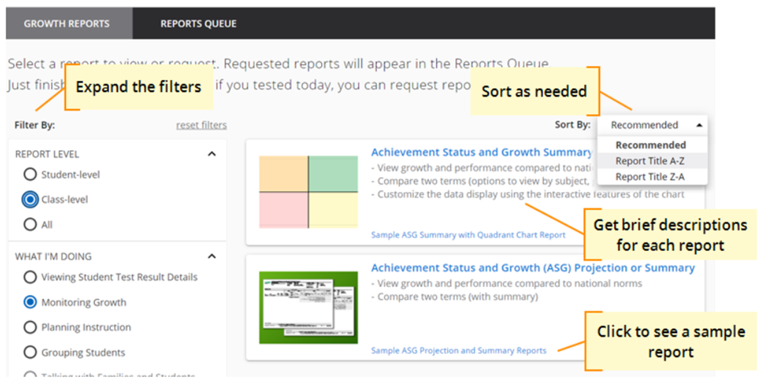
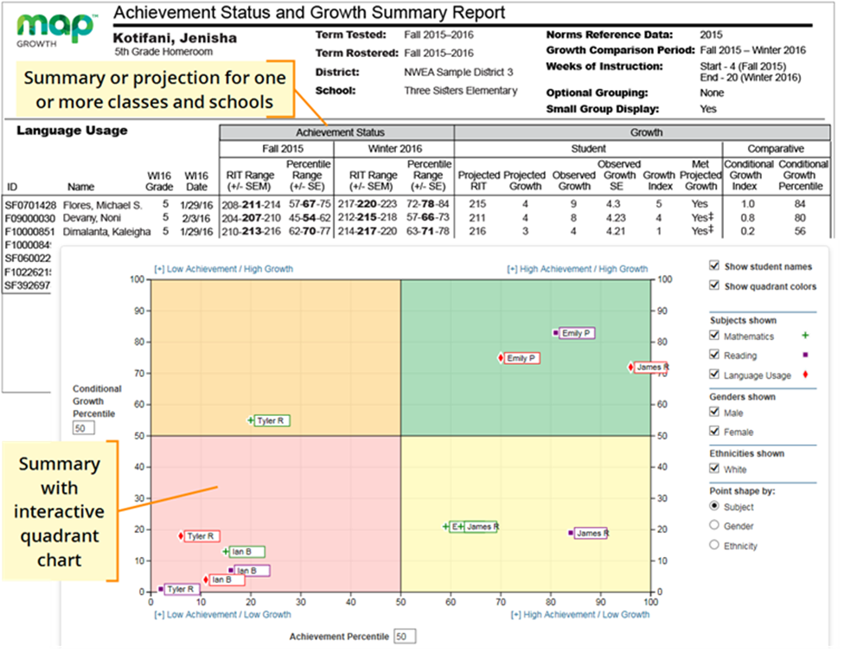
Leveraging Technology to Support Learning
TIP #3: Build a library of reporting resources and give opportunities for teachers to provide feedback on reporting tools and supports.
You can access a variety of reports from your local assessment vendors and Student Information System (example below). Once you have a library of potential resources for teachers to use, allow time for teachers to provide feedback (either in PLCs, during data days, etc.) on these resources.
Notes:
To support accessibility, leveraging technology is fundamental. A helpful tip is to build a library of reporting resources and give opportunities for teachers to provide feedback on reporting tools and supports.
You can access a variety of reports from your local assessment vendors and Student Information System (example below). Once you have a library of potential resources for teachers to use, allow time for teachers to provide feedback (either in PLCs, during data days, etc.) on these resources.
On this slide are examples of reporting tools from NWEA Map, where you can find achievement and growth information for students in your school to catch red flags and support students in moving forward. As an example, if your school is prioritizing student engagement, having a dashboard with accessible data about attendance and other student engagement measures would be a helpful support for teachers to monitor progress.

Slide 12
Changing Attitudes about Data Systems
Common Misconceptions
Shifting Misconceptions and Why it Matters
Data systems are primarily focused on accountability (e.g., assessment results).
Shifting focus towards a variety of data types informs and supports teaching and learning throughout the year.
Data systems rely on aggregate data that tell an overall picture of the school.
Shifting focus towards aggregate and individual data creates a stronger emphasis on gathering information on student learning and collecting/accessing data more frequently.
Data systems focus on information management, or the collection and dissemination of accountability results.
Shifting towards knowledge management focuses efforts on how to best support using data at the classroom level.
Notes:
Early in process of implementation - shouldn’t be a gotcha, it is a tool

Slide 13
Summary of Key Points
Collect data to address questions that are relevant to your school.
Create systems that support timely, credible, short-cycle data collection.
Create systems that support high quality, interpretable data.
Leverage technology to support learning.
Teacher feedback should be built into the system.

Slide 14
Coming Next
The next video will focus on the following topics:
  Building mindsets and attitudes that support data use
  Developing data analysis skills

Slide 15
Thank you for your time!
Email any questions to uiphelp@cde.state.co.us

