Slide 1
Accountability Work Group
Input Session
September 29, 2023

Slide 2
Welcome

Slide 3
Introductions - Game on!
If needed, please update your name in zoom
Please include name and organization
What are your favorite things about fall or fall activities?

Slide 4
Purpose of AWG
The Accountability Work Group (AWG) serves as an advisory group on policy implementation and CDE practice in support of federal and state accountability. This group will consider input from other stakeholders, when possible, in developing recommendations for policies and practices.

Slide 5
Agenda
Welcome and Overview
Shortened Focus- New Measures Input
Next Meeting
Meeting Practices
This meeting is being recorded. Slides and the recording will be posted to the CDE website. Small group breakouts are not recorded at this time.
Please mute your sound if you are not speaking. Be on screen if tech allows.
Non‐members: add your Name/Affiliation to the chat box. All non‐AWG members should hold any comments until the end of the meeting to ensure we have sufficient time to address all meeting agenda items.

Slide 6
Overarching Accountability Timeline
2023 Frameworks Released
1241 Task Force Begins*
Fall 2023
2023 Supplemental Framework Report
Winter 2024
Spring 2024
Interim Report Due
2024 Framework with New Measures for Points
Final Report Due
Fall 2024
* Per HB23-1241

Slide 7
Updates - Accountability in 2023 Legislative Session
H.B. 23-1241: Task Force to Study K-12 Accountability System
Link to Bill: https://leg.colorado.gov/bills/hb23-1241
Purpose: Creates a representative task force of 26-members that studies academic opportunities, inequities, promising practices in schools, and improvements to the accountability and accreditation system.
Website: https://www.cde.state.co.us/accountability/accountability-task-force
Builds upon: Accountability Audit and the Local Accountability System Grant
Timeline:
July 1, 2023: Task force members appointed
August 15, 2023: Department contracts with a facilitator
No later than September 1, 2023: Convene first meeting
March 1, 2024: Interim report
November 15, 2024: Final report reflecting findings and recommendations to the education committees of the house of representatives and senate, the governor, the state board, the commissioner of education and the department.

Slide 8
What do we need from the AWG today?
Build awareness on the potential new measures
Before state board votes in November, gather feedback on any benefits and considerations
Document AWG members feedback here: https://docs.google.com/spreadsheets/d/10J4ypPNbrcsH22rkmvtgMtkXapUV99tF9K-kdQabyAk/edit#gid=0

Slide 9
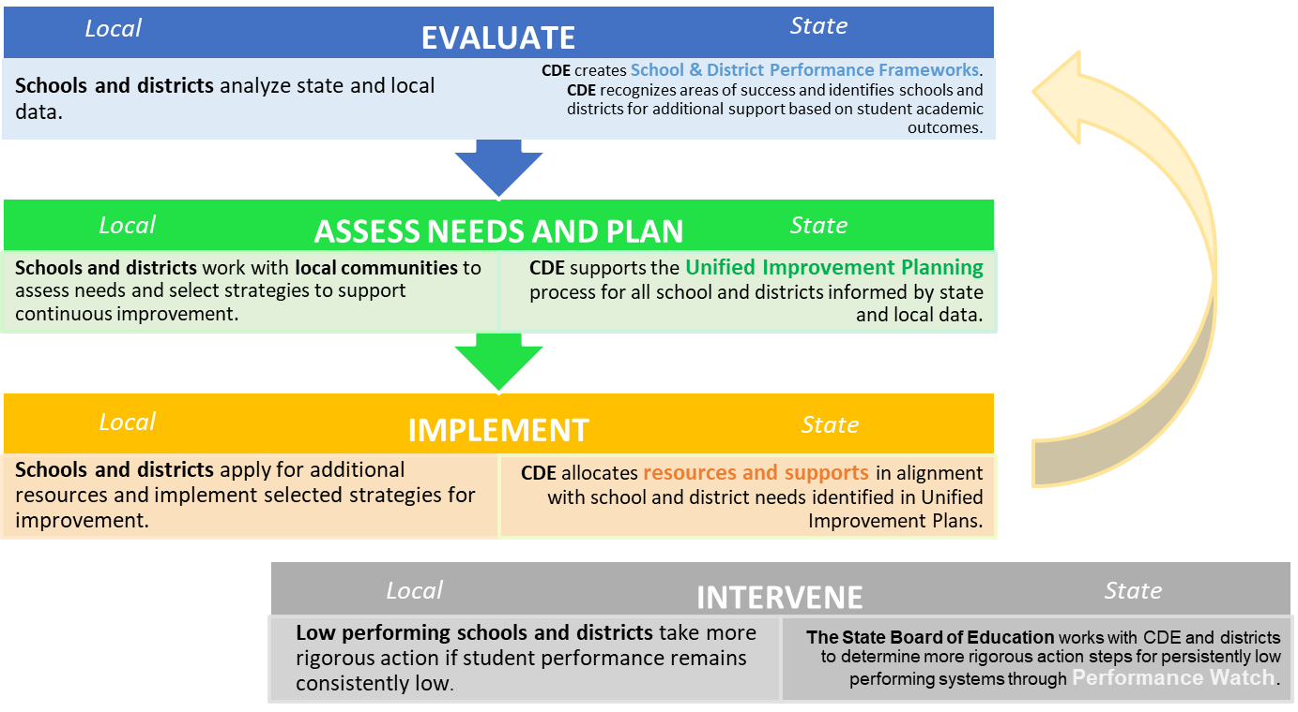
Accountability Theory of Action
Accreditation

Slide 10
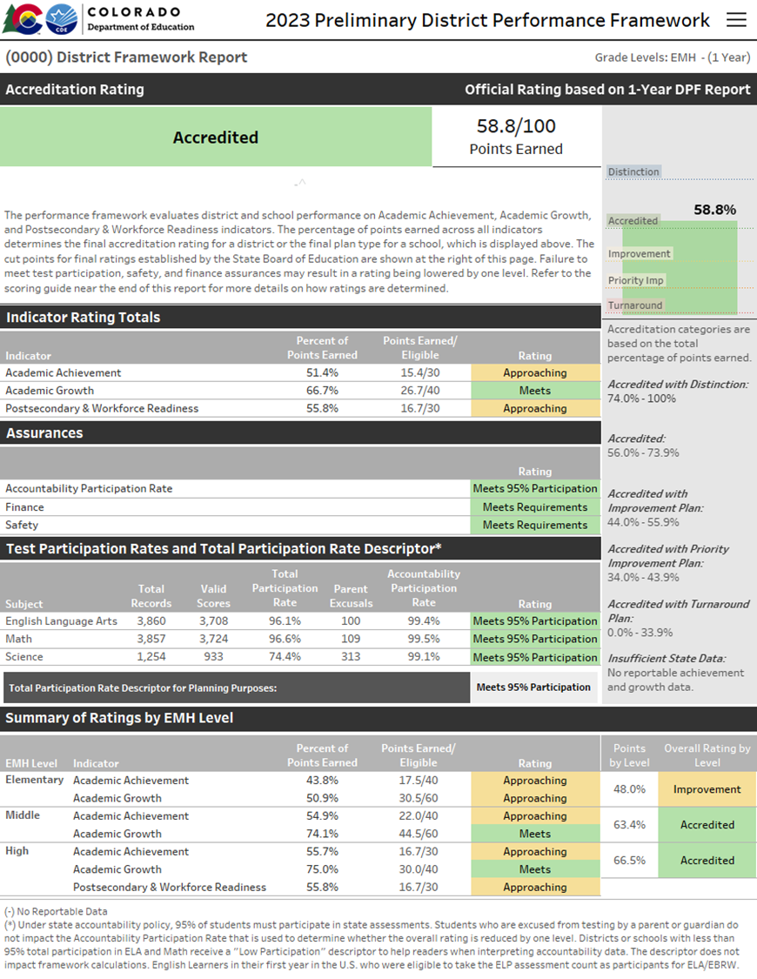
Performance Frameworks | Purpose
Provides a statewide evaluation of student performance that highlights areas of success and areas for improvement.
Identify those districts and schools whose students are lowest-performing based on academic achievement, growth and postsecondary workforce readiness data, and direct state support and intervention appropriately.
Identify those districts and schools whose students are the highest-performing based on academic achievement, growth and postsecondary and workforce readiness data, recognize them and learn from their practices.

Slide 11
Performance Frameworks | Performance Indicators
Performance Indicator | Performance Data
Academic Achievement | Mean Scale Score English Language Arts and Math Assessments Overall and for disaggregated groups
Academic Growth | Median Student Growth Percentile English language arts, mathematics and English language proficiency assessments English language proficiency On Track metric Overall and for disaggregated groups
Postsecondary and Workforce Readiness | SAT – Evidence-Based Reading & Writing and Mathematics Graduation Rate Dropout Rate Matriculation Rate (includes 2-year and 4-year Credential/Diploma or Enrollment, Career and Technical Education Enrollment, and Military Enlistment) Overall and for disaggregated groups (except for Matriculation rate)

Slide 12
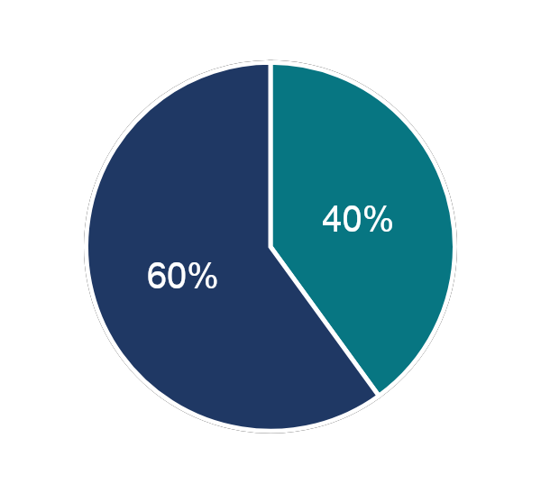
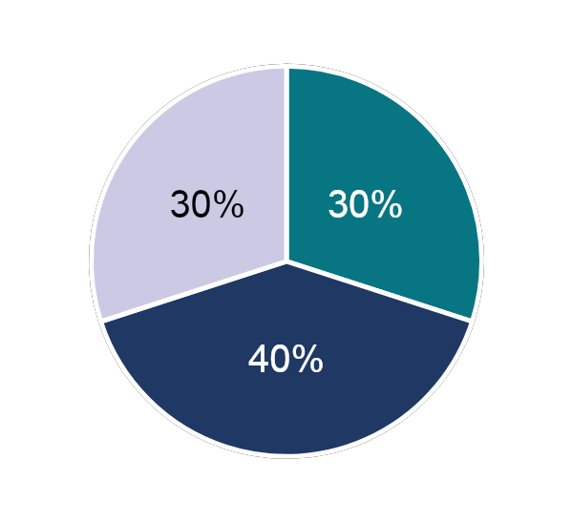
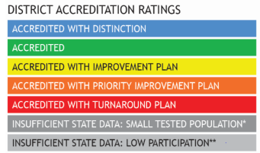
School and District Performance Framework Ratings
Performance Indicator | Weight
Academic Achievement | 40% Elementary & Middle Schools 30% High Schools & Districts
Academic Growth | 60% Elementary & Middle Schools 40% High Schools & Districts
Postsecondary and Workforce Readiness | 30% High Schools & Districts
Elementary & Middle Schools
Ratings
High Schools & Districts

Slide 13
Tentative Timeline for New Measures
Date | Activity
September 2023 | SBE Meeting: Introduction to new measures
October 2023 | SBE Meeting: Discussion on proposed 2024 targets for all metrics in frameworks
November 2023 | SBE Meeting: Vote on 2024 statewide targets and new measures
Early 2024 | CDE provides districts with informational reports for new measures
August 2024 | Preliminary frameworks released, including new measures for points

Slide 14
Summary of Potential Changes within Performance Frameworks
Performance Framework Indicators | Summary of Changes | Elementary & Middle School | High School | District
Academic Achievement: Re-introduction of Science Achievement and Participation | New sub-indicator | ✔ | ✔ | ✔
Growth | No Changes | - | - | -
On Track Growth | New indicator | ✔ | More discussion needed | More discussion needed
PWR: Higher Bar for English Language Arts and Math | Add as a new sub-indicator within PWR | - | More discussion needed | More discussion needed
PWR: Higher Bar for Other Courses | Add as a new sub-indicator within PWR | - | More discussion needed | More discussion needed
PWR = Postsecondary & Workforce Readiness
AP = Advanced Placement
CE = Concurrent Enrollment
IB = International Baccalaureate
CCR = College and Career Readiness

Slide 15
On Track Growth
New Measures
On Track Growth
PWR: Higher Bar for ELA & Math
PWR: Higher Bar for Other Courses

Slide 16
On Track Growth| Definition
Statutory Requirement
Required performance indicator for inclusion in annually-determined school and district rating calculations.
Student academic growth to standards, based on students progress toward meeting the state standards… or for students who meet grade-level expectations on the state standards, progress toward higher levels of achievement, if available, as measure by the statewide assessments. (22-11-204(1)(a)(III))
In Other Words…
The growth to standard or on-track growth metric needs to measure a student’s progress towards meeting a target level of performance within a given timeframe.
This metric needs to update/incorporate observed progress over time.

Slide 17
On Track Growth| History
Relevant History
Spring and fall 2019, state board members considered options for adjusting the elementary and middle school performance frameworks and approved the following:
Incorporate an On Track Growth indicator for CMAS grades 3-8, including
Catch Up: Students not yet meeting grade-level expectations, are expected to advance to the next performance level within two years
Keep Up: Students meeting or exceeding grade-level expectations are expected to maintain grade-level performance over a three-year period.
Indicator weighting should be at 10%, taking 5% from Achievement and 5% from Growth
The high school and district approach were delayed to integrate with other anticipated PWR measures. This work was further delayed by the pandemic.

Slide 18
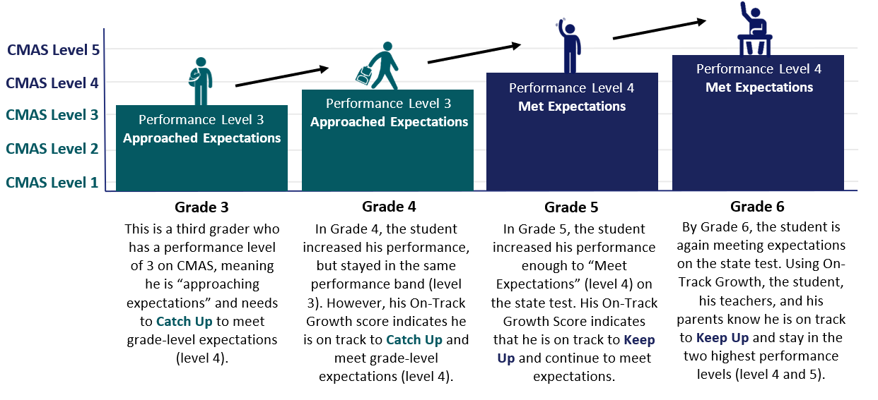
On-Track Growth | Student Example

Slide 19
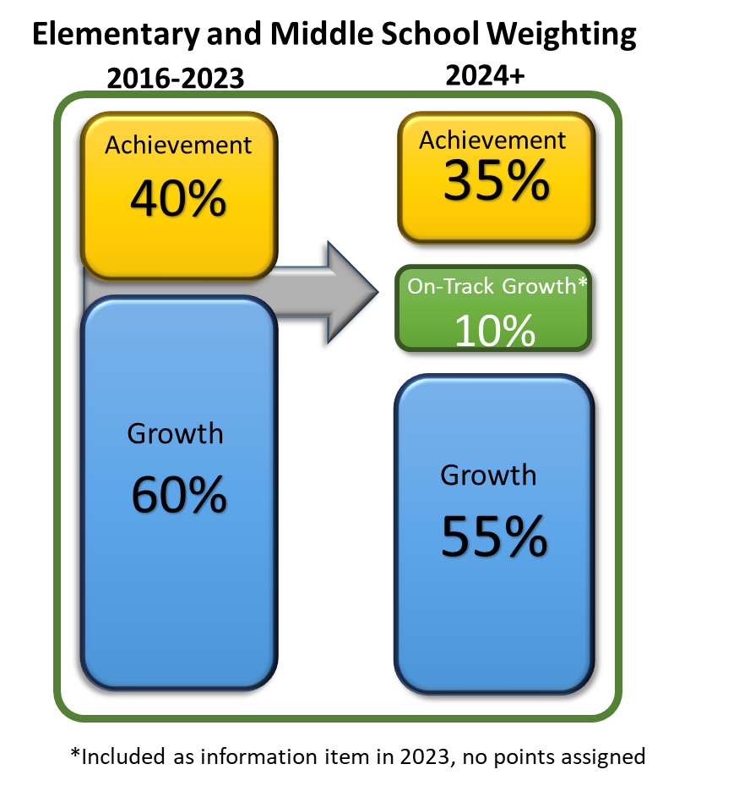
On Track Growth| Integration into Frameworks
Points Eligible for On-Track Growth will follow same approach Achievement and Growth metrics.
All Disaggregated groups combined = ½ All Students group weight.
Sub-indicator cuts set at the 15th-50th-85th percentiles of All Students distributions.
English Language Proficiency (ELP) On-Track measures will move from Growth to On-Track Growth indicator.
State board approved revised indicator weightings for elementary & middle schools

Slide 20
On Track Growth| Outstanding Issues for High School
Differences in proficiency expectations and number of levels for CMAS v. PSAT
PSAT/SAT will be transitioning to a Computer Adaptive format in spring 2024
According to College Board, scores on the digital PSAT/SAT will mean the same thing as the paper and pencil assessments
On Track Growth uses score progressions across prior years to estimate how much growth a student would need to make in future years to reach a target level of proficiency
Current high school On Track Growth estimates are based on paper and pencil score progressions and may not align with upcoming progression from paper to digital or future digital to digital progressions
Would need two consecutive years of digital PSAT/SAT scores to ensure accuracy of progressions and On Track Growth calculations

Slide 21
On Track Growth| TAP Recommendations for High School
Recommendation: Postpone implementation of the new high school On Track Growth metric
Rationale: Transition to digital PSAT/SAT needs to be studied further before using as a new metric in the frameworks.
Implications:
CDE and TAP could study 2024 and 2025 state assessment results.
State board could consider a proposal in fall 2025.
Provide informational reports to districts in early 2026 and then incorporate new metric on frameworks for points on 2026 frameworks.
What is TAP?
CDE’s Technical Advisory Panel on the Colorado Growth Model and Accountability System
State and national experts appointed by the Commissioner
Authorized by state statute. State board must consider TAP recommendations when considering framework calculations.
Website: https://www.cde.state.co.us/accountability/tap

Slide 22
On Track Growth| TAP Recommendations for Districts
Recommendation:
Postpone inclusion of new indicator and roll out all On Track Growth measures at the same time. Informational reports could still be shared as available.
If On Track Growth needs to move forward for elementary and middle schools, then something should also be incorporated for districts at the same time.

Slide 23
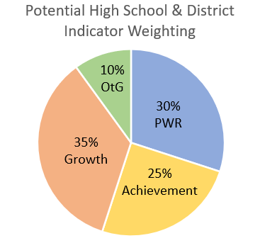
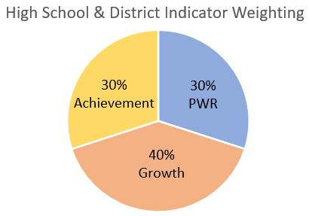
On Track Growth| Proposal for District Weighting
Follow weighting approach for elementary and middle school (i.e., 10% for OTG; 5% from achievement and 5% from growth).
English Language Proficiency On Track Growth would move into this new performance indicator.
Current

Slide 24
On Track Growth| Discussion with the AWG
Group Discussion (unmute or use the chat):
What additional questions do you have about the on track growth measure?
The TAP provided their recommendation from a technical standpoint. What can the AWG add to the conversation with the state board? What do you want them to hear?
If the state board moves forward with adding these measures, what do you recommend CDE think about in managing the change process? What will the field need?
Individual Reflections (benefits, considerations, notes/requests in the blue columns)
https://docs.google.com/spreadsheets/d/10J4ypPNbrcsH22rkmvtgMtkXapUV99tF9K-kdQabyAk/edit#gid=0

Slide 25
Summary of Potential Changes within Performance Frameworks
Performance Framework Indicators | Summary of Changes | Elementary & Middle School | High School | District
Academic Achievement: Re-introduction of Science Achievement and Participation | New sub-indicator | ✔ | ✔ | ✔
Growth | No Changes | - | - | -
On Track Growth | New indicator | ✔ | More discussion needed | More discussion needed
PWR: Higher Bar for English Language Arts and Math | Add as a new sub-indicator within PWR | - | More discussion needed | More discussion needed
PWR: Higher Bar for Other Courses | Add as a new sub-indicator within PWR | - | More discussion needed | More discussion needed
PWR = Postsecondary & Workforce Readiness
AP = Advanced Placement
CE = Concurrent Enrollment
IB = International Baccalaureate
CCR = College and Career Readiness

Slide 26
New Higher Bar Sub Indicators
New Measures
On Track Growth
PWR: Higher Bar for ELA & Math
PWR: Higher Bar for Other Courses

Slide 27
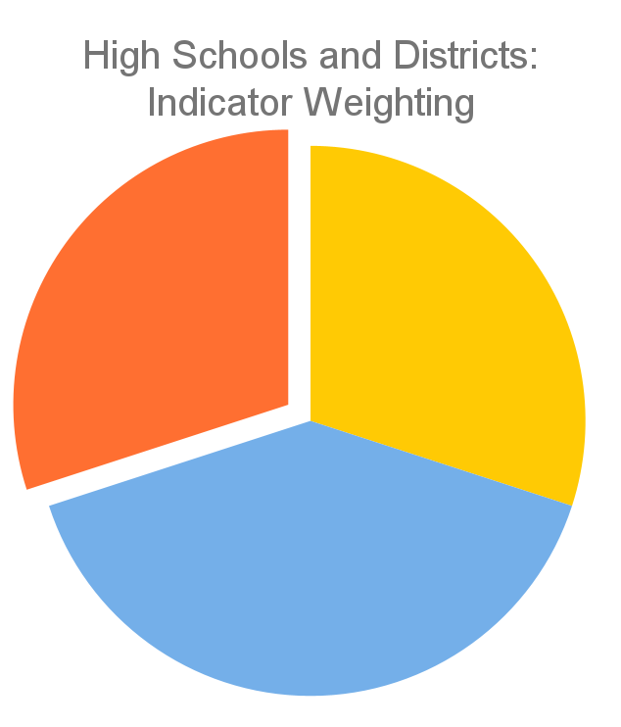
PWR Indicator | Current Framework
Only available for high schools and districts
Contributes 30% of the points in determining overall high school or district plan types
Currently consists of five sub-indicators:
SAT Evidence-Based Reading/Writing
SAT Math
Dropout Rates
Matriculation Rates
Graduation Rates
PWR 30%
Achievement
30%
Growth
40%
Current PWR Indicator: Points by Sub-Indicator & Level
SAT EBRW (8 points): Mean Scale Score [All Students (4) & Disaggregated (1 each)]
SAT Math (8 points): Mean Scale Score [All Students (4) & Disaggregated (1 each)]
Dropout (16 points): Rate [All Students (8) & Disaggregated (2 each)]
Matriculation (4 points): Rate [All Students (4)]
Graduation (16 points): Rate [All Students (8) & Disaggregated (2 each)]

Slide 28
PWR: Higher Bar for ELA & Math (SB 17-272)| Definition
Statutory Requirement
C.R.S. 22-11-204(4)(a)(V) Beginning in the 2020-21 school year, the percentage of students enrolled in the public high school who demonstrate college and career readiness, based on the demonstration options available to the students enrolled in the public high school, at the higher achievement level adopted by the state board that indicates a student is prepared, without needing remediation, to enroll in general education core courses;
C.R.S. 22-11-104(2)(a): "For each of the demonstration options by which a high school student may demonstrate college and career readiness, as recommended by the state board in the high school graduation guidelines adopted pursuant to section 22-2-106 (1)(a.5), the state board shall adopt achievement standards that indicate that a student has demonstrated a level of college and career readiness sufficient for high school graduation and higher achievement standards that indicate that a student is prepared, without needing remediation, to enroll in general education core courses. At a minimum, the higher achievement standards must include: (I) Specified, higher scores on the assessments included in the demonstration options, which scores indicate a student is prepared to enroll in general education core courses without need for remediation; and (II) Receipt of college course credits for concurrent enrollment in career and technical education courses or general education core courses or higher-level courses."

Slide 29
PWR: Higher Bar for Other Content Courses (HB 18-1019)| Definition
Statutory Requirement
C.R.S. 22-11-204(4)(a)(VI) Beginning in the 2020-21 school year, the percentage of students enrolled in the public high school who successfully complete an advanced placement course in a subject other than English language arts or math and earn a score of three or higher on the end-of-course advanced placement exam, the percentage of students who successfully complete a concurrent enrollment course in a subject other than English language arts or math and earn a grade of "B" or higher in the course, and the percentage of students who successfully complete an international baccalaureate course in a subject other than English language arts or math and earn a score of four or higher.

Slide 30
PWR: Higher Bar Measures | Definitions
In Other Words…
Two new sub-indicators added to the PWR indicator
SB17-272- Higher Bar for ELA & Math
Higher achievement levels in ELA and Math. Used cut scores adopted by the state board for the Endorsed Diploma
Eligible assessments include Accuplacer, ACT, ACT Work Keys, AP, ASVAB, Concurrent Enrollment, IB, SAT
HB18-1019- Higher Bar for Other Courses
Successful completion of Advanced Placement (AP), International Baccalaureate (IB), and/or Concurrent Enrollment (CE) for non-ELA and non-Math courses.
AP examination score of 3 or higher
IB examination score of 4 or higher
CE course grade of B or higher

Slide 31
PWR: Higher Bar Measures| History
Relevant History
Began discussion with state board in spring 2020. Further work was delayed by the pandemic.
Renewed discussions with TAP in 2021 through fall 2023 to study measures and formalize recommendations.

Slide 32
PWR: Higher Bar Measures | Proposed Calculation Methodology
At the February 2021 meeting, TAP recommended using the same calculation methodology for both sub-indicators:
Graduation Guidelines reporting is required for graduates
Consistency in the denominator between the two sub-indicators
Counting at graduation allows for a complete dataset across the state
About 85% of IB examinations are taken in the final year of high school
About 65% of AP examinations are taken in the final two years of high school
A graduate is counted in the numerator if they met the requirement at any time during grades 9-12.

Slide 33
PWR: Higher Bar Measures | Data Sources
Measure | Data Source | Higher Bar ELA & Math | Higher Bar Other Courses
Accuplacer | Grad Guidelines Collection | ✔
ACT | Grad Guidelines Collection | ✔
ACT WorkKeys | Grad Guidelines Collection | ✔
Advanced Placement (AP) | College Board, Grad Guidelines Collection | ✔ | ✔
ASVAB | Grad Guidelines Collection | ✔
Concurrent Enrollment (CE) | CO Dept. of Higher Ed., Grad Guidelines Collection | ✔ | ✔
International Baccalaureate (IB) | International Baccalaureate | ✔ | ✔
SAT | CO SAT, Grad Guidelines Collection | ✔
Capstone Projects and Performance Assessments | Grad Guidelines Collection | n/a
Industry Credentials | CO, Dept. of Higher Ed., Grad Guidelines Collection | n/a

Slide 34
PWR: Higher Bar Measures | Data Sources
Data sharing agreement with Colorado Department of Higher Education finalized at the end of 2021
Annual updates to data sharing agreements with College Board and International Baccalaureate
Requires timely receipt of three external data files
Combines six separate data sources (654,480 records in 2022)
Advanced Placement Exams
International Baccalaureate Exams
Aggregated student numerator combining across data sources
Concurrent Enrollment from CDHE
Final student level numerator and denominator flags for both higher bar metrics
Graduation Guidelines Collection
Matriculation File to establish denominator
CO SAT

Slide 35
PWR: Higher Bar Measures | Defining ELA & Math
More than 623 distinct subject and course titles in 2022
Districts get to choose which subjects/courses qualify as ELA and Math
Most allow a variety of social sciences and arts/humanities courses to count for ELA and science/technology courses to count for Math
Subject/course titles are not collected as part of Grad Guidelines
Implication is that some courses will be double-counted for both the ELA/Math and the other course higher bar measures.

Slide 36
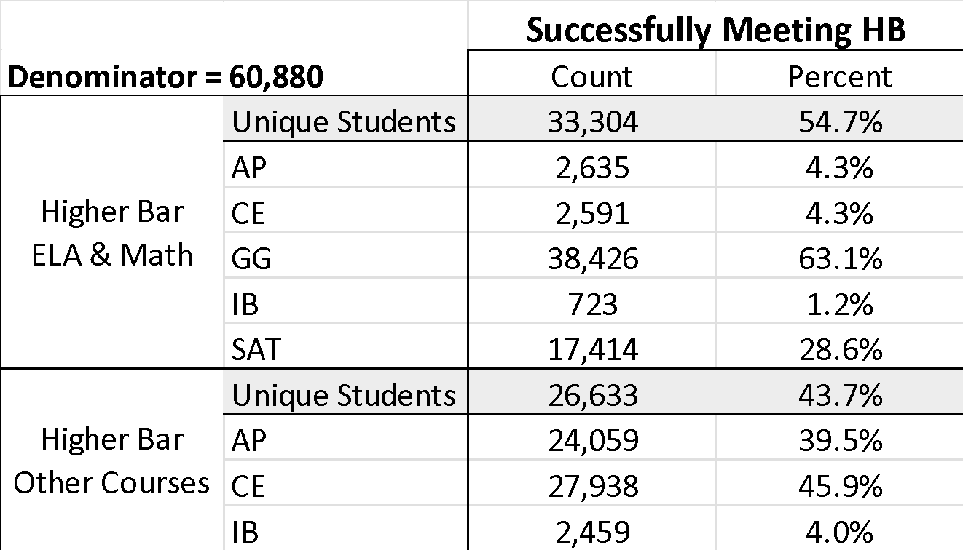
PWR: Higher Bar Measures | 2022 Totals
Note that measure counts include duplicate records and do not add up to the unique student total

Slide 37
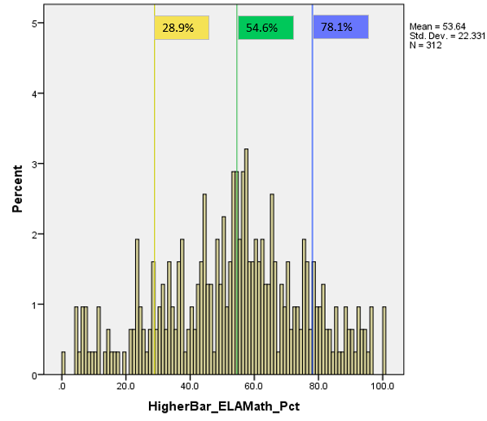
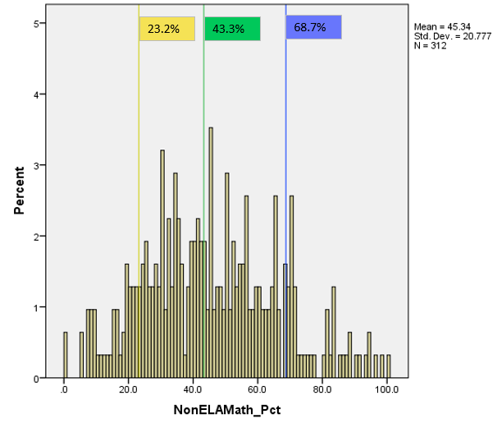
PWR: Higher Bar Measures | Aggregate Measures & Cut-scores
For each school and district, CDE calculates the percent of students meeting the higher bar in one or more courses.
Cut-scores for each sub-indicator set at the 15th-50th-85th percentiles of the school distribution.
2022 Higher Bar ELA & Math
2022 Higher Bar Other Courses
Note that AECs and schools with less than 16 graduates in 2022 are excluded

Slide 38
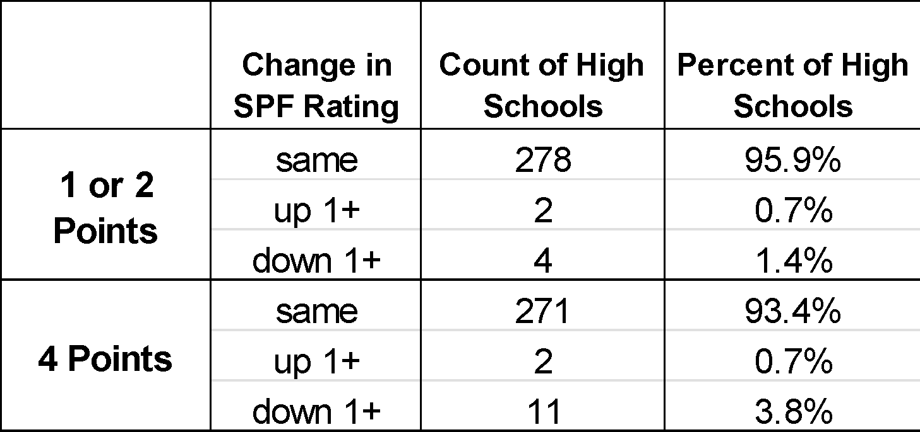
PWR: Higher Bar Measures | Framework Weighting & Impact Data
Investigated three potential weighting scenarios for including new higher bar measures into the PWR indicator- 1, 2, or 4 points for each measure
Calculated impact on 2022 high school SPF ratings
Most (93-96%) schools would earn the same rating, those changing would likely decrease a category

Slide 39
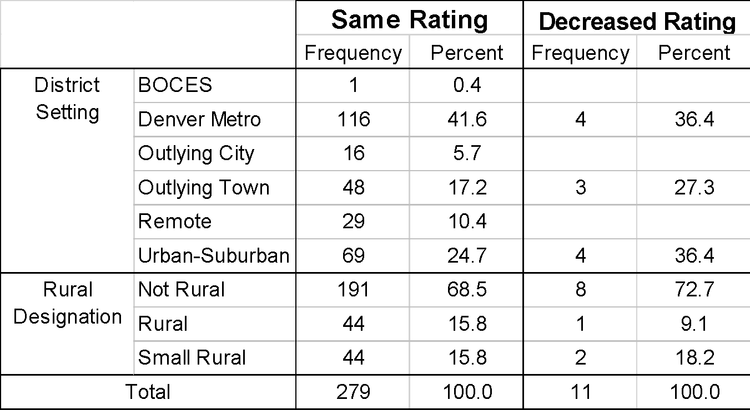
PWR: Higher Bar Measures | Impact Data by District Setting
Questions about equity of access as AP and IB programs tend to concentrate in larger population centers
Concurrent Enrollment opportunities are available to all districts and utilized by most
Outlying towns and urban-suburban settings would experience slightly disproportional decreases in ratings

Slide 40
PWR: Higher Bar Measures | TAP Considerations & Recommendations
Considerations:
Complex data from multiple external sources are of lower quality than other measures in the frameworks
Built-in coding inconsistencies results in double-counting between higher bar measures
Data is labor-intensive to gather and maintain
Anticipate minimal impact on SPF ratings and highly correlated with other PWR sub-indicators
Overall concern that calculations are not reproducible and therefore not transparent.
Recommendation:
New Higher Bar measures should not be added to the school and district performance frameworks at this time until the data quality and transparency concerns can be addressed.
See TAP’s full statement on next slide.

Slide 41
PWR: Higher Bar Measures | TAP Rationale
The proposed higher bar data are highly complex and incorporate data from multiple sources coming from outside CDE including self-reported data from schools and districts. As a result, these data are not of the same quality as most other data used in the performance frameworks. Additionally, there are built-in inconsistencies in how some of the data is coded and it will be labor-intensive to gather and maintain these data. Finally, because of these challenges with the data, it is likely that the measure will not be as accessible and transparent to many users as are other measures on the current performance framework. Moreover, CDE research shows that these higher bar measures will be highly correlated with other PWR measures and therefore will not result in further differentiating performance between schools and districts on the PWR indicator. At the same time, the addition of these measures may reduce the ease with which these frameworks can be understood or explained to schools and communities. Based on these concerns and others around data quality and equity of impacts, and in alignment with the statute that states that these accountability measures must be “fair, balanced, objective, and transparent” [C.R.S. 22-11-102 (2)(e)], it is the professional and technical opinion of the Technical Advisory Panel (TAP) that the available data needed to calculate these new measures does not meet the statutory requirements and, therefore, should not be included in the school and district performance frameworks at this time.

Slide 42
PWR: Higher Bar Measures| Discussion with the AWG
Group Discussion (unmute or use the chat):
What additional questions do you have about the PWR higher bar measures?
The TAP provided their recommendation from a technical standpoint. What can the AWG add to the conversation with the state board? What do you want them to hear?
If the state board moves forward with adding these measures, what do you recommend CDE think about in managing the change process? What will the field need?
Individual Reflections (benefits, considerations, notes/requests in the green columns)
https://docs.google.com/spreadsheets/d/10J4ypPNbrcsH22rkmvtgMtkXapUV99tF9K-kdQabyAk/edit#gid=0

Slide 43
References

Slide 44
On Track Growth Metric Development
On Track Growth describes student growth towards meeting grade level expectations as defined by the underlying assessment (i.e. on CMAS, how much growth would a 3rd grader need to show to be ‘on track’ to reaching the next performance level within a certain amount of time?)
CDE staff worked with the Technical Advisory Panel (TAP) to develop this metric. The development timeline has allowed time to evaluate impact data (models) prior to rulemaking sessions.
The TAP analyzed historical student growth data to ensure that student-level goals are ambitious, yet attainable.
Due to the current lack of state performance expectations for the PSAT and SAT assessments, the proposed on track growth metric applies to grades 3 through 8.
All of the TAP’s conversations are recorded and posted online, and there is time at each meeting for public comment: https://www.cde.state.co.us/accountability/tap

Slide 45
Historical Student Growth Observations
Observed Performance of Students Testing Below Grade Level CMAS Expectations (57% of students overall)
Observed Performance of Students Testing At or Above Grade Level CMAS Expectations (43% of students overall)

Slide 46
TAP Recommendation | On Track Growth Methodology
What target(s)?
Should the target be set to “Meets State Expectations” or should interim targets be used for Catch Up trajectories?
How long to achieve the target(s)?
How many years should students be given to attain their target performance level? Should that vary by grade, content area, and/or initial performance level?
How does the target update over time?
Does the clock start over every year or should this be a set trajectory where we track student progress from the first test result? To be successfully on-track, do students have to maintain the gains made?

Slide 47
TAP Recommendation | On Track Growth Methodology
How long to achieve the target(s)?
How many years should students be given to attain their target performance level? Should that vary by grade, content area, and/or initial performance level?
For Catch Up students, more time means they are more likely to attain their target performance level and the required growth expectations are more attainable than previous definitions.
For Keep Up students longer timeframes make it harder to maintain grade level performance and ensure the growth targets are more ambitious.
To balance the desire in the field for attainable Catch Up targets and ambitious Keep Up targets, the TAP recommended using 3-years as the timeframe for all students to attain/maintain their target performance level.

Slide 48
TAP Recommendation | On Track Growth Methodology
What target(s)?
Should the target be set to “Meets State Expectations” or should interim targets be used for Catch Up trajectories?
The TAP recommended using a stepping-stone approach where students scoring below grade level are expected to increase one or more performance levels within a given timeframe. This provides a pathway for low-performing students making more than typical growth to be considered on track towards reaching higher levels of achievement.
For students at/above grade level, the expectation is that they will maintain grade level performance into future years.
Level 5
Level 4
Level 3
Level 2
Level 1

Slide 49
On Track to Catch Up Methodology
Each student’s observed Student Growth Percentile (SGP) is compared against the year 3 Target Growth Percentile (TGP) to determine if they are On Track to reach the next performance level within 3 years.
Didn’t make it in 1 year
NOT on track to make it in 2 years
On track to make it in 3 years
CMAS Level 3
TGP=69
TGP=58
SGP= 53
TGP=50
CMAS Level 2
grade 3 grade 4 grade 5 grade 6
2017-Prior Year 2018-Current/Year 1 2019-Year 2 2020-Year 3

Slide 50
On Track to Keep Up Methodology
The student’s observed Student Growth Percentile (SGP) is compared against the Target Growth Percentiles (TGPs) for each year to determine if they are On Track or Not On Track to maintain grade level proficiency across 1, 2 and 3 years.
SGP= 42
NOT on track to maintain for 2 years
NOT on track to maintain for 3 years
CMAS Level 4
TGP=30
TGP=49
CMAS Level 3
TGP=39
Maintained for year 1
grade 3 grade 4 grade 5 grade 6
2017-Prior Year 2018-Current/Year 1 2019-Year 2 2020-Year 3

Slide 51
Re-capping 2019 Decisions for CMAS g3-8 ELA & Math On Track Growth Metric
What target(s)?
Should the target be set to “Meets State Expectations” or should interim targets be used for Catch Up trajectories?
Increase 1 proficiency level each year
How long to achieve the target(s)?
How many years should students be given to attain their target performance level?
2 years
How does the target update over time?
Does the clock start over every year or should this be a set trajectory where we track student progress from the first test result?
Resets every year
Do we report students below proficient (Catch Up) and above proficient (Keep Up) separately? Or combined?
Report combined On-Track metric

Slide 52
Re-capping 2019 Decisions for Reporting On-Track Growth
On-Track Growth will be added as a standalone indicator in the school and district performance frameworks.
A minimum N of 20 will be applied for public reporting
For points, report only the All Trajectories group- for both All Students and Disaggregated Groups.
For informational purposes, report the Catch Up and Keep Up results. If either the Catch Up or Keep Up group does not meet minimum N, both categories are suppressed (location still TBD).
Sub-indicator cuts set at the 15th-50th-85th percentiles of All Students distributions

Slide 53
Considerations for the 2024 Digital SAT
The digital test will be adaptive, so it can continue to measure the same core reading, writing, and math knowledge and skills much more efficiently, shortening the overall length of the test while also allowing students more time per question.
This means that for the digital SAT Suite, each test section (Reading and Writing, Math) is divided into two parts called modules. Students answer a set of questions in the first module before moving on to the next. The questions that students are given in the second module depend on how they performed on the first module. Students will be able to practice with the new digital adaptive format starting this fall.
Many large-scale assessments use adaptive testing, and more than 30 years of research shows the benefits of adaptive testing, including:
More precise measurement
Tailored questions to meet students’ needs
Shorter tests
More secure testing
From: https://satsuite.collegeboard.org/digital/faq

Slide 54
Considerations for the 2024 Digital SAT
The SAT will still be scored on a 1600 scale, and educators and students can continue to monitor growth across the suite over time. And scores on the SAT will mean the same thing, so a score of 1050 on the digital SAT corresponds to a score of 1050 on the paper and pencil SAT.
We expect that the digital SAT will maintain strong reliability and predictive validity. We’re conducting extensive research and analysis, including comprehensive predictive validity studies, as we transition to a digital SAT:
Spring/summer 2022: Validity study examining digital SAT relationships with other educational measures
Fall 2023: Preliminary predictive validity study examining college outcomes
Ongoing: Extensive research to ensure the digital SAT offers comparable levels of reliability to the current paper and pencil SAT
From: https://satsuite.collegeboard.org/digital/faq

Slide 55
PSAT/SAT On Track Growth Metric Decisions
What target(s)?
Should the target be set to “Meets State Expectations” or should interim targets be used for Catch Up trajectories?
CMAS increases 1 proficiency level each year
Notes for PSAT/SAT Analysis
PSAT/SAT has only 4 proficiency levels
Lower participation than usual in 2021 (58% g8 Math, 73% g9 and 10 PSAT) with over-representation of higher achieving students
We are in an extended protest period for the HS college entrance suite of assessments procurement. Therefore, we will focus solely on what can be done with high school growth for the fall of 2023.

Slide 56
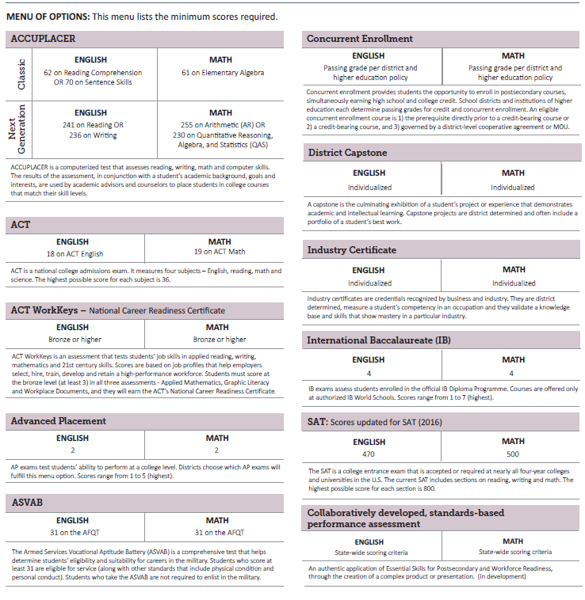
Data Sources, SB17-272
For the ELA and Math higher achievement measure, we would obtain examination scores from the Graduation Guidelines data collection:

Slide 57
Higher Bar Metric Additional Details & Timeline
Three Graduation Guidelines options are not included as options for the higher achievement bar measure:
District Capstones
Collaboratively developed, standards-based performance assessments
Industry Certificates
Graduation Guidelines Timeline
The Graduation Guidelines policy will be fully implemented across the state beginning with the Class of 2022.
The first complete Graduation Guidelines dataset will be available in January 2023.

Slide 58
CDE Direct Data Sources
AP exam data
Provided annually by College Board
Years available- 2017, 2018, 2019, 2021, and 2022
38 distinct exam titles
IB exam data
Provided annually by the International Baccalaureate Organization
Years available- 2018, 2019, 2020*, 2021, and 2022
51 distinct exam/course titles
Concurrent Enrollment data
Provided annually by the Colorado Department of Higher Education, representing 32 universities, colleges and technical colleges
Years available- 2018, 2019, 2020, 2021, and 2022
534 distinct course titles (no common coding practices between institutions)

Slide 59
TAP Recommendation for Identifying ELA and Math AP Exams
AP Capstone Research | Environmental Science | Physics C: Electricity and Magnetism
AP Capstone Seminar | European History | Physics C: Mechanics
Art History | French Language and Culture | Psychology
Biology | German Language and Culture | Spanish Language
Calculus AB | Human Geography | Spanish Literature and Culture
Calculus BC | Italian Language and Culture | Statistics
Chemistry | Japanese Language and Culture | Studio Art: 2-D Design Portfolio
Chinese Language and Culture | Latin | Studio Art: 3-D Design Portfolio
Comparative Government and Politics | Macroeconomics | Studio Art: Drawing Portfolio
Computer Science A | Microeconomics | United States Government and Politics
Computer Science Principles | Music Theory | United States History
English Language and Composition | Physics 1 | World History
English Literature and Composition | Physics 2

Slide 60
TAP Recommendation for Identifying ELA and Math for IB Exams
ART HISTORY | FURTH. MATHS | PHILOSOPHY
BIOLOGY | GEOGRAPHY | PHYSICS
BUS MAN | GERMAN AB. | PSYCHOLOGY
CHEMISTRY | GERMAN B | REF PROJECT
CHINESE B | GLOB. POL | RUSSIAN A
CLASS.GREEK | HISTORY | SOC.CUL.ANTH.
COMPUTER SC. | ITALIAN AB. | SPANISH A
DANCE | ITGS | SPANISH A LAL
DESIGN TECH. | JAPANESE AB. | SPANISH A LIT
ECONOMICS | LATIN | SPANISH AB.
ENGLISH A | LIT AND PERF | SPANISH B
ENGLISH A LAL | MANDARIN AB. | SPORTS EX SCI
ENGLISH A LIT | MATH ANALYSIS | THEATRE
ENV. AND SOC. | MATH APPS | THEORY KNOWL.
FILM | MATH.STUDIES | VISUAL ARTS
FRENCH AB. | MATHEMATICS | WLD. STUDIES
FRENCH B | MUSIC | WORLD RELIG.

Slide 61
TAP Recommendation for Identifying ELA and Math for Concurrent Enrollment Courses
AAA | APPM | BUS | COMP | ECE | ENP | FST | HOS | IWKS | MAR | MTR | ODEA | PHT | REE | SWK
AAS | AR | BUSA | COMR | ECO | ENTP | FSW | HPE | JMP | MARK | MU | OENG | PHY | RLST | TECI
ABUS | ART | CAD | CON | ECON | ENV | FVM | HPPE | JOU | MAS | MUS | OHPR | PHYS | RST | TED
ACC | ARTE | CADT | COS | ED | ENVS | GEG | HPR | JPN | MASS | MUSA | OHVA | PLU | RTE | THE
ACCT | ASC | CAR | COUN | EDEC | ENY | GEO | HSCI | JPNS | MAT | MUSC | OMAP | PMUS | RTV | THEA
ACT | ASE | CAS | CPD | EDHD | EPER | GEOG | HSE | JPS | MATC | MUSP | OMAT | POL | RUS | THTR
ADE | ASI | CCR | CRIM | EDU | ESL | GEOL | HST | JRNL | MATH | NAT | ONAT | POLS | SBM | TRI
AEC | ASL | CET | CRJ | EDUC | ESS | GER | HTL | KI | MCCN | NRE | ONUA | POS | SCI | TSTC
AES | AST | CHE | CRJU | EGG | EST | GEY | HUM | KIN | MET | NUA | OPHT | PRA | SES | TSTG
AGB | AT | CHEM | CRMJ | EGT | ETH | GIS | HUMN | KINA | MGD | NUR | OSH | PRO | SKB | UEDU
AGE | AUT | CHI | CS | EIC | ETST | GPS | HVA | KINE | MGDA | NURA | OUT | PS | SOC | UNIV
AGP | AVT | CHIN | CSC | ELCE | EXHP | GRMN | HWE | LAT | MGMT | NUT | OWEL | PSC | SOCO | US
AGR | BA | CHS | CSCI | ELT | FILM | GWS | ID | LATN | MGT | OACT | PAR | PSCI | SOCY | VA
AGRS | BAR | CIS | CUA | EMS | FIN | HEQ | IHP | LEA | MKT | OASE | PBHL | PSY | SPA | VET
AGY | BIO | CJ | CUAR | EMTS | FINE | HGP | IMA | LIT | MKTG | OBAR | PED | PSYC | SPAN | WEL
AH | BIOL | CJC | CWB | EN | FIW | HHP | IND | MAC | MOAP | OCIS | PES | PTA | SPCH | WELD
AIM | BIOM | CLDE | DAN | ENG | FMT | HIS | INDS | MAE | MOT | OCN | PH | PTE | SPED | WEST
AME | BTE | CNG | DEA | ENGC | FR | HIST | INOV | MAMT | MST | OCNG | PHI | PUAD | SPN | WRTG
ANT | BUAD | COM | DPM | ENGL | FRE | HLDR | IPP | MAN | MTE | OCOS | PHIL | PVT | STAT | WST
ANTH | BUGB | COMM | EBIO | ENGR | FREN | HLT | ITL | MAP | MTH | OCUA | PHO | READ | SVT | ZOO

Slide 62
Data Sources for Higher Bar and Non-ELA/Math Metrics
Advanced Placement Exams
Aggregated student level file. Contains 1 student record from each contributing file that provides “best-of” outcome for that data stream.
International Baccalaureate Exams
Unique by Student ID. Includes “best-of” numerator value from all available files for Higher Bar metric and Non-ELA/Math metric
Concurrent Enrollment from CDHE
Graduation Guidelines Collection
Matriculation File to establish denominator
CO SAT

Slide 63
Potential PWR Weighting Scenarios
Investigated 3 potential scenarios for incorporating the new PWR metrics- 1 point, 2 points, or 4 points for All Students Group and no points for disaggregated groups
 | All Students |  | Disaggregated
SAT EBRW | 4 |  | 4
SAT Math | 4 |  | 4
Dropout Rate | 8 |  | 8
Matriculation Rate | 4 |  | --
Graduation Rate | 8 |  | 8
 | Current | 1 Point | 2 Points | 4 Points
Higher Bar ELA & Math | -- | 1 | 2 | 4
Higher Bar Non-ELA/Math | -- | 1 | 2 | 4
Total PWR Points | 52 | 54 | 56 | 60

Slide 64
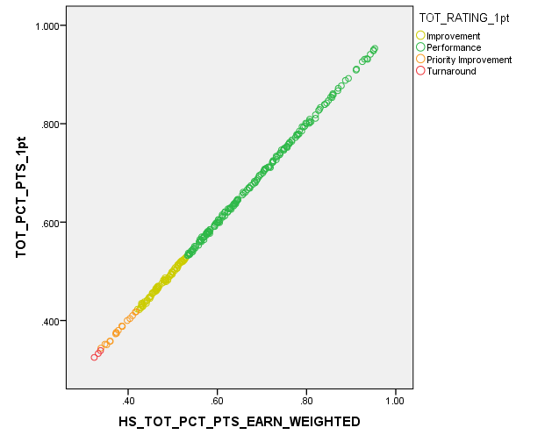
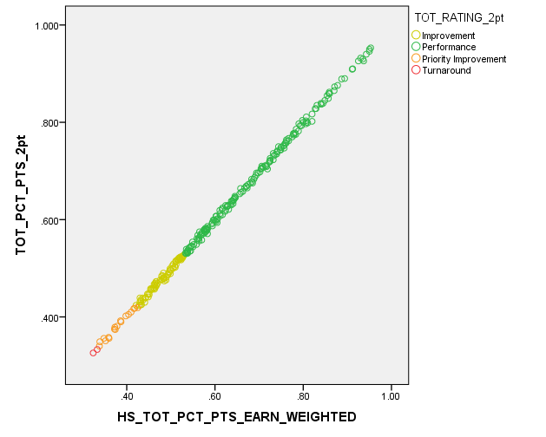
2022 School Level Impact Data by Potential Weighting Scenario (adding 2022 Higher Bar Data)
1 Point
2 Points
4 Points

Slide 65
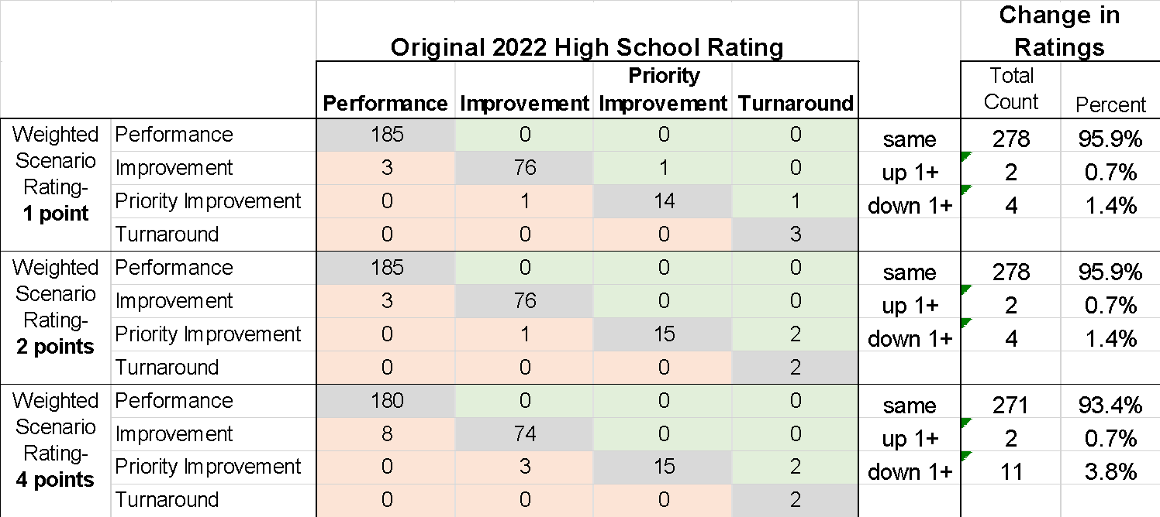
2022 School Level Impact Data by Potential Weighting Scenario (adding 2022 HB Data)

Slide 66
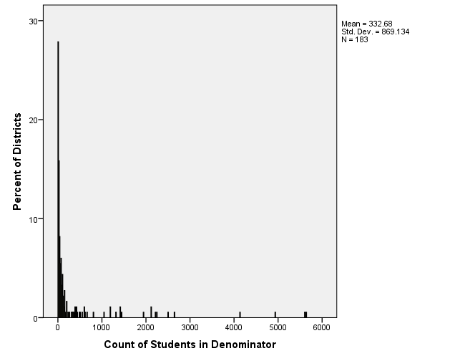
2022 Distribution of District N-counts Included in Matriculation Rate
Note that almost 30% of districts did not meet the minimum reporting N of 16 for matriculation rate.
This means these districts will not have results for either of the new Higher Bar measures

Slide 67
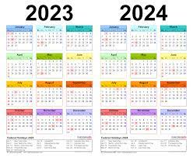
Next Meeting
Scheduled for November 3rd
AND….

Slide 68
Thank you!

