Slide 1
Alternative Education Campus (AEC) Accountability/UIP Overview
2022

Slide 2

Agenda
AEC Overview
  Enrollment trends
  Policy
  AEC School Performance Framework
    Optional Measures
2022 AEC Accountability
  Changes in 2022
  Federal identifications
    EASI grant funds
Improvement Planning as an AEC
  General process
  Data
  Timelines
Meeting Norms
This webinar is being recorded. Slides and the recording will be posted to the CDE website. Q&A at the end of this session won’t be recorded.
Please mute your sound if you are not speaking.
Use the chat feature to ask questions throughout the presentation. We will take pause breaks to answer chat questions.

Slide 3
Reflection Activity
What is one thing that has made you feel hopeful about this school year?
What are you hoping to get out of this webinar today?
Please feel free to share in the chat.

Slide 4
AEC Overview

Slide 5
AEC Background & Overview:
Alternative Education Campuses in Colorado
In Colorado, schools that serve primarily high-risk students are called “Alternative Education Campuses”, or AECs for short.
AECs are outlined in C.R.S. 22-7-604.5 as schools:
(I) “Having a specialized mission and serving a special needs or at-risk population”,
(V) “Having nontraditional methods of instruction delivery”,
(VI) (A) “Serving students who have severe limitations…”, and
(VI)(B) “Serving a student population in which more than 90% of the students have an individualized education program…or meet the definition of a high-risk student”.

Slide 6
AEC Background & Overview:
Alternative Education Campuses in Colorado
There are 93 Alternative Education Campuses in Colorado in the 2022-2023 school year.
AECs serve over 21,000 students statewide and make up 2.5% of the state’s student population.
AECs enroll students in grades K-12, but 70% of students enrolled in AECs are in 11th or 12th grade.
Average enrollment in AECs in 2022 was 229 students. Enrollment ranged from 9 to 5328 students, and all but four schools enrolled less than 500 students.
40% of AECs are served by three large districts (DPS, JeffCo, D11). The other 60% of AECs are in districts serving 3 or fewer AECs. 37 AECs are the only AEC in their district.

Slide 7
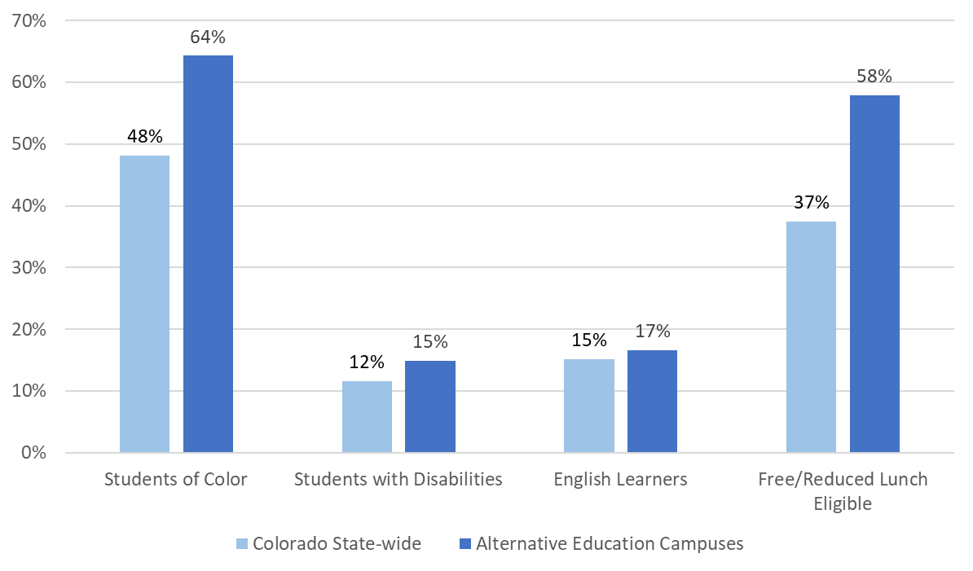
Enrollment Trends at Colorado AECs
Alternative Education Campuses (AECs) in Colorado currently make up 2.5% of the total student enrollment. These schools enroll higher populations of highly at risk students.

Slide 8
AEC Background & Overview:
AEC Statute, Rules & Policy
Statute: Education Accountability Act of 2009
Section 22-7-604.5, C.R.S. permits schools to apply to state board for designation as an AEC; outlines minimum criteria for receiving AEC designation; authorizes CDE to evaluate AECs based on criteria established by State Board
Rules: Administration of Accountability for AECs
1 CCR 301-57 defines timelines and process for seeking AEC designation and establishes the 4 indicators that will be used to evaluate AEC performance (achievement, growth, postsecondary workforce readiness, & student engagement)
CDE Policy: AEC Policy Guidance
(updated annually)

Slide 9
AEC Background & Overview
Year at a Glance
Sept-Dec
Jan-Feb
March-April
May-June
July-August
Beginning of Year (BOY) optional measure data collection
October Count - base of designation
Midyear optional measure data collection
Notification of first time AEC applicants by 1/31
Designation data files developed by CDE
AEC Designation Collections opens
AEC designation recommendations developed for the state board
End of Year (EOY) optional measure data collection
Optional measure data collection opens
AEC School Performance Framework (SPF) calculation
Board votes on AEC designations

Slide 10
AEC Background & Overview:
AEC School Performance Framework (SPF)
The AEC SPF is the same as the traditional SPF:
The AEC SPF differs from the traditional SPF:
Same structure of framework (sub indicator 🡪 indicator 🡪 overall rating)
Inclusion of Academic Achievement, Academic Growth, and Postsecondary and Workforce Readiness measures
State assessment data included
Dropout rate included in both
Same rating categories
AEC SPF is the official accreditation report for AECs
Inclusion of Student Engagement indicator
Flexible weighting within indicators
Cut points for state-required measures are normed on Colorado AEC population
Data aggregated across all EMH levels served
State-required data aggregated across most recent three years
Best-of completion rate instead of best-of graduation rate
Inclusion of optional measures

Slide 11
AEC Background & Overview:
Elements of an Optional Measure
Optional measures should be:
  Representative of the entire school population
  Aligned with the mission of the school
  From an assessment or survey which provides valid and reliable student scores
    For assessments, preferably those aligned with Colorado Academic Standards
    For surveys, nationally normed surveys and surveys that can demonstrate pre/post growth are preferred
  Instructionally and programmatically relevant to school
  Agreed upon by both district and school leadership
From AEC Policy Guidance

Slide 12
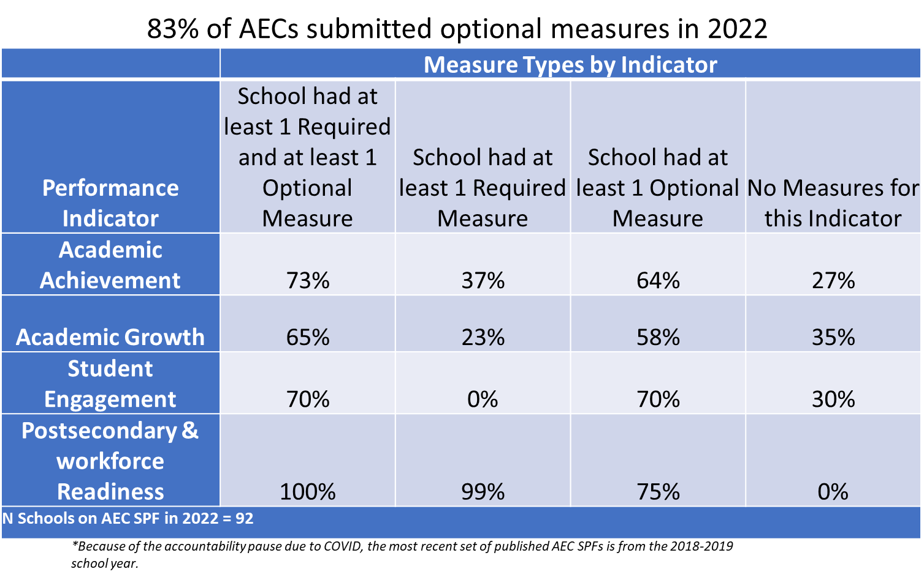
Optional Local Data Measure Impact

Slide 13
AEC Background & Overview:
Creating Mission-Aligned Optional Measures
Random AEC from Random District:
Our school’s mission is to provide accelerated credit recovery opportunities, using a blended learning model, for students who have been unsuccessful in traditional school settings or who have been involved in the criminal justice system. This is a place where students can come to re-engage in learning, find joy in academics, and complete their high school education.
How do we translate this mission statement into quantifiable supplemental SPF measures?

Slide 14
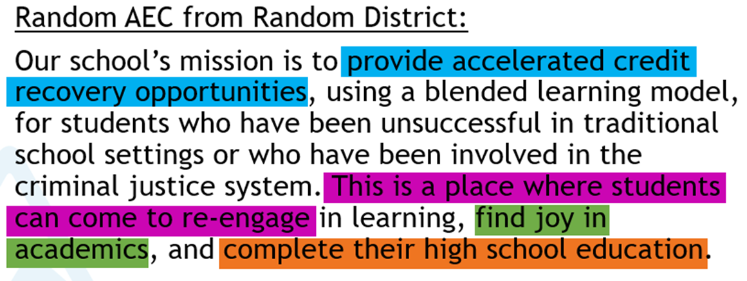
AEC Background & Overview:
Creating Mission-Aligned Optional Measures
DATA FOR IMPROVEMENT
AEC SPF Optional Measures
Additional Data (Ex: UIP)
Credit/Course Completion Rate
Quality and use of Blended Learning options
Focus group data to understand barriers to re-engagement
Student behavior incident recidivism
Student Re-Engagement Rate
Student Climate Survey Positive Response Rate
Best-of Completion Rate (required)

Slide 15
2022 State Accountability for AECs

Slide 16

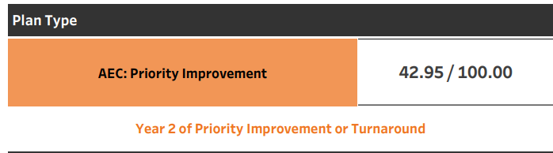
SB 22-137 - Transition Back to Standard K-12 Accountability
Restarts framework calculations for fall 2022 using 2019 statewide performance indicator targets.
Addition of growth participation rate to framework reports.
Accreditation and plan type ratings are assigned, but clock status will not automatically advance (on or off).

Slide 17
SB 22-137 - Transition Back to Standard K-12 Accountability
Change in clock status may be approved through request to reconsider process, and opens request to reconsider process back up more broadly- includes alternative education campuses.
The State Board may take into consideration the 2022-2023 plan type for schools and districts (currently 12 schools and 2 districts) with directed action.
Expands the School Transformation grant (currently embedded with EASI grant) to districts with Improvement plan type.
To see the language, go to SB 22-137

Slide 18
Alternative Education Campus School Performance Framework:
Changes to 2022 AEC SPFs
Changes to the 2022 AEC SPF
Use of 1 year of state required data (no 3 year aggregates)
Temporary removal of attendance and truancy measures.
Assignment of Insufficient State Data plan type for AECs

Slide 19
Alternative Education Campus School Performance Framework:
Changes to 2022 AEC SPFs
Changes to the 2022 AEC SPF
Use of 1 year of state required data (no 3 year aggregates)
Temporary removal of attendance and truancy measures.
Assignment of Insufficient State Data plan type for AECs
Optional measure data can still be submitted for up to the most recent three years if the school has been able to administer consistent assessments for that time period.
Consistency in administration requires both the same assessments to have been administered and that those assessments were administered in the same modality (in person vs. remote).

Slide 20
Alternative Education Campus School Performance Framework:
Changes to 2022 AEC SPFs
Changes to the 2022 AEC SPF
Use of 1 year of state required data (no 3 year aggregates)
Temporary removal of attendance and truancy measures.
Assignment of Insufficient State Data plan type for AECs
The attendance collection changed from aggregate to student level data submission at the start of the pandemic. This change has made the data incomparable to previous years. Until these state required measures are reintroduced, schools have the option to submit attendance and truancy measures of their own.

Slide 21
Alternative Education Campus School Performance Framework:
Changes to 2022 AEC SPFs
Changes to the 2022 AEC SPF
Use of 1 year of state required data (no 3 year aggregates)
Temporary removal of attendance and truancy measures.
Assignment of Insufficient State Data plan type for AECs
Based on the potential changes listed above, and given that many schools have struggled to administer assessments consistently through the pandemic, we recognize that AECs in particular face a high degree of missing data this year. Use of ISD as a plan type may prevent AECs with missing data from being identified as Priority Improvement or Turnaround.

Slide 22
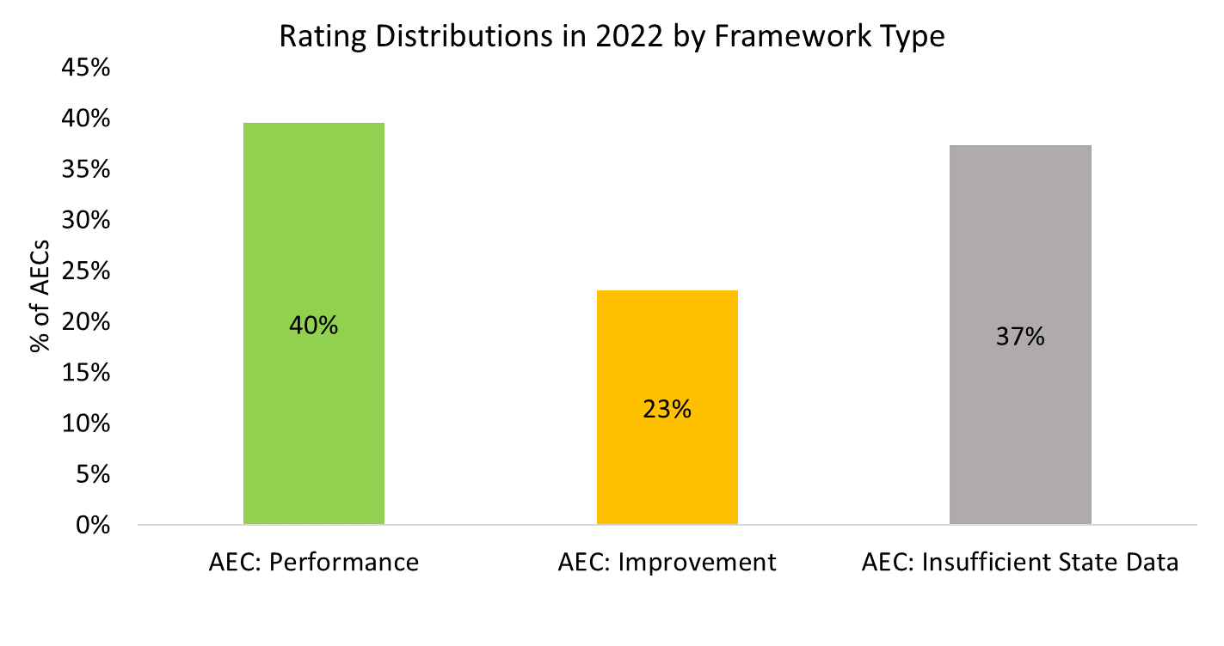
Preliminary 2022 AEC School Performance Framework Results
Notes:
Given the transitional nature of the 2022 frameworks, and given that this framework cycle is the first in which AECs received Insufficient State Data plan types, comparisons to previous years’ rating distributions are less clear and useful than in previous years.

Slide 23

Planning for 2023 and Beyond
Given data availability, anticipate aggregating across two years of data for the 2023 frameworks
Attendance and truancy measures are expected to be included again for the 2023 frameworks

Slide 24
ESSA Identification
ESSA Identification process has prioritized low-graduation /completion rates, regardless of Title I status.
The identification makes federal resources available to AEC’s that have not previously been accessible.
Attention has been given to making the application for accessing these resources responsive and adaptive to the school context (e.g. EASI application).
Notes:
FYI- 51 of the 90 AEC’s are identified under ESSA (Comprehensive low performing, Comprehensive Low Grad, Targeted Support and Additional Targeted)

Slide 25
CDE Supports for AECs - EASI
EASI grant funds are aimed at districts with schools that are designated as (1) Comprehensive Support and Improvement (CS) and Targeted Support and Improvement (TS), Additional Targeted Support and Improvement (A-TS) under ESSA, and (2) Improvement, Priority Improvement, Turnaround or Watch through the state accountability system.
Important Dates:
Release of EASI App - September 26
Virtual EASI Support Fair - October 19
Application Due - December 9

Slide 26
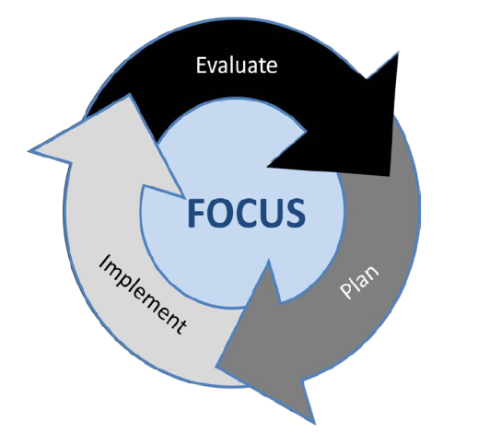
Unified Improvement Planning

Slide 27
The UIP “Flowmap”
PRIORITIZE
Data Narrative
Priority Performance Challenges
Prepare to
Plan
Target
Setting
Action
Planning
DIAGNOSE
Root Causes
Data
Narrative
Review Current Performance
Describe Notable
Trends
Prioritize Performance Challenges
Identify
Root
Causes
STRATEGIZE
Major Improvement Strategies
Set Student Centered Targets
ID Major Strategies & Action Steps
IMPLEMENT
Annual Targets
Interim Measures
Implementation Benchmarks
Action Plans
Progress Monitoring
Identify
Interim Measures
Identify Implementation Benchmarks

Slide 28
Making the UIP an authentic, living document
Connecting the school’s mission and values to…
Prioritized challenges
Strategies selected
Measures established and data collected
  Think optional measures!

Slide 29
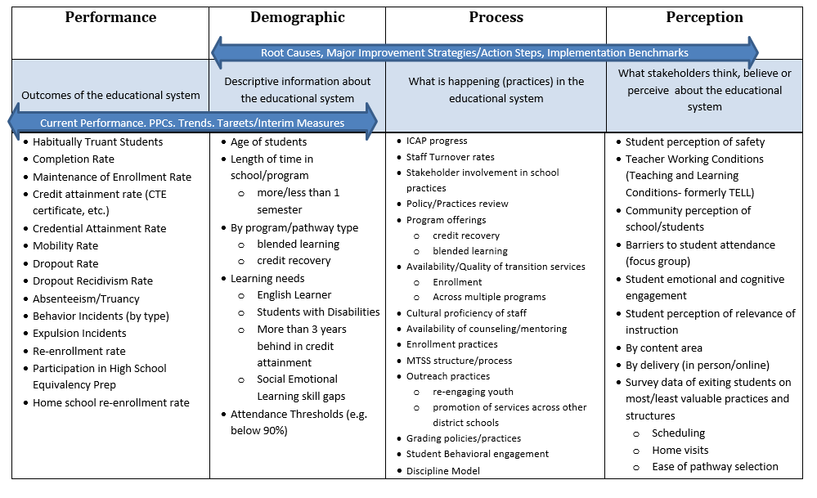
Data for Improvement Planning

Slide 30
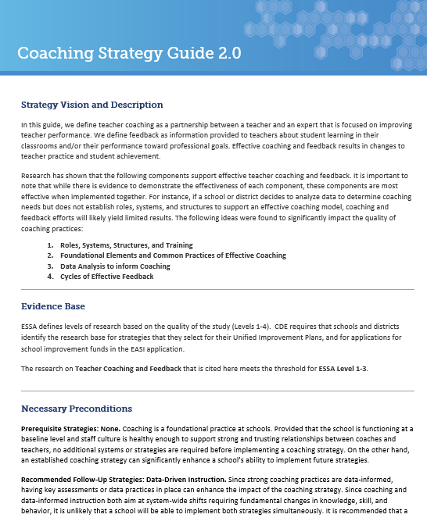
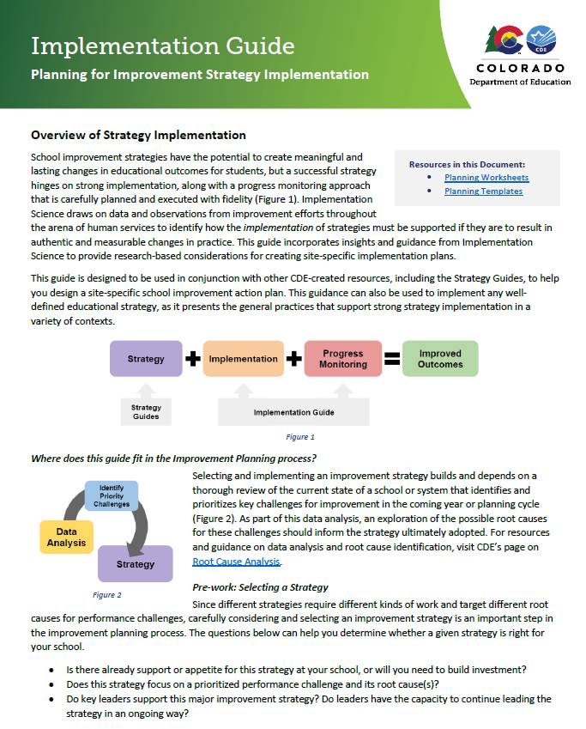
Strategy Guides and Implementation Guide
Strategy Guide
Implementation Guide

Slide 31
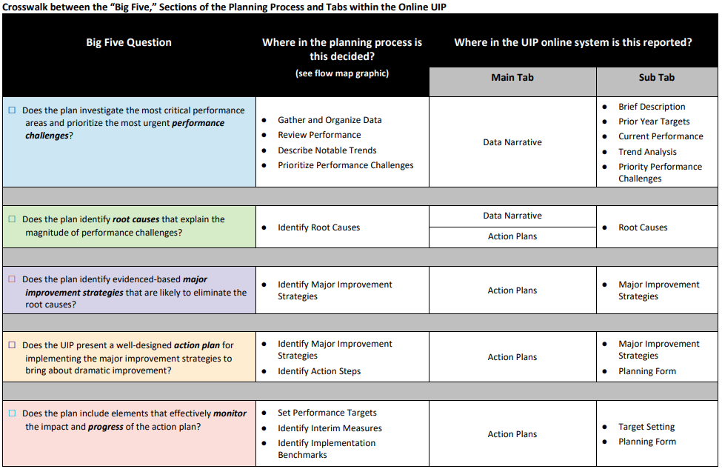
UIP Quality Criteria
UIP Quality criteria: https://www.cde.state.co.us/uip/school_qcrubric
Includes separate requirements for those federally identified (e.g. Comprehensive Support, Targeted Support, Additional Targeted Support).

Slide 32

2022 Performance Framework Delay
Adjusted Timelines
AEC and Non-AEC Performance Framework Released to Districts
August 24 → September 2
Request to Reconsider Materials Due
October 17 → October 25
Unified Improvement Plan (UIP) Submission Deadline
October 17 → October 25

Slide 33
UIP Timeline Flexibilities
At District Discretion
Biennial Flexibility- District Option for submitting a UIP for public posting every other year. Insufficient state data is not eligible. In online UIP and posted spreadsheet.
Combined Plan Flexibility- Submitting one plan for all schools and district level. Under 1000 automatic, 1000-1200 CDE approval.
January 17th UIP Submission- additional requirements to be met in plan, may need additional time: Year 0, Request to Reconsider, New ESEA Comprehensive Support
Just because you can, doesn’t mean you …have to.

Slide 34
Resources
State accountability resources: https://www.cde.state.co.us/accountability/stateaccountability
AEC accountability resources: https://www.cde.state.co.us/accountability/stateaccountabilityaecs
UIP resources: https://www.cde.state.co.us/uip/uip_general_resources
  UIP 101 videos: https://www.cde.state.co.us/uip/uip101
  UIP Strategy Guides and the Implementation Guide: https://www.cde.state.co.us/uip/strategyguides

Slide 35
Q & A

