Slide 1

1241 Task Force
Meeting #3
OCTOBER 17, 2023
Notes:
Kady

Slide 2


Words from the Task Force Chair and Vice Chair
Dr. Wendy Birhanzel
Rebecca McClellan
Task Force Chair
Superintendent
Task Force Vice Chair
State Board of Education

Slide 3
Objectives
Task Force Participants will:
Review group norms to guide the task force’s deliberations moving forward
Build connections among each other in relation to the task force’s work
Realign on the legislative charge of the task force
Review and discuss a draft roadmap of upcoming meeting topics aligned to the legislative charge that includes the completion of the interim and final reports
Discuss the task force’s follow up questions to CDE on the current accountability system

Slide 4
Agenda
10:00 - 10:30 am | Welcome
10:30 - 10:45 | Review Norms
10:45 - 12:00 | Discussion & Activity
12:00 - 1:00 | Lunch & Small Group Activity
1:00 - 1:30 | Align with our Legislative Charge
1:30 - 2:00 | Review Roadmap
2:00 - 2:15 | Break
2:15 - 3:45 | CDE Accountability Follow-Up Presentation
3:45 - 4:00 pm | Wrap Up & Next Steps

Slide 5
Agenda
10:00 - 10:30 am | Welcome
10:30 - 10:45 | Review Norms
10:45 - 12:00 | Discussion & Activity
12:00 - 1:00 | Lunch & Small Group Activity
1:00 - 1:30 | Align with our Legislative Charge
1:30 - 2:00 | Review Roadmap
2:00 - 2:15 | Break
2:15 - 3:45 | CDE Accountability Follow-Up Presentation
3:45 - 4:00 pm | Wrap Up & Next Steps

Slide 6
Norms
Assume positive intent from others’ thoughts and input
Agree to disagree
Maintain flexibility and allow for opinions to change
Share the speaking and listening space with fellow members in an equitable and respectful manner
Respect the candidness of others as a gift
Expect non-closure

Slide 7
Agenda
10:00 - 10:30 am | Welcome
10:30 - 10:45 | Review Norms
10:45 - 12:00 | Discussion & Activity
12:00 - 1:00 | Lunch & Small Group Activity
1:00 - 1:30 | Align with our Legislative Charge
1:30 - 2:00 | Review Roadmap
2:00 - 2:15 | Break
2:15 - 3:45 | CDE Accountability Follow-Up Presentation
3:45 - 4:00 pm | Wrap Up & Next Steps

Slide 8

Discussion & Activity
Please share with the task force:
Why were you identified?
What is your connection to the accountability system?
What do we, as a task force, need to make the best decisions for our state and our students?
As task force members share, write at least one question or comment for every task force member based on what you heard them share.

Slide 9
Agenda
10:00 - 10:30 am | Welcome
10:30 - 10:45 | Review Norms
10:45 - 12:00 | Discussion & Activity
12:00 - 1:00 | Lunch & Small Group Activity
1:00 - 1:30 | Align with our Legislative Charge
1:30 - 2:00 | Review Roadmap
2:00 - 2:15 | Break
2:15 - 3:45 | CDE Accountability Follow-Up Presentation
3:45 - 4:00 pm | Wrap Up & Next Steps

Slide 10
Agenda
10:00 - 10:30 am | Welcome
10:30 - 10:45 | Review Norms
10:45 - 12:00 | Discussion & Activity
12:00 - 1:00 | Lunch & Small Group Activity
1:00 - 1:30 | Align with our Legislative Charge
1:30 - 2:00 | Review Roadmap
2:00 - 2:15 | Break
2:15 - 3:45 | CDE Accountability Follow-Up Presentation
3:45 - 4:00 pm | Wrap Up & Next Steps

Slide 11

Legislative Charge: The “Tasks”
C.R.S. 2-2-2103
(1)(a) In completing the study required in this part 21, the task force, at a minimum, shall consider:
(i) Academic opportunities or inequities that may impact academic achievement gaps;
(ii) Improvements to the accountability and accreditation system to expand and incentivize academic opportunities and address inequities;
(iii) Promising practices in school and school districts; and
(iv) Recommendations for legislation or rules, as necessary.
(2) The task force shall consult with parent organizations, student organizations, and additional stakeholders as needed to address questions necessary to finalize its findings and recommendations.

Slide 12

Legislative Charge: The “Tools”
C.R.S. 2-2-2103 (1)(b) To support the considerations of the task force set forth in subsection (1)(a) of this section, the task force may review:
(i) The results of the statewide education accountability systems audit report described in section 2-3-127;
(ii) The local accountability systems described in part 7 of article 11 of title 22;
(iii) The results of the local accountability system grant program created in section 22-11-703;
(iv) The annual report and evaluation from the high school innovative learning pilot program created in article 35.6 of title 22;
(v) The results of the school transformation grant program created in section 22-13-103;
(vi) The interim and final reports from the secondary, postsecondary, and work-based learning integration task force created in part 2 of article 35.3 of title 22;
(vii) Promising practices from other states as identified by task force members; and
(viii)Leading indicators or instructional practices that could be added to the accountability measures.

Slide 13
Legislative Charge: The “Tasks” and “Tools”
IN COMPLETING THE STUDY REQUIRED IN THIS PART 21, THE TASK FORCE, AT A MINIMUM, SHALL CONSIDER:
ACADEMIC OPPORTUNITIES OR INEQUITIES THAT MAY IMPACT ACADEMIC ACHIEVEMENT GAPS;
IMPROVEMENTS TO THE ACCOUNTABILITY AND ACCREDITATION SYSTEM TO EXPAND AND INCENTIVIZE ACADEMIC OPPORTUNITIES AND ADDRESS INEQUITIES;
PROMISING PRACTICES IN SCHOOLS AND SCHOOL DISTRICTS; AND
RECOMMENDATIONS FOR LEGISLATION OR RULES, AS NECESSARY.
TO SUPPORT THE CONSIDERATIONS OF THE TASK FORCE SET FORTH IN SUBSECTION (1)(a) OF THIS SECTION, THE TASK FORCE MAY REVIEW:
THE RESULTS OF THE STATEWIDE EDUCATION ACCOUNTABILITY SYSTEMS AUDIT REPORT DESCRIBED IN SECTION 2-3-127;
THE LOCAL ACCOUNTABILITY SYSTEMS DESCRIBED IN PART 7 OF ARTICLE 11 OF TITLE 22;
THE RESULTS OF THE LOCAL ACCOUNTABILITY SYSTEM GRANT PROGRAM CREATED IN SECTION 22-11-703;
THE ANNUAL REPORT AND EVALUATION FROM THE HIGH SCHOOL INNOVATIVE LEARNING PILOT PROGRAM CREATED IN ARTICLE 35.6 OF TITLE 22;
THE RESULTS OF THE SCHOOL TRANSFORMATION GRANT PROGRAM CREATED IN SECTION 22-13-103;
THE INTERIM AND FINAL REPORTS FROM THE SECONDARY, POSTSECONDARY, AND WORK-BASED LEARNING INTEGRATION TASK FORCE CREATED IN PART 2 OF ARTICLE 35.3 OF TITLE 22;
PROMISING PRACTICES FROM OTHER STATES AS IDENTIFIED BY TASK FORCE MEMBERS; AND
LEADING INDICATORS OR INSTRUCTIONAL PRACTICES THAT COULD BE ADDED TO THE ACCOUNTABILITY MEASURES.
“TASKS”
“TOOLS”

Slide 14
Legislative Charge: The Reports
C.R.S. 2-2-2103
(3) On or before March 1, 2024, the task force shall submit an interim report, including its initial findings and recommendations on issues identified in subsection (1) of this section, to the education committees of the house of representatives and the senate, or their successor committees; the governor; the state board; the commissioner of education; and the department.
(4) On or before November 15, 2024, the task force shall submit a final report…
Proposed Interim Report
Review Charge
Report on Activity of the Task Force
Identify Future Direction of the Task Force
Proposed Final Report
Review Charge
Report on Activity of the Task Force
Identify Recommendations for rules or legislative change

Slide 15
Agenda
10:00 - 10:30 am | Welcome
10:30 - 10:45 | Review Norms
10:45 - 12:00 | Discussion & Activity
12:00 - 1:00 | Lunch & Small Group Activity
1:00 - 1:30 | Align with our Legislative Charge
1:30 - 2:00 | Review Roadmap
2:00 - 2:15 | Break
2:15 - 3:45 | CDE Accountability Follow-Up Presentation
3:45 - 4:00 pm | Wrap Up & Next Steps

Slide 16
Roadmap: Report Deadlines
The report deadlines divide the task force work into two phases
PHASE I – “THE WHAT”
PHASE II – “THE HOW”
“ON OR BEFORE MARCH 1, 2024, THE TASK FORCE SHALL SUBMIT AN INTERIM REPORT, INCLUDING ITS INITIAL FINDINGS AND RECOMMENDATIONS ON ISSUES IDENTIFIED IN SUBSECTION (1) OF THIS SECTION, TO THE [LEGISLATURE]…”
“ON OR BEFORE NOVEMBER 15, 2024, THE TASK FORCE SHALL SUBMIT A FINAL REPORT, INCLUDING ITS FINDINGS AND RECOMMENDATIONS ON ISSUES IDENTIFIED IN SUBSECTION (1) OF THIS SECTION, …”

Slide 17
Roadmap: Legislative “Shall” Statements are Used to Guide Meetings
“In completing the study required in this part 21, the task force, at a minimum shall consider:..”
“Academic opportunities or inequities that may impact academic achievement gaps;”
“Improvements to the accountability and accreditation system to expand and incentivize academic opportunities and address inequities;”
“Promising practices in schools and districts;”
“Recommendations for rules or legislation, as necessary.”

Slide 18
Roadmap: Phase 1 – Interim Report & “The What”
November 3 | December 1 | January TBD | January TBD
Refine and adopt the final road map. | Review & identify priorities from Nov meeting | Review & identify priorities from Dec meeting | Review & identify priorities from Jan meeting
What are the academic opportunities that may impact academic achievement gaps? | What are the opportunities for improvements to the accountability and accreditation system to expand and incentivize academic opportunities? | What are promising practices within Colorado? | Review & identify interim report details that outline the “what(s)” that are higher priority for the task force
What are the inequities that may impact academic achievement gaps? | What are the opportunities for improvements to the accountability and accreditation system to address inequities? | What are promising practices from other states?
Look ahead to next meeting to identify areas to prepare resources. | Look ahead to next meeting to identify areas to prepare resources. | Look ahead to next meeting to identify areas to prepare resources. | Look ahead to next meeting to identify areas to prepare resources.
Content and agendas for these meetings to be developed from task force feedback, along with the “tools” listed in legislation.
Feedback from “parent organization, student organizations and additional stakeholders as needed” to be incorporated throughout Phase I as identified by Task Force member.
Notes:
Incorporate interim not final here and in the leg charge section
Add box from slide 24

Slide 19
Roadmap: Phase II – Interim Report & “The How”
February TBD | March TBD | TBD | TBD
How do we improve on the “what’s” that were identified as priorities by the task force in the “Academic opportunities or inequities that may impact academic achievement” section? | How do we accomplish the “what’s” that were identified as priorities by the task force in the “Improvements to the accountability and accreditation system to expand and incentivize academic opportunities and address inequities” section? | How do we incorporate priorities from the “promising practices in schools and districts” section? | How do “rules or legislation” need to change?
At least one additional meeting may be needed to finalize the report.
Feedback from “parent organization, student organizations and additional stakeholders as needed” to be incorporated throughout Phase II as identified by Task Force member.

Slide 20
Roadmap: Overall Proposed Timeline
Meeting | Topic | Add’l
November 3 | PHASE I – WHAT: Academic opportunities or inequities that may impact academic achievement gaps? | Agendas & Stakeholder Engagement Strategies (e.g., Parent organizations, Student groups) set based on feedback from task force members Ongoing feedback surveys
December 1 | PHASE I – WHAT: Improvements to the accountability and accreditation system to expand and incentivize academic opportunities and address inequities?
January TBD | PHASE I – WHAT: Promising practices from schools, districts and other states?
January TBD | PHASE I – REFINE: Review and identify interim report details
February TBD | PHASE II - HOW: How do we improve on the “what’s” that were identified as priorities by the task force in the “Academic opportunities or inequities that may impact academic achievement” section?
March TBD | PHASE II - HOW: How do we accomplish the “what’s” that were identified as priorities by the task force in the “Improvements to the accountability and accreditation system to expand and incentivize academic opportunities and address inequities” section?
TBD | PHASE II – HOW: How do we incorporate priorities from the “promising practices in schools and districts” section?
TBD | PHASE II - HOW: How do “rules or legislation” need to change?
March 1st
Interim report submitted to the legislature, et al.
November 15th
Final report submitted to the legislature, et al.

Slide 21

Roadmap: Next Steps
Refine roadmap based on task force feedback
Adopt a final proposed roadmap (but not detailed agendas) at next meeting
Develop agendas on a rolling basis based on task force feedback using surveys between meetings.

Slide 22
Agenda
10:00 - 10:30 am | Welcome
10:30 - 10:45 | Review Norms
10:45 - 12:00 | Discussion & Activity
12:00 - 1:00 | Lunch & Small Group Activity
1:00 - 1:30 | Align with our Legislative Charge
1:30 - 2:00 | Review Roadmap
2:00 - 2:15 | Break
2:15 - 3:45 | CDE Accountability Follow-Up Presentation
3:45 - 4:00 pm | Wrap Up & Next Steps

Slide 23
Agenda
10:00 - 10:30 am | Welcome
10:30 - 10:45 | Review Norms
10:45 - 12:00 | Discussion & Activity
12:00 - 1:00 | Lunch & Small Group Activity
1:00 - 1:30 | Align with our Legislative Charge
1:30 - 2:00 | Review Roadmap
2:00 - 2:15 | Break
2:15 - 3:45 | CDE Accountability Follow-Up Presentation
3:45 - 4:00 pm | Wrap Up & Next Steps

Slide 24
Responses on 1241 Task Force Questions from September Meeting
October 17, 2023

Slide 25
Agenda
Recap on Foundations of State Accountability
Activity: Jigsaw on Responses from September Meeting
Deeper Dive
  Growth Model
  On Track Growth
Setting Direction

Slide 26
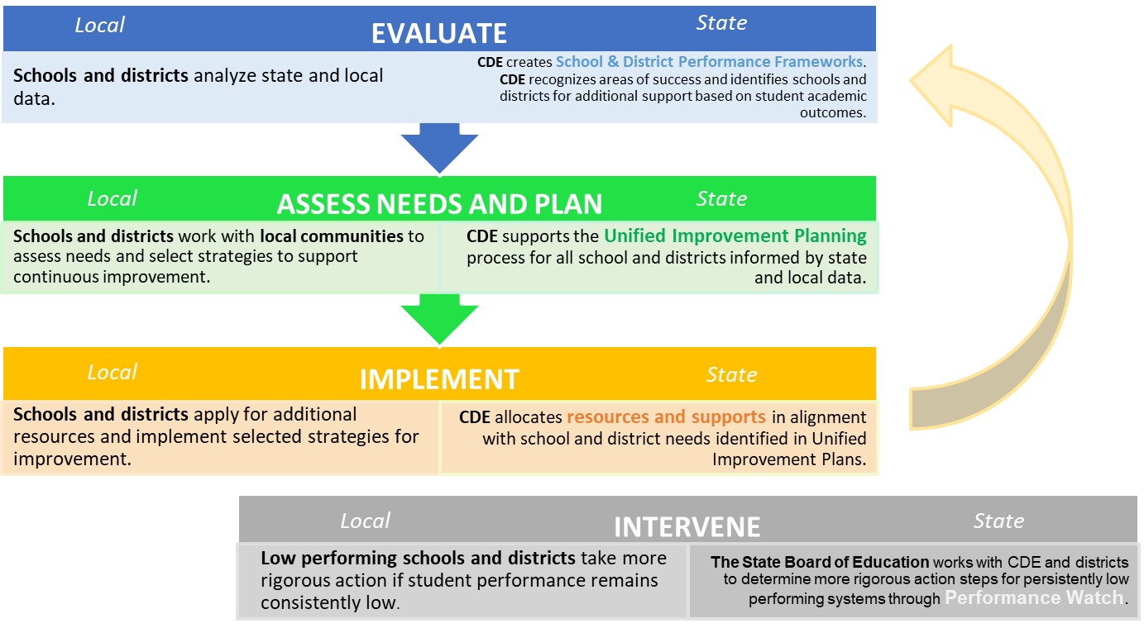
Accountability Theory of Action
Accreditation

Slide 27
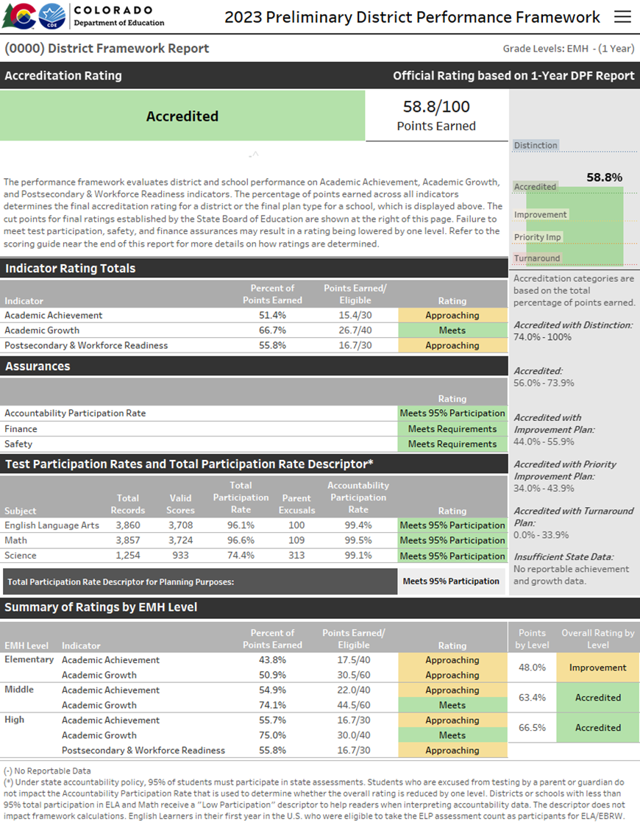
Performance Frameworks | Purpose
Provides a statewide evaluation of student performance that highlights areas of success and areas for improvement.
Identify those districts and schools whose students are lowest-performing based on academic achievement, growth and postsecondary workforce readiness data, and direct state support and intervention appropriately.
Identify those districts and schools whose students are the highest-performing based on academic achievement, growth and postsecondary and workforce readiness data, recognize them and learn from their practices.

Slide 28
Performance Frameworks | Performance Indicators
Performance Indicator | Performance Data
Academic Achievement | Mean Scale Score English Language Arts and Math Assessments Overall and for disaggregated groups
Academic Growth | Median Student Growth Percentile English language arts, mathematics and English language proficiency assessments English language proficiency On Track metric Overall and for disaggregated groups
Postsecondary and Workforce Readiness | SAT – Evidence-Based Reading & Writing and Mathematics Graduation Rate Dropout Rate Matriculation Rate (includes 2-year and 4-year Credential/Diploma or Enrollment, Career and Technical Education Enrollment, and Military Enlistment) Overall and for disaggregated groups (except for Matriculation rate)

Slide 29
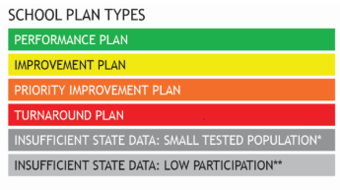
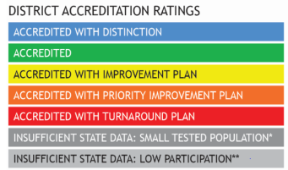
Performance Frameworks | Weightings and Ratings
Elementary & Middle Schools
Performance Indicator | Weight
Academic Achievement | 40% Elementary & Middle Schools 30% High Schools & Districts
Academic Growth | 60% Elementary & Middle Schools 40% High Schools & Districts
Postsecondary and Workforce Readiness | 30% High Schools & Districts
Ratings
High Schools & Districts

Slide 30
Agenda
Recap on Foundations of State Accountability
Activity: Jigsaw on Responses from September Meeting
Deeper Dive
  Growth Model
  On Track Growth
Setting Direction

Slide 31

Activity: Jigsaw on Responses from September Meeting
Refer to the CDE responses from the September meeting.
Read through your assigned section.
In your small group:
  Introduce yourselves
  Designate a note taker and a reporter
Discuss these questions:
  How can you summarize the responses for the whole group in 1 minute?
  What is one major takeaway and one area where the small group has remaining questions?
Share out with the whole group

Slide 32
Agenda
Recap on Foundations of State Accountability
Activity: Jigsaw on Responses from September Meeting
Deeper Dive
  Growth Model
  On Track Growth
Setting Direction

Slide 33

Why is student growth data important?
Shows how well schools are doing in helping each student progress.
  All students can show growth – even high performing students
  Less of a relationship to student characteristics outside the control of schools (e.g., poverty) than other measures (e.g., achievement, PWR).
Integral for accountability determinations.
    Growth indicator must be given the most weight in the frameworks
Growth data informs improvement planning within schools and districts.
Helps track student, school, district and state recovery from pandemic.
Notes:
So jumping in, why is student growth data important?

Slide 34
What is the Colorado Student Growth Model?
Developed by CDE and the National Center for the Improvement of Educational Assessment. First used n 2009.
Growth data shows how much progress individual students have made between last year and this year as measured by the CMAS and PSAT/SAT assessments in English language arts and math. Also, growth is calculated for WIDA-ACCESS based on the overall score.
Student Growth Percentiles are determined by how much students have progressed compared to their “academic peers.” It is a normative comparison of change.
Growth data can be summarized for specific groups of students, schools and by district.
Notes:
Growth scores, as they’re utilized in Colorado result from the Application of the Colorado growth model. The development of the model started in 2006 and it was first used to measure growth in 2009 Today it is being utilized in some fashion by nearly half of the states in the U.S. Some of the states include south Dakota, Wyoming, Nevada, Arizona, Georgia, Wisconsin, Oregon, Washington, etc.
The growth model, measures growth for every student regardless of where they start, comparing individual students to other who have the same score history. It includes metrics for students, groups of students, schools and districts.

Slide 35
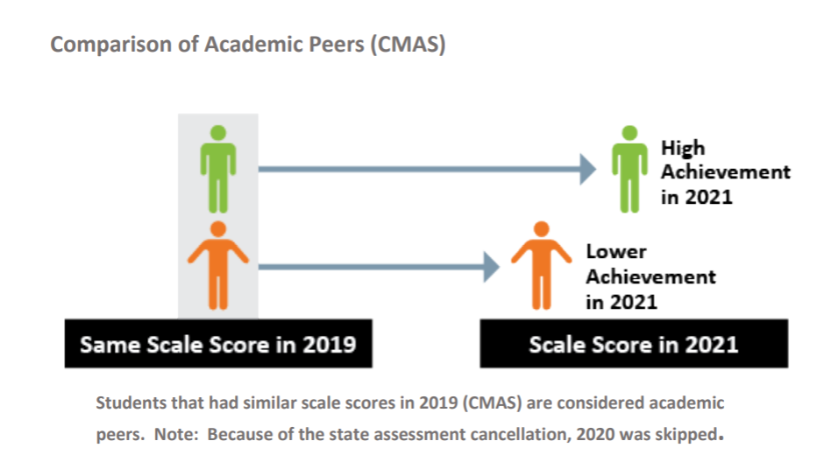
Big Ideas: Academic Peers
Higher Achievement in 2022
Lower Achievement in 2023
Same Scale Score in 2022
Scale Scores in 2023
Students that had similar scale scores in 2022 are considered academic peers in 2023. Other designations (e.g., IEP status, location) are not considered in designating academic peers.

Slide 36
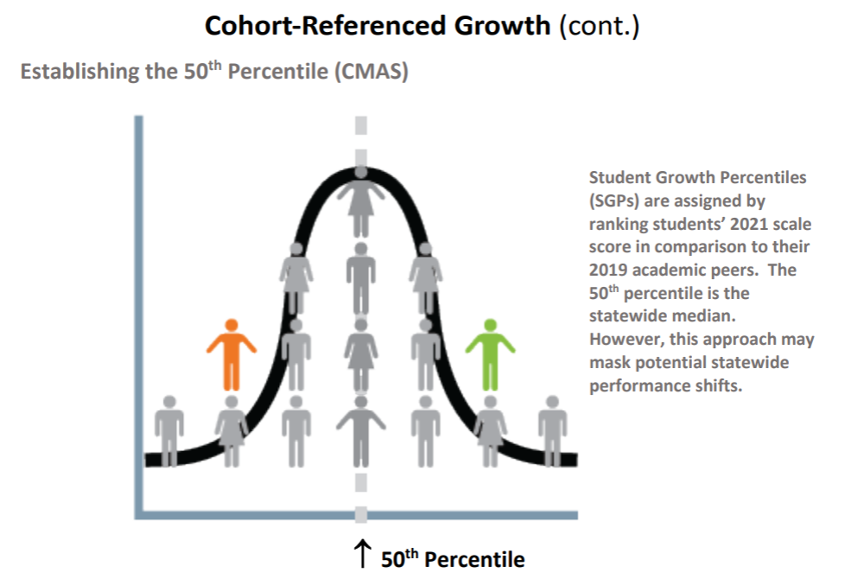
Big Ideas: 50th Percentile
Student Growth Percentiles (SGPs) are assigned by ranking students’ 2023 scale score in comparison to their 2022 academic peers. The 50th percentile is the statewide median.

Slide 37
Summary: Calculating Student Growth Percentiles (SGPs)
The student growth percentile (SGP) tells us how a student's current test score compares to those of other students across the state with similar score histories.
SGPs are calculated based on at least two sequential state assessment scores that follow a normal grade progression.
Current SGPs use scale scores from up to three prior years of assessment data (whenever possible).
Notes:
In Colorado, student growth percentiles are calculated for every student that has two consecutive years of valid scores on the state summative assessment (CMAS PARCC) or the ELL (WIDA-ACCESS) and now for PSAT9 to SAT11 assessment. The percentiles are calculated for Math and English Language Arts for CMAS PARCC, For ACCESS an overall growth percentile is calculated, and for SAT growth is calculated for EBRW and Math. The calculation methodology is rather complex.

Slide 38
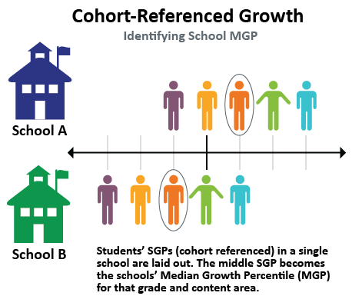
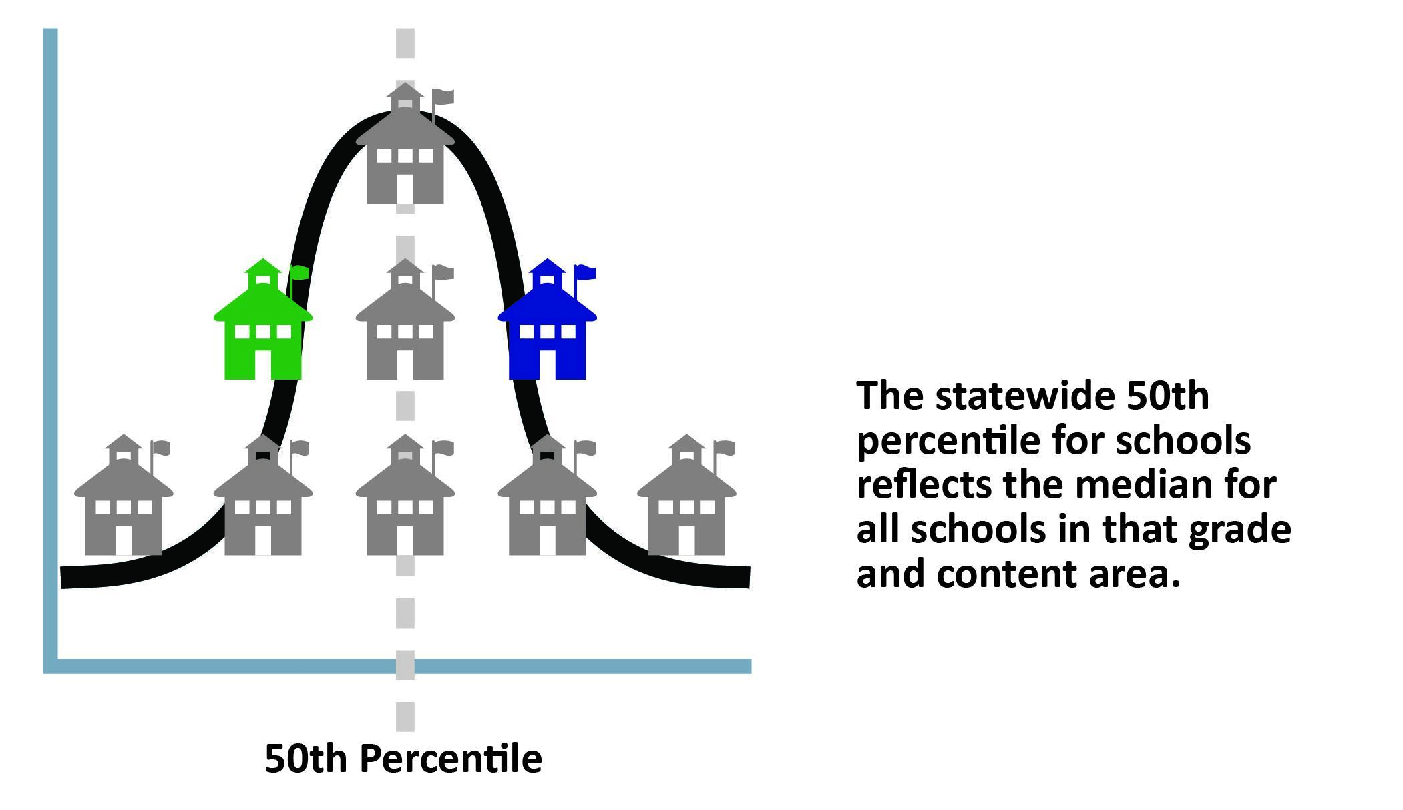
Big Ideas: 50th Percentile for Schools
Establishing the 50th Percentile

Slide 39
Summary: Calculating Median Growth Percentiles (MGPs)
The median student growth percentile (MGP) tells us how well a group of students is growing in comparison with other groups. The MGP tells us how much growth that a group as a whole is achieving.
  The metric provided is the “median” of the student growth percentiles for that disaggregated group – the median student growth percentile.
Median growth percentiles are aggregated by CDE for the following groups:
  State, district, and school (overall and by grade)
  Minority, Migrant, Performance Level, Gifted, FRL, IEP, Multilingual Learner, and Gender
Notes:
In addition to the Student growth percentile we can calculate median growth percentiles to represent different groups of students. The MGP helps us understand how a group of students are doing overall much like a average, however, the median is used as it better represents a group of students and is less impacted by extreme scores. If we are interested in disaggregated group growth, for example all ELL students), it would be calculated the same way as school growth except that only students in the disaggregated group are considered (e.g. English language learners). The metric that is provided is the “median” of the student growth percentiles for that group. So, for example, we would see the median student growth percentile for English Learners, or students on an IEP.

Slide 40
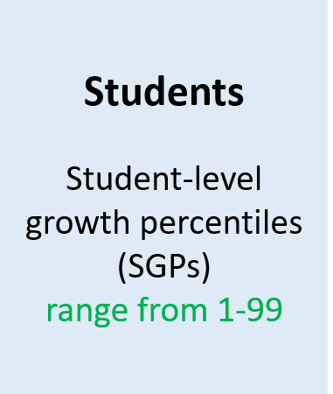
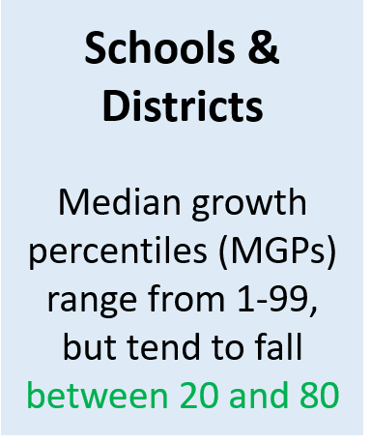
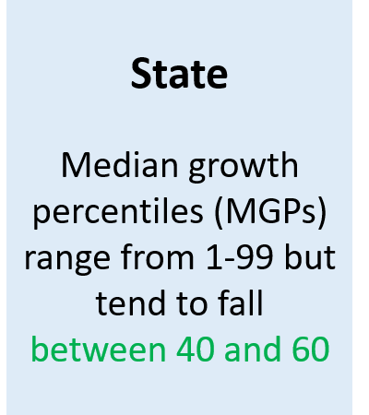
Summary: Growth Percentiles at Different Levels

Slide 41
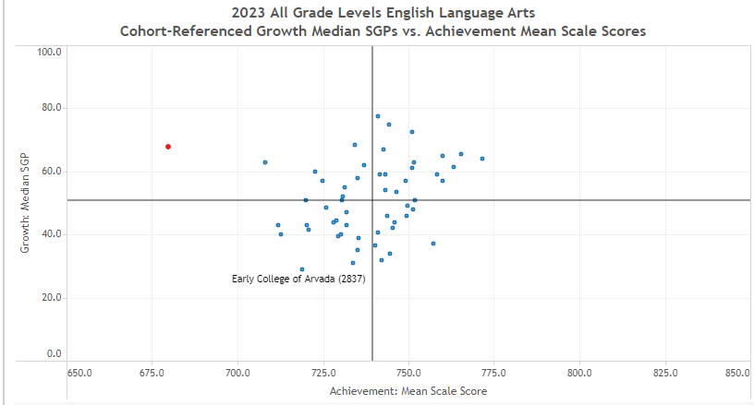
Big Ideas: Analyzing Growth
High growth can be an indicator of progress, but it may not be enough to help students catch up
Growth should always be considered in relation to achievement!
High Growth/ Low Ach
High Growth/ High Ach
Low Growth/ Low Ach
Low Growth/ High Ach
Problem of Practice: What if you are the school circled in red? You are at the 50th percentile! How much growth is needed to attain higher achievement?

Slide 42

Activity: Process with a Partner
Turn to a partner and process the basics on the growth model.
Can you explain why growth and achievement need to be considered together?
Jot down any remaining questions on a sticky note.

Slide 43
Agenda
Recap on Foundations of State Accountability
Activity: Jigsaw on Responses from September Meeting
Deeper Dive
  Growth Model
  On Track Growth
Setting Direction

Slide 44
Summary of Potential Changes within Performance Frameworks
Performance Framework Indicators | Summary of Changes | Elementary & Middle School | High School | District
Academic Achievement: Re-introduction of Science Achievement and Participation | New sub-indicator | ✔ | ✔ | ✔
Growth | No Changes | - | - | -
On Track Growth | New indicator | ✔ | More discussion needed | More discussion needed
PWR: Higher Bar for English Language Arts and Math | Add as a new sub-indicator within PWR | - | More discussion needed | More discussion needed
PWR: Higher Bar for Other Courses | Add as a new sub-indicator within PWR | - | More discussion needed | More discussion needed
PWR = Postsecondary & Workforce Readiness
AP = Advanced Placement
CE = Concurrent Enrollment
IB = International Baccalaureate
CCR = College and Career Readiness

Slide 45
On-Track Growth | Definition
Statutory Requirement
Required performance indicator for inclusion in annually-determined school and district rating calculations.
Student academic growth to standards, based on students progress toward meeting the state standards… or for students who meet grade-level expectations on the state standards, progress toward higher levels of achievement, if available, as measure by the statewide assessments. (22-11-204(1)(a)(III))
In Other Words…
The growth to standard or on-track growth metric needs to measure a student’s progress towards meeting a target level of performance within a given timeframe.
This metric needs to update/incorporate observed progress over time.

Slide 46
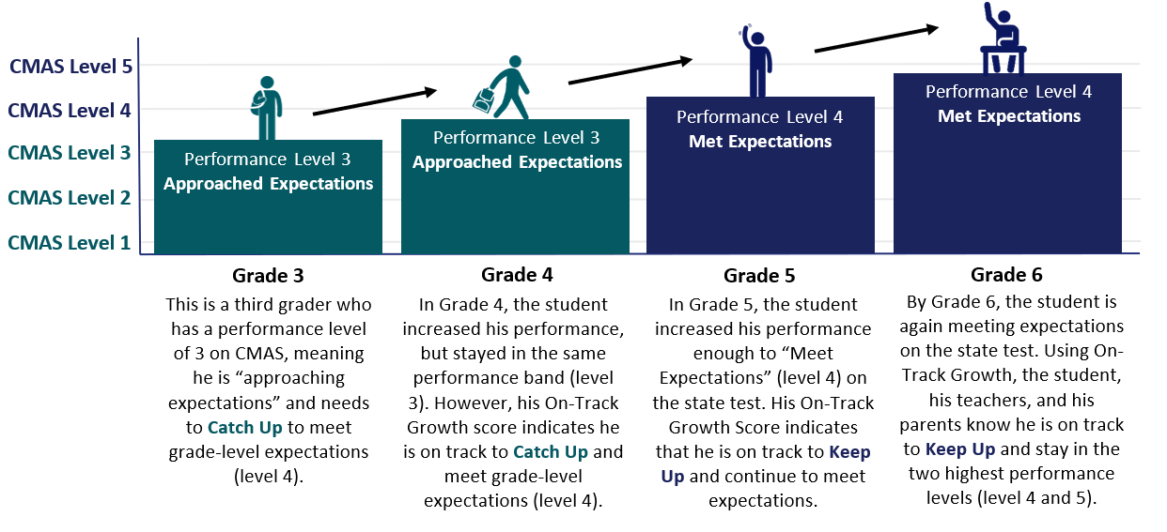
On-Track Growth | Student Example
Key Terms
    Catch Up: Students not yet meeting grade-level expectations, are expected to advance to the next performance level within two years
    Keep Up: Students meeting or exceeding grade-level expectations are expected to maintain grade-level performance over a three-year period.

Slide 47
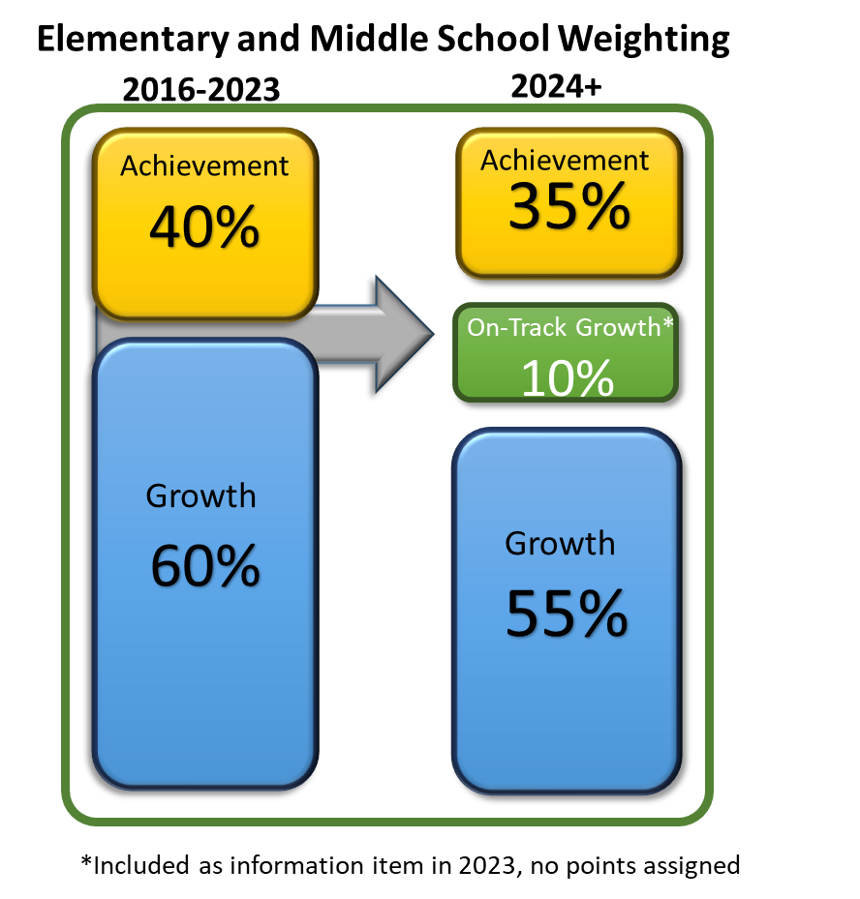
On Track Growth| Integration into Frameworks
Points Eligible for On-Track Growth will follow same approach Achievement and Growth metrics.
  All Disaggregated groups combined = ½ All Students group weight.
Sub-indicator cuts set at the 15th-50th-85th percentiles of All Students distributions.
English Language Proficiency (ELP) On-Track measures will stay in existing Growth Indicator.
State board approved revised indicator weightings for elementary & middle schools

Slide 48
On Track Growth| Impact Data on Plan Assignments for Elementary and Middle Schools
Current 2023 Prelim Rating | Rating with On Track Growth
 | Performance Plan | Improvement Plan | Priority Improvement | Turnaround Plan | Total
Performance Plan | 818 ⬄ | 9 ⇩ | 0 | 0 | 827
Improvement Plan | 4 ⇧ | 234 ⬄ | 5 ⇩ | 0 | 243
Priority Improvement Plan | 0 | 10 ⇧ | 98 ⬄ | 6 ⇩ | 114
Turnaround Plan | 0 | 0 | 2 ⇧ | 28 ⬄ | 30
Total | 822 | 253 | 105 | 34 | 1214
Takeaway: Minimal changes to school-level framework plan type assignments.
Note that counts include elementary, middle and EM schools (excludes schools serving high school grades).
English Language Proficiency On Track Growth remained in the Growth Performance Indicator.
Changes in Plan Type Assignment | Total
Same Assignment ⬄ | 1178 (97.0%)
Up 1 Level ⇧ | 16 (1.3%)
Down 1 Level ⇩ | 20 (1.6%)

Slide 49
On Track Growth| Outstanding Issues for High School
Differences in proficiency expectations and number of levels for CMAS v. PSAT
PSAT/SAT will be transitioning to a Computer Adaptive format in spring 2024
  According to College Board, scores on the digital PSAT/SAT will mean the same thing as the paper and pencil assessments
  On Track Growth uses score progressions across prior years to estimate how much growth a student would need to make in future years to reach a target level of proficiency
  Current high school On Track Growth estimates are based on paper and pencil score progressions and may not align with upcoming progression from paper to digital or future digital to digital progressions
  Would need two consecutive years of digital PSAT/SAT scores to ensure accuracy of progressions and On Track Growth calculations
Notes:
Hand over to lisa

Slide 50
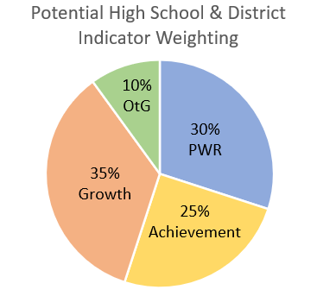
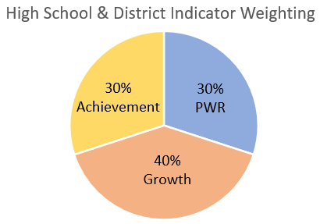
On Track Growth| Proposal for District Weighting
Follow weighting approach for elementary and middle school (i.e., 10% for OTG; 5% from achievement and 5% from growth).
English Language Proficiency On Track Growth would move into this new performance indicator.
Current

Slide 51
On Track Growth| Impact Data on Plan Assignments for Middle/High and Elementary/Middle/High Schools
Current 2023 Prelim Rating | Rating with On Track Growth
 | Performance Plan | Improvement Plan | Priority Improvement | Turnaround Plan | Total
Performance Plan | 27 ⬄ | 0 ⇩ | 0 | 0 | 27
Improvement Plan | 1 ⇧ | 71 ⬄ | 0 ⇩ | 0 | 72
Priority Improvement Plan | 0 | 0 ⇧ | 11 ⬄ | 0 ⇩ | 11
Turnaround Plan | 0 | 0 | 0 ⇧ | 2 ⬄ | 2
Total | 28 | 71 | 11 | 2 | 112
Takeaway: Minimal changes to school-level framework plan type assignments.
Note that counts include MH and EMH schools
English Language Proficiency On Track Growth remained in the Growth Performance Indicator.
Changes in Plan Type Assignment | Total
Same Assignment ⬄ | 111 (99.1%)
Up 1 Level ⇧ | 1 (0.9%)
Down 1 Level ⇩ | 0 (0.0%)

Slide 52
On Track Growth| Impact Data on Plan Assignments for Districts
Current 2023 Prelim Rating | Rating with On Track Growth
 | Distinction | Accredited | Improvement | Priority Improvement | Turnaround | Total
Accredited with Distinction | 13 ⬄ | 0 | 0 | 0 | 0 | 13
Accredited | 0 | 66 ⬄ | 2 ⇩ | 0 | 0 | 68
Acc. with Improvement | 0 | 0 | 47⬄ | 0 | 0 | 47
Acc. with Priority Improvement | 0 | 0 | 0 | 16 ⬄ | 0 | 16
Acc. with Turnaround | 0 | 0 | 0 | 0 | 1 ⬄ | 1
Total | 13 | 66 | 49 | 16 | 1 | 145
Takeaway: Very minimal changes to district-level framework rating assignments.
Note that districts with Insufficient State Data were not included.
English Language Proficiency On Track Growth remained in the Growth Performance Indicator.
Changes in Rating | Total
Same Assignment ⬄ | 143 (98.6%)
Up 1 Level ⇧ | 0 (0.0%)
Down 1 Level ⇩ | 2 (1.4%)

Slide 53
On Track Growth| Emerging Feedback from the Field
CDE has been gathering input from variety of stakeholder groups (e.g., Accountability Work Group, 7C’s, K-12 Advocacy Group) and will continue to gather input.
Early themes
Benefits | Concerns
Support for moving forward with informational reporting Agreement that it will be a helpful measure and provide new information to support students and school improvement | Agreement with TAP’s recommendations Desire to keep frameworks stable post-pandemic – and as 1241 Task Force works on recommendations Complex measure – educators need time to understand it before needing to explain it to communities

Slide 54
Activity: Process with a Partner
Turn to a partner and process the basics on the On Track Growth.
Discuss how this could be a helpful measure to better understand the relationship between growth and achievement.
Discuss any feedback you would like to provide to the state board as they consider adopting this measure into the frameworks or to at least share out for public reporting.
Jot down your feedback on a sticky note.

Slide 55
Agenda
Recap on Foundations of State Accountability
Activity: Jigsaw on Responses from September Meeting
Deeper Dive
  Growth Model
  On Track Growth
Setting Direction

Slide 56

Setting Direction
Help staff prepare for future meetings:
What additional deep dives would be helpful (e.g., accountability clock analyses, federal requirements)?
What additional questions or analysis would be beneficial to the whole task force?

Slide 57
Agenda
10:00 - 10:30 am | Welcome
10:30 - 10:45 | Review Norms
10:45 - 12:00 | Discussion & Activity
12:00 - 1:00 | Lunch & Small Group Activity
1:00 - 1:30 | Align with our Legislative Charge
1:30 - 2:00 | Review Roadmap
2:00 - 2:15 | Break
2:15 - 3:45 | CDE Accountability Follow-Up Presentation
3:45 - 4:00 pm | Wrap Up & Next Steps

Slide 58

Wrap Up & Next Steps
Review admin and feedback survey
  Questions for next meeting
  2024 meeting dates
1:1s with new facilitators
Next meeting

