Slide 1
Accountability Work Group: Discussion on Request to Reconsider
March 26, 2021

Slide 2
Request to Reconsider Subcommittee Overarching Questions for Recommendations
Does the benefit of participating in a request process warrant the effort required by schools, districts and the state?
How should the overall structure of the process operate?
What parameters should be included in student performance review (state and local data)?
What parameters should be included in the qualitative review (improvement plan, site visit)?

Slide 3
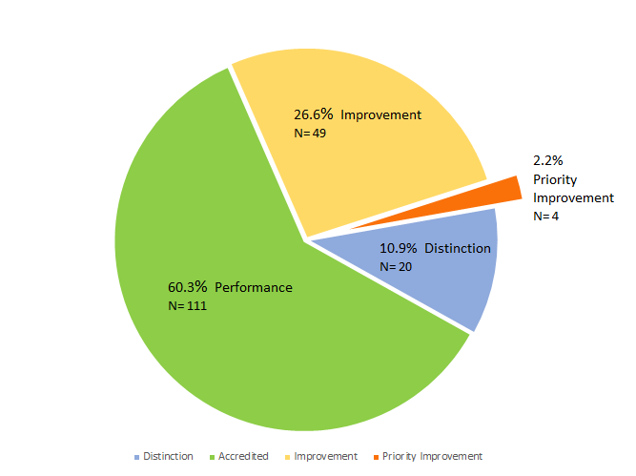
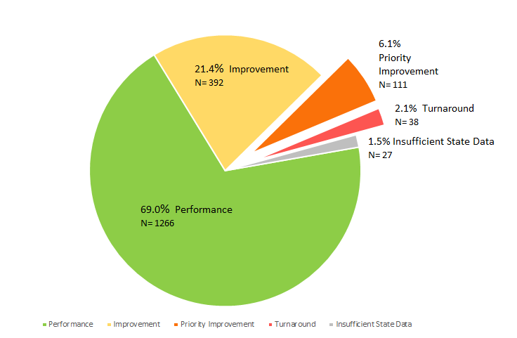
Districts and Schools on Performance Watch in 2020
Districts
Schools
 | Districts | Decreased Due to Participation | Schools | Decreased due to Participation
# on Clock (PI, Turnaround) | 4 |  | 149 (+2 ISD) across 49 dists | 13
Years 1-3 | 3 | 1 (Y1) | 131 (+1 ISD) | 12 (9 at Y1; 2 at Y2; 1 at Y3)
Years 4-5 | n/a |  | 13 (+1 ISD) | 1 at Y5
Years 6+ | 1 |  | 5
# on Watch (Imp, Performance) | 2 |  | 28
# with an SBE Order (inc Early Action and On Watch) | 2 |  | 9 | 1 (early action Y5)
Notes:
Of the 87 schools that were Y1 in 2020 (and 2019), 17 were on clock in 2017. For 42 of the schools Y1 in 2020 (and 2019), this is the first time ever they’ve been on the clock (1 is on hold because of ISD; PI in 2018 in first year of operation).

Slide 4
Accountability Clock Process
Level of State Intervention
Year 1
Year 4
Year 5
And Beyond
Local Accountability and Transparency
Improvement Planning and Review
Grants and Supports
State Review Panel
State Board Hearing and Order
Ongoing Progress Monitoring

Slide 5
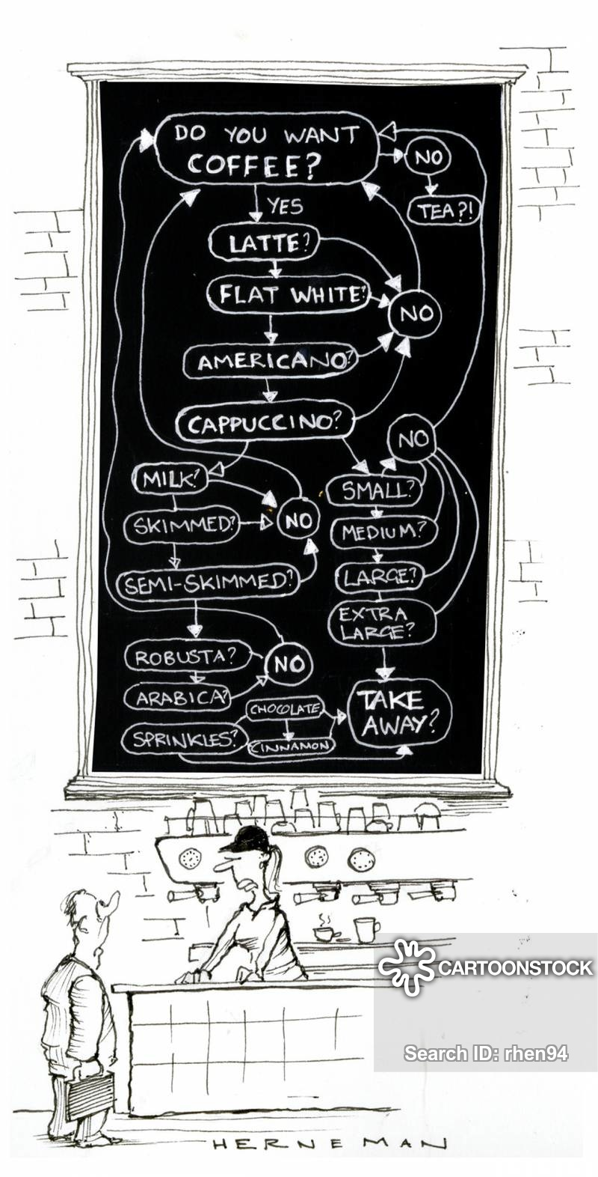
Setting the Stage
A lot is at play on the policy front (e.g., state legislature, state board)
As a thought exercise: What if statute is passed for a year 2 accountability pause that allows for a request to reconsider process?
No decisions have been made. CDE is only gathering input from the field.
Potential parameters for an adjusted R2R:
High bar based upon compelling evidence
Balance with current messages of learning loss due to COVID
Cannot fully exit schools/districts from Performance Watch without a performance framework
Keep improvement work and support moving forward
Relax and put on your thinking cap. This is complicated stuff.

Slide 6
Request to Reconsider Scenarios
With a Year 2 Pause
Scenario (Rating as of 2020-21) | 2021-22 (Approved R2R) | 2022-23 (Frameworks resume) | 2023-24
PI – Y3 | Improvement Y3 | Improvement On Watch Y3 | Improvement (exit performance watch)
With a Year 3 Pause (if that were to happen)
Scenario (Rating as of 2020-21) | 2021-22 (Approved R2R) | 2022-23 (Year 3 Pause) | 2023-24 (Frameworks resume) | 2023-24
PI – Y3 | Improvement Y3 | Improvement Y3 | Improvement On Watch Y3 | Improvement (exit performance watch)

Slide 7
Possible Path for Accountability Adjustments During Accountability Pause Year 2 (2021-22)
DRAFT – For Discussion Only
}
Request to Reconsider
Technical fixes only and non-performance related adjustments
Performance
Improvement
Accountability Clock
Stage 1: Quantitative Data Review of State and/or Local Data. See Data Filter Decision Tree: https://docs.google.com/document/d/1yClDnsSpWxbqBSQ0t4xskUqjJdWa7aPOcjUJE2_hKtU/edit
Stage 2: Use an adjusted body of evidence:
Strong plan: Approved UIP with strong research-based strategies
AND
Solid implementation: Documented through an external review (State Review Panel)
Priority Improvement
}
Turnaround

Slide 8
Adjusted R2R Review Process
DRAFT – For Discussion Only
Stage 1: Quantitative Data Review (State and Local Data)
Participation thresholds
No locally developed assessments
What are appropriate thresholds? Disaggregated groups?
What if participation is not great? What if its COVID related?
Analysis
Nationally normed vendor assessments.
Use a detailed template
How good is good enough?
Stage 2: Qualitative Data Review (UIP and Site Visit)
Detailed review of UIP
Looking for an approvable plan with strong research based strategies and action plan
Place for non-assessment data
Site Visit
May use State Review Panel -- Need to balance with 10 progress monitoring visits
Need to alter protocols and process (e.g., length, number of visitors)
What evidence is needed?
Timeline?

Slide 9
School Improvement Support
Approach to EASI during 21-22 school year
Feedback from the field

Slide 10
Context
With the passage of HB21-1161, Colorado will experience another accountability pause in 21-22.
As a result, no schools will be added to the eligibility list for CDE’s School Improvement Support and Funding through the EASI grant process
Given that context, CDE is interested in gathering field input on how to approach EASI in the coming year.
In addition, CDE has the opportunity to allocate stimulus funds to support identified schools. We would appreciate field input on how best to allocate those funds.

Slide 11
Options for EASI Timeline
EASI is the process through which schools opt into CDE supports (e.g. Turnaround Leadership, Turnaround Network, Diagnostic Reviews) and how school improvement funding is allocated
Maintain the timeline/flow of EASI (open in Sept, due in Dec.) or adjust the timing?
If we change the application window, what timing would be most supportive?
Thoughts & Reflections?

Slide 12
Options for use of stimulus funds aligned to EASI
Because of the accountability pause, no new schools will be eligible for EASI (and current schools will remain eligible even with R2R with a few exceptions)
Option 1: Open eligibility for support programs to non-EASI schools. These schools would not be eligible for funding, but could gain access to support.
Option 2: Allocate some ESSER funding to EASI without expanding eligibility list. ESSER funding could enable CDE to serve more schools who apply.
Option 3: Allocate some ESSER funding to EASI and expand eligibility.
Thoughts/Reflections?

Slide 13
CDE’s current ‘menu’ of support
Currently EASI has four ‘routes’ of support that allow for districts to match school needs with various levels of support from CDE. These include: Exploration, CDE Offered Services, District-Designed and Led, and Piloted Services.
Looking ahead to next year, what types of support or resources would be helpful from CDE?

Slide 14
CDE Supports, continued
Would it be helpful to have diagnostic review from CDE staff or external partners? What areas of focus would be helpful for a diagnostic review?
Would progress monitoring visits from CDE or external partners be helpful?
Would districts be interested in partnering with organizations that have expertise in school design/strategic planning in areas such as scheduling, staffing, and curriculum?
Would you support allocating funds to schools that should be ending supports but are in limbo with the accountability pause (e.g. a Year 3 school finishing UVA but not able to exit performance watch).
What might we be missing?

Slide 15
Quick survey
We’ve created a quick feedback survey that captures some of these questions. Please complete it or let us know who else we could forward it to who may want to weigh in on these questions.
Feedback Survey
Thank you for all of your help and feedback! We appreciate it!

