Slide 1
Accountability Working Group (AWG)
May 21, 2021

Slide 2
Plans for Today
Purpose: Updates and Report out on Subcommittee Progress
Time: | Content
1030AM | Welcome
1035 - 1045 | Accountability Updates
1045 - 1055 | Subcommittee Report: Comprehensive Support
1055 -1105 | Subcommittee Report: SQSS
1105 - 1115 | Subcommittee Report: Request to Reconsider
1115-1135 | AWG Breakout Groups
1135-1155 | Debrief and Recommendations for Next Year
1155-12 | End of Whole Group R2R Subcommittee Begins

Slide 3
Welcome

Slide 4
Purpose of AWG
The Accountability Work Group (AWG) serves as a policy advisory group to explore ideas in support of federal and state accountability policies (e.g., Every Student Succeeds Act implementation, state accountability during the pause year) and make recommendations to the state. This group will consider input from other stakeholders, when available and appropriate, in developing recommendations.
It was first convened by the Commissioner of Education in 2014 to gather input on improving the state accountability performance framework reports. In 2016, the focus shifted to serving as the ESSA Accountability Spoke. It is now time to repurpose the group back to providing input on all accountability matters (both state and federal).

Slide 5
Accountability and Improvement

Slide 6
Accountability Updates
Assessment Waiver: CDE received approval on March 26, 2021.
Federal Accountability Waiver: CDE received approval from USDE on April 21, 2021.
State Accountability Pause Y2: HB 21-1161 passed, pausing the state accountability for a second year (2021-22). The state may offer a request to reconsider process for schools and districts on the accountability clock.

Slide 7
Subcommittee Updates

Slide 8
CS Subcommittee Recommendations
Reminder:
•for CS-lowest 5%
•Schools identified for PI or TA and on state accountability clock - defer to state accountability pathway (no additional federal action steps)
•Supported by the full AWG
•Taking to CoP on June 1st
Other Recommendations: General
Actions should
Be aligned with reasons for identification (i.e., CS-lowest %, low graduation rate, student group)
Be aligned with and build upon improvement efforts already being implemented or having recently been implemented
Be co-developed between school, district, and CDE
Include a menu of options for the school and district to choose from
Be supportive of the school to help meet exit criteria; not just be punitive

Slide 9
CS Subcommittee Recommendations - Menu of Options ~ Based on a Decision Tree
A diagnostic review by an external entity within the past 2 years (similar to the State Review Panel) and requirement to include results in the CS improvement plan (UIP)
Co-development of CS improvement plan (UIP) with a CDE representative (e.g., Support Coordinator, UIP Team) or an external partner (e.g., vendor, a higher performing school/district)
MTSS training and leadership coaching for effective implementation of MTSS and grade level teaming structures
Progress monitoring training to ensure that the school's improvement strategies are implemented with fidelity and making adjustments to the strategies when desired outcomes are not being achieved
For high schools identified as CS-low grad rate, training on metrics that measure and identify when students are not on track for graduation
For high schools identified as CS-low grad rate, training and coaching on systemic practices or actions that help keep students on track for graduation (e.g., remediation, credit recovery)
For high schools identified as CS-low grad rate, training and coaching on progress monitoring student performance to ensure students are on-track for graduation
For Alternative Education Campuses (AECs), participating in learning cohorts with other AECs to share practices and collaborate on common challenges
For AEC, a diagnostic review designed specifically for AECs and support on developing. using, and progress monitoring an implementation plan
For AECs, trainings developed by CDE for addressing the unique needs of AECs

Slide 10
Please Cast Your Votes!
Please complete the survey to provide your input on these recommendations before they are presented to the Committee of Practitioners on June 1st as the final set of recommendations from the AWG.
Survey should take less than 30 minutes to complete!
Due by Friday, May 28, 2021 at midnight!
Thank you for your input and collaboration!!

Slide 11
SQSS Subcommittee Input
Subcommittee reviewed crosswalk of potential measures for SQSS Indicator and discussed pros/cons and considerations for each
Subcommittee members were asked to select their top 5 measures; the following 12 measures received at least one vote (bold indicates more than one vote):
Student, educator, or parent ratings of school climate or safety
Chronic absenteeism (current short-term measure)
Teacher engagement as measured by teacher attendance, attrition, retention, and/or mobility
Quality of instruction as measured by students taught by novice or out-of-field teachers
Quality of instruction as measured by availability of programs to support and mentor new teachers
Elementary/middle school readiness
Postsecondary readiness as measured by performance on college admissions or placement exams
Postsecondary readiness as measured by attainment of an industry credential/certification and/or completion of a CTE program of study
Postsecondary readiness as measured by dropout rates (current short-term measure)
Measures of social emotional learning and persistence
Science achievement (current short-term measure)
Student growth to standard

Slide 12
SQSS Subcommittee Input, Cont.
Measures not selected by subcommittee members:
School climate and safety as measured by school discipline
Student access to postsecondary resources/preparation as measured by student access to dual enrollment / advanced coursework or student access to effective career guidance and counseling
Student engagement as measured by student participation in electives, athletics, extracurricular, and/or after-school activities
Other measures of student engagement
Teacher engagement as measured by student reports and/or leadership ratings/observations
Parent engagement as measured by attendance at school events or volunteering/serving on a committee
Quality of instruction as measured by student surveys of teaching quality or teacher participation in professional development
Postsecondary readiness as measured by college credits earned, 9th/10th grade credit earning, or matriculation rates

Slide 13
AWG Input Needed
Review the crosswalk of potential measures for the SQSS Indicator, compiled with input from the SQSS Subcommittee
Use the Google Form to:
Based on the measures selected by the SQSS Subcommittee, select the top 3 measures you would like considered for the long-term plans for Colorado’s SQSS Indicator
Indicate whether you support CDE’s proposal to exclude the measures not selected by the SQSS Subcommittee from Colorado’s long-term plans for the SQSS Indicator
If you are not in support of this decision, please indicate which measure(s) you would like included and why

Slide 14
Amended Request to Reconsider Process for 2021-22
From HB 21-1161
Only available to schools and districts on the accountability clock (Priority Improvement, Turnaround). AECs are included.
Plan types may be adjusted, but not years on the clock. Two consecutive years at Improvement or higher are still needed to fully exit.
An alternative body of evidence may include state and local assessments and input from the State Review Panel.
State board may promulgate rules to determine time frame and process.
Scenario:
2019 SPF (Rating as of 2020-21) | 2021-22 (Approved R2R) | 2022-23 (Frameworks Resume) | 2023-24
Priority Improvement Y3 | Improvement Y3 | Improvement On Watch Y3 | Improvement (Exit performance watch)

Slide 15
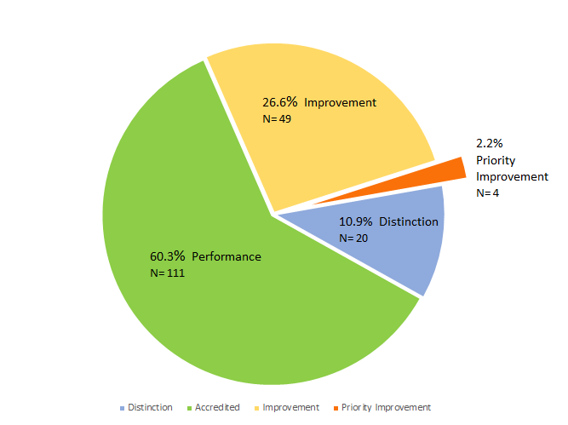
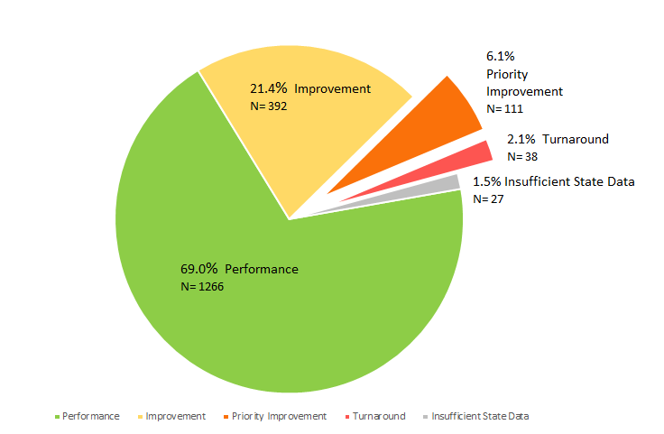
Districts and Schools on Performance Watch in 2020
Districts
Schools
 | Districts | Schools
# on Clock (PI, Turnaround) | 4 | 149 (+2 ISD) across 45 dists
Years 1-3 | 3 | 131 (+1 ISD)
Years 4-5 | n/a | 13 (+1 ISD)
Years 6+ | 1 | 5
# on Watch (Imp, Performance) | 2 | 28
# with an SBE Order (inc Early Action and On Watch) | 2 | 12
* ISD = Insufficient State Data

Slide 16
DRAFT Timeline for Request to Reconsider Process
DRAFT – For Discussion Only
Spring 2021: Stakeholder Feedback (AWG)
Aug 2021: Launch R2R and Technical Assistance
Jan 2022: CDE updates public reporting of 2021 plan types
June-Aug 2021: SBE Rule Process
Dec 2021: SBE votes on final recommendations

Slide 17
DRAFT Request to Reconsider Structure in 2021-22
DRAFT – For Discussion Only
}
Request to Reconsider
Not eligible
Performance
Improvement
Accountability Clock
Stage 1: Quantitative Data Review of State and Local Data.
Priority Improvement
}
Turnaround
Stage 2: Use an adjusted body of evidence:
Strong Plan: Approved UIP with strong research-based strategies
AND
Solid Implementation: Documented through an external review (State Review Panel)

Slide 18
Flow Map of Proposed Request to Reconsider Process for 2021-22
DRAFT – For Discussion Only
State Assessment
Local Assessment
Results meet 2019 targets
Results inconclusive
Results meet expectations
Results inconclusive
Qualitative Review
UIP meets expectations
UIP not meeting expectations– asked to revise
Recommend New Plan Type
Site Visit demonstrates strong implementation
Site Visit does not demonstrate strong implementation

Slide 19
DRAFT Recommendation Capture from AWG to Date
The Accountability Working Group (AWG) consists of regional superintendent representatives, school and district leadership, charter school leadership, CASE, CASB, CEA leaders, advocacy and civil rights group members and parents. The AWG has served as a policy advisory group to research and explore ideas in support of federal and state accountability policies and decision points and to collect input from additional stakeholders in developing recommendations.
Highlights to date:
Proposed process worth the effort for districts/schools showing significant improvements
Staged process (i.e., quantitative review, then qualitative review)
Participation representativeness and data appropriateness to draw inferences of performance
Local assessments nationally normed with validity/reliability evidence
Approximations of performance relative to past state expectations
Qualitative review should include review of the UIP and then a site visit.
The State Review Panel protocols should be amended to fit this process. The name should be changed to avoid confusion.
An analysis of non-assessment data may be submitted, but not required.
Build in school improvement supports wherever possible.
DRAFT – For Discussion Only

Slide 20
DRAFT - Small Group Discussion
In a small group, discuss the following questions:
What connections do you see between the various processes being proposed? In what ways do the processes fit well and do you see any gaps?
2) Are there any connections that should be considered across proposals that might impact districts?
We will have 6 minutes to discuss.

Slide 21
Logistics

Slide 22
Next Steps
CS Subcommittee and SQSS recommendations going to CoP, then being drafted for the ESSA State Plan and opened for public comment over the summer. We will resume work with AWG in early fall to prepare for submitting the revisions to the ESSA State Plan in October, 2021.
Next Year!
We would like to invite you to continue to serve on the AWG in 2021-2022. If you are interested in continuing to serve on the AWG, please resubmit the application by July 31, 2021. If you would like to resign after this year, please email Nazie Mohajeri-Nelson or Lisa Medler to let us know.

Slide 23
State Accountability Contacts
Accountability and Continuous Improvement Unit | Position | E-mail
Lisa Medler | Executive Director, ACI Unit | medler_l@cde.state.co.us
Marie Huchton | Supervisor, Accountability Analytics | huchton_m@cde.state.co.us
Erin Loften | Co-Lead, School Improvement and Planning | loften_e@cde.state.co.us
Susan Barrett | Co-Lead, School Improvement and Planning | barrett_s@cde.state.co.us
School and District Transformation Unit | Position | E-mail
Lindsey Jaeckel | Executive Director, SDT Unit | jaeckel_l@cde.state.co.us

Slide 24
Federal Accountability ~ ESEA Office: Data, Accountability, Reporting & Evaluation Team
ESEA Office | Position | Phone | E-mail
Nazie Mohajeri-Nelson | Director of ESEA Office | 303-866-6205 | Mohajeri-nelson_n@cde.state.co.us
DeLilah Collins | Assistant Director of ESEA Office | 303-866-6850 | Collins_d@cde.state.co.us
Emily Owen | Program Support | 303.866.6700 | Owen_e@cde.state.co.us
Marissa Gonzales | Program Support | 303-866-6963 | Gonzales_m@cde.state.co.us
DARE Team | Expertise | Phone | Email
Tina Negley | ESSA Accountability, Program Evaluation, and Reporting | 303-866-5243 | negley_t@cde.state.co.us
Alan Shimmin | ESSA Reporting and Data Collections | 303-866-6209 | shimmin_a@cde.state.co.us
Mary Shen | ESSA Program Evaluation, Research, and Accountability | 303-866-4571 | shen_m@cde.state.co.us

Slide 25
Thank you!
Have a Great Summer!

