Slide 1
Accountability Working Group (AWG)
March 26, 2021

Slide 2
Plans for Today
Purpose: Updates and Report out on Subcommittee Progress
Time: | Content
1030AM | Welcome
1035 - 1045 | General Accountability Updates (Federal Accountability Waiver, SB 21-1161)
1045 - 1055 | Subcommittee Report: Comprehensive Support
1055 -1105 | Subcommittee Report: SQSS
1105 - 1115 | Subcommittee Report: Request to Reconsider
1115 | End of Whole Group R2R Subcommittee Begins

Slide 3
Welcome
Notes:
Presenter: Everyone

Slide 4
Purpose of AWG
The Accountability Work Group (AWG) serves as a policy advisory group to explore ideas in support of federal and state accountability policies (e.g., Every Student Succeeds Act implementation, state accountability during the pause year) and make recommendations to the state. This group will consider input from other stakeholders, when available and appropriate, in developing recommendations.
It was first convened by the Commissioner of Education in 2014 to gather input on improving the state accountability performance framework reports. In 2016, the focus shifted to serving as the ESSA Accountability Spoke. It is now time to repurpose the group back to providing input on all accountability matters (both state and federal).
Notes:
Nazie -
history

Slide 5
Accountability and Improvement
Notes:
Nazie

Slide 6
Accountability Updates
Assessment Waiver: CDE submitted to USDE on March 17 -- No response yet
Federal Accountability Waiver: CDE has released a draft and is collecting feedback by March 31
State Accountability Pause Y2: HB 21-1161 passed, pausing the state accountability for a second year (2021-22). The state may offer a request to reconsider process for schools and districts on the accountability clock.

Slide 7
Subcommittee Updates
Notes:
Nazie - 15 minutes [10:00 - 10:15]

Slide 8
Placeholder for CS Update
Review
CS Identification trends and types of schools impacted
Previous stakeholder input
Recommendations for CS-lowest 5%
Schools identified for PI or TA and on state accountability clock - defer to state accountability pathway (no additional federal action steps)
Remaining Decisions
Recommendations for
CS-lowest 5% - not on state accountability clock
CS-low grad rate
Brainstormed potential options
Next steps
CDE to synthesize and organize brainstormed ideas
Subcommittee to develop pros/cons of each
Bring to larger group for consideration

Slide 9
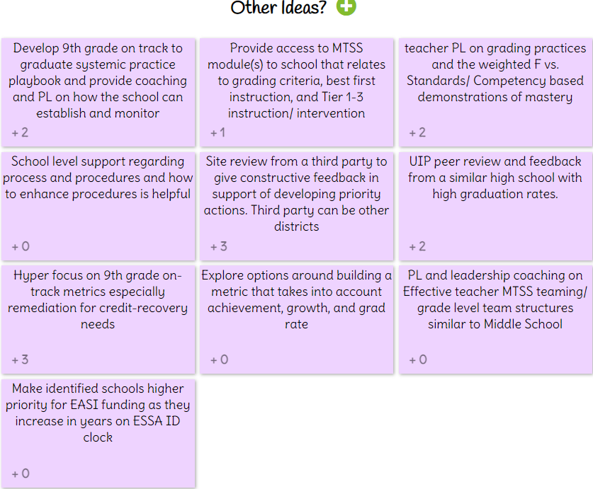
Input from CS Subcommittee via IdeaBoardz

Slide 10
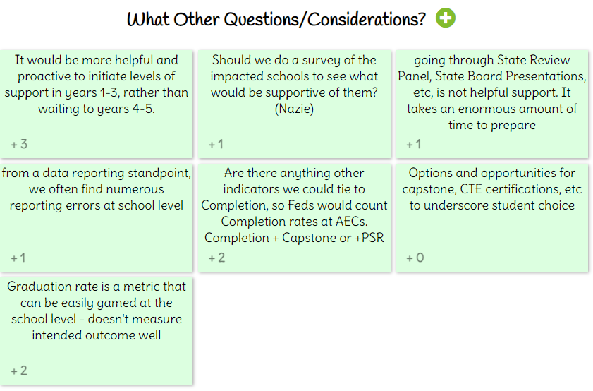
Input from CS Subcommittee via IdeaBoardz

Slide 11
SQSS Subcommittee Update
Review
ESSA Requirements and implementation of SQSS Indicator
Research on chronic absenteeism
Measures currently collected by CDE
Input requested
Should Colorado keep its approved short-term measures?
Concerns with chronic absenteeism
Impacts of remote and hybrid learning
Excused vs. unexcused absences
Science achievement
Additional achievement measure
Importance of STEM
Should Colorado consider any additional measures?
Climate and culture data
Next steps
Creating table of potential measures with pros/cons of each

Slide 12
AWG Subcommittee: Request to Reconsider Subcommittee
Focus on HB 21-1161
Accountability pause for 2021-22 with possibility to offer request to reconsider for schools and districts on clock to adjust plan type, but not years
Defined the eligible schools (149) and districts (4)
Discussed designing a process that
Is still rigorous and fair
Uses representative and reliable state and local data as the first filter, if available
Offers a qualitative review (e.g., UIP review, research-based strategies, site visits)
Future Discussion
Defining the overall process
Defining parameters for a data review (state and local data)
Defining parameters for a qualitative review (improvement plan, site visits)

Slide 13
Logistics
Notes:
Nazie

Slide 14
Next Steps
Next Meetings
April 9 for Small Groups (1030-noon; noon-130)
April 23 for Large Group (1030-1130) with follow up for the R2R subcommittee
Homework
If you haven’t already completed the Application Form, go to: https://www.surveymonkey.com/r/33RVX7X

Slide 15
State Accountability Contacts
Accountability and Continuous Improvement Unit | Position | E-mail
Lisa Medler | Executive Director, ACI Unit | medler_l@cde.state.co.us
Marie Huchton | Supervisor, Accountability Analytics | huchton_m@cde.state.co.us
Erin Loften | Co-Lead, School Improvement and Planning | loften_e@cde.state.co.us
Susan Barrett | Co-Lead, School Improvement and Planning | barrett_s@cde.state.co.us
School and District Transformation Unit | Position | E-mail
Lindsey Jaeckel | Executive Director, SDT Unit | jaeckel_l@cde.state.co.us
Julie Woods | Accountability Specialist | woods_julie@cde.state.co.us

Slide 16
Federal Accountability ~ ESEA Office: Data, Accountability, Reporting & Evaluation Team
ESEA Office | Position | Phone | E-mail
Nazie Mohajeri-Nelson | Director of ESEA Office | 303-866-6205 | Mohajeri-nelson_n@cde.state.co.us
DeLilah Collins | Assistant Director of ESEA Office | 303-866-6850 | Collins_d@cde.state.co.us
Emily Owen | Program Support | 303.866.6700 | Owen_e@cde.state.co.us
Marissa Gonzales | Program Support | 303-866-6963 | Gonzales_m@cde.state.co.us
DARE Team | Expertise | Phone | Email
Tina Negley | ESSA Accountability, Program Evaluation, and Reporting | 303-866-5243 | negley_t@cde.state.co.us
Alan Shimmin | ESSA Reporting and Data Collections | 303-866-6209 | shimmin_a@cde.state.co.us
Mary Shen | ESSA Program Evaluation, Research, and Accountability | 303-866-4571 | shen_m@cde.state.co.us

Slide 17
Thank you!
R2R Subcommittee remain in this room. We’ve got work to do. :)
Notes:
Lisa - 1 hour [10:15 - 11:15]

