Slide 1
Accountability Working Group (AWG) CS Subcommittee
May 7, 2021

Slide 2
Plans for Today
Purpose: Develop Recommendations to the Full AWG Group
Time: | Content
12:00 - 12:10 | Welcome
12:10 – 12:30 | Review Synthesis and Pros/Cons
12:30 - 1:00 | Overview of Options for AECs [Special Guests]
1:00 – 1:20 | Final Input and Recommendations
1:20 - 1:30 | Wrap-Up and Next Steps

Slide 3
Introductions: Name and Organization

Slide 4
Purpose of AWG
The Accountability Work Group (AWG) serves as a policy advisory group to explore ideas in support of federal and state accountability policies (e.g., Every Student Succeeds Act implementation, state accountability during the pause year) and make recommendations to the state. This group will consider input from other stakeholders, when available and appropriate, in developing recommendations.
It was first convened by the Commissioner of Education in 2014 to gather input on improving the state accountability performance framework reports. In 2016, the focus shifted to serving as the ESSA Accountability Spoke. It is now time to repurpose the group back to providing input on all accountability matters (both state and federal).

Slide 5
Accountability and Improvement

Slide 6
Subcommittee Continuing Work

Slide 7
When We Last Met…
Recommendations for CS-lowest 5%
Schools identified for PI or TA and on state accountability clock - defer to state accountability pathway (no additional federal action steps)
Supported by the full AWG
Taking to CoP next
Remaining Decisions
Recommendations for
CS-lowest 5% - not on state accountability clock
CS-low grad rate
Brainstormed potential options
Next steps
CDE to synthesize and organize brainstormed ideas
Subcommittee to develop pros/cons of each
Bring to larger group for consideration

Slide 8
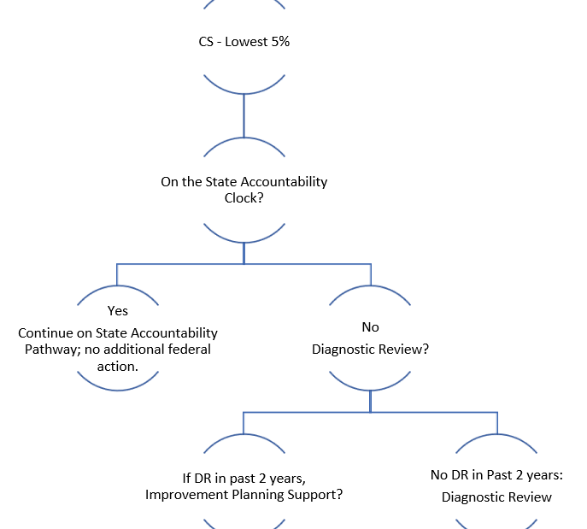
Next Steps for Traditional Schools
Take vote at full AWG meeting
Develop a decision tree
Take to CoP
Develop a written plan
Collect public comment
In the fall
Bring back revised plan to AWG members
Take final recommendations back to CoP

Slide 9
AEC Options Johann Liljengren, B Sanders, Renee Martinez, and Rachel Matson

Slide 10
Potential connections to CS Low Grad - More rigorous Action
Early Support Options
Support/training for specific practices | Diagnostic Review | Peer feedback | Funding support
Year 4 requirement options
State Review Panel | Diagnostic Review | Peer feedback | Optional measures support

Slide 11
Background
About 1 in every 12 high school students in CO attend an AEC school.
Impacting our state graduation rate (now above 80%), reducing our dropout rate (down to just over 2%), and addressing disparities
AECs have higher percentages of students of color, Free/ Reduced Lunch, disabilities, ELL
89% (81 of 91) of AECs were identified in the 2019 year by our accountability system
Notes:
51 CS low grad (AECs), including 30 identified for the 3rd year in a row
12 (AECs) and 6 (onlines) receiving a rating of Priority Improvement or Turnaround or On Watch

Slide 12
Overall Rationale
There is still a high level of need
Other potential areas of need
Statewide, there was a drop in enrollment and many AECs are operating at low capacity.
We have seen more AECs apply to EASI each year
Over the last 3 years, 40 AECs have been awarded funding

Slide 13
EASI application
Over the last 3 years, 40 AECs have been awarded funding through EASI
 | 17-18 | 18-19 | 19-20 | 20-21
District Designed and Led | 3 | 5 | 1
School Turnaround Leaders |  | 2
Diagnostic Review |  | 1 | 6 | 1
AEC Diagnostic Review |  | 4 | 5 | 5
Connect for Success |  | 1 | 1 | 5?

Slide 14
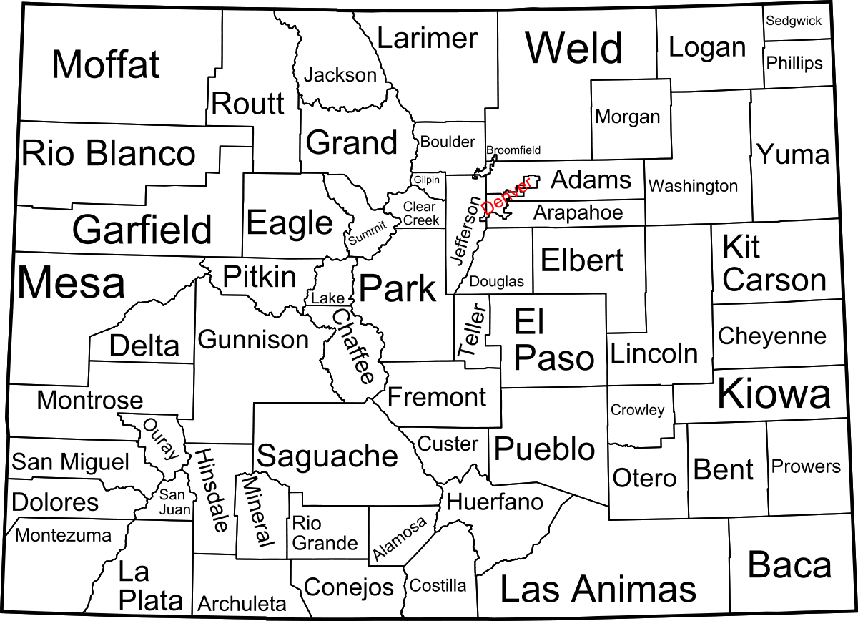
CDE supports for AECs and Online Schools
2018-2019 School Year
2019-2020 School Year
2020-2021 School Year
Diagnostic Review
5 schools participated
Diagnostic Review
5 schools participated
Diagnostic Review
5 schools awarded
AEC Implementation Network
5 schools
Notes:
Johann

Slide 15
Current Diagnostic Review process
Self Assessment | Diagnostic Visit
Formal report | Site visits

Slide 16
Self-Assessment
LEADERSHIP FOR RAPID IMPROVEMENT | TALENT MANAGEMENT | INTENTIONAL INSTRUCTIONAL TRANSFORMATION | CULTURE and CLIMATE
Program and School Design Program and School Design should reflect the unique needs of students and how the design is being intentionally built to support student and staff needs.
School Operations and Instruction Operations and Instruction should be tailored to meet the unique needs of the students you are serving.
Full tool is available here
Notes:
Johann

Slide 17
Diagnostic Review
Self Assessment | Diagnostic Visit
Formal report | Site visits
“Strong structures, reliable supports, and helpful models of what improvement can look like.”
“The process was about finding what was effective and leveraging that address what needs improvement. It was a positive process that is guiding our continuous improvement.”
“Great feedback for our program and the improvement process.”

Slide 18
Option #1 and 1b: Leadership learning cohorts
Description: The leadership cohort (one for online, one for AEC) will be a year long opportunity to engage with other leaders across the state of Colorado in alternative education to share practices, advice, and collaborate on common challenges. This will include:
Three half day school visits throughout the year to observe school practices. Visits will include a school tour, in-depth exploration of one strategy, and a problem of practice for discussion and sharing.
Three 1.5 hour virtual collaborative opportunities. Opportunities will include an opportunity to highlight one school and focus a discussion on a unique practice within each visit.
The 1b option would use a similar structure but would focus all sessions on aspects of one topic (ie blended learning, project based learning, etc.)
Outcomes:
Participants: The goal is that participants are able to implement at least one strategy that they learned from the network and that they receive valuable feedback from other leaders.
Evidence Base: This service is designed based on the success of learning networks and will focus on school based strategies shown to be effective in alternative education and for youth who have disconnected from school.
Learning Network: Summary of research on school improvement networks.
AEC Framework: This framework is based off of the Four domains for school turnaround and the NAEA 15 effective practices.

Slide 19
Option #2: School strategy and design support
Description: The intention of this add on is to use the Diagnostic Review service as a launching pad for implementation and help the school design an implementation plan, begin implementation, design an evaluation and monitoring plan, and identify and apply for needed resources. This will include:
Monthly check-ins with school leadership from DR to September 2022, then quarterly.
Templates for monitoring and evaluation and support in using them for the selected school.
Guidance and feedback on resources that can strengthen implementation.

Slide 20
Option #3: Training Series
Description: The intention of this support is to provide a structured training series that can be accessed by multiple AECs across the state.
Four to five session training series with specific content and collaboration opportunities
CDE can contract with outside experts to provide content
Potential topics include data based decision making, trauma informed instruction, attendance and engagement strategies, project based learning.
CDE staff will facilitate collaboration and sharing opportunities
Evidence Base: This will vary depending on the topic that is selected. CDE will ensure that the strategies being selected have a strong evidence base.
Outcomes:
Participants: The goal is that all sites implement the selected strategies to a medium or high level by the end of the year.

Slide 21
Next Steps
Any questions/discussion on these options?
Which of the 3 options described could be used for the long-term actions for
CS-low graduation AEC?
CS-lowest 5% AEC?
Do you have any other recommendations you’d like to add?

Slide 22
Logistics

Slide 23
Next Steps
Next Meetings
May 21, 2021 – Full AWG Meeting (vote on recommendations to put forth)
Over the summer, CDE will draft revisions to ESSA state plan based on input and develop proposed implementation plan
In the fall, AWG members will have the opportunity to review and provide input on the proposed implementation plan and ESSER section on long-term actions for CS schools
Homework
None – unless we come up with something during the session

Slide 24
Federal Accountability ~ ESEA Office: Data, Accountability, Reporting & Evaluation Team
ESEA Office | Position | Phone | E-mail
Nazie Mohajeri-Nelson | Director of ESEA Office | 303-866-6205 | Mohajeri-nelson_n@cde.state.co.us
DeLilah Collins | Assistant Director of ESEA Office | 303-866-6850 | Collins_d@cde.state.co.us
Emily Owen | Program Support | 303.866.6700 | Owen_e@cde.state.co.us
Marissa Gonzales | Program Support | 303-866-6963 | Gonzales_m@cde.state.co.us
DARE Team | Expertise | Phone | Email
Tina Negley | ESSA Accountability, Program Evaluation, and Reporting | 303-866-5243 | negley_t@cde.state.co.us
Alan Shimmin | ESSA Reporting and Data Collections | 303-866-6209 | shimmin_a@cde.state.co.us
Mary Shen | ESSA Program Evaluation, Research, and Accountability | 303-866-4571 | shen_m@cde.state.co.us

Slide 25
State Accountability Contacts
Accountability and Continuous Improvement Unit | Position | E-mail
Lisa Medler | Executive Director, ACI Unit | medler_l@cde.state.co.us
Marie Huchton | Supervisor, Accountability Analytics | huchton_m@cde.state.co.us
Erin Loften | Co-Lead, School Improvement and Planning | loften_e@cde.state.co.us
Susan Barrett | Co-Lead, School Improvement and Planning | barrett_s@cde.state.co.us
School and District Transformation Unit | Position | E-mail
Lindsey Jaeckel | Executive Director, SDT Unit | jaeckel_l@cde.state.co.us
Julie Woods | Accountability Specialist | woods_julie@cde.state.co.us

Slide 26
Thank you so much!
Look forward to seeing you next time!!

