Slide 1
Accountability Working Group (AWG) CS Subcommittee
April 9, 2021

Slide 2
Plans for Today
Purpose: Updates and Report out on Subcommittee Progress
Time: | Content
12:00-12:20 | Welcome
12:20–1:20 | Review Synthesis and Develop Pros/Cons
1:20-1:30 | Wrap-Up and Next Steps

Slide 3
Introductions: Name and Organization

Slide 4
Purpose of AWG
The Accountability Work Group (AWG) serves as a policy advisory group to explore ideas in support of federal and state accountability policies (e.g., Every Student Succeeds Act implementation, state accountability during the pause year) and make recommendations to the state. This group will consider input from other stakeholders, when available and appropriate, in developing recommendations.
It was first convened by the Commissioner of Education in 2014 to gather input on improving the state accountability performance framework reports. In 2016, the focus shifted to serving as the ESSA Accountability Spoke. It is now time to repurpose the group back to providing input on all accountability matters (both state and federal).

Slide 5
Accountability and Improvement

Slide 6
Accountability Updates
Assessment Waiver: CDE submitted to USDE on March 17 – Approved March 26
CMAS English Language Arts: 3rd, 5th, and 7th grades
CMAS Math: 4th, 6th, and 8th grades
CMAS Science: 8th grade
Federal Accountability Waiver: CDE released a draft and collected feedback until March 31; based on stakeholder input, CDE submitted accountability waiver on 4/6/21 to USDE – waiting for response.
State Accountability Pause Y2: HB 21-1161 passed, pausing the state accountability for a second year (2021-22). The state may offer a request to reconsider process for schools and districts on the accountability clock.

Slide 7
Subcommittee Updates

Slide 8
When We Last Met…
Recommendations for CS-lowest 5%
Schools identified for PI or TA and on state accountability clock - defer to state accountability pathway (no additional federal action steps)
Supported by the full AWG
Taking to CoP next
Remaining Decisions
Recommendations for
CS-lowest 5% - not on state accountability clock
CS-low grad rate
Brainstormed potential options
Next steps
CDE to synthesize and organize brainstormed ideas
Subcommittee to develop pros/cons of each
Bring to larger group for consideration

Slide 9
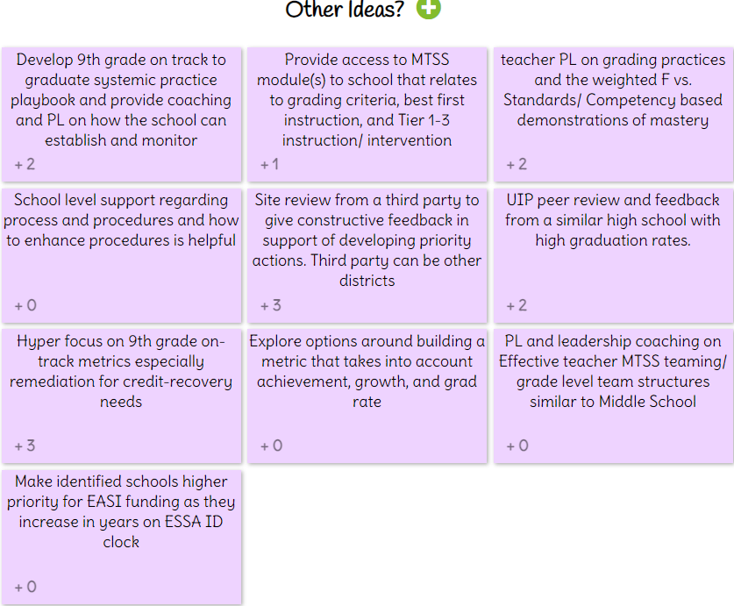
Input from CS Subcommittee via IdeaBoardz

Slide 10
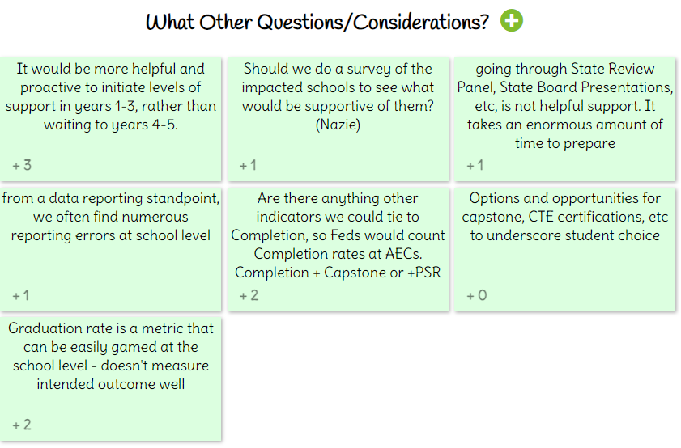
Input from CS Subcommittee via IdeaBoardz

Slide 11
Synthesis of the Ideas To Date
In reviewing the generated ideas:
Does this idea pertain to low grad rate or lowest 5% or both?
Does this idea capture your input?
Any ideas to add?
Can any of the ideas be eliminated?
What should CDE consider in moving forward with this idea?
What are pros/cons of each?

Slide 12
Next Steps
Do we need more time to flesh out these ideas before moving forward?
If ready to move forward, next step would be to develop a proposed implementation plan and timeline

Slide 13
Logistics

Slide 14
Next Steps
Next Meetings
April 23 (1030-1130) for full AWG with follow up for the R2R subcommittee
May 7, 2021 (12:00-1:30) CS Subcommittee
Homework
None – unless we come up with something during the session

Slide 15
Federal Accountability ~ ESEA Office: Data, Accountability, Reporting & Evaluation Team
ESEA Office | Position | Phone | E-mail
Nazie Mohajeri-Nelson | Director of ESEA Office | 303-866-6205 | Mohajeri-nelson_n@cde.state.co.us
DeLilah Collins | Assistant Director of ESEA Office | 303-866-6850 | Collins_d@cde.state.co.us
Emily Owen | Program Support | 303.866.6700 | Owen_e@cde.state.co.us
Marissa Gonzales | Program Support | 303-866-6963 | Gonzales_m@cde.state.co.us
DARE Team | Expertise | Phone | Email
Tina Negley | ESSA Accountability, Program Evaluation, and Reporting | 303-866-5243 | negley_t@cde.state.co.us
Alan Shimmin | ESSA Reporting and Data Collections | 303-866-6209 | shimmin_a@cde.state.co.us
Mary Shen | ESSA Program Evaluation, Research, and Accountability | 303-866-4571 | shen_m@cde.state.co.us

Slide 16
State Accountability Contacts
Accountability and Continuous Improvement Unit | Position | E-mail
Lisa Medler | Executive Director, ACI Unit | medler_l@cde.state.co.us
Marie Huchton | Supervisor, Accountability Analytics | huchton_m@cde.state.co.us
Erin Loften | Co-Lead, School Improvement and Planning | loften_e@cde.state.co.us
Susan Barrett | Co-Lead, School Improvement and Planning | barrett_s@cde.state.co.us
School and District Transformation Unit | Position | E-mail
Lindsey Jaeckel | Executive Director, SDT Unit | jaeckel_l@cde.state.co.us
Julie Woods | Accountability Specialist | woods_julie@cde.state.co.us

Slide 17
Thank you so much!
Look forward to seeing you next time!!

