Slide 1
Technical Advisory Panel Meeting
May 16, 2024

Slide 2
Welcome & Introductions
Welcome from CDE
  The purpose of the TAP is to provide non‐binding technical recommendations to CDE regarding the Colorado Growth Model, state accountability, and other topics as needed.
Meeting Logistics:
  Non‐members, please add your Name/Affiliation to the chat box.
  Everyone please mute your sound.
  We ask all non‐TAP members to hold any comments until the end of the meeting. We do this to ensure we have sufficient time to address all meeting agenda items.
Introductions with Ryan Marks, TAP Chair

Slide 3
Agenda for Today
Welcome and Introductions
  Information Item
Accountability Updates – Lisa Medler
  Information Item
Update on Digital PSAT/SAT Administration – Joyce Zurkowski & Marie Huchton
  Feedback Item
Taskforce Updates and Stakeholder Discussion – Lisa Medler & Ryan Marks
  Feedback Item
Wrap-Up

Slide 4
Accountability Updates
Information Item
Lisa Medler

Slide 5
Overarching Accountability Timeline
2023 Frameworks Released
1241 Task Force Begins*
Fall 2023
2023 Supplemental Framework Report
Winter 2024
Spring 2024
Interim Report Due
2024 Framework with New Measures for Points
Final Report Due
Fall 2024
* Per HB23-1241

Slide 6
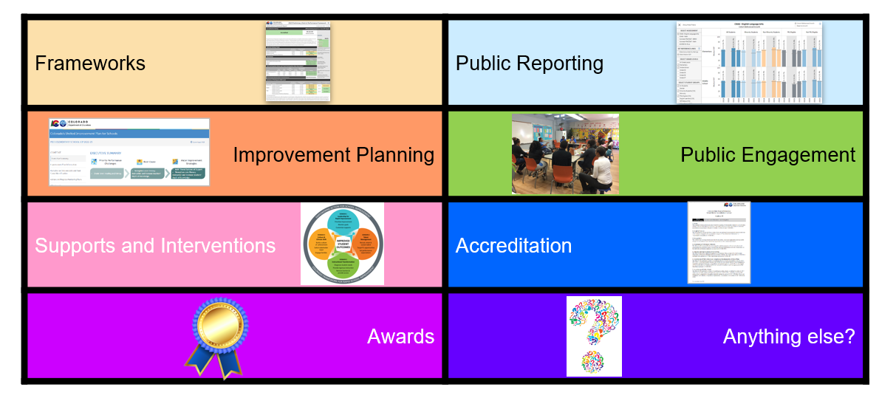
Elements of the Current State Accountability System

Slide 7
Draft 2024 State Accountability Timeline
Anticipated Timeframe | Activities/Actions
Late June | Districts receive ACCESS Growth Data
Mid-August | Districts receive performance framework data files for Achievement, Growth, Postsecondary & Workforce Readiness indicators, and Participation Data; UIP and Secure Data Explorer (N of 1) Data Dashboards available
Late August - Early September | Public Release of Colorado Growth Data Results; Alternative Education Campus (AEC) Designations Finalized; Public Data Dashboards updated Preliminary Performance Frameworks Released to Districts. Public Release 3 days later. Performance data updated in online UIP system for assurances and plan requirements.
Early-Mid September | Identification letter to districts with schools on the accountability clock (i.e., Priority Improvement, Turnaround, On Watch) and/or ESSA Identifications (i.e., CS, TS, A-TS).
Mid-September | AEC Performance Frameworks Released to Districts. Public Release 3 days later.
September 23 | Accreditation Form Submissions Due - ALL Districts
October 16 | Unified Improvement Plan (UIP) Submissions Due Final Request to Reconsider (R2R) Materials Due - Participating Districts
November 13-14 (SBE Meeting) | District Accreditation Ratings & School Plan Types Finalized for Districts/Schools not participating in R2R
December 11-12 (SBE Meeting) | District Accreditation Ratings & School Plan Types Finalized for Districts/Schools participating in R2R
By December 31 | District Accreditation Contracts Due
January 15 | January UIP Submissions Due - Newly Identified, Sites that Participated in R2R
*SBE = State Board of Education

Slide 8


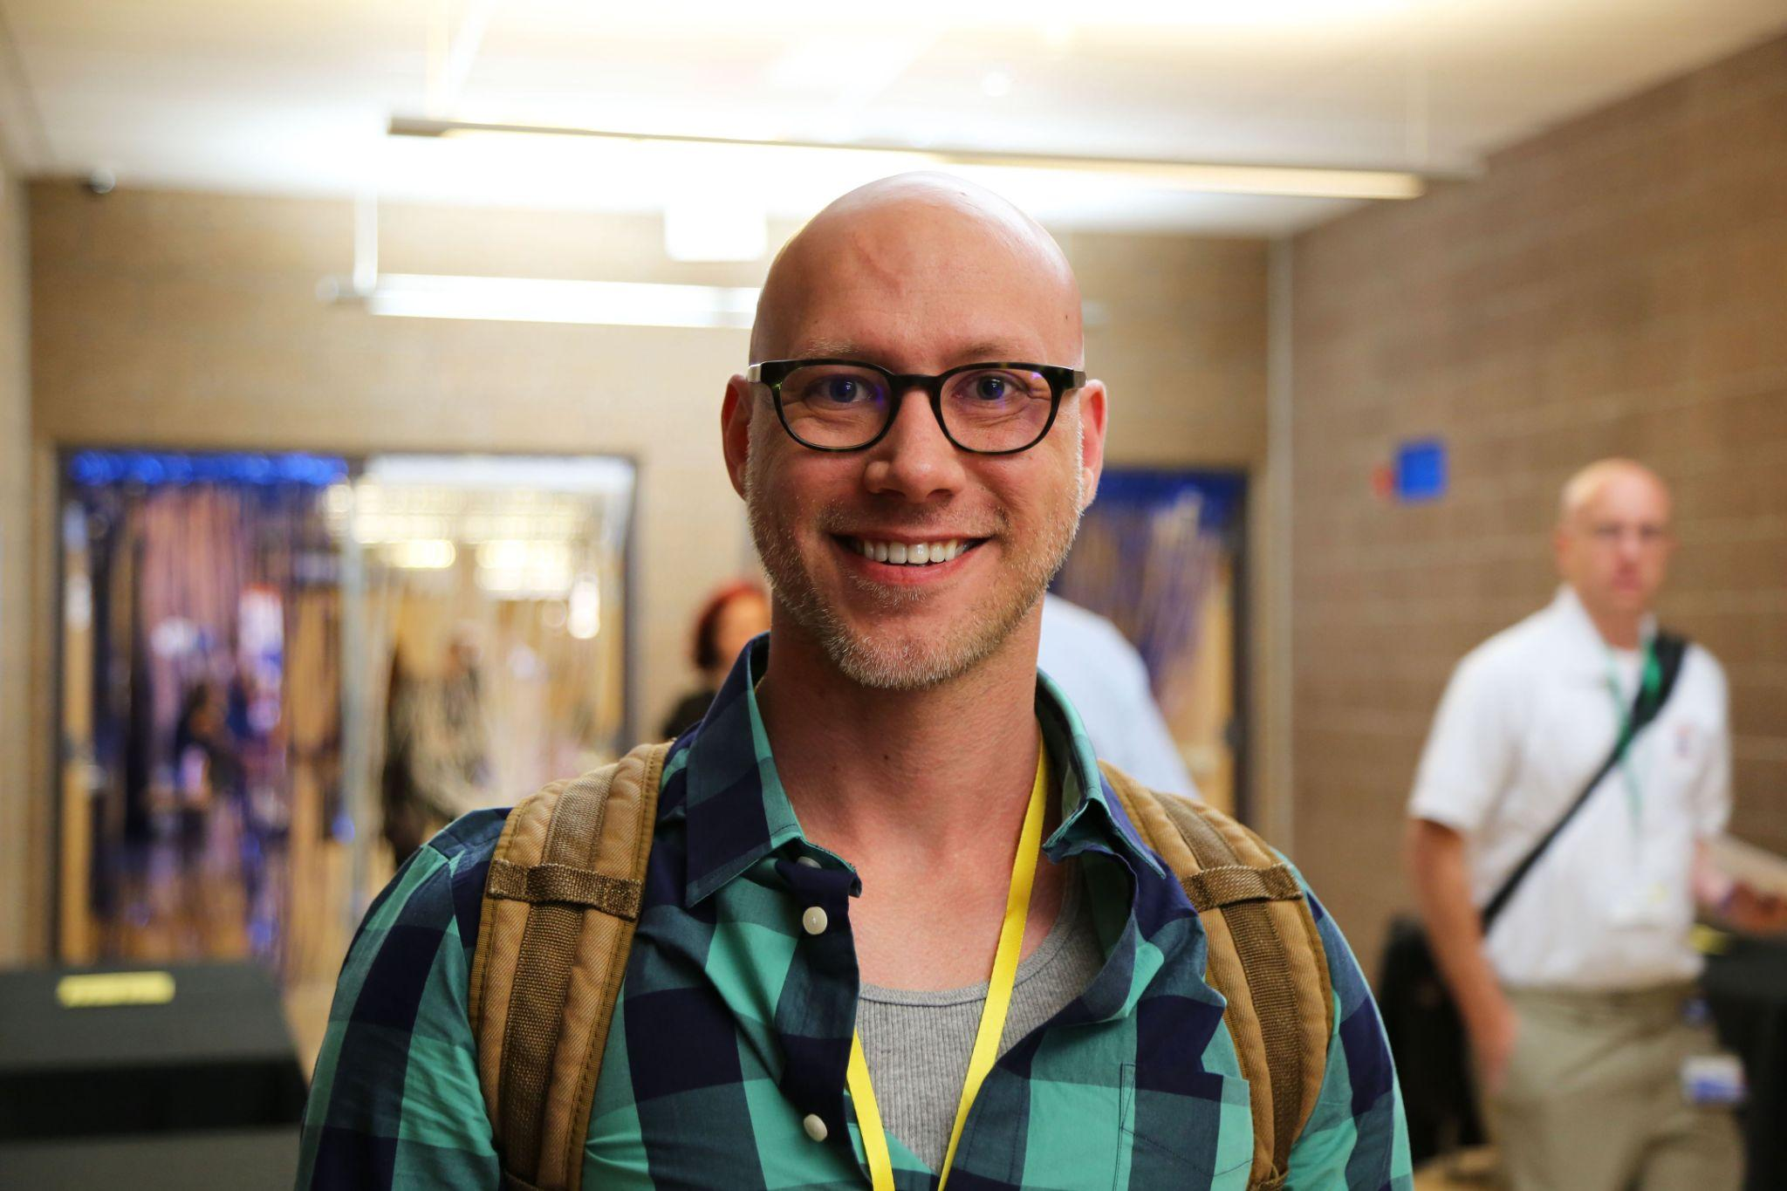



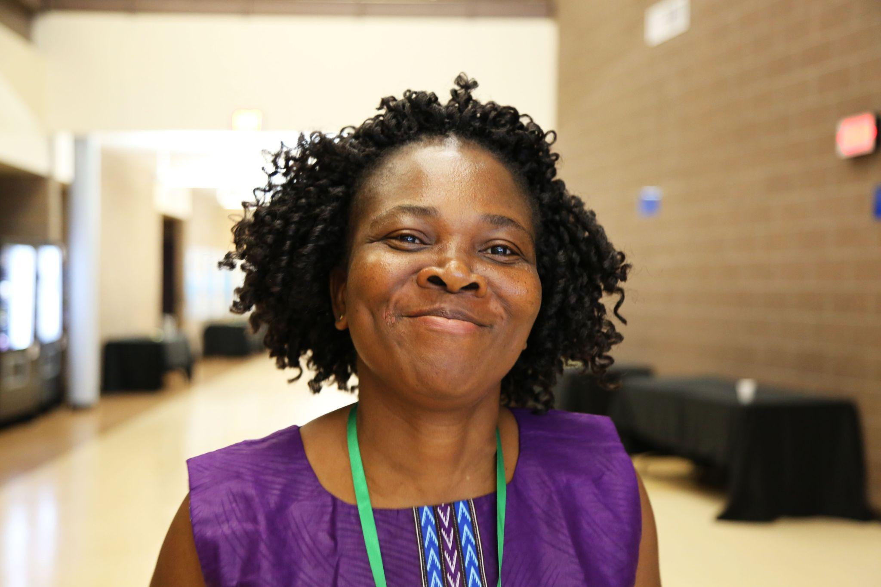
State Highlights from the 2024 Teaching and Learning Conditions Colorado Survey
‹#›
Notes:
Welcome.
In Colorado, we are fortunate to have a tool for feedback from educators called the Teaching Learning Conditions Colorado survey.

Slide 9
What is the survey intended to do?
Amplify Educator Voices
Educators and staff from across the state have continued to value the TLCC survey, leading to valuable trends and statewide comparisons.
Engage in Continuous Improvement
Help staff to identify positive trends in school conditions, as well as identify areas that merit further discussion.
Support Research and Policy
This survey provides insight into schools across the state that can lead to more informed policies and practices. It informs statewide policies and practices as well.
Notes:
The survey is intended to help us amplify the voices of our educators, including teachers, school leaders, support staff and and special service providers
we use the feedback to help us continually improve
amd we also are able to have the data that is so important to drive a k-12 research agenda
Thank the partners
Similar to previous years, we found that most educators have a positive outlook on their school experience and say their school is a good place to work and for students to learn. They feel respected by parents and supported by the community. Educator retention looks promising.
But we continue to see challenges with teachers having the time they need to be adequately prepared for their classes , seivings student’s social-emotional needs and support for working with students with special needs or who are multilingual learners.
More on the results, I turn this over to Lisa Medler, our Executive Director of Accountability and Continuous Improvement

Slide 10
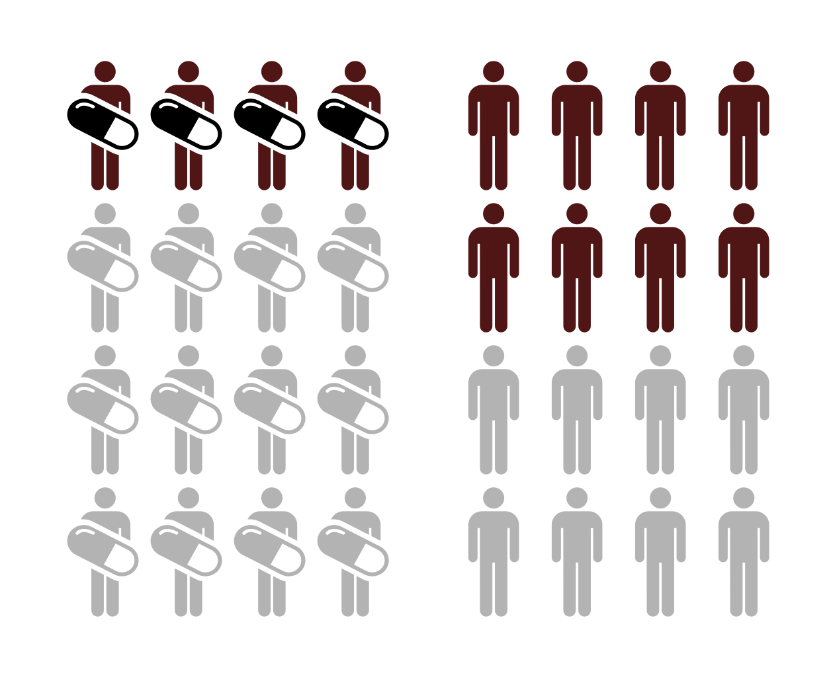
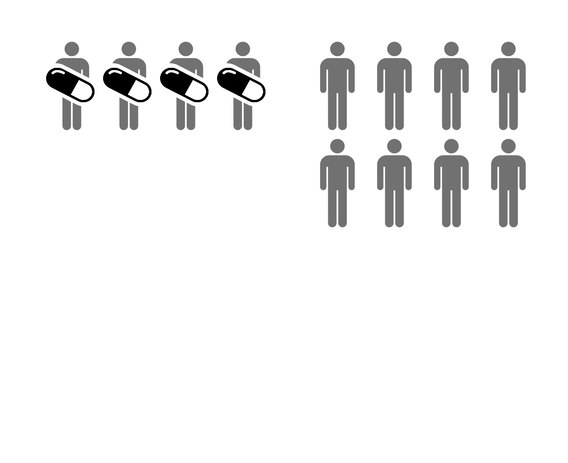

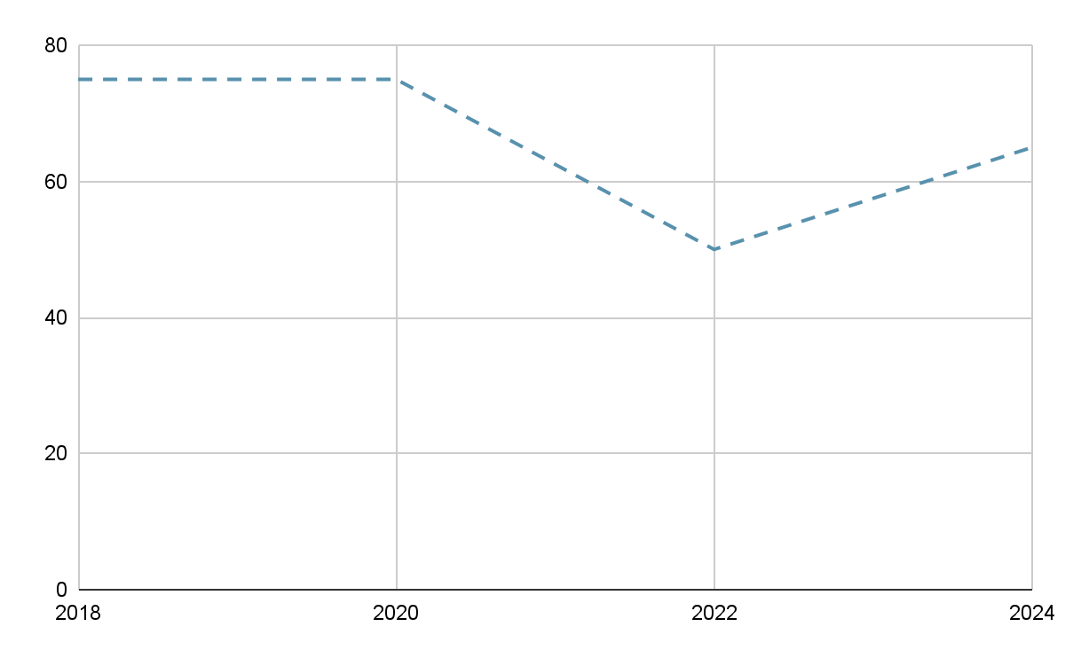
2024 TLCC Survey Results at-a-glance
More than 45,000 Colorado school-based educators participated in the survey this spring (50%), including teachers, building leaders, special service providers and educator support professionals.
Most educators have a positive outlook on their school experience. They report their school is a good place to work and for students to learn. They feel respected by parents and supported by the community. Educator retention looks promising.
There are signs that educators are recovering from the pandemic and we see findings that deserve further attention (e.g., time to complete duties, social and emotional supports, more support needed for special populations of students).
Notes:
Every two years educators are invited to participate in this anonymous survey to collect information on what is working well and what needs improvement in schools and districts.
This is my first TLCC survey as commissioner and I am excited for the results, which we released today.
More than 45,000 educators filled out the survey, which was open to teachers, education support professionals (including positions such as teacher assistants and paraprofessionals), school leaders and special service providers such as psychologists and social workers.

Slide 11
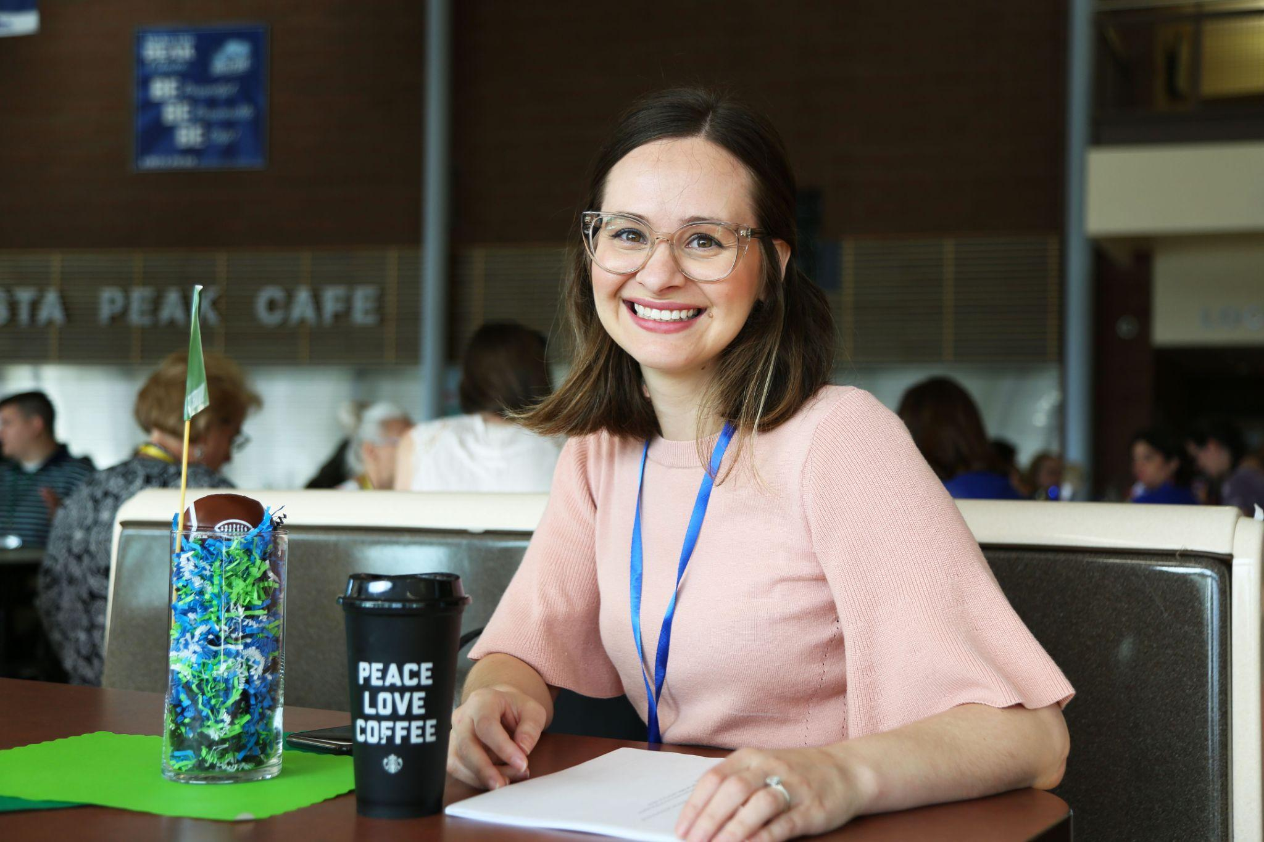

Highlights of Initial Findings

Slide 12
Who participated in the survey?
50% of Colorado educators and staff participated for a totally of including 45,000+ respondents (similar to prior administrations)
The majority of districts and schools had enough participation for public reporting, including 112 districts (60%) and 1120 schools (59%)
Vast majority of respondents (32,000+) are classroom-based teachers
Notes:
Mention first bullet - note vast majority are classroom teachers. We took care to differentiate who we are referencing. All respondents - not educators. Share the threshold #s

Slide 13
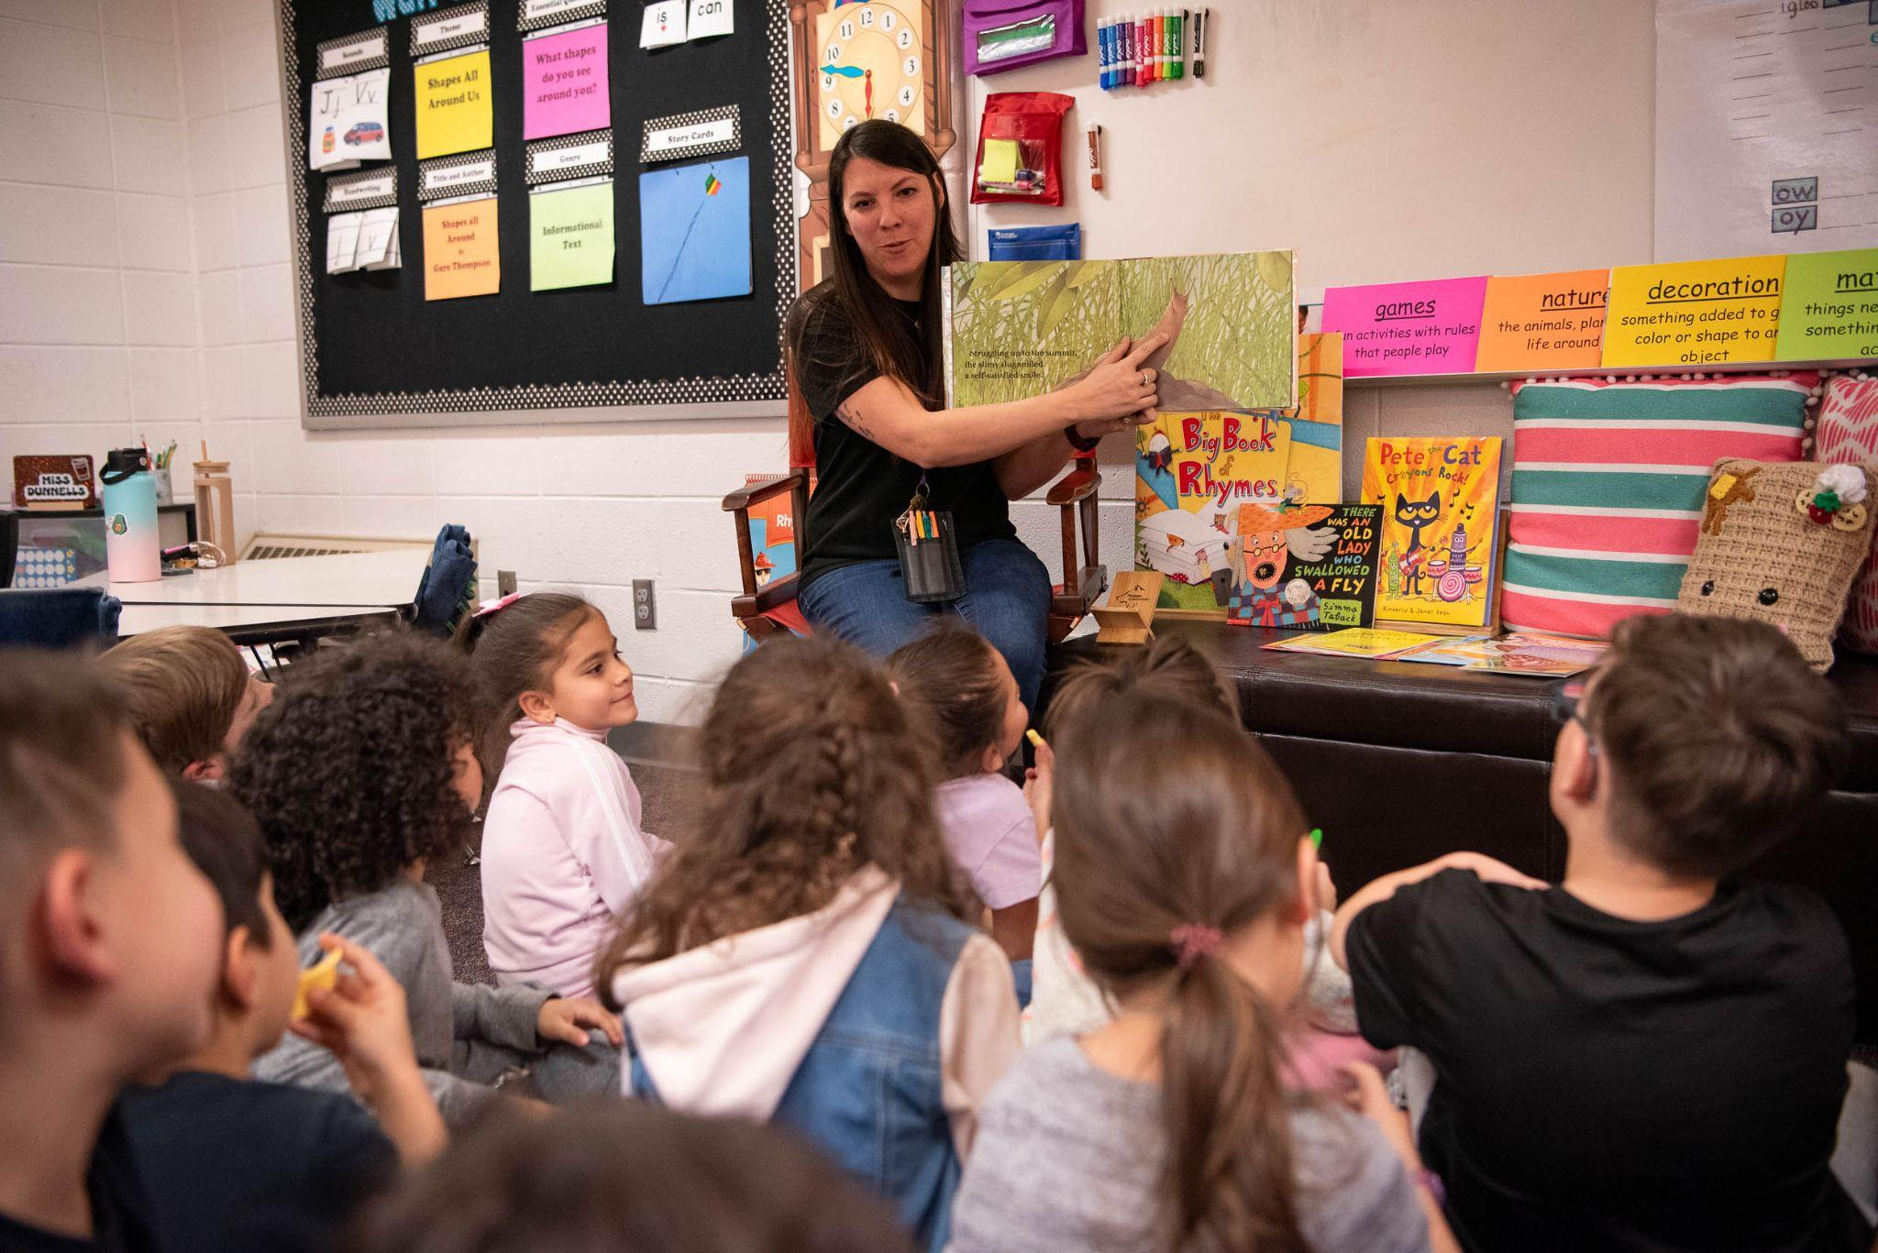
  The majority of school staff (8 out of 10) agreed that, overall, they have positive impressions of their schools.
  Most respondents said their schools are:
Good places to work
86% (▲1% from 2022; ◄ level with 2020)
Good places for students to learn
88% (▼1% from 2022; ◄ level with 2020)
Led by an effective team
81% (▼ 1% from 2022; ◄ level with 2020)
87% of school staff also say their schools have the support of the broader community (▲ 2% from 2022; ▲ 1% from 2020)*
*Note: Community support and involvement questions were modified to increase clarity and saw an overall increase in favorability. New items, including for the Teacher Recruitment and Retention study, do not have longitudinal data.
Notes:
The good news is that we see our educators as a good place to work and learn and they have the broader support Research has shown a positive relationship between community support and student growth,

Slide 14

Findings show that most educators are positive about their working conditions.
The majority of educators said that:
Class sizes are reasonable
78% (▲ 1% from 2022; ▲ 5% from 2020)
Instructional resources are adequate
79% (▲ 2% from 2022; ▲ 4% from 2020)
Teachers are trusted to use their professional judgment
76%*
*New items, including for the Teacher Recruitment and Retention study, do not have longitudinal data.
Notes:
While we are seeing majority of teachers have reasonable class sizes, adequate instructional resources and are trusted to use their professional judgement. We do see that teachers continue to struggle with access to enough time to perform their duties.

Slide 15
Even with some improvements, results show the use teacher time as the lowest-rated section of survey responses.
64% of teachers and support personnel agreed that they have enough time to engage in professional learning (▲7% increase from 2022, ▲1% 2020)
61% of teachers and support personnel report having adequate time to prepare for their primary duties (▲2% from 2022, ▲4% from 2020)
53% of teachers agreed that new initiatives are given enough time to determine effectiveness (▲3% increase from 2022, ◄ level with 2020)
50% of teachers say it is easy to secure a substitute for personal leave*
38% of teachers are able to meet position expectations within the contracted work hours*
*New questions in 2024 survey; longitudinal data not yet available.
Notes:
Comm. Cordova mentioned that there are tremendous demands on educators’ time. The survey data backs this up and has an historical trend. Look at press release. Highlight the 2 bullets at the end.

Slide 16
Responses show that educators need more support with social
and emotional needs both for themselves and their students.
95% of teachers are comfortable discussing resilience strategies with students
▼1% from 2022; not asked in 2020
81% of teachers are comfortable discussing mental health with students
▼5% from 2022; not asked in 2020
52% of teachers are comfortable discussing suicide with students
▼4% from 2022; not asked in 2020
53% of teachers reported that their district leaders pay attention to supporting their emotional and mental health*
Building leaders also identified supporting students’ social, emotional and mental health as the most common area where they most need support.
*New question in 2024 survey; longitudinal data not yet available.
Notes:
Refer to the Heathly Kids Survey quote from press release. We know that x kids contemplated committing suicide. Teachers as an important figure in students their comfort with supporting students…Teachers are comfortable with …but not… Adults need to take care of themselves to serve others
The most recent Colorado Healthy Kids Survey reported nearly 40% of students surveyed experienced feeling sad or hopeless and 17% seriously considered suicide in the past year. TLCC survey results show that while most educators (95%) feel comfortable discussing resilience strategies with their students, only 52% feel comfortable discussing suicide.

Slide 17
Student conduct has been a focus during the pandemic recovery, and survey results indicate some improvements
Questions related to managing student conduct saw an increase in favorable responses in comparison to 2022 and 2020.
Students know how they are expected to act in the school
81% (▲4% from 2022; ▲1% from 2020)
Students have the behavioral supports needed to focus on learning
71% (▲5% from 2022; ▲4% from 2020)
Rules for student behavior are enforced in a consistent manner
56% (▲3% from 2022 and from 2020)
Notes:
While improvements in students understanding, still see issues in consistency in how students are held accountable. Encouraged to some improvements since 2020.

Slide 18
Teachers are asking for more support in their work with special populations of students.
Teachers and support personnel indicate that the top three areas where they need more support is with serving students who:
Have experienced trauma
Have IEPs or 504 plans
Are multilingual learners
Teachers and support personnel also need support with:
Developing students’ social emotional skills
Content area and best practices
Survey responses indicate declines in educator perceptions of the support available to certain student groups:
74% say that multilingual learners are adequately supported in their schools
▼5% from 2022; ▼4% from 2020
80% say that students with special needs are adequately supported in their schools
▼1% from 2022, ◄ level with 2020
Notes:
Educators ranked ordered (top 5). Refer back to earlier points on SEL. Pull out for student groups…
Search/replace disabilities to students with special needs

Slide 19

This year’s survey included questions focused on teacher recruitment and retention.
87% agreed their work at their school makes them feel satisfied*
85% of teachers are satisfied with their choice
to become a teacher*
Only 6% of educators reported that they plan to
retire or leave the field of education
▼ 9% from 2022; ▼ 4% from 2020
Educators continue to rate school leadership as the top reason for remaining at their school, ahead of both “school staff” and “salary”
◄ level with 2022 and 2020
*New question in 2024 survey; longitudinal data not yet available.

Slide 20
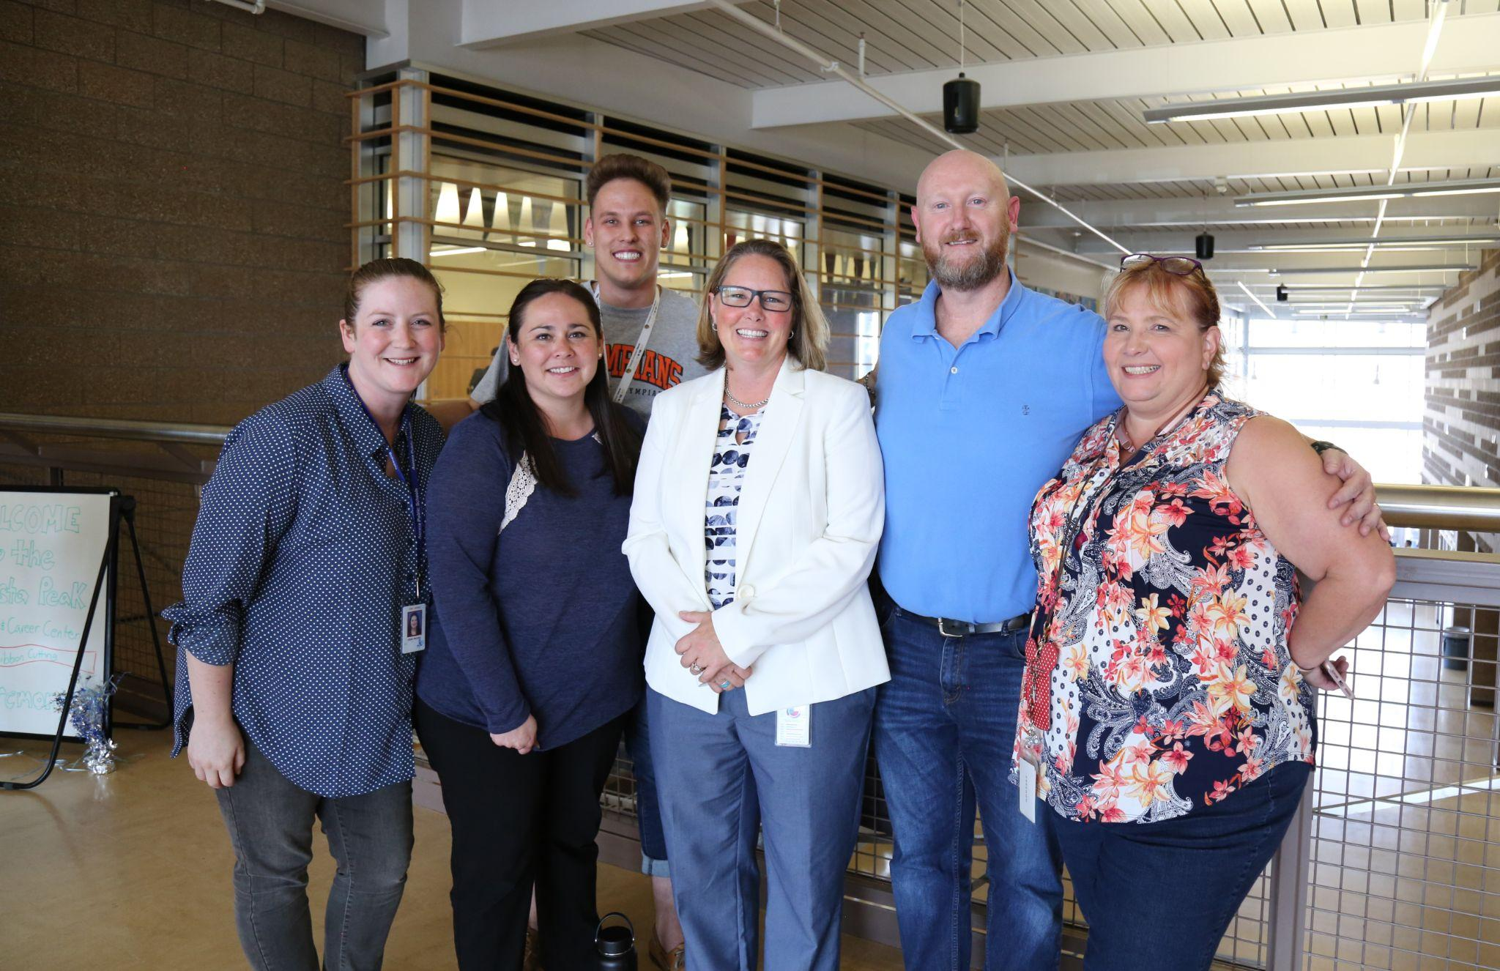
Findings from these recruitment and retention questions show that educators feel connected and supported in their schools.
98% agreed they have at least one colleague at their school that they trust*
89% agreed they feel like they belong in their schools*
87% agreed they have access to support if they had concerns about their own mental health
▲ 4% from 2022; not asked in 2020
*New question in 2024 survey; longitudinal data not yet available.

Slide 21
We see mixed results on job satisfaction and clarity from our Education Support Professionals.*
94% reported being comfortable with the tasks they are asked to perform (◄ level with 2022)
70% responded favorably that they have ways to advance their careers in education (▲2% from 2022)
45% feel adequately compensated for their work (▲9% from 2022)
39% said frequent changes in duties make their jobs more stressful (▼18% improvement from 2022)
*2022 was the first year that Education Support Professionals were included in the TLCC Survey.
Notes:
Positions such as Teaching Assistant, Therapist Assistant, Student Monitor, Health Tech.. Were pleased to see the overwhelming majority are comfortable

Slide 22
Overall, while Colorado educators need more prep time and support, most have positive perceptions of their working conditions.
Most respondents say their schools are good places to work (86%), good places to learn (88%), and have supportive communities (89%).
Educators need more time to prepare for lessons and fulfill their many responsibilities:
61% feel that they have adequate prep time
50% of teachers say that external substitutes are readily available
Educators need more support with:
Students’ social, emotional and mental health.
Serving students who have experienced trauma
Meeting the needs of certain student populations
More educators plan to stay in the classroom:
Only 6% of educators say they plan to leave or retire
This is ▼ 9% from 2022 and ▼ 4% from 2020

Slide 23
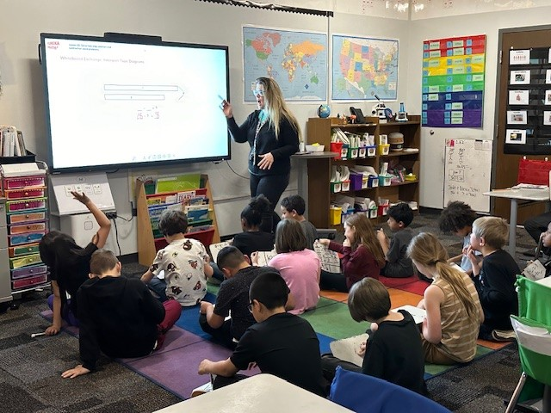
Visit www.tlccsurvey.org for more.

Slide 24
Update on Digital PSAT/SAT Administration
Feedback Item
Joyce Zurkowski & Marie Huchton

Slide 25
Colorado School Day
Digital PSAT & SAT
Spring 2024
State Board of Education Meeting
May 9, 2024

Slide 26
Topics
Executive Summary
Adaptive Tests
Technical Approaches
Test Design and Content
Implications for Score Interpretation

Slide 27
Executive Summary: This spring, Colorado administered the new Digital PSAT/SAT assessments
This spring high school students took the Digital PSAT/SAT, College Board’s new tests.
  The tests are shorter because they are adaptive.
  The items, content distributions, and technical models were also revised.
Colleges and universities are accepting the resulting SAT scores for purposes of entrance.

Slide 28
Adaptive tests adjust items students see later in a test based on their performance on earlier items
Item level adaptive – after a student completes an item, the difficulty of the next item a student receives is based on performance on the prior item(s)
Stage adaptive – rather than adjusting item-by-item, students take a set of items that then determines the items that they will get in the next set
INTENT: create a shorter test with the same or better reliability
  Instead of having students take a mix of 60 easy, medium and hard items, students get fewer, more targeted items. The scores they get from an adaptive and a “fixed” form grade-level assessment should be comparable.

Slide 29
PSAT/SAT is now two stage adaptive: the second module a student receives is based on performance on the first module
Students take two sets of questions (modules) for Reading/Writing and two for Math.
Students are not told whether they get the easier or more difficult second module.
Module 2A – Easier
20 - 25 questions
Students are given a targeted mix of questions of varying difficulty (more easy items, fewer hard items) based on their performance in Module 1.
Student’s Score for that Section
Module 1:
20 - 25 questions
All students are given the same broad mix of easy, medium, and hard questions.
Module 2B – More difficult
20 - 25 questions
Students are given a targeted mix of questions of varying difficulty (more hard items than easy items) based on their performance in Module 1.

Slide 30
Students who take either the easier or more difficult modules can get a score above Met Expectations and meet the College Board College and Career Readiness Benchmark (CB CCRB)
Math
Reading/Writing
800
Met Expectations/
CB CCRB
Met Expectations/
CB CCRB
200
Higher
Lower
Higher
Lower
Final scores are NOT based on the number of items that students get correct.

Slide 31
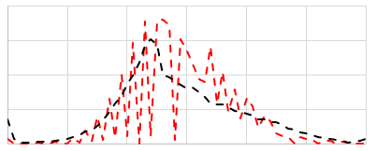
A more precise technical model makes more difficult items worth more than easier items and provides for more possible score values
New technical model* means that two students who each get ten items correct will not automatically get the same score
  A student who gets ten more difficult items right will get a higher score than a student who gets ten easier items right.
  In some cases, this model will lead to more possible scores on the scale.
New model
Old approach ------
A more precise technical approach makes more difficult items worth more than easier items and provides for more possible score values
-------
Percent of Students
Scale Score
*A similar technical model currently is and has been used for other Colorado assessments going back to CSAP.

Slide 32


The Reading and Writing section has fewer items, takes less time, and has more, but shorter, passages
Past years:
Paper-based SAT
Reading Section and Writing Section
New
Digital PSAT/SAT
Reading & Writing Section
96 total questions (2 sections)
54 total questions (1 section)
100 total minutes (1.04 min/question)
64 total minutes (1.19 min/question)
Set based questions
Discrete questions
Passage or Set Word Count: 400-750
Passage or Set Word Count: 25-150
Content distributions also have been adjusted
(see first slide in the appendix)

Slide 33
The Math section has fewer items, takes less time, allows a calculator throughout, and has fewer items in context
Past years:
Paper-based SAT
New
Digital PSAT/SAT
58 total questions
2 sections – calculator and no calculator
44 total questions
1 section – with calculator
80 total minutes (1.38 min/question)
70 total minutes (1.59 min/question)
Discrete and set based questions
Multiple-choice ≈78%
Student-produced response ≈22%
Items in Context ≈100%
(unofficial)
Discrete and set based questions
Multiple-choice ≈75%
Student-produced response ≈25%
Items in Context ≈30%
Content distributions also have been adjusted
(see first slide in the appendix)

Slide 34
Spring 2023 study: Students who took both the paper-based and Digital SAT had comparable scores
College Board’s Conclusion: Scores from the digital SAT can be used in the same manner as scores from the historical paper-based version
  College Board Digital SAT Suite Concordance and Vertical Scaling Studies (College Board, 2023)*
Colleges and universities are using scores from the Digital SAT to inform entrance decisions
*See Slide 40 in the appendix for study result details.

Slide 35
Inferences about differences between 2024 and 2023 scores should take into consideration a variety of factors
Differences seen between 2024 and 2023 scores will be attributed to a combination of factors:
  True differences in student achievement
And, in part:
  The computer-based administration mode
  Different technical model
  New item models
  Adjustments to content distributions
Making inferences in future years will be easier, as the test will be the same going forward.

Slide 36
Scores will start to be released to students next week
May 16: students with College Board accounts or the BigFuture School app will start to get access to their electronic reports.
June 10: educators with the relevant privileges will get access to student and confidential aggregated scores via the College Board reporting portal.
Although we can’t have preliminary high level results (all students without disaggregated groups) prior to the June Board meeting, we may be able to present them at the Board meeting.

Slide 37
Appendix
Notes:
Joyce

Slide 38
The Reading & Writing content distributions have been revised. The most significant change is the increase in number of passages with reduced lengths
Paper-based 2023 Evidence-based Reading and Writing |  | Digitally-based Reading and Writing
Information and Ideas | 15-20% | Information and Ideas | 26%
Rhetoric and Synthesis | 30-35% | Craft and Structure | 28%
Expression of Ideas | 28% | Expression of Ideas | 20%
Standard English Conventions | 23% | Standard English Conventions | 26%
Additional Information
Passage (Set) Word Count | 400-750 | Passage (Set) Word Count | 25-150

Slide 39
The Math content distributions have been revised. For SAT, there is less problem-solving/data analysis and advanced math but more geometry
Paper-based 2023 |  | Digitally-based 2024
Algebra | 33% | Algebra | 35%
Problem-solving & Data Analysis | 29% | Problem-solving & Data Analysis | 15%
Advanced Math | 28% | Advanced Math | 35%
Additional Topics (Geometry) | 10% | Geometry | 15%

Slide 40
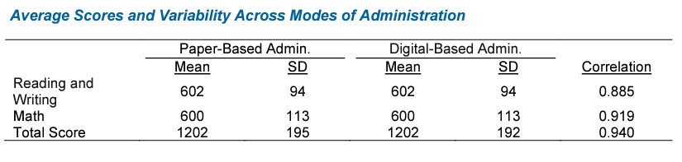
Concordance Study Results (Spring 2023)
Section means and standard deviations were essentially equal across two versions
Total score means were essentially equal across the two versions
Total score standard deviation was slightly different
Correlations were high for both sections and total score
College Board’s Conclusion: Scores from the digital SAT can be used in the same manner as scores from the historical paper-based version
-College Board Digital SAT Suite Concordance and Vertical Scaling Studies (College Board, 2023)

Slide 41
TAP Discussion

Slide 42
TAP Discussion and Recommendation
TAP Feedback-
What preparation(s) would be appropriate for fall 2024 frameworks?
Renorming PSAT and SAT achievement measures based on 2024 results?
Restricting multi-year frameworks to only use 2024 PSAT and SAT data? Just Achievement? Both Achievement and Growth?
Rating or ISD for small high schools if they have reportable PSAT/SAT Growth but no PSAT Achievement?
For Dashboards and other public reporting tools?
Do we need to visually differentiate paper/pencil versus new adaptive assessment results?

Slide 43
Break
(10 minutes)

Slide 44
Taskforce Updates and Stakeholder Discussion
Feedback Item
Lisa Medler & Ryan Marks

Slide 45
H.B. 23-1241: Accountability, Accreditation, Student Performance, and Resource Inequity Task Force
Link to Bill: https://leg.colorado.gov/bills/hb23-1241
Purpose: Creates a representative task force of 26-members that studies academic opportunities, inequities, promising practices in schools, and improvements to the accountability and accreditation system.
Website: https://www.cde.state.co.us/accountability/accountability-task-force
Builds upon: Accountability Audit and the Local Accountability System Grant
Task Force members are working in study groups now focused on frameworks and then will focus on the other accountability elements later this spring.
Gathering stakeholder input now through stakeholder panels and a survey. Go to website for links to access the survey.
Timeline:
  July 1, 2023: Task force members appointed
  August 15, 2023: Department contracts with a facilitator
  No later than September 1, 2023: Convene first meeting
  March 1, 2024: Interim report
  November 15, 2024: Final report reflecting findings and recommendations to the education committees of the house of representatives and senate, the governor, the state board, the commissioner of education and the department.
Upcoming Meetings:
  June 4
  Fall meetings have not yet been set

Slide 46
Updated TAP Principles
Student growth percentile data is by far the most valuable part of the accountability system.
Data included in the accountability system should be verifiable and valid, accessible and transparent.
There should be consistency across grade bands, schools, and districts, and the greatest practicable use of growth data in making accountability calculations.
Recommendations should be grounded in empirical analysis when possible, including deliberate study of the impact on historically disadvantaged groups and the schools and districts that serve them.
Recommendations should consider the need for flexibility to adapt to changing contexts across schools.
Recommendations should be grounded in/motivated by a clear theory of action indicating how the recommendation will accomplish the intended aims (and consider potential unintended consequences)
Some metrics are more technically sound than others. Metrics should be evaluated on criteria related not only to reliability of the interferences they will yield. A somewhat less reliable measure of the right thing is preferable to a highly reliable metric that has negative consequences for historically disadvantaged groups and the schools and districts that serve them.
Link to Google Document

Slide 47
Public Comments and Meeting Close

Slide 48
Technical Advisory Panel
Meeting Summary
  Suggested future analysis
  TAP recommendations from this meeting
Public Comment
Close Meeting
  Next Scheduled Meeting: TBD, here is a link to the survey to schedule meetings for next year. Please try to fill this out by 6/14. Have a great summer!

