Slide 1
Technical Advisory Panel Meeting
March 7, 2024

Slide 2
Welcome & Introductions
Welcome from CDE
  The purpose of the TAP is to provide non‐binding technical recommendations to CDE regarding the Colorado Growth Model, state accountability, and other topics as needed.
Meeting Logistics:
  Non‐members, please add your Name/Affiliation to the chat box.
  Everyone please mute your sound.
  We ask all non‐TAP members to hold any comments until the end of the meeting. We do this to ensure we have sufficient time to address all meeting agenda items.
  Welcome Laurie Rossback (from Durango Public Schools) and Carrie Olson (new CASB representative from DPS), new TAP members!
Introductions with Ryan Marks, TAP Chair

Slide 3
Agenda for Today
Welcome and Introductions
  Information Item
Accountability Updates – Lisa Medler
  Information Item
Taskforce Updates and Stakeholder Discussion – Lisa Medler
  Feedback Item
PWR Indicator – Daniel Mangan
  Information Item
CMAS Science – Marie Huchton & Daniel Mangan
  Feedback Item
Wrap-Up

Slide 4
Accountability Updates
Information Item
Lisa Medler

Slide 5
Overarching Accountability Timeline
2023 Frameworks Released
1241 Task Force Begins*
Fall 2023
2023 Supplemental Framework Report
Winter 2024
Spring 2024
Interim Report Due
2024 Framework with New Measures for Points
Final Report Due
Fall 2024
* Per HB23-1241

Slide 6
Newcomer Multilingual Learners (MLs)
Newcomer MLs in Accountability: Students with a language proficiency designation of Non-English Proficient (NEP) or Limited English Proficient (LEP) who are new to U.S. schools within the last 12 months, are identified as Limited or Interrupted Formal Education (SLIFE) and have enrolled in their current school after October 1 of the current year.
Will be included as participants (i.e., count in numerator & denominator) in participation calculations
Scores for students who choose to test will not be included in Achievement Calculations
For ACCESS SBD (beginning next Monday), Districts are highly encouraged to submit Newcomer MLs who enrolled on or before February 9th to the Assessment Division using the Newly Arrived to the U.S. Student Failsafe form. See the SBD Layout file below or contact the Assessment team for more information. Additional details will be included in next week's District Assessment Coordinator communication about ACCESS SBD.
Resources:
February Accountability Contact Communication
Guidance Table with State Accountability Considerations
CMAS and CoAlt Procedures Manual, see pg. 31
SBD Layout ACCESS 2024 - includes additional details about the Failsafe form

Slide 7
Taskforce Updates and Stakeholder Discussion
Feedback Item
Lisa Medler & Ryan Marks

Slide 8
H.B. 22-1215: Study Of Expanding Extended High School Programs
Link to Bill: https://leg.colorado.gov/bills/hb22-1215
Purpose: Develop and recommend policies, laws and rules to support the equitable and sustainable expansion and alignment of programs that integrate secondary, postsecondary and work-based learning opportunities in every region of the state.
Task Force Website: https://www.cde.state.co.us/postsecondary/secondary_postsecondary_and_work-based_learning_integration_task_force
Timeline:
  July 2022: Convened first meeting
  December 1, 2022: Interim report
  December 1, 2023: Final report reflecting findings and recommendations to the governor, the Education Leadership Council, the State Board of Education, the Colorado Commission on Higher Education, and the Education Committees of the Senate and the House of Representatives, or any successor committees.

Slide 9
H.B. 23-1241: Accountability, Accreditation, Student Performance, and Resource Inequity Task Force
Link to Bill: https://leg.colorado.gov/bills/hb23-1241
Purpose: Creates a representative task force of 26-members that studies academic opportunities, inequities, promising practices in schools, and improvements to the accountability and accreditation system.
Task Force Website: https://www.cde.state.co.us/accountability/accountability-task-force
Builds upon: Accountability Audit and the Local Accountability System Grant
Timeline:
  July 1, 2023: Task force members appointed
  August 15, 2023: Department contracted with a facilitator
  August 24, 2023: Convened first meeting
  March 1, 2024: Interim report
  November 15, 2024: Final report reflecting findings and recommendations to the education committees of the house of representatives and senate, the governor, the state board, the commissioner of education and the department.
Upcoming Meetings:
  March 12
  April 2
  May 7 (Tentative)
  June 4 (Tentative)
  Fall meetings have not yet been set

Slide 10
PWR Indicator
Information Item
Daniel Mangan

Slide 11
Matriculation Data Concordance Study
Rationale
CDE has heard questions from the field regarding the accuracy and representativeness of data used in calculations for the matriculation PWR sub-indicator.
Stakeholders in the field have also expressed confusion around data sources and methodology for calculating matriculation rates.
CDE's goals are to:
  Clarify data sources and procedures used in matriculation calculations
  Investigate how well data received from CDHE corresponds to other data sources
  Communicate findings with stakeholders and work collaboratively to improve processes

Slide 12
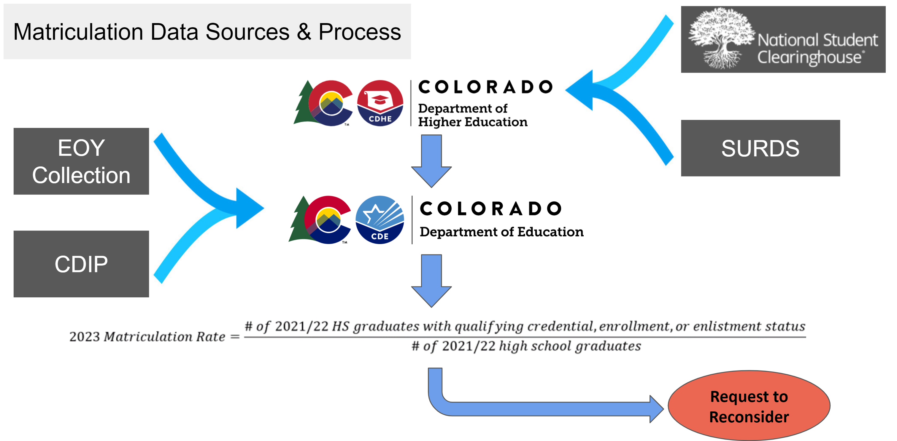
Matriculation Data Sources & Process

Slide 13
Matriculation Data Concordance Study
Prior Research
As of 2021, NSC reports nationwide coverage rates of 97.4%. Rates vary by state and type of institution. For Colorado, 2021 coverage was 90.6%.
  Students can choose not to have their records reported to NSC (FERPA).
  Some institutions do not report or report late.
Dynarski et al. (2015) compared NSC data against a federal database, finding coverage rates to be higher among institutions that are public, 4-year, and more selective. Non-White students were also covered at a lower rate.
Pyle (2018) examined NSC data in WA State, finding overlap of 89.1%. Again, community and technical colleges appeared less likely to report to NSC, with Asian, Hispanic, and multilingual students having the highest proportion not found in NSC data.
Nagaoka and Mahaffie (2020) examined NSC data in IL, noting specific strengths and limitations of NSC data:
  Strengths: consistent, generally comprehensive, national coverage
  Limitations: limited info about student programs/degrees, incomplete coverage, potential representativeness concerns

Slide 14
Matriculation Data Concordance Study
Next Steps
Design study to examine concordance between matriculation data received from CDHE and other sources (districts).
Engage stakeholders (e.g., PPRSAC, TAP, AWG) for feedback.
Ongoing discussions with CDHE and NSC.
Phase 1: Partner with a small number of districts to establish protocol for sharing and analyzing data.
  1 large district, 1 medium, 1 small
  Timeline: Feb - mid March
  Communicate findings with stakeholders
Phase 2: Use information from initial partnerships to potentially expand study to more representative sample (late March - April)
  Examine implications for accountability (May)
  Connect with stakeholder groups to provide updates on findings from the study and potential next steps.

Slide 15
Break
(10 minutes)

Slide 16
CMAS Science
Feedback Item
Marie Huchton & Daniel Mangan

Slide 17
Setting the Stage for Science in 2024 Performance Frameworks
In November 2023, the State Board of Education voted to re-introduce science achievement in the 2024 frameworks.
Last included in frameworks in 2019. Paused due to pandemic, and adoption of new state standards and launch of new science assessment.
In January 2024, CDE released informational data to districts to see how 2023 plan type assignments would have shifted if science achievement had been included. A commitment was made to further examine the impact of the participation data and consult with the TAP.
CDE has already announced that science participation will not be used in calculating accountability participation in 2024. This means a plan type will be decreased one level only if both ELA and math are below 95% accountability participation after parent excusals are removed.

Slide 18
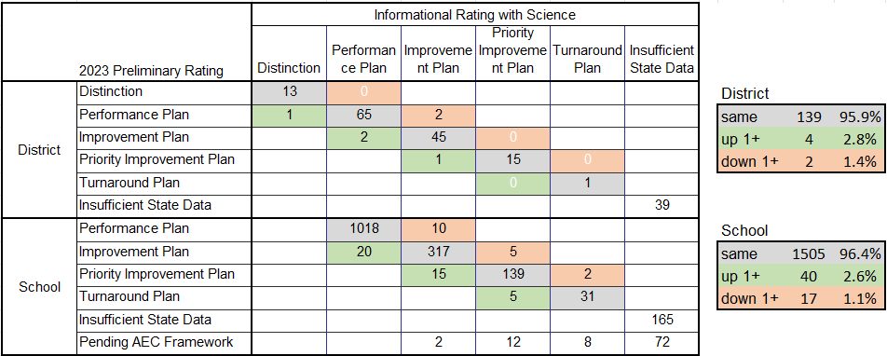
Impact of Including Science on Traditional Ratings

Slide 19
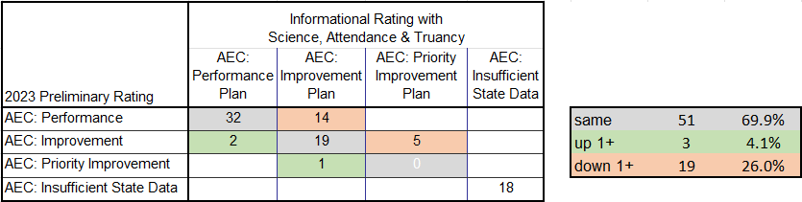
Impact of Including Science, Attendance, and Truancy on AEC Framework Ratings

Slide 20
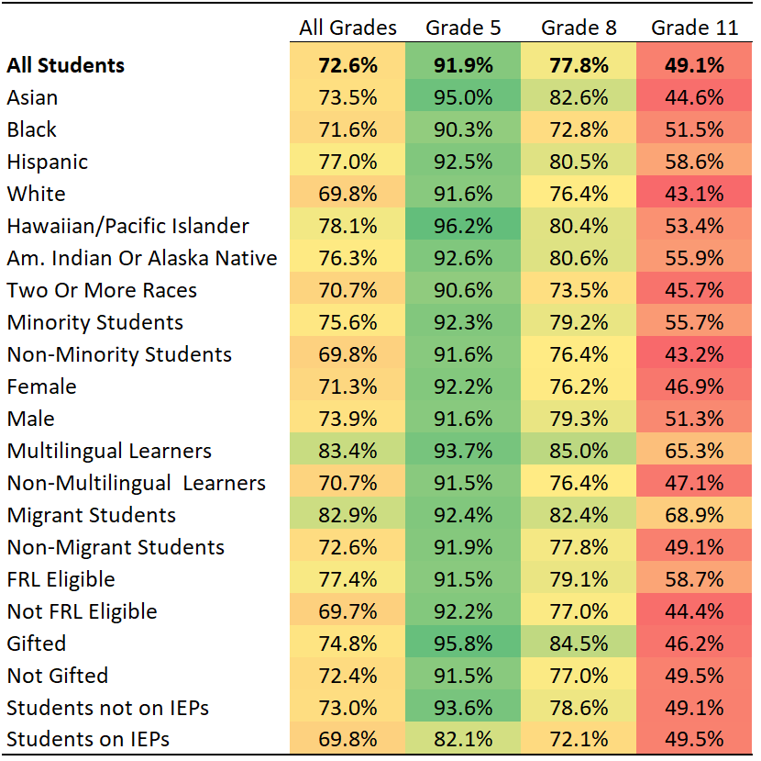
Overall CMAS Science Participation Rates
Overall participation = 72.6%, but vast differences exist across grade levels.
  Grade 5 = 91.9%
  Grade 11 = 49.1%
Participation rates higher for:
  Minority Students
  Multilingual Learners
  FRL Eligible
  Migrant Students
  Males

Slide 21
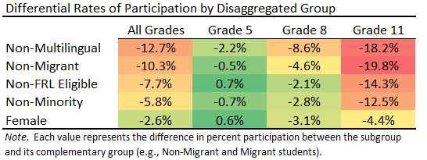
Differential Rates of Participation, by Disaggregated Group
In other words, students who are traditionally more advantaged appear to be opting out of CMAS Science at higher rates than their historically disadvantaged counterparts.
Differences are most pronounced in high school.
Females are also opting out at slightly higher rates than males.
Raw participation rates do not necessarily provide accurate information on the demographic makeup of test-takers compared to the overall population.
To better assess generalizability, we need to look at the proportion of students who took the test in each subgroup as compared to the proportion of the overall study body they represent.

Slide 22
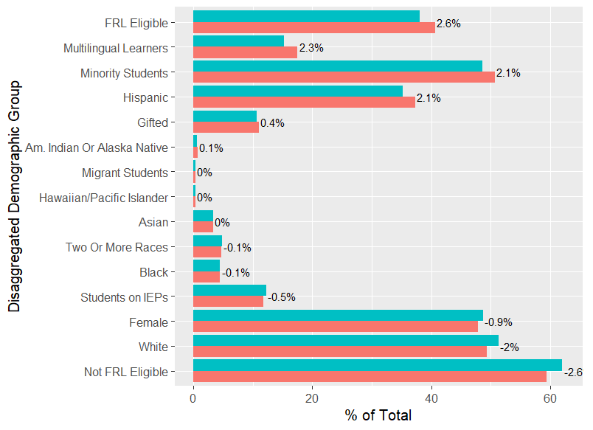
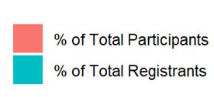
Representativeness of Tested Groups (State-Level)
All Grades
Here we examine representativeness as a function of share of total students for each group.
Blue bars represent the percent of total students registered for CMAS Science (similar to % enrolled) represented by that subgroup.
Red bars represent the percent of total students who took CMAS Science represented by that subgroup.
The number at the end of each pair of bar is thus a measure of the representativeness of that subgroup.
  0% would indicate perfect representativeness.
  Positive values show over-representation.
  Negative values show under-representation.
  Differences harder to detect for very small subgroups.

Slide 23
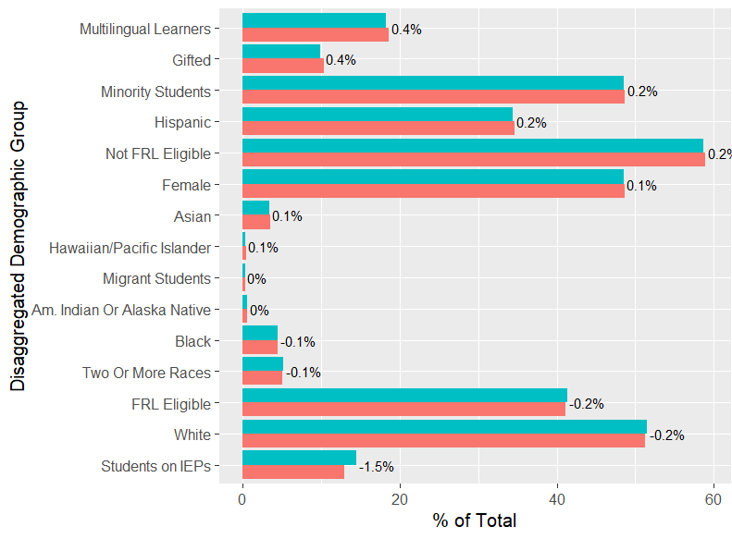
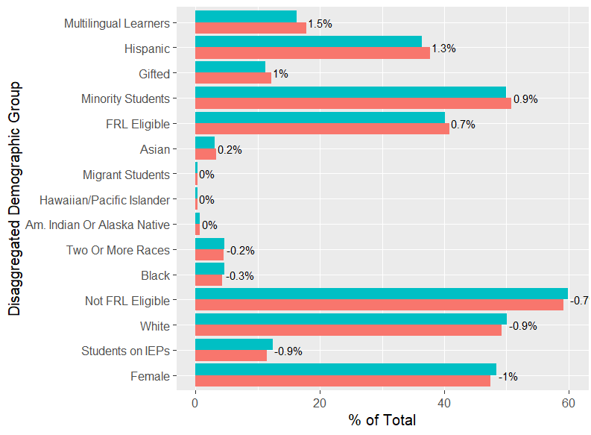
Representativeness of Tested Groups (State-Level)
Grade 5
Grade 8

Slide 24
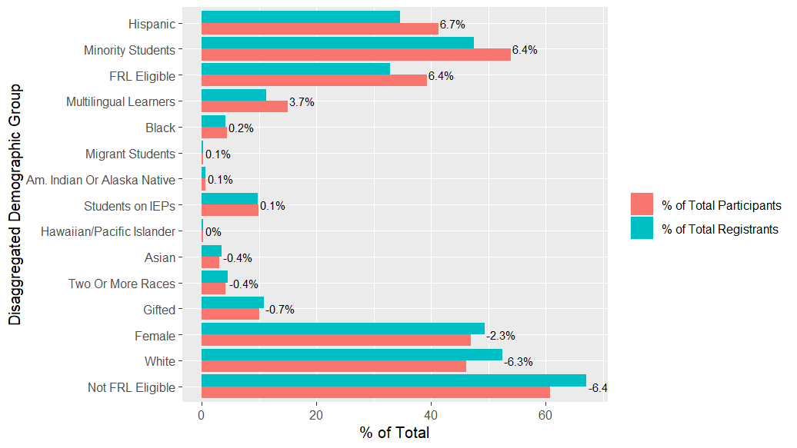
Representativeness of Tested Groups (State-Level)
Most over-represented:
  Hispanic
  Minority
  FRL Eligible
  Multilingual
Most under-represented:
  Non-FRL Eligible
  White
  Female
Grade 11

Slide 25
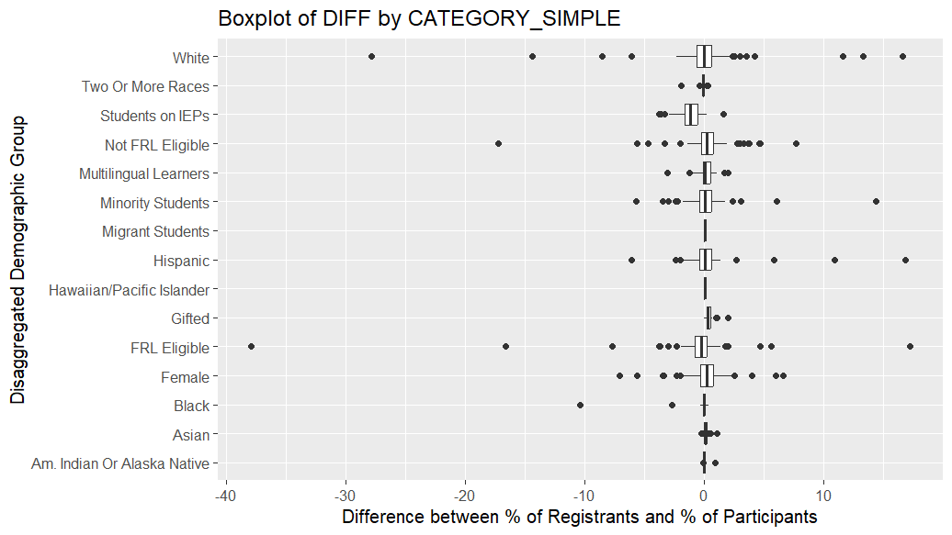
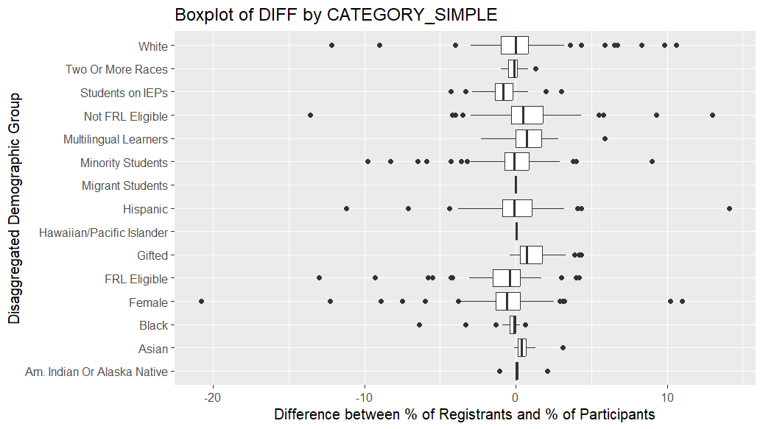
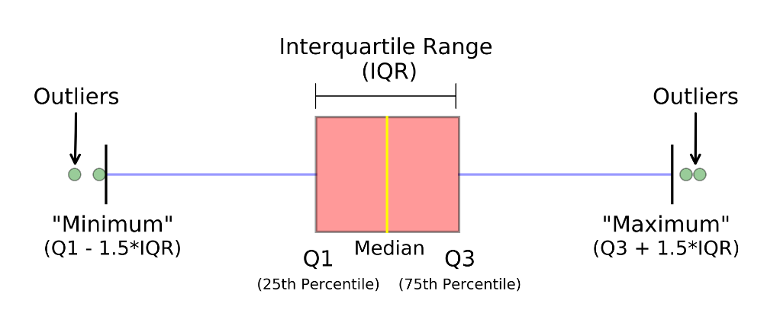
Distribution of the Difference between % Registrants and % Participants (District-Level)
Grade 5
Grade 8
For each district, we calculate the difference between % enrolled and % tested.
Each data point represents an individual district.
Narrow IQRs indicate low overall variability around the median difference for each group.
Overall differences shown in prior slides may thus be driven largely by outliers.
Reminder: Interpreting Boxplots

Slide 26
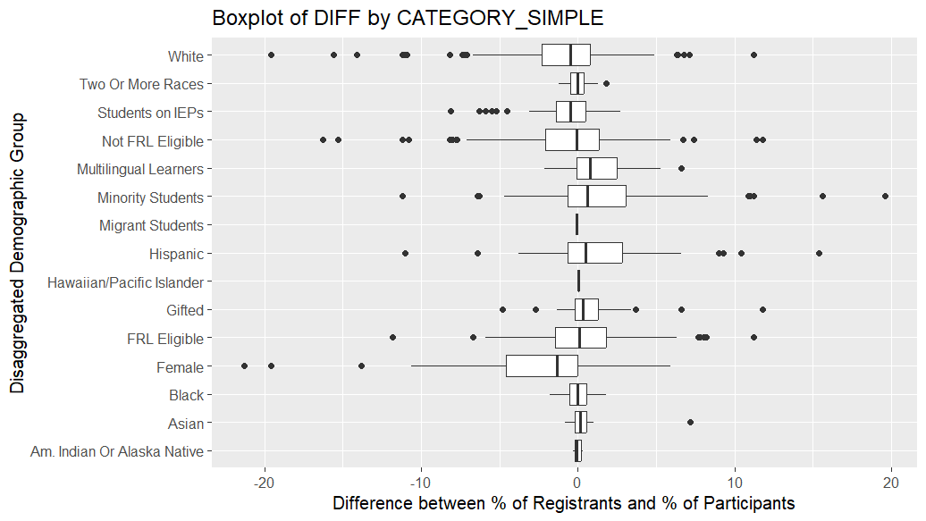
Distribution of the Difference between % Registrants and % Participants (District-Level)
Substantially more variability exists among districts in participation differentials for 11th graders as compared to 5th and 8th.
Outliers tend to exist on both sides of the distribution, although not for Females.
Grade 11

Slide 27
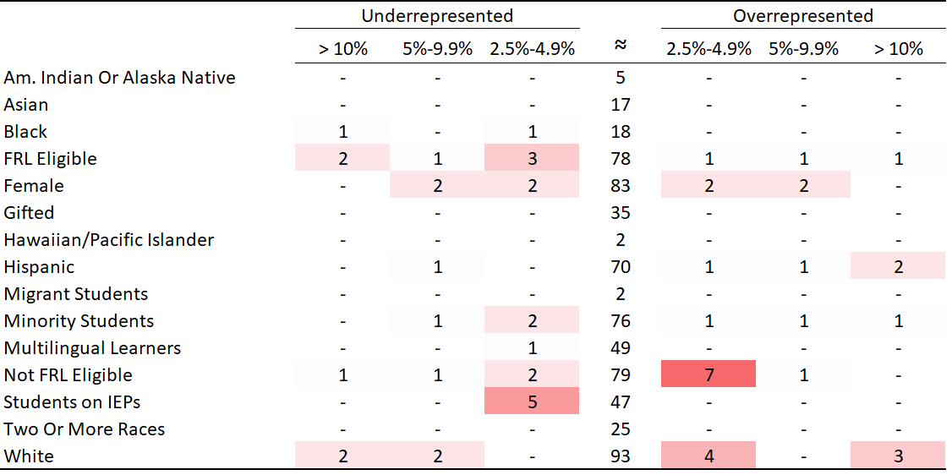
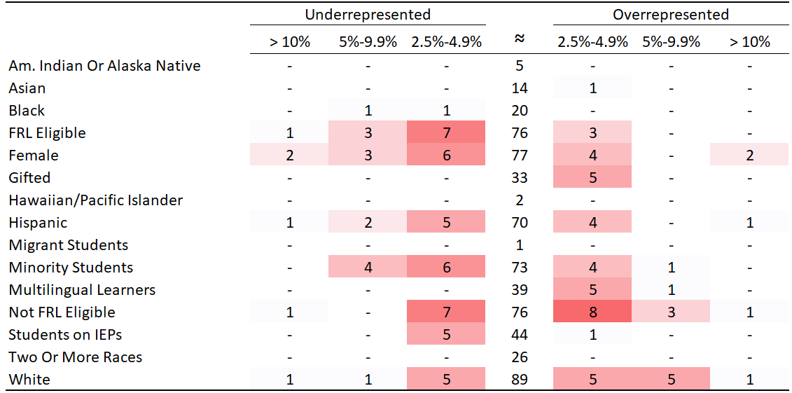
Count of Districts with Disproportionate Representation
Grade 5
Grade 8

Slide 28
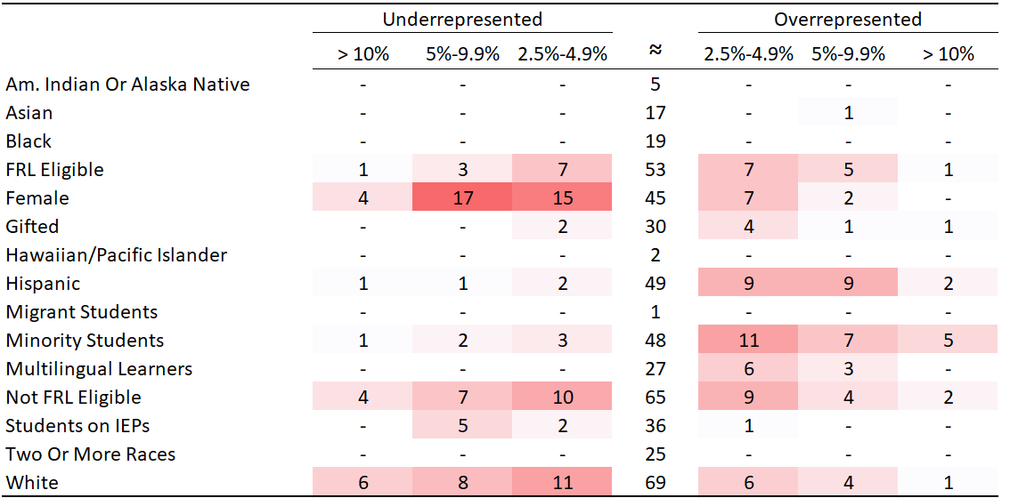
CMAS Science Participation
Count of Districts with Disproportionate Representation
Grade 11

Slide 29
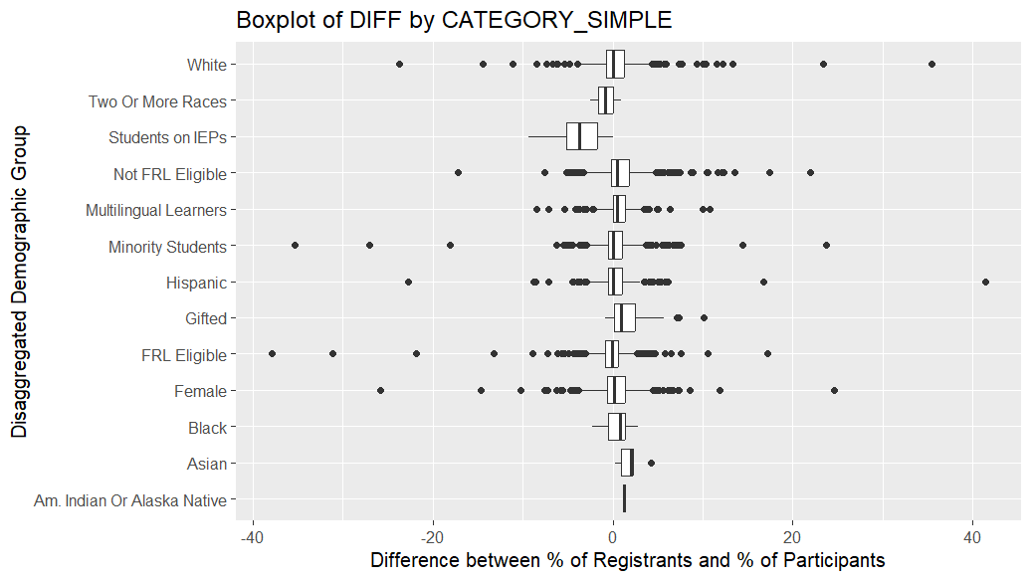
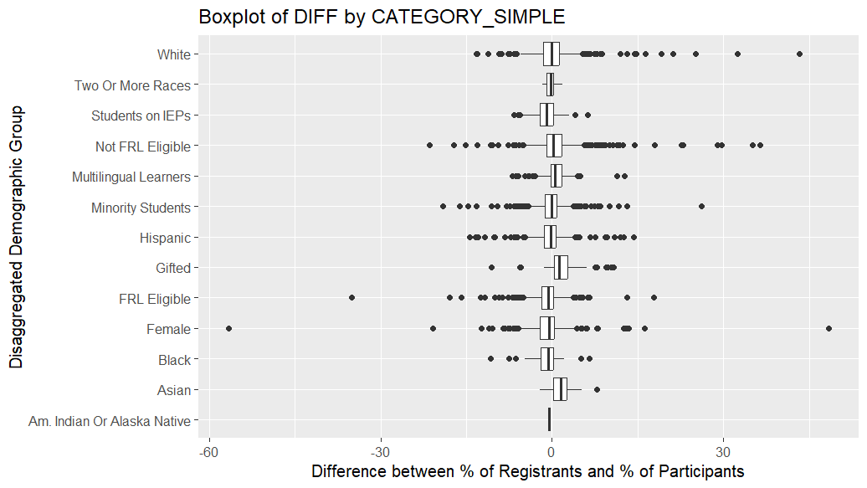
Distribution of the Difference between % Registrants and % Participants (School-Level)
Grade 5
Grade 8

Slide 30
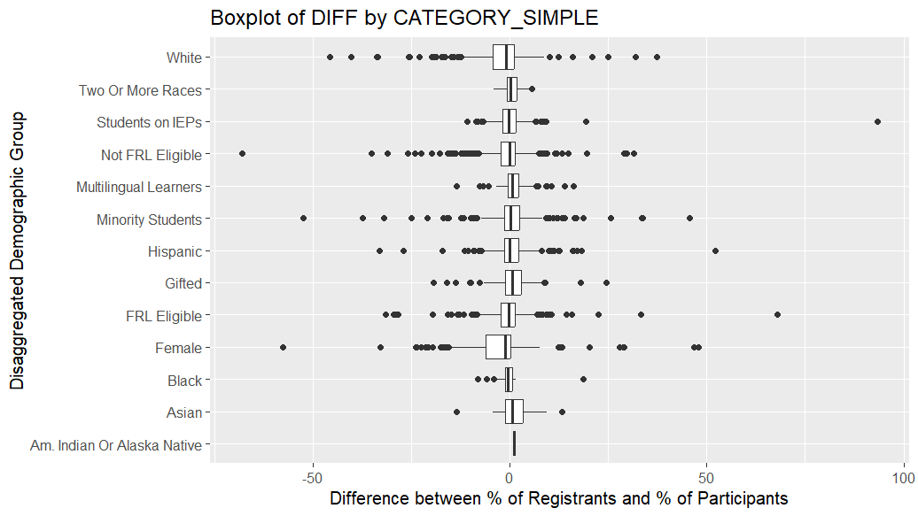
Distribution of the Difference between % Registrants and % Participants (School-Level)
Grade 11

Slide 31
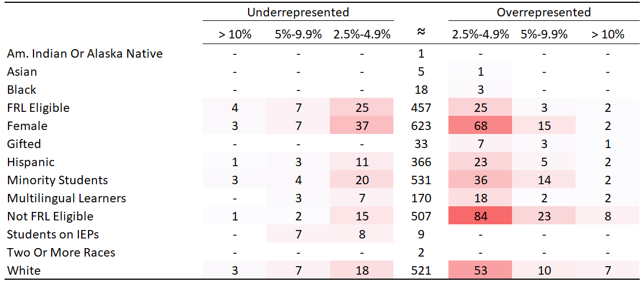
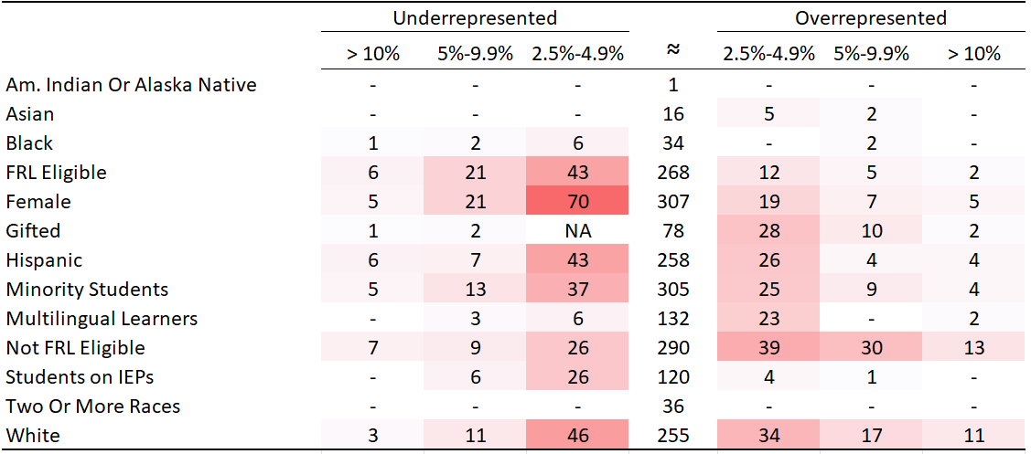

Count of Schools with Disproportionate Representation
Grade 5
Grade 8

Slide 32
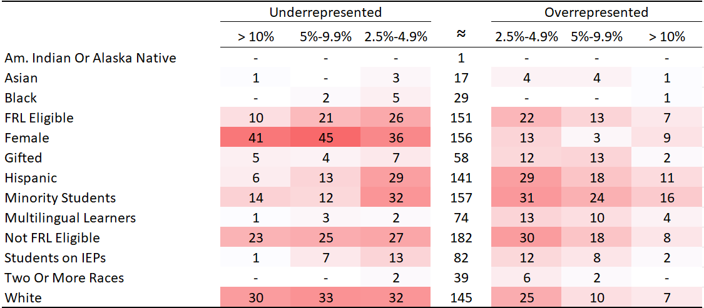
Count of Schools with Disproportionate Representation
Grade 11

Slide 33
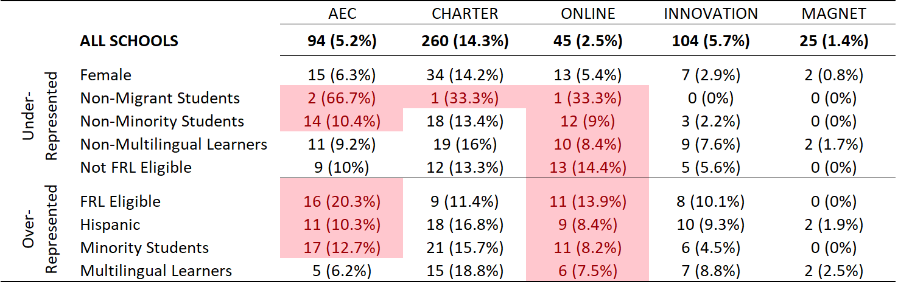
Profile of Schools with Disproportionate Representation, by School Type
Each subgroup is limited to cases where the count of registered students is >= 20 and where misrepresentation is >= 2.5 percentage points.
  “All Schools” does not include this limitation.
  Example interpretation: Of the schools where Females are under-represented, 31 (6.2%) are AECs. In the overall sample, 4.2% of schools are AECs. Cases where the difference between % of total schools and % of under/over-represented schools is greater than +5 percentage points are shown in red.
Takeaways:
  Schools where historically disadvantaged students are over-represented are disproportionately likely to be AEC or Online schools.
  There does not appear to be a strong relationship between under-representation of Female students and school type.
Notes:
Note that there are fewer schools with migrant n size as compared to non, which is why doesn’t show up in bottom panel.

Slide 34
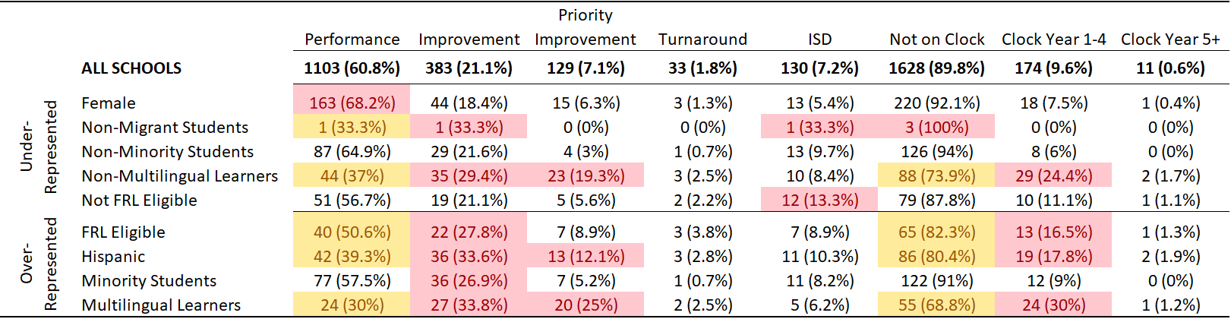
Profile of Schools with Disproportionate Representation, by School Plan Type / Clock Status
Schools where Female students are under-represented tend to be Performance schools.
Schools where historically disadvantaged students are over-represented are less likely to be Performance and more likely to be on the clock.
In other words, our more advantaged students appear to be opting out at higher rates in schools with lower plant type assignments and schools on the accountability clock.
Notes:
Note harder to differentiate turnaround

Slide 35
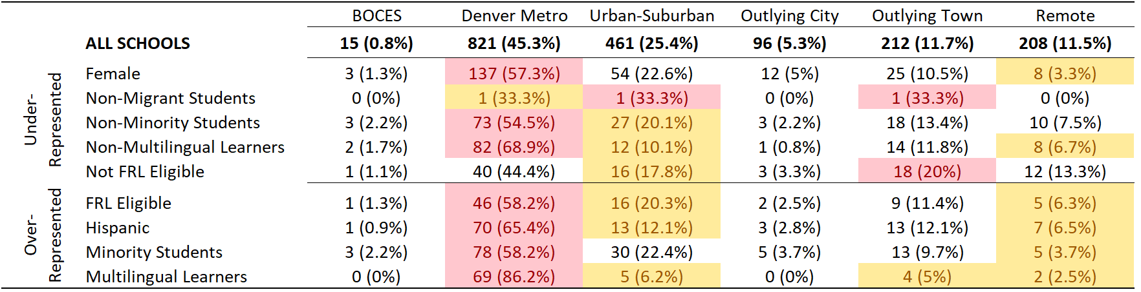
Profile of Schools with Disproportionate Representation, by Setting
Schools where females are under-represented are more likely to be Denver Metro schools and less likely to be Remote settings.
Schools where historically disadvantaged students are over-represented are also more likely to be Denver Metro, and less likely to be Remote or Urban-Suburban.
In other words, schools where our more advantaged students appear to be opting out at higher rates are more likely to be Denver Metro schools and less likely to be Urban-Suburban or Remote.

Slide 36
CMAS Science Representativeness Takeaways
Participation at the HS level is much lower than other grades (less than 50%).
At the HS level, we also find that our White, non-FRL, non-ML students appear to be opting out at much higher rates than their historically disadvantaged peers. Female students are also under-represented.
It’s important to note that, in general, most schools do not have high rates of under/over representation and that there are outliers in both directions for all subgroups.
Schools where historically disadvantaged students are over-represented are more likely to be AECs, Online, on the clock, and be in Denver Metro. They are less likely to have Performance plan types and be in Urban/Suburban or Remote settings.
Schools where Female students are under-represented are more likely to be Performance schools and in Denver Metro.

Slide 37
Accountability Takeaways
About 96% of schools and districts would receive the same rating when including Science Achievement data. About 3% would see increased ratings and 1% decreased ratings.
For high schools, white, female and non-FRL students opted out at disproportionately higher rates. In general, these demographic groups show higher levels of achievement than historically disadvantaged student groups.
As the accountability sub-indicator ratings are normed based on the observed tested population, it's likely that the high school cuts from 2023 are lower than they would have been if all students tested.
This also means schools/districts with better representativeness may receive slightly higher Science Achievement ratings.
This aligns with the general finding that more schools and districts would receive increased ratings with the inclusion of science.

Slide 38
TAP Recommendation
Given the potentially unrepresentative participation in Science at high school, does the TAP recommend making any accommodations for performance frameworks?
Considerations-
Science achievement is legislatively required to be included in performance frameworks, and was approved for re-introduction by the State Board in November
For 2024, Science will not contribute to Decreased Due to Participation
Should there be a Request to Reconsider pathway around low participation in Science?
  What could that look like?
  How do we not incentivize future opt-outs?

Slide 39
Public Comments and Meeting Close

Slide 40
Technical Advisory Panel
Meeting Summary
  Suggested future analysis
  TAP recommendations from this meeting
Public Comment
Close Meeting
  Next Scheduled Meeting: April 18th, 1-4pm

