Slide 1
Technical Advisory Panel Meeting
March 20, 2025

Slide 2
Welcome & Introductions
Welcome from CDE
The purpose of the TAP is to provide non‐binding technical recommendations to CDE regarding the Colorado Growth Model, state accountability, and other topics as needed.
Meeting Logistics:
Non‐members, please add your Name/Affiliation to the chat box.
Everyone please mute your sound.
We ask all non‐TAP members to hold any comments until the end of the meeting. We do this to ensure we have sufficient time to address all meeting agenda items.
Introductions with Ryan Marks, TAP Chair

Slide 3
Agenda for Today
Welcome and Introductions
Information Item
Updates from AEC Workgroups - Bee Sanders & Lisa Steffen
Information Item
UIP Categories - Lisa Steffen, Greg Nusz, & Aislinn Wales
Feedback Item
HB25-1278 Education Accountability System - Lisa Medler
Information Item
Wrap-Up

Slide 4
Updates from AEC Workgroups
Bee Sanders & Lisa Steffen
Information Item

Slide 5
AEC Workgroup - January- April 2025
AEC Framework [Group 1]
AEC Collections [Group 2]
AEC Supports [Group 3]
Review optional measures process to determine validity, quality and equity across AECs. Review AEC framework plan type distributions and framework cuts.
Review current data collections (e.g., optional measures, designation), approach to monitoring collections, and gather feedback on current processes.
Review current CDE supports (e.g., professional development, diagnostic reviews), school improvement funding, bright spots, and AEC collaboration opportunities.

Slide 6
Updates on Workgroups
2024 AEC Workgroup Collaboration Space
Workgroup 2 - slides
The group has made recommendations to CDE on guidance documents and changes to AEC collections
Workgroup 3 - slides
This group has made recommendations to CDE on current CDE supports, both universal supports and those in response to state/federal identification

Slide 7
Workgroup 1 - Guiding Principles for AEC Optional Measures
Measure is a technical fit with performance frameworks
Measure uses student outcome/performance data
Measure has established rigor and validity needed for accountability use
Measure demonstrates sufficient variability in performance to justify use in a normative accountability system
These were used in practice, but have not been codified or consistently communicated as requirements for effective and approvable AEC optional measures.

Slide 8
Workgroup 1 - Applying Guiding Principles
Optional Measure Sunset Process
For 2025 frameworks:
All current measures allowable for submission for 2025
After conclusion of the AEC workgroups, CDE will review, create, and publish a list of sunset measures
Measures flagged for sunset will not be submittable for 2026 (2025 is last year of use)
September - October
Optional measures appearing on most recent frameworks are reviewed for quality and rigor
October - November
List of measures flagged for sunset are published to field
Flagged measures can be renegotiated for future approval but may not be approved
Annual review of optional measures for quality and fit
May-June
Flagged measures can be submitted and used one last time
Optional measure list

Slide 9
Workgroup 1 – Cut Point Renorm
Measures that meet all principles except sufficient variability are being identified for potential cut point renorm, not sunset at this time.
Cut point renorm analysis uses a combination of between and within group approaches based on available local data
Cut Point Renorm
Measure does not meet all AEC guiding principles for optional measures
Technical fit
Student outcome/performance data
Rigor and validity
Sufficient variability in performance

Slide 10
UIP Categories
Lisa Steffen, Greg Nusz, & Aislinn Wales
Feedback Item

Slide 11
Background
How can we make better use of Unified Improvement Plan (UIP) data?
From a combination of research projects and internal coding, we identified primary categories used by schools and districts for their UIP’s performance priorities, root causes, and improvement strategies
Beginning with the 2023-24 UIP cycle, schools and districts could self-select from one of the categories above for each of their performance priorities, root causes, and strategies

Slide 12
Goals
CDE Supports
Strategic Planning
Networking
UIP Process
Identify areas of focus to develop CDE resources and to coordinate technical assistance (e.g., trainings, cohorts).
Inform CDE’s strategic planning process (i.e., monitor trends, track implementation, identify bright spots).
Facilitate cross-district networking (e.g., connect districts that are working on the same strategies).
Districts and schools can use this data to inform improvement planning supports.

Slide 13
Participation
Of the approximate 1,800 plans submitted in 2024-25:
 | School UIPs | District UIPs
Number of Schools Represented | 1057 | -
Number of Districts Represented | 76 | 101
Performance Challenges Categorized | 65% | 55%
Root Causes Categorized | 45% | 34%
Strategies Categorized | 61% | 48%

Slide 14
UIP Categories Dashboard
Purpose
Audience
Location
Make the UIP student performance priority, root cause, and major improvement strategy data more accessible and transparent
CDE Staff
District / School Administrators
Embedded in the UIP template, potentially CDE’s website
Planned Release Date: April 15th in time for template rollover

Slide 15
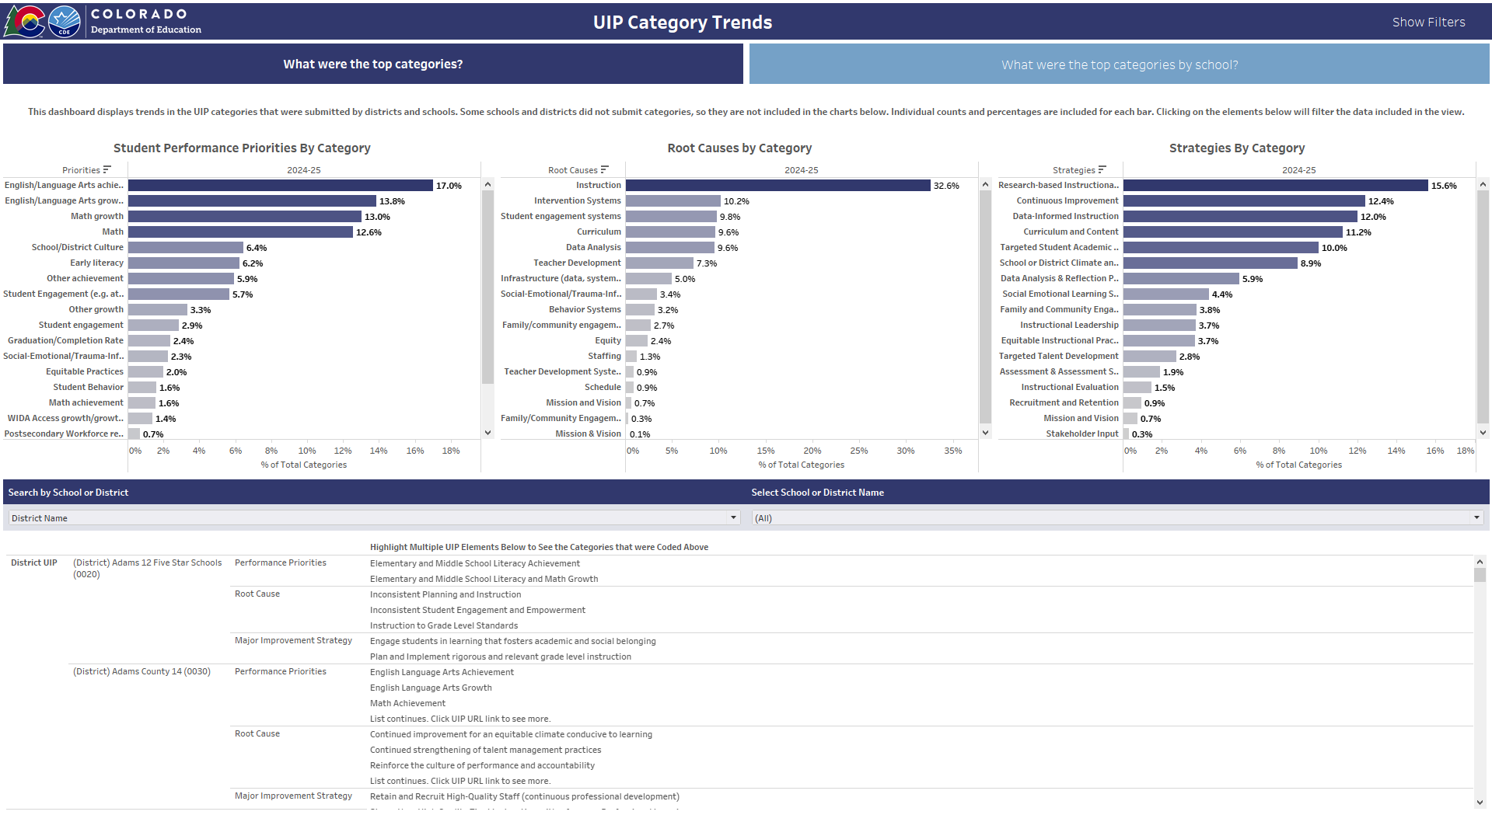
UIP Categories Dashboard - Overall
Additional filters are available
Clicking any bar or text will filter the view
Hover overs show N size
Table displays UIP text
Can view trends by District UIPs and School UIPs
Link directs users to UIP

Slide 16
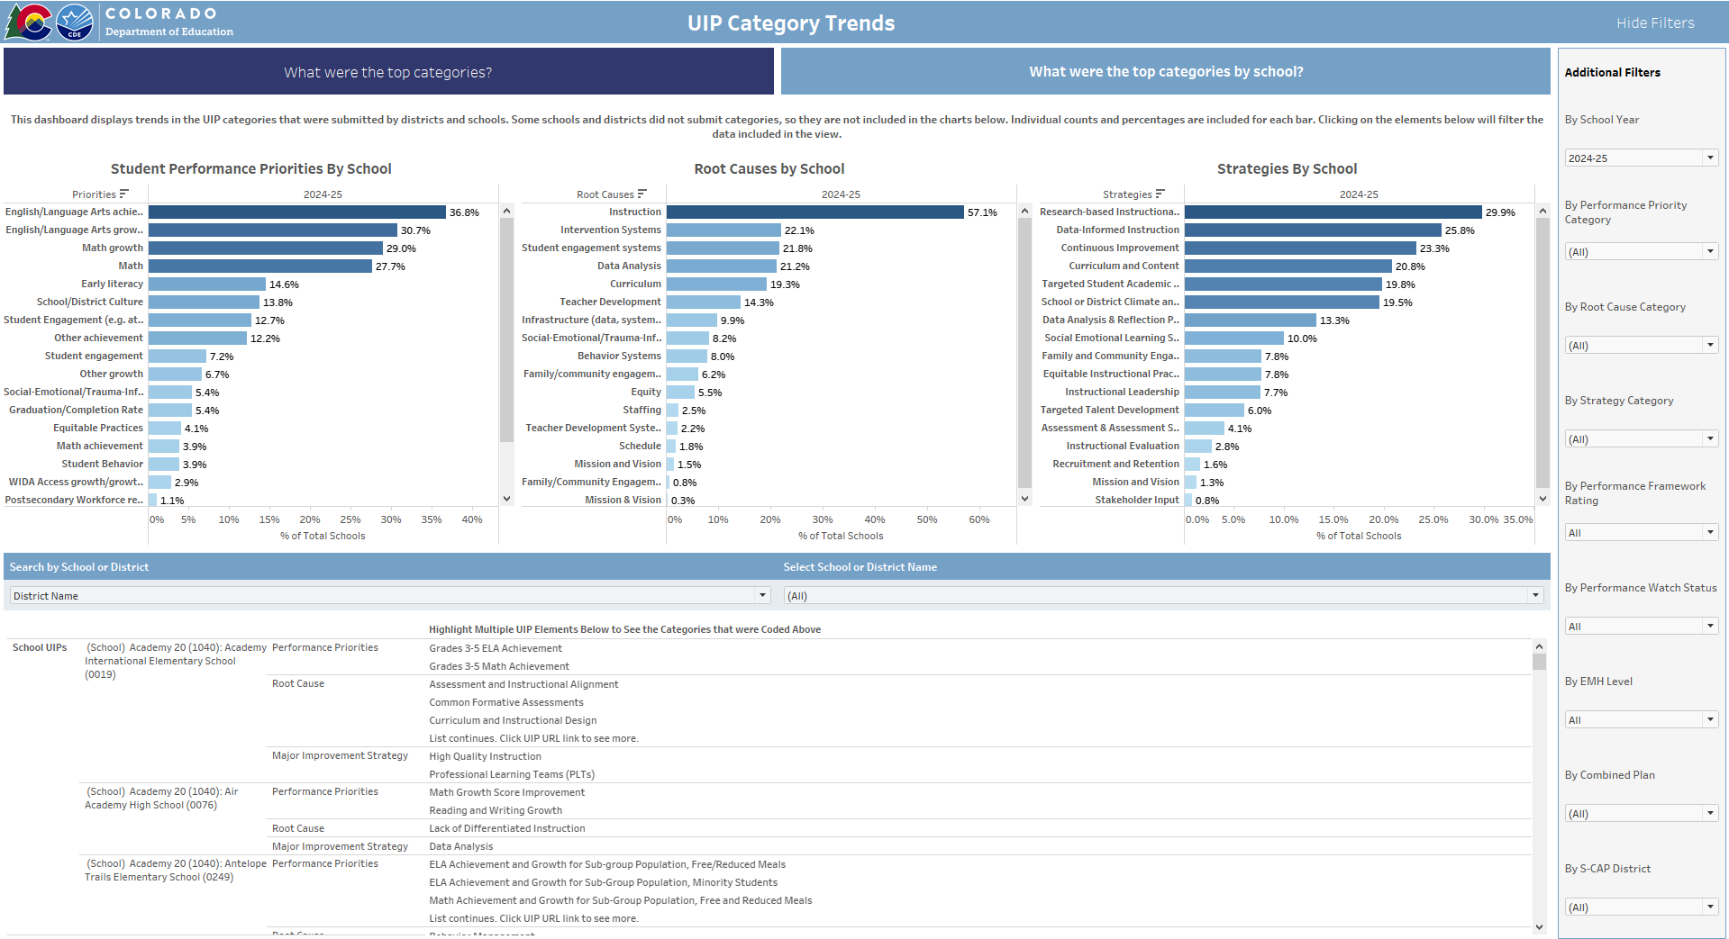
UIP Categories Dashboard – By School
UIP data can be updated automatically each week
Also displays the charts by distinct school count
Can filter by Performance, by EMH level, or UIP type
At any point, data can be downloaded into an Excel file
Notes:
Displaying the data by school helps remove some of the noise in the data from schools selecting multiple categories multiple times

Slide 17
Evaluation of UIP Coding

Slide 18
UIP Coding Categories Theory of Action
Straightforward Coding Process
Straightforward Coding Process: UIP authors are able to quickly and easily apply codes to the main components of their UIP
Accurate Data: Coding data form a concise summary of the improvement priorities and activities occurring in schools
Data-Informed Decision Making: Support providers such as CDE and districts can utilize the data to guide decisions directing support efforts
Differentiated Support: schools receive supports that are relevant to their identified priorities
Accurate
Data
Evaluation Logic Model
Data-Informed Decision Making
Differentiated Support

Slide 19
Theory of Action
Straightforward Coding Process
We must ensure coding process is:
Accurate: Category selection truly represents the prioritization and improvement work in progress
Actionable: Data are specific enough to inform differentiated supports
Clear: UIP Authors can easily identify the most appropriate category for their UIP priority
Complete: Categories represent the full span of potential priorities in each area
Accurate
Data
Evaluation Logic Model
Data-Informed Decision Making
Differentiated Support

Slide 20
Abbreviations
Straightforward Coding Process
Three coded prioritization areas:
SPP: Student Performance Priority
RC: Root Cause
MIS: Major Improvement Strategy
Accurate
Data
Evaluation Logic Model
Data-Informed Decision Making
Differentiated Support

Slide 21
UIP Categories Evaluation
Straightforward Coding Process
CDE is currently investigating:
Possible contributors to data missingness
Potential challenges in category selection
This evaluation will inform:
Changes to coding categories
UIP support and process improvements
Accurate
Data
Evaluation Logic Model
Data-Informed Decision Making
Differentiated Support
Notes:
In this initial phase of the evaluation process, we are focused primarily (but not entirely) on Student Performance Priorities

Slide 22
Missingness by Priority Type
Categories Types | Percent Coded
Student Performance Priorities | 63%
Root Causes | 43%
Strategies | 59%
Notes:
Here we observe that root causes is the category type that UIP authors seem to have the most trouble coding.

Slide 23
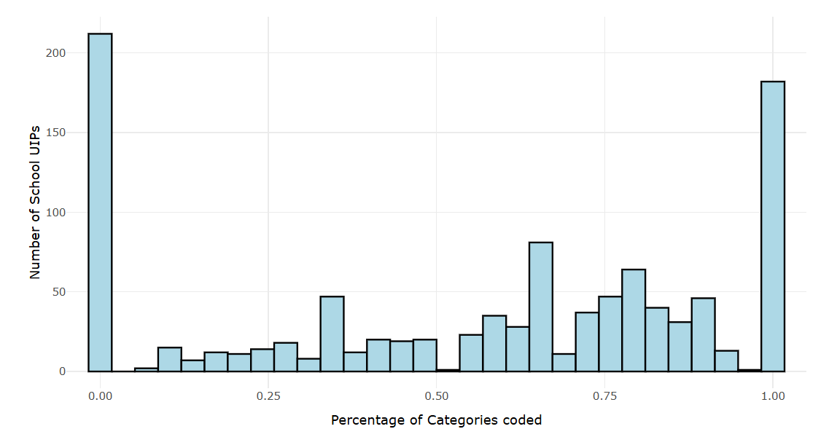
Missingness by School UIP
Notes:
By school UIP we see that most schools either coded all or nothing. Zooming in on the ones in the middle - schools that coded some but not all, may be more informative in discerning causes.

Slide 24
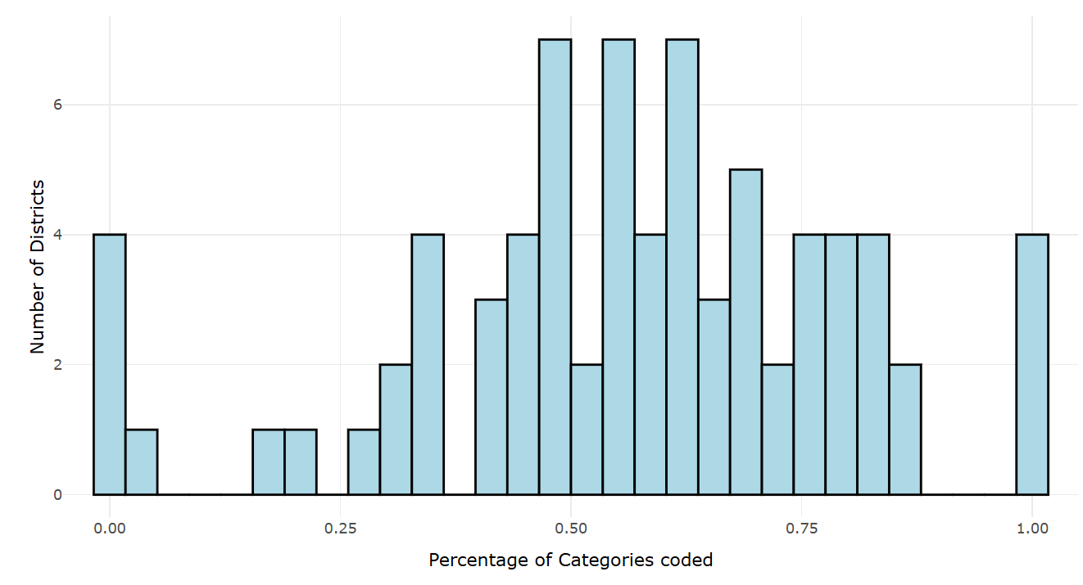
Missingness by School District
Notes:
This graph shows a histogram of percentage of coded categories for all school UIPs by district. Here we see most districts are in the middle. It is worth noting that the 4 districts that had 0% completion and the 4 that had 100% completion all had only one school UIP submitted. So this tells us that it’s unlikely that district TA is meaningfully driving missingness.

Slide 25
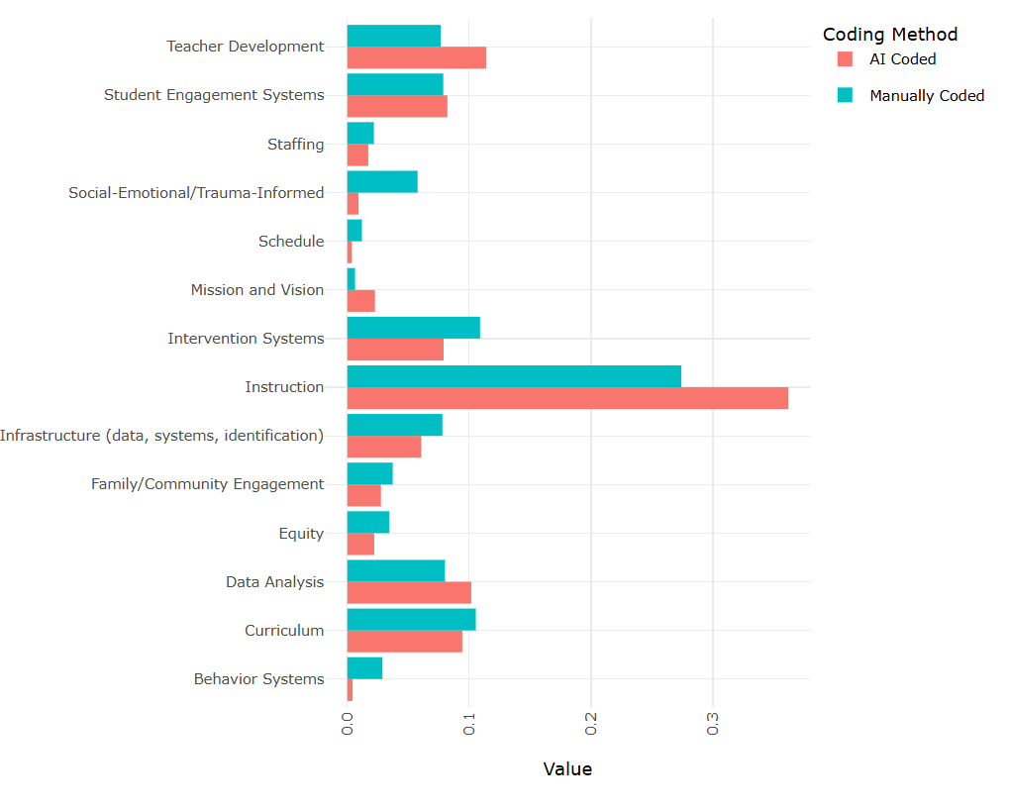
Missingness by Root Cause Category
Notes:
As root cause cause is the area where UIP authors had the lowest rates of coding, we looked here first. We compared the relative frequency of coded categories, to AI matching of Root Cause titles (since this is a required field). We found that the relative distribution of categories coded by authors is similar to the distribution of uncoded categories. Instruction, and Teacher Development are both found slightly more frequently in the uncoded data, suggesting that these might be two areas where authors are having trouble finding an appropriate category to code.

Slide 26
Missingness Summary
Most schools are either coding all, or no UIP elements.
This may suggest that TA around coding, or making it a required field would improve completeness, but still ~⅓ of schools coded a subset of all elements, suggesting further clarity in the categories and/or coding process would further improve completeness.
There does not appear to be a clear missingness trend within districts
This can inform CDE TA regarding coding categories
Coded and uncoded root causes have a similar frequency distribution
This suggests missingness isn’t highly correlated with specific categories so wordsmithing category names may not have as much impact on improving completeness
For root causes specifically, “Instruction” and “Teacher Development” are coded slightly less frequently by authors than AI summaries would predict, suggesting clarifying these categories may improve selection clarity for authors.

Slide 27
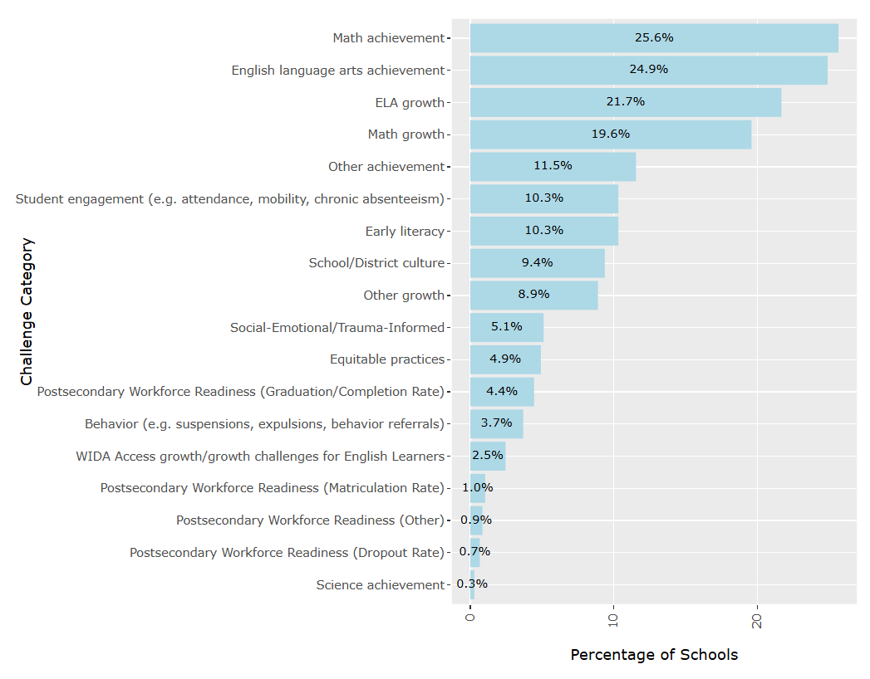
SPP Category Granularity
Student Performance Priority Categories
Notes:
For this portion of the study, we focused first on SPPs. Root Causes and the strategies employed to address them are very contextual to the school. So as a first step, we are focusing our evaluation efforts on Student Performance Priorities as good data there will provide the most useful information to both CDE and districts in understanding the focus of school improvement efforts.
The primary problem that we heard back from the field with this SPP categorization schema is the inclusion of separate categories for achievement and growth for both ELA and Math. Schools told us (justifiably so) that it didn’t make sense to have those separate - after all what sort of intervention would you expect to move student achievement in math without also providing growth. So when we think back about our priorities for categories to be: accuraction, actionable, clear and complete, this is a pretty clear violation of “clear.”

Slide 28
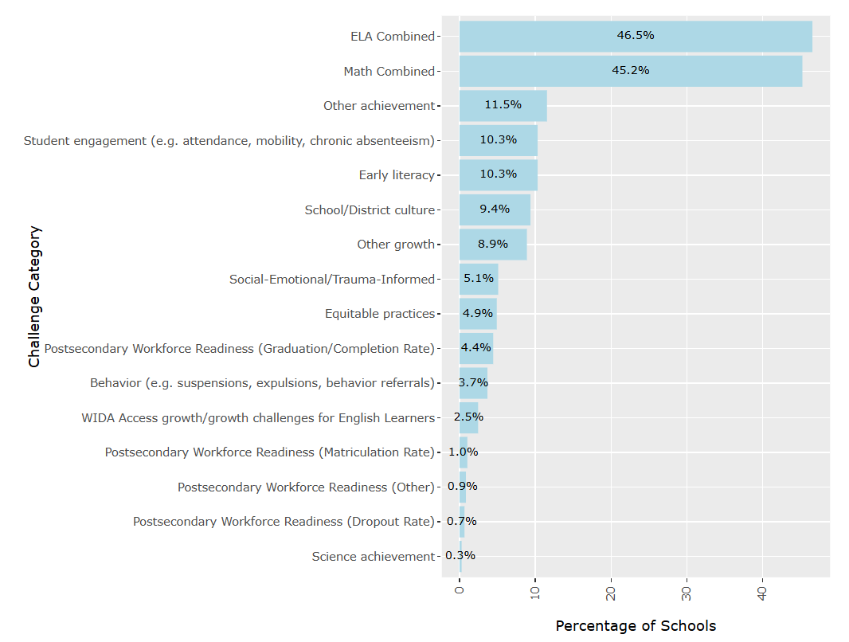
SPP Category Granularity – Combined ELA/Math
Student Performance Priority Categories
Notes:
As a first pass to resolving this clarity issue, we looked at what the distribution of Student Performance Priorities would look like if we simply combined Math and ELA achievement and growth respectively. (It’s not exactly the sum of the two prior categories because some schools had both). But we now see that almost half of all school UIPs include each of those specific SPPs. This is getting us into to danger of violating our priority of “actionable.” If a district looks at their data and sees that half of their schools are focusing on math, and half on ELA, that doesn’t really give them enough information to differentiate supports for their schools.

Slide 29
SPP Category Granularity – By AI Groupings
ELA Performance Priority AI Groupings
Academic Achievement in ELA
Academic Growth in ELA
Subgroup Performance
Literacy and Reading Proficiency
Writing Proficiency
Assessment and Data Analysis
Instructional Quality and Curriculum
Intervention and Support
Equity and Access
Professional Development and Teacher Support
Math Performance Priority AI Groupings
Growth and Achievement Gaps
Subgroup Performance Disparities
Instructional Quality and Curriculum Implementation
Data-Driven Instruction and Intervention
Mathematical Reasoning and Modeling
Post-Pandemic Recovery
Teacher Retention and Professional Development
Student Engagement and Motivation
Resource Allocation and Support
Alignment with State and District Standards
Notes:
To see if we could discern some sub-topics within these SPPs, I fed all the written descriptions of all the student performance priorities that were coded is either ELA or Math into Deepseek and asked it to categorize them it to the top ten most frequent themes. Note that this was a clean prompt and I did provide any information about root causes or any other of our categorizations.

Slide 30
SPP Category Granularity – Root Causes
ELA Performance Priority AI Groupings
Academic Achievement in ELA
Academic Growth in ELA
Subgroup Performance
Literacy and Reading Proficiency
Writing Proficiency
Assessment and Data Analysis
Instructional Quality and Curriculum
Intervention and Support
Equity and Access
Professional Development and Teacher Support
Math Performance Priority AI Groupings
Growth and Achievement Gaps
Subgroup Performance Disparities
Instructional Quality and Curriculum Implementation
Data-Driven Instruction and Intervention
Mathematical Reasoning and Modeling
Post-Pandemic Recovery
Teacher Retention and Professional Development
Student Engagement and Motivation
Resource Allocation and Support
Alignment with State and District Standards
These are root causes!
Notes:
The first thing we see is that there are lots of root causes showing up in the description of performance priorities. Perhaps this isn’t too surprising since UIPs are written all at once, and schools are instructed to match their SPPs with root causes, so it makes sense that there would be some reference to the causes in their authored descriptions. However, after going back and reviewing specific entries, it’s pretty clear that many UIPs are conflating CDE’s intended definitions of SPPs with RCs.
I also want to note that in a separate section of the UIP, authors can indicate if the specific SPP they are identifying is specific to a student group.

Slide 31
SPP Category Granularity Summary
Having separate student performance priority categories for Math Growth and Math Achievement is confusing for UIP authors (similarly for ELA).
The high frequency of categorizations (45%) combining Math Growth with Math Achievement highlights the lack of differentiability in the category data that limits its utility for support planning.
Deeper analysis suggests that in addition to a granularity problem in the categories themselves, underlying disconnects between intended CDE UIP process distinctions between SPPs, RCs, and Strategies may highlight further need for process clarification and/or technical assistance.
Notes:
Third Bullet Point: If you recall, one of the intended purposes behind the categorizations was to help put rails on the types of topics UIP authors are using - e.g. that they are using appropriate root causes. This finding suggests that while the categorization may be helping, it may also be masking a disconnect that persists.

Slide 32
TAP Recommendation
Regarding the UIP Categorization Data and Corresponding Dashboard:
Beyond its use in helping CDE and districts identify and differentiate supports, what other use cases for the UIP categorization data can you envision?
How can we make these data more reliable, transparent, and accessible?
Regarding the evaluation of the UIP categories themselves:
How can we improve the categories to be more: accurate, actionable, clear and complete?
What recommendations do you have about further studies we could conduct on the 24-25 data to inform final categorizations for the 25-26 UIPs?

Slide 33
Break
5 minutes

Slide 34
HB25-1278 Education Accountability System
Lisa Medler
Information Item

Slide 35
Updates on the Accountability Bill (HB 25-1247)
Policy Development Structures
State Legislature
State Board of Education
CDE Documentation and Guidance
(Feb 20) Bill introduced on Feb 20: https://leg.colorado.gov/bills/hb25-1278
(Feb 28) State board voted to pursue changes: https://go.boarddocs.com/co/cde/Board.nsf/goto?open&id=DE2PMV6533FD
(March 11) Fiscal Note published: https://leg.colorado.gov/sites/default/files/documents/2025A/bills/fn/2025a_hb1278_00.pdf
Amendments are being drafted now

Slide 36
Main Sections of the Accountability Bill (HB 25-1278) - 1 of 4
Theme Area | 1241 Task Force Recs | Current Bill Summary | SBE/CDE Proposal
State Assessments | Divide CMAS into sections for students with disabilities Translate CMAS into more languages Results to districts sooner | Divide CMAS for all students Expands translation to all content areas in multiple languages Specifies June 1 deadline for results | Study dividing CMAS into sections Alternate language to create threshold for translation Re-examine June 1 deadline
Framework Adjustments | Move SAT to Achievement Combine student groups Expand how students with disabilities are counted Add criteria for earning a Distinction rating | Generally follows TF recommendations Students with 504 plans are referenced instead of students on IEPs | Adjust special ed definition to students on IEPs Adjust level of specificity on the Distinction criteria

Slide 37
Main Sections of the Accountability Bill (HB 25-1278) - 2 of 4
Theme Area | 1241 Task Force Recs | Current Bill Summary | SBE/CDE Proposal
Frameworks - PWR Indicator | Add a “college and career readiness before graduation” subindicator Change “matriculation” to “postsecondary progression” subindicator | Generally follows the TF recommendations New PWR measures by 2026-27 | More flexibility in defining PWR measures Adjust timing to 2027-28 Align CCR before graduation to the “Big Three” (postsecondary credit, industry credentials, work-based learning)
Public Reporting | Create a single coherent state dashboard for state and local data Enhance user experience and functionality | Include state dashboard with some additional reporting, including on participation | Add stakeholder engagement and a cost analysis for a cohesive state dashboard

Slide 38
Main Sections of the Accountability Bill (HB 25-1278) - 3 of 4
Theme Area | 1241 Task Force Recs | Current Bill Summary | SBE/CDE Proposal
Insufficient State Data (ISD) | Require a corrective action plan, including a hearing with the state board in Year 3 | Follows the TF recommendations Connects to indicators of distress | Delete the connect to indicators of distress Enhanced proposal to enable CDE to collect more information to address root causes
Continuous Improvement (inc accountability clock) | Fourteen recs on increasing universal supports, early clock supports, late clock supports and action, improvement planning and awards | Adds early indicators of distress Supports for bold solutions for sites on clock Guidance for local boards on planning Evaluation of external managers | Differentiate indicators of distress from clock Add more tools for end of clock options and refine language Move some requirements from schools to districts

Slide 39
Main Sections of the Accountability Bill (HB 25-1278) - 4 of 4
Theme Area | 1241 Task Force Recs | Current Bill Summary | SBE/CDE Proposal
Areas for Further Study | Four recommendations for additional study, plus additional areas suggested throughout report | Adds 12 new studies with 10 legislative reports All reports due Nov 2026 Expands TAP to include 3 sups | AWG is an option for additional membership Move timelines to 2027 Wording on Studies #2 and #9
Studies include
Lowering Student Count Thresholds on Accountability Calculations and Reporting
Addressing inherent volatility of test score measurements for local education providers with small student populations
College and career readiness before graduation sub-indicator
Weighting the performance frameworks and potential adjustments
Implementing adaptive assessment technology
Data and strategies for [sites] in Year One or Year Two of a Priority Improvement or Turnaround
Performance awards and make recommendations on additional benefits
Expansions to the State Review Panel
How to align the accreditation system and to increase equitable access to state assessments
Make recommendations on accreditation category label ratings
Determine best practices for participation in the school accountability system
Adjustments to state assessments based on available technology

Slide 40
Public Comments & Meeting Close
Aislinn Wales & Ryan Marks

Slide 41
Technical Advisory Panel
Meeting Summary
Suggested future analysis
TAP recommendations from this meeting
Public Comment
Close Meeting
Next Scheduled Meeting: April 17

