Slide 1
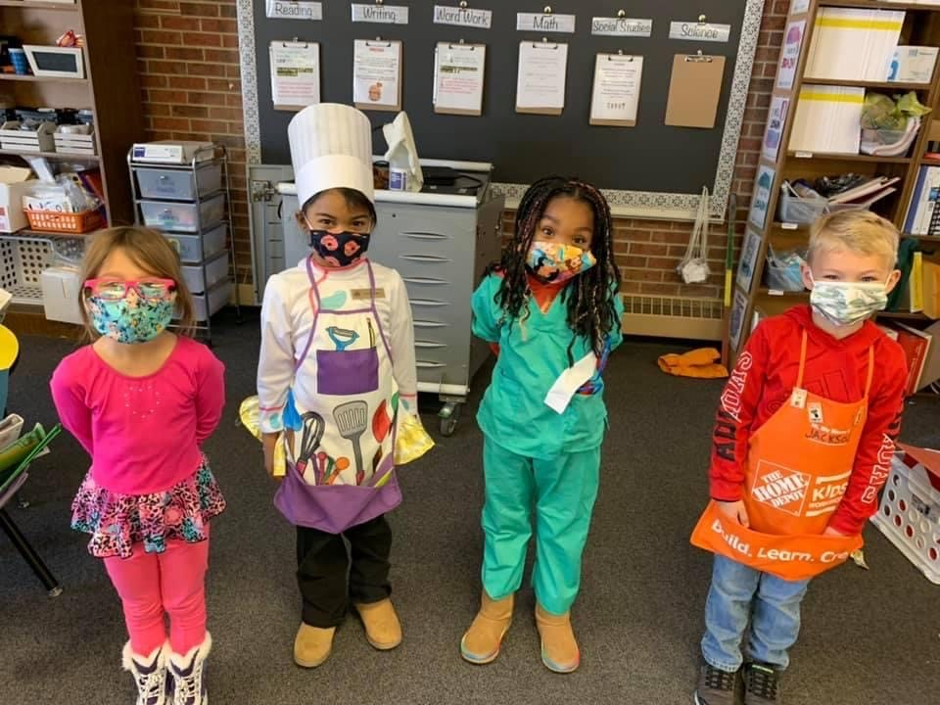
Demographics Matter

Slide 2
Example
Read the following and
develop a summary of the text
Read and answer the question asked

Slide 3
Considerations
This is our time to make a large impact on serving our most underserved populations and provide them a voice
Perhaps the current Colorado system is setting too easy of an achievement target for wealthy districts and too difficult a target for impoverished districts, which doesn’t foster improvement for schools, more just maintaining the status quo
We are not measuring student outcomes in our current system; rather, we are measuring input and social economic levels

Slide 4
Facts
Achievement mean scale scores exhibit a strong negative correlation with %FRL
These correlations are true for both contents ELA and Math
The achievement scoring is still a significant portion of the framework total score
    It is 40% of the total score for elementary and middle schools
    It is 30%* of the total score for high schools and districts
      *If you include the SAT as an achievement metric, it is closer to 39% of the total score
The Colorado Growth model has very weak to weak correlations with demographics
Student gaps are not being identified in all systems as they can hide

Slide 5
2023 DPF
> 50% FRL
>70% Minority
At least 5,000 students
DIST_NAME | K12_ENROLLMENT | K12_PCT_FRL | RATING_FINAL
Harrison 2 | 12,267 | 75% | Accredited
Denver County 1 | 83,002 | 63% | Accredited with Improvement Plan
Greeley 6 | 22,143 | 65% | Accredited with Improvement Plan
Mapleton 1 | 6,554 | 68% | Accredited with Improvement Plan
Pueblo City 60 | 14,404 | 77% | Accredited with Improvement Plan
Westminster Public Schools | 7,430 | 79% | Accredited with Improvement Plan
Adams-Arapahoe 28J | 36,373 | 76% | Accredited with Priority Improvement Plan
Adams County 14 | 5,293 | 83% | Accredited with Priority Improvement Plan

Slide 6
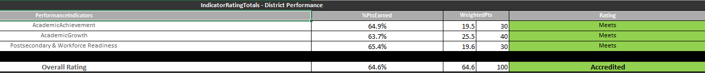
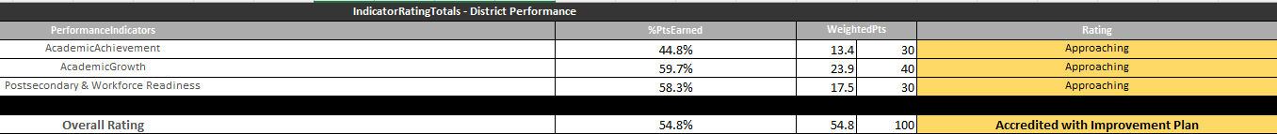
Cherry Creek
DPF that is published and shared
DPF if only counting subgroups
:

Slide 7
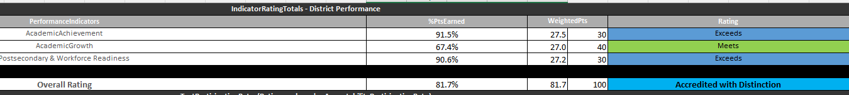
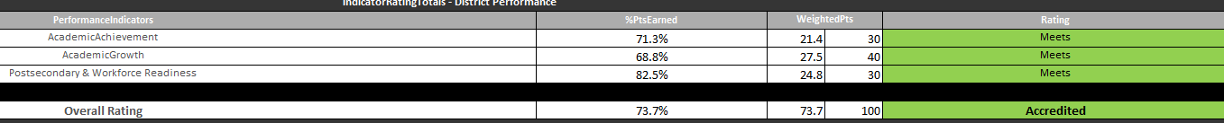
Cheyenne Mountain D12
DPF that is published and shared
DPF if only counting subgroups

Slide 8
Goals
We want to measure all student outcomes
We want to identify gaps of students not performing
We want to minimize or delete the impact of demographics on our frameworks

Slide 9
Then….
(ideas from educators in the system)
We can increase the weight on growth as it isn’t highly affected by demographics
Factor a metric into achievement for those with certain poverty levels
Analyze the gaps between top achieving group and lowest achieving group
Set goals by individual school and district based on previous performance (MA, GA)
Use multiple research-based sources that show impact
  Attendance
  School climate
  Closing gaps (measure of subgroup data)
Incorporate local measures that are meaningful to the community

Slide 10
Student thoughts
“Quit continuing the stereotype that students in poverty are less than,” Blair Middard
“Be brave. Challenge the status quo. Show that you value all students in Colorado regardless of their background,” Joaquin Chavez
“We are already called ‘ghetto kids’ when we go play sports, please don’t continue to allow people to look down on us with academics,” Diego Hernandez
“Quit judging us based on our family income. I didn’t ask to be born into poverty,” Goddess Innis

