Slide 1
Technical Advisory Panel Meeting
October 5, 2023

Slide 2
Welcome & Introductions
Welcome from CDE
  The purpose of the TAP is to provide non‐binding technical recommendations to CDE regarding the Colorado Growth Model, state accountability, and other topics as needed.
Meeting Logistics:
  Non‐members, please add your Name/Affiliation to the chat box.
  Everyone please mute your sound.
  We ask all non‐TAP members to hold any comments until the end of the meeting. We do this to ensure we have sufficient time to address all meeting agenda items.
Introductions with Ryan Marks, TAP Chair

Slide 3
Agenda for Today
Welcome and Introductions
  Information Item
Accountability Updates – Lisa Medler
  Information Item
New Higher Bar Sub Indicators – Marie Huchton
  Information Item
On-Track Growth Indicators – Marie Huchton
  Feedback Item
Wrap-Up

Slide 4
Accountability Updates
Information Item
Lisa Medler

Slide 5
Current State Accountability

Slide 6
Overarching Accountability Timeline
2023 Frameworks Released
1241 Task Force Begins*
Fall 2023
2023 Supplemental Framework Report
Winter 2024
Spring 2024
Interim Report Due
2024 Framework with New Measures for Points
Final Report Due
Fall 2024
* Per HB23-1241

Slide 7
2023 State Accountability Timeline
Anticipated Timeframe | Activities/Actions
June 29 | Districts Receive ACCESS Growth Data
August 14 | Districts Receive CMAS and P/SAT Achievement, Growth, Participation Data; UIP Data Dashboards available
August 17 (SBE Meeting) | Public Release of Colorado Growth Data Results; Alternative Education Campus (AEC) Designations Finalized
August 21 | Districts Receive Matriculation Data
August 23 | Preliminary Performance Frameworks Released to Districts. Public release August 29.
September 12 | AEC Performance Frameworks Released
Early September | ESSA Identifications (i.e., CS, TS, A-TS) Released to Districts. Districts will need to notify schools.
September 22 | Accreditation Form Submissions Due for ALL Districts
October 16 | Unified Improvement Plan (UIP) Submissions Due Final Request to Reconsider Materials Due (for participating districts)
November 8-9 (SBE Meeting) | District Accreditation Ratings & School Plan Types Finalized for Districts/Schools not participating in request to reconsider
December 13-14 (SBE Meeting) | District Accreditation Ratings & School Plan Types Finalized for Districts/Schools participating in request to reconsider
By December 31 | District Accreditation Contracts Due
Late January | Informational reports release to districts with new measures (e.g., PWR Higher Bar measures).

Slide 8
Timeline for Upcoming Accountability Discussions
with the State Board of Education
Anticipated Timeframe | Activities/Actions
September 13 & 14 | CDE presents on statewide trends of 2023 Preliminary Performance Frameworks (informational) AND CDE presents on New framework measures (informational)
October 11 & 12 | CDE presents on statewide framework targets for 2024 including anticipated new measures (informational)
November 8 & 9 | SBE votes on 2024 statewide framework targets (vote) AND SBE finalizes District Accreditation Ratings & School Plan Types not participating in request to reconsider (consent item)
December 13-14 | SBE finalizes District Accreditation Ratings & School Plan Types Finalized for Districts/Schools participating in request to reconsider (vote)

Slide 9
Task Force Updates

Slide 10
H.B. 23-1241: Accountability, Accreditation, Student Performance, and Resource Inequity Task Force
Link to Bill: https://leg.colorado.gov/bills/hb23-1241
Purpose: Creates a representative task force of 26-members that studies academic opportunities, inequities, promising practices in schools, and improvements to the accountability and accreditation system.
Task Force Website: https://www.cde.state.co.us/accountability/accountability-task-force
Builds upon: Accountability Audit and the Local Accountability System Grant
Timeline:
  July 1, 2023: Task force members appointed
  August 15, 2023: Department contracted with a facilitator
  August 24, 2023: Convened first meeting
  March 1, 2024: Interim report
  November 15, 2024: Final report reflecting findings and recommendations to the education committees of the house of representatives and senate, the governor, the state board, the commissioner of education and the department.

Slide 11
H.B. 22-1215: Study Of Expanding Extended High School Programs
Link to Bill: https://leg.colorado.gov/bills/hb22-1215
Purpose: Develop and recommend policies, laws and rules to support the equitable and sustainable expansion and alignment of programs that integrate secondary, postsecondary and work-based learning opportunities in every region of the state.
Task Force Website: https://www.cde.state.co.us/postsecondary/secondary_postsecondary_and_work-based_learning_integration_task_force
Timeline:
  July 2022: Convened first meeting
  December 1, 2022: Interim report
  December 1, 2023: Final report reflecting findings and recommendations to the governor, the Education Leadership Council, the State Board of Education, the Colorado Commission on Higher Education, and the Education Committees of the Senate and the House of Representatives, or any successor committees.

Slide 12
New Higher Bar Sub Indicators
Information Item
Marie Huchton

Slide 13
Two New PWR Sub-Indicators
S.B. 17-272- Higher Bar for ELA & Math
  Higher achievement levels in ELA and Math, as defined by the State Board, on certain graduation guidelines measures
    (Accuplacer, ACT, ACT Work Keys, AP, ASVAB, Concurrent Enrollment, IB, SAT).
H.B. 18-1019- Higher Bar for Other Courses
  Successful completion of AP, IB, and/or Concurrent Enrollment for non-ELA and non-Math courses.
    AP examination score of 3 or higher
    IB examination score of 4 or higher
    CE course grade of B or higher

Slide 14
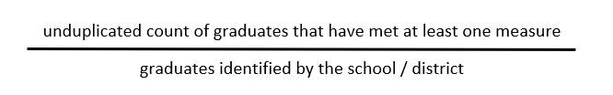
PWR Sub-Indicator Calculation Methodology
At the February 2021 meeting, TAP recommended using the same calculation methodology for both sub-indicators: Graduation Guidelines reporting is required for graduates Consistency in the denominator between the two sub-indicators Counting at graduation allows for a complete dataset across the state
About 85% of IB examinations are taken in the final year of high school About 65% of AP examinations are taken in the final two years of high school A graduate is counted in the numerator if they met the requirement at any time during grades 9-12.
Notes:
Ensures that concurrent enrollment data collected via graduation guidelines includes all students who met the requirement at any time during high school will be counted as a success

Slide 15
Data Build for Higher Bar and Non-ELA/Math Metrics
Advanced Placement Exams
Aggregated student level file. Contains 1 student record from each contributing file that provides “best-of” outcome for that data stream.
International Baccalaureate Exams
Unique by Student ID. Includes “best-of” numerator value from all available files for Higher Bar metric and Non-ELA/Math metric
Concurrent Enrollment from CDHE
Grad Guidelines Collection
Matriculation File to establish denominator
CO SAT

Slide 16
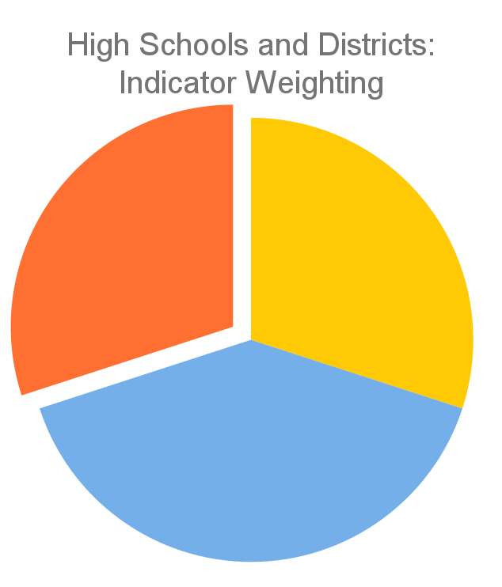
Current PWR Indicator Points
Only available for high schools and districts
Contributes 30% of the points in determining overall high school or district plan types
Currently consists of five sub-indicators:
  SAT Evidence-Based Reading/Writing
  SAT Math
  Dropout Rates
  Matriculation Rates
  Graduation Rates
PWR 30%
Achievement
30%
Growth
40%
Current PWR Indicator: Points by Sub-Indicator & Level
SAT EBRW (8 points): Mean Scale Score [All Students (4) & Disaggregated (1 each)]
SAT Math (8 points): Mean Scale Score [All Students (4) & Disaggregated (1 each)]
Dropout (16 points): Rate [All Students (8) & Disaggregated (2 each)]
Matriculation (4 points): Rate [All Students (4)]
Graduation (16 points): Rate [All Students (8) & Disaggregated (2 each)]

Slide 17
August TAP Meeting -
Recommendation to the State Board of Education
At the August TAP Meeting, TAP members finalized the following statement for the board:
“The proposed higher bar data are highly complex and incorporate data from multiple sources coming from outside CDE including self-reported data from schools and districts. As a result, these data are not of the same quality as most other data used in the performance frameworks. Additionally, there are built-in inconsistencies in how some of the data is coded and it will be labor-intensive to gather and maintain these data. Finally, because of these challenges with the data, it is likely that the measure will not be as accessible and transparent to many users as are other measures on the current performance framework. Moreover, CDE research shows that these higher bar measures will be highly correlated with other PWR measures and therefore will not result in further differentiating performance between schools and districts on the PWR indicator. At the same time, the addition of these measures may reduce the ease with which these frameworks can be understood or explained to schools and communities. Based on these concerns and others around data quality and equity of impacts, and in alignment with the statute that states that these accountability measures must be ‘fair, balanced, objective, and transparent’ [C.R.S. 22-11-102 (2)(e)], it is the professional and technical opinion of the Technical Advisory Panel (TAP) that the available data needed to calculate these new measures does not meet the statutory requirements and, therefore, should not be included in the school and district performance frameworks at this time.”

Slide 18
Update - September 14 Board Meeting
Link to the recording: https://www.cde.state.co.us/cdeboard/watchlive, presentation begins 1 minutes & 30 seconds into the 9/14 meeting

Slide 19
Break
(10 minutes)

Slide 20
On-Track Growth Indicator
Feedback Item
Marie Huchton

Slide 21
On-Track Growth | Overview
Colorado’s educational accountability law requires a metric that determines whether a student is making enough growth to reach a target level of achievement within a given timeframe. This measure has not been included in frameworks since 2015, when it was referred to as adequate growth.
In 2019, the State Board of Education voted to adopt the following methodology for On-Track Growth for grades 3-8:
  Catch Up: Whether students scoring below grade level are catching up to grade-level expectations within two years.
  Keep Up: Whether students who are already meeting grade-level expectations are maintaining their performance for two years.
A methodology still needs to be determined for high schools and districts. Conversations with the board about this occurred during the September 14th board meeting and will continue this fall.

Slide 22
Elementary/Middle School
On-Track Growth

Slide 23
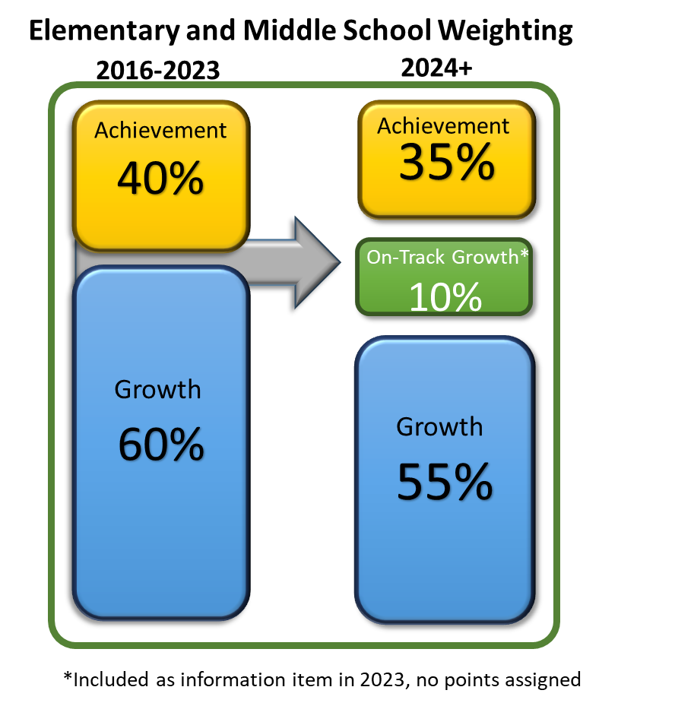
Approved Indicator Weightings for Elementary & Middle School
Points Eligible for On-Track Growth will be the same as for the Achievement and Growth metrics. (All Disaggregated groups combined = ½ All Students group weight)
ELP On-Track measures will move into On-Track Growth indicator.
State board approved revised indicator weightings for elementary & middle schools (see graphic)

Slide 24
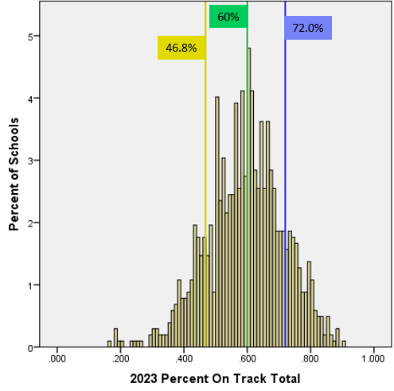
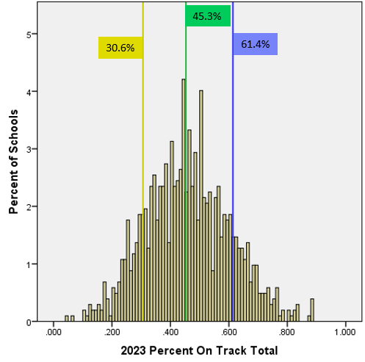
2023 On-Track Growth Targets- Elementary
2023 CMAS ELA
2023 CMAS MATH

Slide 25
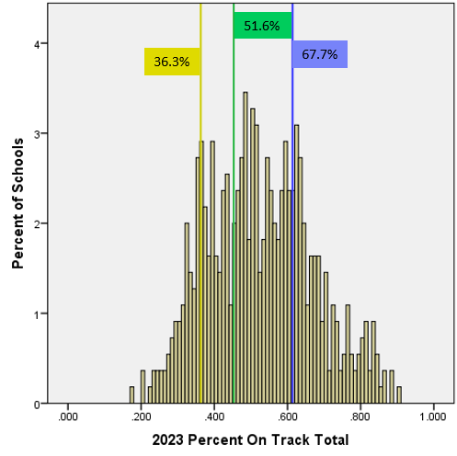
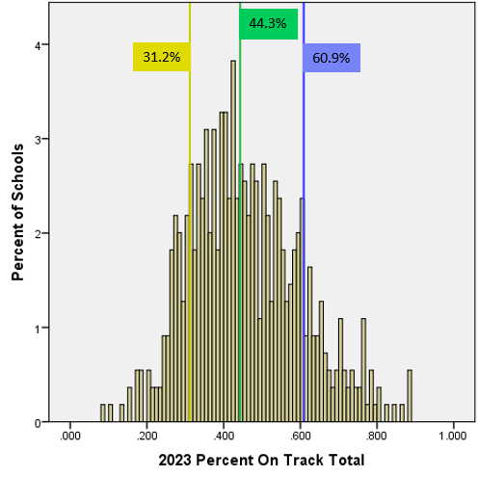
2023 On-Track Growth Targets- Middle School
2023 CMAS ELA
2023 CMAS MATH

Slide 26
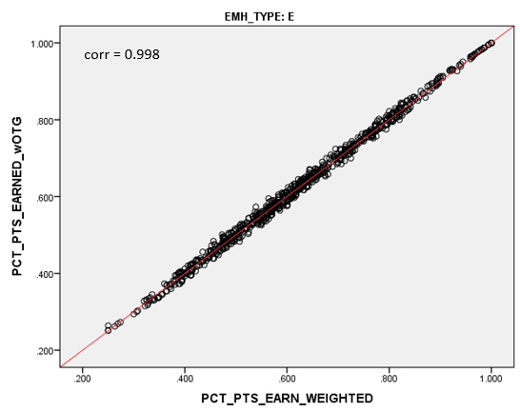
On-Track Growth Impact Data- Elementary Only

Slide 27
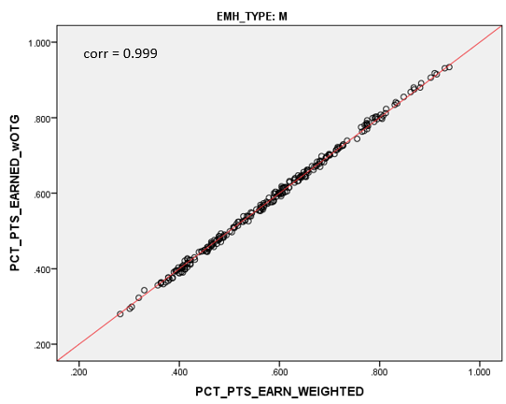
On-Track Growth Impact Data- Middle School Only

Slide 28

On-Track Growth Impact Data- Elementary & Middle Combined

Slide 29
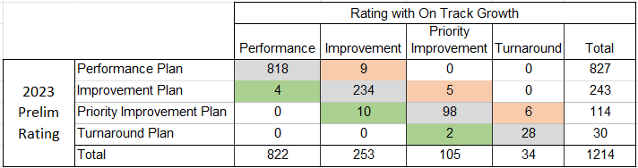

On-Track Growth Impact Data- E, M, & EM
Results in minimal changes to school-level framework ratings.
Note that this count includes Elementary, Middle, and EM schools (excludes school serving high school grades).

Slide 30
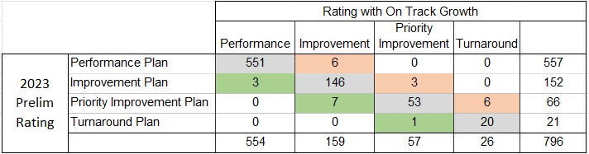

On-Track Growth Impact Data- Elementary
Results in minimal changes to school-level framework ratings.
Note that this count includes only Elementary schools.

Slide 31


On-Track Growth Impact Data- Middle
Results in minimal changes to school-level framework ratings.
Note that this count includes only Elementary schools.

Slide 32
High School/District
On-Track Growth

Slide 33
High School/District On-Track Growth Considerations
Limitations in analyses presented in March TAP meeting:
  Differences in proficiency expectations and number of levels for CMAS v. PSAT
  Lower participation than usual in 2021 (58% g8 Math, 73% g9 and 10 PSAT) with over-representation of higher achieving students
  Student progress and projections were baselined against a composite academic peer group with scores from 2017, 2018, and 2019
  2018 was the first-year grade 9 PSAT was administered, so baseline projections for grade 9 Math were not available
PSAT/SAT has been confirmed as the vendor for Colorado’s high school assessments starting in spring 2024

Slide 34
Considerations for the 2024 Digital SAT
Presentation from CDE’s Assessment Unit with additional detail on the transition to digital PSAT/SAT test administration.

Slide 35
Prior TAP Recommendations
At the May TAP meeting:
For high schools and districts, TAP recommended delaying the On-Track Growth measure to gather more information about changes to the digital version of the PSAT/SAT.
For elementary/middle schools, TAP recommended sharing the On-Track Growth data to districts or in spreadsheets but not using the measure for accountability purposes until there is a better plan for On-Track Growth for high schools and districts.

Slide 36
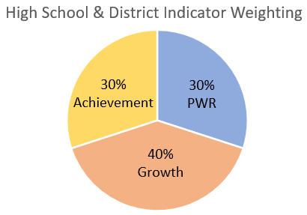
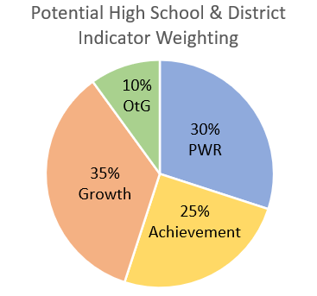
High School & District Indicator Weightings
Current weightings
Would need to investigate and get SBE approval for any revised weightings before adding On-Track to framework

Slide 37
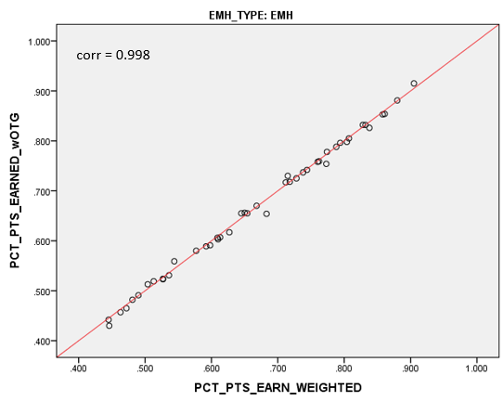
On-Track Growth Impact Data- Elementary, Middle, High Combined

Slide 38
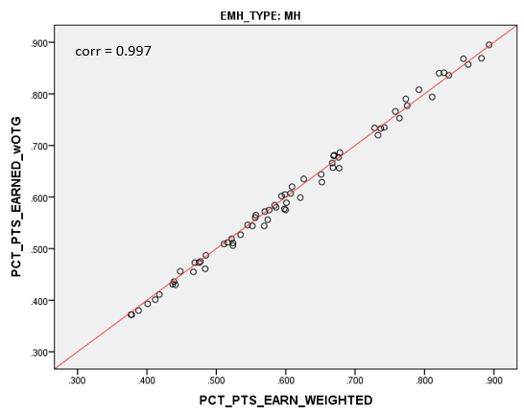
On-Track Growth Impact Data- Middle & High Combined

Slide 39
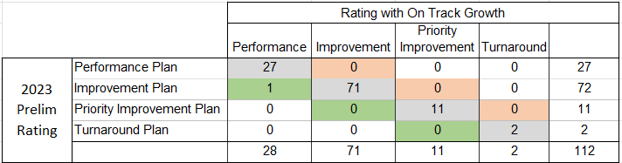

On-Track Growth Impact Data- MH & EMH
Results in minimal changes to school-level framework ratings.
Note that this count includes MH and EMH schools.

Slide 40
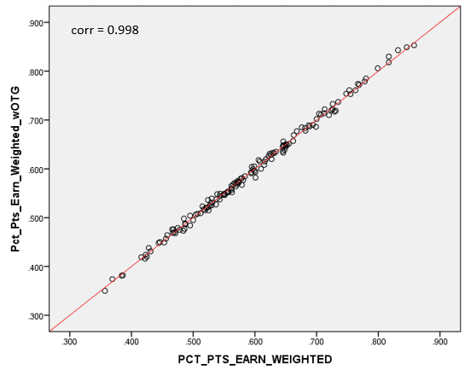
On-Track Growth Impact Data- Districts

Slide 41
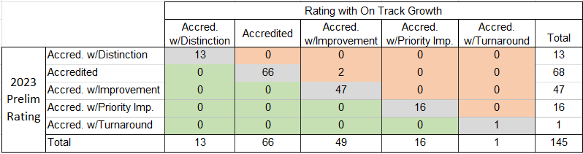

On-Track Growth Impact Data- Districts
Results in minimal changes to district-level framework ratings.

Slide 42
Limitations to Impact Analysis
Presented outcomes do not move the points for ELP On Track Growth into the new On Track Growth outcome.
Potential issue: ELP On Track as part of the heavily weighted growth indicator is currently worth about 4.3% of E and M total framework points and 2.9% for districts and schools serving high school grades.
If ELP On Track was incorporated into new On Track indicator at the current 2-point level, it would be worth 0.8% of total framework points for all schools and districts.
What approach (if any) would make the most sense?

Slide 43
TAP Recommendation
If the State Board wants to move forward with implementing Elementary and Middle School On Track Growth for 2024, does the TAP recommend applying 10% of the total points in the district performance framework calculations to On Track Growth and decrease Achievement to 25% and Growth to 35%?
Or should CDE re-run these analyses with other weight options? and/or with ELP On Track included?

Slide 44
Public Comments and Meeting Close

Slide 45
Technical Advisory Panel
Meeting Summary
  Suggested future analysis
  TAP recommendations from this meeting
Public Comment
Close Meeting
  Next Scheduled Meeting: November 16, 1-4pm

