Slide 1
WIFI ACCESS
COW-GUEST-WIRELESS
No Login Needed

Slide 2
UIP Updates:
2017-18 School Year
Notes:
Handouts:
Changes to template doc
Quality Criteria???

Slide 3
Topics for UIP Updates
Updates on the online system
Reminders for expectations in UIP
New and upcoming expectations in UIP
Sharing back: data from the system
Notes:
How many people

Slide 4
Updates for the Online System

Slide 5
Performance “Framework” (2017 framework)
Academic Achievement
Students have met the learning objectives described in the standards for a given content area and grade level or course
ELA, Math, Science, PSAT
All students, Previous READ Plan, Dissaggregated group
Academic Growth
Students are meeting learning objectives over a given span of time
ELA, Math, PSAT, English Language Proficiency*
All students, Dissaggregated group
Post-Secondary Workforce Readiness
Graduates demonstrate the knowledge and skills needed to succeed in postsecondary settings and to advance in career pathways as lifelong learners and contributing citizens
Dropout Rate, Graduation Rate, Matriculation, SAT
NWEA MAP Mean RIT Scores, Galileo students at benchmark, DIBELS % at benchmark
STAR Growth Percentiles; K-3 literacy growth: change in number of students at benchmark from fall to spring
CTE Participation Rate, Concurrent Enrollment Rate, FAFSA Completion
Performance Indicator
Indicator
Definition
Performance Framework Measures
Possible Local Measures
Big Idea
Ways to Measure “Big Idea”
(Current Performance, Notable Trends, Priority Performance Challenges, Target Setting)

Slide 6
Performance “Framework” (2017 framework)
Academic Achievement
Students have met the learning objectives described in the standards for a given content area and grade level or course
ELA, Math, Science
All students, Previous READ Plan,PSAT, Dissaggregated group
Academic Growth
Students are meeting learning objectives over a given span of time
ELA, Math, P(SAT) English Language Proficiency*
All students, Dissaggregated group
Post-Secondary Workforce Readiness
Graduates demonstrate the knowledge and skills needed to succeed in postsecondary settings and to advance in career pathways as lifelong learners and contributing citizens
Dropout Rate, Graduation Rate, Matriculation, SAT
NWEA MAP Mean RIT Scores, Galileo students at benchmark, DIBELS % at benchmark
STAR Growth Percentiles; K-3 literacy growth: change in number of students at benchmark from fall to spring
CTE Participation Rate, Concurrent Enrollment Rate, FAFSA Completion
Performance Indicator
Indicator
Definition
Performance Framework Measures
Possible Local Measures
Locally Defined Performance Indicator
Locally defined: Whole Child, Social Emotional Learning, Arts Integration, etc.
Locally Defined Measure
Big Idea
Ways to Measure “Big Idea”
(Current Performance, Notable Trends, Priority Performance Challenges, Target Setting)

Slide 7
Implications for Improvement Planning
Structure of UIP template
Descriptors of Trends, Targets
Theses are NOT new “requirements,” but flexibility to respond to local priorities

Slide 8
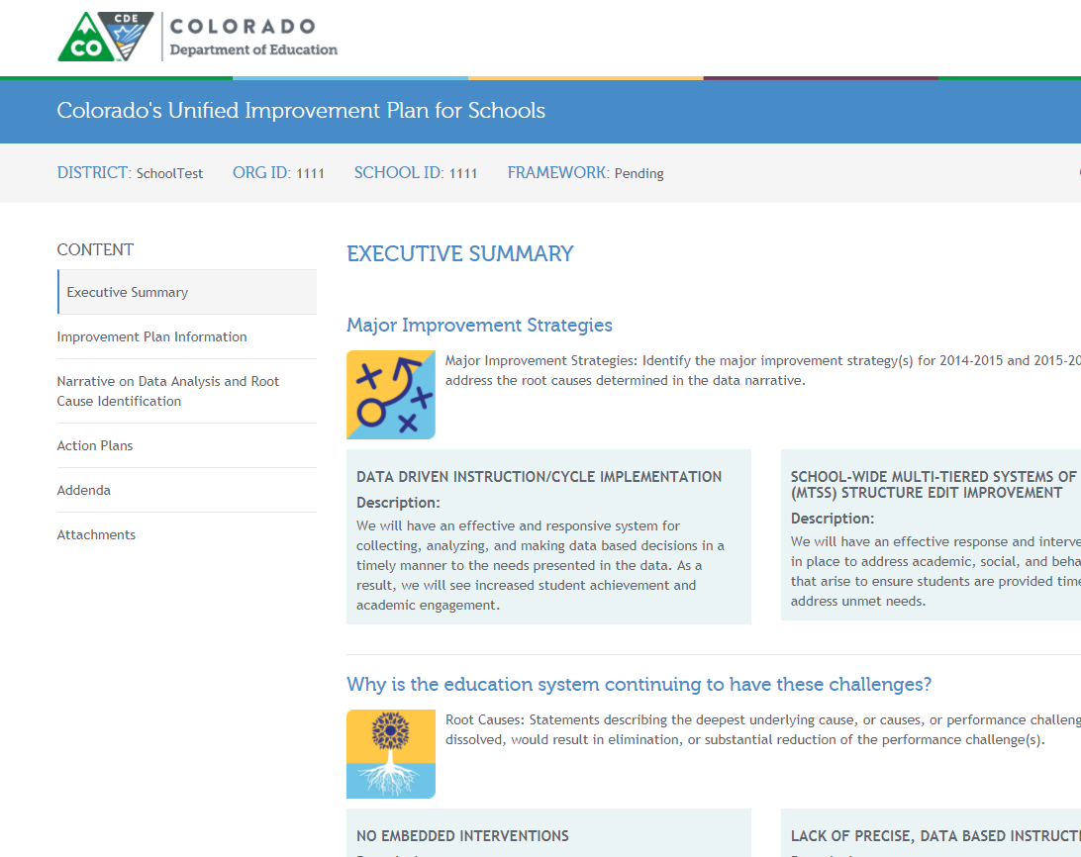

Slide 9
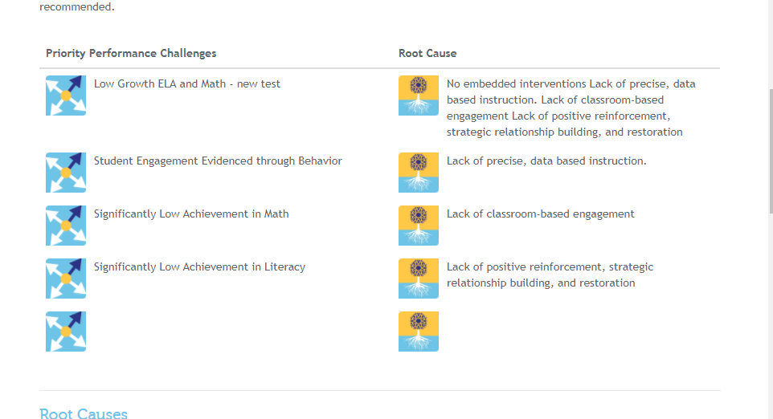

Slide 10
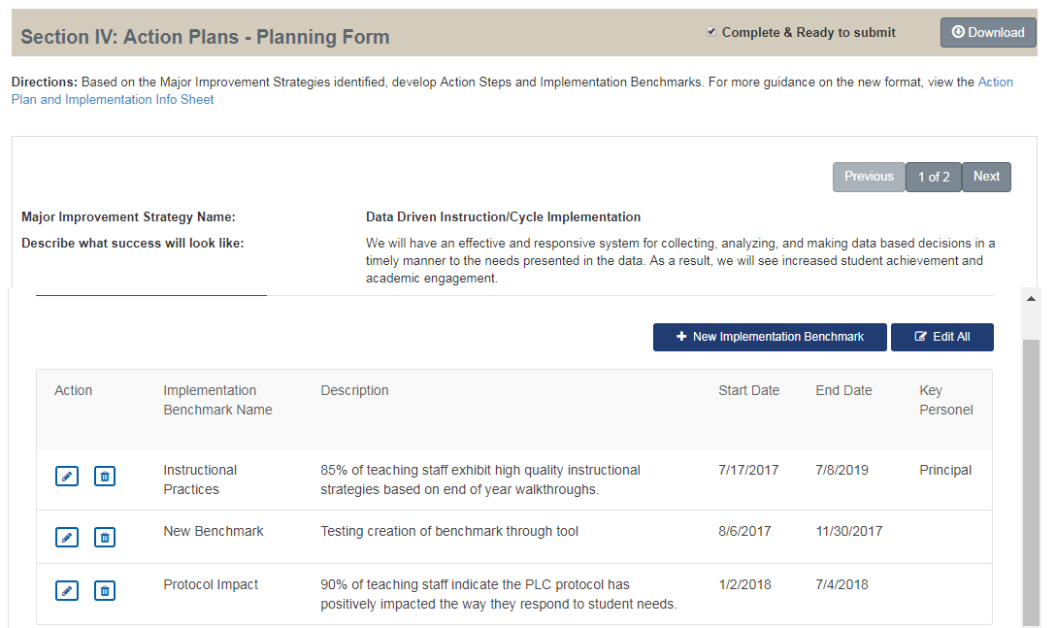

Slide 11
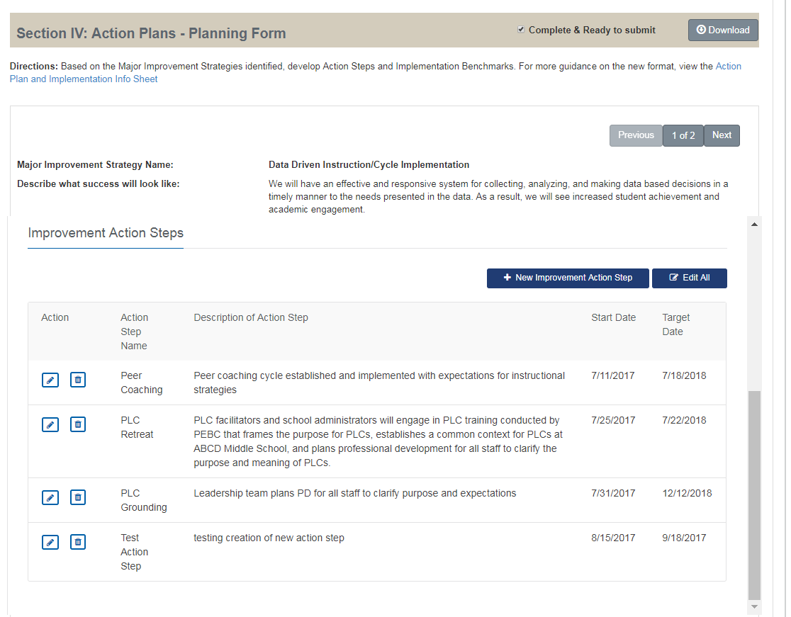

Slide 12
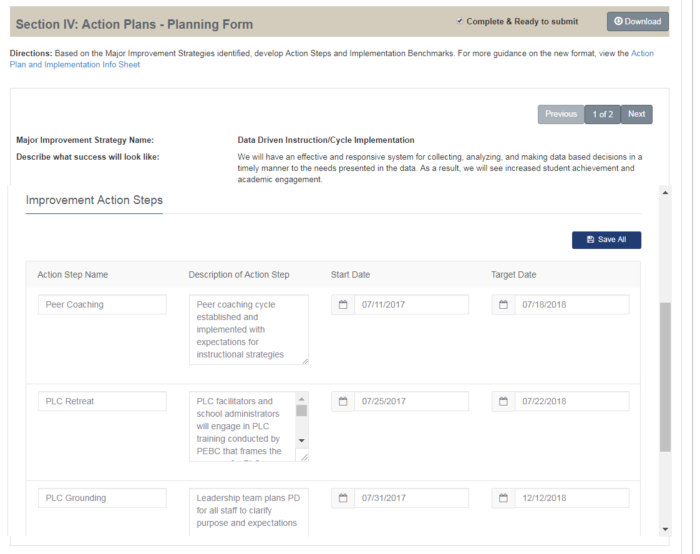

Slide 13
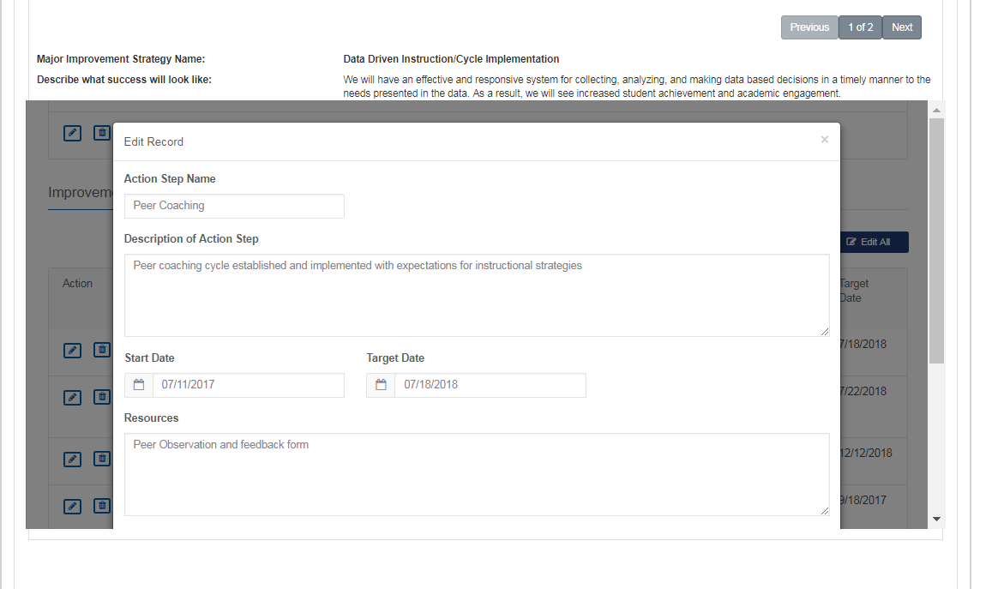

Slide 14
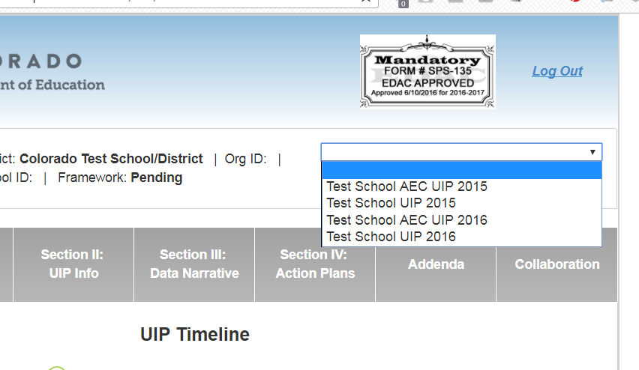

Slide 15
Expectations in the UIP

Slide 16
Highlights for Attention
Student Course Taking Analysis
All schools and districts
Report will be updated and available November 1
Public Report available this year
READ Act Expectations
Two part target setting (SRD and Grade Level)
Missing action plan component
Participation
If plan is lowered due to participation, it should be acknowledged in the data narrative
Title II- Equitable Distribution of Teachers
Notes:
EDT Backed off, not a new, but as a reminder this will be coming back. More information on identification and expectation.

Slide 17
New Expectations SB 17-103
CONCERNING IMPLEMENTING RESEARCH-BASED EARLY LEARNING STRATEGIES AS CORRECTIVE ACTIONS IN THE PUBLIC ELEMENTARY AND SECONDARY EDUCATION ACCOUNTABILITY SYSTEM.

Slide 18
New Expectations: ESSA
21st CCLC Grant program
Grantee schools and districts
School Identification
Identification of schools under ESSA
Comprehensive Support and Improvement
Low Performing
Low Graduation Rate
Targeted Support and Improvement
Notes:
Notification in the coming weeks

Slide 19
Comprehensive and Targeted Support Planning Requirements
Comprehensive Support and Improvement Plan
Approved by school, LEA and CDE
Developed in consultation with stakeholders
Formula and other ESSA funds may support strategies
CDE monitors plan implementation
Targeted Support and Improvement Plan
Approved by school and LEA. If applying for funds, then CDE will review plan.
May use the UIP to meet plan requirements:
Formula and other ESSA funds may support strategies
CDE offers planning support
Developed in consultation with stakeholders
Use UIP to meet plan requirements:
Informed by student performance
Includes school-level needs assessment
Identifies evidence based interventions
Address resource inequities
CDE offers planning support
Informed by student performance for disaggregated group(s)
Identifies evidence based interventions
Additional Targeted also addresses resource inequities
LEA monitors plan implementation. If awarded funds, CDE will monitor too.

Slide 20
Sharing back: Data from the system

Slide 21
Biennial Flexibility

Slide 22
Trends
Patterns
Single point of data
SPF Restatements
Averaging
Limited number of trends that provide a system perspective for Priority Performance Challenges
Limited local data trend analysis
+ Higher number of comparison point references
Improvements
Additional precision in measures, years, and results
Identify positive trends
Provide trends that lay foundation for “decision making process” of improvement planning

Slide 23
Priority Performance Challenges
Patterns
Mixing performance challenges with “what needs to happen”
Mixing challenges with root causes
Improvements
Focusing on student outcomes, not adults
Statements focused on what has happened in the past, not “where we need to go”
Notes:
Example
Student achievement across all content at the Elementary/Middle School has declined since 2011 and continues to be significantly below state expectations.
From 2013 to 2015 an average of 21% of students in K-3rd grades have significant reading deficiencies according to DIBELSNext data and will not or will not likely to be reading at grade level by fourth grade. In 2016 DIBELS results increased to 25% SRD.

Slide 24
Root Causes
Patterns
+ Root causes are generally a stronger area within the plan, many focusing on systems.
Many still plans still weak in communicating validation of root cause.
Some cases of still framing root causes in “student factors”, particularly with AEC’s.
Improvements
Consider how additional precision could focus improvement efforts
Identify process and perception data that would provide information that root causes are on track for validation.

Slide 25
Action Plan
Patterns
Limited number of action steps (2-5)
Implementation benchmarks that were left blank
Implementation benchmarks that are variations of action steps
Improvements
Strategies that provide vision for improvement.
Action steps that can be “checked off.”
Implementation benchmarks that look at changes in practice or perception (what you actually care about).

Slide 26
Targets
Patterns
General targets for whole school
Not tightly aligned to Performance Challenge
Difficulty in making growth targets actionable
Lack of understanding of Colorado Growth Model
Improvements
Provide additional targets that address performance indicator, particularly achievement and growth
Specify targets for groups if the PPC applies to disaggregated groups as well

Slide 27
Thank you!

