Slide 1
Strategy Guides
How to use Strategy Guides in the Improvement Planning Process

Slide 2
Objectives
This video will answer the following questions:
What are Strategy Guides, and where can they be found?
How can Strategy Guides be used when selecting a school improvement strategy?
How can Strategy Guides be used when planning your implementation of a strategy?
Note: For additional information on the school improvement terminology used throughout this video, please consult the UIP Handbook or UIP 101 videos, available through the CDE website: https://www.cde.state.co.us/uip/uip101

Slide 3
What are Strategy Guides?
CDE has created a number of Major Improvement Strategy Guides to help schools and districts better understand what research says about strategies that are commonly used in improvement planning and the UIP.
These Strategy Guides…
highlight commonly used, high-impact strategies
synthesize core components from research meeting ESSA Levels 1-3
connect leaders to research and other supporting resources available

Slide 4
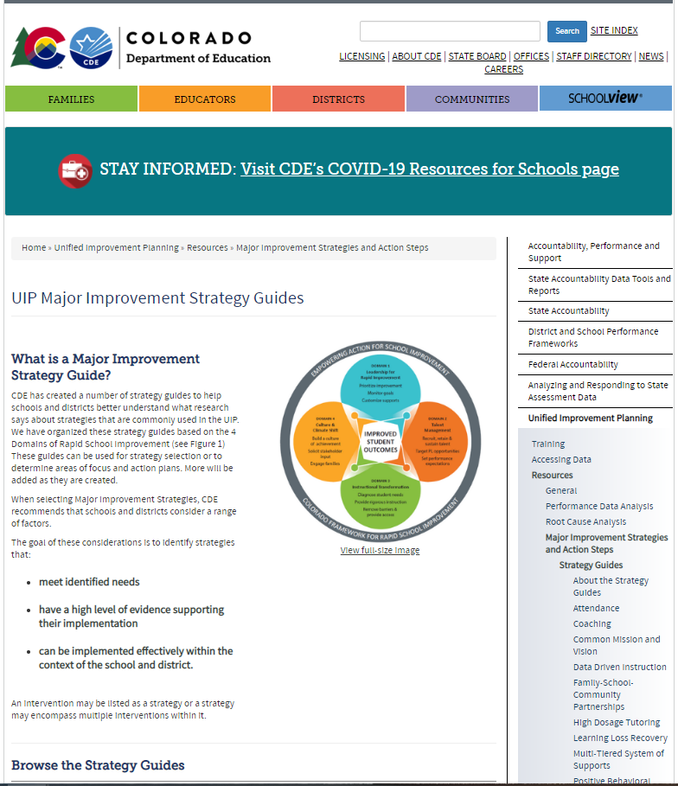
Where to find the Strategy Guides
Access the strategy guides here: https://www.cde.state.co.us/uip/strategyguides
Or, from the CDE main page (www.cde.state.co.us), search for “Strategy Guides.”

Slide 5
Structure of Strategy Guides
Introduction
Gives a brief overview of the strategy, including the definitions of any key terms.
Evidence Base
Describes the level of research available supporting the effectiveness of the strategy (all strategy guides meet ESSA Level 3 or higher).
Considerations
Contains some guiding questions to help assess whether the strategy is the right fit for the school
Implementation Guide
Outlines the Core Components of the strategy, broken down into Elements or Action Steps of greater detail and granularity.
Sources Consulted
Lists research and implementation sources synthesized in the Strategy Guide.
*May be titled “Academic Studies Leading to ESSA Rating”

Slide 6
The role of strategies in Improvement Planning
Prepare to
Plan
Target
Setting
Action
Planning
Data
Analysis
Review Current Performance
Describe Notable Trends
Prioritize Performance Challenges
Identify Root Causes
Set Student Centered Targets
ID Major Strategies & Action Steps
The UIP Flow-Map
Progress Monitoring
Identify Interim Measures
Identify Implementation Benchmarks

Slide 7
The role of strategies in Improvement Planning
Data Analysis
Performance Challenge Prioritization
The Improvement Planning Process
Root Cause Identification
Effective Implementation results in Improvement
Strategy Selection

Slide 8
Selecting a Strategy
Considerations for Contextual Fit: The following questions and considerations can help you to evaluate whether or not a strategy is a good fit for your school:
Does the strategy address an identified root cause of a performance challenge?
Does the strategy have support from school leadership?
Does the school have the resources needed to implement the strategy?
Does the team have adequate capacity (time and bandwidth) for making changes?
Do systems and structures to support changes exist or will they need to be created?
Does the school have adequate resources to support changes (e.g., internal expertise or ability to contract with external partner)?

Slide 9
Using the Strategy Guide to determine focus for year
Introduction
Robust strategies generally take more than one year to implement fully.
Whether you are adopting an entirely new strategy or building on a strategy that is already in place, the Strategy Guide can help you to determine the best next step for your school.
Strategy

Slide 10
Using the Strategy Guide to determine focus for year
Review the Implementation Guide (Core Components and Elements or Action Steps) section of the Strategy Guide.
Implementation Guide
Note the essential components of the strategy
Determine where the school already has components or elements in place, and where work is needed.
Select next steps to focus improvement efforts for the coming plan cycle (1-2 years).

Slide 11
Examples
1
2
3
4
Strategy Guide:
Coaching
Core Components:
Establish Roles, Systems, and Structures
Implement Concrete Data Analysis
Collaborate with Coaches
Monitor Coaching Impact
School 1: New to Strategy
Focus of Year 1
Focus of Year 2
School 2: Building on initial progress
Already in place
Focus of Year 1
Focus of Year 2
Focus of Year 2

Slide 12
Further Reading
Sources Consulted
If you have additional questions about your strategy, or you simply want to learn more about it, consult the list of Sources at the end of the Strategy Guide. That section will list resources to help you deepen your understanding or provide additional guidance on how to use and refine the strategy.

Slide 13
Thank you for your time!
Email any questions to
uiphelp@cde.state.co.us

