Slide 1


Facilitating Root Cause Analysis for Unified Improvement Planning
Notes:
Peter

Slide 2


Introductions
CDE: Improvement Planning Unit | Center for Transforming Learning and Teaching (UCD)
Erin Loften Lisa Medler | Julie Oxenford O’Brian Mary Beth Romke
Notes:
Peter

Slide 3
Session Purpose
Prepare leaders to facilitate root cause analysis as part of working with local planning teams to develop/update their unified improvement plans.
Notes:
The purpose for this session is to:
Ensure school planning teams are prepared to identify notable trends and prioritize performance challenges as part of unified improvement planning.

Slide 4

Introductions
Identify a burning question you have about root cause analysis and capture it on a sticky note.
Share:
  Name, Job Title, School/District/Organization.
  Your role in Unified Improvement Planning.
  Your question about root cause analysis.

Slide 5
Materials
Notes:
We’ll be using:
UIP Template
UIP Handbook
UIP Tools Packet

Slide 6


The materials used during this session were developed in partnership with the Center for Transforming Learning and Teaching in the School of Education and Human Development at the University of Colorado Denver.

Slide 7
Norms
The standards of behavior by which we agree to operate while we are engaged in learning together.

Slide 8
Ways to Talk
Table
Whip around
Round robin
Partner
Buzz
Notes:
Materials:
Talking Points:
Whip around: word or phrase from everyone -- maybe 5-10 seconds/person
Round robin: couple sentences from everyone, if time go around again – 15-30 seconds/person
Partner: 2 people to speed conversation/share time – time is halved
Buzz: quick conversation – lots of talk in 3-5 minutes
Table: all talk – usually 10-15 minutes
Facilitator Notes:

Slide 9
Session Outcomes
Define and explain the role of root cause analysis in Unified Improvement Planning (UIP).
Describe who should participate in root cause analysis, when and how.
Describe the critical steps of a root cause analysis as part of improvement planning.
Facilitate each step in a root cause analysis.
Identify where planning teams can “get off track” in root cause analysis and how to get them back on track.
Evaluate the effectiveness of facilitation strategies used for RCA.
Plan to facilitate a RCA.
Engage in hands-on learning activities and dialogue with colleagues.
Access additional resources.
Complete follow-up activities.

Slide 10
Self-Assessment
Turn to Self-Assessment (Note catcher, p. 3-4).
Re-write today’s learning objectives in language that has meaning for you.
Create a bar graph which describes where you currently believe you are in relationship to each learning target.
Leave the “reflections” column blank for now.
Learning Target | I don’t know what this Is | I need more practice | I’ve got It | I can teach someone about it | Reflections
Define and explain the role of root cause analysis in Unified Improvement Planning In my words: I know when planning teams engage in root causes analysis as part of UIP and how it relates to the other processes that are part of UIP..
Notes:
As we get started, we are going to dig into these learning targets with greater depth while at the same time asking you to assess yourself currently in relationship to each target. In a minute I’m going ask you to take out a document we have called Progress Monitoring. It looks something like the chart you see on the screen. When you have completed the first activity this morning, it should also look like what you see on this screen. That is, each learning target for the day should be rewritten in your own language. And the appropriate boxes should be colored-in to reflect your self-assessment in relationship to each target. For now, leave the column labeled “reflections” blank so that we can work with that column as part of the closing session.
It is great if you want to talk with your neighbors about the learning targets and compare your understanding of what they mean. You have about 10 minutes to do this.

Slide 11
Capturing Notes
Facilitating Root Cause Analysis Note Catcher:
Self-Assessment
Background on Root Cause Analysis
Preparing for Root Cause Analysis
Planning to Facilitate Root Cause Analysis (put a sticky note here)
  Building Background
  Facilitating the Steps in Root Cause Analysis
  Follow-Up to Capture Results of Root Cause Analysis

Slide 12
Agenda
Root Cause Analysis Background
Preparing for
Root Cause Analysis
Steps in Root Cause Analysis
Facilitate Root Cause Processes

Slide 13
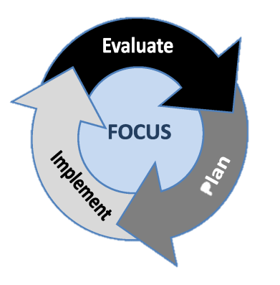
UIP: A framework for Performance Management & Continuous Improvement
Focus on the right things (Performance Indicators)
Evaluate performance (by gathering, analyzing and interpreting data about performance)
Plan (strategies for improvement)
Implement planned strategies
Evaluate (or monitor performance throughout the school year)
Make adjustments to Planned improvement strategies and Implement revised strategies as needed

Slide 14
Unified Improvement Planning Processes
Gather and Organize
Data
Preparing to Plan
Section IV:
Target Setting
Section IV:
Action Planning
Section III: Data Narrative
Review
Current Performance
Describe Notable
Trends
Prioritize Performance Challenges
Identify
Root
Causes
Set
Performance Targets
Identify Major Improvement Strategies
Ongoing:
Progress Monitoring
Identify
Interim Measures
Identify Implementation Benchmarks
Notes:
The Unified Improvement Planning Template includes several planning processes. In Section I of the template, the primary process in which local planners are engaging is reviewing a summary of the school or district performance.
[Click to highlight Data Analysis]
Section II is designed to support data analysis processes and the development of the school or district data narrative. This includes: gathering and organizing data, describing performance trends, prioritizing performance challenges, and identifying root causes.
Section IV includes two distinct Processes.
[Click to highlight Target Setting.]
The first includes going back to the priority performance challenges identified in section three and setting annual performance targets for two years, for each priority performance challenge. Then for each annual performance target, an interim measure (or measures) should be identified that will be monitored during the year.
[Click to highlight Action Planning.]
The second part of Section IV is action planning. Action planning starts from the root causes that were identified in section three. Major improvement strategies should be identified for each root cause (with some major improvement strategies addressing more than one root cause). Major improvement strategies include action steps, timeline, key personnel, and resources. Then for each action step implementation benchmarks must also be identified. Teams should also indicate the status of action steps that are already in progress.
[Click to highlight progress monitoring.]
The interim measures and implementation benchmarks identified in the unified improvement plan establish two critical components for schools and districts to monitor their progress multiple times during the school year.

Slide 15
UIP Template
Section I | Section II | Section III | Section IV
Summary Information about the School/District | Additional Information about the School/ District Improvement Plan Information Contact Information | Progress Monitoring of Prior Year’s Targets Data Worksheet Notable Trends Priority Performance Challenges Root Causes | School Target Setting Form Priority Performance Challenges Annual Performance Targets (2 years) Interim Measures Major Improvement Strategies
 |  | Data Narrative Description of School/District and Process for Data Analysis Review Current Performance Trend Analysis Priority Performance Challenges Root Causes and Validation | Action Planning Form Major Improvement Strategies Associated Root Causes Accountability Provision Action Steps Timeline Key People Resources Implementation Benchmarks Status of Action Steps
Notes:
This table illustrates the sub-components of each of the sections of the unified improvement planning template.
Note that section II includes a data worksheet which is a table where local leaders should identify significant trends, priority performance challenges, and root causes. Section III also includes a box where local leaders should enter their data narrative.
Section IV also has two different places for local leaders to enter information. In the Schools Goals Worksheet priority performance challenges should be restated and then associated targets and interim measures identified.
In the Action Planning Worksheets of Section IV, major improvement strategies are described, including action steps, timeline, key people involved, resources used, implementation benchmarks and the root causes to which the improvement strategy responds.
Take a few minutes now to mark the beginning of each section on the school UIP template. You can use a sticky note or some other way of locating these sections so they will be easier to refer to later in the tutorial.
The components highlighted in red represent changes from the 2010-11 template. The term “Priority Performance Challenge” has replaced “Priority Need”. A new worksheet has been added to support schools and districts in reviewing their 2010-11 performance in relationship to the performance targets they had set.

Slide 16

The Role of Root Cause Analysis
Root Cause Analysis
Action Plan
Priority
Performance Challenges
Notes:
Root causes build a bridge [click to animate bridge] between the priority performance challenges and the action plan.

Slide 17
Root Cause Analysis in UIP
Turn to Root Cause Analysis (excerpted from the UIP Handbook) (Tools, p. 9).
As you read this description of Root Cause Analysis for improvement planning, consider the following questions:
  Why is it important to identify root causes?
  How will you know when you have identified a root cause?
When you have finished reading: buzz with a partner with your answers to these questions.
Notes:
Let’s go back to the “Unified Improvement Planning Handbook” to get some back ground on Root Cause Analysis. Read the section beginning in the middle of page 10 that describes Root Cause Analysis. As you read, consider these questions:
Why is it important to identify root causes?
How will you know when you have identified a root cause?
[Pause and wait for click to move on to the next slide.]

Slide 18
Root Causes are. . .
Statements describing the deepest underlying cause, or causes, of performance challenges.
Causes that, if dissolved, would result in elimination or substantial reduction of the performance challenge(s).
The “why” behind current patterns of performance.
Things that can change and need to change.
The focus of major improvement strategies.
About adult actions.
Notes:
Root Causes are statements that describe the deepest underlying cause, or causes, of performance challenges.
They are the causes that if dissolved would result in elimination, or substantial reduction of the performance challenge(s).
Root causes describe why we see the performance that we see. They are the things we most need to change and can change. They become the focus of our major improvement strategies.

Slide 19
Non-examples of Root Causes
What is NOT a root cause?
  Student attributes (poverty level)
  Student motivation
  Individual teachers (e.g., Mr. Jones)
Do a whip around with your table group sharing explanations that might appear to be root causes but don’t qualify.
Notes:
Before we introduce some steps to use to arrive at root causes, we’d like to consider non-examples, or what is NOT a root cause.
In general “root causes” should not be fixed attributes of students, such as their poverty level. This is not something the school or district can control. Rather the planning team needs to consider what services the school or district is providing to their students given fixed characteristics. In other words, a root cause may be that the school does not provide support for students who arrive at the school with learning deficits related to poverty.
Student motivation is another often offered cause that shouldn’t be allowed to stand as a root cause. Again, this is placing blame with the student rather than focusing on causes that the school can control. In this case the planning team should ask why students aren’t motivated to learn and if there are ways to make the learning experiences provided to students more engaging.
Take a few minutes to brainstorm a list of explanations that may come up with your planning team, but that are NOT root causes.
Click here when you are done.
[Pause and wait for click to advance to next slide.]

Slide 20
Background: Root Cause Analysis
Why identify root causes?
To get past “symptoms” to an explanation(s) that is worth taking action on.
Read: Root Cause Basics (Tools, p. 3).
Work with a partner to create a 1 sentence description of “Root Cause” that you believe will resonate with groups with which you work.
Share some examples with the full group.
Notes:
As we enter into root cause analysis, it will be important to first build background related to what a root cause is and why it is important to engage in Root Cause Analysis. The book “Root Cause Analysis” by Paul Preuss provides some context for this work. Take a few minutes to read the excerpt from that book on Root Cause Basics. Then work with your group to develop a 1 sentence description of Root Cause that will guide your work moving forward.

Slide 21
Common understanding of data-driven collaborative inquiry
Grab your tools packet, Key Research Findings Related to Collaboration (Tools, p. 21).
Stand up and find a partner that you haven’t talked with yet today, number off 1, 2.
  Partner number 1, read finding #1 and share what it means to you with your partner.
  Partner number 2, read finding #2 and share what it means to you with your partner.
Find another partner and repeat for finding #3 and #4.
Find a third partner and repeat for finding #5 and #6.

Slide 22
Guiding Assumptions of Collaborative Inquiry
Colorado’s Unified Improvement Planning processes engage planning teams in “collaborative inquiry”.
Turn to Guiding Assumptions of Collaborative Inquiry (Tools, p. 25).
Work with a partner:
  Read one row in the chart (individually and silently).
  When each partner has completed a row, look up and “say something.” Something might be a question, a brief summary, a key point, an interesting idea or personal connection to the text.
  Continue until you complete all of the rows in the table.
Share out. . . How could these guiding assumptions be used to create context within which collaborative inquiry occurs?

Slide 23
Building Background on RCA: Tools and Strategies
Tools
Facilitation Strategies
UIP Process Diagram
UIP Handbook excerpt
Root Cause Basics (reading)
Guiding Assumptions of Collaborative Inquiry
Using text as a source of expertise
Focusing questions to guide reading
Partner Buzz
Whip around
Developing counter examples
Developing/adapting definition from reading
Say Something Protocol

Slide 24
Building Background on Root Cause Analysis
Turn to the Planning to Facilitate Root Cause Analysis (Note Catcher, p. 7).
Make notes about how you will build background knowledge on root cause analysis.
  What tools/resources will you use?
  How will you facilitate this?
  What preparation will be required?
Share out plans.

Slide 25
Agenda
Root Cause Analysis Background
Preparing for
Root Cause Analysis
Steps in Root Cause Analysis
Facilitate Root Cause Processes

Slide 26
Creating and Effective Facilitation Context
Determine who will participate and how participation will be structured.
Clearly identify roles.
Establish commonly held Norms, or behavioral expectations.
Develop common understanding of the group’s locus of control/circle of influence.
Other?

Slide 27
Who should participate in Root Cause Analysis?
Root cause analysis is problem identification (why we have our performance challenges).
It leads to determining what will be done to solve the problem.
Who should participate?
  Everyone who will be part of solving the problem.
  How folks participate may vary to make it possible to engage large groups.
Buzz with a partner: Why?

Slide 28
Structuring Participation
What if the staff of the school is too large to engage them all in root cause analysis at the same time? What if timing (and contract agreements) make it impossible to get the whole staff together for this purpose?
How can you structure a group to engage in small group discussions, but identify a jointly owned root cause?
Talk with a partner – identify at least two options.
Form a quad – share your options. Did you add to your list?
Make notes in your note catcher (p. 6) about how to structure different groups for root cause analysis.

Slide 29
Clearly Defined Roles
Turn to Four Possible Meeting Roles (Tools, p. 35-39).
Consider, within your context, who might play each of the identified roles? Can a facilitator and recorder be the same person?
Make notes about:
  How you will explain different roles to the group with which you work.
  How you might talk to a school/district leader with authority about their role.

Slide 30
Commonly held norms or behavioral expectations
What are norms?
The standards of behavior by which we agree to operate while we are engaged in learning together.
How can you establish norms for a group with which you will engage in root cause analysis?

Slide 31
Norms
Turn to Setting Norms Protocol (Tools, p. 29).
Read this protocol.
Try this out with your table group:
  Each person writes (three) norms on sticky notes.
  Work with your table group to divide into categories (procedural and interpersonal).
  Group similar suggestions together.
  Name the norms (summarize the grouped norms).
  Reach consensus on which you will accept.

Slide 32
More on Norms
When does it make sense to have a group generate norms?
When does it make sense to provide norms for the group?
Turn to:
  Norms from CTLT (Tools, p. 31).
  The Seven Norms of Collaborative Work, from Adaptive Schools (Tools, p. 33).
Which of the ideas on these two documents might you adopt or use?
Capture notes on how you will establish norms for your group (note catcher, p. 6).

Slide 33
Locus of Control
Circle of Influence
Root causes must address things within the group’s locus of control or at least their circle of influence.
Locus of Control = the things we can change without outside permission (e.g., the instructional strategies we use).
Circle of Influence = the things we can influence that impact what happens within our school (e.g., district curriculum).
Outside our Circle of Influence = the things we cannot influence (e.g., the characteristics of our students).

Slide 34
Agenda
Root Cause Analysis Background
Preparing for
Root Cause Analysis
Steps in Root Cause Analysis
Facilitate Root Cause Processes

Slide 35
Steps in Root Cause Analysis
Focus on a performance challenge (or closely related performance challenges).
Consider school/district context (process/perception data).
Generate explanations (brainstorm).
Categorize/ classify explanations.
Narrow and prioritize explanations.
Deepen thinking to get to a “root” cause.
Validate with other data.
Incorporate external reviews.
Iterative
Notes:
Root cause analysis can be broken down into several different sub-steps.
It is important to note that root cause analysis is focused on a clearly defined performance.
The process of getting to root causes of priority performance challenges (priority needs) can be described as similar to a funnel. It starts broad, like the widest part of the top of a funnel, with brainstorming in a way that brings everyone’s thinking into the process. It is important to start broad for two reasons. First, so that everyone who you want to be part of the solution will have a chance to help define what needs to be fixed. Second, so that the possibility for “out of the box” thinking is present.
Next, the ideas that are generated through the brainstorm should be systematically narrowed, first by categorizing or grouping like causes together, and then by applying criteria. This takes you to the narrow point in the funnel.
Once the list of possible causes has been narrowed, the team needs to intentionally deepen their thinking to get to an actual “root” causes. Several possible processes can help deepen your teams thinking. We’ll introduce a tool called the 5 Why’s.
Once the team believes a root cause has been identified, it will be important to validated with other data.
This may not be the end of the process, however. [Click to animate “iterative”]. This process is iterative rather than linear. Planning teams may get through the deepening process only to realize they had prioritized the wrong cause, or validation may result in the team starting over with a different possible root cause.
First we are going to focus on the first three steps in root cause analysis

Slide 36
Steps in Root Cause Analysis
Focus on a performance challenge (or closely related performance challenges).
Consider school/district context (process/perception data).
Generate explanations (brainstorm).
Categorize/ classify explanations.
Narrow and prioritize explanations.
Deepen thinking to get to a “root” cause.
Validate with other data.
Incorporate external reviews.
Iterative
Notes:
Root cause analysis can be broken down into several different sub-steps.
It is important to note that root cause analysis is focused on a clearly defined performance.
The process of getting to root causes of priority performance challenges (priority needs) can be described as similar to a funnel. It starts broad, like the widest part of the top of a funnel, with brainstorming in a way that brings everyone’s thinking into the process. It is important to start broad for two reasons. First, so that everyone who you want to be part of the solution will have a chance to help define what needs to be fixed. Second, so that the possibility for “out of the box” thinking is present.
Next, the ideas that are generated through the brainstorm should be systematically narrowed, first by categorizing or grouping like causes together, and then by applying criteria. This takes you to the narrow point in the funnel.
Once the list of possible causes has been narrowed, the team needs to intentionally deepen their thinking to get to an actual “root” causes. Several possible processes can help deepen your teams thinking. We’ll introduce a tool called the 5 Why’s.
Once the team believes a root cause has been identified, it will be important to validated with other data.
This may not be the end of the process, however. [Click to animate “iterative”]. This process is iterative rather than linear. Planning teams may get through the deepening process only to realize they had prioritized the wrong cause, or validation may result in the team starting over with a different possible root cause.
First we are going to focus on the first three steps in root cause analysis

Slide 37
Root Causes and Priority Performance Challenges
Root causes are always focused on at least one priority performance challenge.
They explain why we see the patterns of performance that we see.
So. . . priority performance challenges must be clearly identified first.

Slide 38
Priority Performance Challenges
Work with a partner. Turn to UIP Handbook Priority Performance Challenges Excerpt (Tools, p. 45).
Read lightly (not word for word) and discuss these questions:
  On what should priority performance challenges focus?
  What are examples of priority performance challenges?
  What are non-examples?
  How do you determine the appropriate level of a priority performance challenge?
Share questions that you have about priority performance challenges.

Slide 39
Scenario: Elementary School
School Performance (Plan Type Assignment: Turnaround year 3):
  Academic Achievement: Does Not Meet
  Academic Growth: Does Not Meet
  Academic Growth Gaps: Does Not meet
Priority Performance Challenges:
  In the performance indicator areas of achievement, performance in all grade levels and in all content areas are below minimum state expectations and have been flat for the last three years.
  The MGP for all grade levels and subgroups in all content areas is below the state expectation of 55 and has been flat (35-32-38) for the last three years.
Are these appropriate?

Slide 40
How groups “get off track” with their focus.
Table discussion: What do you do if. . .
  Your group has not identified at least one priority performance challenge.
  The priority performance challenge(s) that the group identified is not at an appropriate magnitude given the over-all performance for the school.
  Your group has identified too many priority performance challenges.
Share out (good time to capture the thinking in your note catcher. . .)

Slide 41
Planning to Facilitate Root Cause Analysis
Turn to the Planning to Facilitate Root Cause Analysis (note catcher, p. 7).
Make notes about how you will focus teams on appropriate priority performance challenges:
  What tools/resources will you use?
  How will you facilitate focusing your team on a priority performance challenge or more than one related priority performance challenge?
  What will you need to do to prepare for this step in root cause analysis?

Slide 42
Steps in Root Cause Analysis
Focus on a performance challenge (or closely related performance challenges).
Consider school/district context (process/perception data).
Generate explanations (brainstorm).
Categorize/ classify explanations.
Narrow and prioritize explanations.
Deepen thinking to get to a “root” cause.
Validate with other data.
Incorporate external reviews.
Iterative
Notes:
Root cause analysis can be broken down into several different sub-steps.
It is important to note that root cause analysis is focused on a clearly defined performance.
The process of getting to root causes of priority performance challenges (priority needs) can be described as similar to a funnel. It starts broad, like the widest part of the top of a funnel, with brainstorming in a way that brings everyone’s thinking into the process. It is important to start broad for two reasons. First, so that everyone who you want to be part of the solution will have a chance to help define what needs to be fixed. Second, so that the possibility for “out of the box” thinking is present.
Next, the ideas that are generated through the brainstorm should be systematically narrowed, first by categorizing or grouping like causes together, and then by applying criteria. This takes you to the narrow point in the funnel.
Once the list of possible causes has been narrowed, the team needs to intentionally deepen their thinking to get to an actual “root” causes. Several possible processes can help deepen your teams thinking. We’ll introduce a tool called the 5 Why’s.
Once the team believes a root cause has been identified, it will be important to validated with other data.
This may not be the end of the process, however. [Click to animate “iterative”]. This process is iterative rather than linear. Planning teams may get through the deepening process only to realize they had prioritized the wrong cause, or validation may result in the team starting over with a different possible root cause.
First we are going to focus on the first three steps in root cause analysis

Slide 43

If you’re only looking at Student Learning, you’re missing 65% of the data.
– Victoria Bernhardt
Notes:
Use as “Handshake quote”

Slide 44

Multiple measures must be considered and used to understand the multifaceted world of learning from the perspective of everyone involved.
-Victoria Bernhardt

Slide 45

What types of data do we have?
Demographics
Perceptions
School Processes
Student Learning/ Performance
Notes:
5 minutes:
V. Bernhardt describes these 4 types.
Major job is student learning – think about all factors that impact student learning
More Facts from…
Wellman and Lipton: “How teachers teach is as much the curriculum as what teachers teach.”
Bernhardt: “10,000 kids told us, (when we asked “What is most important for them to be able to learn?”) – ‘The teacher has to care about me.’ What does that mean? ‘They have fun making us learn.’ When asked, “What do you wish we would have asked?” ‘You didn’t ask us if the principal cared about us.’ ‘My principal and my teacher are the MOST IMPORTANT people in my life.’”
“The most effective teachers were asked “What would it take to improve student learning?” They answered, ‘Climate of learning.’ ‘I like seeing results of my students.’ ‘I love teaching my children.’ If these are low, there isn’t any data that will help.
“School Processes data gets left out the most.”

Slide 46
Demographics
Enrollment, Attendance,
Race/Ethnicity, Gender,
Drop-Out Rate,
Language Proficiency, Mobility
Victoria Bernhardt
Notes:
The first type of data described by Victoria Bernhardt are demographic data. This includes (read slide).
Information about school community
Help understand the part of the system we have no control over but can learn from, identify trends, predict and plan

Slide 47
Perceptions
Perceptions of Learning Environment, Perceptions of Teacher Working Conditions, Values and Beliefs, Attitudes, Observations
Victoria Bernhardt
Notes:
The next type of data, perception data, is a type that you may not have much of in your environment. This includes survey data from various actors in the system – students, parents, teachers, administrators – and helps you understand what people believe or think about their experiences.
Important because people act in congruence with what they believe

Slide 48
Student Learning (performance)
State-Administered Tests, District Interim Assessments, Cross-classroom assessment, End of unit assessment
Victoria Bernhardt
Notes:
The third type of data is the type we have been looking at so far today, student learning data. Note that student learning data is more than standardized assessment results, and can include a variety of data formats.

Slide 49
School Processes
Records of School Programs and Processes, Classroom Records, Classroom Observations
Victoria Bernhardt
Notes:
The final type of data is school process data – or data that tell you what curriculum, what materials, what instructional practices are being used. Often this is the most actionable area.
Hardest for teachers to describe – things teachers do automatically; or too busy to document & reflect

Slide 50
Demographics
School Processes
Provides information that allows for the identification of actions, processes, programs that best meet the needs of all students.
Perceptions
Student Learning
Victoria Bernhardt

Slide 51
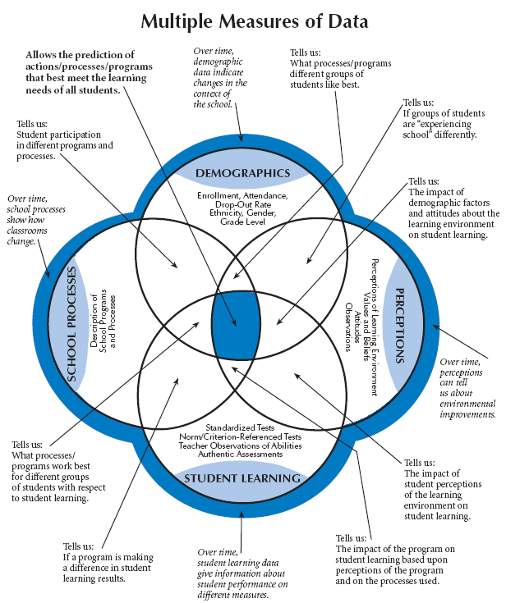
What combination/ intersection(s) of different types of data helps us answer:
Do students’ experiences in school differ based on their characteristics?
Is participation in a reading intervention program associated with increased student performance?
Are teacher perceptions of their working environment associated with different levels of student performance?
Victoria Bernhardt
Notes:
Take out the handout from your data-primer tab that looks like this slide.

Slide 52

Activity: Data Questions
Refer to the Data Intersection Questions worksheet (Tools, p. 51).
Consider the questions listed. For each, identify what different types of data would be needed.
Identify 2 additional questions at your table. As a group, identify what data would be needed.
Notes:
Pull out the “Data Questions Activity” worksheet. This activity is intended to help you think about what data you will need to answer educationally relevant questions. As you work through this worksheet you may find that some of the questions you identify would help you to verify your explanations from the previous session.

Slide 53
Activity: Data Intersections
Refer to the Creating Intersections Activity (Tools, p. 53-54).
How could you use this activity with your staff to get them thinking about what data might be available for root cause analysis work?

Slide 54
Unified Improvement Planning | Types of data (intersections) needed
Review current performance and prior performance targets or goals | Performance data (intersected with demographic data)
Analyze data to identify notable trends | Performance data (intersected with demographic data)
Prioritize performance challenges | Performance data (intersected with demographic data)
Identify root causes of performance challenges | Process and perception data (intersected with demographic data)
Establish annual performance targets | Performance data (intersected with demographic data) and state and local expectations
Identify measures and monitor the impact of action steps on student performance. | Performance data (intersected with demographic data)
Identify implementation benchmarks & monitor implementation of action steps. | Process and perception data (intersected with demographic data)
Looking Backward
LOOKING FORWARD
Notes:
Use the Multiple Measures of Data graphic and the table for matching UIP uses of data to data types.
Consider these uses of data in the UIP:
Reviewing current performance and prior year’s targets
Analyzing data to identify significant trends
Prioritizing performance challenges
Identifying root causes
Identifying interim measures
Identifying implementation benchmarks
What type of data (intersections of data) need to be considered for each use?

Slide 55
Process and Perception Data for Root Cause Analysis
What process and perception data is available to help planning teams understand the context as they engage in root cause analysis?
  EDT Reports
  TELL Survey Results
  Implementation Benchmarks
  School Climate/Culture Surveys (students, parents)
  Curriculum Alignment Studies
  MTSS/RTI Implementation Review
  External School Reviews
Other?

Slide 56
TELL Survey Results
TELL = Teaching, Empowering, Learners, and Learning.
On-line anonymous survey of public school educators about perceptions of current teaching and learning conditions.
Last administration – Spring 2013.
Next administration during the upcoming school year.
Because teaching conditions. . .
  Matter for students
  Matter for teacher retention
  Are viewed differently by teachers and principals

Slide 57
What we have learned…
Overall, Colorado educators are very positive about school conditions.
Time is consistently the biggest challenge.
Sense of efficacy and support from leadership affects teacher attrition more than other factors (e.g., salary).
Effective induction support and mentoring is not systematically available to novice educators.
The construct with the strongest relationship to student performance is community involvement and support.

Slide 58
TELL Survey Basics
Work with a partner, and review the TELL Survey Basics handout (Tools, p. 59).
Answer the following questions:
What is the purpose of the TELL Survey? How should it be used? What are ways it should not be used?
From whom is data collected?
What response rate is required for results to be reported?
Did your district/school have a high enough response rate for results to be reported? Have you accessed your district/school TELL survey results?

Slide 59
Accessing TELL Results
www.tellcolorado.org
All districts and schools with at least a 50% response rate (and a minimum of 5 responses).
Survey Results:
  By District
  By School

Slide 60
TELL Terminology
Consider the “TELL Terminology” – at the end of the TELL Survey Basics handout (Tools, p. 64).
What is a construct?
What are items?
What does TELL mean by “Teaching Conditions”?

Slide 61
Survey Focus: TELL Constructs
  Time
  Facilities and Resources
  Community Support and Involvement
  Managing Student Conduct
  Teacher Leadership
  School Leadership
  Professional Development
  Instructional Practices and Support
Consider the description of the TELL Survey Focus, discuss the following:
Why would it be important to find out about teachers’ responses related to each of the listed constructs?
How could knowing about teacher perception of these aspects of their working conditions help with root cause analysis?

Slide 62
TELL Reports
Tellcolorado.org
Three Reports/Views:
  Summary Results for 2013 [Excel]
  Detailed Results for 2013 [PDF]
  Summary Comparison Results 2011 to 2013 [Excel]
Additional reports for districts (not public):
  Scatterplot
  Growth Heat Map
  2013 Heat Map

Slide 63
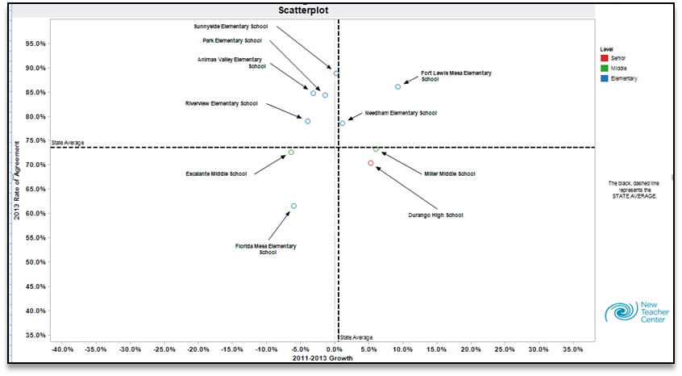
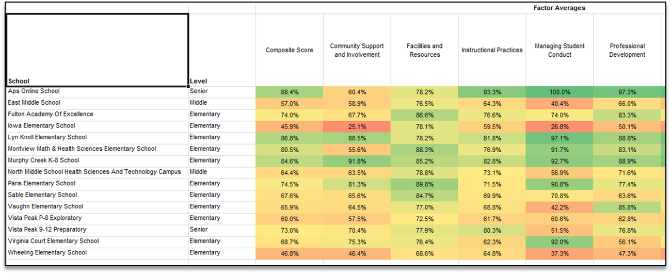

Slide 64
Path Through the TELL Data
Review Constructs
Examine Items Within the Construct
Determine an Item of Focus
Determine a Construct on which to Focus
Analyze Individual Items

Slide 65
Lots of data, where to start?
Use HEAT Maps:
  For which constructs were our teachers’ responses significantly lower than other schools at the same level (elem, middle, high)?
  Compared to what?
Consider state-level results:
  The construct with the strongest relationship to student performance is community involvement and support.
  Time is consistently the biggest challenge.
  Sense of efficacy and support from leadership affects teacher attrition more than other factors (e.g., salary).

Slide 66
Practice
Access ROCKY ES TELL Survey Results and Heat Maps (Scenario Packet).
Consider:
    On which construct(s) would you focus first?
    What would be your path through this school’s TELL data?

Slide 67
Reviewing Perception Data: Example
This school has TELL data available from the most recent school year.
Strategy:
  Divide into eight different table groups (=number of TELL constructs) with each group focused on one construct.
  Identify areas where the school’s results are red or close to red (this is where this school differs substantially from other elementary schools).
  Groups capture list of contextual features that could impact performance in priority areas.
  Group share out of areas of concern.

Slide 68
Consider Other Resources Available from CDE
Turn to Resources Available from CDE to Support Root Cause Analysis (Tools, p. 65).
Have you used any of these resources?
Do any of these tools address topics likely to be important in your context?
Discuss: How could you use these resources to collect data to support your root cause analysis?

Slide 69
Inventory of “other” data sources
Consider Inventory of Data Sources other than Student Performance Data (Toolkit, p. 67-68).
What elements are included in this inventory?
  Review the “legend”
  Do you have any questions about the elements?
Identify at least 2 data sources that you would include in this inventory (complete 2 rows).
This inventory should be completed in advance of engaging in root cause analysis.

Slide 70
Matching Process & Perception Data to Priority Performance Challenges
Use a completed “Inventory of Data Other than Performance Data”.
For each priority performance challenge, identify what other data might be reviewed prior to and/or used as part of root cause analysis.
Organize these data and provide reports to your planning team.

Slide 71
How groups “get off track” considering context
Off Track
Getting Back On Track
Group members don’t know how to “make meaning” of context data.
Group spends too much time on context without focusing on how it could impact student performance results.
No “formal” context data/information is available.
Plan in advance how you will have teams interpret their context data. Break it into smaller chunks for interpretation (have sub-groups look at parts of it).
Have team members identify theories about the relationship between the context data and student performance before they look at it (if it isn’t already part of the context data).
Talk about the context in categories (consider using causal theories reading as a guide for categories).

Slide 72
Planning to Facilitate Root Cause Analysis
Turn to the Planning to Facilitate Root Cause Analysis (note catcher, p. 8).
Make notes about how you will consider context data as part of engaging in root cause analysis:
  What tools/resources will you use?
  What data will your team review prior to root cause analysis? How will you facilitate groups considering context data?
  What will you need to do to prepare for this step in root cause analysis?

Slide 73
Steps in Root Cause Analysis
Focus on a performance challenge (or closely related performance challenges).
Consider school/district context (process/perception data).
Generate explanations (brainstorm).
Categorize/classify explanations.
Narrow and prioritize explanations.
Deepen thinking to get to a “root” cause.
Validate with other data.
Incorporate external reviews.
Iterative
Notes:
Root cause analysis can be broken down into several different sub-steps.
It is important to note that root cause analysis is focused on a clearly defined performance.
The process of getting to root causes of priority performance challenges (priority needs) can be described as similar to a funnel. It starts broad, like the widest part of the top of a funnel, with brainstorming in a way that brings everyone’s thinking into the process. It is important to start broad for two reasons. First, so that everyone who you want to be part of the solution will have a chance to help define what needs to be fixed. Second, so that the possibility for “out of the box” thinking is present.
Next, the ideas that are generated through the brainstorm should be systematically narrowed, first by categorizing or grouping like causes together, and then by applying criteria. This takes you to the narrow point in the funnel.
Once the list of possible causes has been narrowed, the team needs to intentionally deepen their thinking to get to an actual “root” causes. Several possible processes can help deepen your teams thinking. We’ll introduce a tool called the 5 Why’s.
Once the team believes a root cause has been identified, it will be important to validated with other data.
This may not be the end of the process, however. [Click to animate “iterative”]. This process is iterative rather than linear. Planning teams may get through the deepening process only to realize they had prioritized the wrong cause, or validation may result in the team starting over with a different possible root cause.
First we are going to focus on the first three steps in root cause analysis

Slide 74
Causal Theories
Independently read Identifying Causal Theories” from Got Data? Now What? (Tools, p. 79).
With a partner, answer these questions:
  What is a causal theory?
  How does a causal theory relate to root causes?

Slide 75
Generate Explanations
Turn to Brainstorming Strategies (Tools, p. 69).
Brainstorming Rules:
  There are no dumb ideas.
  Don’t criticize other people’s ideas.
  Build one idea upon another.
  Reverse the thought of “quality over quantity”.
Practice explaining these rules to a partner. What will you say? How could you use there rules (or others like them) with your group?
Jones, M. (1998). “The Thinkers Toolkit: 14 Powerful Techniques for Problem Solving”. New York: Three Rivers Press.

Slide 76
Brainstorming and Categorizing: Two Approaches
Tree (fish) Diagram:
  Start with “typical” categories of root causes of performance challenges.
  Brainstorm within these categories.
Circle Map:
  Brainstorm causes of performance challenges.
  Group like causes together to form categories.

Slide 77
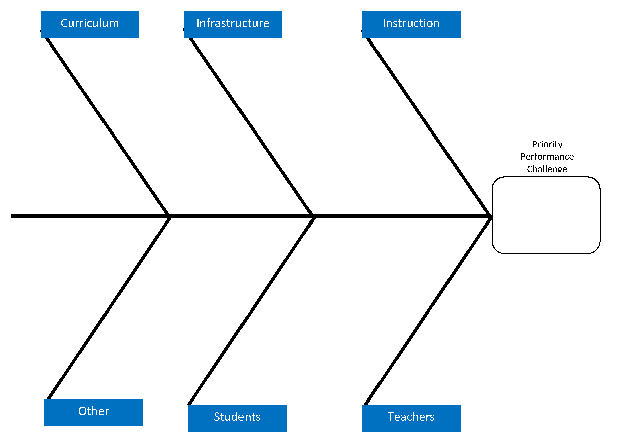

Slide 78
Tree Diagram: Brainstorm Causes within Categories
Review Tree Diagram Directions (Tools, p. 85).
Clarify the question that will focus the brainstorming.
Determine pre-defined root cause categories, consider:
  Causal Categories (Wellman and Lipton) – Toolkit, p. 91
  Levels of Root Causes (Preuss) – Toolkit, p. 93
  Research-Based Factors (Marzano) – Toolkit, p. 95
Set up the “Tree Diagram” (Example; Tools, p. 83).
Brainstorm within categories (using sticky notes).
Summarize within each category.

Slide 79
What
process(es)
did we use?
What context data did we consider?
All possible explanations of performance challenge go in the outer circle
Possible Explanation
Possible Explanation
Performance Challenge
Possible Explanation
Possible Explanation
School Process Data
Perception Data
Circle map used with permission from Thinking Maps, Inc. Specific training required before implementing Thinking Maps.
For more information, visit www.thinkingmaps.com.

Slide 80
Circle Map, part 1: Brainstorm Causes of Performance Challenges
Review Circle Map Directions (Tools, p. 89).
Clarify what will focus your brainstorming (priority performance challenge).
Set up the Circle Map (Example; Tools, p. 87).
Create the frame (identify what data you reviewed in preparation for engaging in root cause analysis).
Brainstorm about the possible causes of your priority performance challenge:
  Individuals capture one idea per sticky note.
  Place sticky notes on the circle map.
Notes:
Using a circle map, write your priority performance challenge(s) in the center.
Around the center circle, brainstorm all of the possible causes of that performance challenge.
Frame this brainstorm with:
External Review Results
Categories of causes of performance challenges
Additional local data that was considered

Slide 81
Circle Map, Part 2: Categorize your Causes
Sort ideas into natural themes by asking: what ideas are similar?
  Work in silence with each person moving sticky notes around on the circle map. Keep moving notes until a consensus is reached.
  Discuss the groupings.
  If some ideas don’t fit into any theme, leave as a stand alone idea.
  If some fit more than one, create a copy and put in both groups.
Create a short 3-5 word description for each grouping.
Notes:
In determining how to categorize the explanations it could be important to consider other examples of ways that different groups have categorized explanations of performance challenges. Consider the following handouts:
Levels of Root Causes
SST Standard categories
Marzano Factors
Once the planning team has decided which resource(s) will frame their categorization of explanations, they should then consider the causes that were identified for the focus performance challenge(s) and use color to categorize the explanations (incorporating the frame as appropriate).

Slide 82
Scenario: Priority Performance Challenges
In the performance indicator areas of achievement and growth, performance in all grade levels and in all content areas are below minimum state expectations and have been flat for the last three years.
The MGP for all grade levels and subgroups in all content areas is below the state expectation of 55 and has been flat (35-32-38) for the last three years.

Slide 83
Scenario: Context Information
Group Identified Priorities:
  All teachers indicated they have insufficient time for instruction.
  70% indicated they have insufficient access to instructional materials and resources.
  83% indicate teachers do not have an appropriate level of influence in the school, 60% indicated they don’t have effective processes for solving problems.
  65% indicate school leadership does not consistently enforce rules for student conduct.
  65-70% indicate professional development is inadequate.
  65% indicate curriculum taught does not meet the need of students.

Slide 84
Practice Brainstorming, Categorizing, and Summarizing
With your table group, select an approach (Tree Diagram or Circle Map).
Recorders, draw a Tree Diagram or Circle Map on a flip chart page.
Use the directions for that approach (Tree Diagram Directions; Tools, p. 85 or Circle Map Directions; Tools p. 89).
Focused the Rocky ES “priority performance challenge”, brainstorm, categorize and summarize your explanations for why the school has that pattern of performance. Consider the context for Rocky ES as well.
Capture summary statements on the flip chart.

Slide 85
Learning from Colleagues
Gallery Walk.
With your table group, view each of the flip chart pages where other groups have captured their brainstorming, categorizing and summarizing of explanations of priority performance challenges.
Return to your table and consider:
  What did we see in the work of the other groups?
  Is there anything we would refine about our current explanations?

Slide 86
How groups “get off track” brainstorming and categorizing
Off Track
Getting Back On Track
Group members “shut down” or “evaluate” ideas during brainstorm.
Some group members don’t participate.
Some group members dominate the conversation.
Reinforce rules for brainstorming.
Use sticky notes for individual brainstorming before sharing ideas with group.
Use a whip around or round robin where everyone gets a turn to add something.
Ask individuals who haven’t had a chance to contribute what they think or would add.
Pull aside “dominant” group members and ask them to help elicit information from all group members.

Slide 87
Tools to Support Root Cause Analysis
Root Cause Analysis Step:
Tools to use:
Focus on a performance challenge (or closely related performance challenges).
Consider school/district context (process/ perception data).
Generating explanations (brainstorm).
Categorize/ classify explanations.
UIP Handbook, Quality Criteria (Priority Performance Challenges).
Multiple Measures; Data Intersections; Equitable Distribution of Teachers; TELL Survey Basics; Resources available from CDE; Inventory.
Brainstorming Strategies; Identifying Causal Theories.
Tree Diagram (and directions); Circle Map (and directions); Causal Categories (Wellman); Levels of Root Causes (Preuss); Marzano Factors.
Notes:
Several tools have been which may help planning teams engage in root cause analysis, including tools for five of the six steps in the root cause analysis process.

Slide 88
Planning to Facilitate Root Causes Analysis
Take out the Planning to Facilitate Root Cause Analysis (note catcher, p. 8).
Make notes about how you will categorize and summarize explanations for priority performance challenges:
  What approach will you use? What materials/tools will you use?
  How will you facilitate this?
  What will you do to prepare?

Slide 89
Steps in Root Cause Analysis
Focus on a performance challenge (or closely related performance challenges).
Consider school/district context (process/perception data).
Generate explanations (brainstorm).
Categorize/ classify explanations.
Narrow and prioritize explanations.
Deepen thinking to get to a “root” cause.
Validate with other data.
Incorporate external reviews.
Iterative
Notes:
Root cause analysis can be broken down into several different sub-steps.
It is important to note that root cause analysis is focused on a clearly defined performance.
The process of getting to root causes of priority performance challenges (priority needs) can be described as similar to a funnel. It starts broad, like the widest part of the top of a funnel, with brainstorming in a way that brings everyone’s thinking into the process. It is important to start broad for two reasons. First, so that everyone who you want to be part of the solution will have a chance to help define what needs to be fixed. Second, so that the possibility for “out of the box” thinking is present.
Next, the ideas that are generated through the brainstorm should be systematically narrowed, first by categorizing or grouping like causes together, and then by applying criteria. This takes you to the narrow point in the funnel.
Once the list of possible causes has been narrowed, the team needs to intentionally deepen their thinking to get to an actual “root” causes. Several possible processes can help deepen your teams thinking. We’ll introduce a tool called the 5 Why’s.
Once the team believes a root cause has been identified, it will be important to validated with other data.
This may not be the end of the process, however. [Click to animate “iterative”]. This process is iterative rather than linear. Planning teams may get through the deepening process only to realize they had prioritized the wrong cause, or validation may result in the team starting over with a different possible root cause.
First we are going to focus on the first three steps in root cause analysis

Slide 90
Narrowing the Explanations
An approach to identifying explanations that are within the group’s locus of control or at least their sphere of influence.
Read: Criteria for Narrowing Explanations (Tools, p. 97).
Key ideas:
    Setting aside explanations outside of our control doesn’t mean not considering them as relevant.
    This may result in refocusing an explanation from student characteristics to adult actions.
    Powerful: Ask folks to “tell a story” for how the proposed explanation resulted in the pattern of performance for the school.
    Clarifying the language matters.
Notes:
The tool “Criteria for Narrowing Explanations” gives planning teams a process for considering the current explanations and getting rid of some of them.
Take out “Criteria for Narrowing Explanations”.
Cross out any explanation which the school cannot influence or control (student characteristics).
Note: teams may want to capture the eliminated explanations on a separate chart.
3. Eliminate additional explanations which fail to meet the following criteria:
It derives logically from the data
It is an explanation, not just an opinion
It is plausible, it could be verified or tested
Planning teams can cross out explanations on the circle map.
Prioritize your remaining explanations (getting down to at most two).
Clarify the language, if needed, for your priority explanations.

Slide 91
Practice: Narrowing Explanations
Eliminate (take sticky notes off and set aside) any explanation which the school cannot influence or control (e.g., student characteristics).
Eliminate additional explanations which fail to meet the following criteria:
    It derives logically from the data.
    It is an explanation, not just an opinion.
    It is plausible, it could be verified or tested.
Prioritize your remaining explanations (getting down to at most two), and circle your priority explanations.
Clarify the language, if needed, for your priority explanations.

Slide 92
How groups “get off track” while narrowing explanations
Off Track
Getting Back On Track
Group stays focused on explanations over which they have no control or influence (e.g., student background knowledge).
Group removes explanations that are core to their performance challenges and that they could possibly influence but do not control (e.g., district curriculum).
Other?
Provide a separate parking lot where folks can put those explanations. Go back to them to identify associated “adult actions” (e.g., instead of our students don’t come with enough vocabulary, we don’t have a specific intervention to address vocabulary gaps our students come with).
Review explanations that groups have removed to ask the question – can we influence this? How?

Slide 93
Steps in Root Cause Analysis
Focus on a performance challenge (or closely related performance challenges).
Consider school/district context (process/perception data).
Generate explanations (brainstorm).
Categorize/ classify explanations.
Narrow and prioritize explanations.
Deepen thinking to get to a “root” cause.
Validate with other data.
Incorporate external reviews.
Iterative
Notes:
Root cause analysis can be broken down into several different sub-steps.
It is important to note that root cause analysis is focused on a clearly defined performance.
The process of getting to root causes of priority performance challenges (priority needs) can be described as similar to a funnel. It starts broad, like the widest part of the top of a funnel, with brainstorming in a way that brings everyone’s thinking into the process. It is important to start broad for two reasons. First, so that everyone who you want to be part of the solution will have a chance to help define what needs to be fixed. Second, so that the possibility for “out of the box” thinking is present.
Next, the ideas that are generated through the brainstorm should be systematically narrowed, first by categorizing or grouping like causes together, and then by applying criteria. This takes you to the narrow point in the funnel.
Once the list of possible causes has been narrowed, the team needs to intentionally deepen their thinking to get to an actual “root” causes. Several possible processes can help deepen your teams thinking. We’ll introduce a tool called the 5 Why’s.
Once the team believes a root cause has been identified, it will be important to validated with other data.
This may not be the end of the process, however. [Click to animate “iterative”]. This process is iterative rather than linear. Planning teams may get through the deepening process only to realize they had prioritized the wrong cause, or validation may result in the team starting over with a different possible root cause.
First we are going to focus on the first three steps in root cause analysis

Slide 94
How to deepen thinking. . .
Two tools to deepen team thinking about getting to root causes:
  The Five Why’s (Root Cause Identification Form).
  Multi-Flow Map (cause effect).
Both based on getting beyond symptoms to deeper causes of performance challenges.

Slide 95
Deepening to Root Causes:
The Five Why’s
Turn to The Five Why’s - Root Cause Identification Form (Tools, p. 99).
Steps:
  Write your priority performance challenge in the top margin of this form (as a reminder).
  Write your current best explanation in the upper quarter of the form.
  Ask “Why” about the explanation. Capture the collective “because”.
  Repeat this process for each “because” until you have done this five times.

Slide 96
Getting to Root Cause
Priority
Explanation
Because
Why?
Because
Why?
Because
Why?
Priority
Performance
Challenge
Priority
Explanation
Because
Why?
Because
Why?
Because
Why?
Multi-flow map used with permission from Thinking Maps, Inc. Specific training required before implementing Thinking Maps. For more information, visit www.thinkingmaps.com.
(Tools, p. 101)

Slide 97
Try out: Deepening to Root Cause
Choose someone to be the recorder and to write one priority explanation at the top of the worksheet.
Begin the process of asking “why” and identifying “because” for your explanation following the directions on the form.
Circle your “root cause” explanation(s).

Slide 98
How groups “get off track” while deepening to root causes
Off Track
Getting Back On Track
The group gets to a “because” that is something the cannot control or influence (rabbit hole).
The “because” is too narrow – results in a root cause that doesn’t reflect the magnitude of their priority performance challenge(s).
Other?
Have the group go back up a level and ask why, because again. Put this restriction on their response: identify something they can control, shift the answer into something they can at least influence, stay at the level above.
Go back to the original explanation (or one step above in the why because process). Consider adding an “and” or using the later explanation to provide examples or details about the over-all explanation.

Slide 99
Planning to Facilitate Root Cause Analysis
Turn to the Planning to Facilitate Root Cause Analysis (note catcher, p. 8).
Make notes about how you will narrow and prioritize explanations and deepen thinking to root causes:
  What tools/resources will you use?
  What data will your team review prior to root cause analysis? How will you facilitate groups considering context data?
  What will you need to do to prepare for this step in root cause analysis?

Slide 100
Steps in Root Cause Analysis
Focus on a performance challenge (or closely related performance challenges).
Consider school/district context (process/perception data).
Generate explanations (brainstorm).
Categorize/ classify explanations.
Narrow and prioritize explanations.
Deepen thinking to get to a “root” cause.
Validate with other data.
Incorporate external reviews.
Iterative
Notes:
Root cause analysis can be broken down into several different sub-steps.
It is important to note that root cause analysis is focused on a clearly defined performance.
The process of getting to root causes of priority performance challenges (priority needs) can be described as similar to a funnel. It starts broad, like the widest part of the top of a funnel, with brainstorming in a way that brings everyone’s thinking into the process. It is important to start broad for two reasons. First, so that everyone who you want to be part of the solution will have a chance to help define what needs to be fixed. Second, so that the possibility for “out of the box” thinking is present.
Next, the ideas that are generated through the brainstorm should be systematically narrowed, first by categorizing or grouping like causes together, and then by applying criteria. This takes you to the narrow point in the funnel.
Once the list of possible causes has been narrowed, the team needs to intentionally deepen their thinking to get to an actual “root” causes. Several possible processes can help deepen your teams thinking. We’ll introduce a tool called the 5 Why’s.
Once the team believes a root cause has been identified, it will be important to validated with other data.
This may not be the end of the process, however. [Click to animate “iterative”]. This process is iterative rather than linear. Planning teams may get through the deepening process only to realize they had prioritized the wrong cause, or validation may result in the team starting over with a different possible root cause.
First we are going to focus on the first three steps in root cause analysis

Slide 101
What additional information do we need to validate our “root cause” explanations?

Slide 102
Validate Root Causes (example)
0
Priority Performance Challenge: The % proficient/adv students in reading has been substantially above state expectations in 3rd grade but substantially below and stable (54%, 56%, 52%) in 4th and 5th for the past three years.
Possible Root Causes | Questions to Explore | Data Sources | Validation
K-3 is using new teaching strategies, 4-5 are not. | What strategies are primary vs. intermediate teachers using ? | Curriculum materials and Instructional plans for each grade. | K-3 strategies are different from 4-5.
Less time is given to direct reading instruction in 4-5. | How much time is devoted to reading in primary vs. intermediate grades? | Daily schedule in each grade level. | No evidence that less time is devoted to reading in 4-5.
More ELL students in grades 4 & 5. | Is there a difference between ELL and other students’ scores? | NWEA results disaggregated by ELL status. | ELL student performance in reading is higher.
Notes:
This slide provides an example of the type of thinking in which your planning team will engage to validate root causes.
In this example, the priority performance challenge is: The %proficient/adv students in reading has been substantially above state expectations in 3rd grade but substantially below and stable (at 54%, 56%, 52%) in 4th and 5th for the past three years. Our planning team has prioritized the following possible root causes pf this performance challenge:
K-3 is using new teaching strategies, 4-5 are not.
Less time is given to direct reading instruction in 4-5
More ELL students in grades 4 & 5
These possible root causes lead to more questions, that can be answered by data (some qualitative and some quantitative). The questions help the team to identify what additional data they should look at to validate their root causes. Notice that in this example, after the team looked at the different data sources, only one of their root causes was validated.
The data sources used to validate root causes should be captured in the data narrative.

Slide 103
Validating Root Causes
Typically will require time outside of the rest of the RCA.
Must be explicitly identified in the UIP Data Narrative.
Taps Process and Perception Data.
Could include the same data used in considering the school/district context.
Consider the Inventory of Data Other than Performance Data.
May require additional data collection (e.g., identification of what instructional program is being used in different grade levels).
External Reviews can provide data for validation of root causes.

Slide 104
Practice: Validating Our Theories
Use the Validate Root Causes job aide to identify additional data needed to verify possible root causes (Tools, p. 103).
Identify at least two additional data sources that could help.
On a flip chart page, capture the priority performance challenge, possible root cause, questions it raises, and two additional sources of data that could be used to validate the identified root causes.
Share your example.
Notes:
Now it’s your turn. Using the Validate Root Causes job aide, identify the additional data needed to verify your root cause. To complete this step in the UIP process the planning team will need to actually review the proposed data. If the possible root cause is not validated with additional data, the team may need to go back and rethink the root cause.

Slide 105
Data Wall Chart
Priority Performance Challenge:
Possible Root Cause:
Questions to explore:
Data sources:
Notes:
This slide is an organizer that the team can use to capture the process of validating root causes.

Slide 106
Did we get to root causes?
Ask the key questions for identifying whether a cause is a root cause:
  Would the problem have occurred if the cause had not been present?
  Will the problem reoccur if the cause is corrected or dissolved?
  Will correction of dissolution of the cause lead to similar events?
Make any final revisions to root cause explanation(s) as needed.
Preuss, P. (2003). Root Cause Analysis: School Leaders Guide to Using Data to Dissolve Problems, Larchmont, NY: Eye on Education.
Notes:
Once the team believes it has arrived at a root cause of performance challenges, there is one last check that might be helpful. The team can ask these three questions of their root cause. . .
Would the problem have occurred if the cause had not been present?
Will the problem reoccur if the cause is corrected or dissolved?
Will correction of dissolution of the cause lead to similar events?
These questions come from a book called Root Cause Analysis: School Leaders Guide to Using Data to Dissolve Problems by Paul Preuss.

Slide 107
Tools to Support Root Cause Analysis
Root Cause Analysis Step:
Tools to use:
Narrow and prioritize explanations.
Deepen thinking to get to a “root” cause.
Validate with other data.
Criteria for Narrowing Explanations.
The Five Why’s: Root Cause Identification Form;
Getting to Root Cause.
Validate Root Causes; Inventory of Data other than Performance Data.
Did we get to root causes questions?
Notes:
Several tools have been which may help planning teams engage in root cause analysis, including tools for five of the six steps in the root cause analysis process.

Slide 108
Planning to Facilitate Root Causes Analysis
Take out the Planning to Facilitate Root Cause Analysis (note catcher, p. 9).
Make notes about how you will validate root causes with other data:
  What approach will you use ? What materials/tools will you use?
  How will you facilitate this? How will you ensure teams “get back on track” if they “get off track”?
  What will you do to prepare?

Slide 109
Steps in Root Cause Analysis
Focus on a performance challenge (or closely related performance challenges).
Consider school/district context (process/perception data).
Generate explanations (brainstorm).
Categorize/classify explanations.
Narrow and prioritize explanations.
Deepen thinking to get to a “root” cause.
Validate with other data.
Incorporate external reviews.
Iterative
Notes:
Root cause analysis can be broken down into several different sub-steps.
It is important to note that root cause analysis is focused on a clearly defined performance.
The process of getting to root causes of priority performance challenges (priority needs) can be described as similar to a funnel. It starts broad, like the widest part of the top of a funnel, with brainstorming in a way that brings everyone’s thinking into the process. It is important to start broad for two reasons. First, so that everyone who you want to be part of the solution will have a chance to help define what needs to be fixed. Second, so that the possibility for “out of the box” thinking is present.
Next, the ideas that are generated through the brainstorm should be systematically narrowed, first by categorizing or grouping like causes together, and then by applying criteria. This takes you to the narrow point in the funnel.
Once the list of possible causes has been narrowed, the team needs to intentionally deepen their thinking to get to an actual “root” causes. Several possible processes can help deepen your teams thinking. We’ll introduce a tool called the 5 Why’s.
Once the team believes a root cause has been identified, it will be important to validated with other data.
This may not be the end of the process, however. [Click to animate “iterative”]. This process is iterative rather than linear. Planning teams may get through the deepening process only to realize they had prioritized the wrong cause, or validation may result in the team starting over with a different possible root cause.
First we are going to focus on the first three steps in root cause analysis

Slide 110
External School Reviews
An on-site review of school processes (and school staff perceptions) designed to identify causes of low school performance.
Reviewers include: former school leaders, other experts.
Final Reports are organized by topics/standards/focus areas derived from the “effective schools literature.”
Usually includes:
  Findings – Strengths and Weaknesses (areas for improvement).
  Recommendations (which may or may not be prioritized).
Several different entities providing external reviews in Colorado schools (state contractors, districts, vendors).

Slide 111
External and Internal Add Value
The lens/perspective of staff within a school and the external reviewers about what is happening in the school are different.
Teachers:
  Deeply understand their classroom.
  May understand to some degree team mates’ classrooms.
  May not understand what is happening across the school.
External Reviewers:
  Have a perspective of what is happening across the school.
  May only have a shallow understanding of each individual classroom.
Both add value to Root Cause Analysis.

Slide 112
Example: Rocky ES DRV Report
Share with a partner. Turn to the Diagnostic Review Report (Scenario, p. 15).
Consider:
  How is the report organized? What categories structure the organization of findings?
  Where are the findings?
  Where are the recommendations?
Do you have questions about what is included in this report?

Slide 113
Including External Reviews in RCA
Before reviewing External Review Reports:
  Determine on what priority performance challenge(s) to focus.
  Consider school/district context (process/perception data).
  Generate explanations (brainstorm).
  Categorize/classify explanations.
Review external report (with team):
  Identify key findings that could help explain priority performance challenges.
  Capture each on a sticky note (use a different color than brainstormed explanations).
  Add to categorized explanations.
Proceed with Narrowing Explanations

Slide 114
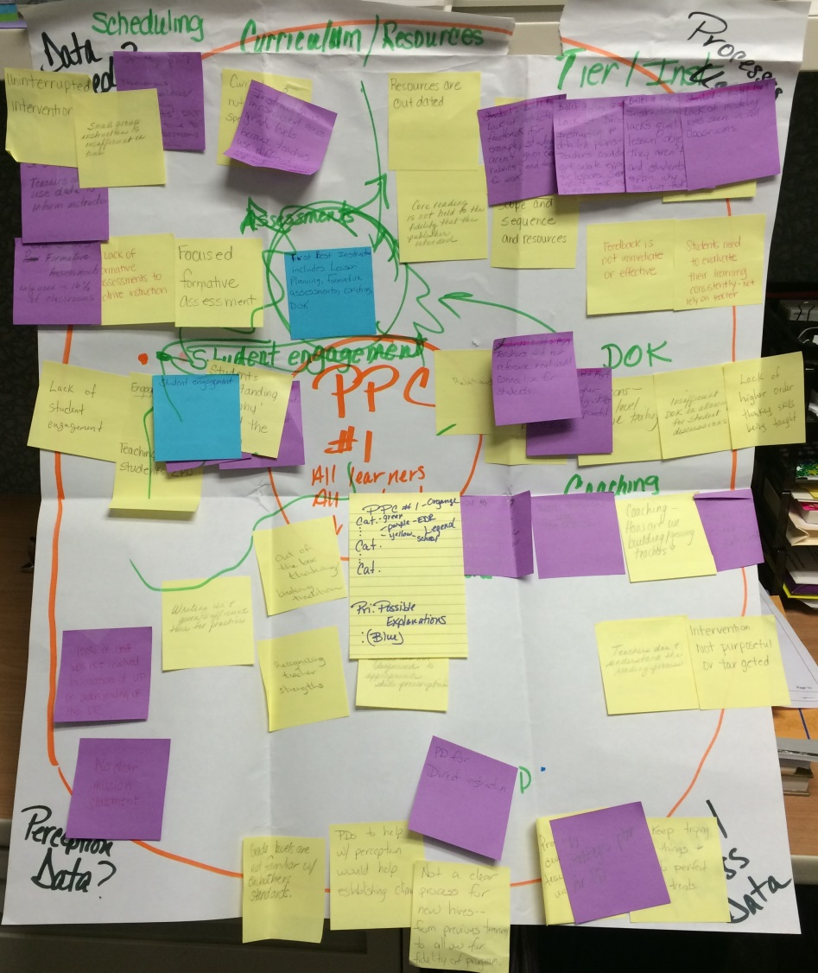
Example

Slide 115
Including External Reviews in RCA
Narrow and prioritize with additional explanations in the mix.
Determine if findings of External Reviews align with prioritized explanations.
Go back to External Review Results as a source of data for validating root causes.

Slide 116
Planning to Facilitate Root Causes Analysis
Take out the Planning to Facilitate Root Cause Analysis (note catcher, p. 10).
Make notes about how you will incorporate the findings from external reviews into your root cause analysis:
  What materials/tools will you use?
  How will your facilitate this?
  What will you do to prepare?

Slide 117
Follow-Up: After Root Cause Analysis
With the full group, or a smaller sub-set (leadership team):
  Validate root causes.
  Identify additional data used in validation.
  Evaluate the quality of the root causes identified against the UIP Quality Criteria.
  Make revisions if necessary.
School leaders, or smaller sub-set of staff (leadership team):
  Describe root cause(s) of each priority performance challenge in the UIP Data Narrative.
  Describe the process by which root causes were identified.

Slide 118
Quality Criteria for Unified Improvement Planning
Review: UIP Quality Criteria, Section I, Data Narrative and Section III, Root Cause Analysis (Tools, p. 11).
Consider:
  To what degree does the root cause meet the quality criteria?
  How could the root cause be improved?
Notes:
The UIP Quality Criteria are another check to make sure that the planning team has effectively described the root causes of their performance challenges. This check can be done through out as each root cause is identified.

Slide 119
Capturing Root Causes in the Data Narrative
Turn to Data Narrative Outline (Tools, p. 15).
Root causes must be explicitly associated with priority performance challenges.
Identify what must be included in the Data Narrative about Root Causes.
Note: Root Causes are also listed in the:
  Data Analysis Worksheet.
  Action Plan (associated with major improvement strategies).

Slide 120
Planning to Facilitate Root Causes Analysis
Take out the Planning to Facilitate Root Cause Analysis (note catcher, p. 10).
Make notes about how to accomplish the follow-up that must occur after Root Cause Analysis is completed:
  What materials/tools will you use?
  How will your facilitate this?
  What will you do to prepare?

Slide 121
Agenda
Root Cause Analysis Background
Preparing for
Root Cause Analysis
Steps in Root Cause Analysis
Facilitate Root Cause Processes

Slide 122
Your Turn to Practice!
Groups of five people.
Each person in the group will facilitate one or two of the steps in the process:
  Focus on a performance challenge (or closely related performance challenges).
  Consider school/district context (process/perception data).
  Generate explanations (brainstorm). AND Categorize/classify explanations.
  Narrow and prioritize explanations.
  Deepen thinking to get to a “root” cause.

Slide 123
Getting Ready
Form Groups of Five.
Determine facilitation responsibilities (see “sign-up sheets”).
When not facilitating, be an “Engaged Participant” – review that role.
We will create a “pace” for the groups to work through the different steps.
Take time to prepare for your facilitation component:
  Use “Scenario Two: Mountain Elementary School”.
  Use your notes of “Planning to Facilitate Root Cause Analysis” for that step.
  Identify any additional questions you have that we can answer before your group gets started.

Slide 124
Steps in Root Cause Analysis
Focus on a performance challenge (or closely related performance challenges).
Consider school/district context (process/perception data).
Generate explanations (brainstorm).
Categorize/ classify explanations.
Narrow and prioritize explanations.
Deepen thinking to get to a “root” cause.
Validate with other data.
Incorporate external reviews.
Iterative
Notes:
Root cause analysis can be broken down into several different sub-steps.
It is important to note that root cause analysis is focused on a clearly defined performance.
The process of getting to root causes of priority performance challenges (priority needs) can be described as similar to a funnel. It starts broad, like the widest part of the top of a funnel, with brainstorming in a way that brings everyone’s thinking into the process. It is important to start broad for two reasons. First, so that everyone who you want to be part of the solution will have a chance to help define what needs to be fixed. Second, so that the possibility for “out of the box” thinking is present.
Next, the ideas that are generated through the brainstorm should be systematically narrowed, first by categorizing or grouping like causes together, and then by applying criteria. This takes you to the narrow point in the funnel.
Once the list of possible causes has been narrowed, the team needs to intentionally deepen their thinking to get to an actual “root” causes. Several possible processes can help deepen your teams thinking. We’ll introduce a tool called the 5 Why’s.
Once the team believes a root cause has been identified, it will be important to validated with other data.
This may not be the end of the process, however. [Click to animate “iterative”]. This process is iterative rather than linear. Planning teams may get through the deepening process only to realize they had prioritized the wrong cause, or validation may result in the team starting over with a different possible root cause.
First we are going to focus on the first three steps in root cause analysis

Slide 125
Reflect on Experiences Facilitation Root Cause Analysis Steps
De-Brief with your “practice” group:
  What was effective about your practice root cause analysis?
  What could have be improved upon from your practice root cause analysis?
  Do you have additional questions now?
Individually make any additional notes/revisions to Planning to Facilitate Root Cause Analysis (note catcher, p. 8-12).
Share out additional questions.

Slide 126
Give us Feedback!!
Written: Use sticky notes
  + the aspects of this session that you liked or worked for you.
  ⬇The things you will change in your practice or that you would change about this session.
  ? Question that you still have or things we didn’t get to today.
  Ideas, Ah-Has, Innovations.
Oral: Share out one Ah Ha!

