Slide 1
Early Literacy UIP Requirements
Notes:
Speaker Notes
Hello and welcome to the Early Literacy UIP Requirements
This video will cover the Early literacy requirements within the Unified Improvement Plan.

Slide 2
Session Outcomes
This video will answer the following questions:
What are the Early Literacy Requirements in the UIP?
What is the role of Early Literacy Requirements in the UIP process?
Notes:
Speaker Notes
This video will answer the following questions:
What are the early literacy requirements in the UIP?
What is the role of the early literacy requirements in the UIP process?
Check by angelina fara from NounProject.com

Slide 3
What is the READ Act?
Prioritizes early literacy development for all students kindergarten through third-grade and especially for students at risk to not read at grade level by the end of the third grade.
Focuses on the areas of phonemic awareness, phonics, vocabulary development, reading fluency including oral skills, and reading comprehension.
Schools select an interim assessment to monitor reading outcomes for K-3 students from a list of approved assessments.
Core, supplemental and intervention curriculum must be scientifically and evidence-based to meet the needs of all learners.
Notes:
Speaker Notes
The READ Act was passed by the CO legislature in 2012 prioritizes early literacy development for all students in kindergarten through third grade and especially for students at risk to not read at grade level by the end of third grade.
It focuses on the areas of phonemic awareness, phonics, vocabulary development, reading fluency including oral skills, and reading comprehension.
Schools select an interim assessment to monitor reading outcomes for K-3 students from a list of approved assessments.
Core, supplemental and intervention curriculum must be scientifically and evidence-based to meet the needs of all learners.

Slide 4
What are the Early Literacy Requirements in the UIP?
Data Narrative
Data and trends from a READ interim assessment for grades K-3.
Action Planning
Specific actions to support students who are identified as having a significant reading deficiency (SRD) and students who are not yet reaching grade level expectations.
Target Setting
Set targets to improve reading outcomes for students as measured by a READ interim assessment.
Notes:
Speaker Notes
The early literacy requirements of the UIP include:
Data Narrative
Data and trends from a READ interim assessment for grades K-3 should be included.
Action Planning
Specific actions to support students who are identified as having a significant reading deficiency (SRD) and students who are not yet reading on grade level.
Target Setting
Set targets to improve reading outcomes for students as measured by a READ interim assessment.

Slide 5
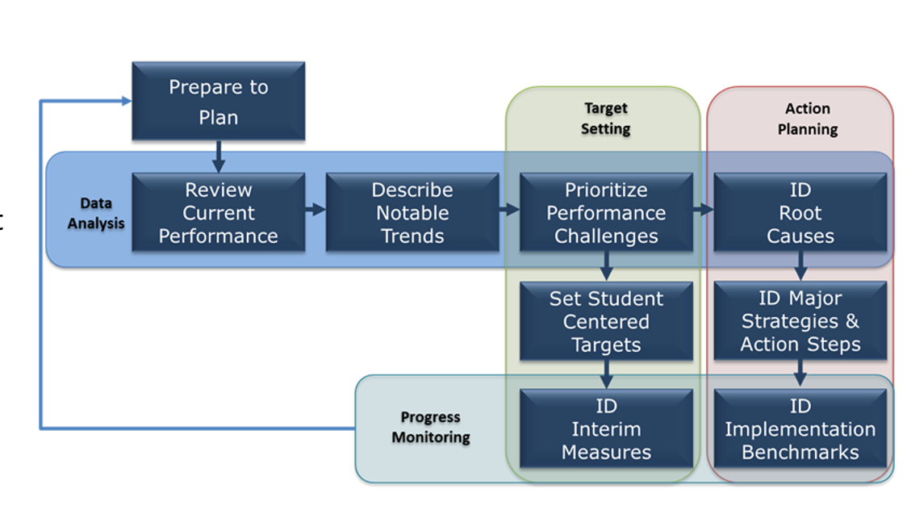
What is the role of Early Literacy Data in the UIP Process?
Early literacy is critical in students’ future academic success. Therefore, early literacy data is critical to include as part of a school’s data analysis to inform improvement efforts.
Look Fors:
READ Act Assessment Data:
At/above Grade Level
Below Grade Level
Significantly Below Grade Level
SRD Rates over time
Notes:
Speaker Notes
We’ll use this visual representation of the unified improvement planning process to build context for the READ Act requirements within the UIP.
Imagine you’re part of a school leadership team, and you’re charged with completing a Unified Improvement Plan each year.
This is the process that CDE recommends schools use.
It starts with gathering and organizing data, and reviewing the data to identify significant trends.
READ Act assessment data should be analyzed to focus on Early Literacy.
The UIP should include trend data that considers K-3 Read Act assessments by individual grade levels across the most recent two consecutive years at minimum, to aid in identifying trends in early literacy.

Slide 6
Example of Early Literacy Data in a UIP
Student Grade | Percent On Grade Level |  | Percent Significantly Below Grade Level (i.e., SRD)
 | 2018 | 2019 | 2018 | 2019
Kindergarten | 56% | 25% | 24% | 44%
First Grade | 70% | 45% | 20% | 18%
Second Grade | 75% | 72% | 13% | 10%
Third Grade | 67% | 55% | 13% | 21%
Strengths:
✔ Data reflects percent of students on grade level and students who are SRD
✔ Identifies a trend over time
Notes:
Speaker Notes
We have included a sample of early literacy data reported in the UIP.
This data reflects the percentage of students identified as having a Significant Reading Deficiency (SRD) as well as those reaching grade level expectations.
Each READ Act interim assessment uses specific terminology to designate levels of risk so column headers may be specific to the assessment you are using.
All READ Act interim assessments provide a range that indicates SRD.

Slide 7
What is the role of Early Literacy Target Setting in the UIP Process?
Once areas of growth are identified in the data, targets are set to measure to impact of improvement efforts aligned to those areas of growth.
Look Fors:
Increase students reaching grade level
Decrease SRDs
Notes:
Speaker Notes
Once schools identify their challenges and root causes, the next steps include setting performance targets and identifying strategies to reach those targets.
When setting performance targets, they are required to set targets related to READ Act data, including increasing the number/percentage of students reaching grade level expectations according to the READ Act assessment and decreasing the number of students with an SRD.
They are also required to identify and include strategies to reach those targets.

Slide 8
Early Literacy Targets Example
Performance Indicator: Academic Achievement
Measure/Metric: Reading
2021-22: Students on grade level will increase by 10% as measured by iStation
2022-23: Students on grade level will increase by 13% as measured by iStation
Strengths:
✔ The targets explicitly focus on increasing the percentage of students reading on grade level and decreasing the percentage of students identified as SRD
Performance Indicator: Academic Achievement
Measure/Metric: Reading
2021-22: There will be a 15% decrease in students SGBL (i.e., SRD) as measured by iStation
2022-23: There will be a 15% decrease in students SGBL (i.e., SRD) as measured by iStation
Notes:
Speaker Notes
Early literacy targets should be focused on decreasing the percentage of students identified as having a significant reading deficiency and increasing the percentage of students reaching grade level expectations.

Slide 9
What is the role of Early Literacy Action Planning in the UIP Process?
In order to address the needs of students who are not yet reading on grade level, schools must plan for action(s) to specifically support student who are SRD and/or not yet on grade level.
Look For:
Improvement efforts to impact Early Literacy Outcomes
Notes:
Speaker Notes
After schools identify and prioritize performance challenges the next steps include identifying the root causes and identifying major strategies and action steps to impact early literacy outcomes.
The action plan should identify strategies and action steps focused on early literacy that the school will implement.

Slide 10
Early Literacy Action Planning Example
Implement Early Literacy Instruction
In order to effectively support Early Literacy, we will implement instructional systems that have coherence and focus on foundational skills. K-3rd classes will have a dedicated daily phonics block that follows the Science of Reading methodology as supported by the CDE Modules, Heggerty curriculum and Orton Gillingham methodology.
Teachers will receive coaching to have a deeper understanding of foundational skills. Success will be measured by decreasing the amount of students significantly below grade level by 15% and increasing the amount of students on grade level by 10% (especially Black, MLL, and Black MLL students).
This aligns to district priorities around Early Literacy and phonics to provide a high-quality literacy program incorporates research and evidence-based principles for instruction, fosters independence and confidence, and leverages assessment practices that give teachers and leaders actionable feedback on how to best serve the needs of diverse learners across all classrooms.
Strengths:
✔ Reflect a plan to target the needs of students who are not yet on grade-level
✔ Scientifically and evidence-based actions
Notes:
Speaker Notes
Action plans should include steps that will be taken to target the needs of students who are not yet on grade level and support students identified with a significant reading deficiency.
Action steps should be scientifically and evidence-based.

Slide 11
Common Misconceptions
A student on a READ plan does not necessarily mean that they have a Significant Reading Deficiency (SRD).
Incorrect identification of root causes of SRD.
Early Literacy data is not the same as the Early Learning Needs Assessment, a separate UIP requirement.
Notes:
Speaker Notes
SRD/READ Plan:
Students remain on a READ plan until reaching grade level competency. A student may not have a Significant Reading Deficiency but still have a READ plan.
The Unified Improvement Plan should include specific targets for reducing the number of student identified as having an SRD.
Root Cause:
Identification of root cause of SRD is not linked to assessment data trend analysis.
Major Improvement Strategies must connect to Priority Performance Challenges. Identification of Early Literacy as a Priority Performance Challenge but not including strategies that specifically address early literacy.
Root causes beyond the control of the school are identified as causes of SRD (such as …)
Early Learning Needs Assessment (ELNA)
The Early Learning Needs Assessment process is about the transitioning between preschool to kindergarten.
The Early Learning Needs Assessment and early literacy data in grades K-3 are separate requirements in the UIP and both need to be included.

Slide 12
Thank you for your time!
Email any questions to
uiphelp@cde.state.co.us
Notes:
Speaker Notes
Thank you for viewing the Early Literacy UIP Requirements video.
If you have any questions, please contact uiphelp@cde.state.co.us

