Slide 1
UIP Work Session
Greeley, CO
October 6, 2017
Notes:
Handouts:
Changes to template doc
Quality Criteria???

Slide 2
Introductions
Name, School, Role
What is your experience with UIP PROCESS
1- I know the acronym
5- I could teach a class
What is your experience with the Online UIP System?
1- I’ve heard there is one
5- I have entered a full plan
What about the session today would make would make it a valuable use of your time?

Slide 3
Topics for UIP Work Session
Grounding: Introductions and Overview
The role of vision in Improvement Work
Review Updates for SPF, UIP and Online System
Reviewing School Level Expectations
Work Time with Consultation
Notes:
How many people

Slide 4
What is Unified Improvement Planning?
Alignment | A system to align improvement planning requirements for state and federal accountability into a “single” plan.
Documentation | A common format for schools and for districts to document improvement planning efforts. Schools/districts on accountability clock must demonstrate a coherent plan for dramatic change and adjustments over time. Reviews conducted by CDE and the State Review Panel.
Transparency | A process for including multiple voices, including staff, families and community representatives. Plans are also posted publicly.
Best Practice | A statewide strategy to promote improvement planning based on best-practice, including use of state and local data and engagement in a continuous improvement cycle.
Support | A mechanism for triggering additional supports through CDE (especially for schools/districts on accountability clock).
Notes:
UIP has it’s own tensions reflected in the multiple purposes it fulfills

Slide 5
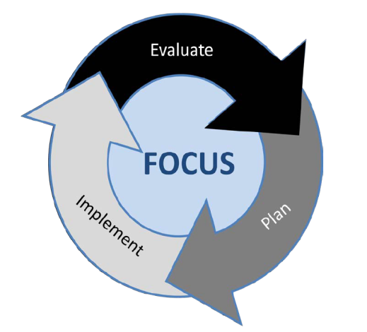
Continuous Improvement

Slide 6
Unified Improvement Planning Processes
Prepare to
Plan
Target
Setting
Action
Planning
Data
Analysis
Review Current Performance
Describe Notable Trends
Prioritize Performance Challenges
Identify Root Causes
Set Student Centered Targets
ID Major Strategies & Action Steps
Progress Monitoring
Identify Interim Measures
Identify Implementation Benchmarks

Slide 7
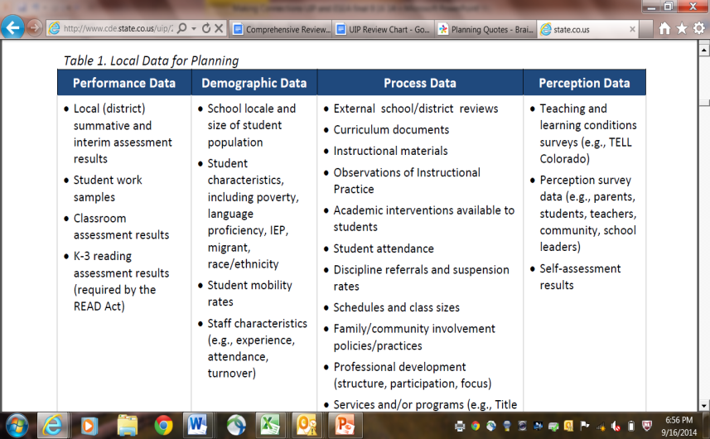
Data for Improvement Planning
UIP: Trends, PPCs, Targets, Interim Measures
UIP: Root Cause, Action Planning Implementation Benchmarks
Notes:
Maintain tensions of data used- despite myth that is only about state assessment

Slide 8
Article: Vision
Read the article
At your table discuss:
What is the vision for your school?
How well is your vision incorporated into your school community?

Slide 9
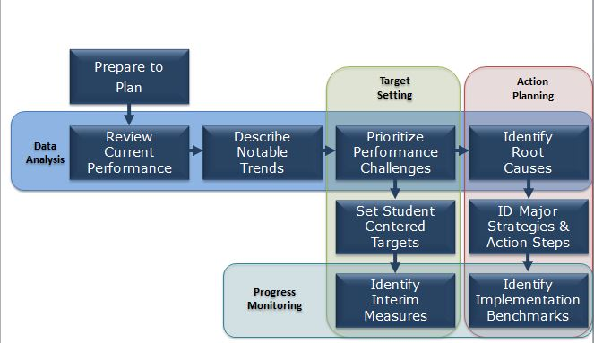
Vision and UIP: Table Discussion
Where does vision come into the UIP process?
Notes:
Walk through examples from the ones they provided.

Slide 10
Topics for UIP Work Session
Grounding: Introductions and Why we are here
The role of vision in Improvement Work
Review Updates for SPF, UIP and Online System
Reviewing School Expectations
Work Time with Consultation
Notes:
How many people

Slide 11
School & District Performance Frameworks
Performance Indicator | Performance Data | Weight
Academic Achievement | Mean scale score English language arts, math, and science CMAS assessments. Also, 10th grade PSAT for Evidence Based Reading and Writing (EBRW) and Math, and DLM (alternate assessment). Overall and for disaggregated groups | 40% (EM) 30% (H, districts)
Academic Growth | Median student growth percentile English language arts and mathematics on CMAS (grades 3-9). PSAT 10 to SAT growth. Overall and for disaggregated groups | 60% (EM) 40% (H, districts)
Postsecondary and Workforce Readiness | Graduation Rate Overall and for disaggregated groups Dropout Rate SAT Mean Scale Scores by content area (EBRW and Math), incorporating DLM results. Matriculation Rate | 30% (H, districts)
Individual indicator point assignments have shifted with the inclusion of the PSAT data in high school achievement, but the overall weightings of each indicator will remain the same.
Notes:
So what data is included in the frameworks, how is it organized?

Slide 12
Accreditation & Plan Types
Accreditation designations:
Accredited with Distinction (10%)
Accredited (50%)
Accredited with Improvement Plan (25%)
Accredited with Priority Improvement Plan (10%)
Accredited with Turnaround Plan (5%)
School plan types:
Performance Plan (60%)
Improvement Plan (25%)
Priority Improvement Plan (10%)
Turnaround Plan (5%)
The presented distributions are baselines from Year 1 of the performance frameworks. For both districts and schools, the percentage rated as PI and Turnaround has declined over time.
Notes:
Based on the data that was just described an overall score is determined and the corresponding rating is identified…

Slide 13
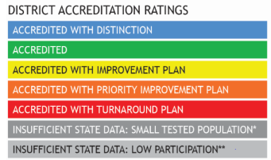
School and District Performance Framework Ratings and Explanatory Notes
Descriptors
Meets Participation
above 95% participation rate in 2 or more content areas
Low Participation
below 95% participation rate in 2 or more content areas
Decreased Due to Participation
below 95% participation, once parent excuses are removed, in 2 or more content areas
Ratings
+

Slide 14
Major Revisions to the Frameworks
The 2017 changes are based on statutory requirements, assessment changes, department analysis, and input from various stakeholder groups, including the Accountability Work Group, the Technical Advisory Panel for Longitudinal Growth, and the Colorado State Board of Education.
The changes included on the following slides are organized by each respective performance indicator.
Notes:
All of the changes that I’m going to touch on are outlined in a revision document that is posted on the accountability resource page. The link to this page is at the end of this presentation.

Slide 15
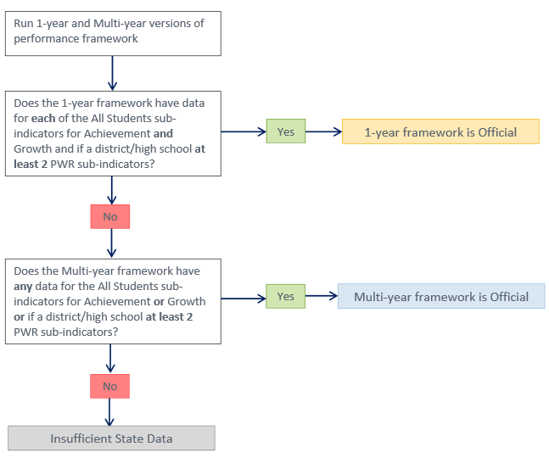
Decision Tree for Official Framework Type

Slide 16
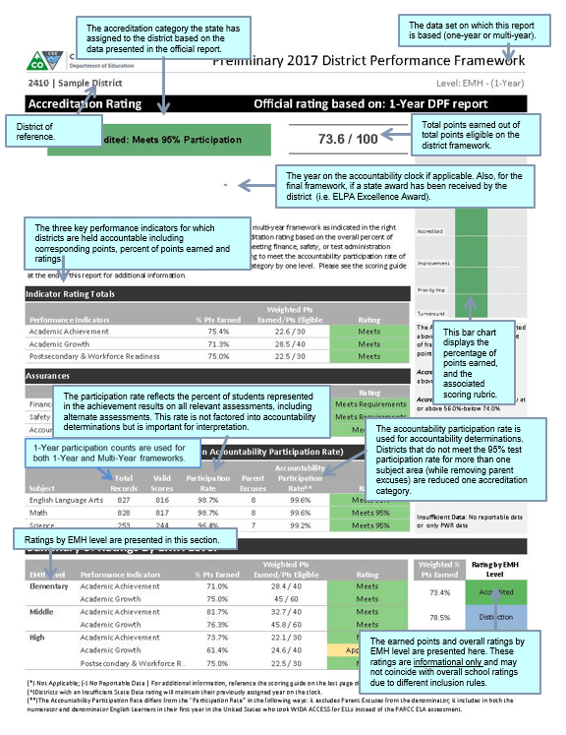
The 2017 DPF and SPF
Notes:
If you haven’t seen the 2017 framework, there appearance is fairly consistent with prior year reports. Here are some screen shots from the district annotated report. This resource is now posted on-line.

Slide 17
Resources & Contacts

Slide 18
Resources
SPF/DPF Resources:
http://www.cde.state.co.us/accountability/performanceframeworksresources
Request to Reconsider Resources:
http://www.cde.state.co.us/accountability/requesttoreconsider
Sign-up for office hours at: http://www.signupgenius.com/go/4090d4daead2fa3ff2-request1
Additional trainings and webinars will be announced in the Scoop

Slide 19
Contact Us
Accountability
Alyssa Pearson
Associate Commissioner
Pearson_A@cde.state.co.us
Dan Jorgensen, Ph.D.
Accountability & Growth Training
303.866.6763
Jorgensen_D@cde.state.co.us
Jessica Knevals
Request to Reconsider
303.866.6778
Knevals_J@cde.state.co.us
Improvement Planning
Lisa Medler
Executive Director
303.866.6619
Medler_l@cde.state.co.us
Erin Loften
Improvement Planning Training
303.866.6642
Loften_e@cde.state.co.us
Notes:
Before we conclude, I want to make sure you have my phone number and email address. Feel free to contact me if I can ever be of assistance. I want to thank each of you for taking the time to participate in this webinar. Have a good day.

Slide 20
UIP Online System Structure
Overview of UIP Online System
Section I: Summary of School
Section II: UIP Info
Section III: Data Narrative
Section IV: Action Plans
Addenda

Slide 21
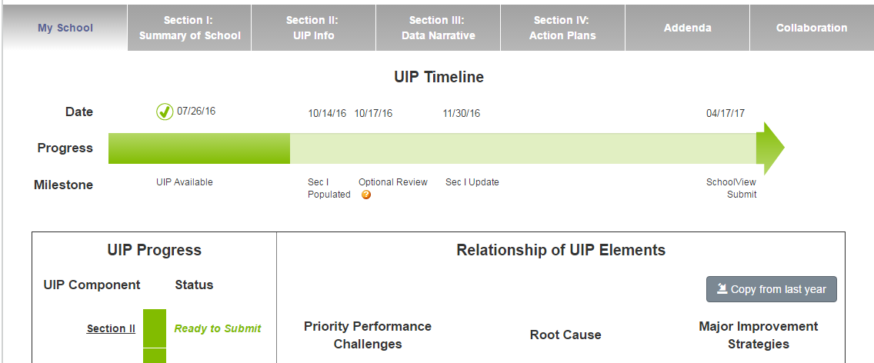
UIP Online System: Orientation

Slide 22
Performance “Framework” (2017 framework)
Academic Achievement
Students have met the learning objectives described in the standards for a given content area and grade level or course
ELA, Math, Science, PSAT
All students, Previous READ Plan, Dissaggregated group
Academic Growth
Students are meeting learning objectives over a given span of time
ELA, Math, PSAT, English Language Proficiency*
All students, Dissaggregated group
Post-Secondary Workforce Readiness
Graduates demonstrate the knowledge and skills needed to succeed in postsecondary settings and to advance in career pathways as lifelong learners and contributing citizens
Dropout Rate, Graduation Rate, Matriculation, SAT
NWEA MAP Mean RIT Scores, Galileo students at benchmark, DIBELS % at benchmark
STAR Growth Percentiles; K-3 literacy growth: change in number of students at benchmark from fall to spring
CTE Participation Rate, Concurrent Enrollment Rate, FAFSA Completion
Performance Indicator
Indicator
Definition
Performance Framework Measures
Possible Local Measures
Big Idea
Ways to Measure “Big Idea”
(Current Performance, Notable Trends, Priority Performance Challenges, Target Setting)

Slide 23
Performance “Framework” (2017 framework)
Academic Achievement
Students have met the learning objectives described in the standards for a given content area and grade level or course
ELA, Math, Science
All students, Previous READ Plan,PSAT, Dissaggregated group
Academic Growth
Students are meeting learning objectives over a given span of time
ELA, Math, P(SAT) English Language Proficiency*
All students, Dissaggregated group
Post-Secondary Workforce Readiness
Graduates demonstrate the knowledge and skills needed to succeed in postsecondary settings and to advance in career pathways as lifelong learners and contributing citizens
Dropout Rate, Graduation Rate, Matriculation, SAT
NWEA MAP Mean RIT Scores, Galileo students at benchmark, DIBELS % at benchmark
STAR Growth Percentiles; K-3 literacy growth: change in number of students at benchmark from fall to spring
CTE Participation Rate, Concurrent Enrollment Rate, FAFSA Completion
Performance Indicator
Indicator
Definition
Performance Framework Measures
Possible Local Measures
Locally Defined Performance Indicator
Locally defined: Whole Child, Social Emotional Learning, Arts Integration, etc.
Locally Defined Measure
Big Idea
Ways to Measure “Big Idea”
(Current Performance, Notable Trends, Priority Performance Challenges, Target Setting)

Slide 24
Implications for Improvement Planning
Structure of UIP template
Descriptors of Trends, Targets
Theses are NOT new “requirements,” but flexibility to respond to local priorities

Slide 25
CMAS PARCC Analysis for Improvement Planning

Slide 26
Participation Matters. . .
Increased numbers of parents excused students from assessments administered beginning in the 2014-15 school year.
Local stakeholders must determine whether student participation affects use of district or school-level aggregate results.
Do aggregate metrics still provide a complete and accurate picture of the performance of the “group” for which the score was calculated (e.g., the school, a grade level)? Data validity question.
Did our demographic proportions match? Did the group of students who tested match the entire group of students who should have tested?
Notes:
Considerations of participation in examination in data
Data validity issue in analysis- Accountability expectations for low participation will be addressed later

Slide 27
The Basics

Slide 28
Content Area Trajectories
Notes:
How scores are different
Overview of sequences available for tests
Group question: What might be the implications for analyses, program design v. accountability measures
7th grade start with Algebra and integrated I, 8th Algebra I, Geometry, Integrated I and II

Slide 29
How are new assessments different?
CMAS and CMAS PARCC
TCAP (CSAP)
Measure student learning of the Colorado Academic Standards (adopted in 2011)
Complex Skills
Critical Thinking
Problem Solving
One ELA test
Primarily administered in an on-line format
Newer interactive, engaging question formats.
Evidence-based writing
Measure student learning of the Colorado Model Content Standards (adopted in 1995)
Separate Reading and Writing tests
Administered in only a pencil and paper format
More traditional question formats (multiple choice and short constructed response).
Experience-based writing

Slide 30
How are they different (scoring)?
TCAP/CSAP
CMAS
Based on a vertical scale
Scale score ranges differ across each grade level, range from 3rd through tenth grade 150 – 950.
Students scale scores assigned to one of four performance levels:
unsatisfactory
partially proficient,
proficient, or
advanced.
Scale scores range from 650 – 850 for every grade level.
CMAS PARCC Math and ELA: student scale scores assigned to one of five performance levels–
did not meet expectations,
partially met expectations,
approached expectations,
met expectations, or
exceeded expectations.

Slide 31
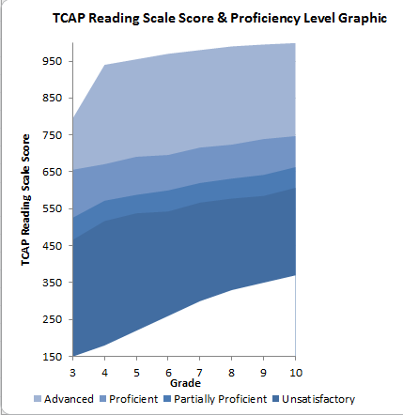
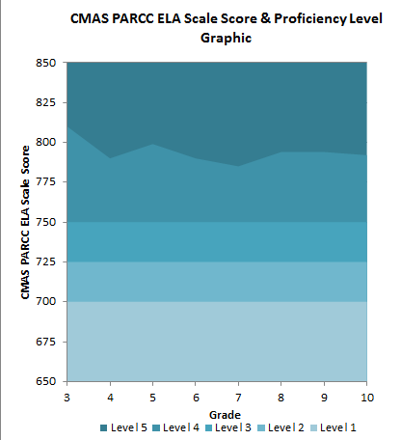
Scoring TCAP v. PARCC
Notes:
Distinction for performance levels
CMAS PARCC:
Level 5: Exceeded Expectations (varies by grade level - 850)
• Level 4: Met Expectations (750 - varies by grade level)
• Level 3: Approached Expectations (725-749)
• Level 2: Partially Met Expectations (700-724)
• Level 1: Did Not Yet Meet Expectations (650-699) as well as scoring

Slide 32
Analysis

Slide 33
Aggregate Metrics for Planning
Achievement
Mean Scale Score
Percent at Benchmark (Level 4 or above)
Percent by performance level
Growth
Median Growth Percentiles
What else are districts using?
Identify any metrics being used at your districts
Notes:
Percent at each performance level, percentile rank, other?

Slide 34
Example: Percent at Benchmark
10% students at or above benchmark

Slide 35
Example: Mean Scale Score
N=800
N=20
650
850
650
850
650
850
Notes:
How is a mean scale score derived, tend to have more low-end skewing
Limitation- cannot link back to performance descriptors
Advantages- less issues related to PII

Slide 36
Sample Middle School ELA Distribution
% by Performance Level
Level 1: 17.3%
Level 2: 18.5%
Level 3: 20.9 %
Level 4: 30.6%
Level 5: 12.5%

Slide 37
Distinction between CMASS PARCC at Benchmark and State “Meets” Cut Point for Performance Frameworks- Middle Level

Slide 38
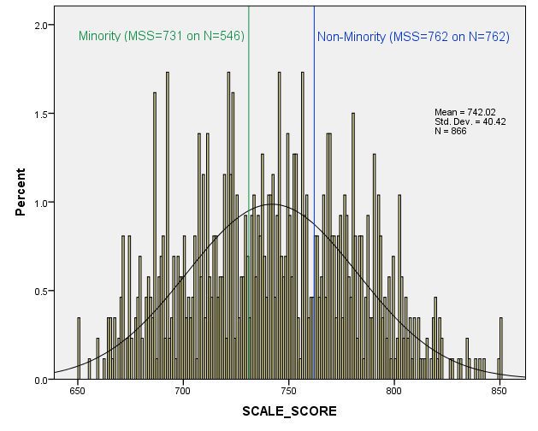
Sample Analysis: Mean Scale Score of Different Groups of Students/ Programs
Mean Scale comparison between Minority and Non-Minority student

Slide 39
Mean Scale Score
Why use mean scale scores?
What is a mean scale score?
Data suppression limitations
State increased expectations
During the transition, norm referenced comparisons may be more helpful in understanding performance in reference to these higher expectations

Slide 40
Comparison Points for CMAS PARCC ELA and Math Results
Mean Scale Score (650-850):
School, district and state mean scale scores.
Percent by Performance Levels (1-5):
Top two performance levels (Levels 4 & 5) = on track for college or career or for the next grade level.
Reading and Writing Scale Scores:
Average of students “just meeting expectations”
School, District, State Averages
Subclaims (1, 2 or 3) :
1) Did Not or Partially Meets Expectations, 2) Approaches Expectations, 3) Meets or Exceeds Expectations
Notes:
What might a school or district look to when comparing results
Erin – I think Julie had some nice resources to pull in here on potential comparison points? Can you add that as a handout? lgm

Slide 41
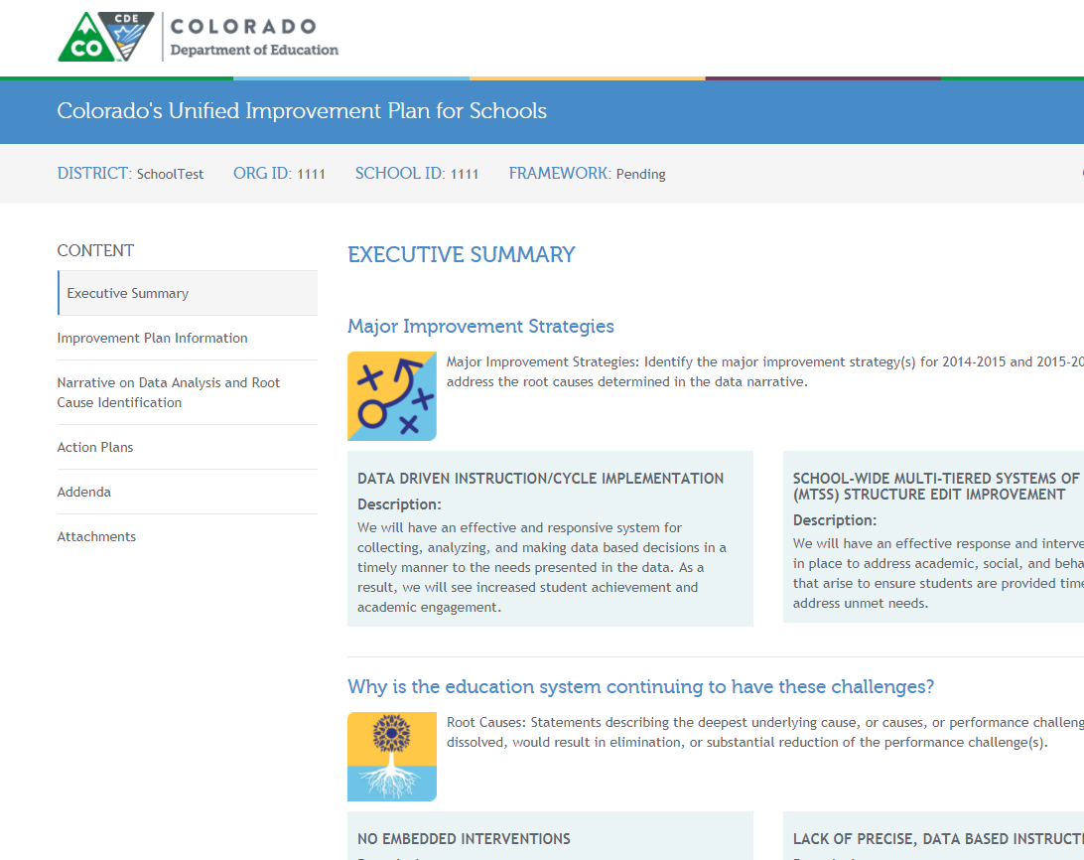

Slide 42
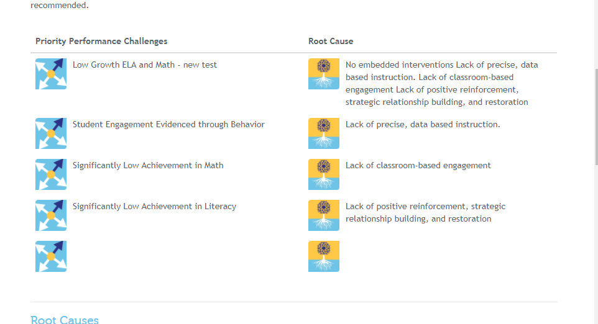

Slide 43
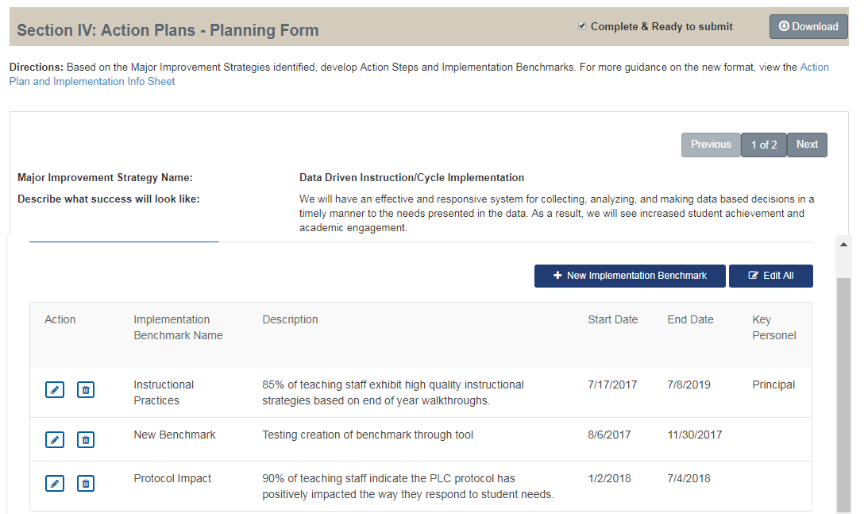

Slide 44
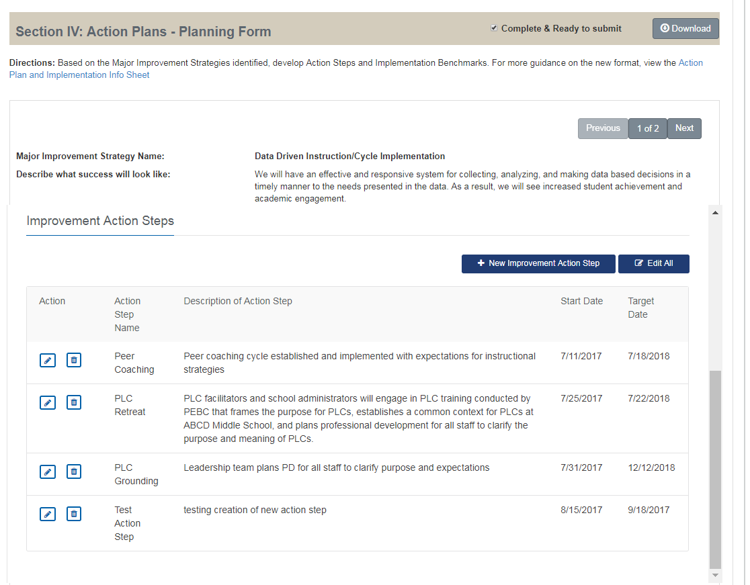

Slide 45
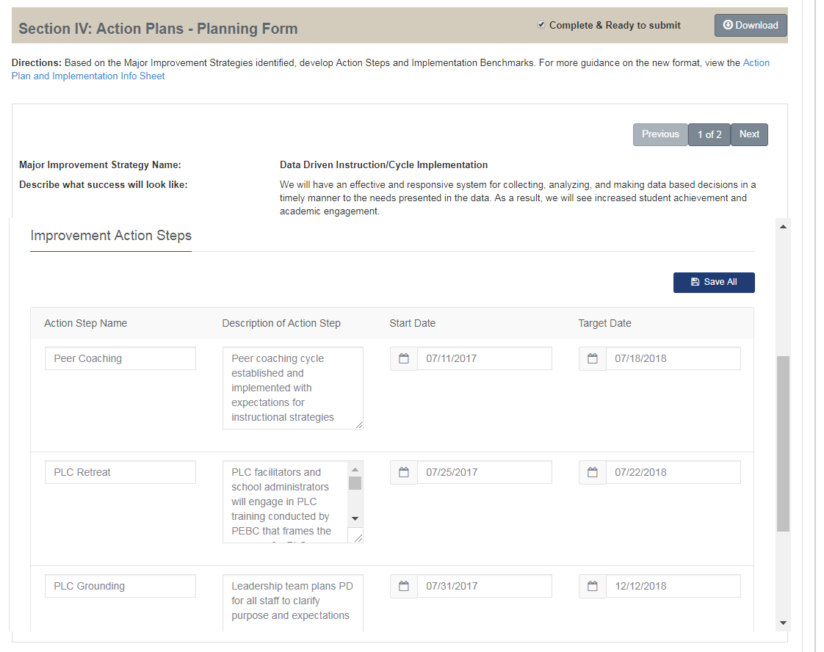

Slide 46
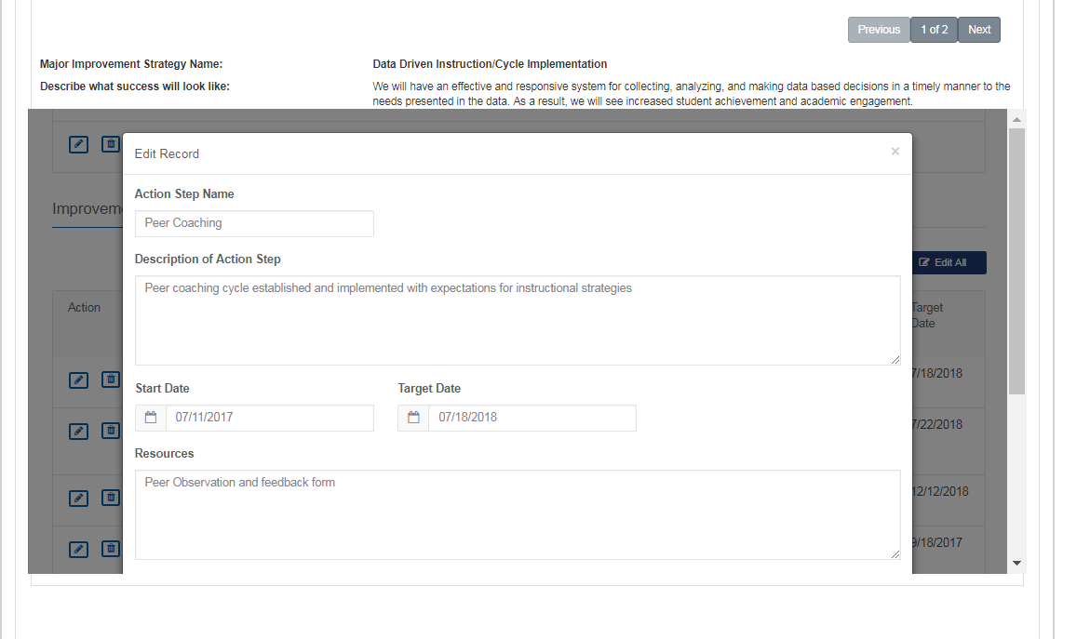

Slide 47
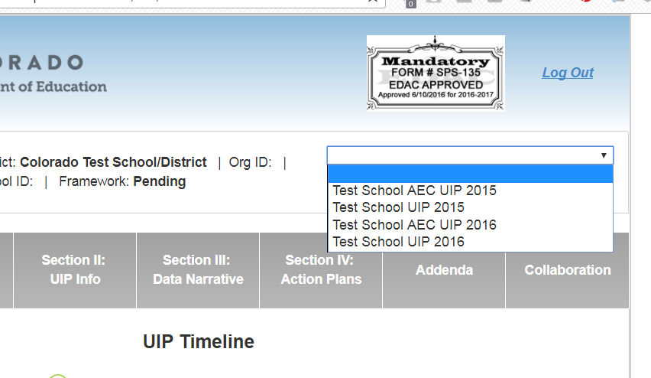

Slide 48
Expectations in the UIP

Slide 49
What is Unified Improvement Planning?
Alignment | A system to align improvement planning requirements for state and federal accountability into a “single” plan.
Documentation | A common format for schools and for districts to document improvement planning efforts. Schools/districts on accountability clock must demonstrate a coherent plan for dramatic change and adjustments over time. Reviews conducted by CDE and the State Review Panel.
Transparency | A process for including multiple voices, including staff, families and community representatives. Plans are also posted publicly.
Best Practice | A statewide strategy to promote improvement planning based on best-practice, including use of state and local data and engagement in a continuous improvement cycle.
Support | A mechanism for triggering additional supports through CDE (especially for schools/districts on accountability clock).
Notes:
UIP has it’s own tensions reflected in the multiple purposes it fulfills

Slide 50
What is the “Why” Underneath?
What is the purpose of Title I?
How does this align with the state accountability expectations?
How does this align with the vision for our school?
Share out

Slide 51
Comprehensive and Targeted Support Planning Requirements
Comprehensive Support and Improvement Plan
Approved by school, LEA and CDE
Developed in consultation with stakeholders
Formula and other ESSA funds may support strategies
CDE monitors plan implementation
Targeted Support and Improvement Plan
Approved by school and LEA. If applying for funds, then CDE will review plan.
May use the UIP to meet plan requirements:
Formula and other ESSA funds may support strategies
CDE offers planning support
Developed in consultation with stakeholders
Use UIP to meet plan requirements:
Informed by student performance
Includes school-level needs assessment
Identifies evidence based interventions
Address resource inequities
CDE offers planning support
Informed by student performance for disaggregated group(s)
Identifies evidence based interventions
Additional Targeted also addresses resource inequities
LEA monitors plan implementation. If awarded funds, CDE will monitor too.

Slide 52
2017-2018 Colorado Schools in Need of Support and Improvement (N = 331)
Schools on State Accountability Clock
(PI/T)
N = 179*
Schools Identified under Federal Accountability
(CS, TS, and A-TS)
N = 230
Based on 2017 Preliminary SPFs and AECs Frameworks
(as of 9/24/17)
Only State
N = 101
Only Federal
N = 152
*Includes one school with insufficient data that was TA in 2016
Some schools are on the state accountability clock and identified through ESSA
N = 78
Notes:
UFPA
There are 164 traditional schools identified as on the clock on the state accountability. AEC frameworks are not yet ready; therefore, this number does not include AECs.
Under ESSA accountability, 230 schools are identified for support and improvement as CS, TS, or Additional TS.
There is overlap between the schools identified under each accountability system. Therefore, 327 schools need support and improvement under one or both state and federal.
Of those, 97 are identified for state only, 163 are identified for federal only and 67 are identified under both federal and state accountability.

Slide 53
Connecting the dots
How to conduct a Comprehensive Needs Assessment (CNA) (including people/data needed);
Program Requirements for Title I Schools, including:
Schoolwide
Targeted Assistance
Comprehensive Support and Improvement (CS)
Targeted Support and Improvement (TS)
Additional Targeted Support and Improvement (A-TS)
How to embed evaluation and progress monitoring considerations into planning.
Notes:
UFPA

Slide 54
Comprehensive Needs Assessment Steps
Gather data.
Review data and compile into easily digestible format.
Onsite review to gather more data, analyze existing data and determine findings.
Create summary of findings to inform improvement planning.
We need to collect as much data, or more, about the actions of adults as we have about students.
Notes:
UIP
Structure – How we deliver instruction
Curriculum – What we teach
Instruction – How we teach
Climate – How people behave
Personnel – Who “teaches”

Slide 55
Segmented Needs Assessment
Can be used to inform:
Specific aspects of school
Based on ESSA Programs
Based on school- or district-specific systems (i.e., interventions)
Learning needs of students
Incremental change
Short-cycle plans
Rationale for Continuing Priorities and Strategies
Notes:
UIP

Slide 56
Methods for Allocating Funds and Delivering Services
Schoolwide Programs
Can use funds to enhance the entire educational program in a Title I school
Targeted Assistance Programs
Funds are targeted to provide extra educational assistance beyond regular classroom instruction to at-risk students, identified as having the greatest need for special assistance
Notes:
UFPA

Slide 57
Schoolwide Plan Strategies
Schoolwide Plan Strategies must address:
equitable opportunities for all children, including low-income students, students from major racial and ethnic groups, students with disabilities, and English learners
methods and instruction that strengthen the academic program in the school, increase the amount and quality of learning time, and help provide an enriched and accelerated curriculum, which may include programs, activities, and courses necessary to provide a well-rounded education
the needs of all children in the school, but particularly the needs of those at risk of not meeting CAS and CELP standards
Notes:
UFPA
Reference SW webpage and SW Plan rubric

Slide 58
Aligning PPC’s and Targets
Example: Our students are not meeting expectations in academic achievement or growth in Math for all grades and subgroups.
PPC Alignment | Target
All student achievement | Mean Scale score of X on CMAS Math
All student growth | Median Growth Percentile of X on CMAS Math
FRL Achievement | Mean Scale score of X on CMAS Math
FRL Growth | Median Growth Percentile of X on CMAS Math
Minority Achievement | Mean Scale score of X on CMAS Math
Minority Growth | Median Growth Percentile of X on CMAS Math
SWD Growth | Median Growth Percentile of X on CMAS Math
SWD Achievement | Mean Scale score of X on CMAS Math
Notes
For this school, n of EL’s was below 16

Slide 59
Targeted Assistance Plan – Best Practice
Refer back to questions in the ESEA Consolidated Application
How does your school identify students for services and align services to students based on need?
How do you make these supports and services systematic?
MTSS Process
Tier II
Flexible grouping based on need
Notes:
UFPA

Slide 60
Schoolwide Plan Requirements
Requirement | Location in UIP
Developed Annually | Data Narrative (Brief Description)
Coordinated with other Federal, State, and local programs | Action Plan
Meaningful Consultation with Stakeholders | Data Narrative (Brief Description)
Regularly Monitored | Action Steps Implementation Benchmarks Interim Measures
Based on CNA | Represented throughout UIP
Publicly Available and in Appropriate Languages | SchoolView Local Posting
Includes Strategies that address school needs | Action Plan (Major Improvement Strategies)
Notes:
UFPA
The schoolwide plan shall include a description of the strategies that the school will be implementing to address school needs, including a description of how such strategies will –
provide opportunities for all children, including each of the subgroups of students to meet CAS and CELP
use methods and instructional strategies that strengthen the academic program in the school, (i.e. increase the amount and quality of learning time, and help provide an enriched and accelerated curriculum, which may include programs, activities, and courses necessary to provide a well-rounded education)
address the needs of all children in the school, but particularly the needs of those at risk of not meeting CAS and CELP.

Slide 61
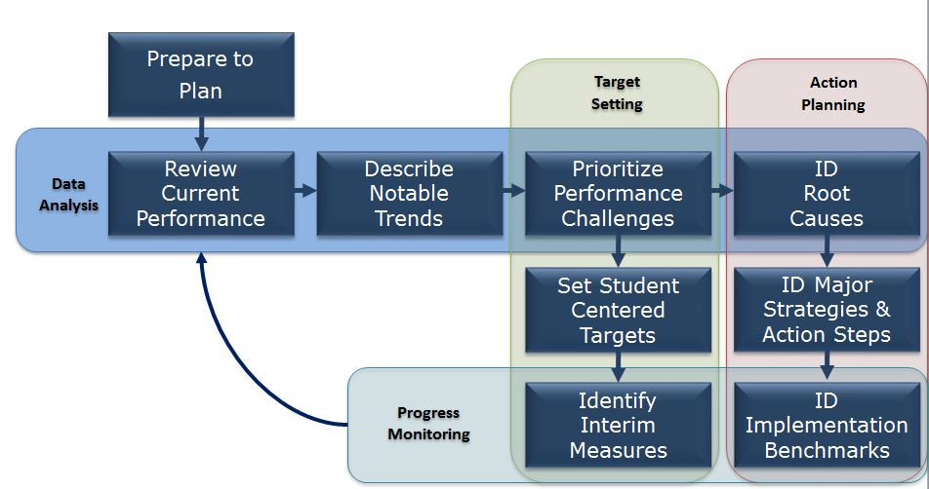
Where does the CNA go?
The CNA (or SNA) is housed within the Data Narrative Section of UIP Online System (show above).
The Data Narrative includes several sub-sections, including:
Brief Description
Prior Year Targets
Current Performance
Trend Analysis
Priority Performance Challenges
Root Causes
The UIP Online System is structured to help schools/districts work through the needs assessment and improvement planning process.
Notes:
UIP

Slide 62
READ Act and the UIP
What are the expectations?
READ Act requirements to be met in school level plans:
Does the data narrative include trend data that considers K-3 literacy data?
Does the plan include strategies that address the needs of K-3 students identified as having significant reading deficiencies?
Does the plan specify target(s) for reducing the number of students who have significant reading deficiencies?
How you have you typically approached this expectation?

Slide 63
Quality Criteria: Big 5 Guiding Questions
Does the plan:
❶ Investigate the most critical performance areas and prioritize the most urgent performance challenges?
❷ Identify root causes that explain the magnitude of the performance challenges?
❸ Identify evidence-based major improvement strategies that have likelihood to eliminate the root causes?
❹ Present a well-designed action plan for implementing the major improvement strategies to bring about dramatic improvement?
❺ Include elements that effectively monitor the impact and progress of the action plan?

Slide 64
Thank you!

